Slide 1
Scale Influences on the Representation of Snowpack Processes
Charles H. Luce
Ph.D. Dissertation Defense
Utah State University
May 8, 2000
Logan, Utah

Slide 2
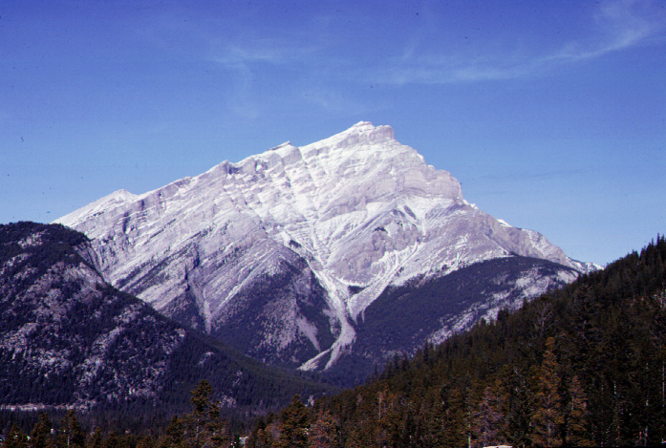
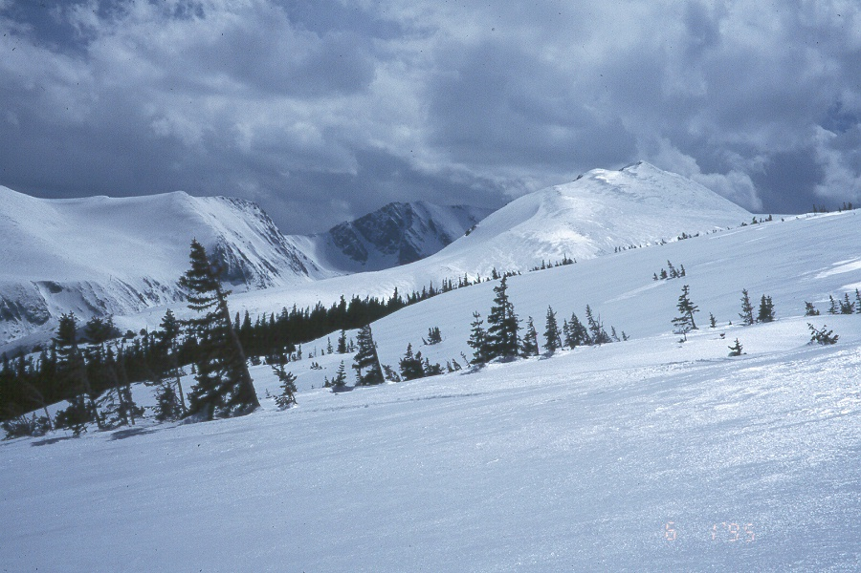
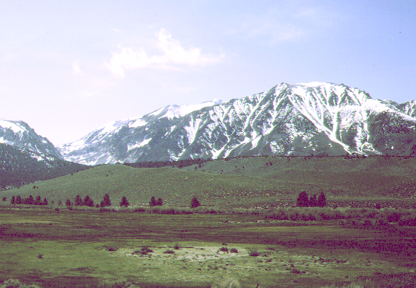

Slide 3
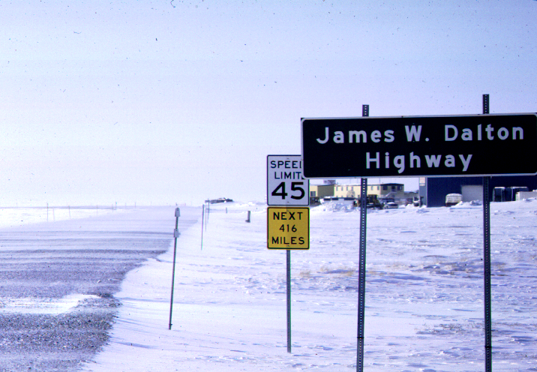
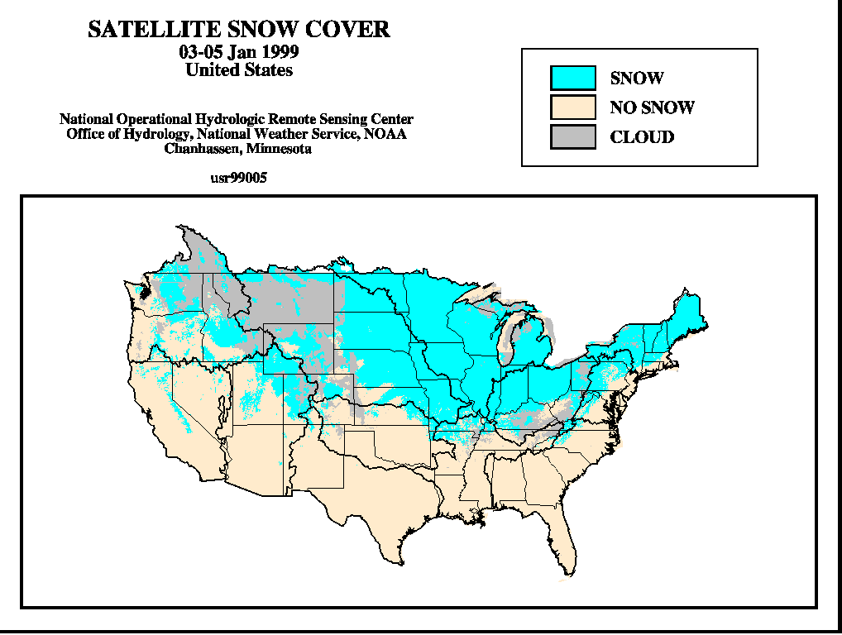

Slide 4
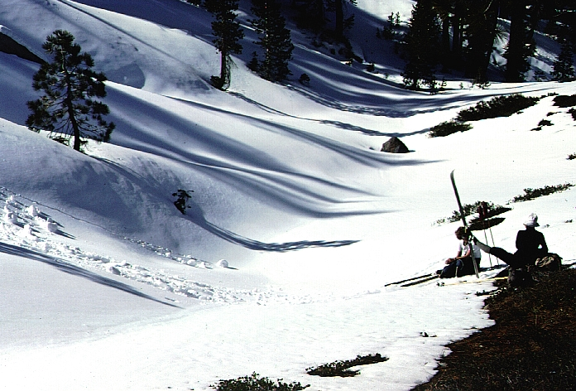

Slide 5
Snowpacks are spatially variable at a range of scales.
What are the effects of this heterogeneity as we change the analysis scale from the point scale to larger basins?
How can we revise our description of properties of the snowpack to better model the evolution of the important properties at scales of interest?

Slide 6
Summary of Results/Findings
CH2-Detailed examination of point scale measurements
  Parameterization of vertical heat distribution with sinusoidal forcing model
  Influence of inversions on basin scale snow distribution
CH3-Dominance of drifting in snowpack variability
CH4-Depletion curve revisited
  as a parameterization of subgrid variability
  derived from snow distribution
CH5-Further development of depletion curve theory
  related snow distributions and distributions of driving inputs (snowfall, drifting, melt energy)

Slide 7
Summary of Results/Findings
CH2-Detailed examination of point scale measurements
  Parameterization of vertical heat distribution with sinusoidal forcing model
  Influence of inversions on basin scale snow distribution
CH3-Dominance of drifting in snowpack variability
CH4-Depletion curve revisited
  as a parameterization of subgrid variability
  derived from snow distribution
CH5-Further development of depletion curve theory
  related snow distributions and distributions of driving inputs (snowfall, drifting, melt energy)

Slide 8
Summary of Results/Findings
CH2-Detailed examination of point scale measurements
  Parameterization of vertical heat distribution with sinusoidal forcing model
  Influence of inversions on basin scale snow distribution
CH3-Dominance of drifting in snowpack variability
CH4-Depletion curve revisited
  as a parameterization of subgrid variability
  derived from snow distribution
CH5-Further development of depletion curve theory
  related snow distributions and distributions of driving inputs (snowfall, drifting, melt energy)

Slide 9
Summary of Results/Findings
CH2-Detailed examination of point scale measurements
  Parameterization of vertical heat distribution with sinusoidal forcing model
  Influence of inversions on basin scale snow distribution
CH3-Dominance of drifting in snowpack variability
CH4-Depletion curve revisited
  as a parameterization of subgrid variability
  derived from snow distribution
CH5-Further development of depletion curve theory
  related snow distributions and distributions of driving inputs (snowfall, drifting, melt energy)

Slide 10
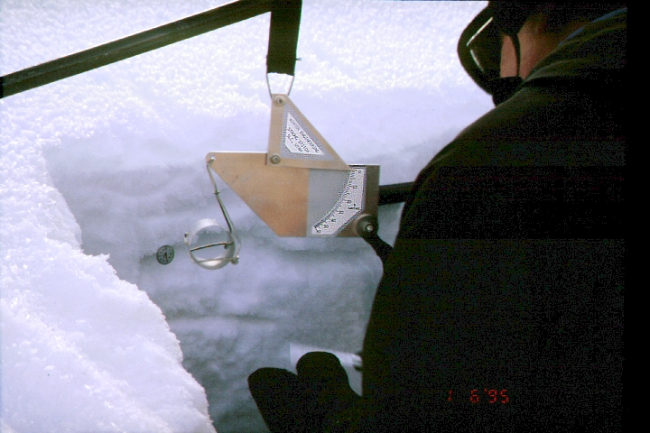
Objectives
Explore issues associated with scaling up snowpack models and propose and test parameterizations.

Slide 12
Why scale up snowmelt models?
To better match observations and models
To take up the opportunities for simplification inherent in a statistical description of a system
Improve description of large-scale processes

Slide 13
(after Blöschl and Kirnbauer, 1994)

Slide 14
Parameterization is the mathematical means of describing the subresolution or microscale processes of the phenomenon, in terms of resolvable scale variables; these macroscale variables are the ones which can be treated explicitly in the analysis or for which records are obtainable.
Brutsaert (1986)

Slide 15
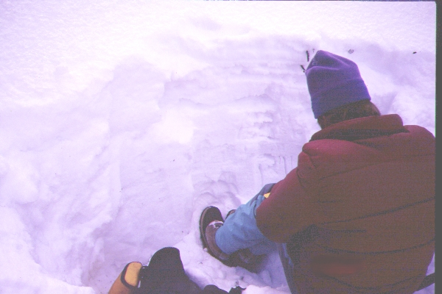
Layers

Slide 18
Summary of amplitude and phase changes

Slide 20
Heat flux estimates
Tave
Force-Restore
Modified
Force-Restore

Slide 31
Logan airport data

Slide 33
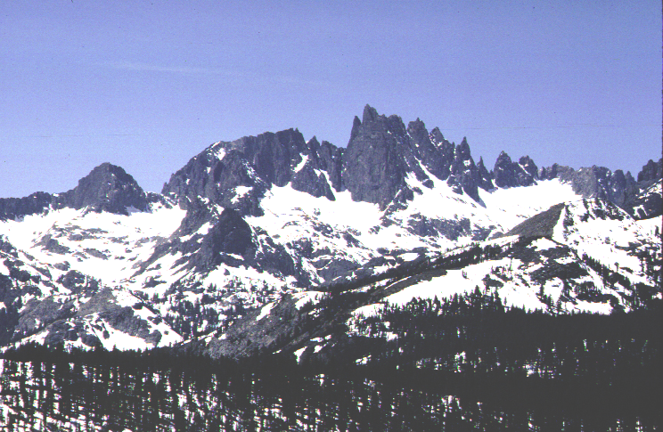
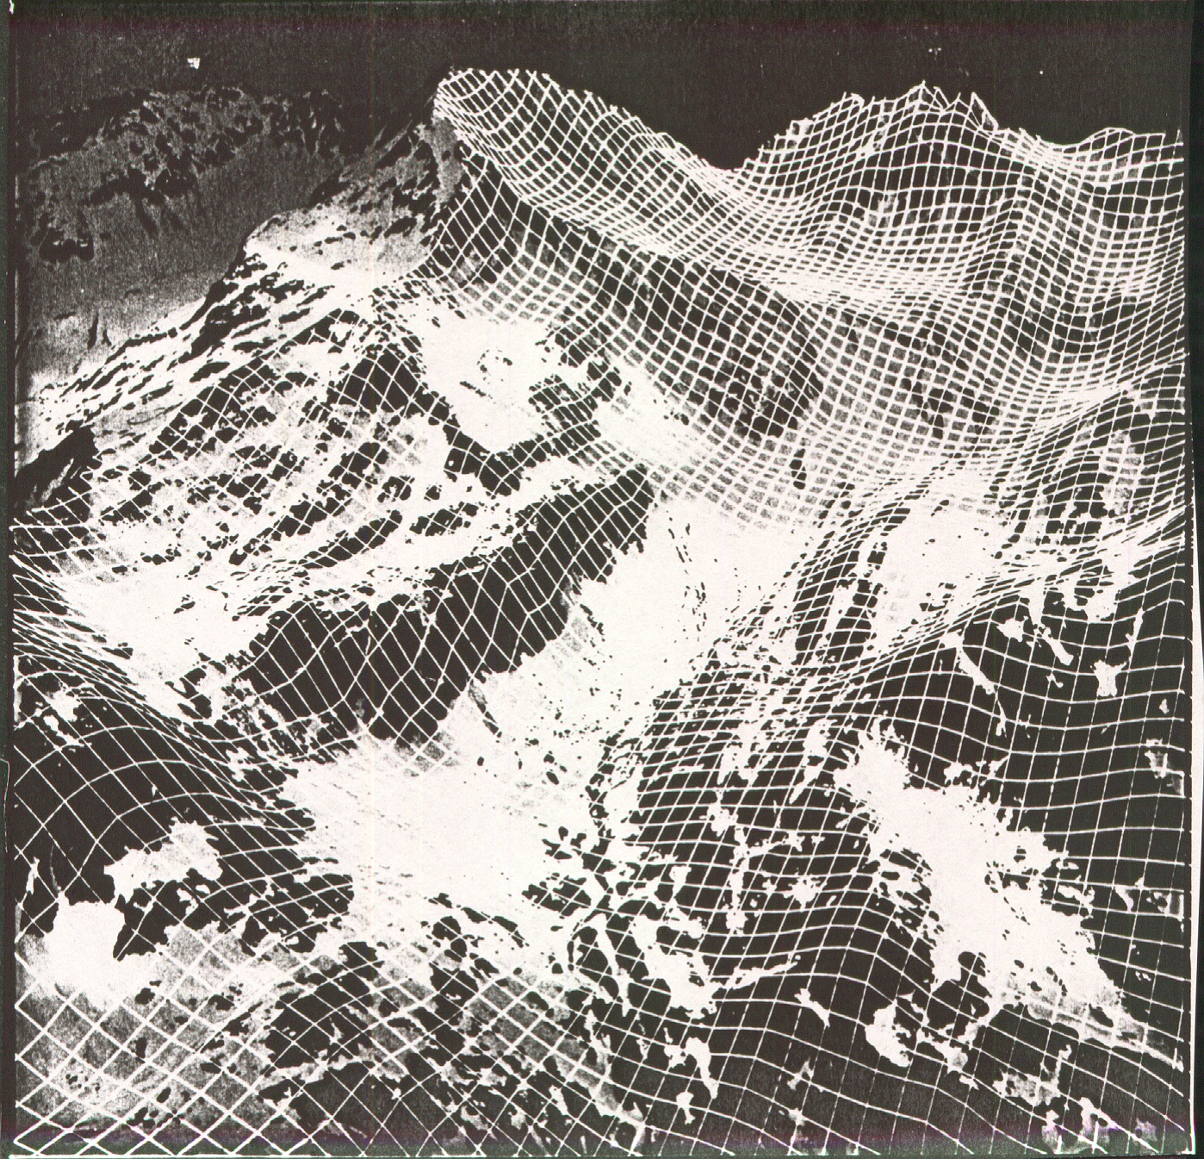
Spatial patterns in snow cover accumulation and melt

Slide 35
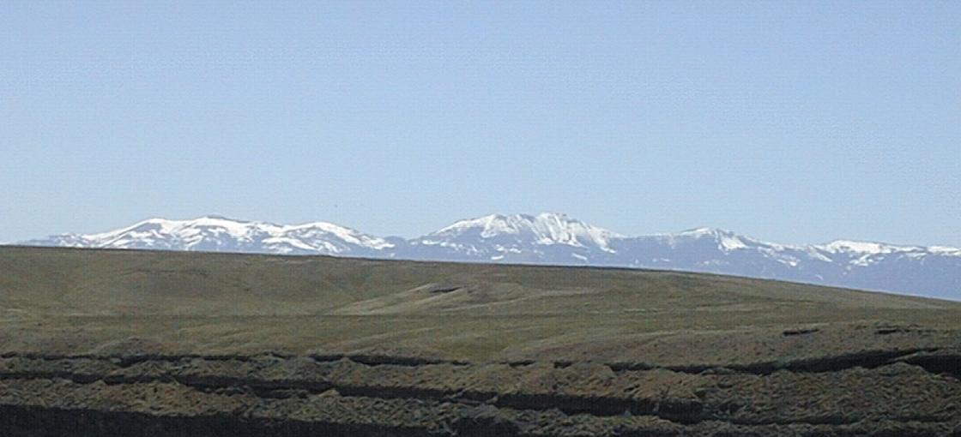
Owyhee Mtn’s
from south of
Boise, Idaho.

Slide 36
Upper Sheep Creek snow sampling grid

Slide 37
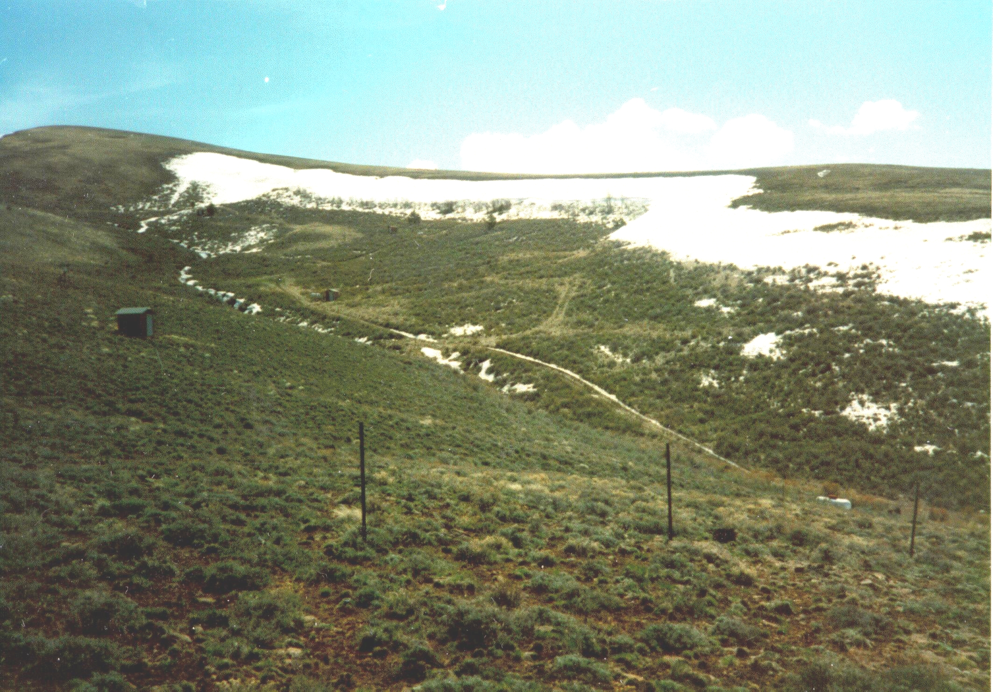
Drift at
Upper Sheep
Creek
Drift factor
map

Slide 39
Four models
Point model – effective parameters
Two-patch model
Distributed model w/o drifting
Distributed model with drifting

Slide 43
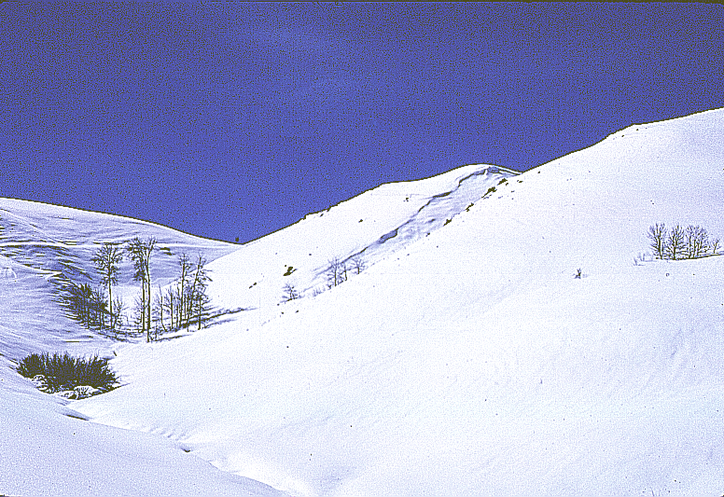
Differential accumulation

Slide 54
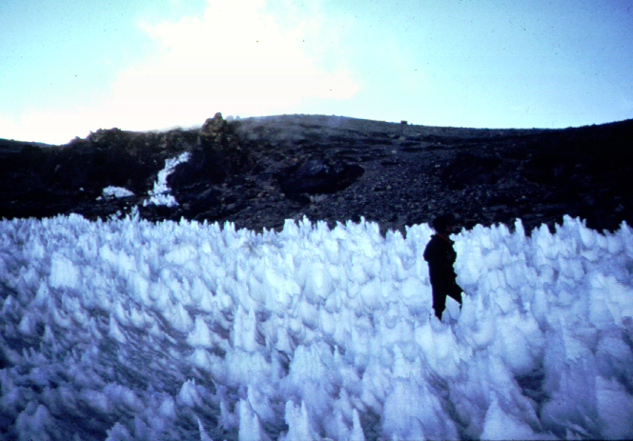
Nieves Penitentes

Slide 55
Hierarchy of statistical characterization
After Blöschl (1996)

Slide 56
Definitions for examination of differential energy input
E_{l} is the local energy input
E_{ba} is the basin average energy input
E_{r} = E_{l}/E_{ba}
Fractional solar exposure

Slide 62
f
ΔW
W
W+ΔW

Slide 63
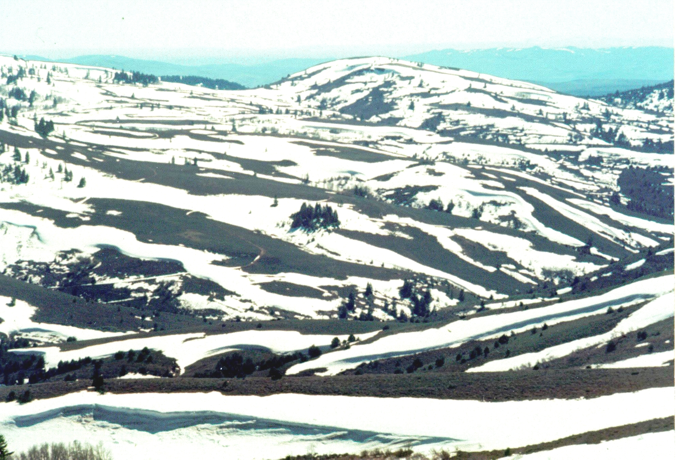
Obvious
element
area?

Slide 64
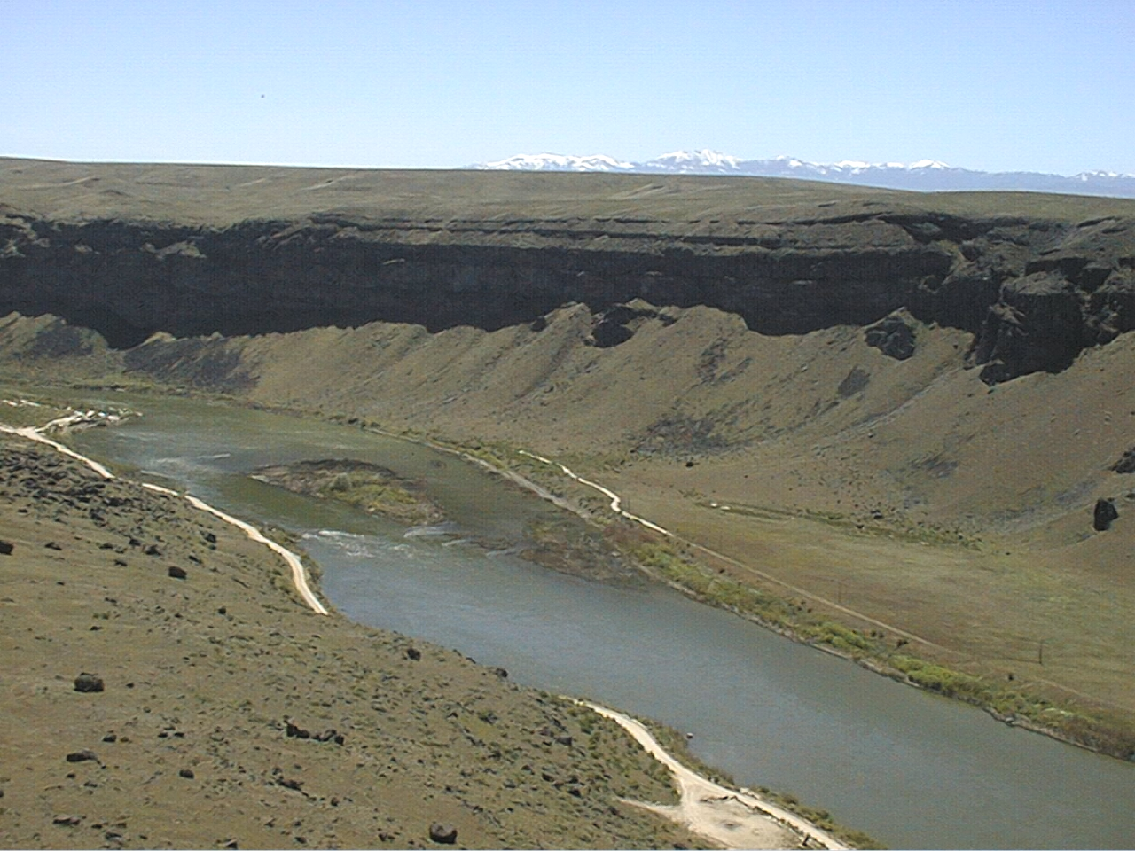

Slide 65
Summary
Parameterization of vertical heat distribution with sinusoidal forcing model
Influence of inversions on basin scale snow distribution
Distributed modeling to examine sources of variability
PDF based parameterization for snow drifting
Covariance of solar radiation and snow drifting

Slide 66
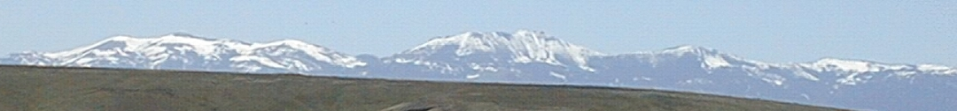
Where to next?
Point Scale
  Heat flow in snow
  Improvements to UEB
Basin Scale
  Larger and steeper basins
  Examining role of other processes

Slide 67
