Slide 1
Some Potential Terrain Analysis Tools for ArcGIS
David G. Tarboton
dtarb@cc.usu.edu
http://www.engineering.usu.edu/dtarb

Slide 2
Overview
Review of digital elevation model grid based flow direction, accumulation and watershed delineation
Channel network delineation. Objective selection of channel delineation threshold and representation of variable drainage density.
Terrain flow fields and their numerical representation. Multiple flow direction approaches.
Specialized grid accumulation functions

Slide 3
Elevation Surface — the ground surface elevation at each point
Digital Elevation Model — A digital representation of an elevation surface. Examples include a (square) digital elevation grid, triangular irregular network, set of digital line graph contours or random points.

Slide 4
Digital Elevation Model Based Flow Path Analysis
Eight direction pour point model D8
Grid network
4
3
2
5
1
6
7
8
Drainage Area
Grid Order
1
1
1
1
1
1
1
1
1
1
1
4
3
3
1
1
2
2
2
1
1
1
12
1
2
1
1
3
1
1
1
1
2
16
1
1
1
1
3
1
1
3
6
25
2
1
2
2
3
1

Slide 5
100 grid cell constant support area threshold stream delineation

Slide 6
Grid network pruned to order 4 stream delineation

Slide 7
200 grid cell constant support area based stream delineation

Slide 8
How to decide on drainage area threshold ?
AREA 2
3
AREA 1
12
Why is it important?

Slide 9
Hydrologic processes are different on hillslopes and in channels. It is important to recognize this and account for this in models.
Drainage area can be concentrated or dispersed (specific catchment area) representing concentrated or dispersed flow.
Objective determination of channel network drainage density

Slide 10
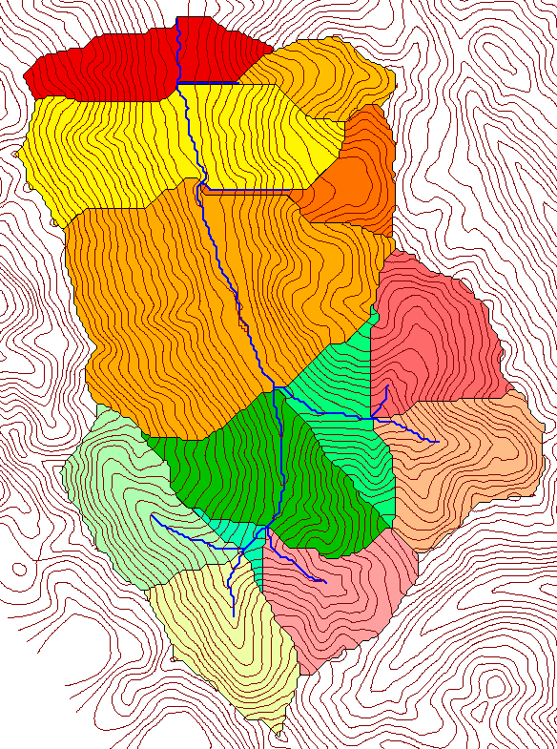
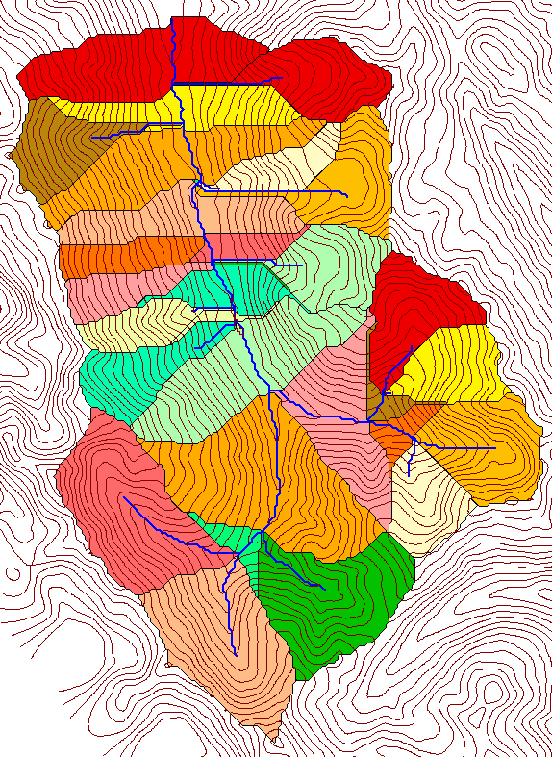
Delineation of Channel Networks and Subwatersheds
500 cell theshold
1000 cell theshold

Slide 11
Examples of differently textured topography
Driftwood, PA
Same scale, 20 m contour interval
Sunland, CA

Slide 12
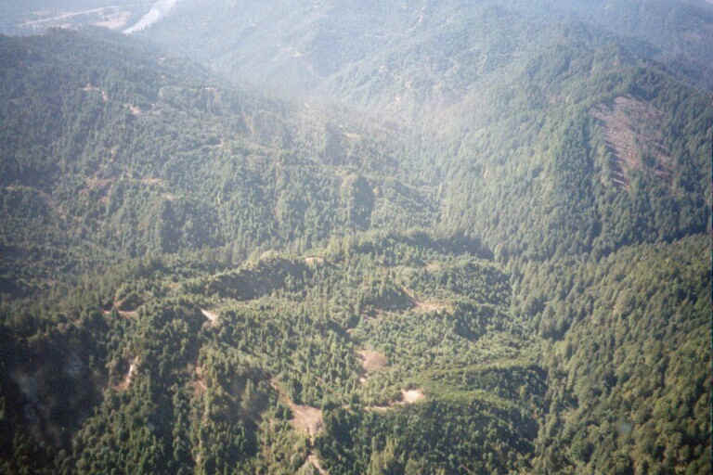
Logged Pacific Redwood Forest near Humboldt, California

Slide 13
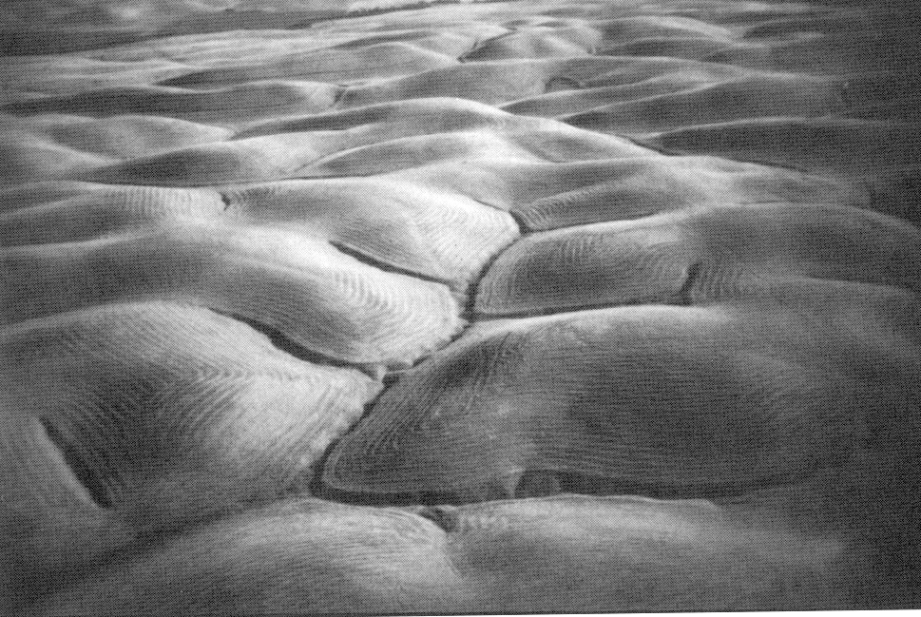
Gently Sloping Convex Landscape
From W. E. Dietrich

Slide 14
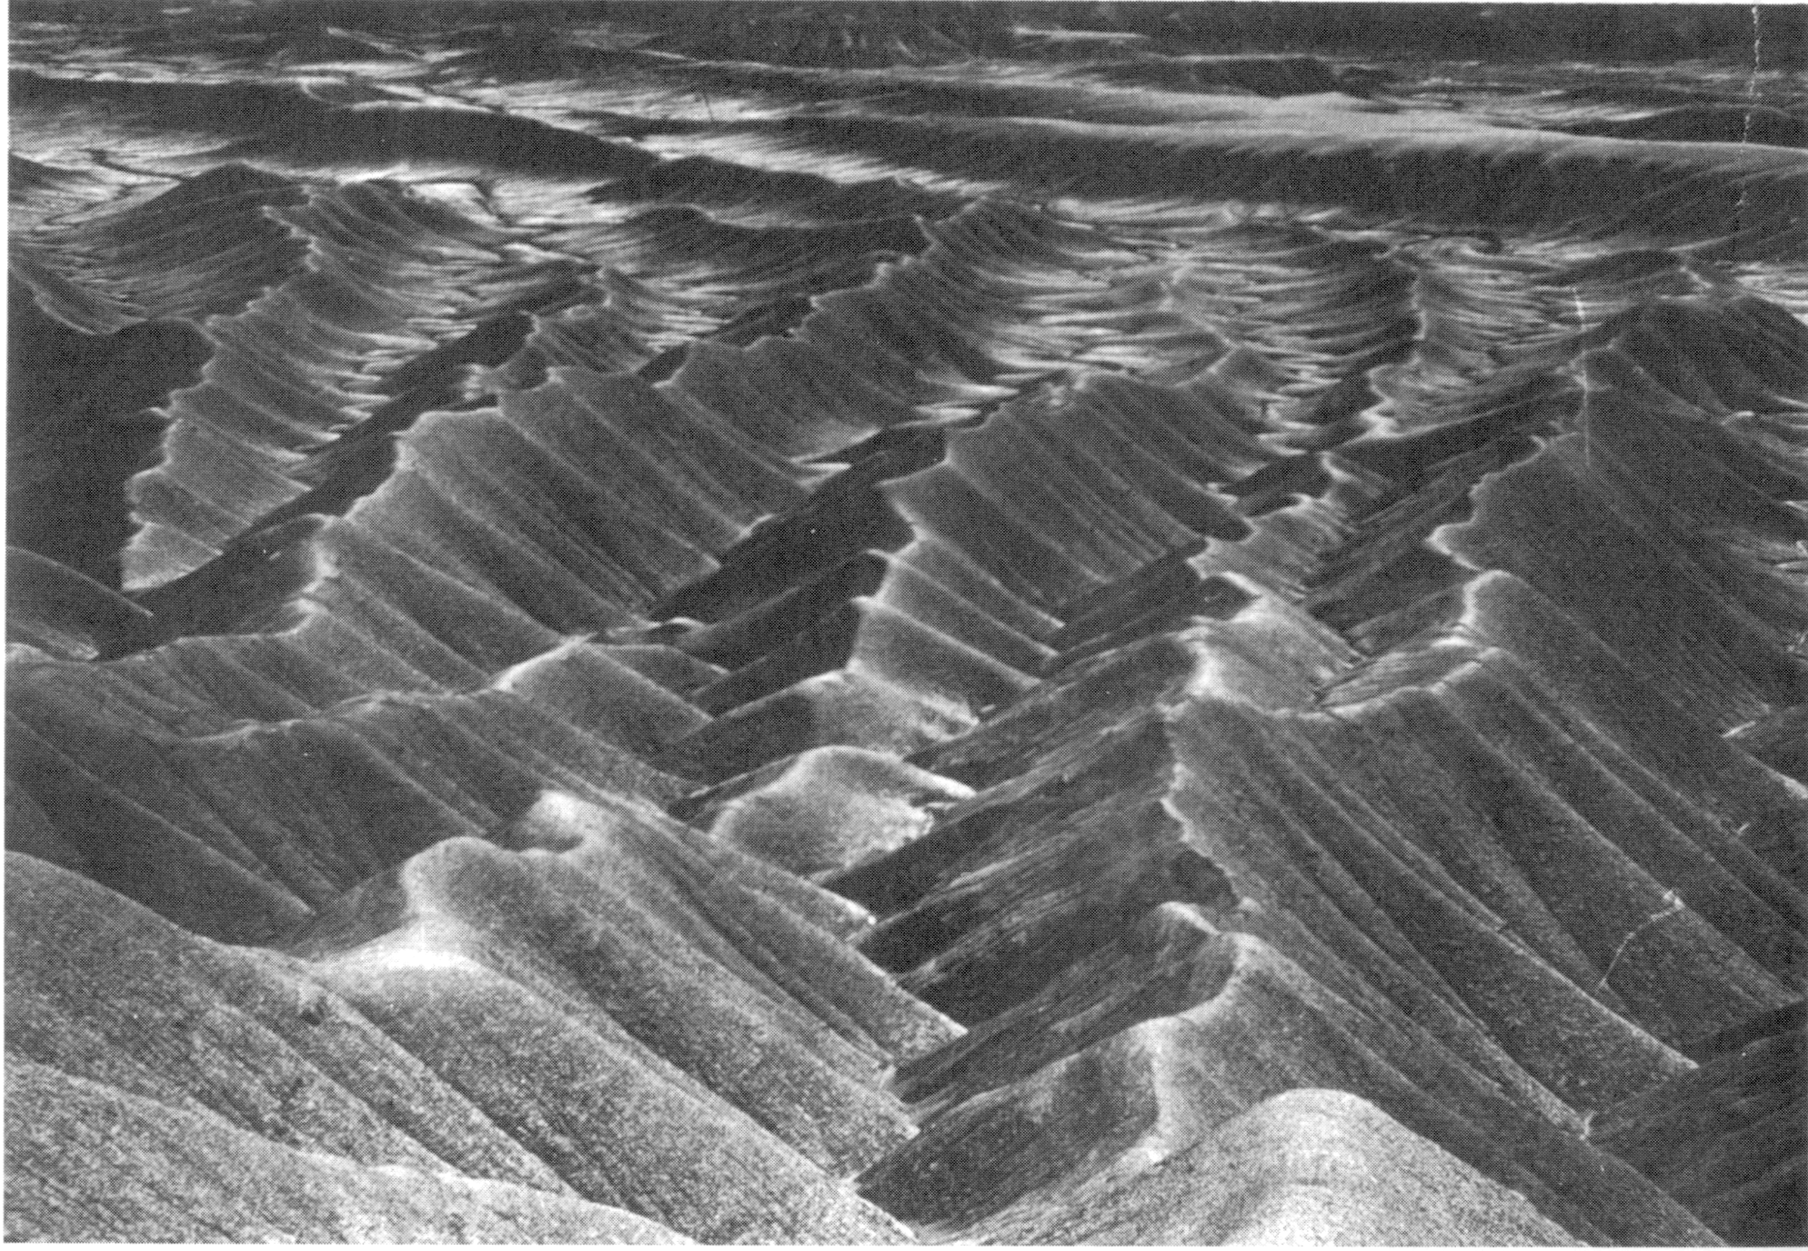
Mancos Shale badlands, Utah. From Howard, 1994.

Slide 15
“landscape dissection into distinct valleys is limited by a threshold of channelization that sets a finite scale to the landscape.” (Montgomery and Dietrich, 1992, Science, vol. 255 p. 826.)
One contributing area threshold does not fit all watersheds.
Suggestion: Map channel networks from the DEM at the finest resolution consistent with observed channel network geomorphology ‘laws’.

Slide 16
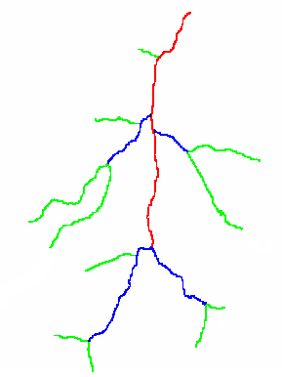
Constant Stream Drops Law based on Strahler Stream Ordering
1
3
1
2
1
2
1
1
1
2
1
1
2
1
1
1
1
Broscoe, A. J., (1959), "Quantitative analysis of longitudinal stream profiles of small watersheds," Office of Naval Research, Project NR 389-042, Technical Report No. 18, Department of Geology, Columbia University, New York.

Slide 17

Stream Drop
Elevation difference between ends of stream
Nodes
Links
Single Stream
Note that a “Strahler stream” comprises a sequence of links (reaches or segments) of the same order

Slide 18
Statistical Analysis of Stream Drops

Slide 19
Constant Support Area Threshold

Slide 20
200 grid cell constant support area based stream delineation

Slide 21
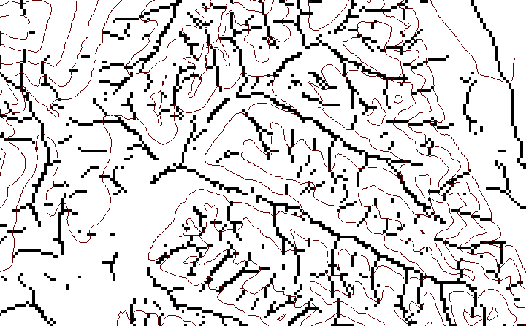
Local Curvature Computation
(Peuker and Douglas, 1975, Comput. Graphics Image Proc. 4:375)
43
48
48
51
51
56
41
47
47
54
54
58

Slide 22
Contributing area of upwards curved grid cells only

Slide 23
Upward Curved Contributing Area Threshold

Slide 24
Curvature based stream delineation

Slide 25
Addressing the limitations imposed by 8 grid directions

Slide 26
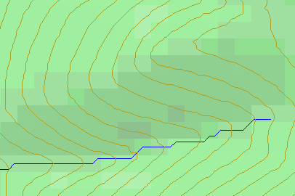
Topographic Slope
?
Topographic Definition Drop/Distance
Limitation imposed by 8 grid directions.
Flow Direction Field — if the elevation surface is differentiable (except perhaps for countable discontinuities) the horizontal component of the surface normal defines a flow direction field.

Slide 27
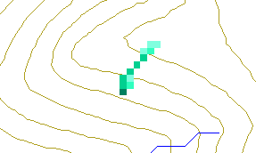
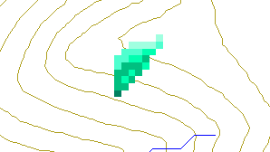
Single Flow Direction Grid — A numerical representation of the flow direction field in which each cell takes on one of eight values depending on which of its eight neighboring cells is in the direction of steepest descent
Multiple Flow Direction Grid — A numerical representation of the flow direction field in which flow is partitioned between one or more or the eight neighboring cells such that proportions add up to one

Slide 28

The D∞ Algorithm
Tarboton, D. G., (1997), "A New Method for the Determination of Flow Directions and Contributing Areas in Grid Digital Elevation Models," Water Resources Research, 33(2): 309-319.) (http://www.engineering.usu.edu/cee/faculty/dtarb/dinf.pdf)

Slide 29
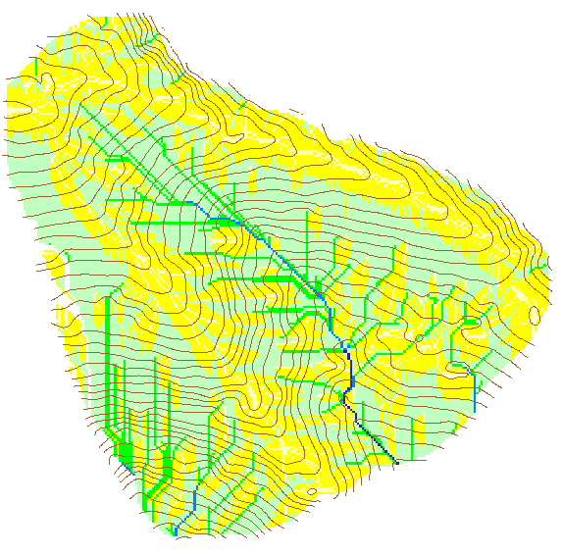

Contributing Area using D∞
Contributing Area using D8

Slide 30
Multiple flow direction grid accumulation functions

Slide 31
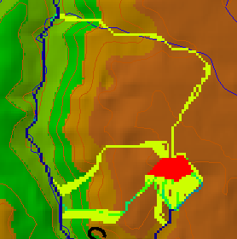
Useful for example to track where sediment or contaminant moves

Slide 32
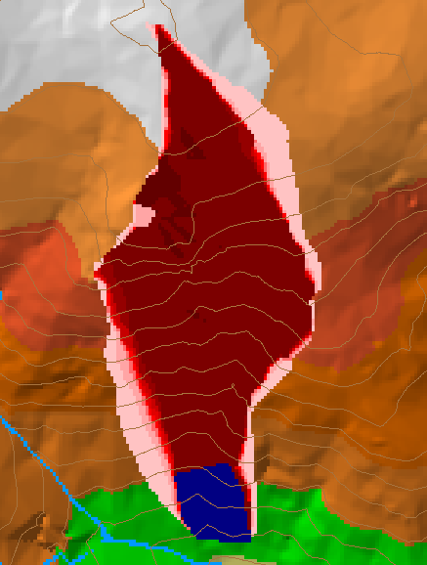
Useful for example to track where a contaminant may come from

Slide 33

Useful for a tracking contaminant or compound subject to decay or attenuation

Slide 34
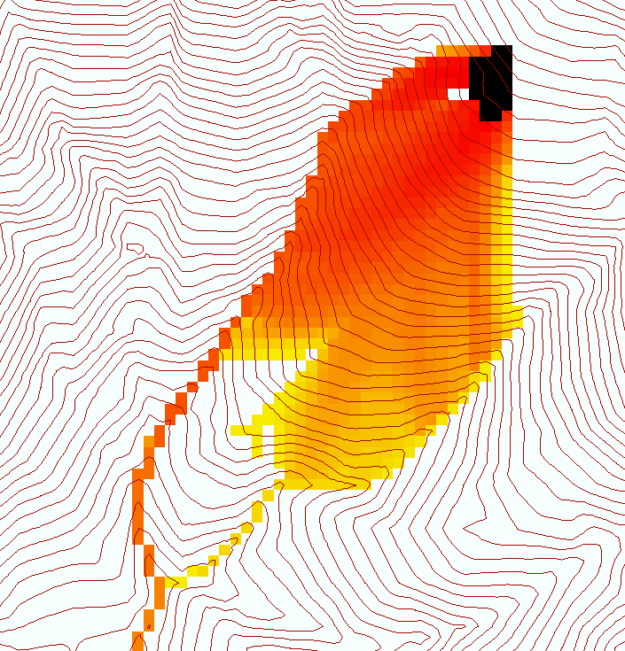
Useful for a tracking a contaminant released or partitioned to flow at a fixed threshold concentration

Slide 35
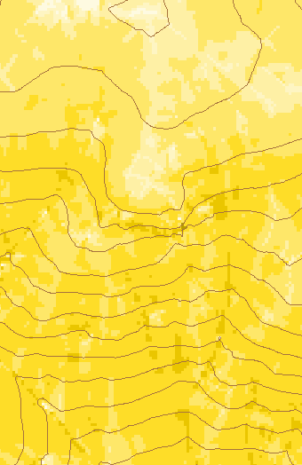
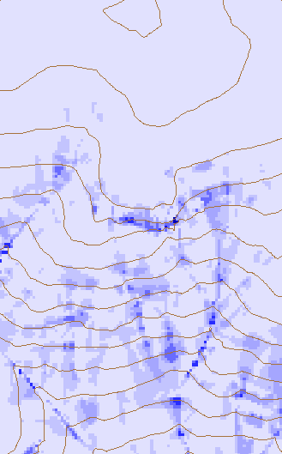
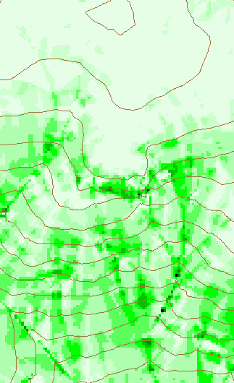
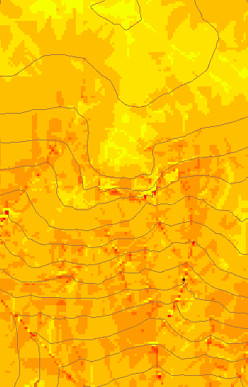
Transport limited accumulation
Useful for modeling erosion and sediment delivery, the spatial dependence of sediment delivery ratio and contaminant that adheres to sediment

Slide 36
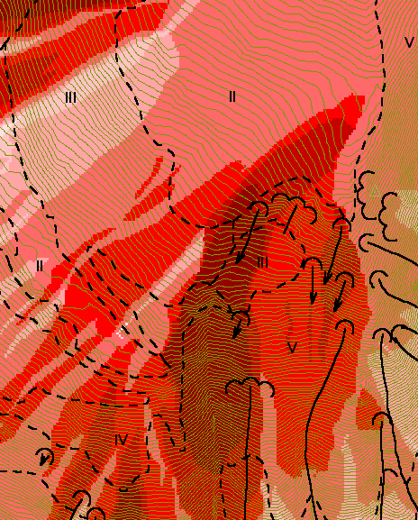
Reverse Accumulation
Useful for destabilization sensitivity in landslide hazard assessment
with Bob Pack

Slide 37
Suggestions for Terrain Analysis Tools for ArcGIS
All of the above
Of course !
Already available as TauDEM ArcGIS toolbar but lacking in support and robustness

Slide 38
Things that could be implemented quickly
Generalized channel network delineation
Geomorphologically based routing of flow across flats (Garbrecht and Martz, 1997)
Multiple flow direction data structure – more general than D∞ angles (and not in radians)
  D∞ flow directions
  Slope^{α} proportioned flow directions
MFD derived functions
  Contributing area (accumulation, weighted, downslope influence)
  Upslope dependence
Edge contamination

Slide 39
Intermediate term or more specialized functions
Additional MFD derived functions
  Transport limited accumulation
  Concentration limited accumulation
  Reverse accumulation
  "average" distance to streams
  Wetness index
  Decaying accumulation
  Partial contributing area
Generalized drainage correction
Hydrologic model integration

Slide 40
Are there any questions ?
AREA 2
3
AREA 1
12
http://www.engineering.usu.edu/dtarb

