Slide 1
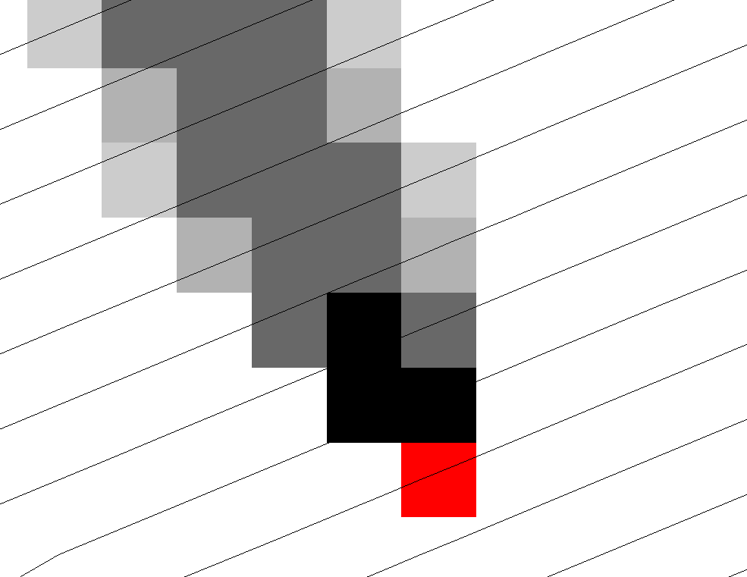
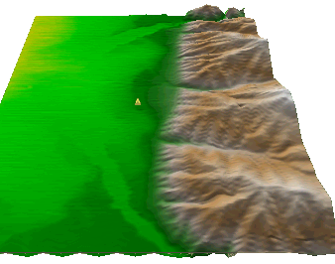
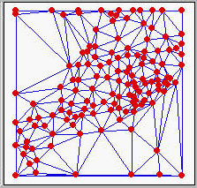
Generalized methods for terrain-based flow analysis of digital elevation models
David G. Tarboton, Utah Water Research Laboratory, Department of Civil and Environmental Engineering, Utah State University, Logan, Utah, USA, david.tarboton@usu.edu
Matthew E. Baker, Department of Watershed Sciences and The Ecology Center, Utah State University, Logan, Utah, USA, matt.baker@usu.edu
Abstract
Topography is an important land surface attribute for hydrology that, in the form of Digital Elevation Models (DEMs), is widely used to derive information for the modeling of hydrologic processes. Much hydrologic terrain analysis is conditioned upon an information model for the topographic representation of downslope flow derived from a DEM, which enriches the information content of digital elevation data. This information model involves procedures for removing spurious sinks, deriving a structured flow field, and calculating derivative surfaces. We present a general method for recursive flow analysis that exploits this information model for calculation of a rich set of flow-based derivative surfaces beyond current weighted flow accumulation approaches commonly available in Geographic Information Systems, through the integration of multiple inputs and a broad class of algebraic rules into the calculation of flow related quantities. This flow algebra encompasses single and multi-directional flow fields, various topographic representations, weighted accumulation algorithms, and enables untapped potential for a host of application-specific functions. We illustrate the potential of flow algebra by presenting examples of new functions enabled by this perspective that are useful for hydrologic and environmental modeling. Future opportunities for advancing flow algebra functionality could include the development of a formulaic language that provides efficient implementation and greater access to these methods. There are also opportunities to take advantage of parallel computing for the solution of problems across very large input datasets.
Flow field representations for a grid DEM
Steepest single direction
48
52
56
67
D8
D∞
Models for the digital representation of terrain
More general flow field representations.
Multiple Flow Direction Grid
TIN
-
Base
Voronoi
Grid
Contour-Flow-Tube Grid
Physical Network
Physical Network
2
5
Physical Network
2
2
4
4
6
6
1
1
3
6
7
4
1
5
1
5
3
5
3
3
4
2
a) Grid
Topological Network
Topological Network
2
Topological Network
1
2
2
6
1
6
2
4
P
1
3
P
=0.5
=0.5
P
P
=0.7
12
=0.7
P
=0.4
P
=1
12
25
P
24
=1
P
=1
25
5
P
13
4
36
46
=0.3
5
=0.5
=0.3
=0.6
=0.7
=0.5
24
14
=0.6
P
47
=1
13
24
P
P
13
P
=1
P
14
36
P
P
P
13
=0.4
P
35
=0.3
P
3
34
P
25
=1
P
=1
7
1
5
3
4
57
3
4
2
5
Contributing Area
b) Triangulated Irregular Network
c) Contour and flowline
Definition
Terrain based flow data model for enriching the information content of a raw digital elevation model (DEM)
r(x)
Numerical Evaluation
x
Sink Removal
Flow Field
Flow Related Terrain Information
Numerical flow field representation
P_{ij} such that
Information science includes the precise representation of physical environments using data models that enhance the capability for analysis and integration of information.

Slide 2
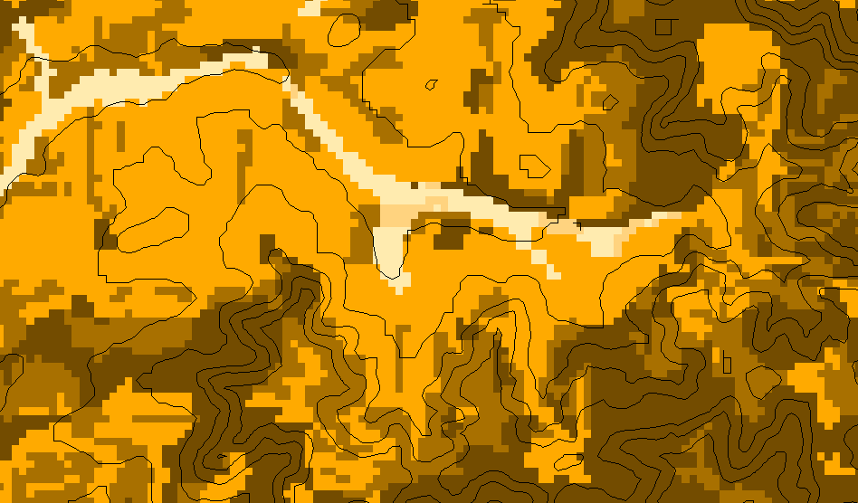
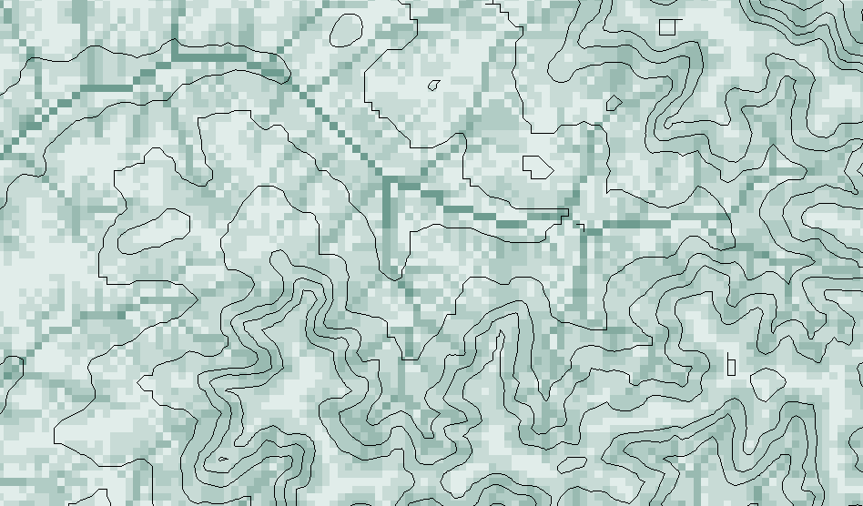
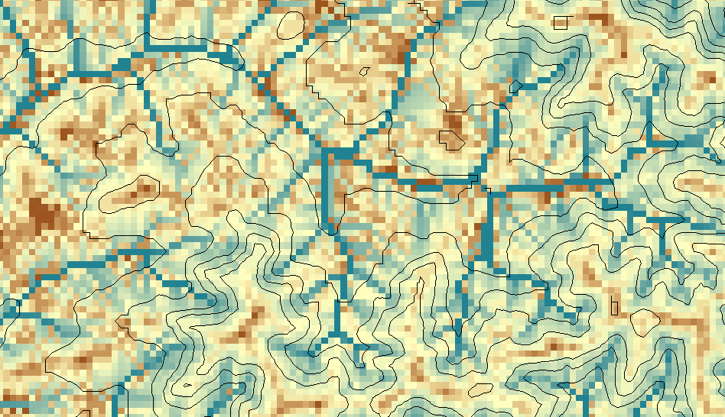
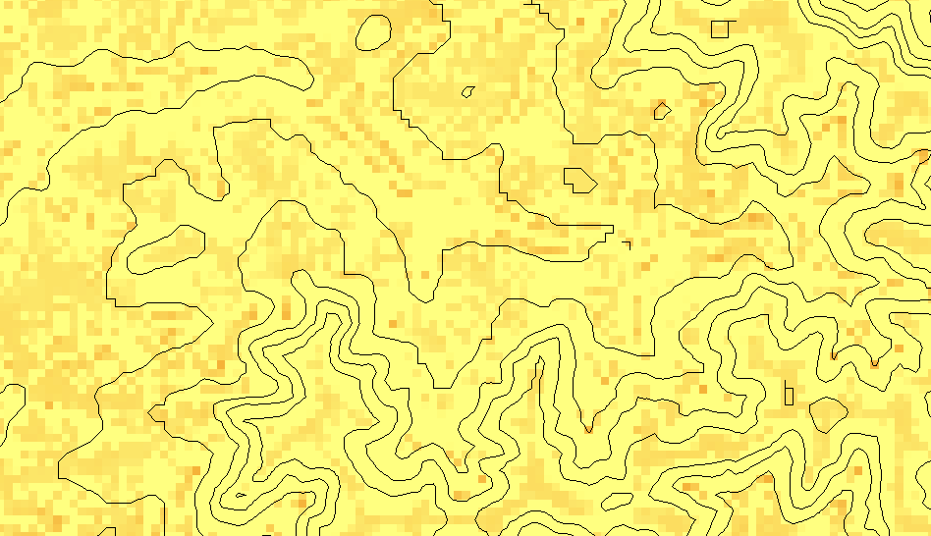
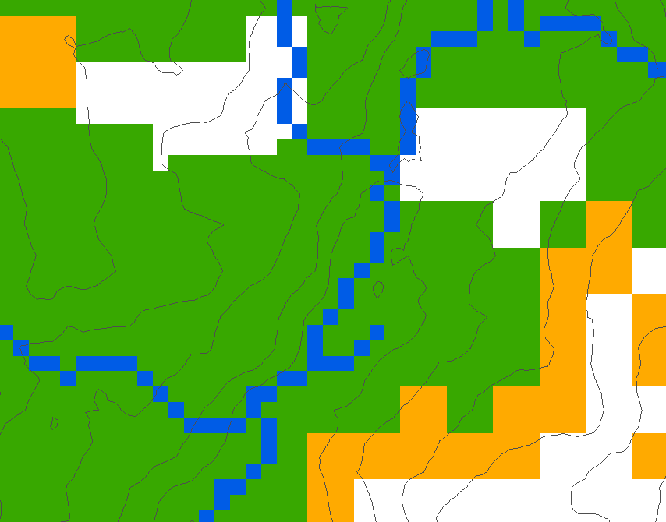
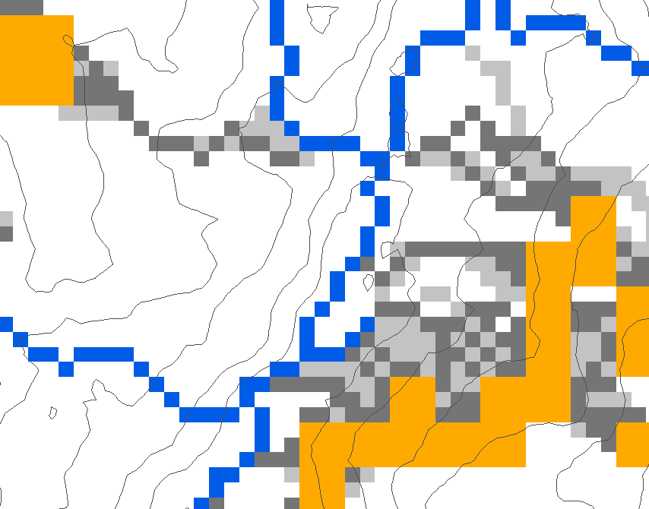
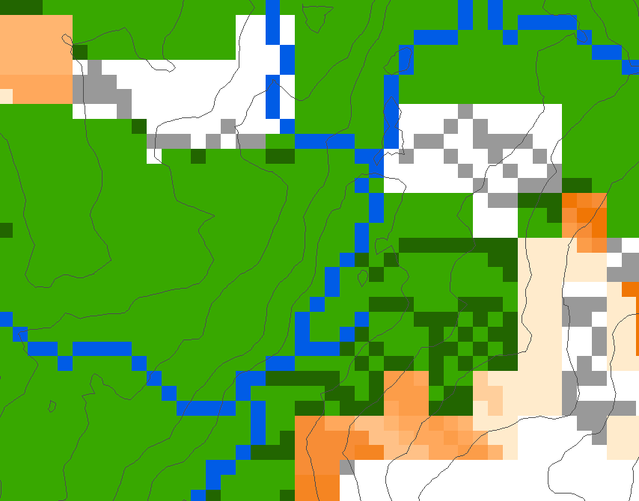
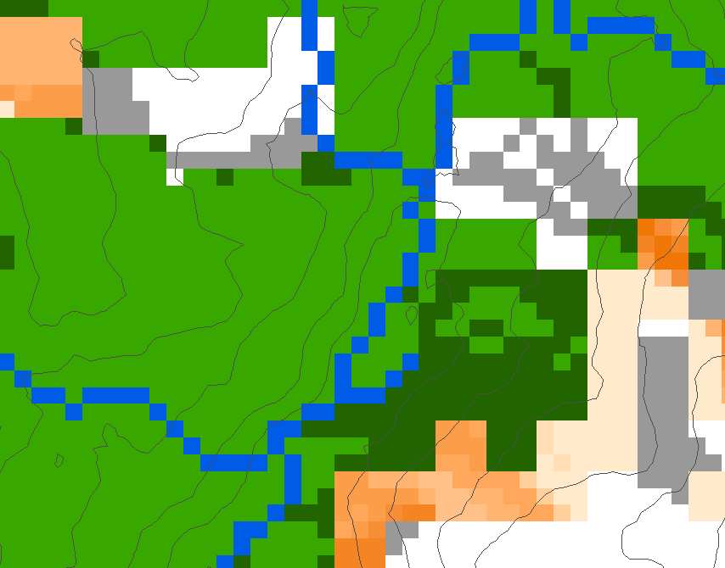
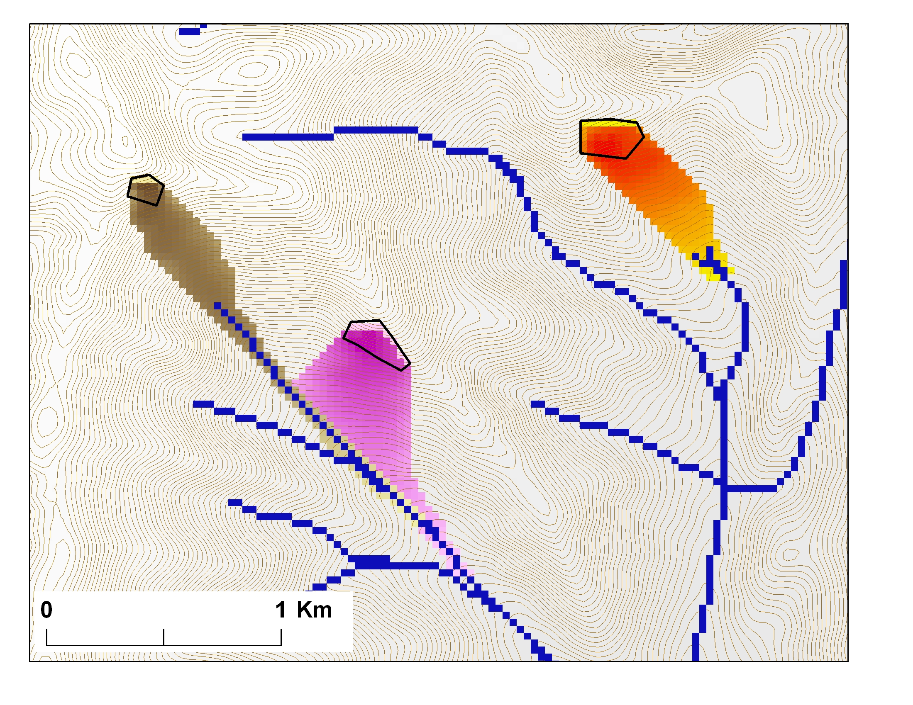
Recursive Flow Analysis – Flow Algebra
A new formalism for deriving flow-based information useful for hydrologic and environmental modeling that embeds additional information and mathematical logic into the recursive flow analysis algorithm
Examples of functions constructed using Flow Algebra
Weighted Flow Distance
Transport limited accumulation
30*0.5/2
0
0
0
0
0
Transport a function of distributed supply and transport capacity.
7.5+42.4*
(0.7+0.5)/2
7.5
32.9
A. Supply
B. Capacity
T
cap
=
χa
2
tan(
β
)
2
38.2
38.2
38.2
38.2
30
38.2
C. Transport
D. Deposition
Stream
D∞ Downslope
Influence
Buffer
Source
D8 Accumulation
Avalanche Runout
A. Inputs
0-10
10-20
20-30
30-40
40-50
50-60
60-70
70-80
80-90
>90m
B. Flow paths
Upslope recursion to determine elevation and distance to point in trigger zone that has the highest alpha angle
1
2
α
3
C. D8 Buffer
D. D∞ Buffer
Weighted flow length-to-stream measures used in buffer analyses for water quality modeling in tributaries of Chesapeake Bay, Maryland, USA.
Decaying Accumulation.
The load r(x) is assumed to move with the flow field but subject to first order decay, d(x), in moving from cell to cell
Conclusions and Future Directions
The terrain based flow field derived from (1) drainage correction and (2) multidirectional proportioning among downslope neighbors, enables a broad class of upstream and downstream recursive functions that comprise flow algebra.
Flow proportions used in flow algebra should sum to one and be non-circulating as is the case for flow derived from the gradient of any potential field.
Flow algebra provides a formalism for thinking about and modeling spatial processes that are related to, or occur embedded within the flow field.
Flow algebra offers the opportunity to reduce some of the gap between real world observations and digital representations of physical processes.
A formulaic language based on flow algebra would provide a computational modeling frameworks that enables the implementation and rapid evaluation of new theories and field based concepts
Flow algebra is not limited to grids or single flow direction approaches and provides a more inclusive modeling framework for flow-related modeling
Efficient implementation taking advantage of block data structures and parallel processing is needed for application to large datasets
For more information, see: Tarboton, D. G. and M. E. Baker, (2008, in press), "Towards an Algebra for Terrain-Based Flow Analysis," in Representing, Modeling and Visualizing the Natural Environment: Innovations in GIS 13, Edited by N. J. Mount, G. L. Harvey, P. Aplin and G. Priestnall, CRC Press, Florida.
TauDEM software available from http://www.engineering.usu.edu/dtarb
Acknowledgements
Some funding for this project was provided by CICEET, the Cooperative Institute for Coastal and Estuarine Environmental Technology. A partnership of the National Oceanic and Atmospheric Administration (NA06NOS4190167) and the University of New Hampshire, CICEET develops tools for clean water and healthy coasts nationwide.

