Slide 1


Hydrologic Terrain Processing Using Parallel Computing
David Tarboton¹, Dan Watson², Rob Wallace,³ Kim Schreuders¹, Teklu Tesfa¹
¹Utah Water Research Laboratory, Utah State University, Logan, Utah
¹Computer Science, Utah State University, Logan, Utah
³US Army Engineer Research and Development Center, Information Technology Lab, Vicksburg, Mississippi
This research was funded by the US Army Research and Development Center under contract number W9124Z-08-P-0420

Slide 2



Hydrologic Terrain Analysis
Raw DEM
Sink Removal
Flow Field
Flow Related Terrain Information
to derive hydrologic information, and inputs to hydrologic models from digital elevation data

Slide 3




The challenge of increasing Digital Elevation Model (DEM) resolution
1980’s DMA 90 m
10² cells/km²
1990’s USGS DEM 30 m
10³ cells/km²
2000’s NED 10-30 m
10⁴ cells/km²
2010’s LIDAR ~1 m
10⁶ cells/km²

Slide 4
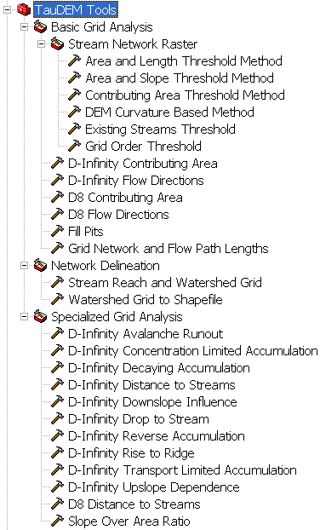

A parallel version of the TauDEM Software Tools
Improved runtime efficiency
Capability to run larger problems
Platform independence of core functionality

Slide 5
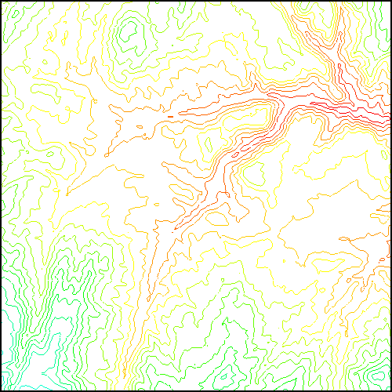
Parallel Approach
MPI, distributed memory paradigm
Row oriented slices
Each process includes one buffer row on either side
Each process does not change buffer row

Slide 6
Pit Removal: Planchon Fill Algorithm
Initialization
1st Pass
2nd Pass
Planchon, O., and F. Darboux (2001), A fast, simple and versatile algorithm to fill the depressions of digital elevation models, Catena(46), 159-176.

Slide 7
Parallel Scheme
Communicate
Initialize( Z,F) Do for all grid cells i if Z(i) > n F(i) ← Z(i) Else F(i) ← n i on stack for next pass endfor Send( topRow, rank-1 ) Send( bottomRow, rank+1 ) Recv( rowBelow, rank+1 ) Recv( rowAbove, rank-1 ) Until F is not modified
Z denotes the original elevation.
F denotes the pit filled elevation.
n denotes lowest neighboring elevation
i denotes the cell being evaluated
Iterate only over stack of changeable cells

Slide 8
Parallel Pit Remove Timing
GSL100 (4045 x 7402 = 29.9 x 10⁶ cells ≈ 120 MB)
Dual Quad Core Xeon Proc E5405, 2.00GHz

Slide 9
Parallel Pit Remove Stack vs Domain Iteration Timing
GSL100 (4045 x 7402 = 29.9 x 10⁶ cells ≈ 120 MB)
it is important to limit iteration to unresolved grid cells
Dual Quad Core Xeon Proc E5405, 2.00GHz

Slide 10
Parallel Pit Remove Block vs Cell IO Timing
GSL100 (4045 x 7402 = 29.9 x 10⁶ cells ≈ 120 MB)
it is important to use block IO
Dual Quad Core Xeon Proc E5405, 2.00GHz

Slide 11
Parallel Pit Remove Timing
NEDB (14849 x 27174 = 4 x 10⁸ cells ≈ 1.6 GB)
Dual Quad Core Xeon Proc E5405, 2.00GHz

Slide 12
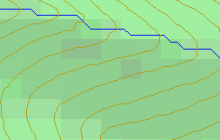
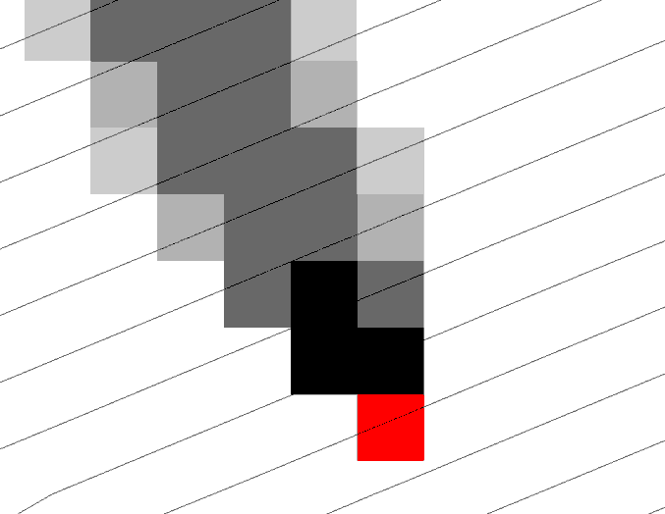
Representation of Flow Field
D8
D∞
Tarboton, D. G., (1997), "A New Method for the Determination of Flow Directions and Contributing Areas in Grid Digital Elevation Models," Water Resources Research, 33(2): 309-319.)
Notes:
This slide shows how the terrain flow field is represented. Early DEM work used a single flow direction model, D8. In 1997 I published the Dinfinity method that proportions flow from each grid cell among downslope neighbors. This, at the expense of some dispersion, allows a better approximation of flow across surfaces.

Slide 13
Pseudocode for Recursive Flow Accumulation
FlowAccumulation(i) for all k neighbors of i if P_{ki}>0 FlowAccumulation(k) next k return
P_{ki}
P_{ki}
P_{ki}
i
θ_{i} = FA(γ_{i}, P_{ki}, θ_{k}, γ_{k})
or generalized flow algebra

Slide 14
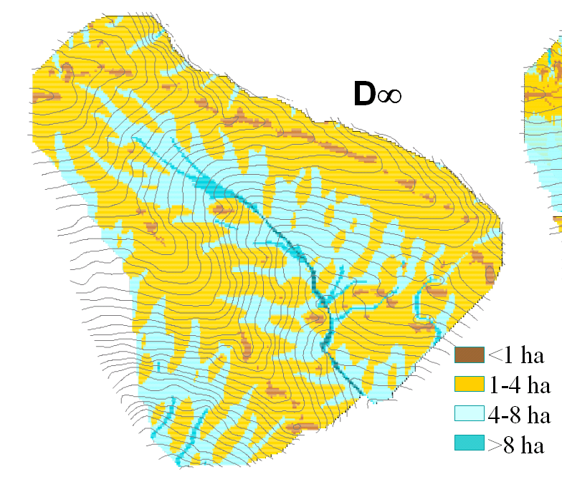
Used to evaluate Contributing Area

Slide 15
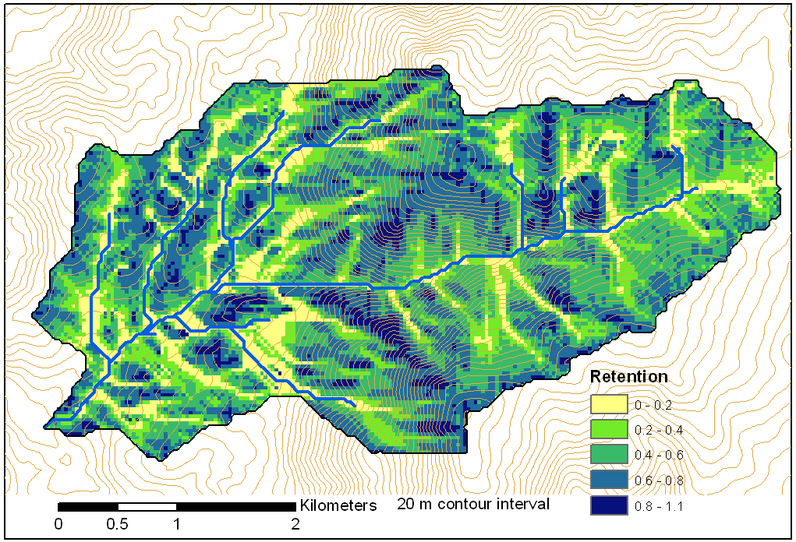
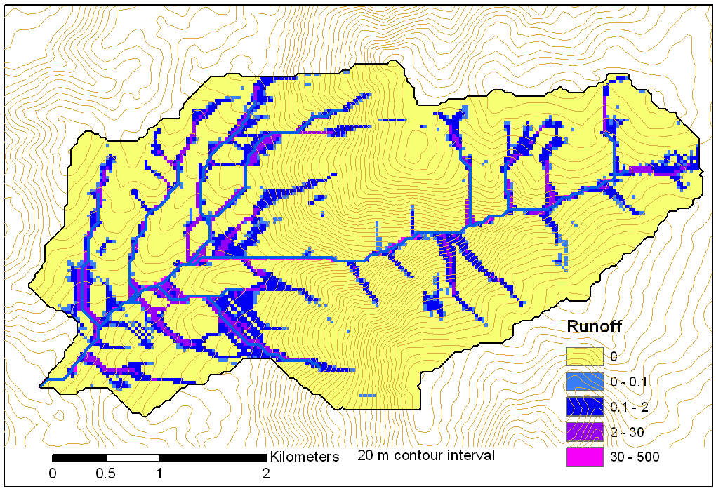
Or extended to more general concepts such as retention limited runoff generation with run-on
FlowAlgebra(i) for all k neighbors of i if P_{ki}>0 FlowAlgebra(k) next k return
q_{k}
r
q_{i}
c

Slide 16
and decaying accumulation
Useful for a tracking contaminant or compound movement subject to decay or attenuation

Slide 17
Parallelization of Contributing Area/Flow Algebra
1. Dependency grid
and so on until completion
resulting in new D=0 cells on queue
Queue’s empty so exchange border info.
Decrease cross partition dependency
Executed by every process with grid flow field P, grid dependencies D initialized to 0 and an empty queue Q. FindDependencies(P,Q,D) for all i for all k neighbors of i if P_{ki}>0 D(i)=D(i)+1 if D(i)=0 add i to Q next
A=1
A=1
A=1
A=1
A=1
A=1
A=1
A=1
D=0
A=1
A=1
A=1
A=1
D=0
D=0
A=1
A=1
A=1
D=0
D=0
A=1
D=0
A=1
A=1
A=1
A=1
A=1
A=1.5
A=1.5
A=3
D=0
A=1.5
A=1.5
D=1
D=0
D=1
D=0
D=0
A=3
D=0
D=3
D=2
D=1
D=0
D=0
D=1
D=1
A=1.5
D=1
A=1.5
A=3
A=3
A=1.5
A=1.5
2. Flow algebra function
B=-2
B=-1
Executed by every process with D and Q initialized from FindDependencies. FlowAlgebra(P,Q,D,θ,γ) while Q isn’t empty get i from Q θ_{i} = FA(γ_{i}, P_{ki}, θ_{k}, γ_{k}) for each downslope neighbor n of i if P_{in}>0 D(n)=D(n)-1 if D(n)=0 add n to Q next n end while swap process buffers and repeat
B=-2
B=-1
A=1
A=1
D=2
D=2
D=1
A=1
D=1
A=1
D=0
A=1
A=1
D=2
D=2
D=2
D=2
D=2
D=1
D=1
D=1
D=1
A=1
D=1
A=1
A=5.5
D=0
A=2.5
D=0
A=1
A=1
D=1
D=1
D=1
A=1
D=1
A=1
D=0
D=0
A=1
D=1
D=1
D=3
D=2
D=1
D=1
D=1
D=1
D=1
A=1
D=1
A=1
D=1
A=6
A=3.5
D=1

Slide 18
D-infinity Contributing Area Timing
GSL100 (4045 x 7402 = 29.9 x 10⁶ cells ≈ 120 MB)
Dual Quad Core Xeon Proc E5405, 2.00GHz

Slide 19
D-infinity Contributing Area Timing
Boise River (24856 x 24000 = 5.97 x 10⁸ cells ≈ 2.4 GB)
Dual Quad Core Xeon Proc E5405, 2.00GHz

Slide 20
Limitations and Dependencies
Uses MPICH2 library from Argonne National Laboratory http://www.mcs.anl.gov/research/projects/mpich2/
TIFF (GeoTIFF) 4 GB file size
[Capability to use BigTIFF and tiled files under development.]
Processor memory

Slide 21
Conclusions
Parallelization speeds up processing and partitioned processing reduces size limitations
Parallel logic developed for general recursive flow accumulation methodology (flow algebra)
New toolbox allows use within model builder
Methods and software soon to be available in TauDEM at: http://www.engineering.usu.edu/dtarb

