Slide 1
New TauDEM Tools for Deriving Hydrologic Information from Digital Elevation Models
David G. Tarboton
Kimberly A. T. Schreuders
Matthew E. Baker
david.tarboton@usu.edu
http://www.engineering.usu.edu/dtarb

Slide 2



Hydrologic Terrain Analysis Information Model
DEM
Sink Removal
Flow Field
Flow Related Terrain Information

Slide 3
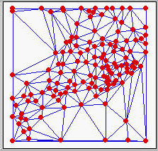
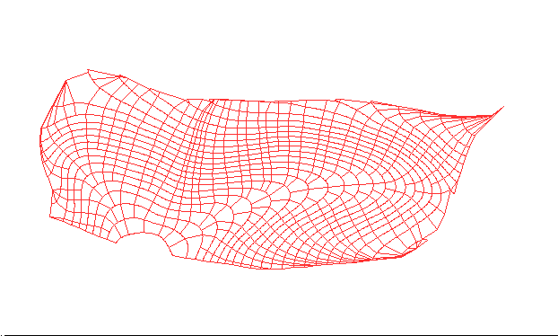
Models for the digital representation of terrain
a) Grid
b) Triangulated Irregular Network
c) Contour and flowline

Slide 4
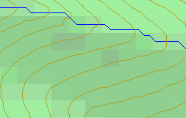
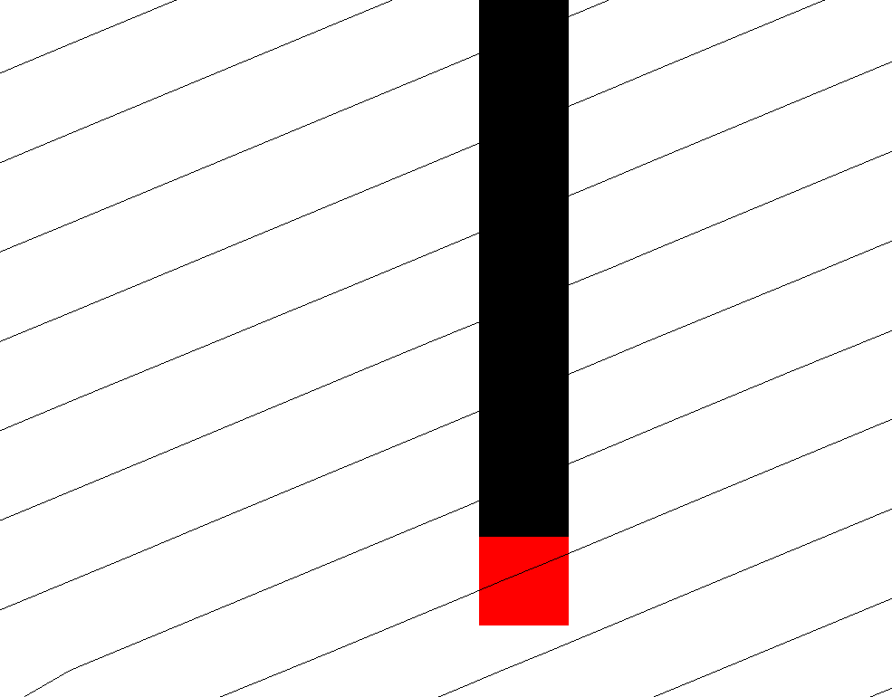
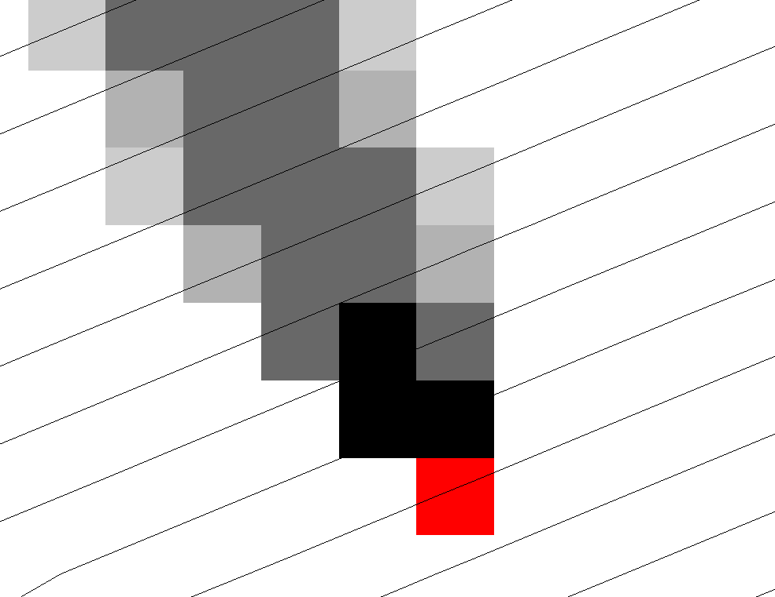
Representation of Flow Field
Steepest single direction
48
52
56
67
D8
D∞

Slide 5
Contributing Area using D∞
Contributing Area using D8
<1 ha
1-4 ha
4-8 ha
>8 ha

Slide 6
More general flow field representations.
Multiple Flow Direction Grid
TIN
-
Base
Voronoi
Grid
Contour-Flow-Tube Grid
Physical Network
Physical Network
Physical Network
2
2
5
2
4
4
6
6
1
3
6
1
4
7
1
5
1
5
3
5
3
2
3
4
Topological Network
Topological Network
Topological Network
2
1
2
2
6
1
6
2
4
P
1
3
P
=0.5
=0.5
P
P
=0.7
12
=0.7
P
=0.4
P
=1
12
25
25
13
36
P
24
=1
P
=1
5
P
4
46
=0.3
5
=0.5
=0.3
=0.6
=0.7
=0.5
14
=0.6
P
24
47
=1
13
24
P
P
13
P
=1
P
14
36
P
P
P
34
P
13
=0.4
P
35
=0.3
3
P
25
=1
P
=1
7
1
5
3
4
57
3
4
2
5

Slide 7
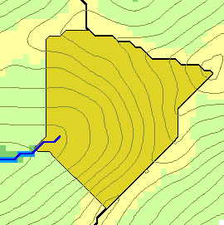
Flow Algebra
r(x)
x

Slide 8
General Pseudocode for Upstream Flow Algebra Evaluation

Slide 9
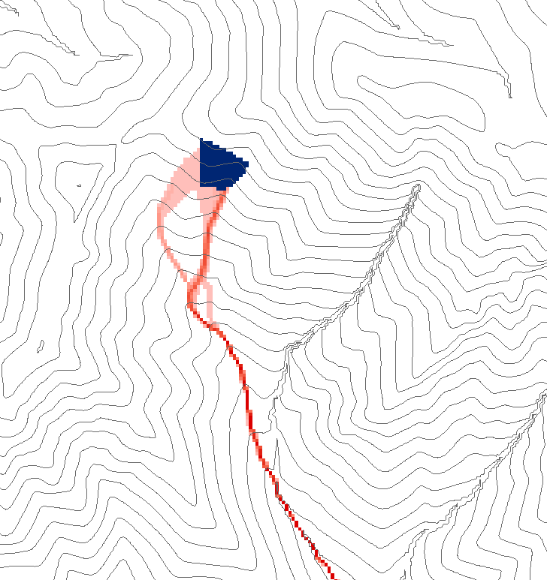
Grid cell y
1
0
0
0.5
0.5
0
0
1
0
0
0.6
0.4
0
0.6
0.4
Influence function of grid cell y
Useful for example to track where sediment or contaminant moves

Slide 10
General Pseudocode for Downstream Flow Algebra Evaluation

Slide 11
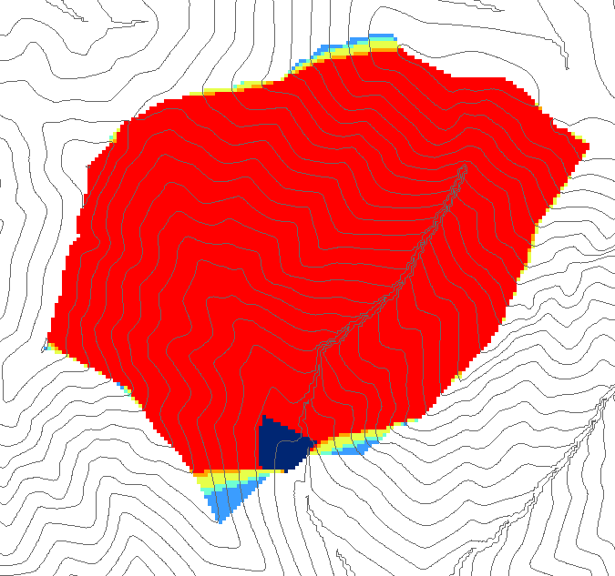
0.6
0
0
0.3
0.3
0
0
0.6
0
0
1
0
0
1
0
Grid cells y
Dependence function of grid cells y
Useful for example to track where a contaminant may come from

Slide 12
Weighted distance to target set.
Example to quantify effectiveness of riparian zone sediment capture based on buffer potential

Slide 13
Buffer potential weighted distance to stream downslope recursion
0
0
0
0
0
30*0.5
15
15+42.4*0.7
44.7
44.7
30
44.7
44.7
44.7
44.7

Slide 14
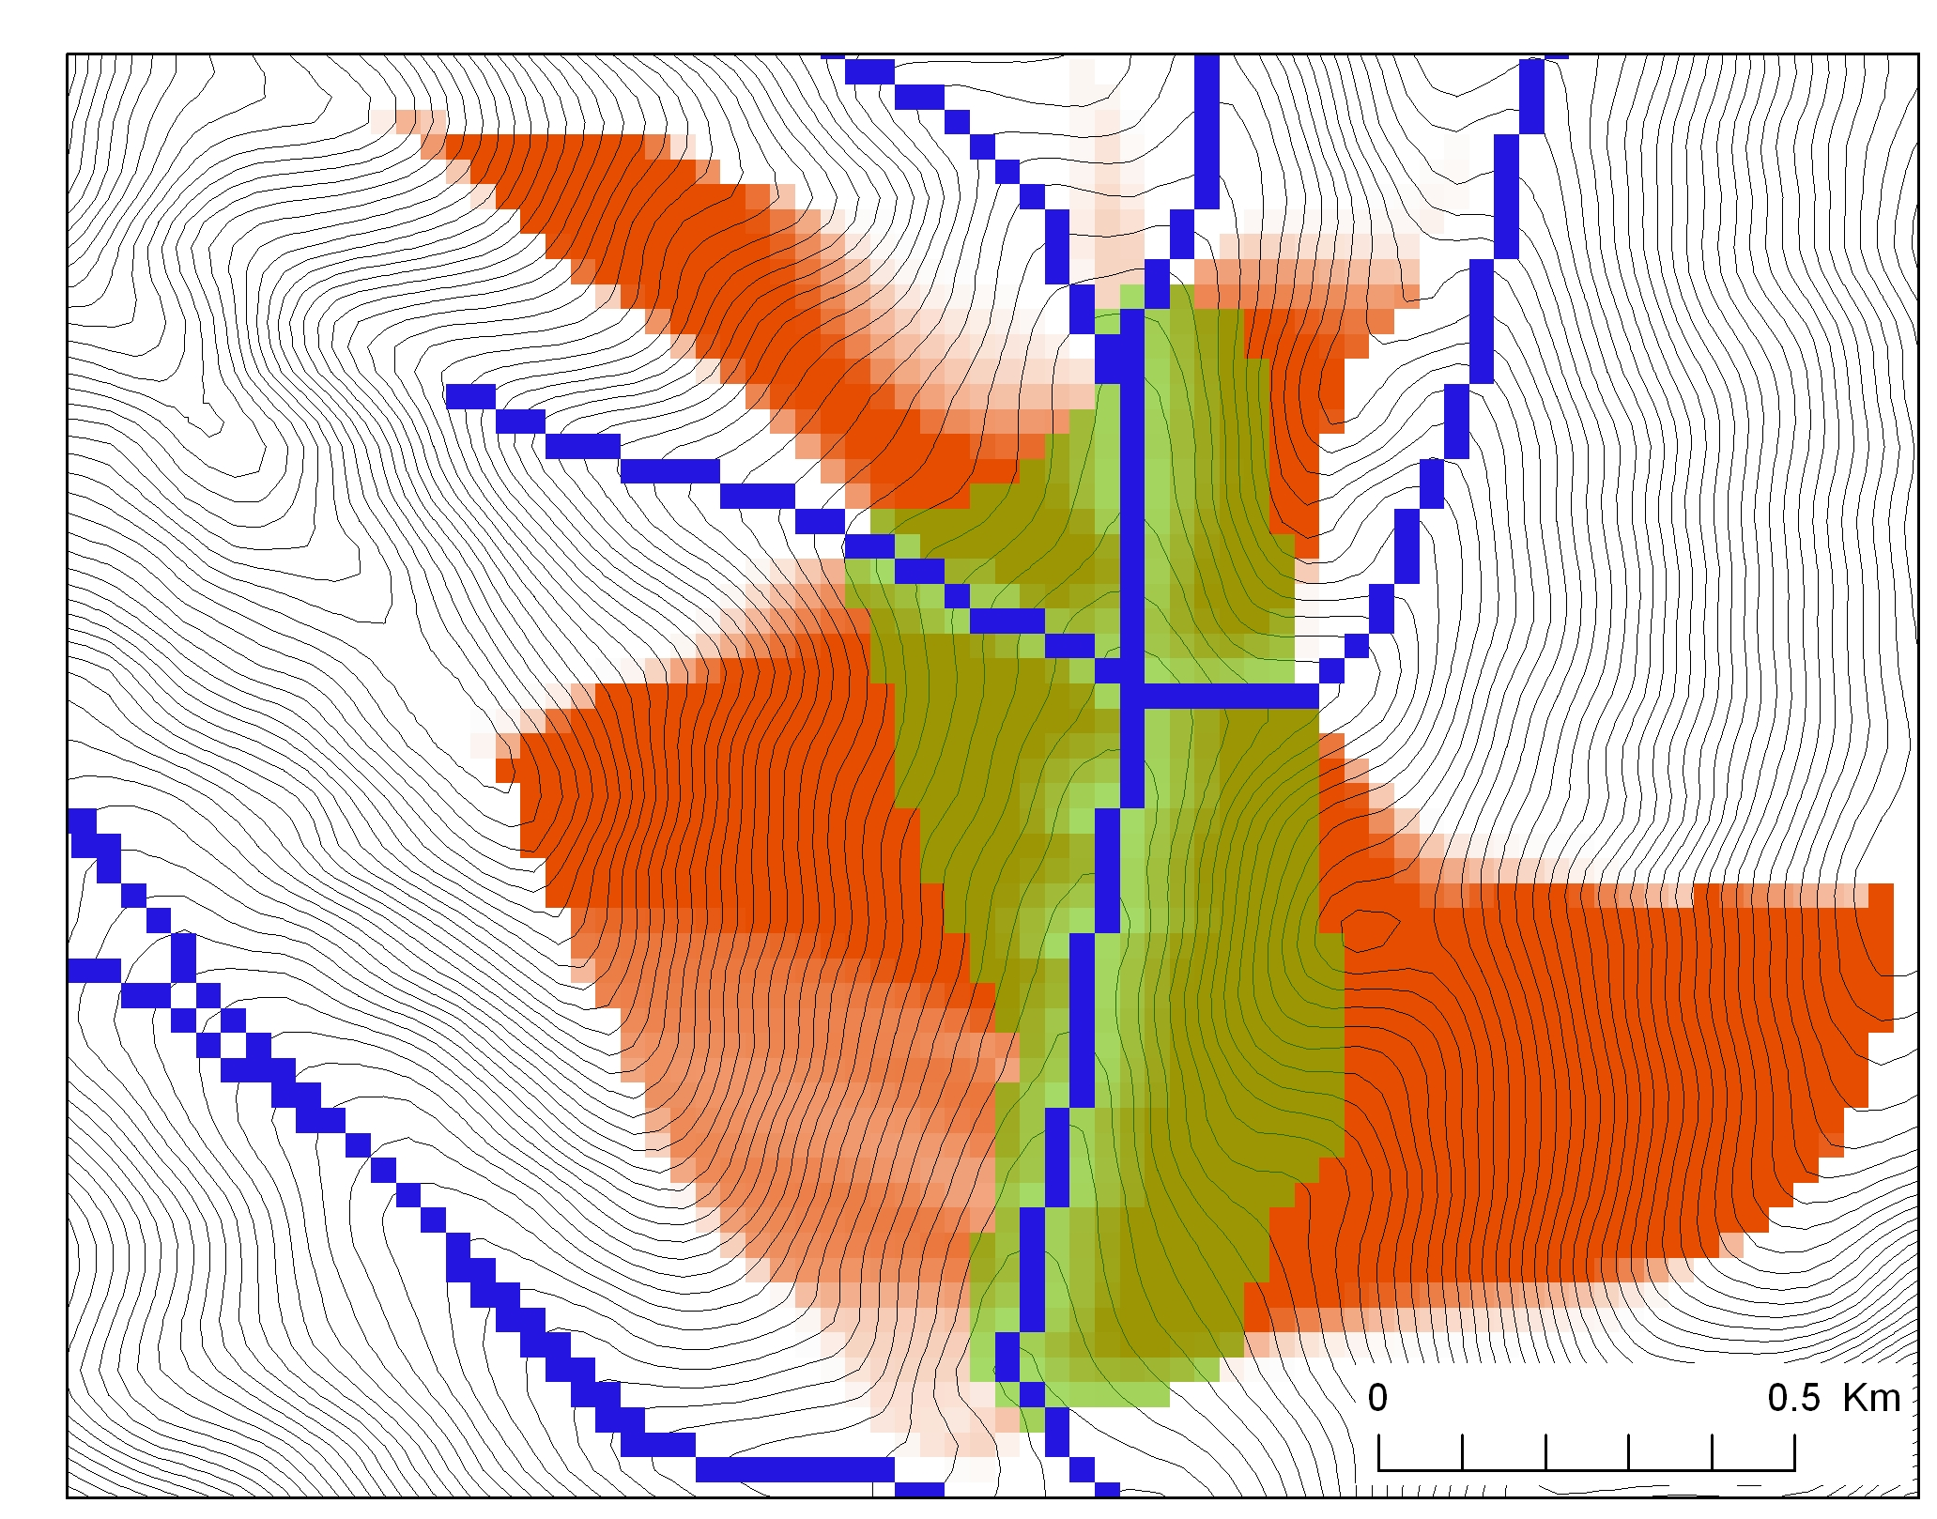
Buffer potential weighted distance to stream

Slide 15
Useful for a tracking contaminant or compound subject to decay or attenuation

Slide 16
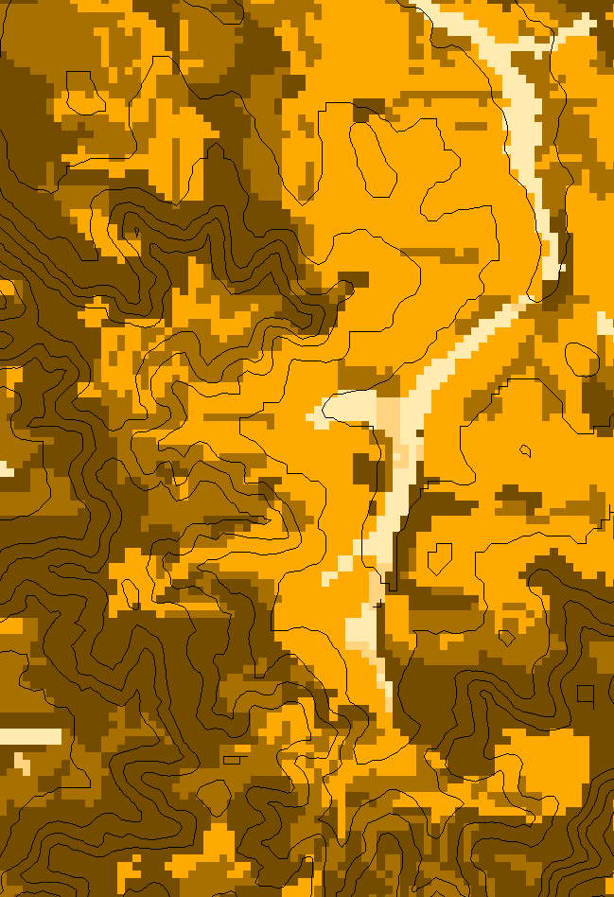
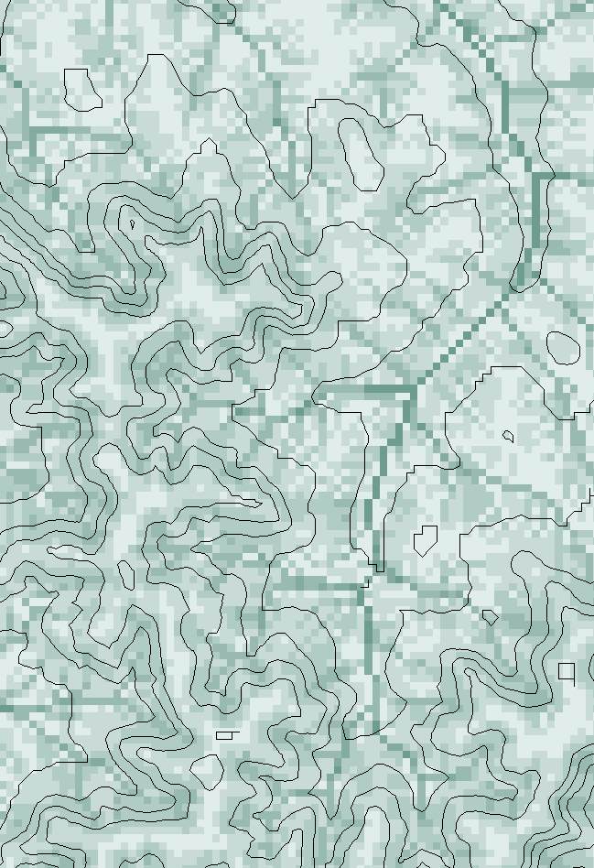
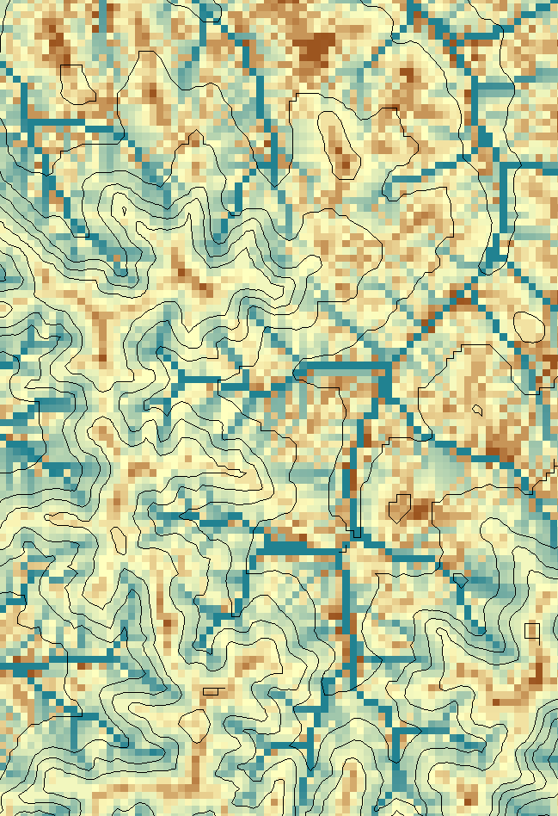
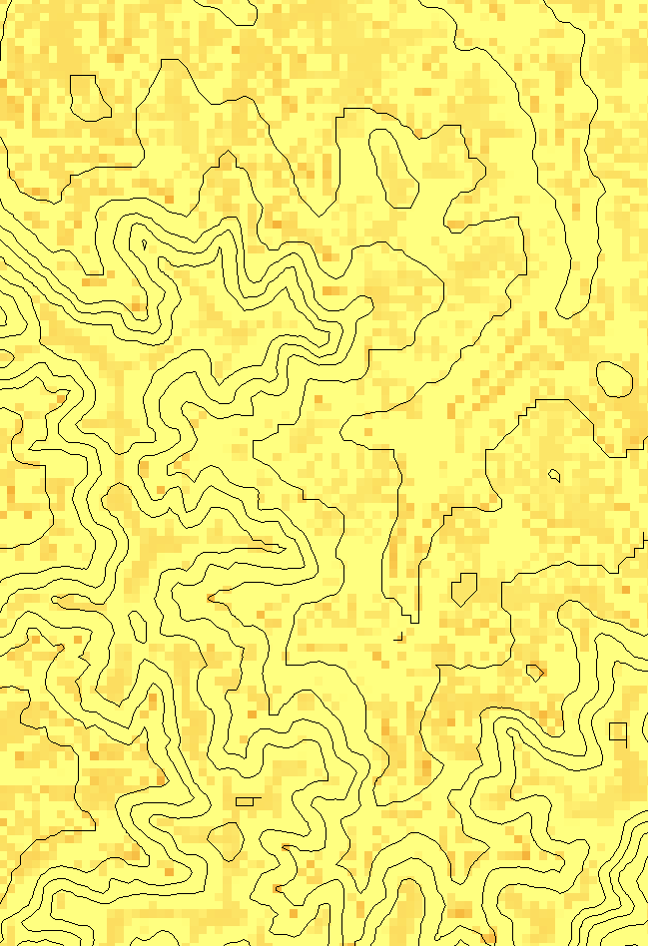
Transport limited accumulation
Supply
Capacity
Transport
Deposition
S
T
=
χa
2
tan(
b
)
2
T
=
min{
S
+
∑
T
,
T
}
D
=
S
+
∑
T
−
T
cap
out
in
cap
in
out
Useful for modeling erosion and sediment delivery, the spatial dependence of sediment delivery ratio and contaminant that adheres to sediment

Slide 17
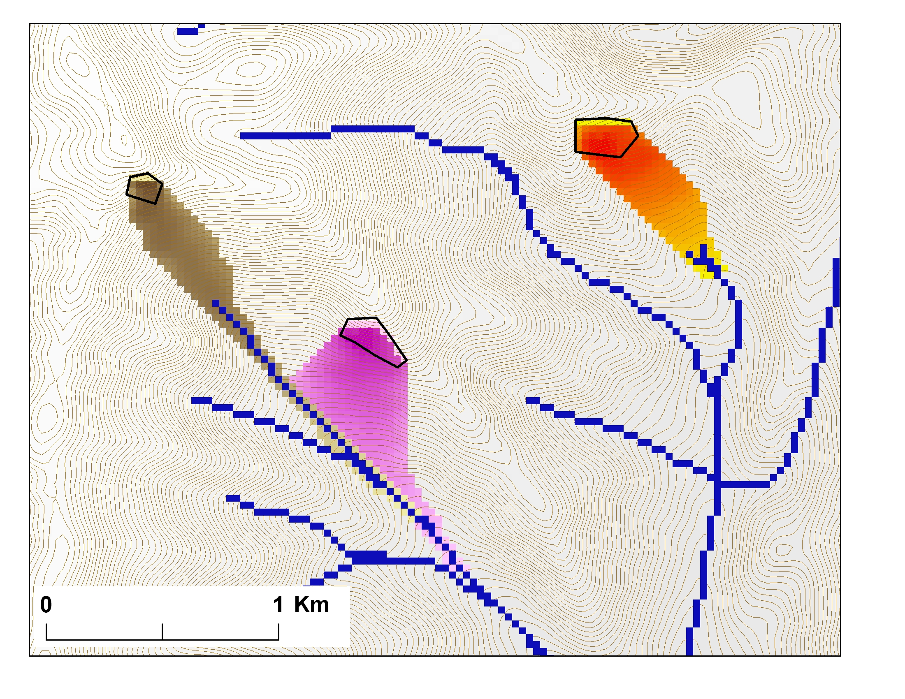
Avalanche Runout
α
Upslope recursion to determine elevation and distance to point in trigger zone that has the highest alpha angle

Slide 18
Conclusions
Terrain based flow data model enriches the information content of digital elevation data
Flow algebra generalizes the recursive flow accumulation methodology
Downslope and upslope recursion
Several new flow algebra functions
Concepts not limited to grids

