Slide 1
Terrain analysis and the modeling of catchment architecture
David G. Tarboton
Kimberly A. T. Schreuders
Matthew E. Baker
david.tarboton@usu.edu
http://www.engineering.usu.edu/dtarb

Slide 2



Hydrologic Terrain Analysis Information Model
DEM
Sink Removal
Flow Field
Flow Related Terrain Information

Slide 3
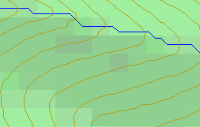
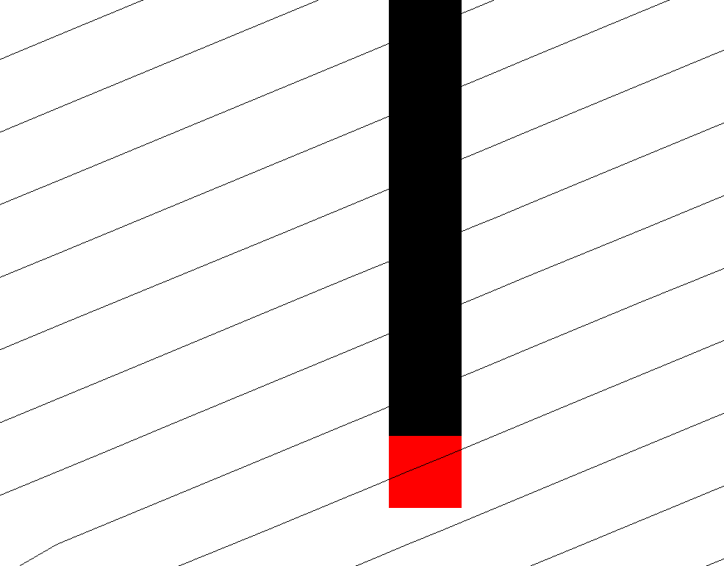
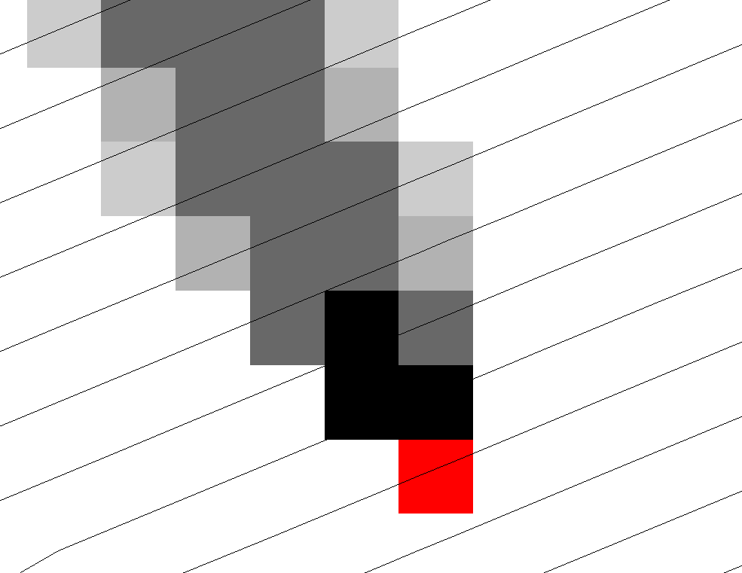
Representation of Flow Field
Steepest single direction
48
52
56
67
D8
D∞

Slide 4
Contributing Area using D∞
Contributing Area using D8
<1 ha
1-4 ha
4-8 ha
>8 ha

Slide 5
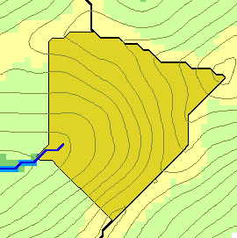
Flow Algebra
r(x)
x

Slide 6
General Pseudocode for Upstream Flow Algebra Evaluation

Slide 7
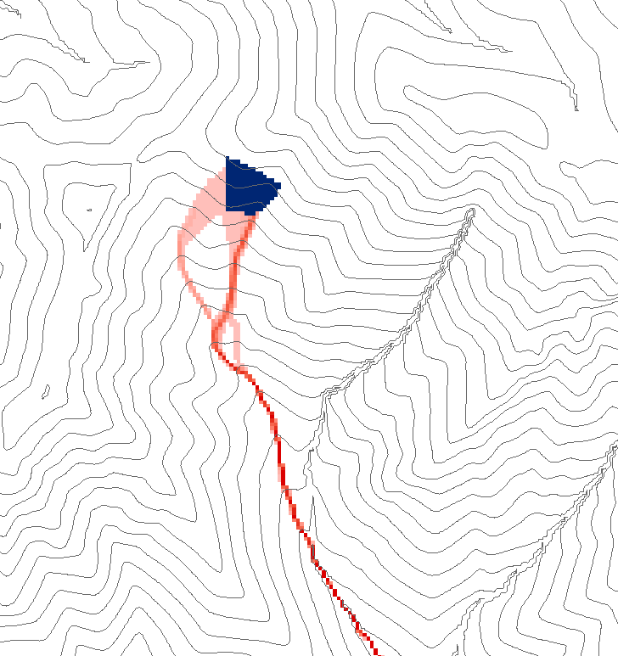
Grid cell y
1
0
0
0.5
0.5
0
0
1
0
0
0.6
0.4
0
0.6
0.4
Influence function of grid cell y
Useful for example to track where sediment or contaminant moves

Slide 8
General Pseudocode for Downstream Flow Algebra Evaluation

Slide 9
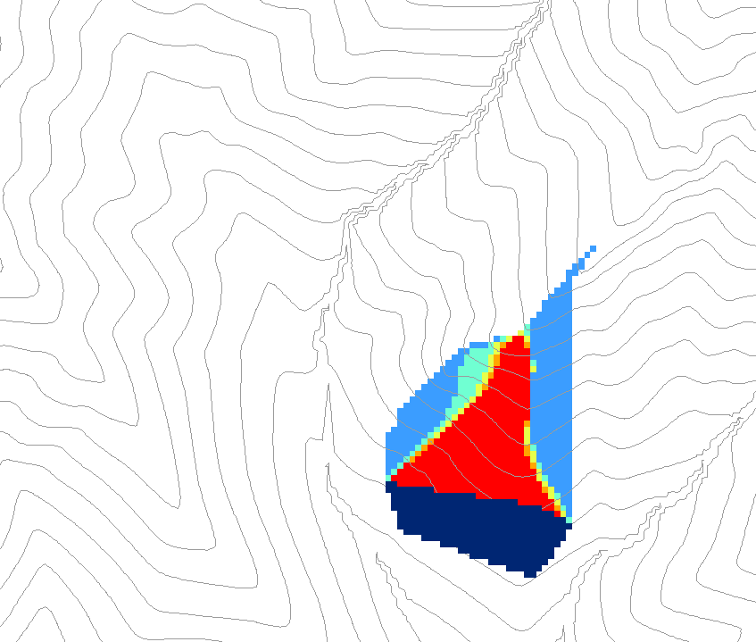
0.6
0
0
0.3
0.3
0
0
0.6
0
0
1
0
0
1
0
Grid cells y
Dependence function of grid cells y
Useful for example to track where a contaminant may come from

Slide 10
Weighted distance to target set.
Example to quantify effectiveness of riparian zone sediment capture based on buffer potential

Slide 11
Buffer potential weighted distance to stream downslope recursion
0
0
0
0
0
30*0.5/2
7.5
7.5+42.4*
(0.7+0.5)/2
32.9
38.2
30
38.2
38.2
38.2
38.2

Slide 12
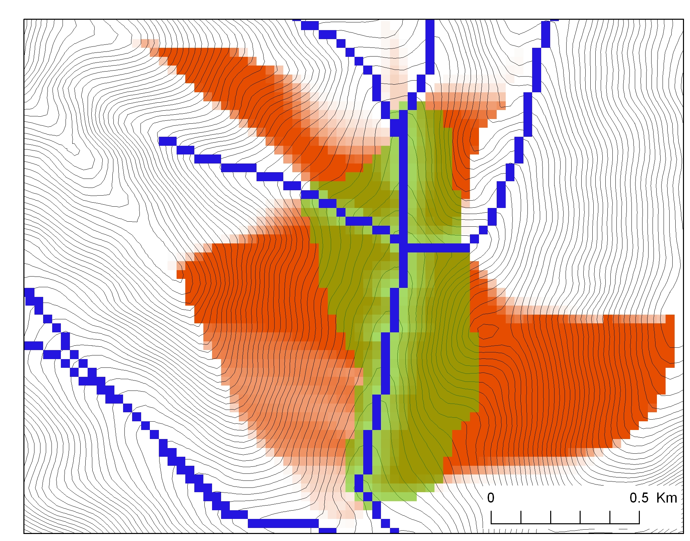
Buffer potential weighted distance to stream

Slide 13
Useful for a tracking contaminant or compound subject to decay or attenuation

Slide 14
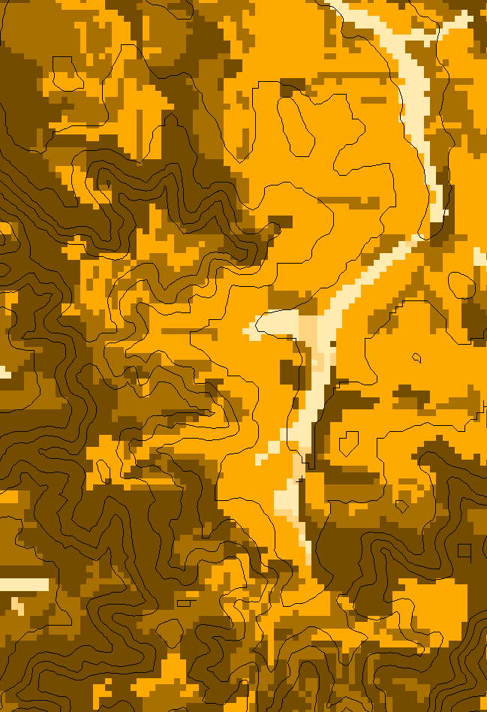
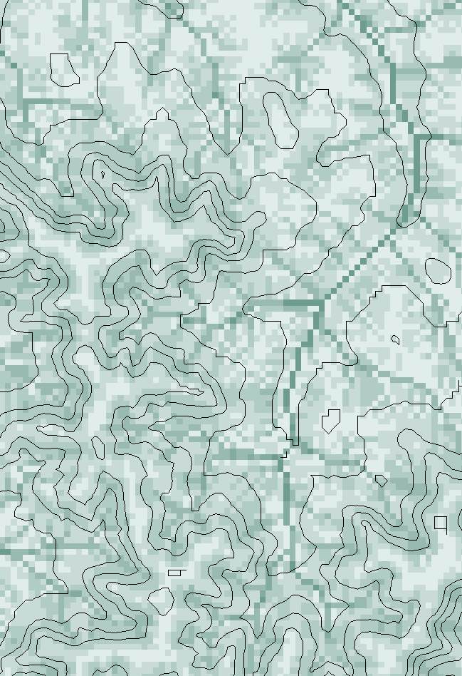
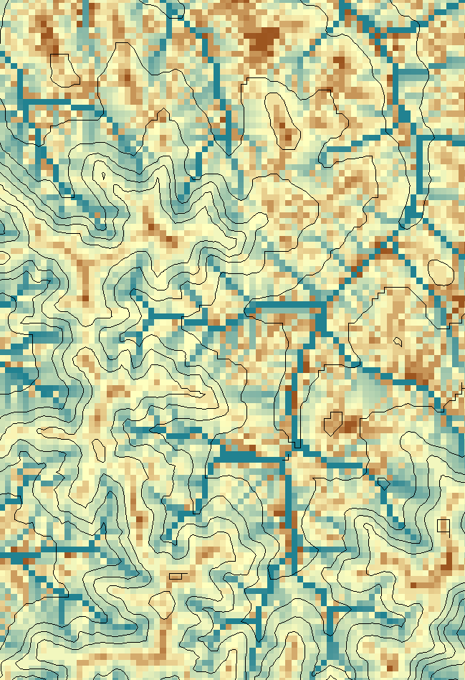
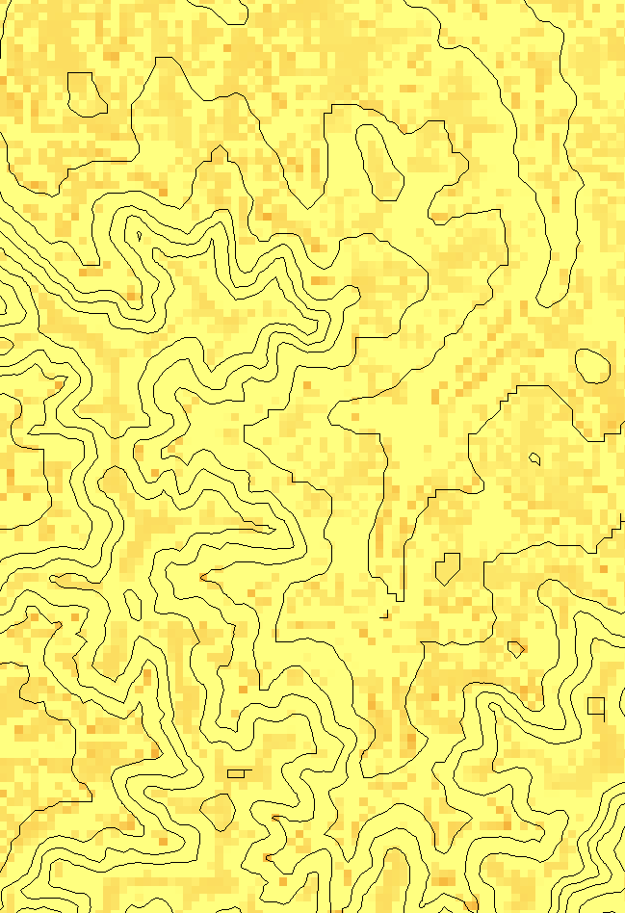
Transport limited accumulation
Supply
Capacity
Transport
Deposition
S
T
=
χa
2
tan(
b
)
2
T
=
min{
S
+
∑
T
,
T
}
D
=
S
+
∑
T
−
T
cap
out
in
cap
in
out
Useful for modeling erosion and sediment delivery, the spatial dependence of sediment delivery ratio and contaminant that adheres to sediment

Slide 15
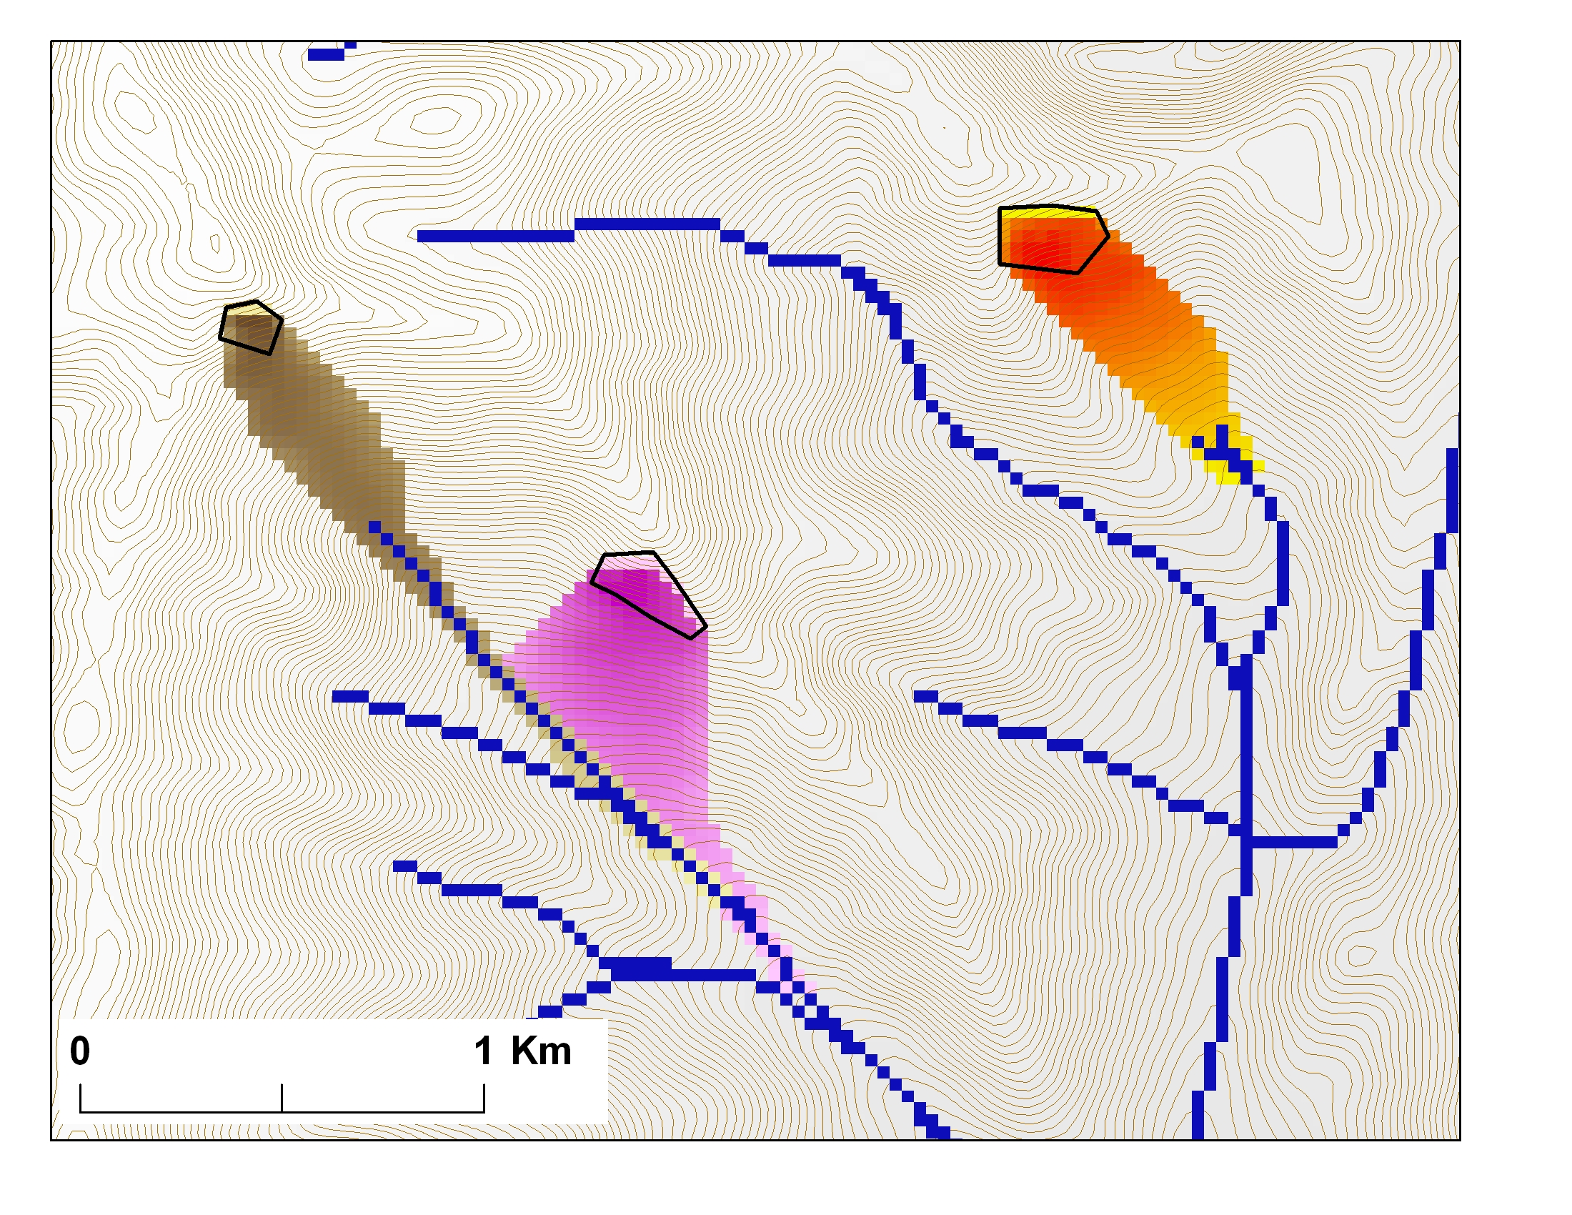
Avalanche Runout
α
Upslope recursion to determine elevation and distance to point in trigger zone that has the highest alpha angle

Slide 16
Conclusions
Terrain based flow data model enriches the information content of digital elevation data
Flow algebra generalizes the recursive flow accumulation methodology
Downslope and upslope recursion
Several new flow algebra functions
Concepts not limited to grids

