Slide 1





Web Based Hydrologic Terrain Analysis through HydroShare
David Tarboton
with contributions from TauDEM developers (Teklu Tesfa, Yan Liu, Ahmet Yildirim, Dan Watson, Kim Schreuders), the HydroShare team (Ray Idaszak, Jeff Horsburgh, Dan Ames, Jon Goodall, Alva Couch, Richard Hooper, Shaowen Wang, Martyn Clark, Pabitra Dash, Hong Yi, Christina Bandaragoda, Tony Castronova, Zhiyu Li, Mohamed Morsy) and others (Anthony Aufdenkampe, Nazmus Sazib, Xing Zheng, David Maidment)
http://hydrology.usu.edu/taudem
http://www.hydroshare.org
OAC-1664061
OAC-1664018
OAC-1664119
2017-2021
ACI-1148453
ACI-1148090
2012-2017

Slide 2
Outline
Hydrologic Terrain Analysis
    Overview of some interesting TauDEM functionality
    Height above Nearest Drainage (HAND) for flood inundation mapping
Web based
    CUAHSI HydroShare
    HydroShare JupyterHub deployment of TauDEM
    Wikiwatershed web based rapid watershed delineation

Slide 3
Why web based
Don’t need your own software and platform to use
Reduce installation, library and platform dependencies (can be set up by the expert/developer)
Data access and size, faster computation
Reproducibility
Transparency
Collaboration
The ultimate vision is a platform for collaboration and computation that integrates data storage, organization, discovery, analysis and modeling through web applications (web apps) and that allows researchers to employ services beyond their desktop to make data storage and manipulation more reliable and scalable, while improving ability to collaborate and reproduce results.

Slide 4
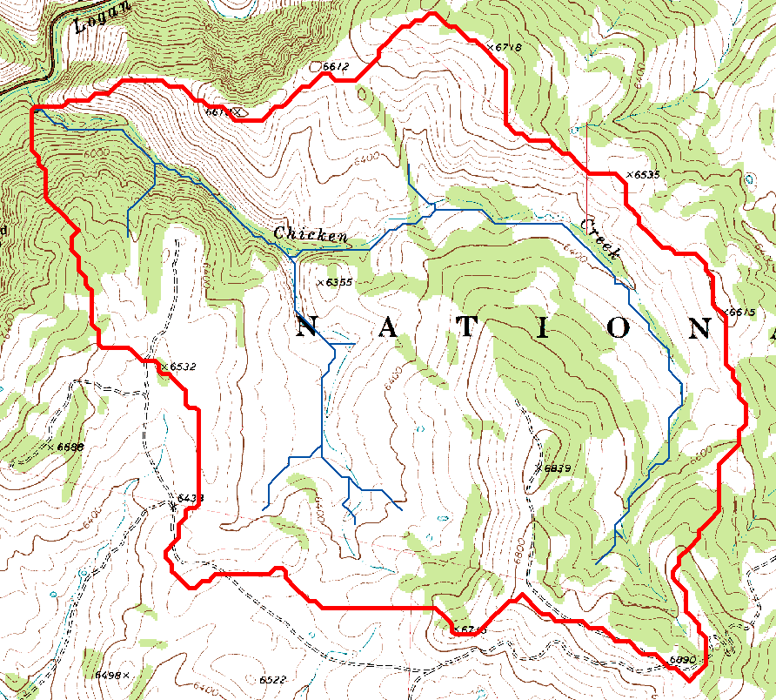
Topography, Hydrology and Water Resources
Watersheds are fundamentally the most basic hydrologic landscape elements
Topography dictates the flow of water across the landscape
Flowing water sculpts the landscape
This synergy is at the heart of much hydrologic modeling relating to questions of runoff generation important for flooding and water resources
Representing hydrologic processes at high resolution is important to help solve these problems

Slide 5




The challenge of increasing Digital Elevation Model (DEM) resolution
e.g. 50,000 km²
Watershed
1980’s DMA 90 m
10² cells/km²
27 MB
1990’s USGS DEM 30 m
10³ cells/km²
240 MB
2000’s NED 10 m
10⁴ cells/km²
2 GB
2010’s LIDAR ~1 m
10⁶ cells/km²
200 GB
A factor 10,000 increase in 30 years

Slide 6




General workflow for computing hydrologic information from digital topography
Input Digital Elevation Model
Contributing Area Grid
Hydrologic Conditioning
(Often Filling)
1
1
1
1
1
1
1
3
3
3
1
1
1
11
1
2
2
1
1
15
1
2
1
5
2
20
2
Steepest Flow Directions
4
Flow Direction Grid
80
74
63
30
5
69
67
56
3
Other channel network and grid information derived from flow direction and contributing area
60
52
48
5
Starting from a simple grid DEM we produce a rich set of data structures and information useful for hydrologic analysis

Slide 7
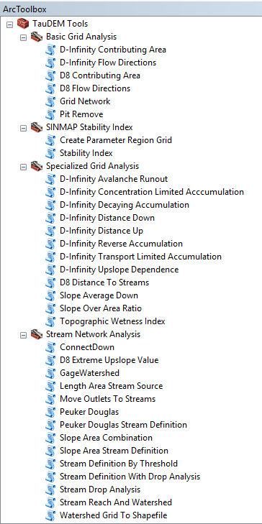

Terrain Analysis Using Digital Elevation Models (TauDEM)
http://hydrology.usu.edu/taudem
Software for hydrologic terrain analysis and stream and watershed delineation
Dinfinity and D8 flow direction models
Calculation of flow based derivative surfaces
Proximity measures such as distance to stream which measured vertically gives height above the nearest drainage (HAND)
Uses parallel algorithms for processing large datasets
Open source platform independent C++ command line executables for each function
Includes an ArcGIS Toolbox with python scripts that drive command line executables

Slide 8
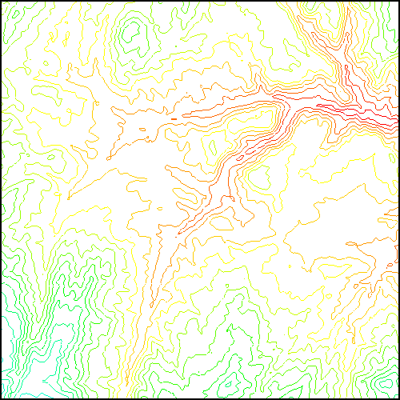
TauDEM Parallel Programming Approach
MPI, distributed memory paradigm
Row oriented slices
Each process includes one buffer row on either side
Each process does not change buffer row
Improved runtime efficiency
Capability to run larger problems
Wallis, C., R. Wallace, D. G. Tarboton, D. W. Watson, K. A. T. Schreuders and T. K. Tesfa, (2009), "Hydrologic Terrain Processing Using Parallel Computing," 18th World IMACS Congress and MODSIM09 International Congress on Modelling and Simulation, ed. R. S. Anderssen, R. D. Braddock and L. T. H. Newham, Modelling and Simulation Society of Australia and New Zealand and International Association for Mathematics and Computers in Simulation, July 2009, p.2540-2545, http://www.mssanz.org.au/modsim09/F13/wallis.pdf.
Wallis, C., D. Watson, D. G. Tarboton and R. Wallace, (2009), "Parallel Flow-Direction and Contributing Area Calculation for Hydrology Analysis in Digital Elevation Models," PDPTA'09, The 2009 International Conference on Parallel and Distributed Processing Techniques and Applications, Las Vegas, Nevada, USA, July 13-16.

Slide 9
Parallel Pit Filling based on Planchon and Darboux approach
Initialization
Communicate
1st Pass
Initialize( Z,F) Do for all grid cells i if Z(i) > n F(i) ← Z(i) Else F(i) ← n i on stack for next pass endfor Send( topRow, rank-1 ) Send( bottomRow, rank+1 ) Recv( rowBelow, rank+1 ) Recv( rowAbove, rank-1 ) Until F is not modified
Z denotes the original elevation.
F denotes the pit filled elevation.
n denotes lowest neighboring elevation
i denotes the cell being evaluated
Iterate only over stack of changeable cells
2nd Pass
Planchon, O. and F. Darboux, (2001), "A fast, simple and versatile algorithm to fill the depressions of digital elevation models," Catena, 46: 159-176, http://dx.doi.org/10.1016/S0341-8162(01)00164-3.

Slide 10
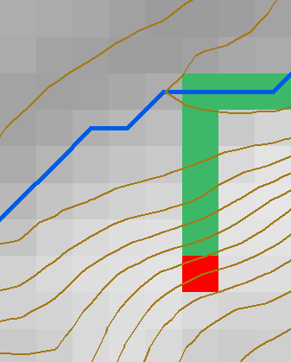
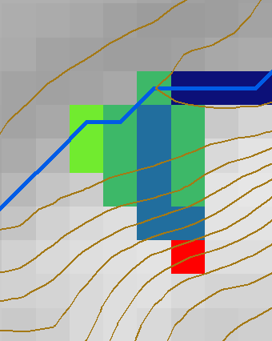
Single and Multiple Direction Representation of Flow Field
D8
D∞
Tarboton, D. G., (1997), "A New Method for the Determination of Flow Directions and Contributing Areas in Grid Digital Elevation Models," Water Resources Research, 33(2): 309-319.)

Slide 11

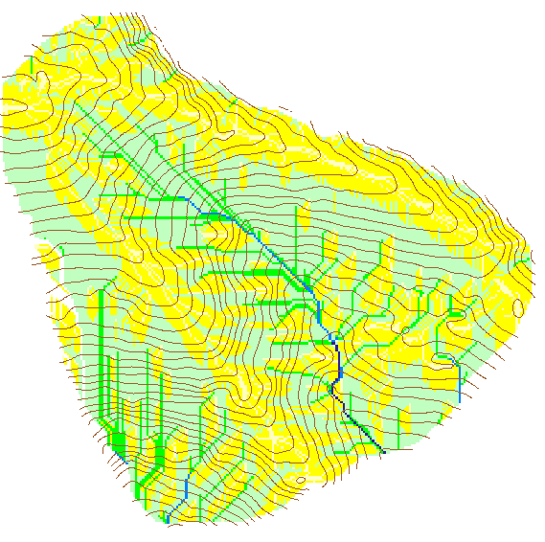
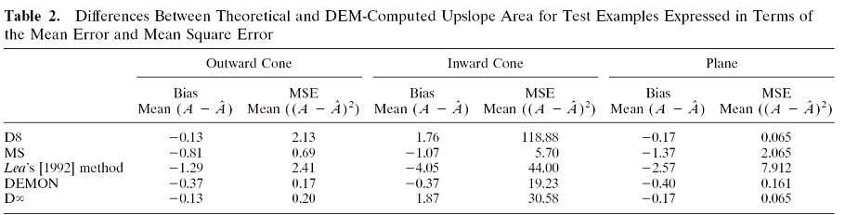
Contributing Area
D∞
D8

Slide 12
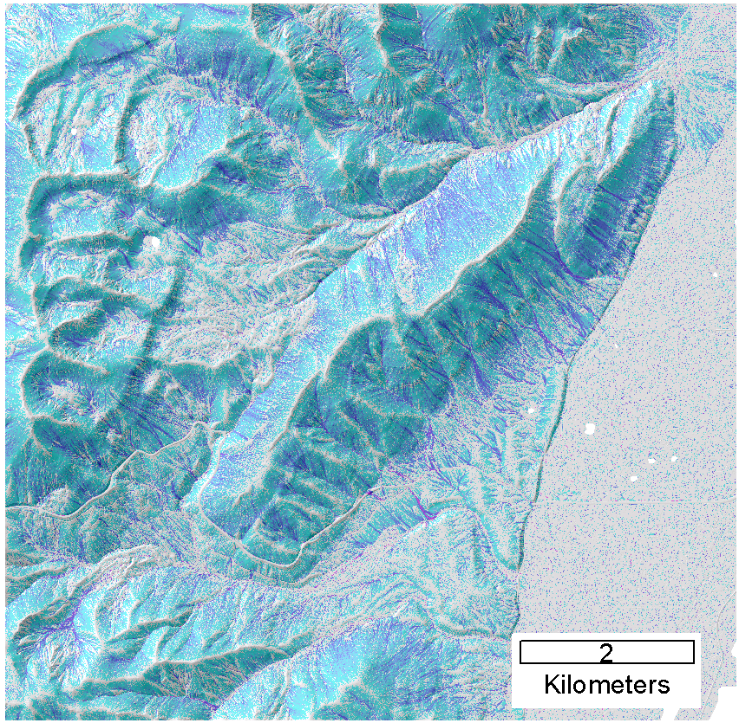
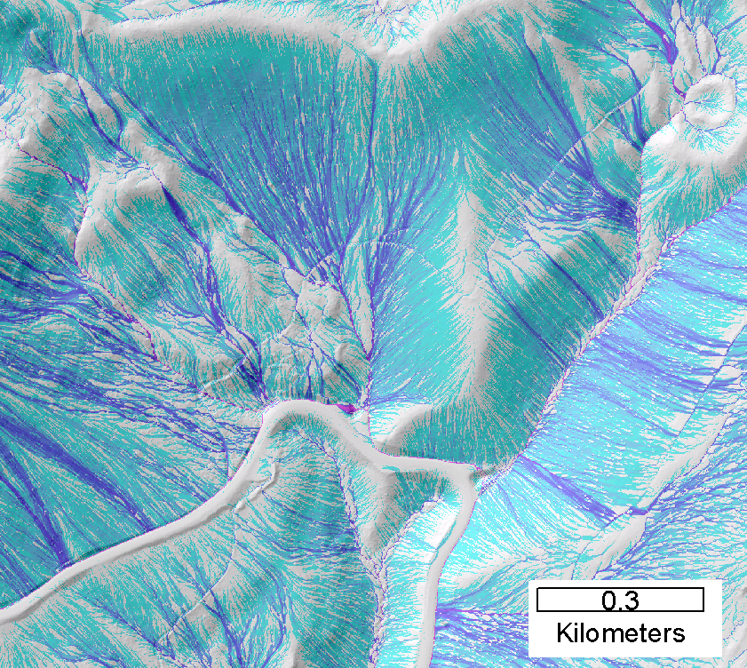
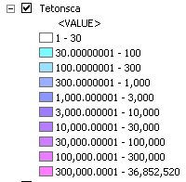

Contributing area from D-Infinity
Data from Open Topography
https://www.opentopography.org/
where some TauDEM products can be generated
Notes:
Note the detail in the representation of flow paths at features such as roads

Slide 13
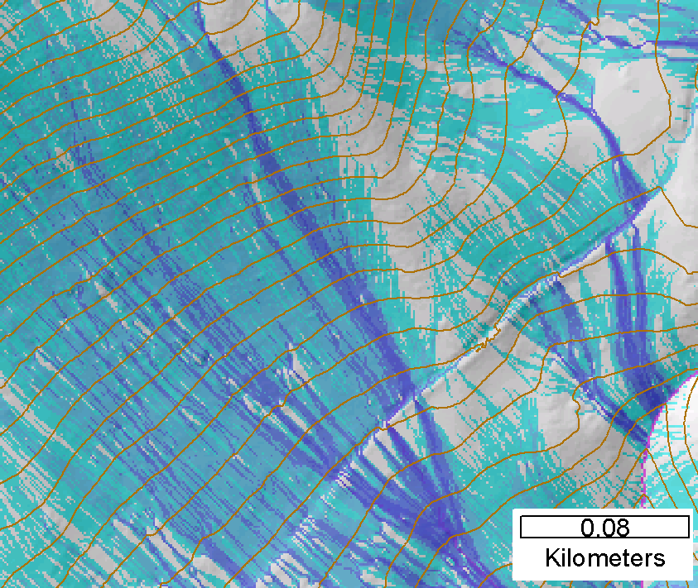
Contributing area from D-Infinity
Notes:
Note the detail in the representation of flow paths at features such as roads

Slide 14
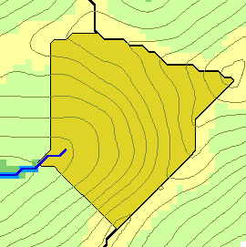
Generalized Flow Accumulation
w(x)
x

Slide 15
Generalization to Flow Algebra
Replace
P_{ki}
P_{ki}
P_{ki}
i
by general function
Flow direction proportions
Input Results from upslope
θ_{i} = F(γ_{i}, P_{ki}, θ_{k}, γ_{k})
Output Result,
Quantity being calculated
Other inputs at cell and upslope
Tarboton, D. G. and M. E. Baker, (2008), "Towards an Algebra for Terrain-Based Flow Analysis," in Representing, Modeling and Visualizing the Natural Environment: Innovations in GIS 12, Edited by N. J. Mount, G. L. Harvey, P. Aplin and G. Priestnall, CRC Press, Florida, p.496, http://dx.doi.org/10.1201/9781420055504.ch12.

Slide 16
General Pseudocode Upstream Flow Algebra Evaluation
Global P, γ, θ FlowAlgebra(i) for all k neighbors of i if P_{ki}>0 FlowAlgebra(k) next k θ_{i} = FA(γ_{i}, P_{ki}, θ_{k}, γ_{k}) return
P_{ki}

Slide 17
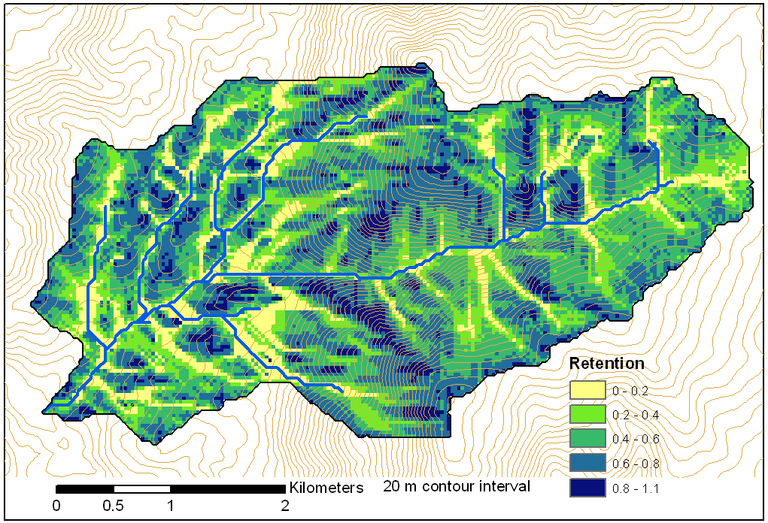
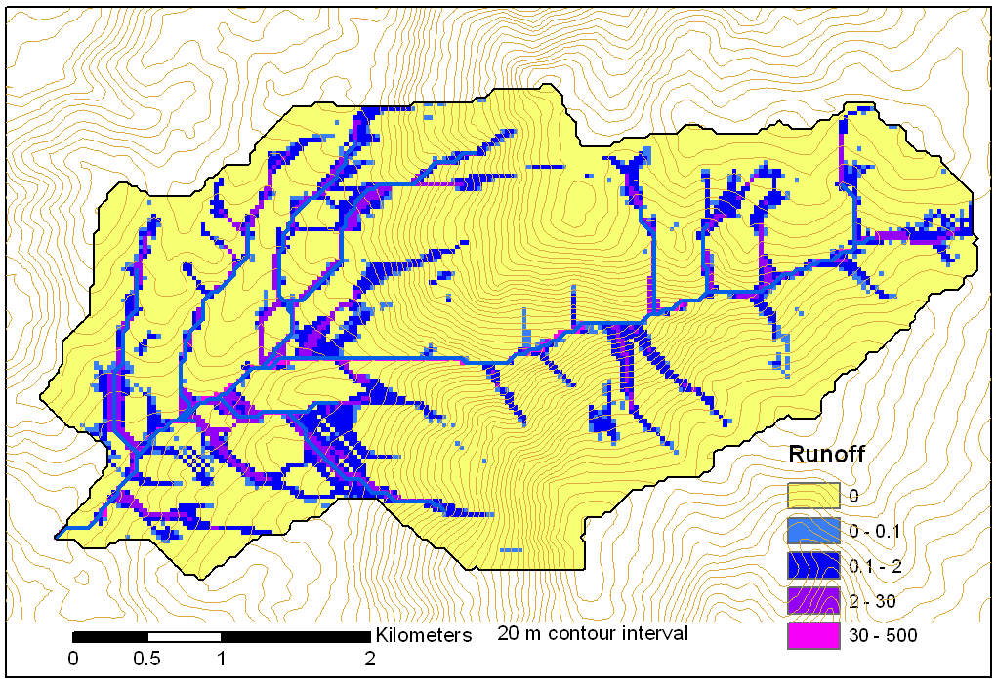
Example: Retention limited runoff generation with run-on
q_{k}
r
Global P, (r,c), q FlowAlgebra(i) for all k neighbors of i if P_{ki}>0 FlowAlgebra(k) next k return
q_{i}
c

Slide 18
General Pseudocode Downstream Flow Algebra Evaluation
Global P, γ, θ FlowAlgebra(i) for all k neighbors of i if P_{ik}>0 FlowAlgebra(k) next k θ_{i} = FA(γ_{i}, P_{ik}, θ_{k}, γ_{k}) return
P_{ki}

Slide 19
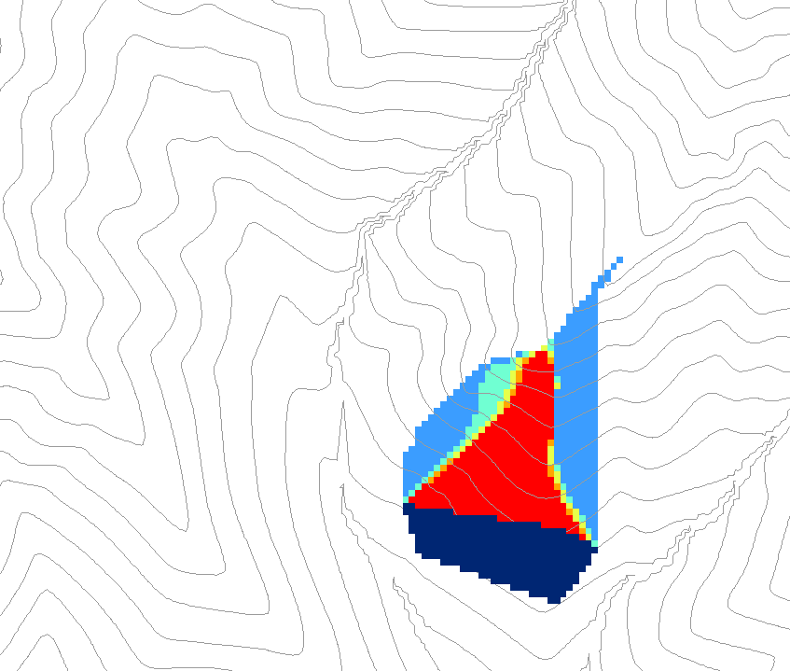
0.6
0
0
0.3
0.3
0
0
0.6
0
0
1
0
0
1
0
Grid cells y
Dependence function of grid cells y
Useful for example to track where a contaminant may come from

Slide 20
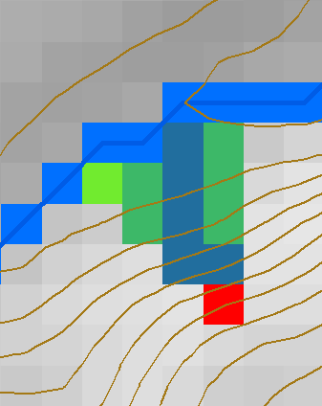
General Proximity Functions as weighted distance to a target set along Dinfinity Flow Directions
Ridge
sr
sr
pr
pr
vr
Point of interest
Stream
ps
ps
ss
vs
ss
D∞
hr
hs
hr
hs
Tesfa, T. K., D. G. Tarboton, D. W. Watson, K. A. T. Schreuders, M. E. Baker and R. M. Wallace, (2011), "Extraction of hydrological proximity measures from DEMs using parallel processing," Environmental Modelling & Software, 26(12): 1696-1709, http://dx.doi.org/10.1016/j.envsoft.2011.07.018.

Slide 21
Decaying Accumulation
Useful for tracking a substance subject to decay or attenuation

Slide 22
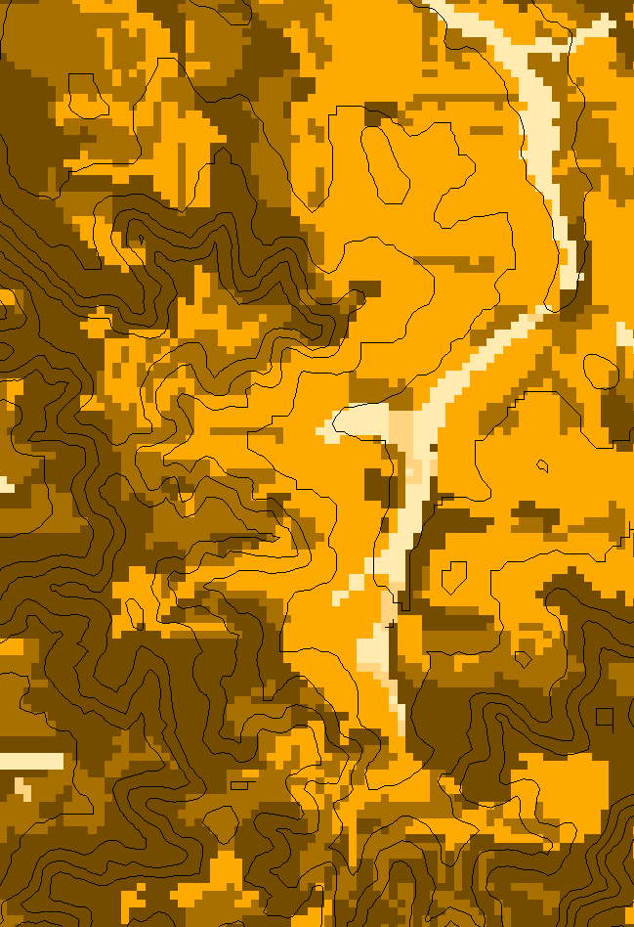
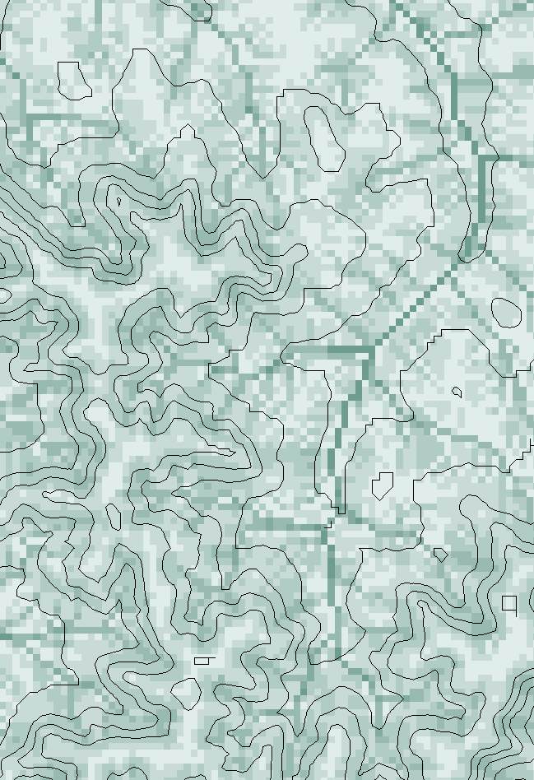
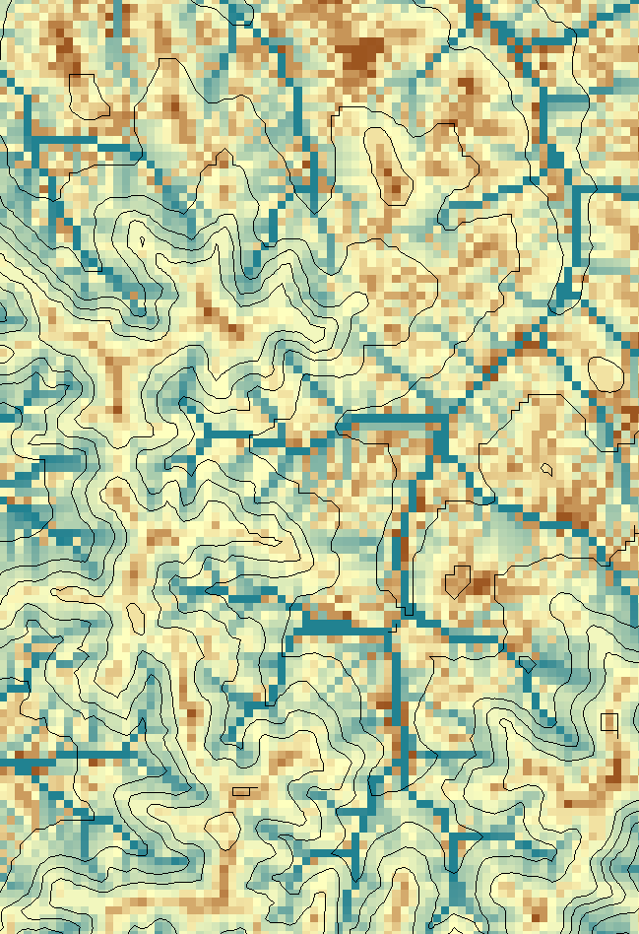
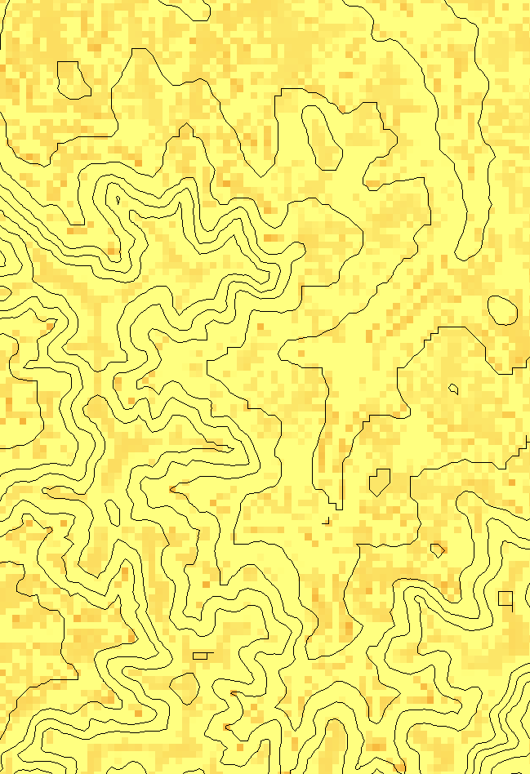



Transport limited accumulation
Supply
Capacity
Transport
Deposition
S
$$T_{cap}=χa^{2}tan{\left(β\right)}^{2}$$
$$T_{out}=min(S+∑T_{in}, T_{cap})$$
$D=S+∑T_{in}−T_{out}$
Useful for modeling erosion and sediment delivery, and the dependence of sediment delivery ratio and contaminant that adheres to sediment, on topography and scale

Slide 23
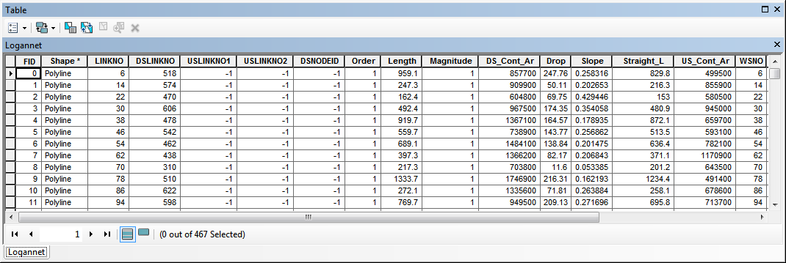
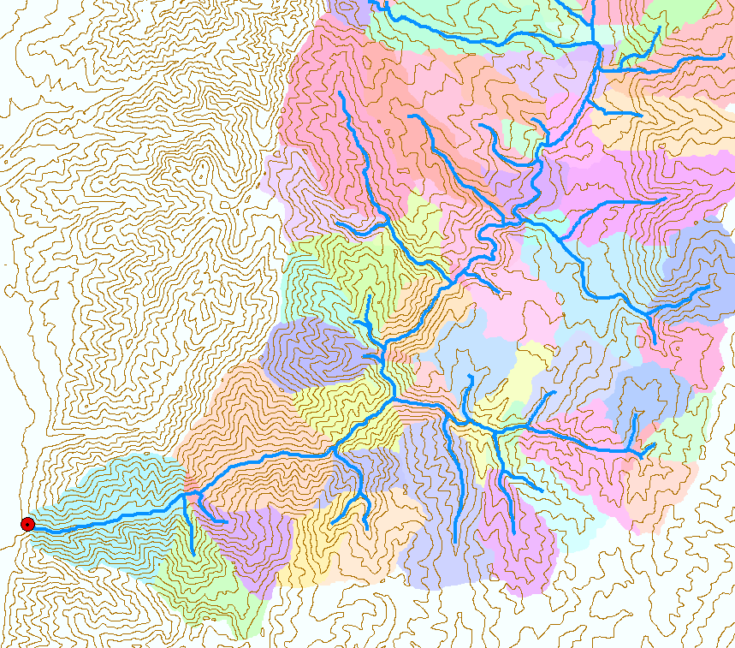
Catchments linked to Stream Network
The starting point for catchment based distributed hydrologic modeling

Slide 24
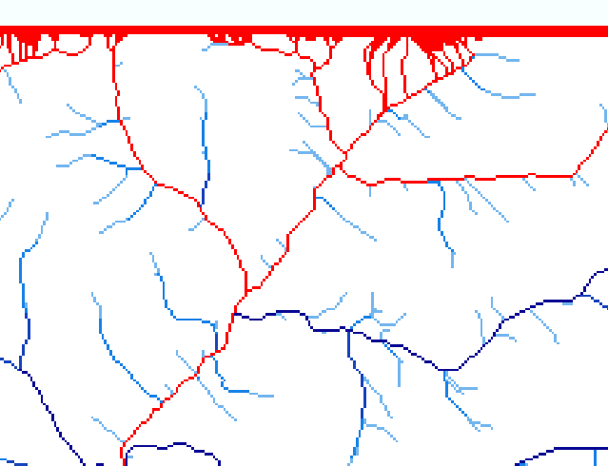
Edge contamination
Edge contamination arises when a contributing area value depends on grid cells outside of the domain. This occurs when drainage is inwards from the boundaries or areas with no data values. The algorithm recognizes this and reports "no data" resulting in streaks of "no data" values extending inwards from boundaries along flow paths that enter the domain at a boundary.

Slide 25
General terrain analysis conclusions
The DEM based terrain flow data model enables the representation of flow processes at and near the earth surface and derivation of a wide variety of information useful for the study of hydrologic processes.
    Slope, flow direction, drainage area, catchments, watersheds and channel networks, multiple other flow related quantities
D8 and Dinfinity options for representing flow field
Flow algebra generalizes the recursive flow accumulation methodology
    Downslope and upslope logic
    Multiple flow algebra functions
Edge contamination checking is important to ensure that results are not impacted by area outside the domain of the DEM analyzed
Parallel methods supports the processing of big terrain data.

Slide 26
Flooding occurs when water depth is greater than Height Above Nearest Drainage (HAND)
Height Above the Nearest Drainage. The distance to streams (nearest drainage) calculated vertically along TauDEM Dinfinity flow directions
Serves to support flood inundation mapping where the data to support hydraulic calculations is limited
Enables evaluation of reach level hydraulic properties
Can take advantage of high resolution DEM data (but is only as good as the given DEM data)
Has been evaluated across continental US using 10 m resolution DEM and NHDPlus streams for use in US National Water Model flood inundation mapping
Flood Depth
Height Above
Nearest Drainage
(HAND)
Normal Depth
Ridge
sr
sr
pr
vr
Point of interest
pr
Stream
ps
vs
ps
ss
ss
hr
hs
hr
hs

Slide 27
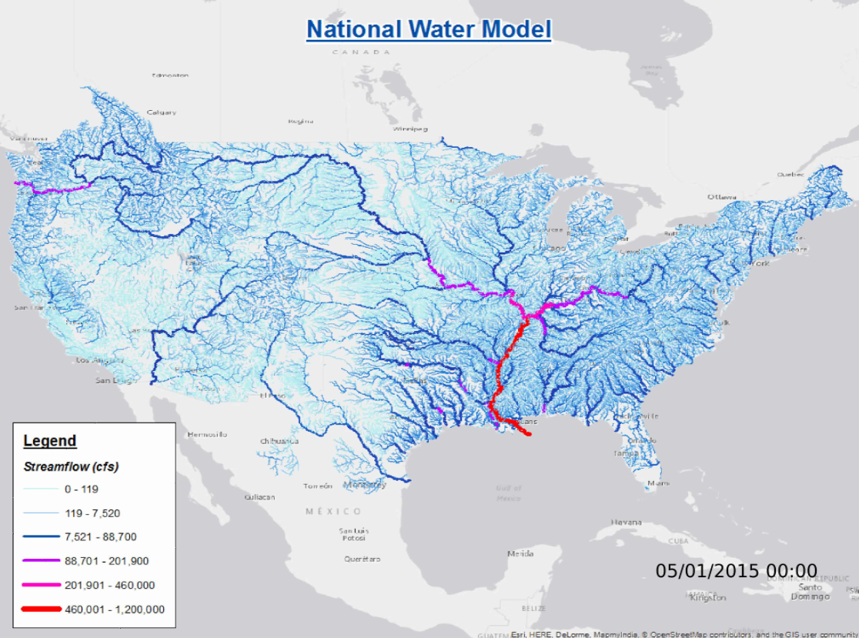
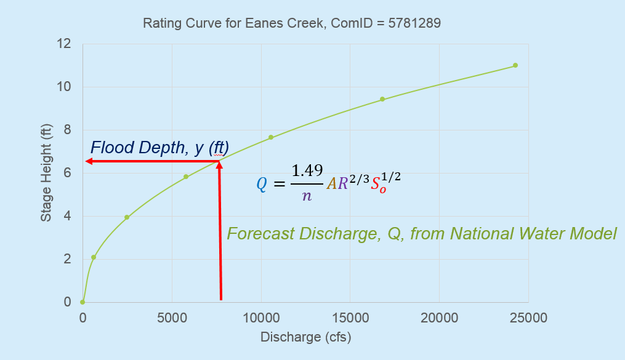
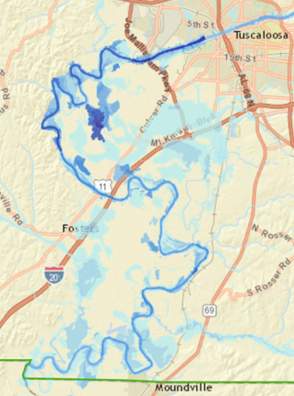
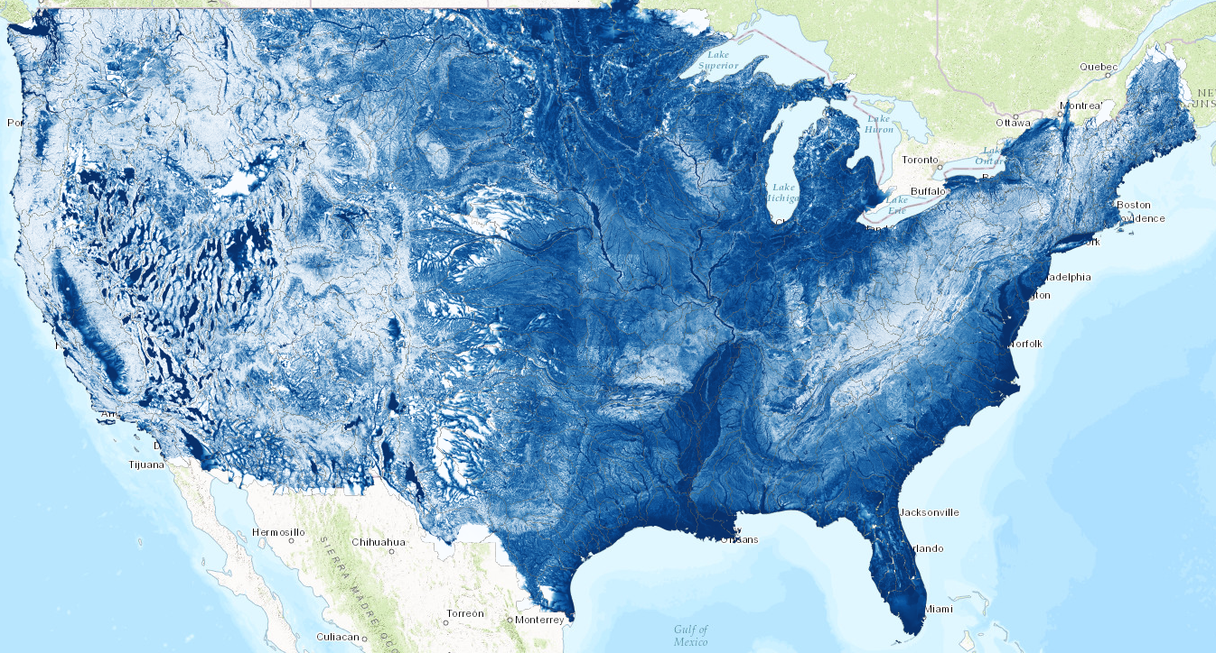
General Approach to Flood Inundation Mapping using HAND
1. Forecast discharge (e.g. with National Water Model)
2. Convert discharge to depth using rating curve
3. Convert depth to inundation using HAND
1
2
3
Slide from David Maidment
Slide from David Maidment

Slide 28
Built on prior work
Rodda, H. J. E., (2005), "The Development and Application of a Flood Risk Model for the Czech Republic," Natural Hazards, 36(1): 207-220, http://dx.doi.org/10.1007/s11069-004-4549-4.
Rennó, C. D., A. D. Nobre, L. A. Cuartas, J. V. Soares, M. G. Hodnett, J. Tomasella and M. J. Waterloo, (2008), "HAND, a new terrain descriptor using SRTM-DEM: Mapping terra-firme rainforest environments in Amazonia," Remote Sensing of Environment, 112(9): 3469-3481, http://doi.org/10.1016/j.rse.2008.03.018.
Nobre, A. D., L. A. Cuartas, M. Hodnett, C. D. Rennó, G. Rodrigues, A. Silveira, M. Waterloo and S. Saleska, (2011), "Height Above the Nearest Drainage – a hydrologically relevant new terrain model," Journal of Hydrology, 404(1–2): 13-29, http://dx.doi.org/10.1016/j.jhydrol.2011.03.051.
Tesfa, T. K., D. G. Tarboton, D. W. Watson, K. A. T. Schreuders, M. E. Baker and R. M. Wallace, (2011), "Extraction of hydrological proximity measures from DEMs using parallel processing," Environmental Modelling & Software, 26(12): 1696-1709, http://dx.doi.org/10.1016/j.envsoft.2011.07.018.
Nobre, A. D., L. A. Cuartas, M. R. Momo, D. L. Severo, A. Pinheiro and C. A. Nobre, (2016), "HAND contour: a new proxy predictor of inundation extent," Hydrological Processes, 30(2): 320-333, http://dx.doi.org/10.1002/hyp.10581.

Slide 29
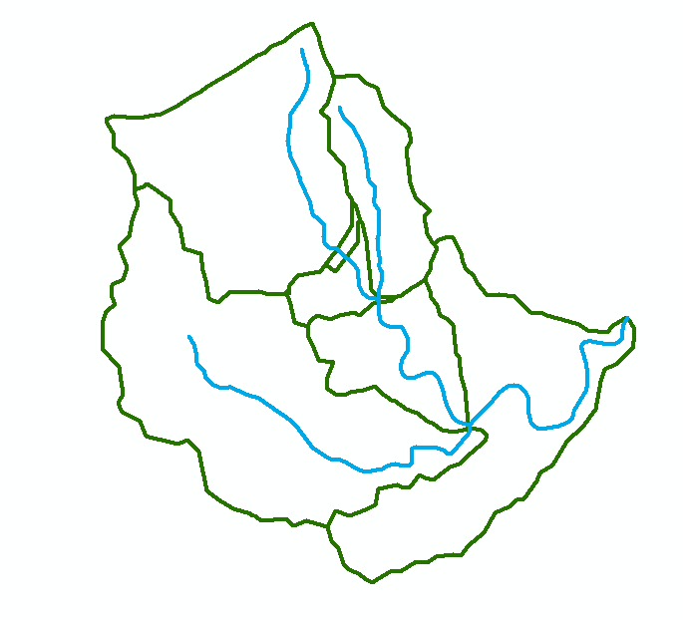
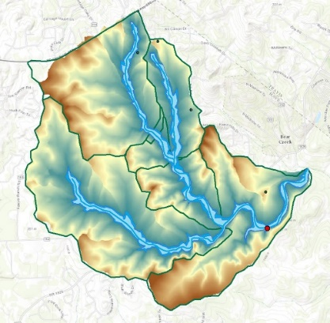
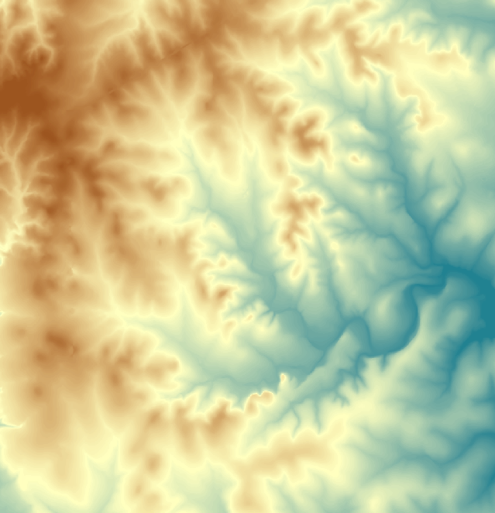
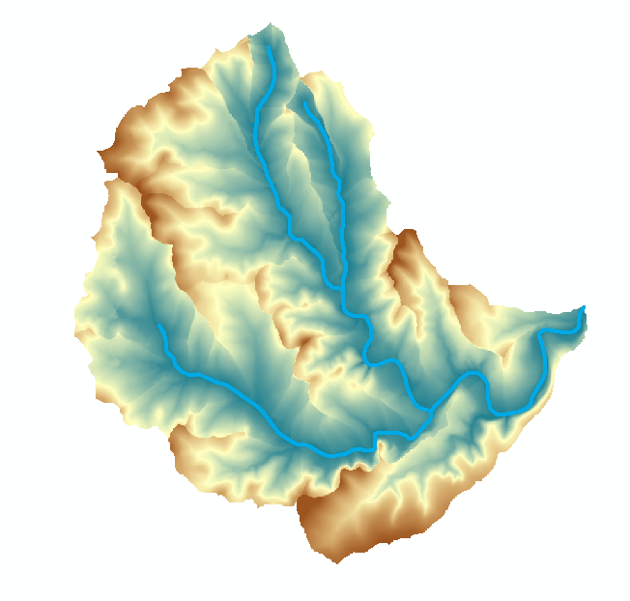
Flood Inundation Mapping – HAND Method
Reach Scale Flood Depth
Comid | Depth (ft)
5781365 | 8
5781381 | 9
5781405 | 10
5781401 | 15
5781399 | 14
5781383 | 12
5781933 | 11
Catchments and Flowlines
Inundation map
(Height above
drainage < water depth)
Digital Elevation Model
Height Above Nearest Drainage
(relative elevation of land surface cell above cell in stream to which it flows)

Slide 30
Mapping Flood Inundation with Height above the Nearest Drainage (HAND)
Each stream reach has a water depth h_{w} (from a hydraulic model)
Each stream reach has an ID
Each grid cell has the ID of the reach it connects to and the height above the nearest drainage h_{d}
Evaluate inundation using h_{w}-h_{d}
    If(h_{w}(id) > h_{d}(id))
      Inundation depth = h_{w}(id) - h_{d}(id)
    Else
      Inundation depth = 0
This is approximate because it neglects many details of the river hydraulics and flow over flood plains. But more detailed approaches often demand hard to obtain and uncertain inputs so this may be a helpful approach to get screening level and real time flood maps
Premised on good elevation model and consistent stream raster

Slide 31
HAND evaluated using TauDEM Dinfinity Vertical Distance Down function
TauDEM Vertical Distance Down a special case of a general hydrological proximity measure
D∞
Ridge
sr
sr
pr
Point of interest
pr
vr
Stream
ps
ps
ss
vs
D∞
ss
hr
hs
hr
hs
Vertical distance to stream evaluated as weighted average over multiple flow paths. This results in a “smooth” height above nearest drainage layer
Tesfa, T. K., D. G. Tarboton, D. W. Watson, K. A. T. Schreuders, M. E. Baker and R. M. Wallace, (2011), "Extraction of hydrological proximity measures from DEMs using parallel processing," Environmental Modelling & Software, 26(12): 1696-1709, http://dx.doi.org/10.1016/j.envsoft.2011.07.018.

Slide 32
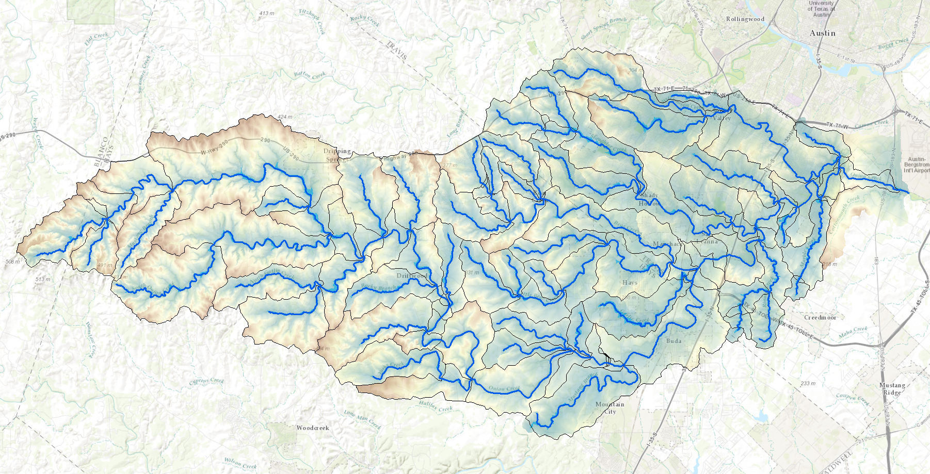
HAND from TauDEM for Onion Creek near Austin Texas
1/3 arc second NED DEM

Slide 33
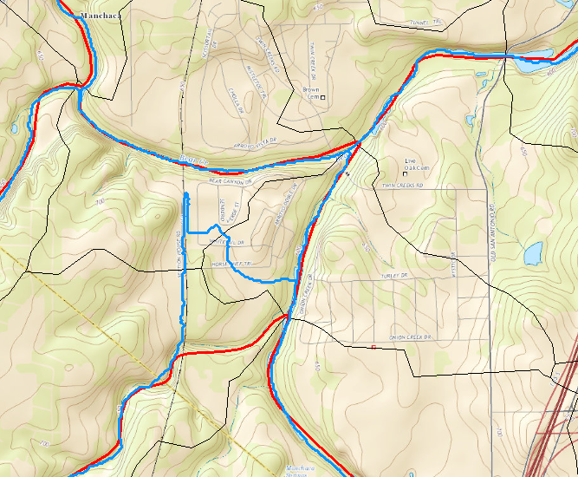
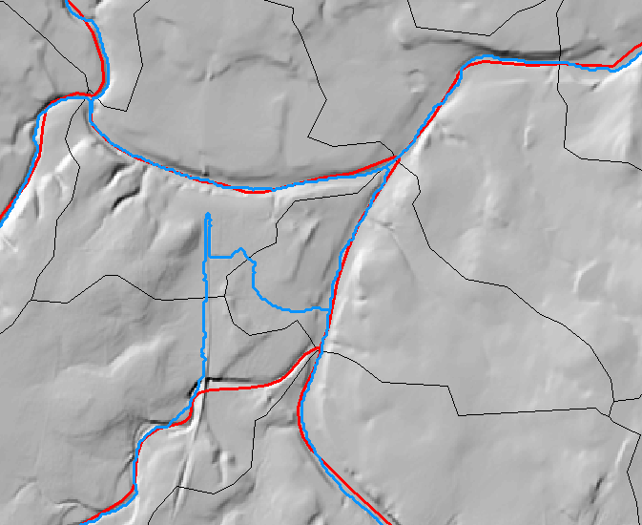

The problem of artificial DEM Barriers

Slide 34
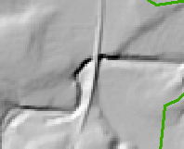
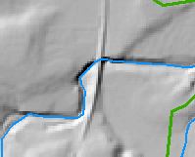
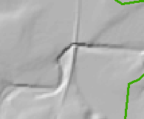
Conditioning the DEM by Obstacle Removal or “etching” using Vector Stream Information used to align and reconcile elevation and hydrography
Flow Direction Conditioning of the Digital Elevation Model
48 | 48 | 49 | 48 | 47
48 | 46 | 50 | 46 | 45
47 | 45 | 51 | 43 | 39
44 | 40 | 51 | 47 | 47
41 | 45 | 52 | 48 | 48
48 | 48 | 49 | 48 | 47
48 | 46 | 50 | 46 | 45
47 | 45 | 51 | 43 | 39
44 | 40 | 51 | 47 | 47
41 | 45 | 52 | 48 | 48
48 | 48 | 49 | 48 | 47
48 | 46 | 50 | 46 | 45
47 | 45 | 40 | 40 | 39
44 | 40 | 51 | 47 | 47
41 | 45 | 52 | 48 | 48
Obstacles, like this railroad that are present in DEM are removed tracing down NHD HR streams ensuring that elevation never increases along a stream.

Slide 35
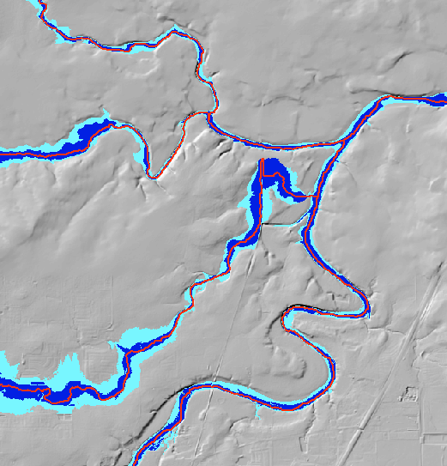
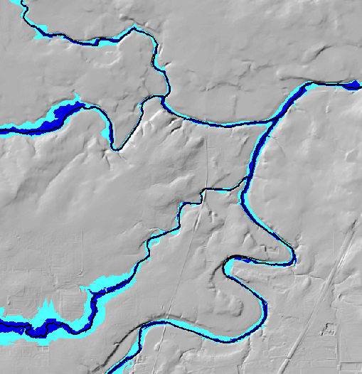
Effect of obstacle removal
Before
After
HAND inundation based on raw 10 m NED DEM
Hand inundation for 10 m NED DEM with obstacles removed using NHD HR

Slide 36
Stream raster consistent with the DEM but at the scale (drainage density) of NHD Plus obtained using D8 flow direction grid and channel heads from NHD Plus streams
DEM derived stream raster
Channel Head
Height Above Nearest Drainage (HAND)
NHD Plus Flowline

Slide 37

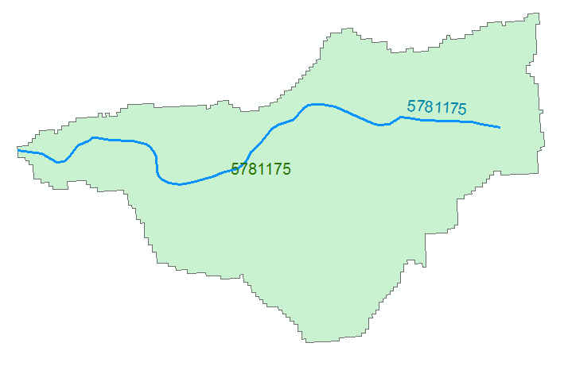

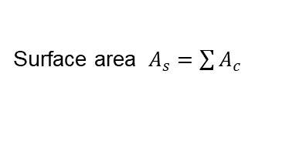

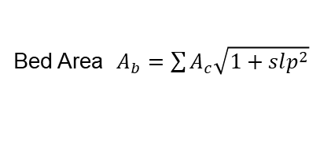

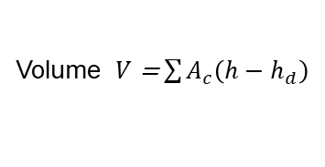


HAND based derivation of “reach scale” hydraulic properties
Comid | H | A | R | P | T | V | Ab | As
5781175 | 3
5781175 | 4
For each Catchment
For each height h
Identify cells where HAND h_{d} < h
A table with reach hydraulic parameters keyed to hydrography
Single Cell Plan Area $A_{c}$ =dx * dy
Surface area $A_{s}=\sum{A_{c}}$
A_{s}
Surface Area
Bed Area $A_{b}=\sum{A_{c}\sqrt{1+slp^{2}}}$
Approximates each cell as sloping plane
Wetted Bed Area
Volume $V$ = $\sum{A_{c}\left(h−h_{d}\right)}$
A_{b}
L
$$A=\frac{V}{L}$$
Cross Section Area
T
V
Volume
P$=\frac{Ab}{L}$
Wetted Perimeter
T$=\frac{As}{L}$
Top Width
Depth
h
A
R$=\frac{A}{P}$
P
Hydraulic Radius
Note: DEM topography should represent river bed elevations
Zheng, X., D. G. Tarboton, D. R. Maidment, Y. Y. Liu and P. Passalacqua, (2018), "River Channel Geometry and Rating Curve Estimation Using Height above the Nearest Drainage," JAWRA Journal of the American Water Resources Association, 54(4): 785-806, http://doi.org/10.1111/1752-1688.12661.

Slide 38


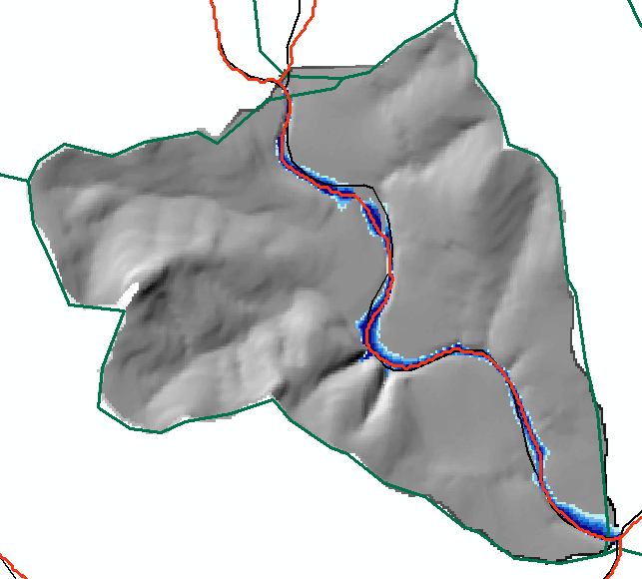
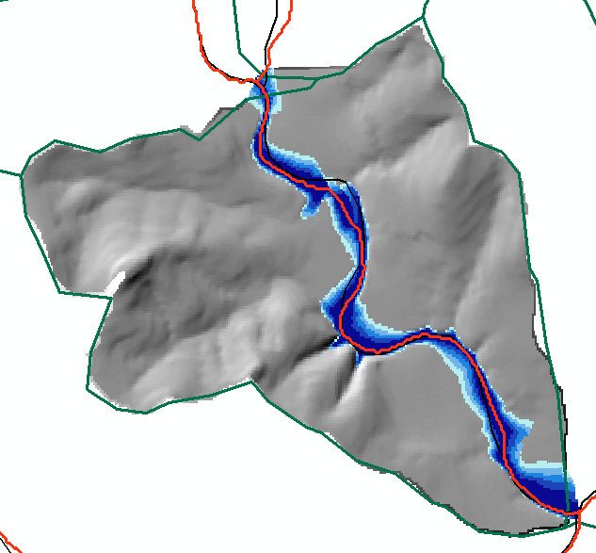
Reach Hydraulic Properties Example
1 m inundation
3 m inundation
Height (m) | A_{s} (m²) | Vol (m³) | A_{b} | L (m) | A=V/L (m²) | P=A_{b}/L (m) | T=A_{s}/L (m) | R=A/P (m)
1 | 129878 | 79466 | 129948 | 2975 | 26.7 | 43.7 | 43.7 | 0.612
3 | 319877 | 530378 | 320414 | 2975 | 178.3 | 107.7 | 107.5 | 1.655

Slide 39
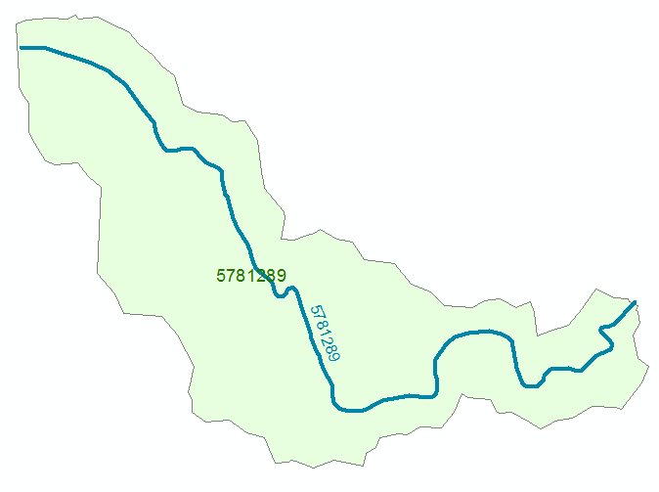
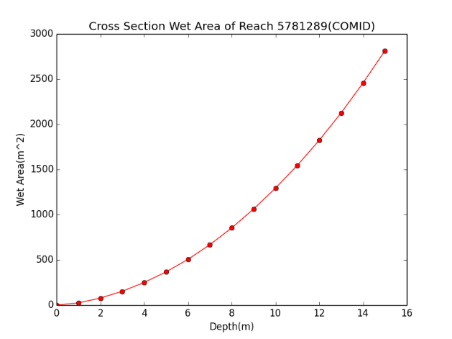
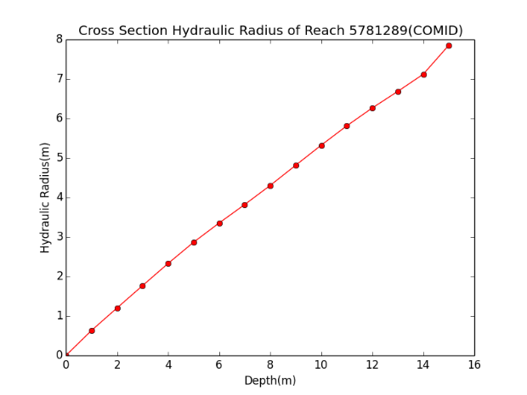

Example Discharge Computation for Reach Catchment 5781289 Eanes Creek, Rollingwood, Texas
Flood Discharge, Q (cfs)
Cross section Area, A
Hydraulic Radius, R
$$Q=\frac{1.49}{n}AR^{2/3}S_{o}^{1/2}$$
n = 0.035 Manning roughness of channel
S_{o} = 0.0163 Bed slope
Slide from David Maidment

Slide 40
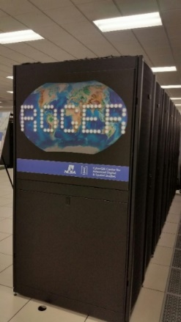
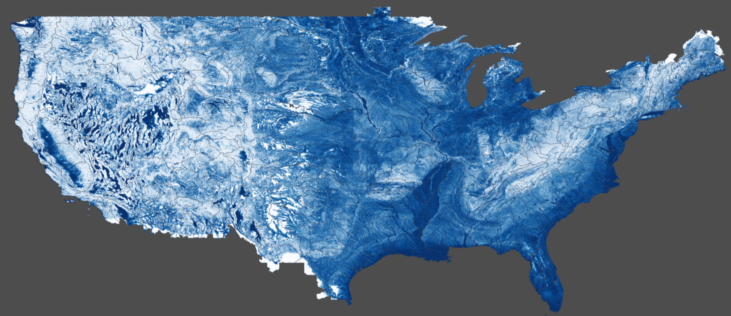
Continental US-Scale HAND layer evaluated on ROGER supercomputer at NCSA
USGS 3DEP 10m DEM
NHD HR Flowline
1:24000
NHDPlus Flowline
1:100000
Obstacle Removal
Pit Removal
Channel Head Extraction
D∞ Flow Direction
D8 Flow Direction
Rasterization
D8 Flow Accumulation
Channel Head Weight Grid
Stream Definition by Threshold
D∞ Flow Direction
Raster
D∞ Distance Down
(Vertical Average)
Stream Raster
HAND Raster
Catchment Features
Flood Inundation Mapping
Results at https://web.corral.tacc.utexas.edu/nfiedata/
Liu, Y. Y., D. R. Maidment, D. G. Tarboton, X. Zheng and S. Wang, (2018), "A CyberGIS Integration and Computation Framework for High-Resolution Continental-Scale Flood Inundation Mapping," JAWRA Journal of the American Water Resources Association, 54(4): 770-784, https://doi.org/10.1111/1752-1688.12660.

Slide 41
Outline
Hydrologic Terrain Analysis
    Overview of some interesting TauDEM functionality
    Height above Nearest Drainage (HAND) for flood inundation mapping
Web based
    CUAHSI HydroShare
    HydroShare JupyterHub deployment of TauDEM
    Wikiwatershed web based rapid watershed delineation

Slide 42




http://www.hydroshare.org
Web-based Hydrologic Information System operated by the Consortium of Universities for the Advancement of Hydrologic Science, Inc. (CUAHSI)
Create and share data and models using a variety of file formats and flexible metadata
Formal publication of data and models with linkages to literature
Includes tools (web apps) that can act on content in HydroShare
The HydroShare Jupyter Notebook app provides general Python or R scripting analysis capability and includes TauDEM toolset.
Contributes to making data Findable, Accessible, Interoperable and Reusable (FAIR)

Slide 43

Collaborative data sharing
Add content to HydroShare to share with your colleagues or permanently publish to document result reproducibility

Slide 44

Resources (data and models) in HydroShare are objects of collaboration (social objects)
For each resource you can
Manage who has access
  To edit
  To view
Comment or rate
Obtain unique identifier
Describe with metadata
Organize into collections
Permanently publish with DOI
Version
Open with compatible web app

Slide 45

Apps act on resources to support web based visualization and analysis http://www.hydroshare.org/apps

Slide 46


A Resource with Digital Elevation Model Data in HydroShare
https://www.hydroshare.org/resource/f186b3fd55fd49e6bb761473e2a49b7f/

Slide 47


HydroShare Jupyter App
A separate server where JupyterHub is installed
Configured to retrieve, work on, and put data back into the HydroShare repository using the HydroShare API
Includes TauDEM command line functions
Can execute user supplied scripts such as for calculation of HAND using TauDEM
Write and execute code acting on content of HydroShare resources
Python Notebook from HydroShare Repository Documenting Work Sequence

Slide 48




Complete Analysis and Save Results back to HydroShare Repository
Collaborate!

Slide 49



How HydroShare Works
Resource exploration
Actions on Resources
Django Website
HydroShare Apps
Organize and annotate your content
Manage access
API
Web software to operate on content you have access to (Apps)
Extensibility
OAuth
Anyone can set up a server/app platform (software service) to operate on HydroShare resources through iRODS and API
API
API
Distributed file storage
Resource Storage
iRODS “Network File System”
SWATShare (Hubzero)
JupyterHub
Unidata – THREDDS
NWM Viewer
Multiple other Tethys Apps
HydroShare Data Store
Federated Data Store

Slide 50

To Learn More About HydroShare
Online Help https://help.hydroshare.org/
Publications https://help.hydroshare.org/about-hydroshare/publish/

Slide 51








Online toolkit for watershed modeling
David Arscott, Steve Kerlin, Melinda Daniels, Matt Ehrhart, Susan E. Gill, Anthony Aufdenkampe, Barry Evans, David Tarboton, Jeffrey S. Horsburgh, Scott Haag, Robert Cheetham, Emilio Mayorga, Nanette Marcum-Dietrich, Carolyn Staudt
An online toolkit to analyze storms and compare conservation or development scenarios in your watershed (in the US and high resolution for Delaware watershed)
Includes TauDEM based real time (rapid – Mississippi in ~45 s) watershed delineation, through merging of local subwatershed with preprocessed watersheds
Analyze land use and soil data across neighborhoods and watersheds
Model stormwater runoff and water-quality impacts
Compare how different conservation or development scenarios could modify runoff and water quality
Share results in HydroShare to collaborate with others
http://wikiwatershed.org

Slide 52

Delineating a Watershed in Delaware River Basin using 1/3 arc sec DEM
http://app.wikiwatershed.org

Slide 53

Analyze Results
Analyze
Landcover
Soils
Terrain
Climate
Point Sources
Animals
Water Quality

Slide 54

Move Outlet

Slide 55

Select a Model

Slide 56

Site storm model

Slide 57








Terrain Analysis Preprocessing for Rapid Watershed Delineation
Data preprocessing:
Delineate subwatersheds that cover the domain
Identify and merge upstream subwatersheds and save for each subwatershed
  Stream grid
  Distance to stream grid
  Flow direction grid
  Full watershed (from merges)
1
2
3
2
3
1
Full Watershed
Distance to Stream
Flow Direction
Local Subwatershed
Notes:
.
The RWD methodology consists of data preprocessing and an algorithm for using preprocessed data to delineate watershed from an arbitrary point over a large area. Prior to preprocessing, we adjust the DEM to make it consistent with geographic shape information on stream hydrography and oceans and estuaries. Grid cells within the ocean/estuary are lowered within a buffer distance of the shoreline, and beyond this are set to no data. This ensures that flow enters the ocean and then limits the algorithms from attempting to process elevation data within the ocean/estuary
The first preprocessing step is to run TauDEM functions to obtain key terrain derivatives (hydrologically conditioned elevation, slope, flow direction, flow accumulation and the stream network). These operations need to be performed only once for a given DEM. Then, end point of each of each stream reach is identified as an outlet that serves to seed the decomposition into subwatersheds. To avoid very small subwatersheds outlet points that have another outlet within an user defined threshold distance downstream are removed. The remaining outlets are used to subdivide the area into multiple (thousands) of subwatersheds draining to outlet points (Figure 4.2 a and b).. Since each subwatershed is associated with one downstream subwatershed, this information is used to identify all upstream subwatersheds that contribute to a subwatershed. These are merged together to form the complete watershed associated with each subwatershed (Figure 4.2 c). Then, the terrain derivatives for each of the subwatershed are extracted from existing preprocessed TauDEM products (Figure 4.2 d) and a directory is created for each subwatershed based on its ID number.

Slide 58

In Real Time
Each subwatershed holds
  Flow direction grid
  Stream indicator grid
  Distance to stream grid
  List of adjoining upstream watersheds
  Dissolved full watershed
Identify subwatershed
[Snap (TauDEM MoveOutlet to slide downslope to stream)]
Delineate within subwatershed (TauDEM Gagewatershed)
Merge adjoining full watersheds

Slide 59
Conclusions
Advances in the field of Geomorphometry are opening new avenues for use of terrain analysis for hydrologic modeling.
Computational methods are improving (parallel methods).
Data resolution is increasing, and challenging our computational capacities.
New functionality is being developed to solve new problems.
Server/Web/Cloud based solutions will increase.
I am looking forward to the presentations and discussions this week ...

Slide 60
Thank You
Are there any questions?
OAC-1664061
OAC-1664018
OAC-1664119
2017-2021
ACI-1148453
ACI-1148090
2012-2017

