Slide 1


Using an Observations Data Model in Hydrologic Information Systems
David G Tarboton
Jeffery S Horsburgh
David R. Maidment
Ilya Zaslavsky
Support
EAR 0622374
http://www.cuahsi.org/his.html

Slide 2
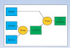
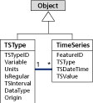
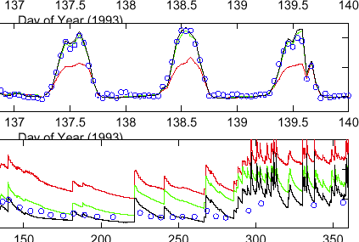

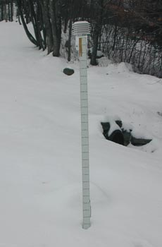

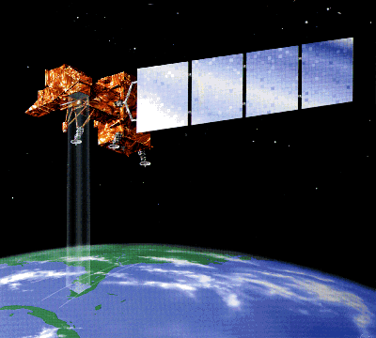
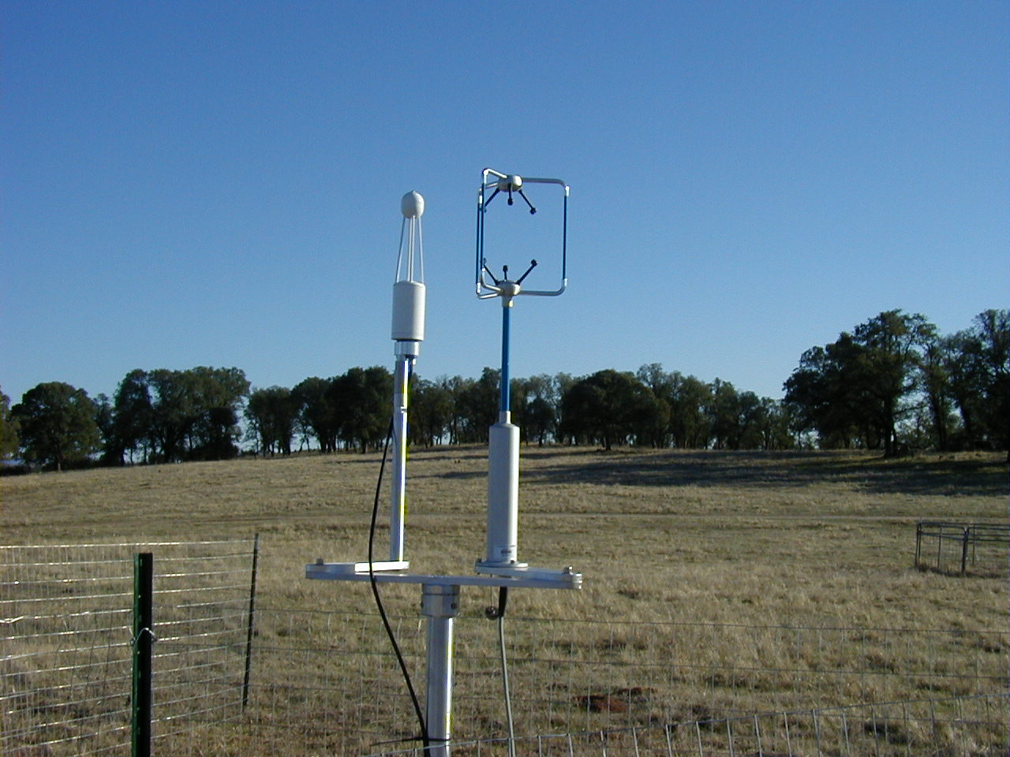
CUAHSI Hydrologic Information System
Goal: Enhance hydrologic science by facilitating user access to more and better data for testing hypotheses and analyzing processes
Models
Advancement of water science is critically dependent on integration of water information
It is as important to represent hydrologic environments precisely with data as it is to represent hydrologic processes with equations
Databases
Analysis
Water quantity
and quality
Rainfall & Snow
Remote sensing
Meteorology
Soil water

Slide 3
Why an Observations Data Model
Syntactic heterogeneity (File types and formats)
Semantic heterogeneity
  Language for observation attributes (structural)
  Language to encode observation attribute values (contextual)
Publishing and sharing research data
Metadata to facilitate unambiguous interpretation
Enhance analysis capability

Slide 4
What are the basic attributes to be associated with each single data value and how can these best be organized?
Value
DateTime
Variable
Location
Units
Interval (support)
Accuracy
Offset
OffsetType/ Reference Point
Source/Organization
Censoring
Data Qualifying Comments
Method
Quality Control Level
Sample Medium
Value Type
Data Type

Slide 5
Point Observations Information Model
Utah State
Univ
Data Source
Little Bear River
Network
GetSites
GetSiteInfo
Little Bear River at Mendon Rd
Sites
GetVariables
Dissolved Oxygen
Variables
GetVariableInfo
GetValues
9.78 mg/L, 1 October 2007, 6PM
Values
{Value, Time, Qualifier, Offset}
A data source operates an observation network
A network is a set of observation sites
A site is a point location where one or more variables are measured
A variable is a property describing the flow or quality of water
A value is an observation of a variable at a particular time
A qualifier is a symbol that provides additional information about the value
An offset allows specification of measurements at various depths in water
Horsburgh, J. S., D. G. Tarboton, D. R. Maidment and I. Zaslavsky, (2008), "A Relational Model for Environmental and Water Resources Data," Water Resources Research (in press).

Slide 6
CUAHSI Observations Data Model
A relational database at the single observation level (atomic model)
Stores observation data made at points
Metadata for unambiguous interpretation
Traceable heritage from raw measurements to usable information
Standard format for data sharing
Cross dimension retrieval and analysis
Streamflow
Groundwater
levels
Precipitation
& Climate
Soil
moisture
data
Water Quality
Flux tower
data
Time
Space
Variables

Slide 7
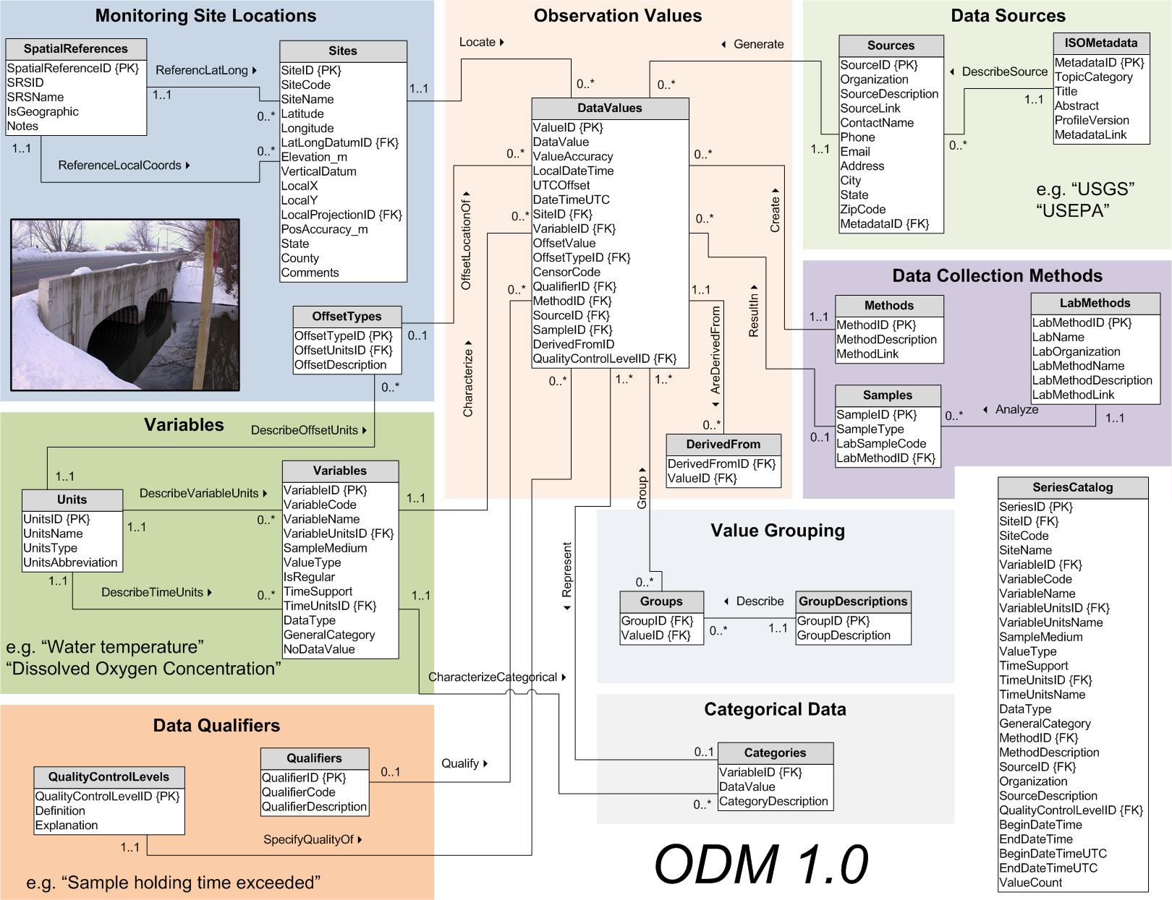
CUAHSI Observations Data Model
http://www.cuahsi.org/his/odm.html

Slide 8
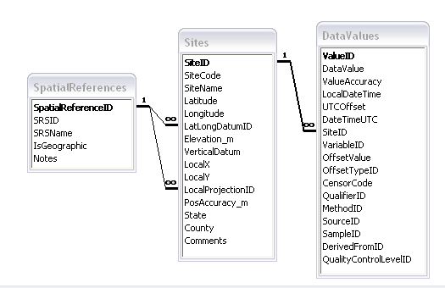
Site Attributes
SiteCode, e.g. NWIS:10109000
SiteName, e.g. Logan River Near Logan, UT
Latitude, Longitude Geographic coordinates of site
LatLongDatum Spatial reference system of latitude and longitude
Elevation_m Elevation of the site
VerticalDatum Datum of the site elevation
Local X, Local Y Local coordinates of site
LocalProjection Spatial reference system of local coordinates
PosAccuracy_m Positional Accuracy
State, e.g. Utah
County, e.g. Cache

Slide 9
Independent of, but can be coupled to Geographic Representation
ODM
Arc Hydro
Feature
Observations Data Model
1
HydroPoint
Waterbody
Watershed
Sites
1
HydroID
HydroID
HydroID
SiteID
HydroCode
*
HydroCode
HydroCode
SiteCode
FType
FType
DrainID
SiteName
OR
Name
Name
AreaSqKm
Latitude
JunctionID
AreaSqKm
JunctionID
Longitude
JunctionID
NextDownID
…
ComplexEdgeFeature
*
SimpleJunctionFeature
*
CouplingTable
1
SiteID
HydroID
1
HydroEdge
HydroJunction
HydroJunction
HydroID
1
HydroJunction
1
HydroID
HydroID
HydroCode
HydroID
HydroCode
HydroCode
ReachCode
HydroCode
NextDownID
NextDownID
Name
NextDownID
LengthDown
LengthDown
LengthKm
HydroNetwork
LengthDown
DrainArea
DrainArea
LengthDown
DrainArea
FType
FType
FlowDir
FType
Enabled
Enabled
FType
Enabled
AncillaryRole
AncillaryRole
EdgeType
AncillaryRole
Enabled
EdgeType
Flowline
Shoreline

Slide 10
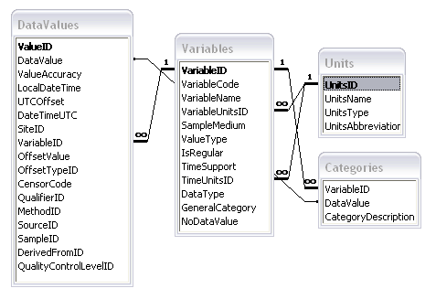
Variable attributes
Cubic meters per second
Flow
m³/s
VariableName, e.g. discharge
VariableCode, e.g. NWIS:0060
SampleMedium, e.g. water
ValueType, e.g. field observation, laboratory sample
IsRegular, e.g. Yes for regular or No for intermittent
TimeSupport (averaging interval for observation)
DataType, e.g. Continuous, Instantaneous, Categorical
GeneralCategory, e.g. Climate, Water Quality
NoDataValue, e.g. -9999

Slide 11
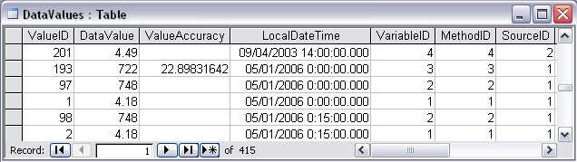
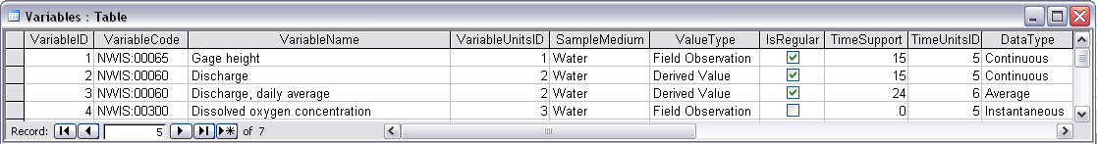
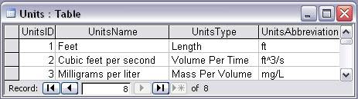
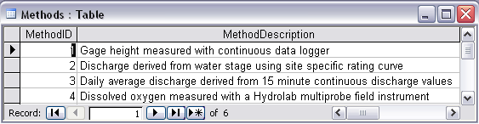
Discharge, Stage, Concentration and Daily Average Example

Slide 12
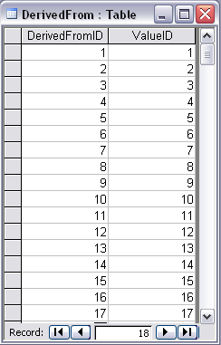
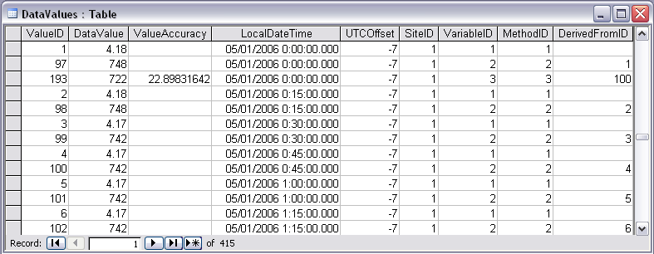
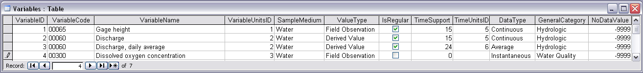
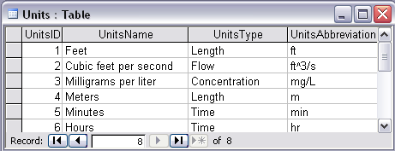
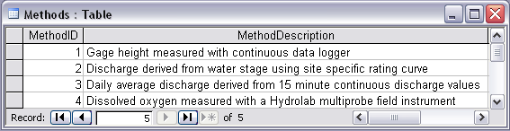
Stage and Streamflow Example
Notes:
Discharge Derived from Gage Height
Concepts:
Data derived from other data – single data point derived from a single observation (discharge from stage)
Data derived using a specific method (discharge from stage using rating curve)
Relationships:
Relationships between Values table and DerivedFrom table on DerivedFromID and ValueID
Relationship between Values table and Variables table on VariableID
Relationship between Values table and Methods table on MethodID
Relationship between Variables table and Units table on UnitID

Slide 13
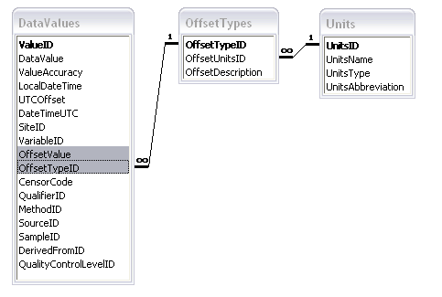
Offset
OffsetValue
Distance from a datum or control point at which an observation was made
OffsetType defines the type of offset, e.g. distance below water level, distance above ground surface, or distance from bank of river

Slide 14
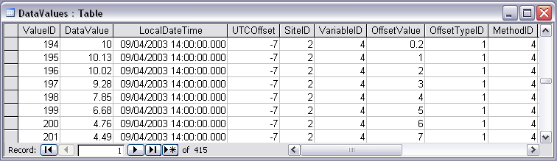

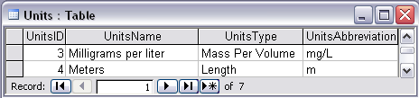
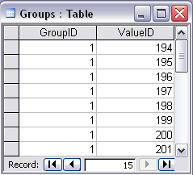


Water Chemistry from a profile in a lake
Notes:
Water Chemistry From a Lake Profile
Concepts:
Grouped observations (all observations in one reservoir profile)
Observations made using an offset (observations made at multiple depths below the surface of a reservoir)
Observations made using a specific method (observations made using a particular field instrument)
Relationships:
Relationship between Values table and the Variables table on VariableID
Relationship between Values table and OffestTypes table on OffsetTypeID
Relationship between Values table and Methods table on MethodID
Relationship between Variables table and Units table on UnitID
Relationship between GroupDescriptions table and Groups table on GroupID
Relationship between OffsetTypes table and Units table on UnitID and OffsetUnitID

Slide 15
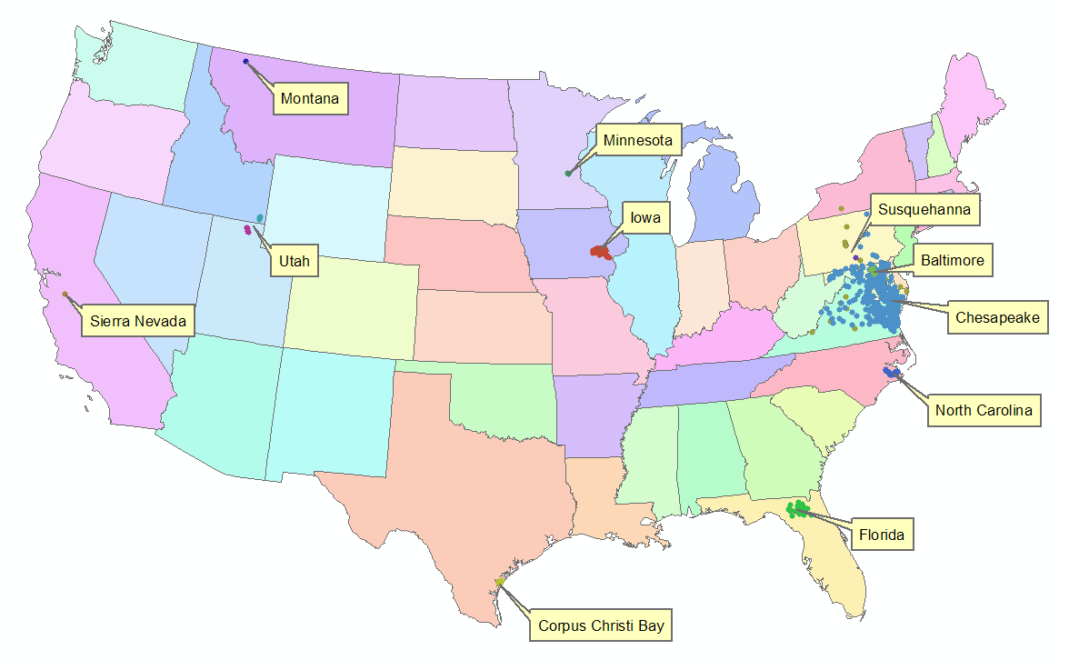

Implementation in WATERS Network Information System
National Hydrologic Information Server
San Diego Supercomputer Center
11 WATERS Network test bed projects
16 ODM instances (some test beds have more than one ODM instance)
Data from 1246 sites, of these, 167 sites are operated by WATERS investigators

Slide 16
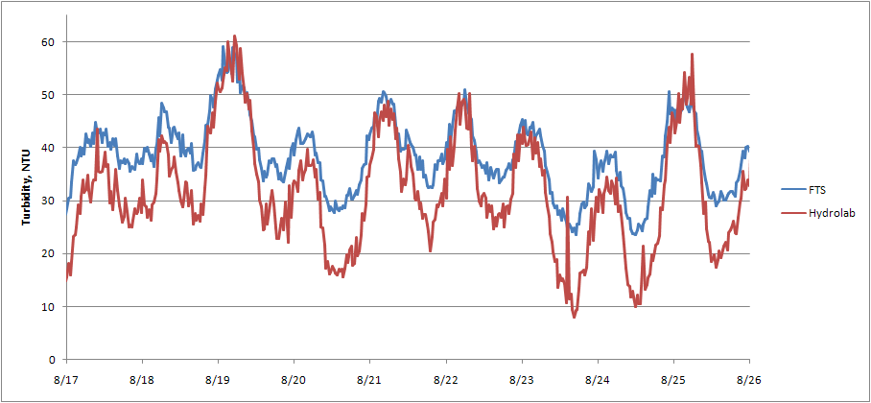
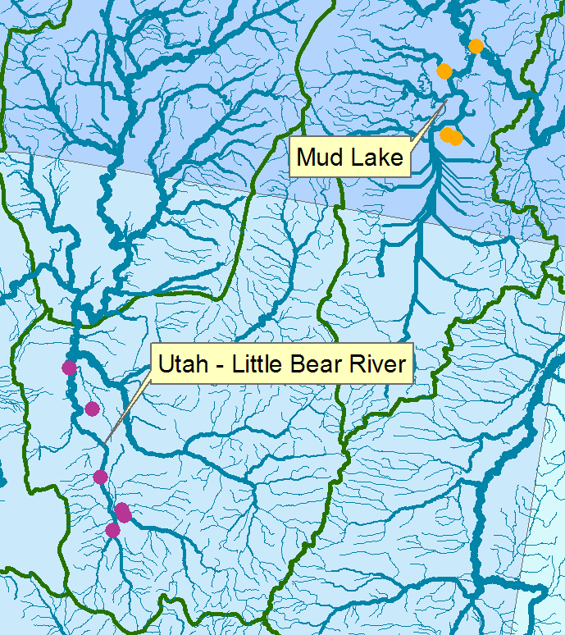
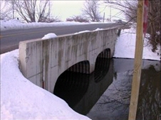
Utah – Little Bear River and Mud Lake
Turbidity
Continuous turbidity observations at the Little Bear River at Mendon Road from two different turbidity sensors.

Slide 17
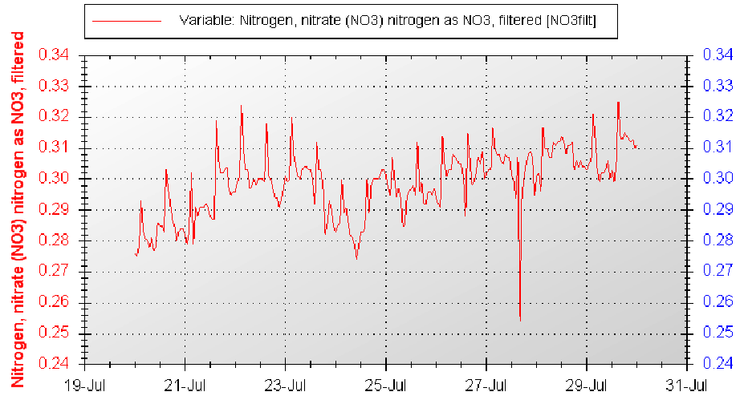
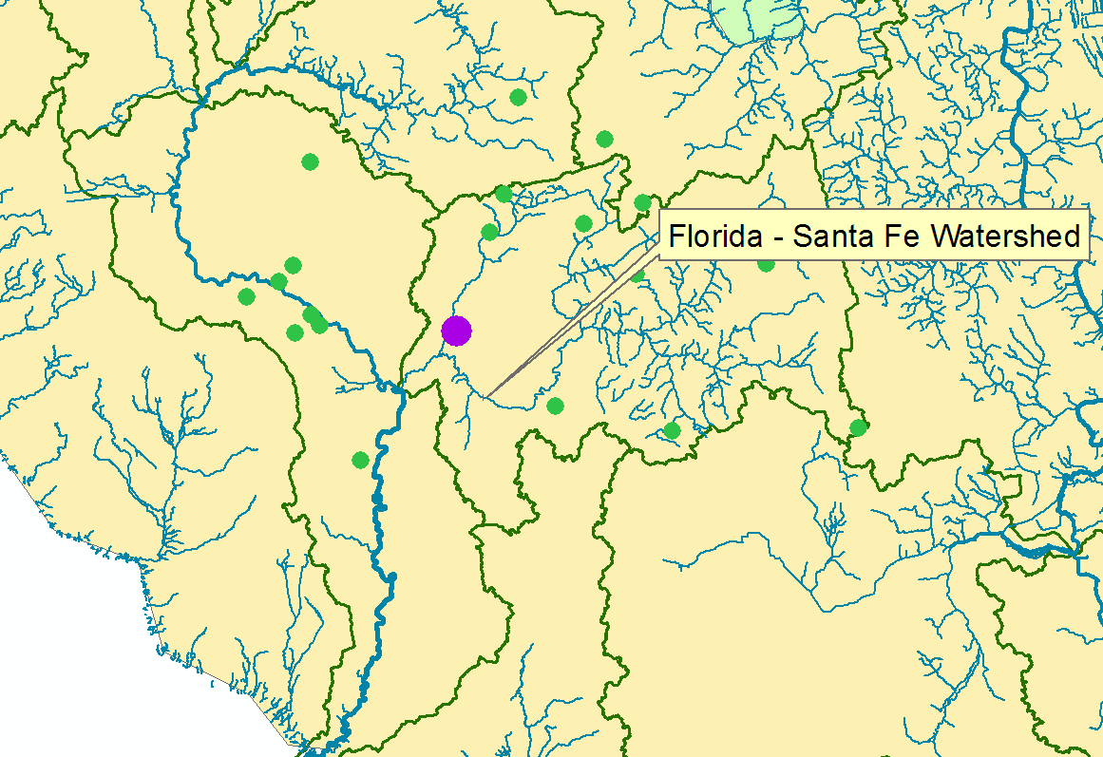
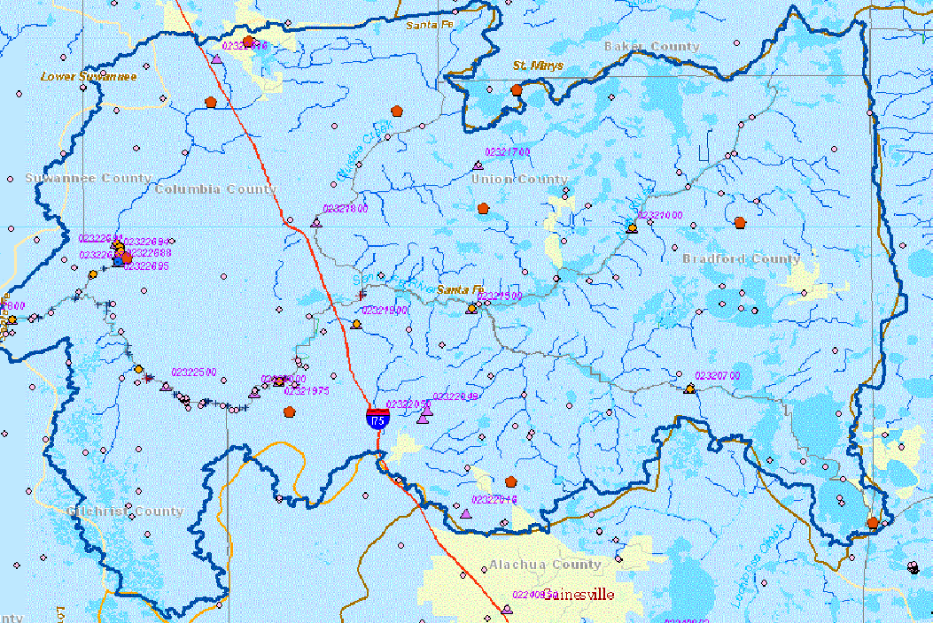
Florida – Santa Fe Watershed
Nitrate Nitrogen (mg/L)
Millpond Spring
PI: Wendy Graham, ….; DM: Kathleen McKee, Mark Newman

Slide 18
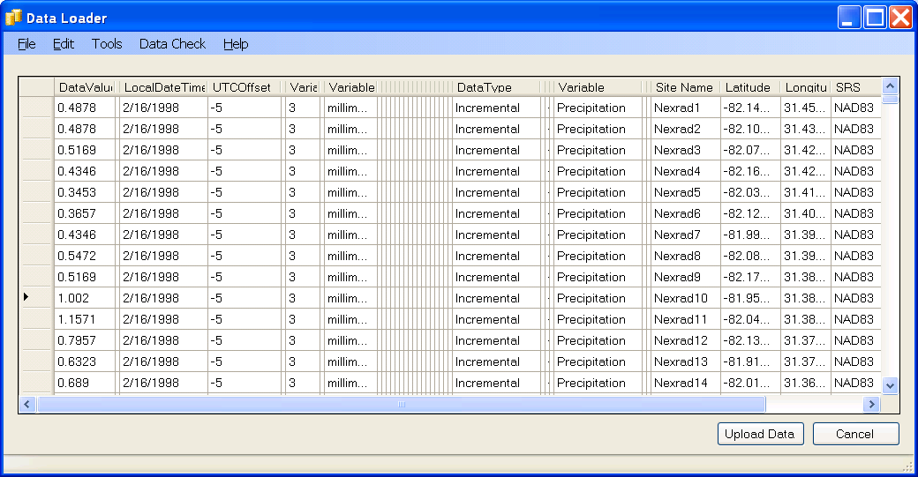
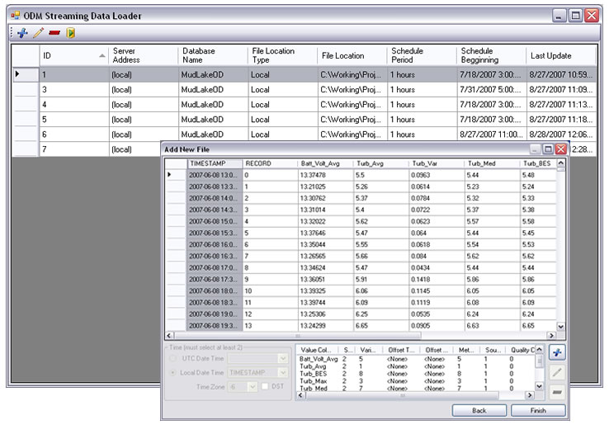
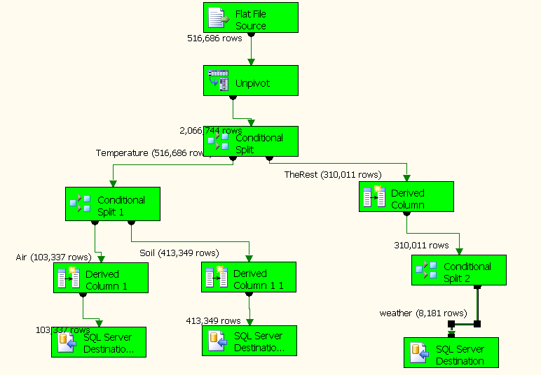
Loading data into ODM
OD Data Loader
Interactive OD Data Loader (OD Loader)
  Loads data from spreadsheets and comma separated tables in simple format
Scheduled Data Loader (SDL)
  Loads data from datalogger files on a prescribed schedule.
  Interactive configuration
SQL Server Integration Services (SSIS)
  Microsoft application accompanying SQL Server useful for programming complex loading or data management functions
SDL
SSIS

Slide 19
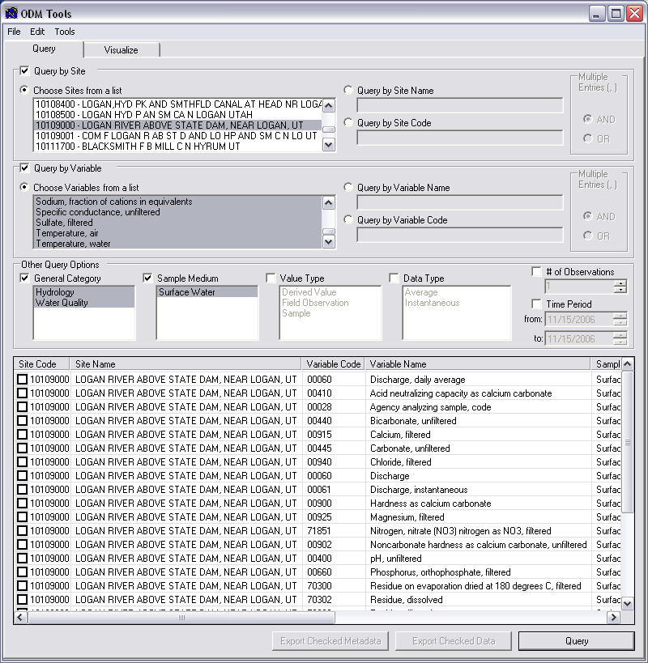
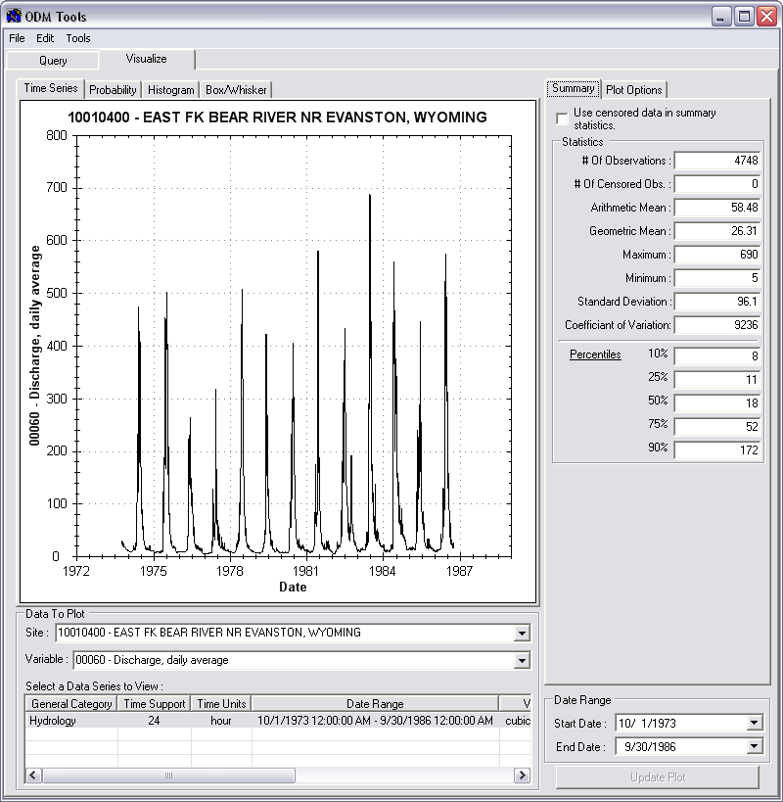
Managing Data Within ODM - ODM Tools
Query and export – export data series and metadata
Visualize – plot and summarize data series
Edit – delete, modify, adjust, interpolate, average, etc.

Slide 20

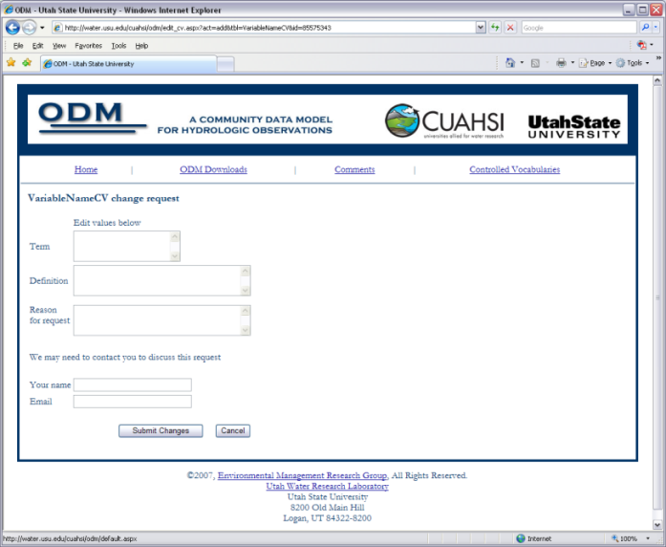

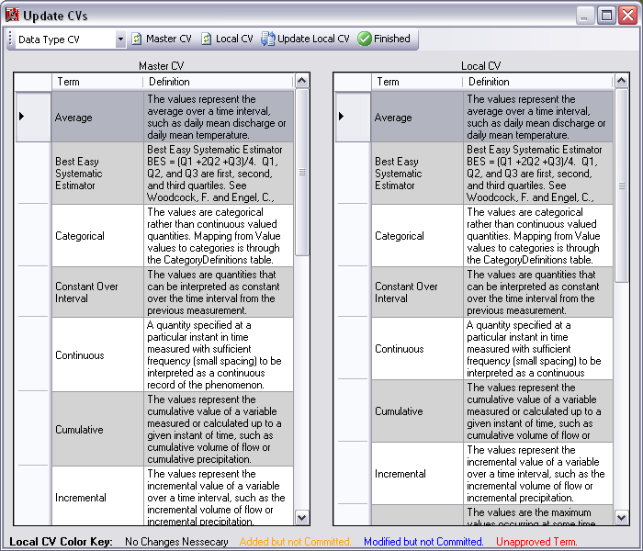
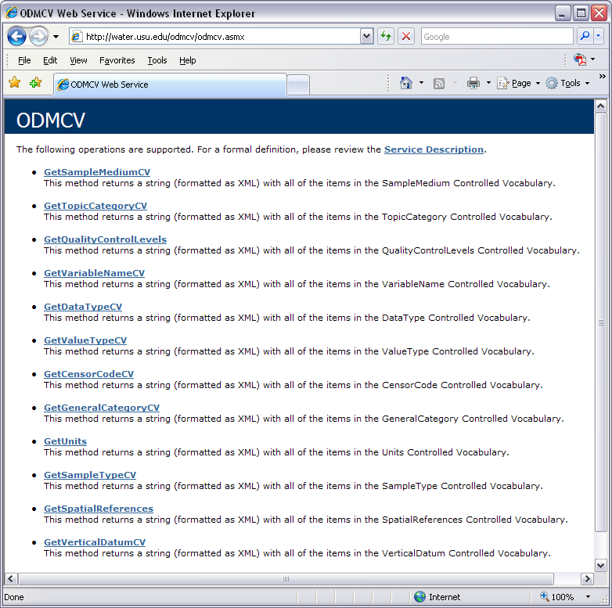
Dynamic controlled vocabulary moderation system
ODM Data Manager
ODM Website
ODM
Tools
ODM Controlled
Vocabulary Moderator
XML
Master ODM Controlled Vocabulary
Local ODM
Database
ODM
Controlled Vocabulary
Web Services
Local
Server
http://water.usu.edu/cuahsi/odm/cv.aspx

Slide 21
Summary
Syntactic consistency (File types and formats)
Semantic consistency
  Language for observation attributes (structural)
  Language to encode observation attribute values (contextual)
A national network of consistent data
Enhanced data availability
Metadata to facilitate unambiguous interpretation
Enhanced analysis capability

Slide 22
Future Considerations
Additional data types (grid, image etc.)
Additional catalog sets to enhance discovery
Unit standardization and conversion
Ownership, security, authentication, provenance
Improve controlled vocabulary constraints to enhance integrity

Slide 23
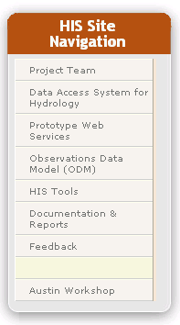
HIS Website http://www.cuahsi.org/his
Project Team – Introduces members of the HIS Team
Data Access System for Hydrology – Web map interface supporting data discovery and retrieval
Prototype Web Services – WaterOneFlow web services facilitating downlad of time series data from numerous national repositories of hydrologic data
Observations Data Model – Relational database schema for hydrologic observations
HIS Tools – Links to end-user applications developed to support HIS
Documentation and Reports – Status reports, specifications, workbooks and links related to HIS
Feedback – Let us know what you think
Austin Workshop – Material from WATERS workshop in Austin

