Slide 1
Snow, Snowpacks and Runoff
David G Tarboton
Charles H Luce

Slide 2
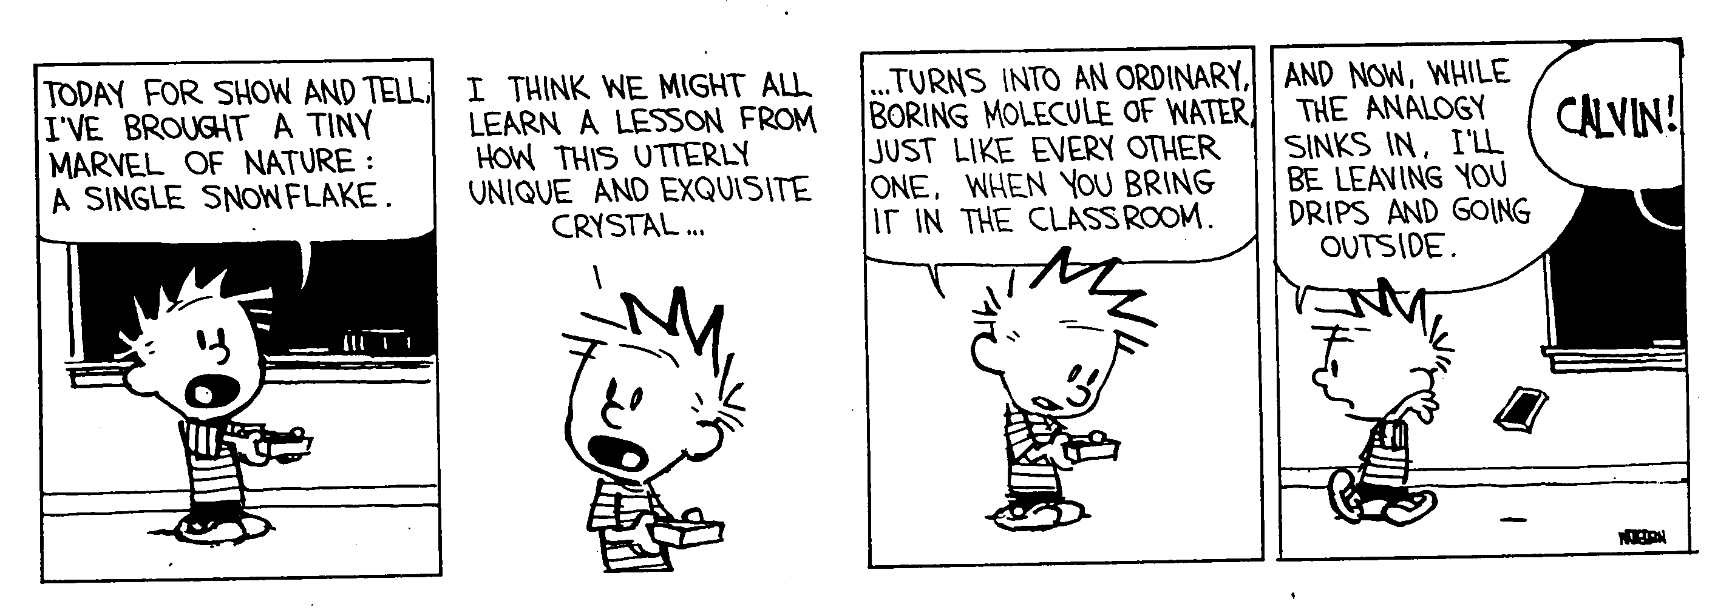
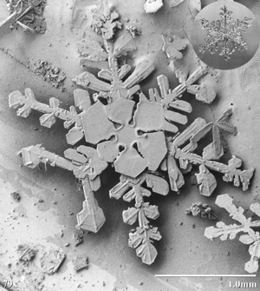
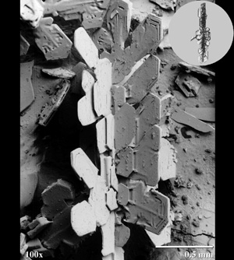
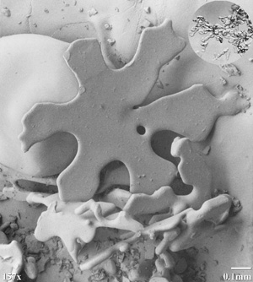
Show and Tell
Images from http://www.anri.barc.usda.gov/emusnow/default.htm

Slide 3
Potential effects of climate change on snow
Advance in snowmelt timing
Smaller snow pack area
Uncertainty in regional variability
(need more research to examine trends, patterns, feedback and nonlinear dynamics. e.g. Mote, 2003, GRL)
Notes:
It may be obvious to this audience, but just to set the stage, in considering snow and runoff some of the potential effects of climate change are: (read from slide). These speak to the need to examine trends and understand the interactions involved.

Slide 4
Quantifying snowmelt runoff requires knowledge of
the quantity of water held in snow packs
the magnitude and rate of water lost to the atmosphere by sublimation
the timing, rate, and magnitude of snow melt
the fate of melt water
Notes:
If we are to quantify snowmelt runoff we need to know the following four things: (read from slide). These involve combining observation and modeling, so a theme that I will promote is learning through integration of observation and modeling.

Slide 5
Attributes of Snow Important in Runoff
Snow Water Equivalent
Heterogeneity
Thermal properties
Notes:
In understanding snow and runoff it is important to quantify these things. Snow water equivalent is the depth of water that results when a snowpack melts and it is the basic quantity used to quantify the amount of snow water present. We do not have a good way to measure or predict snow water equivalent over a large watershed due in large part to spatial heterogeneity. We can measure SWE at a point, but over an area it is difficult. I'll talk about some of the methods in a minute, but measuring SWE patterns over large areas is a significant limitation that needs attention. Snow is also a very interesting substance. Being comprised of ice crystals and air it acts as an insulator to the conduction of heat. Heat transport processes also modify the medium itself. These properties need to be understood and reflected in models to correctly estimate snow melt surface water inputs. I'll talk about some of the recent ideas and improvements in modeling snow thermal properties.

Slide 6
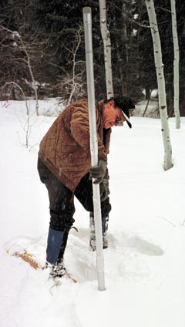
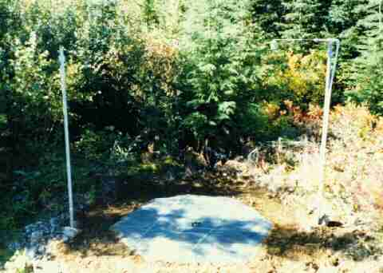
Quantifying Snow Water Equivalent
Field Snow Surveys (courses, pits, tubes)
SNOTEL system
Stereo photo interpretation
Gamma radiation
LIDAR
Gravity
Microwave
Remote sensing
Model + data
assimilation
Notes:
This reviews some of the methods for quantifying snow water equivalent. Ground based methods include field snow surveys and the SNOTEL system based on snow pillows. These have the disadvantage of being point measurements that are hard to extend over a large watershed. Remote sensing offers the only real opportunity to obtain spatial snow water equivalent and here are some of the methods. (Discuss advantages and limitations). I think that to make real progress in quantifying SWE we really need to integrate models with measurements, an assimilation approach. NOHRSC has made quite a bit of progress in this area, but more is needed.

Slide 7
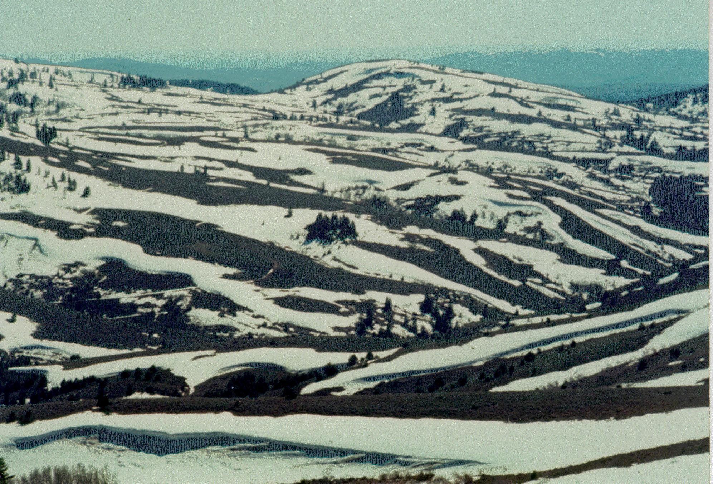
Heterogeneity of snow cover at multiple scales
Precipitation
Drifting. Topography and vegetation / shrubs
Avalanching / Sloughing
Variable exposure to melt energy
Reynolds Creek. Photograph Keith Cooley
Notes:
Now I would like to really focus on heterogeneity of snow at multiple scales. Heterogeneity is caused by a number of processes - listed here. Quantifying and understanding heterogeneity is a major challenge for snow science.

Slide 8
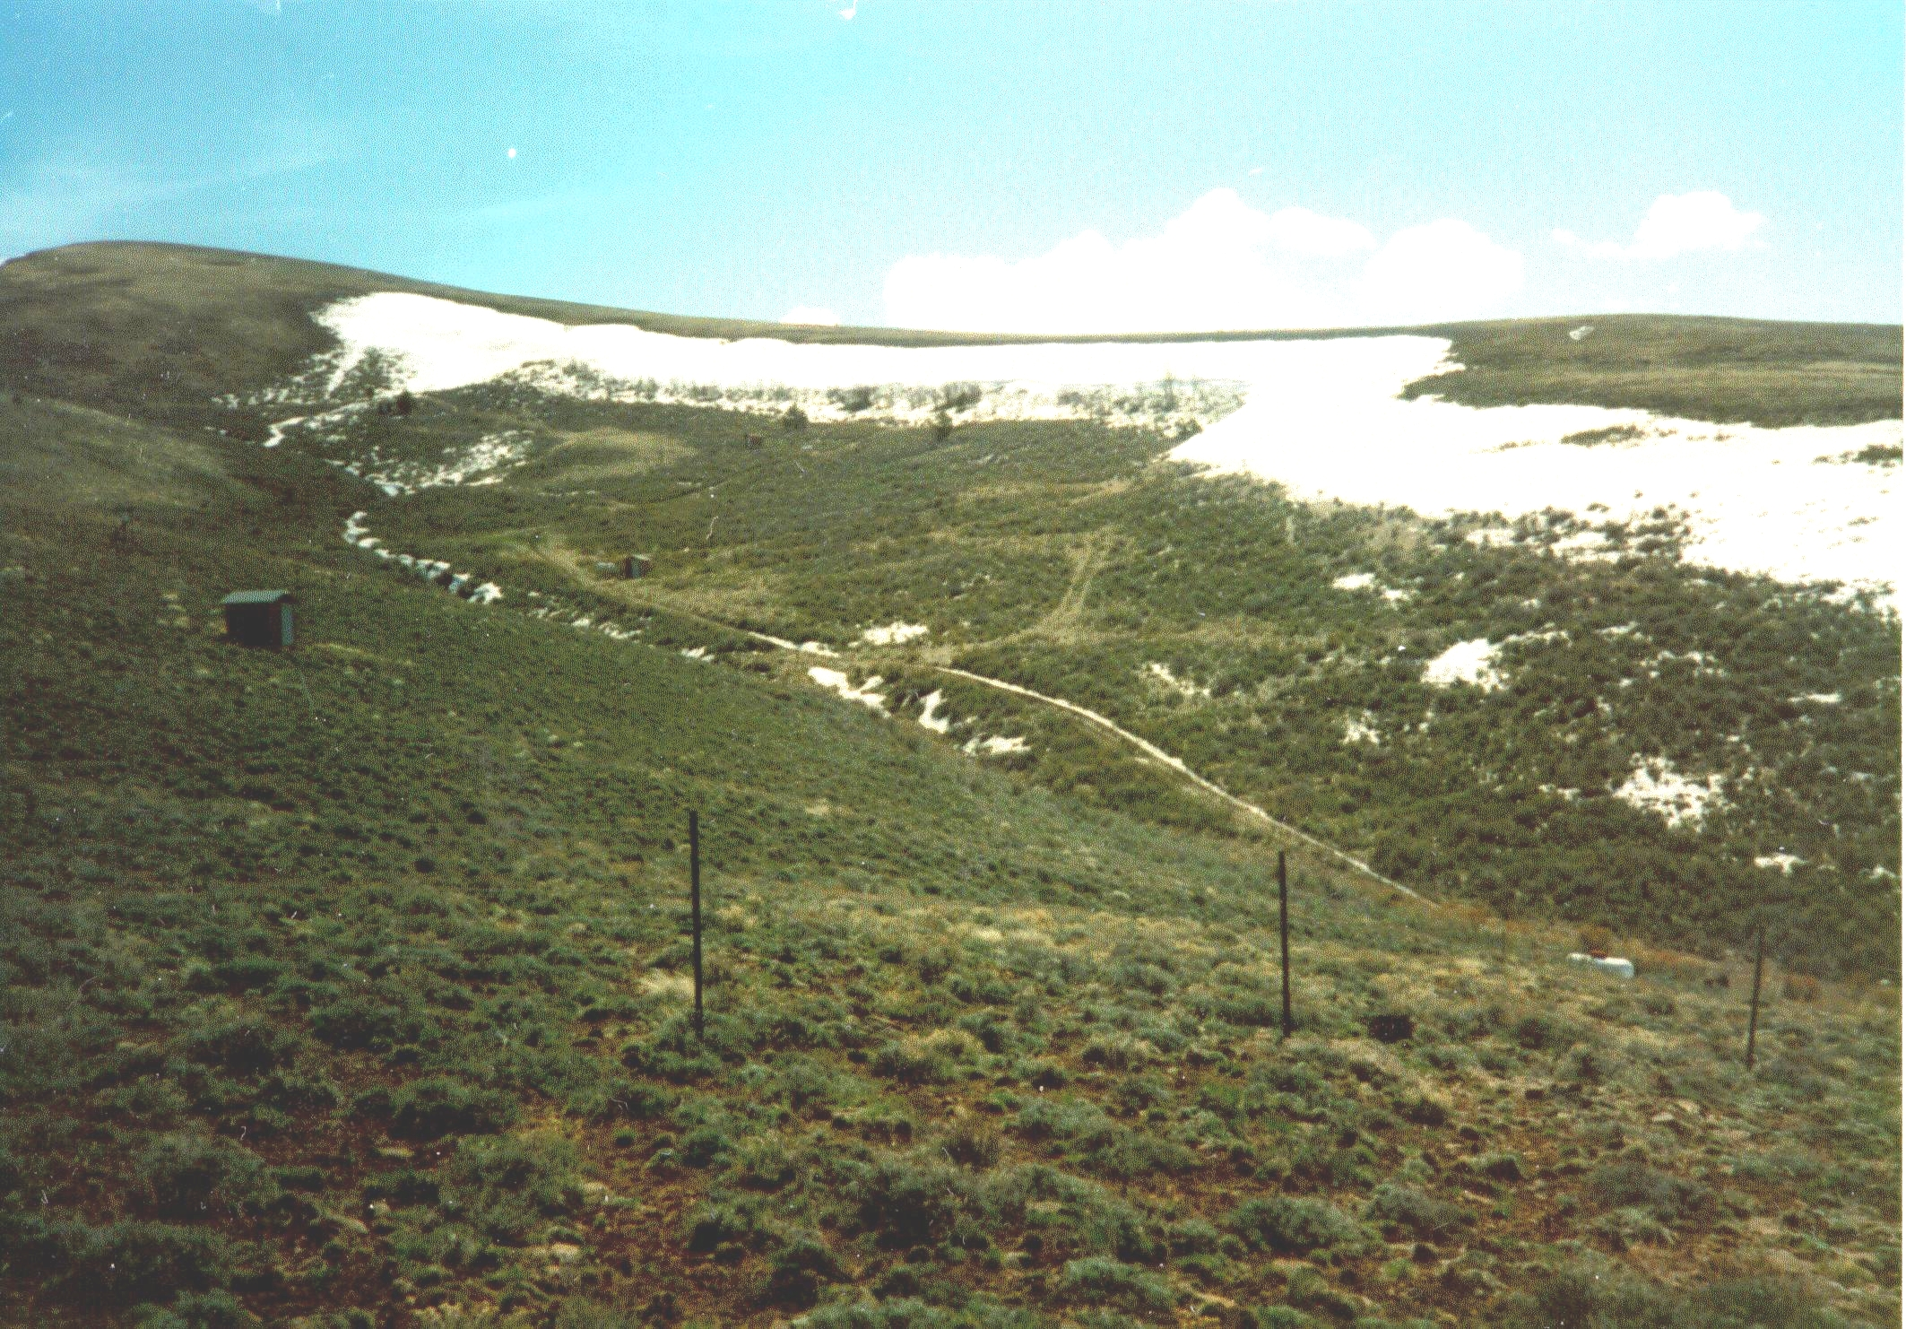
Hydrologic Importance of Heterogeneity
Sustains surface water input late into season
Limits exposure of snow surface to sublimation
Upper Sheep Creek, Photograph Keith Cooley

Slide 9
Approaches to spatially distributed modeling of snow over a catchment
Effective or representative parameters.
Variability parameterized using distribution functions.
Combination of representative points (e.g. fuzzy membership).
Indexed semi-distributed (e.g. elevation zones or HRU's).
Detailed spatially explicit (e.g. grid cells).

Slide 10
Modeling spatial heterogeneity examples
Detailed spatially explicit
Upper Sheep Creek
Point
Luce, C. H., D. G. Tarboton and K. R. Cooley, (1998), "The Influence of the Spatial Distribution of Snow on Basin-Averaged Snowmelt," Hydrological Processes, 12(10-11): 1671-1683.
Accumulation Factors
Notes:
I now go through a series of examples to illustrate the state of the art and future challenges. This slide shows the difference between applying a point model and detailed spatially explicit model over a small area to estimate surface water input. The spatially distributed model sustains surface water input from the drift areas much later in to the spring, more consistent with the observed timing of snowmelt runoff. The spatially distributed model used the accumulation factor concept to relate measured precipitation to accumulation at each location accounting for redistribution due to drifting. In this example at Upper Sheep Creek, accumulation factor was estimated from measurements of SWE at each grid point.

Slide 11
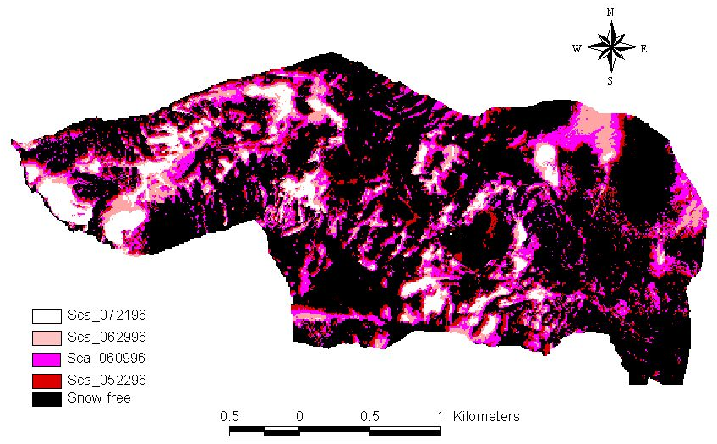
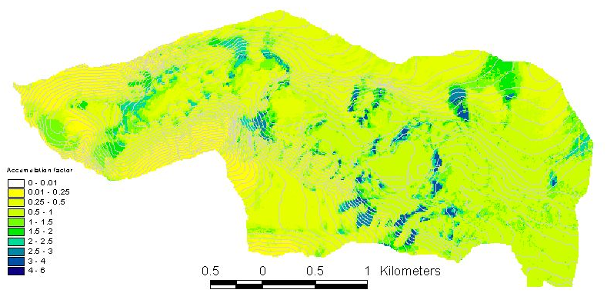
Estimating Accumulation Factor from Snow Covered Area Images
W
Range of AF
AF upper bound
AF lower bound
Snow free
Snow observed
T₁
T₂
Time
Snow Covered Area Images
Estimated Accumulation Factor
Green Lakes Valley Accumulation Factors. Jinsheng You, Unpublished PhD 2004
Notes:
Measurements of SWE are hard to obtain over a larger area so other approaches are needed to estimate accumulation factor. This work from Jinsheng You uses a method based on snow covered area to estimate accumulation factor. The idea is that at each point there is a time/date at which snowcover was last observed and a later date at which a snow free surface was first observed. The accumulation factor in the mass balance equation can be used to adjust a model to have it predicting snow disappearance on either of these dates. This gives the range of AF. Now if we look at edge grid cells in the images and make the assumption that if they are snow covered, they are about to become snow free, or if they are snow free that they just became snow free then one of the bounds on AF can be selected for a subset of the domain. This subset of edge cells is used to calibrate a regression model related to topographic attributed to estimate AF over the entire domain.

Slide 12
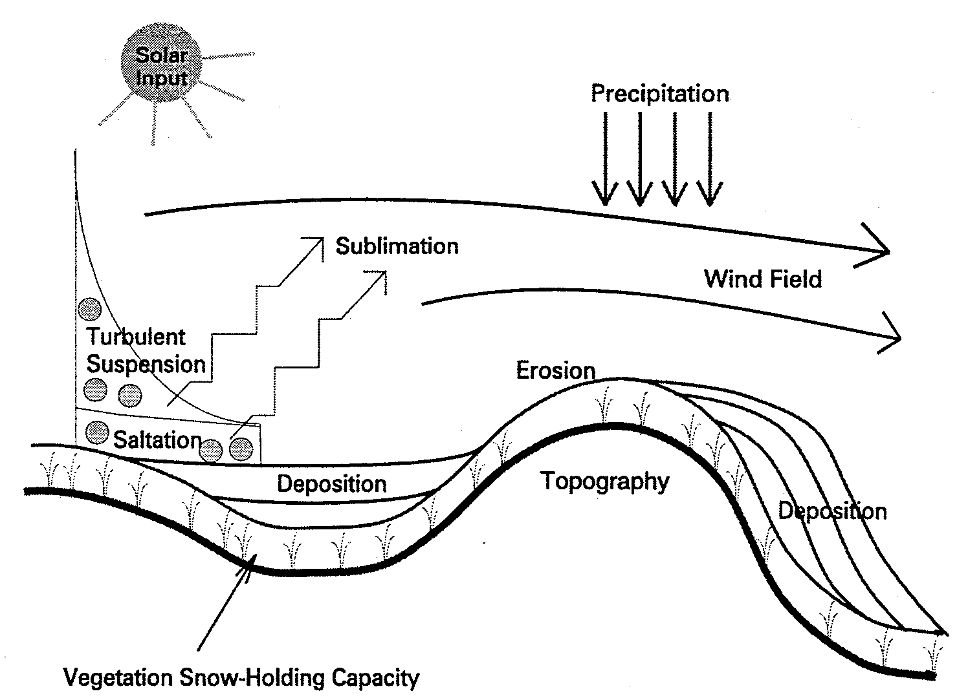
Estimating Accumulation Factor from Blowing Snow Model
SnowTran-3D:
  Wind modeled over topography producing deposition and erosion
  outputs snow depth
  accumulation factors defined as the ratio of simulated SWE to the water equivalent of snowfall
Liston, G. E. and M. Sturm, (1998), "A Snow-Transport Model for Complex Terrain," Journal of Glaciology, 44(148): 498-516.
Notes:
Another approach to modeling the spatial variability of SWE is to use a blowing snow model to physically quantify the effect of snow drifting. This slide illustrates the Snowtran 3D model developed by Liston and Sturm that represents the processes listed.

Slide 13
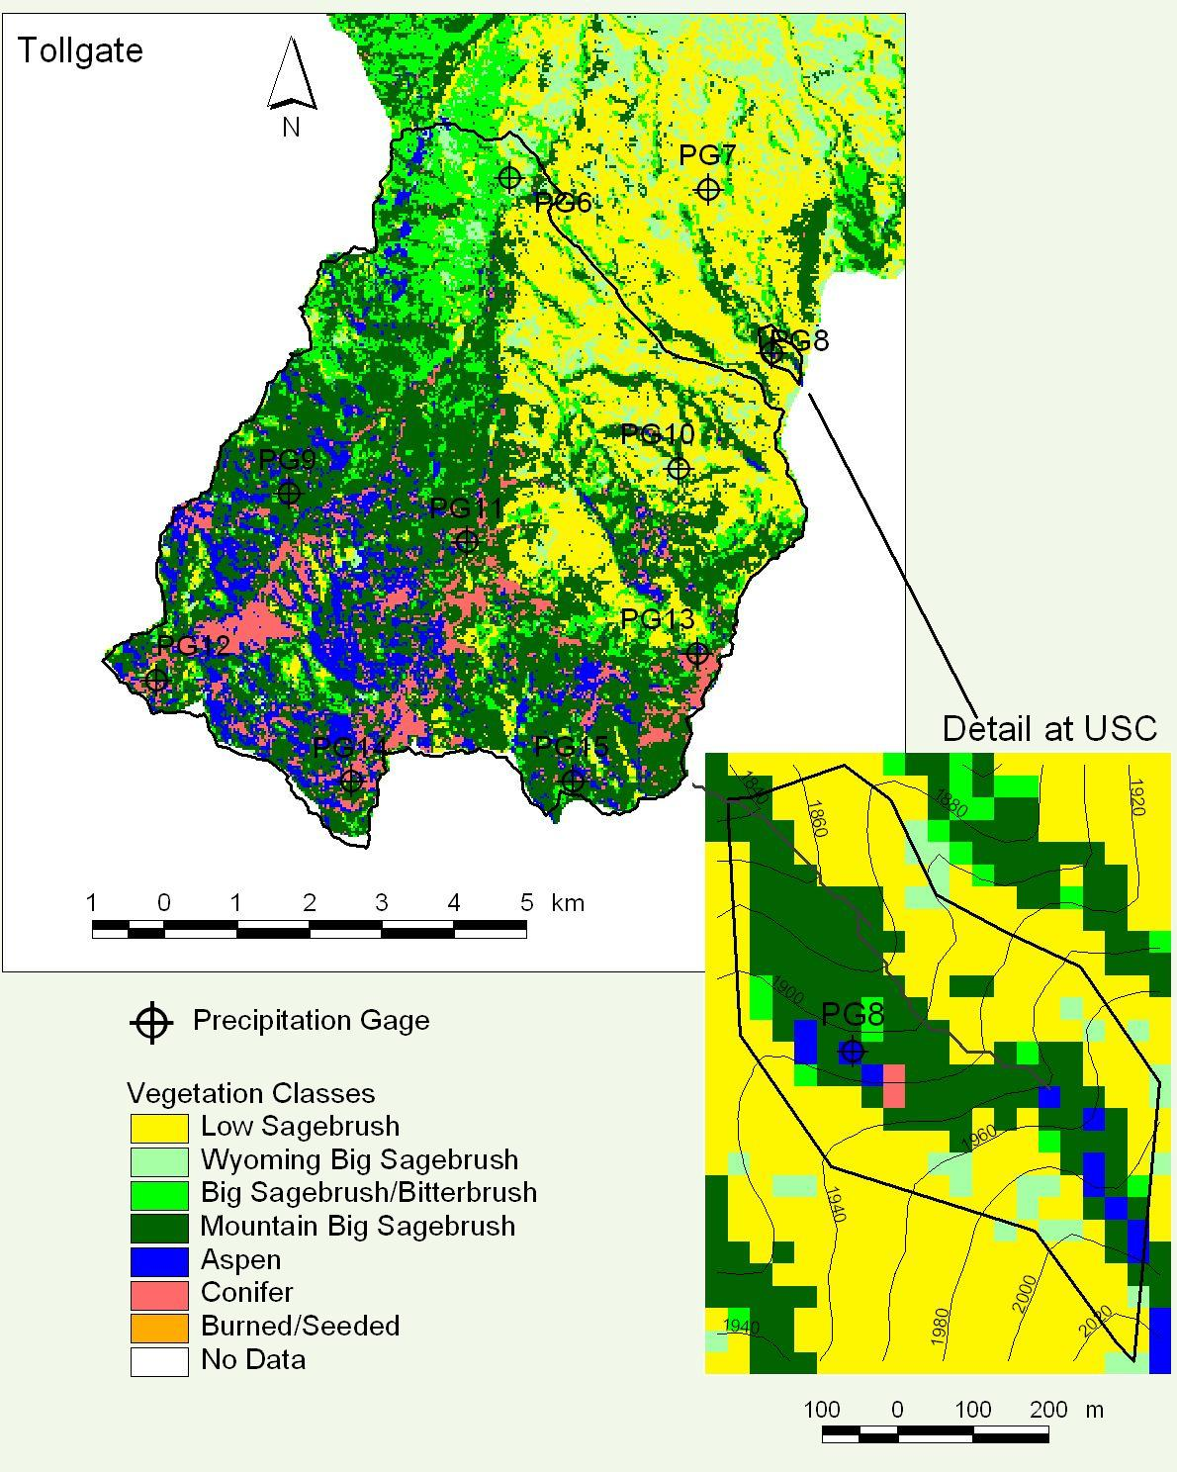
SnowTran-3D Simulations at Reynolds Creek
Point comparison
Distribution comparison
Prasad, R., D. G. Tarboton, G. E. Liston, C. H. Luce and M. S. Seyfried, (2001), "Testing a Blowing Snow Model against Distributed Snow Measurements at Upper Sheep Creek, Idaho, USA," Water Resources Research, 37(5): 1341-1356.
Notes:
Here is an example of application of this model over the upper portion of the Reynolds Creek experimental watershed. Point comparisons were disappointing, but the overall distribution of SWE compared not too badly between model and observations. In some applications it is only this distribution that is needed so these results are still useful. They also point to the need for improving blowing snow models.

Slide 14
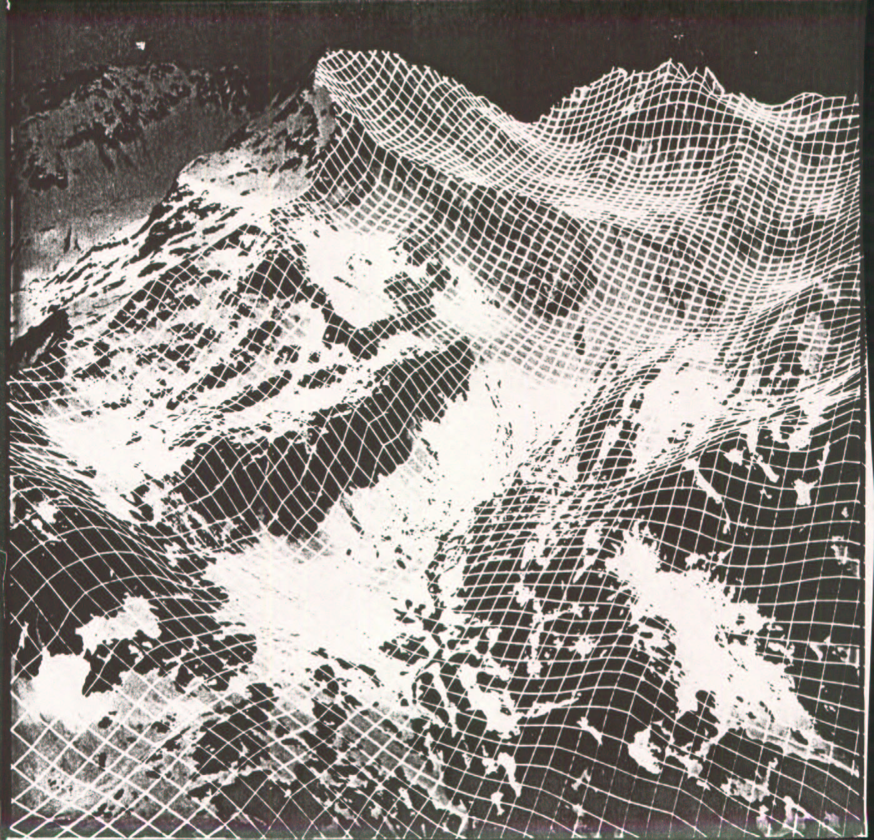
Accumulation Factor estimated from topography using empirical rules
(a₁+a₂z)*(1-f(slope))
*(1+a₃curv)
Blöschl, G., R. Kirnbauer and D. Gutnecht, (1991), "Distributed Snowmelt Simulations in an Alpine Catchment. 1. Model Evaluation on the Basis of Snow Cover Patterns," Water Resources Research, 27(12): 3171-3179.
Notes:
This slide illustrates an empirical approach based on topography developed by Günter Blöschl.

Slide 15
Subgrid Variability Parameterization
Resolved
Resolved by
Subgrid
Element-to-Element
Scale Parameterizations
Spectral Power
2/Δx
Spacing Frequency
(after Blöschl and Kirnbauer, 1994)
Notes:
This is also a slide from Blöschl's work. In snow modeling the scale of model elements controls the extent to which spatial variability can be explicitly represented by the model. Here in this spectral density function the variability associated with each scale or frequency is depicted. On the left at spacings larger than the element size variability is explicitly represented by differences between model elements. On the right at spacings smaller than the model element size variability has to be represented within a model element, i.e. subgrid variability. The representation of subgrid variability has been the focus of much work in snow and other modeling.

Slide 16
Depletion curve for parameterization of subgrid variability in accumulation and melt
Accumulation variability
Melt variability
Luce, C. H., D. G. Tarboton and K. R. Cooley, (1999), "Subgrid Parameterization Of Snow Distribution For An Energy And Mass Balance Snow Cover Model," Hydrological Processes, 13: 1921-1933
Notes:
This slide shows a method we developed to use a depletion curve to represent subgrid variability.

Slide 17
Depletion curve parameterization of a point snowmelt model
Notes:
This slide shows how a depletion curve is used to evolve a point model using energy and mass fluxes over only the snow covered area.

Slide 18
Upper Sheep Creek.
Luce, C. H., D. G. Tarboton and K. R. Cooley, (1999), "Subgrid Parameterization Of Snow Distribution For An Energy And Mass Balance Snow Cover Model," Hydrological Processes, 13: 1921-1933
Notes:
This shows how this works, in comparison to observations and a spatially explicit fully distributed model.

Slide 19
Depletion curves derived using distributions of surrogate variables
Distributed model reference
Elevation, z
Accumulation factor, Φ
Peak accumulation
regression
combining Φ, z
Jinsheng You, Unpublished PhD 2004
Notes:
In the slide just presented the depletion curve was derived based upon detailed spatially distributed measurements. This is impractical for large areas so we need ways to relate the depletion curves to surrogate measures of variability. This slide shows depletion curves derived from the following surrogate variables. (1) Elevation, (2) accumulation factor, in this case estimated from the snow covered area images, and (3) a peak accumulation estimate based on regression with accumulation factor and elevation as predictor variables. The regression parameters were calibrated against peak accumulation from a spatially explicit model. The spatially explicit distributed model is used as a reference. We see that it is possible to get depletion curves that approach the reference depletion curve based on surrogate variables, but that the better estimates still require some reliance on spatially explicit modeling.

Slide 20
Time Stability of Depletion Curves
Depletion curves from several years of data at Upper Sheep Creek (data provided by K. Cooley)
Notes:
In this slide we examine the time stability of depletion curves. One of the foundations of the depletion curve approach is that the same shape of depletion curve is assumed for low and high snow years. The rescaling based on maximum accumulation is important for the ease of practical implementation free from specific date assumptions for peak accumulation. This shows in data from Keith Cooley at Upper sheep creek for 9 years that the depletion curve (at least here) appears to be relatively stable across years. This stability is the basis for another idea for the use of depletion curves. Snow covered area is relatively easy to measure, and if one during a melt season observed Af, one can infer from a depletion curve the fraction of basin average snow water equivalent that has melted and the fraction that remains in the basin. One then just needs an index of scale to infer the actual melt amounts or water equivalent remaining. Potential indices include point measurements, e.g. from SNOTEL, or measurements of melt runoff at a stream gage. This idea is developed further in a minute.

Slide 21
Practical estimation of depletion curves remains a challenge
A suggestion
Assimilate observed snow covered area with modeling to derive depletion curve and surface water input
t₁
t₂
t₃
t₄
A_{f}
A_{f}(t)
t₅
t₆
t₇
t₁
t₂
t₃
t₄
t₅
t₆
t₇
Time
Notes:
There are still challenges in the estimation of depletion curves and following is a suggestion (not tested) that we put forth for possibly doing this. Again this relies on the idea that snow covered area is relatively easy to measure. One can take measurements of snow covered area over time to establish Af(t).

Slide 22
Point model initialized with sufficient snow to sustain snowcover to season end
Melt Rate
m(t)
Cumulative Melt
t₁
t₂
t₃
t₄
t₅
t₆
t₇
Time
Notes:
Next one can initialize a model with sufficient snow to sustain snow cover over a season to obtain potential melt over time.

Slide 23
Combining
A_{f}(t) &
Cumulative Melt
m(t)
A_{f}(m)
A_{f}
Time
Time
A
f
W_{a}
= shaded area
w
m
W_{a}(A_{f}) or A_{f}(W_{a})
Notes:
Combining these gives Af(m). The relationship between snow covered area and potential melt is at the heart of the derivation of depletion curves from the spatial distribution of snow as illustrated here. Given an initial spatially variable snow distribution subject to potential melt m, the remaining snow water equivalent is the integral of snow water equivalent over the area with depths greater than m. This establishes the relationship between basin average snow covered area Wa and melt m. This can be used to establish the depletion curve Wa(Af) or its inverse.

Slide 24
Potential results
Post season reconstruction of W_{a}(t)
(Similar to Cline, D. W., R. C. Bales and J. Dozier, (1998), "Estimating the Spatial Distribution of Snow in Mountain Basins Using Remote Sensing and Energy Balance Modeling," Water Resources Research, 34(5): 1275-1285 who suggested post season reconstruction of spatially distributed peak snow accumulation based on a spatially distributed model)
A_{f}(W_{a}) for future modeling and surface water input estimation
Once depletion curve is in hand observations of A_{f} give fraction of W that has been depleted/is remaining
Notes:
This idea has potential to provide for post season reconstruction of time series of basin average snow water equivalent. Don Cline and colleagues used a similar idea to reconstruct spatially distributed snow water equivalent based on a spatially distributed model. This is also similar to the idea Jinsheng You's results that I showed earlier for estimating accumulation factor from a sequence of images. In these methods I think that uncertainty will be reduced when the function is well defined by frequent snow covered area images. MODIS may be good sensor to try with this method. Once the depletion curve is established through this approach it can be used for future modeling and surface water estimation, as well as in real time to give the fraction of snow remaining in a watershed for operational purposes.

Slide 25
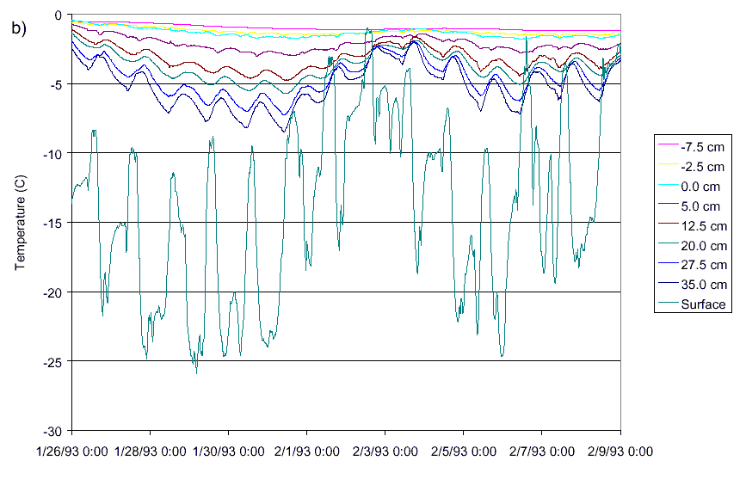
Snow's role in energy fluxes
Temperature fluctuations with depth and insulating effects
Luce, C. H. and D. G. Tarboton, (2001), "A Modified Force-Restore Approach to Modeling Snow-Surface Heat Fluxes," Proceedings of the 69th Annual Western Snow Conference, Sun Valley, Idaho.
Notes:
The role that snow plays in energy fluxes also deserves some attention. This shows thermocouple measurements of snow temperature at different depths in a snowpack as well as infrared measurements of surface temperature. The dampening of fluctuations with depth illustrate the thermal insulating effect of snow.

Slide 26
Heat conduction theory
Semi infinite domain
For diurnal fluctuations at surface
Amplitude
Notes:
These observations can be understood using heat conduction theory over a semi-infinite domain. For diurnal fluctuations at the surface the dampening depth is dependent upon snow properties. This idea was used in the UEB snowmelt model we developed to parameterize the surface temperature without having to resort to layering in the model. These observations can also be used to infer thermal properties of the snow for use in models.

Slide 27
Inference of thermal properties
Amplitude decrease used to evaluate effective conductivity to each depth
z
Amplitude
exp(z/d₁)
z/d₁
d₁
k
λ
cm
C
cm
cm
2
/hr
W/m/K
0
5.52
1.00
0.00
4
0.81
0.15
1.92
2.08
0.57
0.013
11.5
0.59
0.11
2.23
5.16
3.48
0.081
19
0.35
0.06
2.75
6.92
6.26
0.145
26.5
0.28
0.05
2.97
8.91
10.39
0.241
34
0.11
0.02
3.96
8.58
9.64
0.224
39
0.04
0.01
4.86
8.02
8.42
0.196
Notes:
This slide shows some snow properties estimated from these measurements.

Slide 28
Snow temperature measurements useful to track and validate model energy content needed to predict for the onset of snowmelt
Luce, C. H. and D. G. Tarboton, (2001), "A Modified Force-Restore Approach to Modeling Snow-Surface Heat Fluxes," Proceedings of the 69th Annual Western Snow Conference, Sun Valley, Idaho.
Notes:
This slide shows comparisons of modeled and measured snow energy content. We found these measurements of snow temperature useful to validate modeled energy content and correct energy content modeling discrepancies.

Slide 29
Important issues not mentioned
Sublimation
Interception and the role of vegetation
Local advection effects on energy balance
Within snow flow processes resulting in
  Fingers
  Ice columns and lenses
  Implications for runoff generation of concentrated surface water input
Notes:
I have in this presentation focused on the importance of measuring, understanding and modeling heterogeneity, and to a lesser extent touched on some of the thermal properties of snow. There are also many things that I did not mention because of time limitations that are also important and are listed here.

Slide 30
Challenges to understanding snow and runoff processes in a variable climate
Quantifying and measuring input precipitation/snowfall
  basin average and spatial patterns
Measuring SWE over large areas
  spatial patterns
Integration of remote sensing and ground observations and modeling
Notes:
Let me try wrap up some of these ideas. Here is a list of some of the challenges I see where additional snow hydrology research is needed.

Slide 31
Challenges contd.
Quantifying and understanding heterogeneity
  Improve blowing snow models
  Improve relationships with topography (generalization)
  Improve representations of sub grid variability (watershed scale and up)
Better quantify snow thermal properties

