Slide 1
Using Digital Elevation Model Derived Height Above the Nearest Drainage for flood inundation mapping and determining river hydraulic geometry in ungauged basins
David Tarboton¹, Xing Zheng², David Maidment², Yan Liu³
1. Utah State University, dtarb@usu.edu
2. University of Texas at Austin, 3. University of Illinois
http://hydrology.usu.edu/dtarb

Slide 2
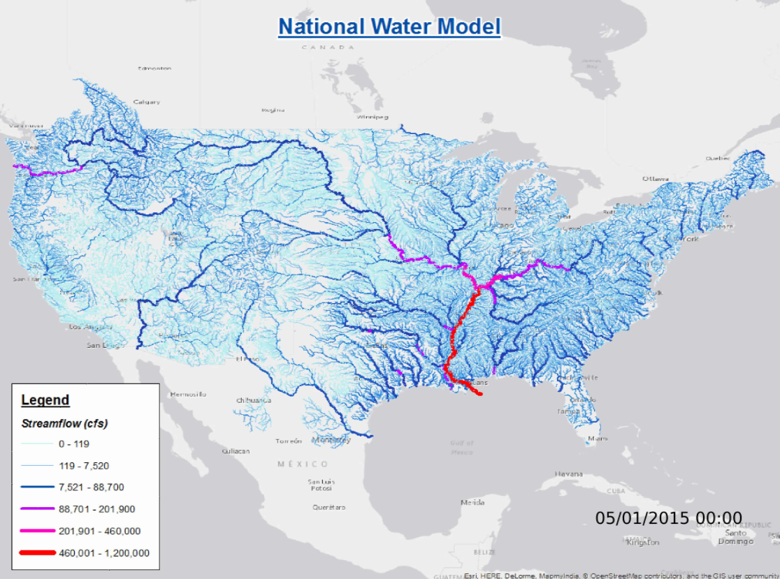
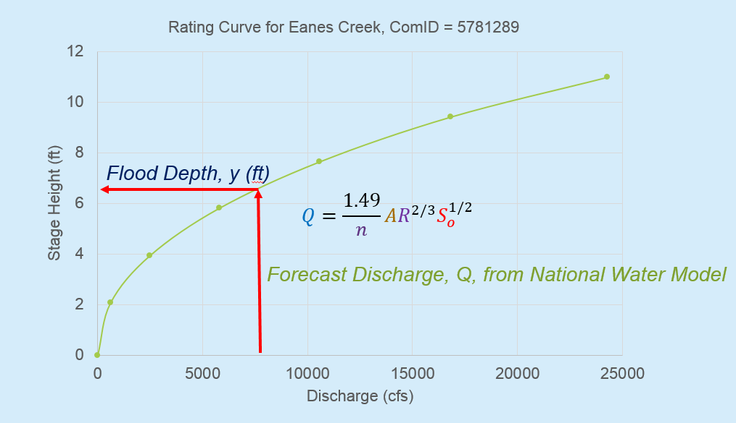
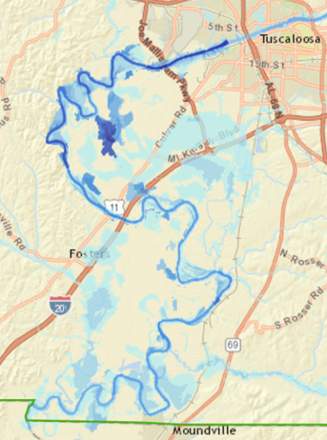
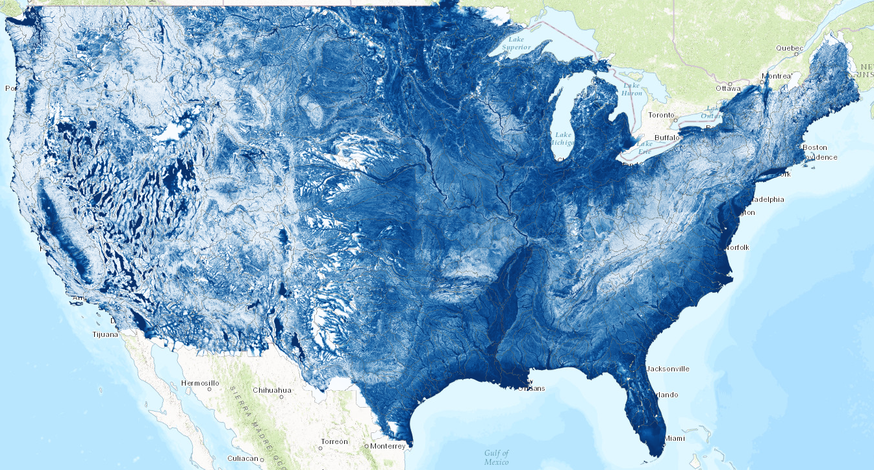
Flood Inundation Mapping
1. Forecast discharge with National Water Model
2. Convert discharge to depth using rating curve
3. Convert depth to inundation using HAND
1
2
3
Slide from David Maidment

Slide 3
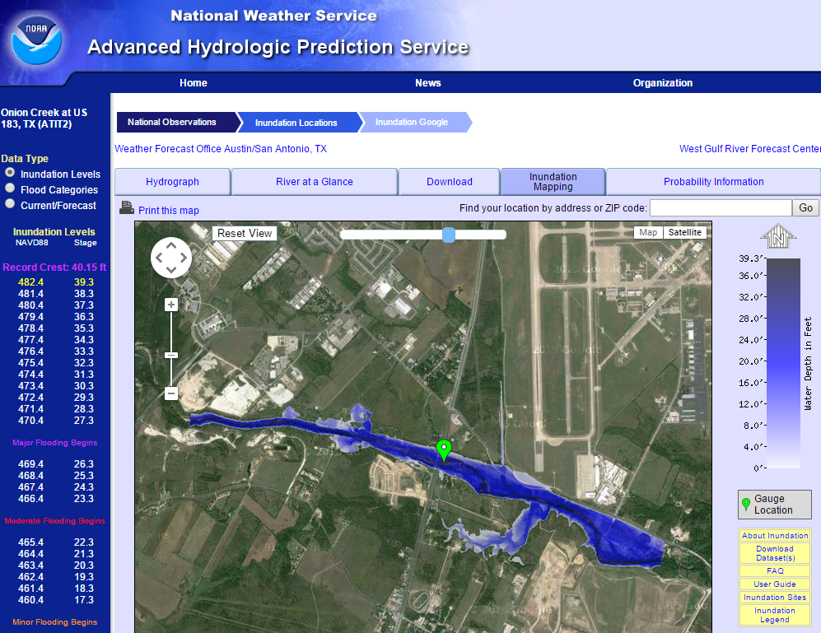
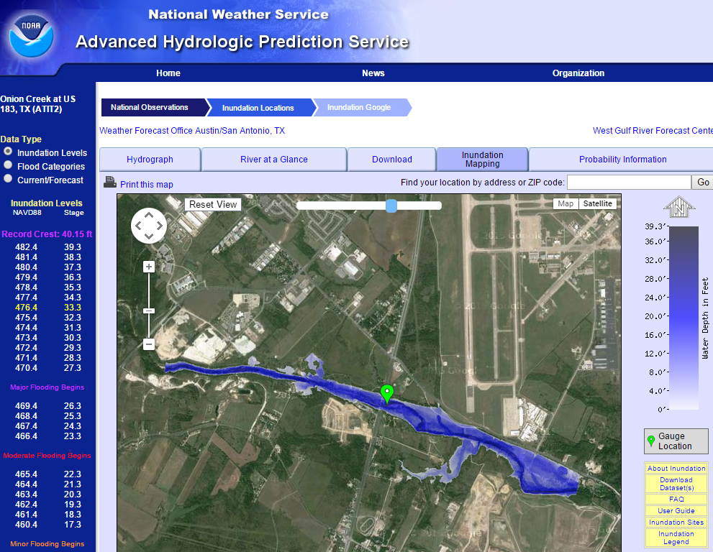
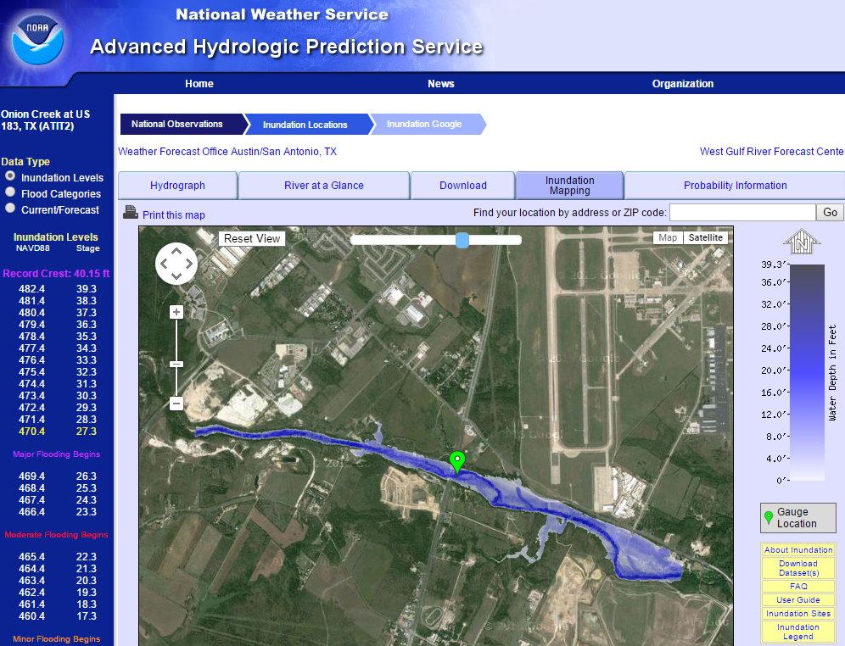

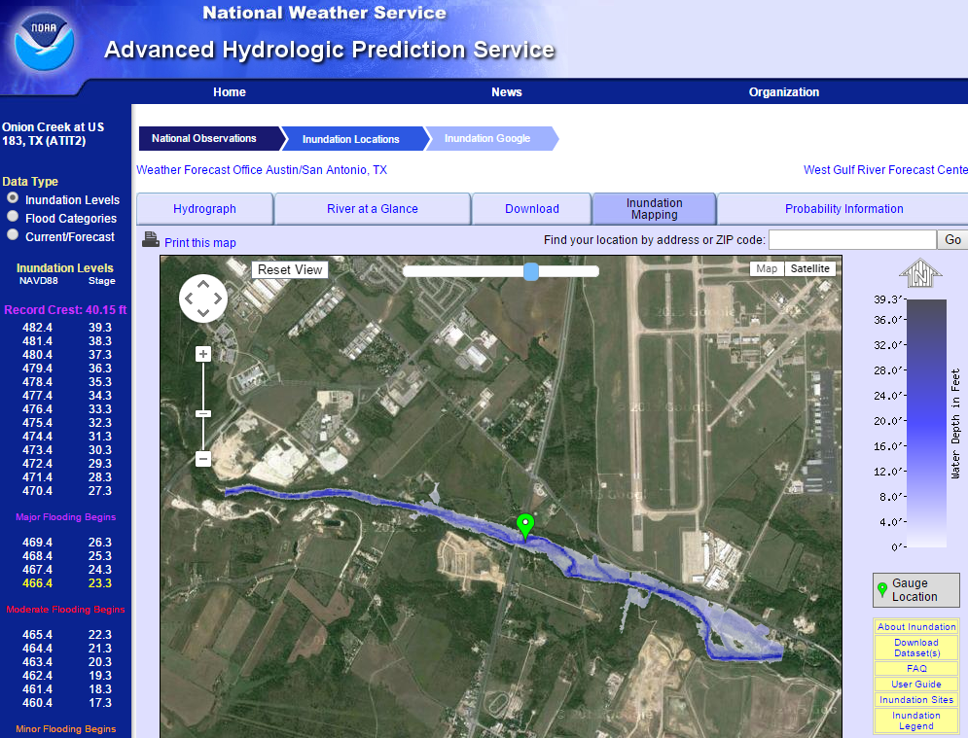
Real-Time Flood Inundation Mapping
Onion Creek at Highway 183
http://water.weather.gov/ahps2/inundation/inundation_google.php?gage=atit2
Slide from David Maidment

Slide 4
Flooding occurs when Water Depth is greater than Height Above Nearest Drainage (HAND)
Address Point
Height Above
Nearest Drainage
(HAND)
Flood Depth
Normal Depth
Stream Bed
May be used to determine flood risk
Slide from David Maidment

Slide 5
Prior Work
Rodda, H. J. E., (2005), "The Development and Application of a Flood Risk Model for the Czech Republic," Natural Hazards, 36(1): 207-220, http://dx.doi.org/10.1007/s11069-004-4549-4.
Rennó, C. D., A. D. Nobre, L. A. Cuartas, J. V. Soares, M. G. Hodnett, J. Tomasella and M. J. Waterloo, (2008), "HAND, a new terrain descriptor using SRTM-DEM: Mapping terra-firme rainforest environments in Amazonia," Remote Sensing of Environment, 112(9): 3469-3481, http://doi.org/10.1016/j.rse.2008.03.018.
Nobre, A. D., L. A. Cuartas, M. Hodnett, C. D. Rennó, G. Rodrigues, A. Silveira, M. Waterloo and S. Saleska, (2011), "Height Above the Nearest Drainage – a hydrologically relevant new terrain model," Journal of Hydrology, 404(1–2): 13-29, http://dx.doi.org/10.1016/j.jhydrol.2011.03.051.
Tesfa, T. K., D. G. Tarboton, D. W. Watson, K. A. T. Schreuders, M. E. Baker and R. M. Wallace, (2011), "Extraction of hydrological proximity measures from DEMs using parallel processing," Environmental Modelling & Software, 26(12): 1696-1709, http://dx.doi.org/10.1016/j.envsoft.2011.07.018.
Nobre, A. D., L. A. Cuartas, M. R. Momo, D. L. Severo, A. Pinheiro and C. A. Nobre, (2016), "HAND contour: a new proxy predictor of inundation extent," Hydrological Processes, 30(2): 320-333, http://dx.doi.org/10.1002/hyp.10581.

Slide 6
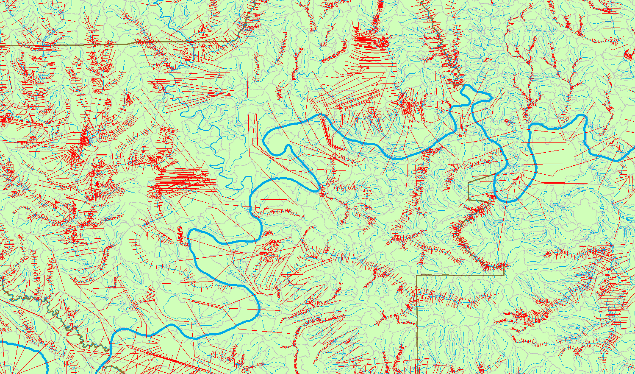
Tractability Challenge of Cross Section Based Approach
NHDPlus MR: 5.2 million kilometers rivers and streams
Cross-Sections for Alabama Rivers compiled in NFIE-I
Slide from David Maidment

Slide 7
Objective
The National Water Model produces flows at reach scale
Need a way to obtain reach level hydraulic properties for inputs to these models
Need a way to map from reach scale stage to flood inundation depth
Exploit high resolution topography and 1:1 relationship between stream reaches (NHD) and their catchments

Slide 8
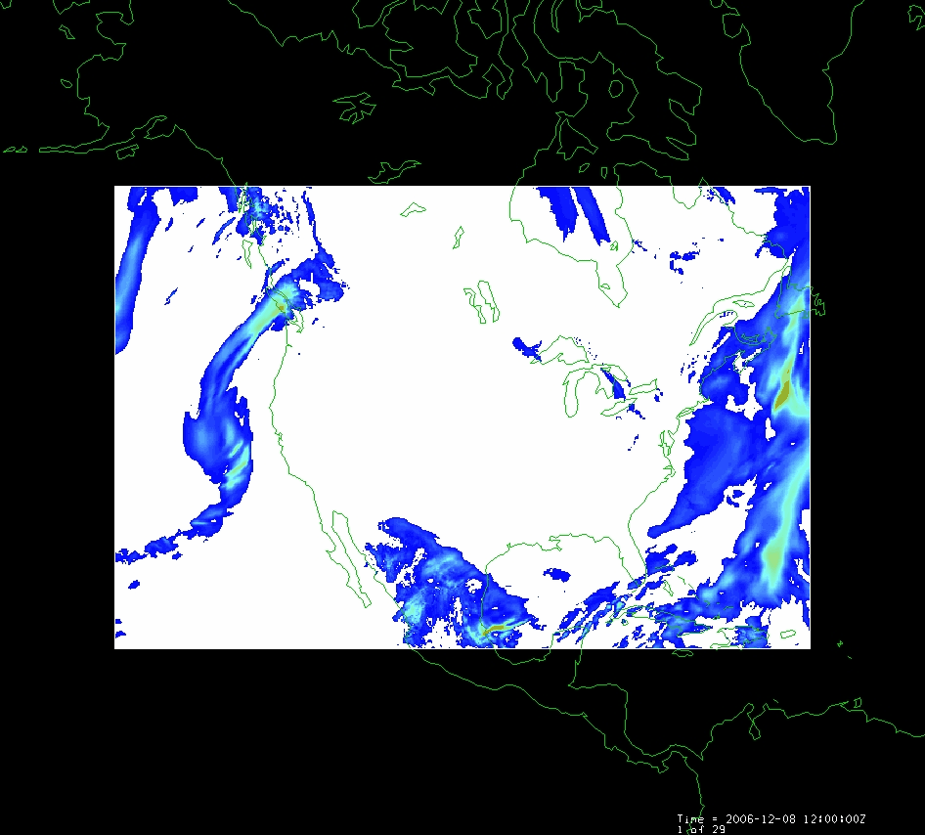
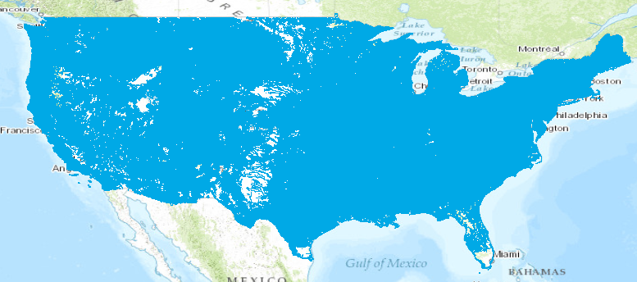
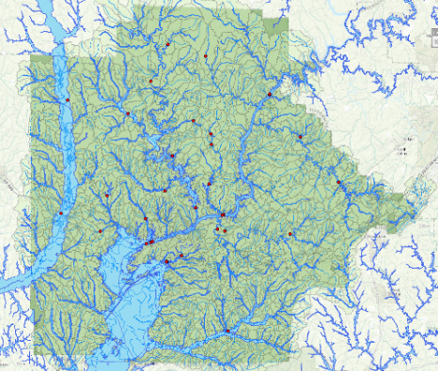
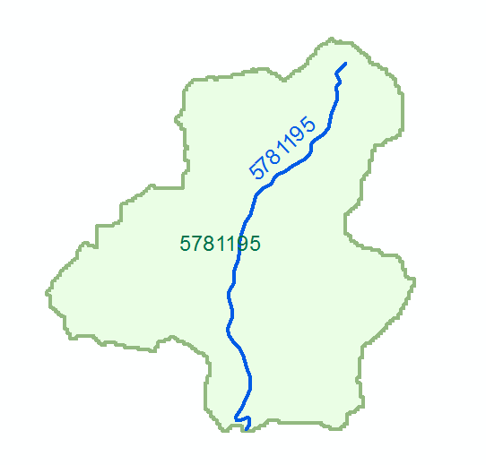
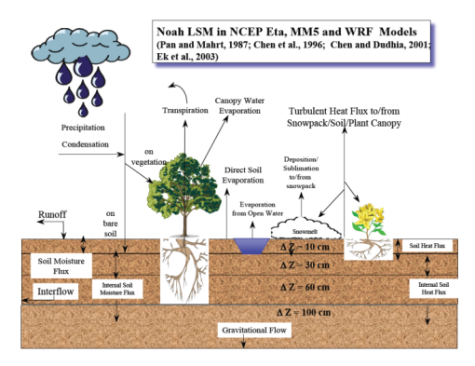
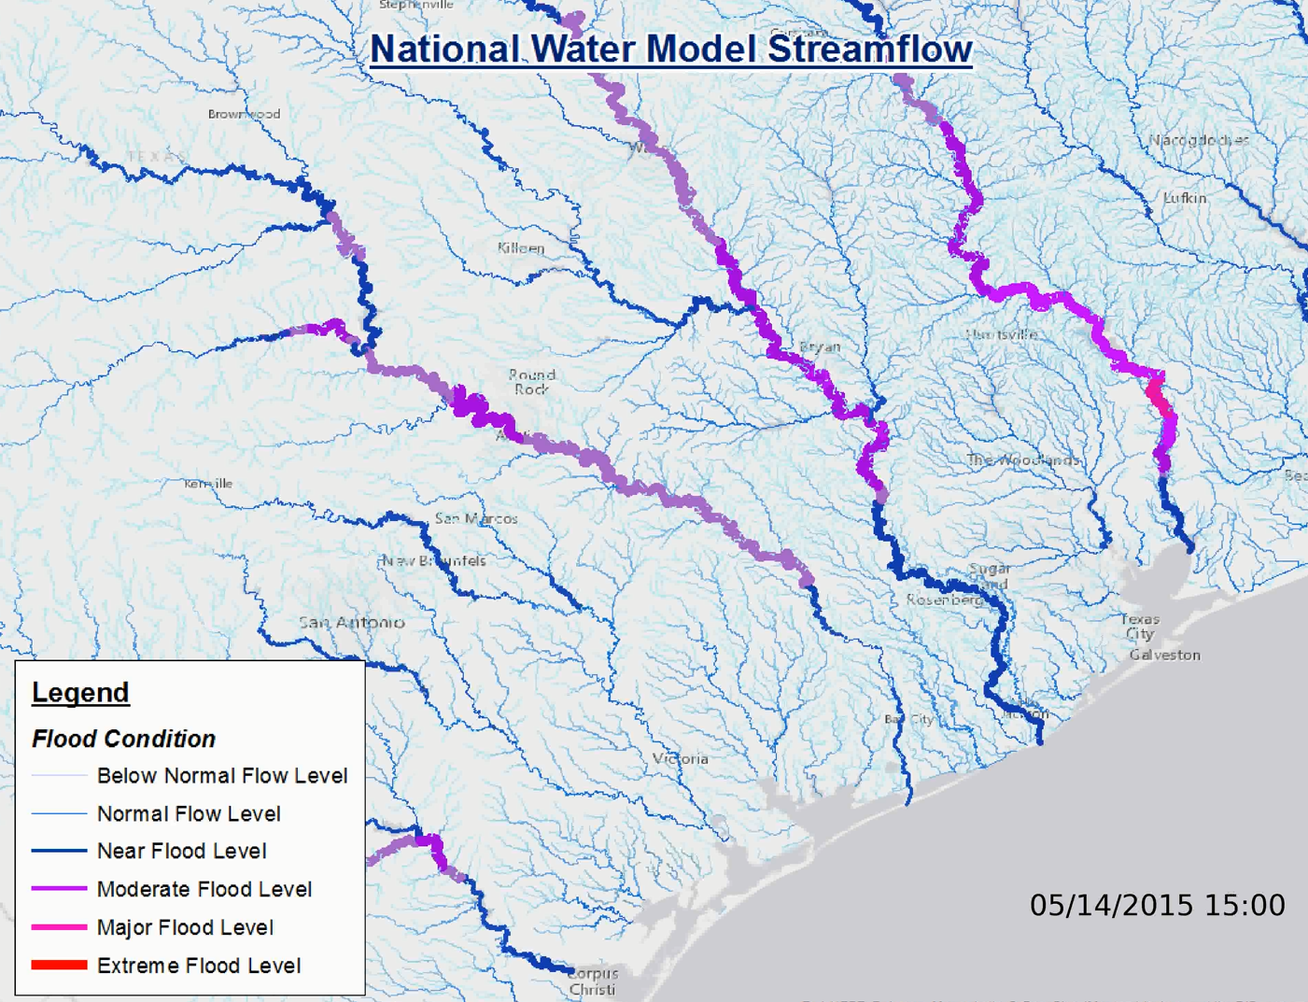
National Water Model
Meteorology
Mapping and Impacts
2.7 million catchments
Hydrology
Hydraulics
Source: Maidment et. al, USGS leadership team briefing. 07/18/2016

Slide 9
Mapping Flood Inundation with Height above the Nearest Drainage (HAND)
Each stream reach has a water depth h_{w} (from a hydraulic model)
Each stream reach has an ID
Each grid cell has the ID of the reach it connects to and the height above the nearest stream h_{s}
Evaluate inundation using h_{w}-h_{s}
    If(h_{w}(id) > h_{s}(id))
      Inundation depth = h_{w}(id) - h_{s}(id)
    Else
      Inundation depth = 0
This is approximate because it neglects many details of the river hydraulics and flow over flood plains. But more detailed approaches often demand hard to obtain and uncertain inputs so this may be a helpful approach to get screening level and real time flood maps
Premised on good elevation model and consistent stream raster

Slide 10
Mapping from height above nearest drainage to flood extent
Reach and Watershed id
Height above nearest drainage raster h_{HAND}
h_{w}(1) = 3.5
h_{w}(2) = 2.5
h_{w}(3) = 1.5
Notes:
Elevations are filled to that of the pools pour point

Slide 11
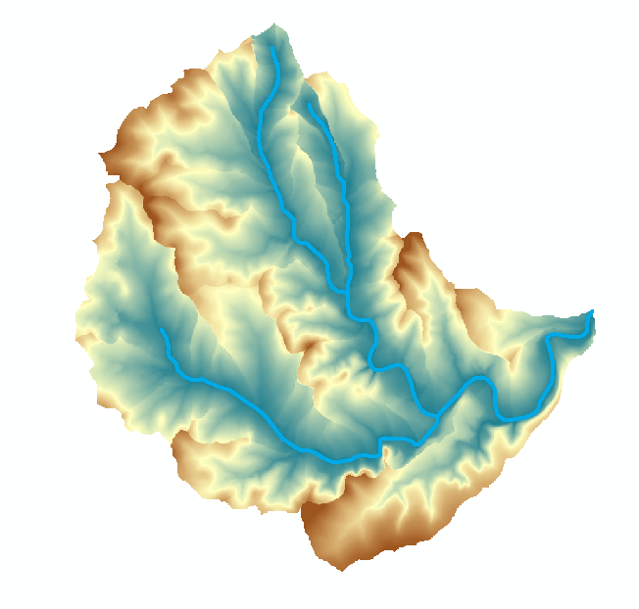
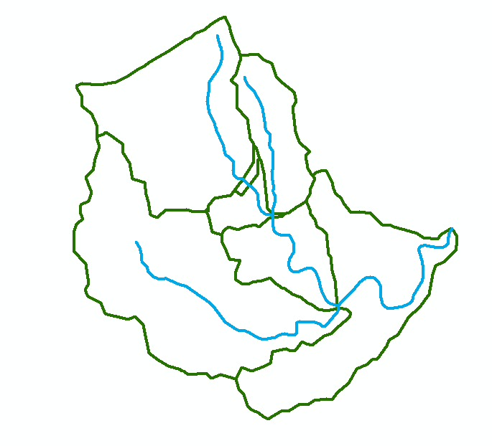
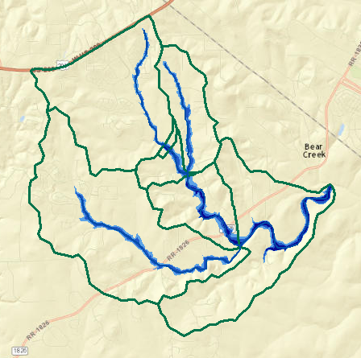
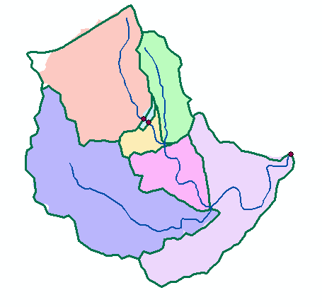
Implementation based on NHDPlus catchments and reaches
Height above stream
(relative elevation of land surface cell above cell in stream to which it flows)
Flowlines
Reach Scale Flood Depth
Comid | Depth (ft)
5781365 | 8
5781381 | 9
5781405 | 10
5781401 | 15
5781399 | 14
5781383 | 12
5781933 | 11
Catchments
Inundation map

Slide 12
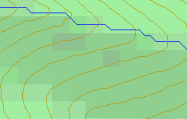
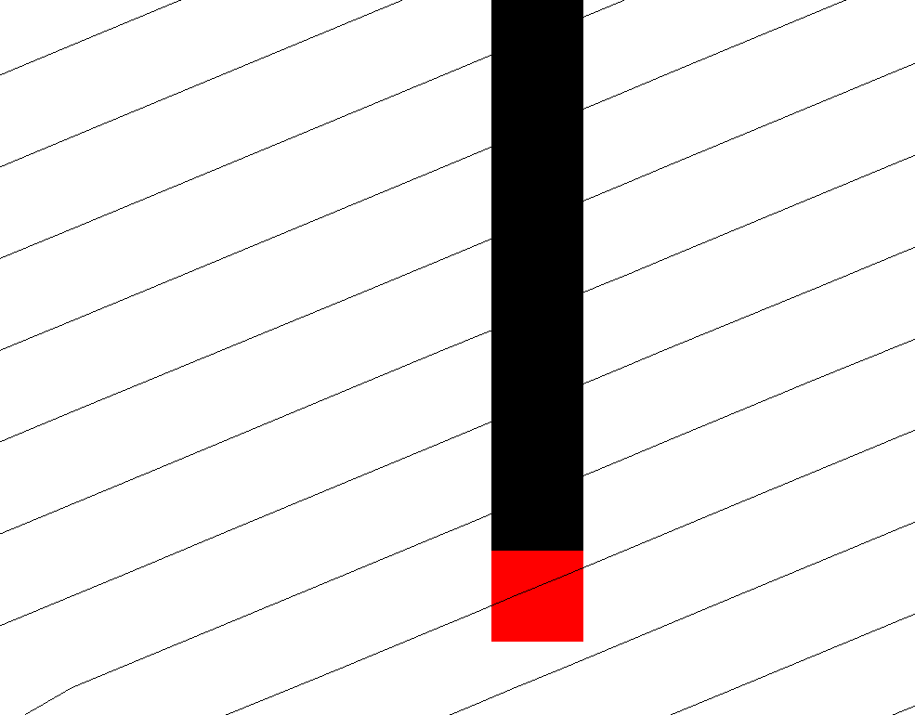
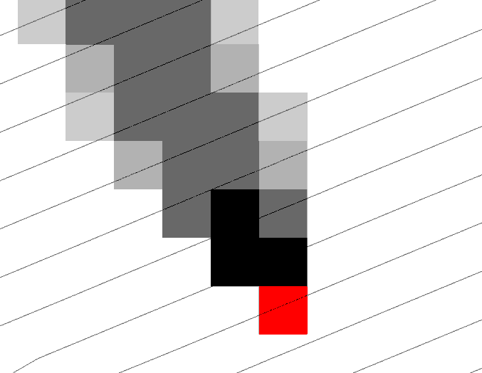
Calculation of HAND from a Digital Elevation Model (DEM)
Steepest single direction
48
52
D8
D∞
56
67
D8
D∞
Tarboton, D. G., (1997), "A New Method for the Determination of Flow Directions and Contributing Areas in Grid Digital Elevation Models," Water Resources Research, 33(2): 309-319.
Notes:
This slide shows how the terrain flow field is represented. Early DEM work used a single flow direction model, D8. In 1997 I published the Dinfinity method that proportions flow from each grid cell among downslope neighbors. This, at the expense of some dispersion, allows a better approximation of flow across surfaces.

Slide 13
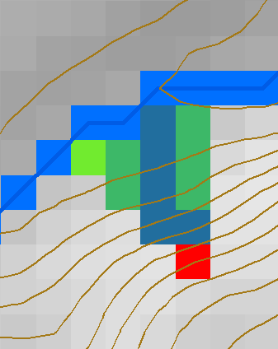
HAND evaluated using TauDEM Dinfinity Vertical Distance Down function
TauDEM Distance Down and Distance Up
Ridge
sr
sr
pr
pr
vr
Point of interest
Stream
ps
ps
ss
vs
ss
D∞
hr
hs
hr
hs
Vertical distance to stream evaluated as weighted average over multiple flow paths. This results in a “smooth” height above nearest drainage layer
Tesfa, T. K., D. G. Tarboton, D. W. Watson, K. A. T. Schreuders, M. E. Baker and R. M. Wallace, (2011), "Extraction of hydrological proximity measures from DEMs using parallel processing," Environmental Modelling & Software, 26(12): 1696-1709, http://dx.doi.org/10.1016/j.envsoft.2011.07.018.

Slide 14

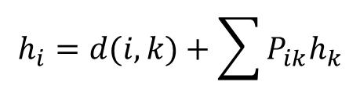

TauDEM model for vertical drop to stream (aka HAND)
$$h_{i}=0 for i on stream raster$$
$$h_{i}=d(i,k)+\sum{P_{ik}h_{k}}$$
i
P_{ik}
P_{ik}
$$d\left(i,k\right)=z_{i}−z_{k} for vertical drop$$

Slide 15
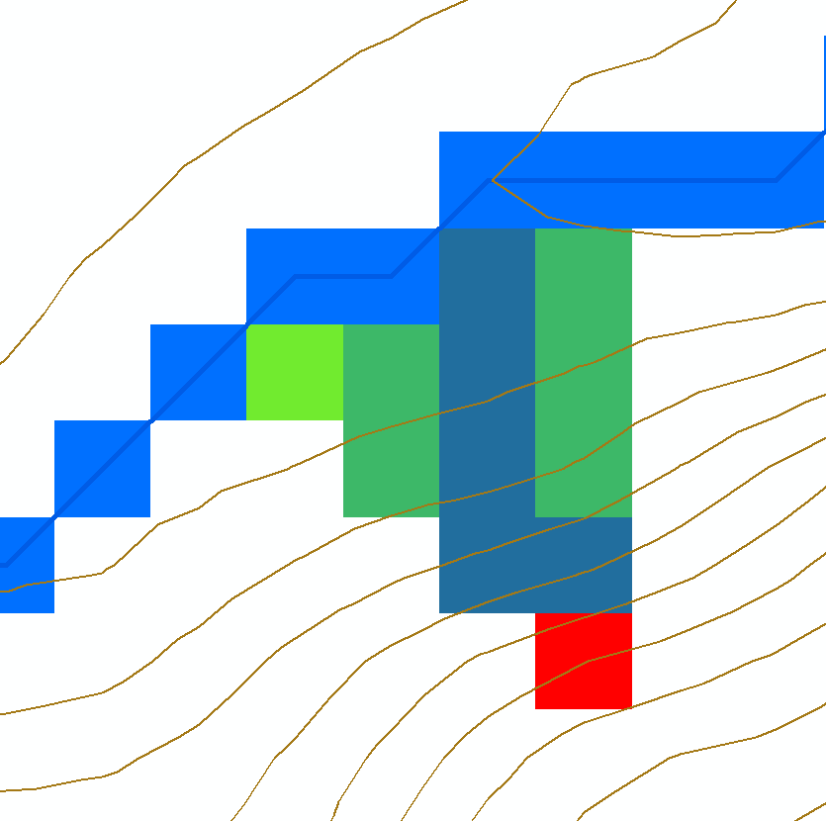
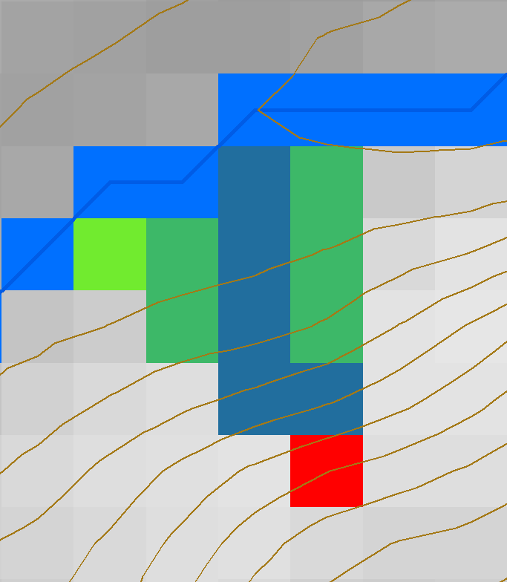





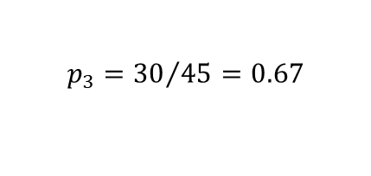
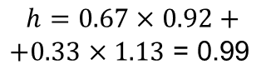

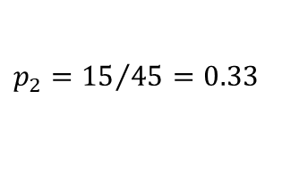
HAND Algorithm
Set h=0 along streams (target input set)
Mark remaining grid cells as “ready” if all down results are available and “not ready” if down results not yet computed
For a “ready” cell find its flow direction and elevation differences to down cells
Calculate h using weighted average
0
0
0
0
0
0
0.99
0
$$z=435.56$$
$$z=435.35$$
$$p_{3}={30}/{45}=0.67$$
$∆_{3}$=$\left(436.48−435.56\right)$=0.92
$p_{2}={15}/{45}=0.33$
$∆_{2}$=$\left(436.48−435.35\right)$=1.13
$$α=1.308 rad= 75°$$
$$z=436.48$$
$$h=0.67×0.92+$$
$+0.33×1.13$ = 0.99

Slide 16






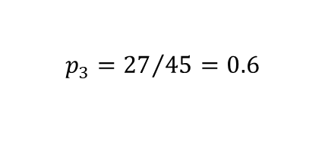

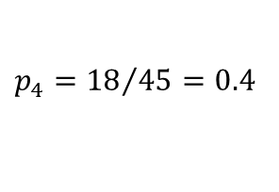

HAND Algorithm Continued
Evaluate up cells when they become “ready”
0
0
0
0
0
0
0.95
0.99
$$z=438.13$$
$$z=437.49$$
$$h=1.88$$
$$h=2.64$$
0
1.88
2.64
$p_{4}={18}/{45}=0.4$
$$p_{3}={27}/{45}=0.6$$
4.88
$$α=1.902 rad= 108°$$
$$z=440.23$$
$∆_{3}$=$\left(440.23−438.13\right)$=2.1
$∆_{4}$=$\left(440.23−437.49\right)$=2.74
$h=0.4×(2.74+1.88)+0.6×(2.1+2.64)$ = 4.88

Slide 17
Result
Elevation z (m)
HAND h (m)
436.01
435.56
0
0
436.44
436.47
436.48
0
0.92
0.99
437.15
437.49
438.13
0.71
1.88
2.64
438.65
439.20
440.22
2.20
3.31
4.68

Slide 18
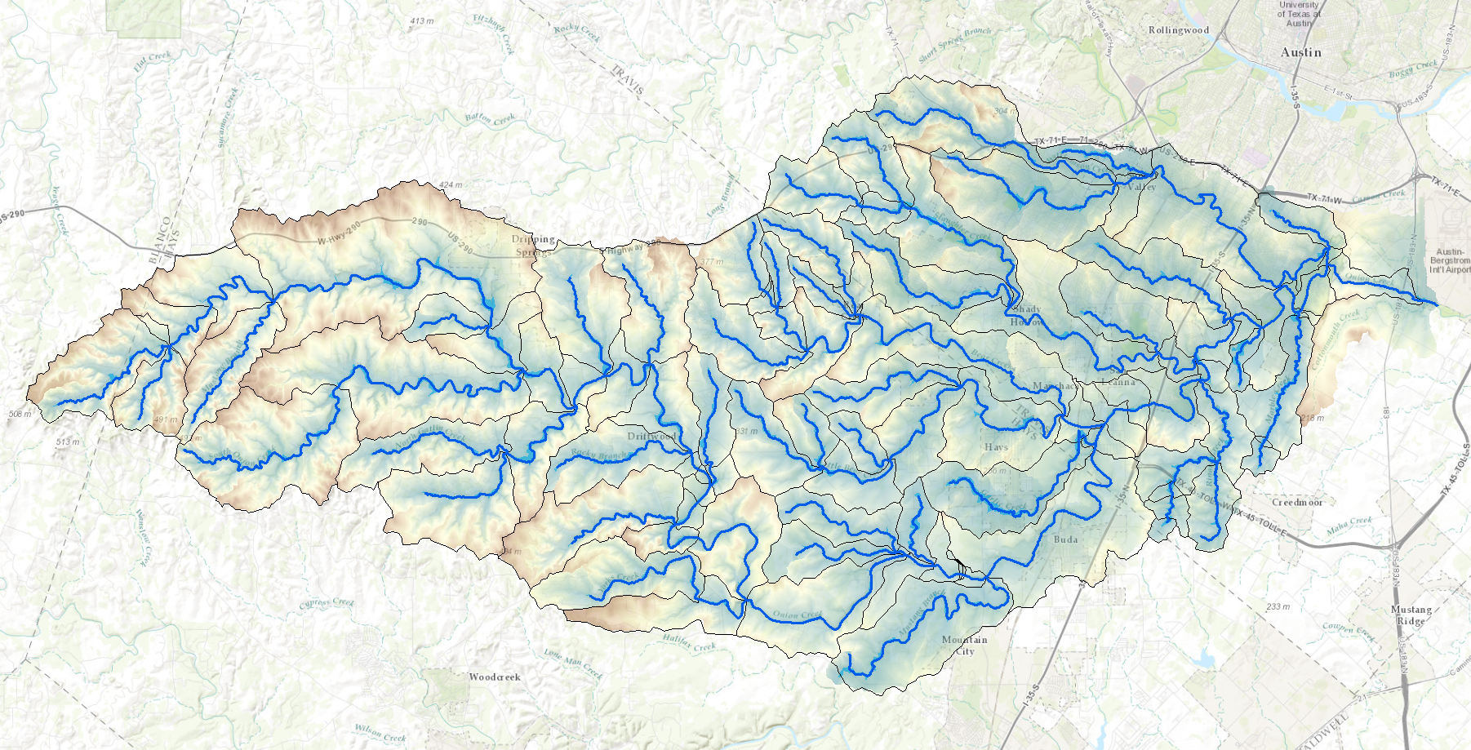
HAND from TauDEM for Onion Creek near Austin Texas
1/3 arc second NED DEM

Slide 19
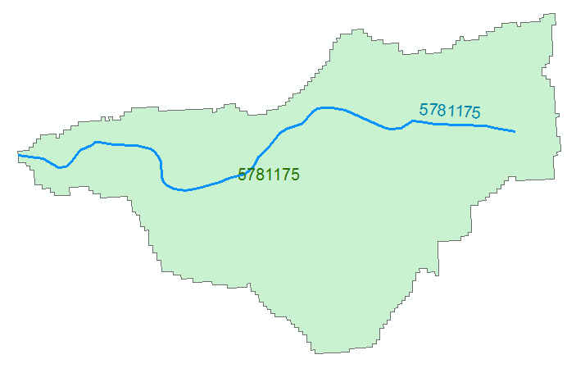

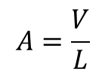



Evaluating River Hydraulic Properties
Comid | H | A | R | P | T | V | Ab | As
5781175 | 3
5781175 | 4
A table with reach hydraulic parameters as keyed to hydrography
A_{s}
Surface Area
Wetted Bed Area
L
V
Volume
A_{b}
T
$$A=\frac{V}{L}$$
Cross Section Area
Depth
h
A
P
P$=\frac{Ab}{L}$
Wetted Perimeter
T$=\frac{As}{L}$
Top Width
R$=\frac{A}{P}$
Hydraulic Radius

Slide 20

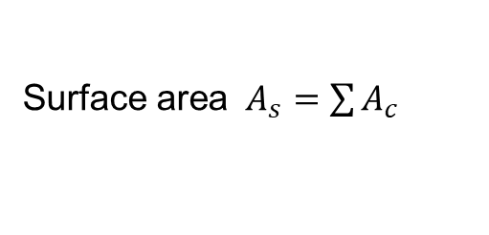

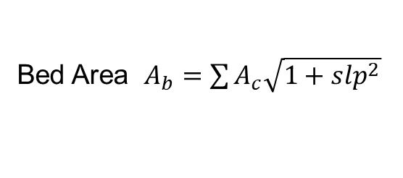
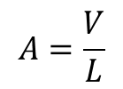
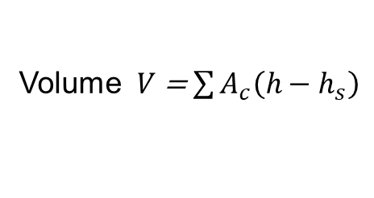


Terrain based derivation of “reach scale” hydraulic properties
For each Catchment
For each height h
Identify cells where h_{s} < h
A_{s}
Surface Area
Single Cell Plan Area $A_{c}$ =dx * dy
Surface area $A_{s}=\sum{A_{c}}$
Bed Area $A_{b}=\sum{A_{c}\sqrt{1+slp^{2}}}$
Wetted Bed Area
L
A_{b}
Approximates each cell as sloping plane
V
Volume
Volume $V$ = $\sum{A_{c}\left(h−h_{s}\right)}$
T
$$A=\frac{V}{L}$$
Cross Section Area
A
P$=\frac{Ab}{L}$
Wetted Perimeter
P
T$=\frac{As}{L}$
Top Width
R$=\frac{A}{P}$
Hydraulic Radius
Based on slide from David Maidment

Slide 21


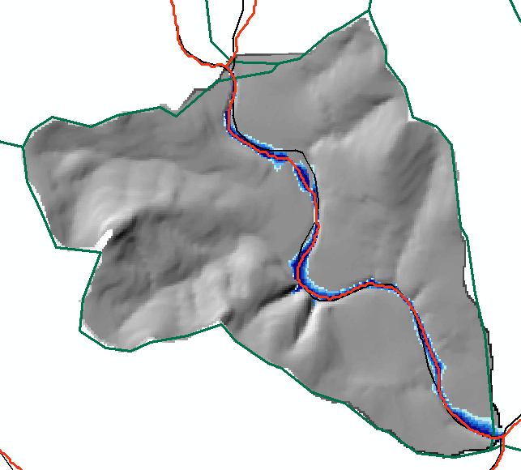
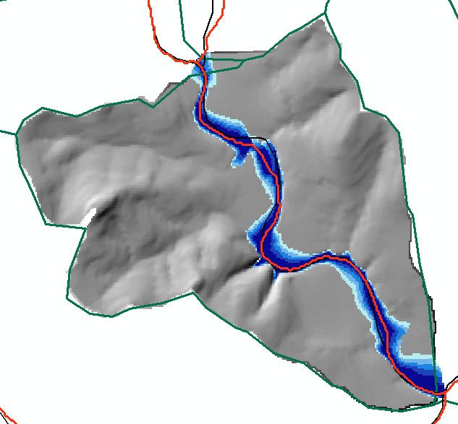
Reach Hydraulic Properties Example
1 m inundation
3 m inundation
Height (m) | A_{s} (m²) | Vol (m³) | A_{b} | L (m) | A=V/L (m²) | P=A_{b}/L (m) | T=A_{s}/L (m) | R=A/P (m)
1 | 129878 | 79466 | 129948 | 2975 | 26.7 | 43.7 | 43.7 | 0.612
3 | 319877 | 530378 | 320414 | 2975 | 178.3 | 107.7 | 107.5 | 1.655

Slide 22
Terrain Approximated Reach Average Hydraulic Properties
Hydraulic Radius
Wetted Perimeter
Cross-sectional Area
Top Width
Need for input to reach scale hydraulic model

Slide 23
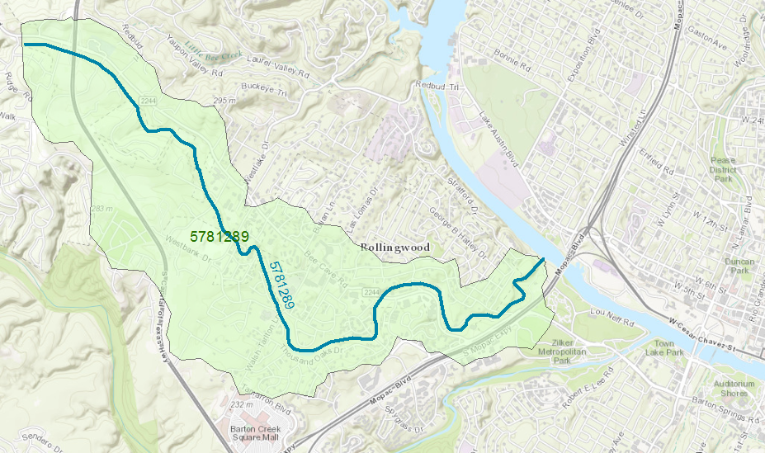
Reach Catchment 5781289
Eanes Creek, Rollingwood, Texas
Drainage area = 3.13 mi²
Reach Length = 4.3 miles
Slide from David Maidment

Slide 24
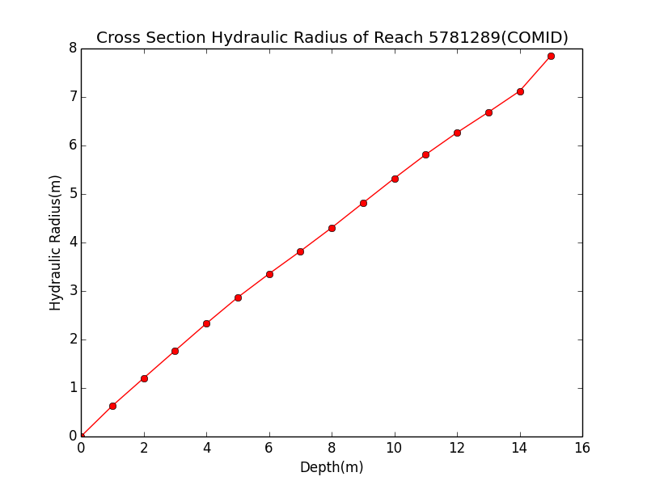
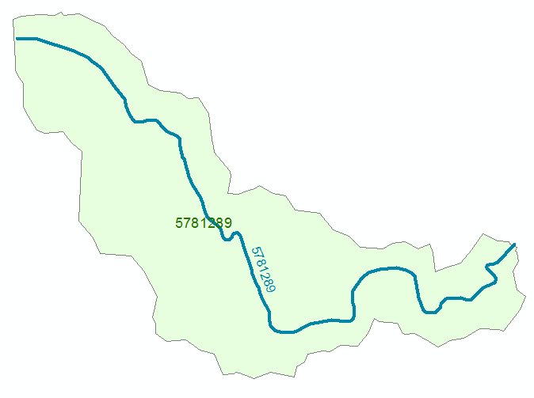
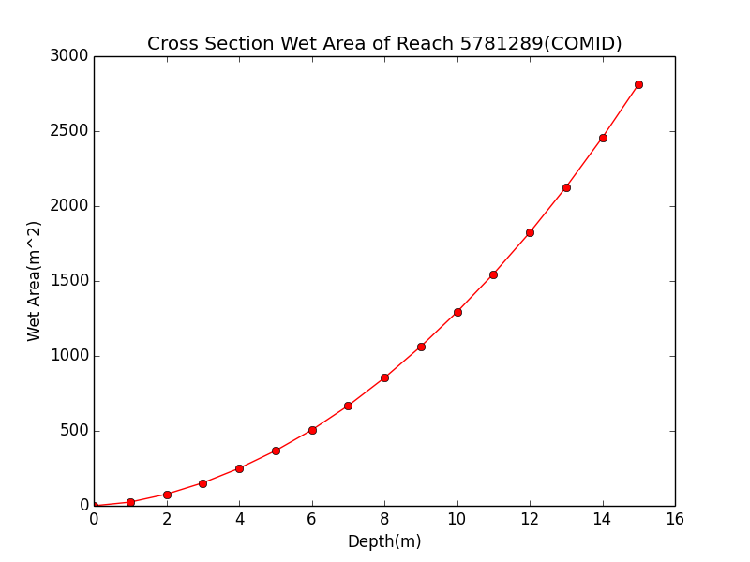

Discharge Computation
Hydraulic Radius, R
Flood Discharge, Q (cfs)
$$Q=\frac{1.49}{n}AR^{2/3}S_{o}^{1/2}$$
Flood Depth, h (ft)
Cross section Area, A
n = 0.035 Manning roughness of channel
S_{o} = 0.0163 Bed slope
Slide from David Maidment

Slide 25

Rating Curve for Eanes Creek
Flood Depth, y (ft)
$$Q=\frac{1.49}{n}AR^{2/3}S_{o}^{1/2}$$
Forecast Discharge, Q, from National Water Model
Slide from David Maidment

Slide 26
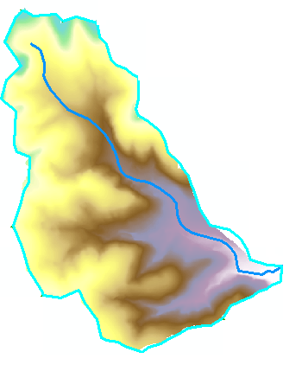
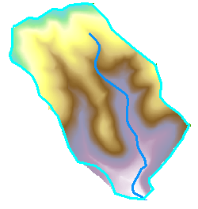
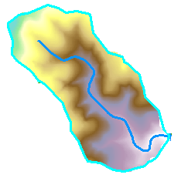
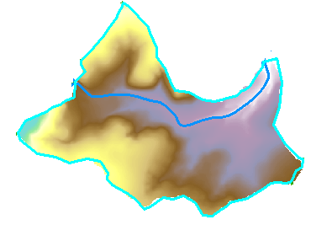
Decompose computation by catchments or River Corridor
Parallel computation
High resolution in some areas
Incremental refinement of DEM
Incremental improvement

Slide 27
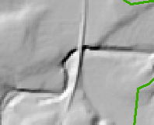
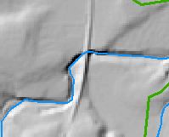

Conditioning the DEM by Obstacle Removal or “etching” using Vector Stream Information
Digital Elevation Model Quality Details
48 | 48 | 49 | 48 | 47
48 | 46 | 50 | 46 | 45
47 | 45 | 51 | 43 | 39
44 | 40 | 51 | 47 | 47
41 | 45 | 52 | 48 | 48
48 | 48 | 49 | 48 | 47
48 | 46 | 50 | 46 | 45
47 | 45 | 51 | 43 | 39
44 | 40 | 51 | 47 | 47
41 | 45 | 52 | 48 | 48
48 | 48 | 49 | 48 | 47
48 | 46 | 50 | 46 | 45
47 | 45 | 40 | 40 | 39
44 | 40 | 51 | 47 | 47
41 | 45 | 52 | 48 | 48
Obstacles, like this railroad that are present in DEM are removed tracing down NHD HR streams ensuring that elevation never increases along a stream.

Slide 28
Obstacle Removal “Etch in” Workflow
Rasterize NHDPlus HR flowline;
Lower the elevation of stream cells on DEM by 100m;
Remove pits on the burned DEM;
Derive D8 flow direction on the pit-removed DEM;
Keep D8 flow direction on stream cells only;
Call TauDEM:flowdircond to burn the original DEM
  Identify ‘top cells’ which are on NHDPlus HR streams, have D8 direction, and are not downstream cells. Put them in a queue;
  For each cell in the queue:
    If the elevation is higher than its neighbors, level the elevation with neighbors;
    If above step makes any of the neighboring cell a non-downstream cell, add the neighboring cell to the queue. This step propagates the burn-in until the upstream connects to the downstream.

Slide 29


Effect of obstacle removal
Before
After
HAND inundation based on raw 10 m NED DEM
Hand inundation for 10 m NED DEM with obstacles removed using NHD HR

Slide 30


Adjustments at railroad crossing
Original DEM – Flow Direction Conditioned DEM

Slide 31


Deriving Terrain Aligned Flow Network
Grids from the NHD Plus channel head cell to the outlet cell are defined as Stream Cells
D8 Flow direction from each grid cell set in the steepest downslope direction to one of eight adjacent neighbors
Routing across flats away from high terrain and towards low terrain (Garbrecht and Martz, 1997)
Channel Head
NHD Plus channel head and flowline
NHD Plus Flowline
48
52
DEM derived stream
NHD HR Stream
56
67

Slide 32
DEM derived stream network is consistent with the DEM but at the scale (drainage density) of NHD Plus.

Slide 33
Height Above Nearest Drainage (HAND) evaluated from 1/3 arc sec NED DEM relative to stream raster derived from NHDPlus medium resolution stream network source grid cells. 2 m contour interval.

Slide 34
Complete HAND Workflow
USGS 3DEP 10m DEM
NHD HR Flowline
1:24000
NHDPlus Flowline
1:100000
Obstacle Removal
Pit Removal
Channel Head Extraction
D∞ Flow Direction
D8 Flow Direction
Rasterization
D8 Flow Accumulation
Channel Head Weight Grid
Stream Definition by Threshold
D∞ Flow Direction
Raster
D∞ Distance Down
(Vertical Average)
Stream Raster
HAND Raster
Catchment Features
Flood Inundation Mapping

Slide 35



Continental-Scale HAND layer evaluated on ROGER supercomputer at NCSA
Catchments and Flowlines
Height Above Nearest
Drainage (HAND)
(relative elevation of land
surface cell above cell in
stream to which it flows)
Digital Elevation Model
Slide from David Maidment

Slide 36





Automated workflow prototyped for Texas Flood Response System by David Maidment and Colleagues
National Water Model discharge forecasts
Conversion of discharge to depth using rating curves
Summary of Impacts for Disaster Districts
Inundation mapping and local impact assessment
ESRI

Slide 37
Conclusions
The height above nearest stream approach suggested as way to rapidly approximate real time flood inundation
Includes an approach to approximate reach scale hydraulic properties
DEM topography should represent river bed elevations to maximal extent possible
DEM conditioning used to align and reconcile elevation and hydrography (obstacle removal approach)
Can exploit high resolution (e.g. LIDAR) data in areas where accuracy is critical

Slide 38
Acknowledgements
Multiple grants from US National Science Foundation and USGS
Papers
Liu, Y. Y., D. R. Maidment, D. G. Tarboton, X. Zheng and S. Wang, (2017), "A cybergis integration and computation framework for high-resolution continental-scale flood inundation mapping," Submitted to Journal of the American Water Resources Association.
Zheng, X., D. G. Tarboton, D. R. Maidment, Y. Y. Liu and P. Passalacqua, (2017), "River channel geometry and rating curve estimation using height above the nearest drainage," Submitted to Journal of the American Water Resources Association

Slide 39
Are there any questions?
HAND 10m for CONUS

