Slide 1
What makes the Great Salt Lake go up and down. Examining the sensitivity of the Great Salt Lake to Changes in inputs
David Tarboton
Utah State University
dtarb@usu.edu
435-797-3172
Reading: Mohammed, I. N. and D. G. Tarboton, (2012), "An examination of the sensitivity of the Great Salt Lake to changes in inputs," Water Resour. Res., 48(11): W11511, http://dx.doi.org/10.1029/2012WR011908

Slide 2
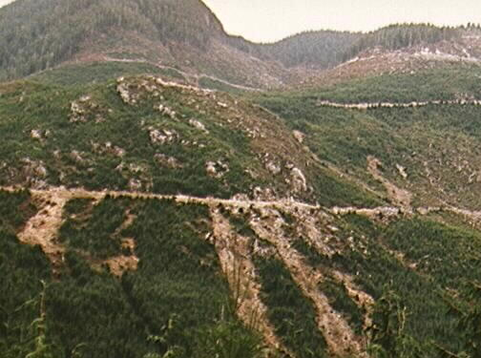
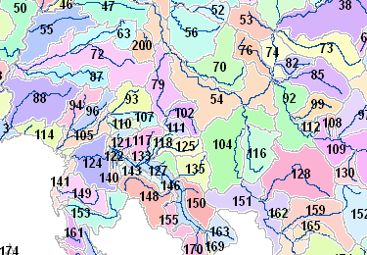
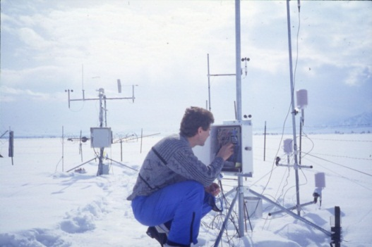
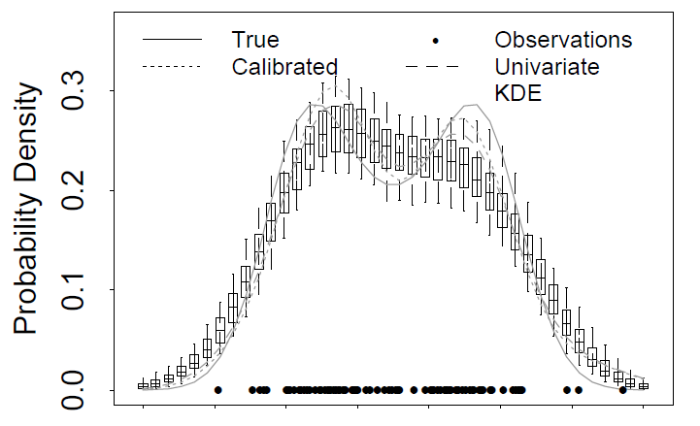
My Research
Hydrologic Information Systems
Digital Elevation Model Terrain Analysis
Hydrology and Geomorphology
Distributed Hydrologic Modeling
Snow and glacier melt
Non parametric stochastic hydrology
Streamflow regimes for stream ecology
The Great Salt Lake
Discovery
Catalog
Metadata
ODM, WaterML
Search
Server
Data
Desktop
Production
Consumption

Slide 3

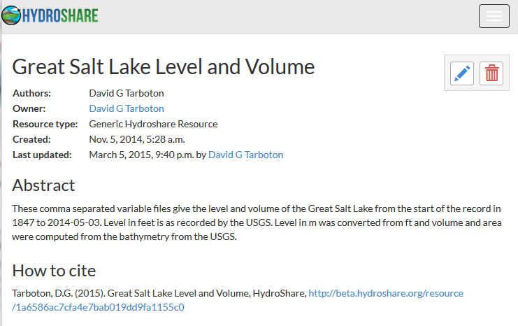
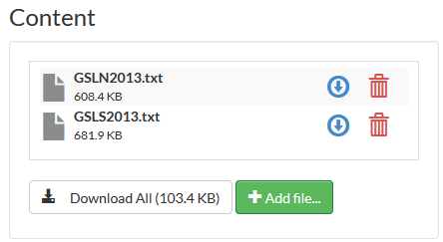
www.hydroshare.org
Please try it out and let us know what you think

Slide 4

HydroShare collaborative environment (being developed) for data sharing, analysis and modeling
Discovery and Filtering
Sharing and publication of data
Social discovery and added value
Model sharing
Model input data preparation
Model execution
Visualization and analysis (best of practice tools)
Actions
Collaboration
Django website
API
Web Apps
Server/Cloud Computation
Platform independence
Big data
Reproducibility
Reduce software installation and configuration limitations
iRODS API
iRODS API
iRODS “Network File System”
Storage

Slide 5
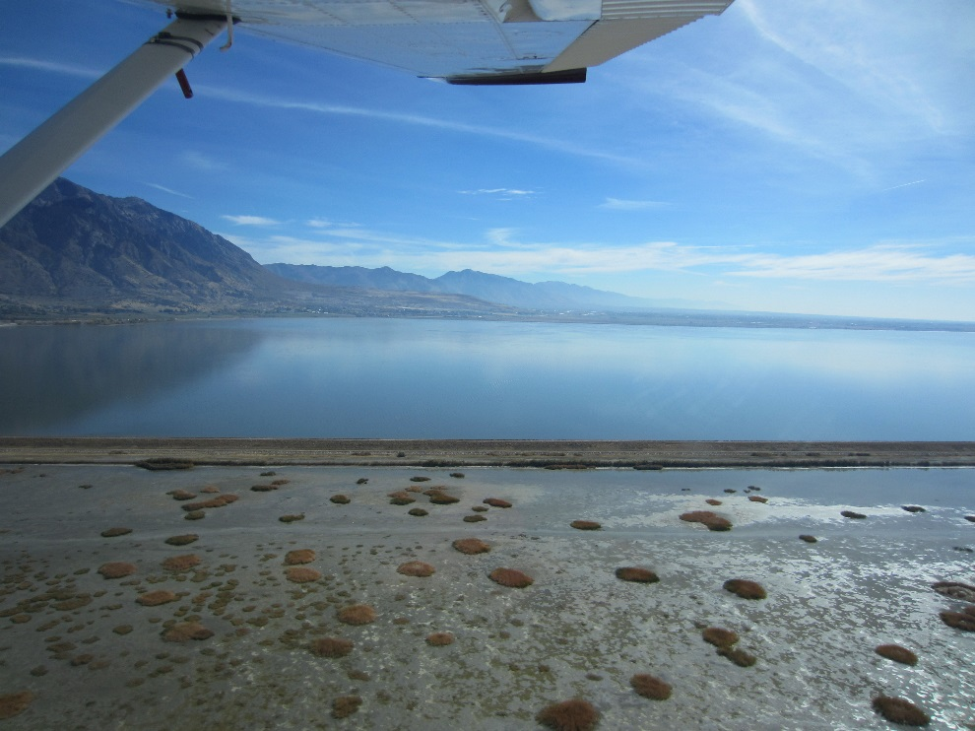
Outline
Overview
How a terminal salt lake works
Water Budget
  Inflow: Precipitation and Streamflow
  Evaporation
Sensitivity
Salinity
Modeling
Conclusions

Slide 6
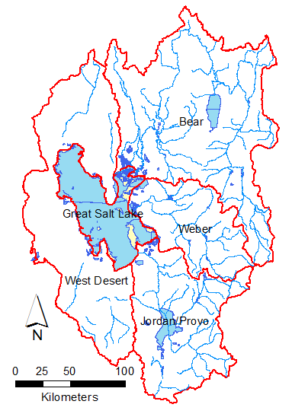
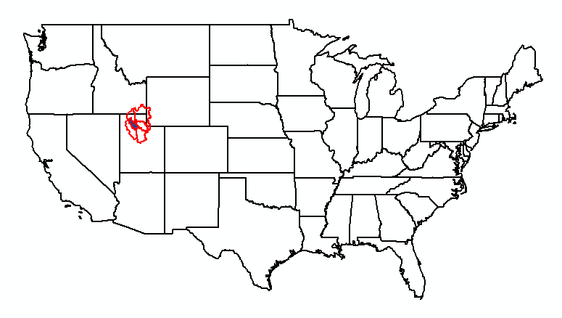
The Great Salt Lake Basin
 | Area (km²)
Great Salt Lake | 4713
Bear | 19262
Weber | 6413
Jordan/Provo | 9963
West Desert | 14604
Total | 54955

Slide 7
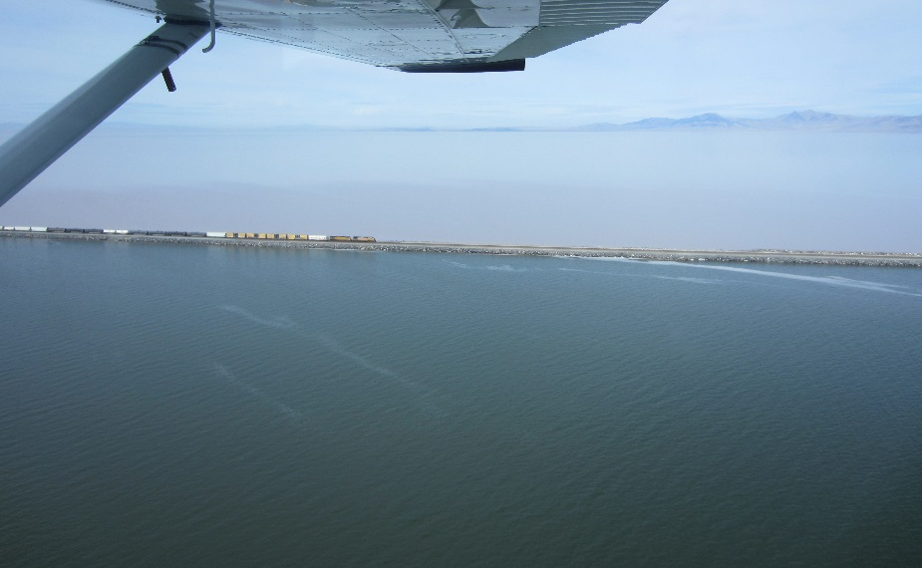
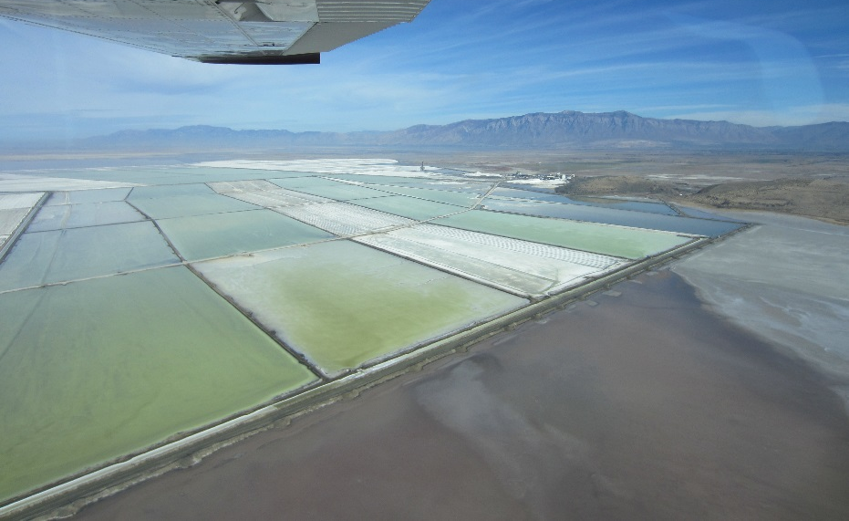
Importance
Economy
  Infrastructure along the shore
  Brine Shrimp Industry
  Mineral Industry
Ecology
  Western Hemisphere Shorebird Preserve
Environment
  Air quality
  Dust
  Moderates Temperature
  Lake effect snow
Recreation
Spectacular Landscape
Art

Slide 8
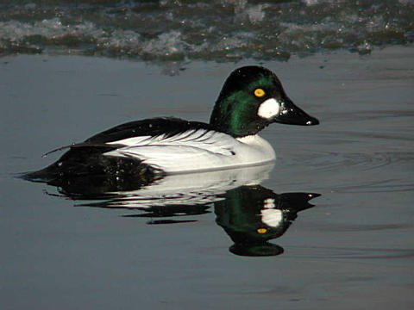
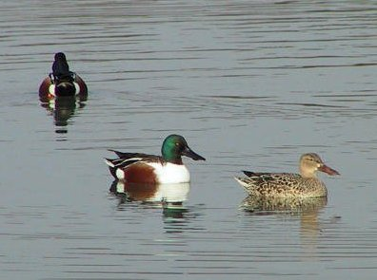
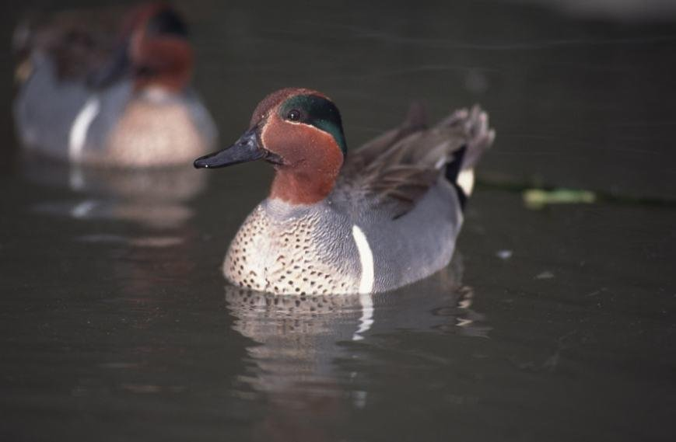
Western Hemispheric Shorebird Reserve
Crossroads of the West
Migratory birds come from Canada and Mexico
Some spend the winter
> 70 Aquatic Species
Slide from Rob Baskin

Slide 9
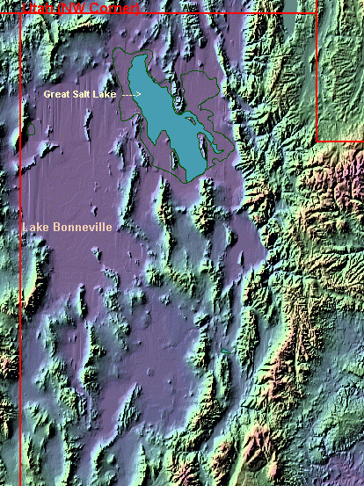
Geologic History: Pleistocene Lake Bonneville
Covered most of western Utah
Extended into Idaho and Nevada
Over 335 m deep
15,500 years ago
52,000 km² in area
Overflowed at Red Rock Pass
Lost 300m of water
Slide from Rob Baskin

Slide 10
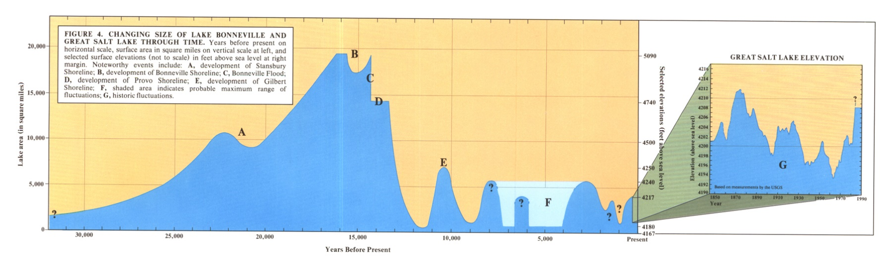
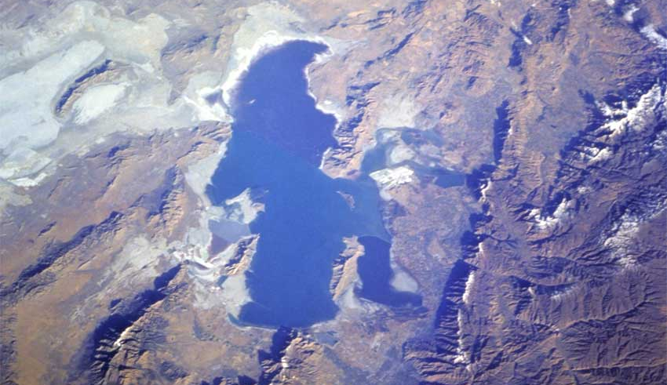
Last 30,000 Years
Source UGS Map 73
Stansbury Level
Lake Bonneville
Breach at Red Rock Pass
Provo Level
Gilbert Level
Pre-GSL Fluctuations
Historic Fluctuations
Slide from Rob Baskin

Slide 12

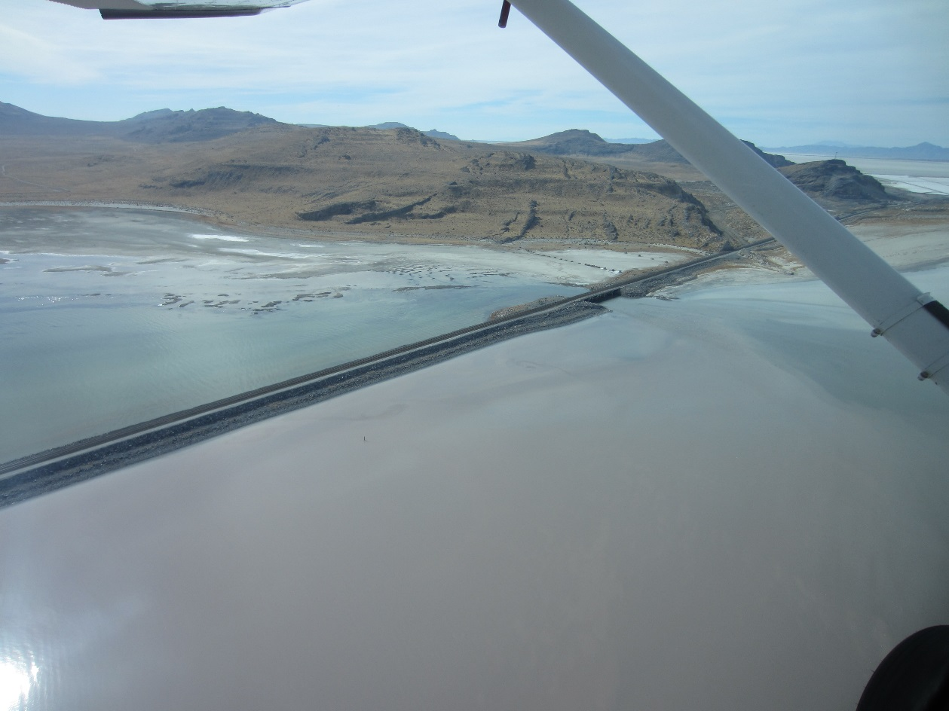
GSL Causeway

Slide 13
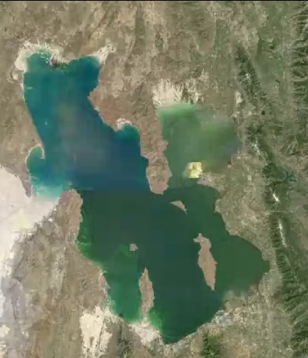
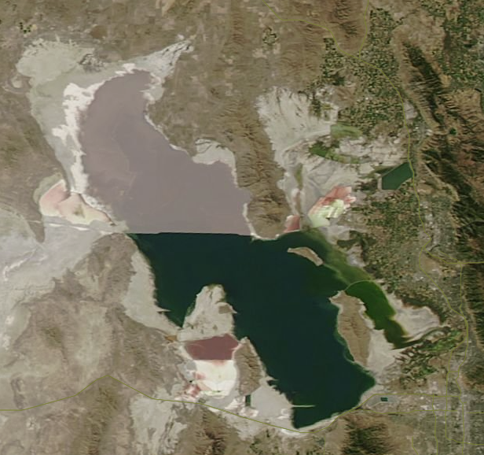
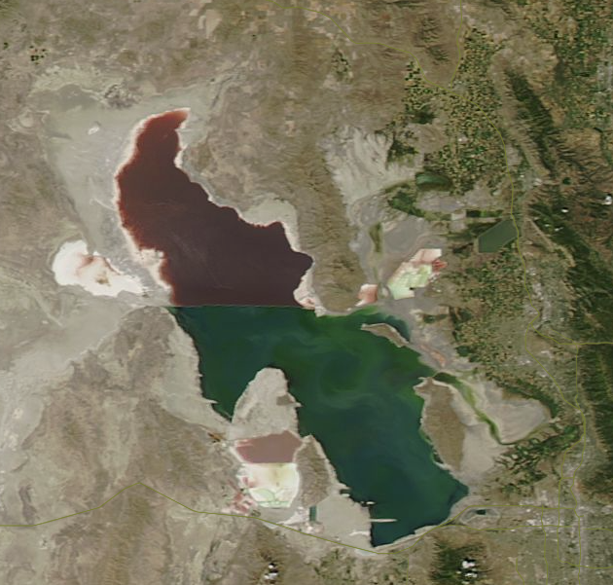
Changes in Lake Area with Lake Level Fluctuations
1986
Google Earth
2012
Modis Worldview
2015
Modis Worldview

Slide 14
How a closed basin (e.g. GSL works)
If I > E x A level rises
If I < E x A level falls
Level adjusts to fluctuating inputs so that on average
I = E x A
I includes inflows from streams and precipitation on the lake
I = Q + P x A
Subject to climate variability.
E is less variable, but also depends on climate and salinity, C.
As C increases E decreases
Evaporation depth E
Evaporation volume E x A
Inflows I
E x A
Level
Area, A
I
E x A
Level
Area, A
Volume, V
Salt Load L
Salt Concentration C=L/V

Slide 15
Water Budget
68%
Q, Streamflow+Groundwater
  3 major rivers. Multiple USGS gauges
  Groundwater 75000 acre ft/yr (Waddell and Barton, 1980)
A, V Area and Volume
  From bathymetry and level
P, Precipitation
  From PRISM (Oregon State University)
E, Evaporation
Withdrawals (West desert pumping, Evaporation ponds)
2%
30%
-96%
-4%

Slide 16
Great Salt Lake Precipitation and Streamflow
Mean Annual Values 1949-2014
Basin | Area (km²) | Precipitation (mm) | Streamflow (1000 acre-ft) | Runoff (mm)
Great Salt Lake | 4713 | 327.6 | -
Bear | 19262 | 537.9 | 1318 (57.4%) | 84 (15.7%)
Weber | 6326 | 657.8 | 364 (15.8%) | 71 (10.8%)
Jordan/Provo | 9963 | 564.1 | 509 (22.2%) | 63 (11.2%)
Davis | 87 | - | 30 (1.3%)
Other (west valley) | - | - | 75 (3.3%)
West Desert | 14604 | 348.3 | - | -
Total | 54955 | 488.2 | 2296 (100%) | 52 (10.5%)
Precipitation from aggregation of PRISM data over each area
Streamflow from multiple USGS gauges
Notes:
Calculations in BasinRunoffRatios.xlsx

Slide 17
Great Salt Lake Inputs (1949-2014)
Adjustments to GSL inputs
West Desert pumping. 2.5 MAF removed 4/87 to 6/89. 27 months
200000 AF return from West Desert. 1/90 to 6/92. 30 months
Pond operations 5 months per year May – Sept with withdrawals based on reported water use and water rights.
Precipitation | 990,076 acre-ft (30%)
Streamflow | 2,295,839 acre-ft (68%)
Groundwater | 75,000 acre-ft (2%)
Total Inflows | 3,360,916 acre-ft
Net pumping and withdrawals | -96,851 acre ft (3%)

Slide 18
Have Streamflow Inputs Changed?
Mean | 1368 x 10³ acre ft
Trend | -4.4 x 10³
100 year reduction | 440 x 10³ (32%)
Adj R² | 0.043
P | 0.016

Slide 19
Have Streamflow Inputs Changed
Mean | 407 x 10³ acre ft
Trend | -3.6 x 10³
100 year reduction | 360 x 10³ (88%)
Adj R² | 0.16
P | < 0.00001

Slide 20
Have Streamflow Inputs Changed
Mean | 101 x 10³ acre ft
Trend | -0.17 x 10³
100 year reduction | 17 x 10³ (17%)
Adj R² | 0.023
P | 0.11

Slide 21
Have Precipitation Inputs Changed?
Data from PRISM (Oregon State University)
Mean | 553 mm
Trend | 0.5 mm/yr
Adj R² | 0.016
P | 0.09

Slide 22

Bathymetry
South Arm
North Arm
the lake bed topography that relates area to level and volume

Slide 23
Salinity dependent evaporation
Penman evaporation equation modified for salinity (Mohammed, 2008)
Where:-
R_{n} Net Radiation,
λ_{v} latent heat of vaporization,
β water activity coefficient,
ν_{a} wind speed,
∆' gradient of saturated vapor content of air corrected for salinity,
γ psychrometric constant,
K_{E} bulk transfer coefficient.
Straight line is USGS Salinity correction factor
SCF=1-0.778 C/ρ_{b}

Slide 24
Salinity in each arm approximated as C = L/V which neglects exchange

Slide 25

What input is the lake level most sensitive to?
$$∆V=P_{v} +Q+G−E_{v}−W_{net}$$
$$φ_{var}=\frac{σ_{var}}{σ_{ΔV}}$$
0.3
0.83
0.55
Sensitivity
Variability dominated by Q, but stabilized by E_{v}
But how does E_{v} depend on area and salinity?
Mohammed, I. N. and D. G. Tarboton, (2012), "An examination of the sensitivity of the Great Salt Lake to changes in inputs," Water Resour. Res., 48(11): W11511, http://dx.doi.org/10.1029/2012WR011908.

Slide 26




How do changes in area and salinity affect evaporation volume
$$E_{v}=A.SCF.E_{fd}$$
0.49
0.09
0.07
$$\frac{{\overline{E} σ}_{A}}{σ_{ΔV}}$$
$$\frac{{\overline{E_{fd}} \overline{A} σ}_{SCF}}{σ_{ΔV}}$$
$$\frac{{\overline{A} σ}_{E_{fd}}}{σ_{ΔV}}$$
Variability in evaporation volume is dominated by changes in area with only small effects due to changes in salinity and changes due to potential evaporation

Slide 27
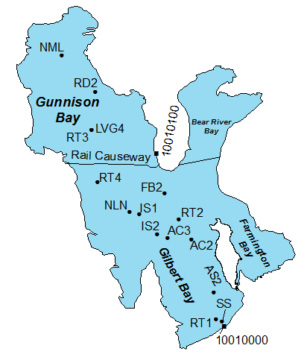
What about salinity?
C≈L/V
North
Causeway Closure
South
Data from Utah Geological Survey (Andrew Rupke 10/10/2012).

Slide 28




Calculation of Salt Load
Lake Level h
z_{1,} C₁
$$h−(z_{1}+z_{2})/2$$
z_{2,} C₂
$$h−(z_{2}+z_{3})/2$$
z_{3,} C₃
$$$$
$$V_{1}=V(h)−V(h−(z_{1}+z_{2})/2)$$
$$V_{2}=V(h−(z_{1}+z_{2})/2)−V(h−(z_{2}+z_{3})/2)$$
$$$$
$$L=C_{1}V_{1}+C_{2}V_{2}+C_{3}V_{3}+$$

Slide 29
Salt Loads
Inferred decline in total dissolved salt in GSL
Data from Utah Geological Survey (Andrew Rupke 10/10/2012). Loads here are reported in US or short tons. 1 US ton = 0.9072 metric tons = 907.2 kg.

Slide 30
Predictive Mass Balance Model
Inputs
  Precipitation (N and S)
  Evaporation (Historic or Calculated)
  Streamflow
  Initial Level
Output
  Levels and volumes
Evaluated separately for N and S arm with Causeway flow by USGS model

Slide 31
Validation
Note: West desert pumping salt loss reduced to 40% of reported to reconcile with load observations
Notes:
GSLFMCausewayModelingHistoric.R

Slide 32
Validation
Note: West desert pumping salt loss reduced to 40% of reported to reconcile with load observations
Notes:
GSLFMCausewayModelingHistoric.R

Slide 33
Validation
Notes:
GSLFMCausewayModelingHistoric.R

Slide 34
Future simulations
Water budget model with inputs P, Q, E/T resampled from historic years retaining each year as a block
Resampling used k-nearest neighbors (based on total streamflow) to group similar years together and maintain statistical dependence
Evaporation used either the historic value from mass balance, or was calculated from salinity
Pumping limits level to 4208 ft
Pond withdrawal and altered bathymetry scenario

Slide 35
100 resampled input simulations
10 year simulations
Distribution of 10 year ahead Levels

Slide 36
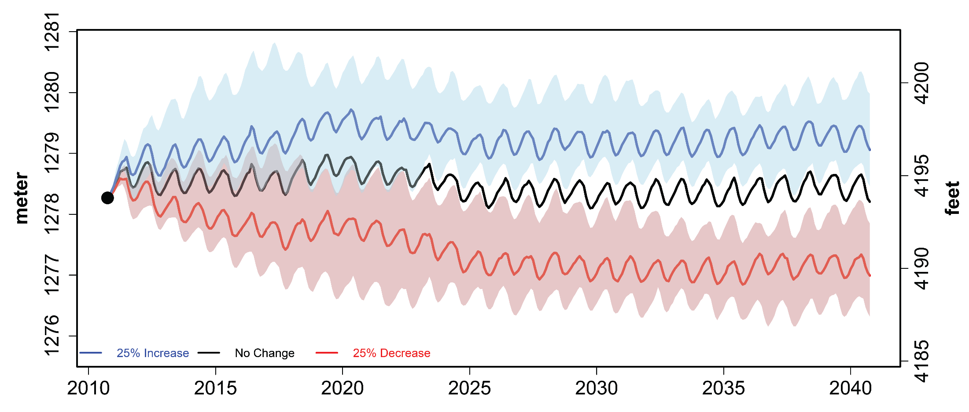
Great Salt Lake level predictions time series under different streamflow input change scenarios
Shaded colored areas give the 25th and 75th percentiles for lake level predictions under streamflow changes. Lines give the median (50th percentile) lake level predictions.
Mohammed, I. N. and D. G. Tarboton, (2012), "An examination of the sensitivity of the Great Salt Lake to changes in inputs," Water Resour. Res., 48(11): W11511, http://dx.doi.org/10.1029/2012WR011908.
Notes:
Great Salt Lake level predictions time series under different streamflow input change scenarios (25% decrease from annual streamflow input, no streamflow input changes, and 25% increase from annual streamflow input). Shaded colored areas give the 25th and 75th percentiles for lake level predictions under streamflow changes. Lines give the median (50th percentile) lake level predictions.
IF THIS IMAGE HAS BEEN PROVIDED BY OR IS OWNED BY A THIRD PARTY, AS INDICATED IN THE CAPTION LINE, THEN FURTHER PERMISSION MAY BE NEEDED BEFORE ANY FURTHER USE. PLEASE CONTACT WILEY'S PERMISSIONS DEPARTMENT ON PERMISSIONS@WILEY.COM OR USE THE RIGHTSLINK SERVICE BY CLICKING ON THE 'REQUEST PERMISSIONS' LINK ACCOMPANYING THIS ARTICLE. WILEY OR AUTHOR OWNED IMAGES MAY BE USED FOR NON-COMMERCIAL PURPOSES, SUBJECT TO PROPER CITATION OF THE ARTICLE, AUTHOR, AND PUBLISHER.

Slide 37
Evaluation of Expansion Pond Alternatives
100 simulated traces of South Arm Level for the no action scenario.
10th year quantiles.
 | South Arm Level
Quantile | 16% | 50% | 84%
NA | 4190.4 | 4194.1 | 4199.8
PA | 4188.1 | 4192.4 | 4199.0
 | North Arm Level
Quantile | 16% | 50% | 84%
NA | 4189.4 | 4192.8 | 4199.4
PA | 4187.0 | 4190.9 | 4198.7
 | South Arm Concentration (g/L)
Quantile | 16% | 50% | 84%
NA | 86.9 | 118.4 | 153.6
PA | 80.8 | 119.5 | 151.5
100 simulated traces of South Arm Level for the proposed action scenario
 | North Arm Concentration (g/L)
Quantile | 16% | 50% | 84%
NA | 263.8 | 337.6 | 343.8
PA | 239.8 | 332.1 | 341.7
Note: These simulations are from the permit request as of 2010. The permit request has since evolved
Net additional withdrawal 280,000 acre-ft/yr

Slide 38
What would the natural level of the lake be without human consumptive use depletions?
100 year trends suggest possible reduction in streamflow of 0.817 MAF (34% of current streamflow)
Utah Div of Water Resources calculations suggest 1.66 MAF (69% of current streamflow)
Add 34% back to observed streamflow to simulate “natural” lake level

Slide 39
Natural lake level would be about 6 ft higher than present record low

Slide 40
Any sensitivity to initial level is lost over ~ 20 years

Slide 41
Extending to Integrated Modeling of the Basin Hydrology
Solar Radiation
Precipitation
Air Humidity
Air Temp.
Mountain Snowpack
Evaporation
GSL Level Volume Area
Soil Moisture And Groundwater
Salinity
Streamflow

Slide 42
Bear River Basin Macro-Hydrology
Streamflow response to basin and annual average forcing.
Runoff ratio = 0.18
Streamflow Q/A mm
Runoff ratio = 0.10
Precipitation mm
LOWESS (R defaults)
Temperature C

Slide 43
Bear River Basin Macro-Hydrology
LOWESS (R defaults)
Annual Streamflow Q/A mm
SNOTEL Max. SWE mm
SNOTEL Max. SWE mm (average of points)
Temperature C (basin average from gridded data)

Slide 44
Great Salt Lake Evaporation from annual mass balance E = P+Q-ΔV
LOWESS (R defaults)
E m³
Area m²

Slide 45
Interpretation
Solar Radiation
Precipitation
Air Humidity
Air Temp.
Increases
Reduces
Mountain Snowpack
Evaporation
Area Control
GSL Level Volume Area
Supplies
Reduces
Soil Moisture And Groundwater
Contributes
Salinity
C≈L/V
Dominant
Streamflow

Slide 46

Conclusions
Multi-year dynamic variability with 5-10 year adjustment time scale
Streamflow is most sensitive input so declines in streamflow due to depletions, withdrawals or climate change a concern
Lake area is most sensitive evaporation determinant
Total dissolved salt load is declining
Integrated water and salt simulation effective for addressing questions about future management scenarios
Depletions appear to be responsible to some degree for current record low lake levels

Slide 47
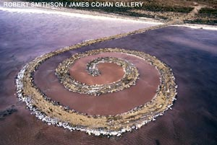
Art – “The Spiral Jetty” by Robert Smithson
Slide from Rob Baskin

