Slide 1
Modeling the Hydrology of the Great Salt Lake: What makes the Great Salt Lake go up and down
David Tarboton
Utah State University
dtarb@usu.edu
435-797-3172

Slide 2
Outline
Lake level fluctuations
Water Budget
Precipitation
Streamflow
Evaporation
Sensitivity
Salinity
Modeling
integrated water and total salt (not individual minerals)

Slide 3
How a closed basin (e.g. GSL works)
If I > E x A level rises
If I < E x A level falls
Level adjusts to fluctuating inputs so that on average
I = E x A
I includes inflows from streams and precipitation on the lake
I = Q + P x A
Subject to climate variability.
E is less variable, but also depends on climate and salinity, C.
As C increases E decreases
Evaporation depth E
Evaporation volume E x A
Inflows I
E x A
Level
Area, A
I
E x A
Level
Area, A
Volume, V
Salt Load L
Salt Concentration C=L/V

Slide 5
Water Budget
69%
Q, Streamflow+Groundwater
3 major rivers. Multiple USGS gauges
Groundwater 75000 acre ft/yr (Waddell and Barton, 1980)
A, V Area and Volume
From bathymetry and level
P, Precipitation
From PRISM (Oregon State University)
E, Evaporation
Withdrawals (West desert pumping, Evaporation ponds)
2%
29%
-96%
-4%

Slide 6
Bathymetry
South Arm
North Arm
the lake bed topography that relates area to level and volume

Slide 7
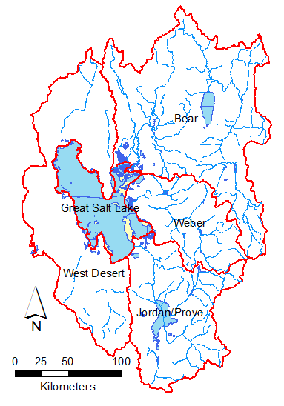
Great Salt Lake Precipitation and Streamflow
Mean Annual Values 1949-2013
Basin | Area (km²) | Precipitation (mm) | Streamflow (acre-ft)
Great Salt Lake | 4713 | 326.7 | -
Bear | 19262 | 536.4 | 1328023 (57%)
Weber | 6413 | 657.4 | 338634 (15%)
Jordan/Provo | 9963 | 563.9 | 509638 (22%)
West Desert | 14604 | 347.7 | -
Other (Davis etc) | - | - | 135240 (6%)
Total | 54953 | 565.6 | 2311434 (100%)
Precipitation from aggregation of PRISM data over each area
Streamflow from multiple USGS gauges

Slide 8
Great Salt Lake Inputs (1949-2013)
Adjustments to GSL inputs
West Desert pumping. 2.5 MAF removed 4/87 to 6/89. 27 months
200000 AF return from West Desert. 1/90 to 6/92. 30 months
Pond operations 5 months per year May – Sept with withdrawals based on reported water use and water rights.
Precipitation | 991,992 acre-ft (29%)
Streamflow | 2,311,435 acre-ft (69%)
Groundwater | 75,000 acre-ft (2%)
Total Inflows | 3,378,427 acre-ft
Net pumping and withdrawals | -132,060 acre ft (4%)

Slide 9
Salinity dependent evaporation
(Penman evaporation equation modified for salinity based on ion activity coefficients, Mohammed and Tarboton, 2008)

Slide 11
What input is the lake level most sensitive to?
$$∆V=P_{v} +Q+G−E_{v}−W_{net}$$
$$φ_{var}=\frac{σ_{var}}{σ_{ΔV}}$$
0.3
0.83
0.55
Sensitivity
Variability dominated by Q, but stabilized by E_{v}
But how does E_{v} depend on area and salinity?
Mohammed, I. N. and D. G. Tarboton, (2012), "An examination of the sensitivity of the Great Salt Lake to changes in inputs," Water Resour. Res., 48(11): W11511, http://dx.doi.org/10.1029/2012WR011908.

Slide 12
How do changes in area and salinity affect evaporation volume
$$E_{v}=A.SCF.E_{fd}$$
0.49
0.09
0.07
Variability in evaporation volume is dominated by changes in area with only small effects due to changes in salinity and changes due to potential evaporation

Slide 13
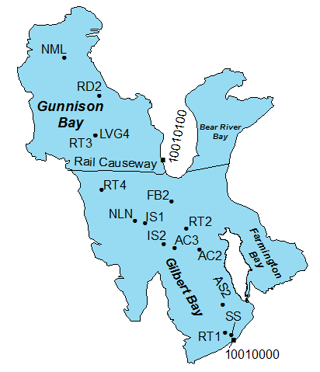
What about salinity?
C≈L/V
North
Causeway Closure
South
Data from Utah Geological Survey (Andrew Rupke 10/10/2012).

Slide 14
Calculation of Salt Load
Lake Level h
z_{1,} C₁
$$h−(z_{1}+z_{2})/2$$
z_{2,} C₂
$$h−(z_{2}+z_{3})/2$$
z_{3,} C₃
$$$$
$$V_{1}=V(h)−V(h−(z_{1}+z_{2})/2)$$
$$V_{2}=V(h−(z_{1}+z_{2})/2)−V(h−(z_{2}+z_{3})/2)$$
$$$$
$$L=C_{1}V_{1}+C_{2}V_{2}+C_{3}V_{3}+$$

Slide 15
Salt Loads
Inferred decline in total dissolved salt in GSL
Data from Utah Geological Survey (Andrew Rupke 10/10/2012). Loads here are reported in US or short tons. 1 US ton = 0.9072 metric tons = 907.2 kg.

Slide 16
Evaluating the impact of Mineral Evaporation Ponds on Lake Level
Input balanced by less evaporation -> Smaller Area
Bathymetry altered due to Pond occupation of part of Lake
Net effect is a difference in lake level
Time series modeling to account for variability
Smaller Area
Change in level

Slide 17
Predictive Mass Balance Model
Inputs
Precipitation (N and S)
Evaporation (Historic or Calculated)
Streamflow
Initial Level
Output
Levels and volumes
Evaluated separately for N and S arm with Causeway flow by USGS model

Slide 18
Validation
Note: West desert pumping salt loss reduced to 40% of reported to reconcile with load observations
Notes:
GSLFMCausewayModelingHistoric.R

Slide 19
Validation
Note: West desert pumping salt loss reduced to 40% of reported to reconcile with load observations
Notes:
GSLFMCausewayModelingHistoric.R

Slide 20
Validation
Notes:
GSLFMCausewayModelingHistoric.R

Slide 21
Future simulations
Water budget model with inputs P, Q, E/T resampled from historic years retaining each year as a block
Resampling used k-nearest neighbors (based on total streamflow) to group similar years together and maintain statistical dependence
Evaporation used either the historic value from mass balance, or was calculated from salinity
Pumping limits level to 4208 ft
Pond withdrawal and altered bathymetry scenario

Slide 22
100 resampled input simulations
10 year simulations
Distribution of 10 year ahead Levels

Slide 23
Evaluation of Expansion Pond Alternatives
100 simulated traces of South Arm Level for the no action scenario.
10th year quantiles.
 | South Arm Level
Quantile | 16% | 50% | 84%
NA | 4190.4 | 4194.1 | 4199.8
PA | 4188.1 | 4192.4 | 4199.0
 | North Arm Level
Quantile | 16% | 50% | 84%
NA | 4189.4 | 4192.8 | 4199.4
PA | 4187.0 | 4190.9 | 4198.7
 | South Arm Concentration (g/L)
Quantile | 16% | 50% | 84%
NA | 86.9 | 118.4 | 153.6
PA | 80.8 | 119.5 | 151.5
100 simulated traces of South Arm Level for the proposed action scenario
 | North Arm Concentration (g/L)
Quantile | 16% | 50% | 84%
NA | 263.8 | 337.6 | 343.8
PA | 239.8 | 332.1 | 341.7
Note: These simulations are from the permit request as of 2010. The permit request has since evolved
Net additional withdrawal 280,000 acre-ft/yr

Slide 24
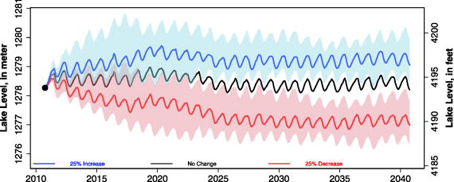
Great Salt Lake level predictions time series under different streamflow input change scenarios
Shaded colored areas give the 25th and 75th percentiles for lake level predictions under streamflow changes. Lines give the median (50th percentile) lake level predictions.
Mohammed, I. N. and D. G. Tarboton, (2012), "An examination of the sensitivity of the Great Salt Lake to changes in inputs," Water Resour. Res., 48(11): W11511, http://dx.doi.org/10.1029/2012WR011908.
Notes:
Great Salt Lake level predictions time series under different streamflow input change scenarios (25% decrease from annual streamflow input, no streamflow input changes, and 25% increase from annual streamflow input). Shaded colored areas give the 25th and 75th percentiles for lake level predictions under streamflow changes. Lines give the median (50th percentile) lake level predictions.
IF THIS IMAGE HAS BEEN PROVIDED BY OR IS OWNED BY A THIRD PARTY, AS INDICATED IN THE CAPTION LINE, THEN FURTHER PERMISSION MAY BE NEEDED BEFORE ANY FURTHER USE. PLEASE CONTACT WILEY'S PERMISSIONS DEPARTMENT ON PERMISSIONS@WILEY.COM OR USE THE RIGHTSLINK SERVICE BY CLICKING ON THE 'REQUEST PERMISSIONS' LINK ACCOMPANYING THIS ARTICLE. WILEY OR AUTHOR OWNED IMAGES MAY BE USED FOR NON-COMMERCIAL PURPOSES, SUBJECT TO PROPER CITATION OF THE ARTICLE, AUTHOR, AND PUBLISHER.

Slide 25
Conclusions
Multi-year dynamic variability with 5-10 year adjustment time scale
Streamflow is most sensitive input
Lake area is most sensitive evaporation determinant
Total dissolved salt load is declining
Integrated water and salt simulation effective for addressing questions about future management scenarios
Questions?
dtarb@usu.edu

