Slide 1

What makes the Great Salt Lake level go up and down ?
Tarboton, David G.^{1.}
Mohammed, Ibrahim N.^{1.}
Lall, Upmanu^{2.}
Utah Water Research Laboratory, Utah State University, Logan, Utah^{1.}
Earth & Environmental Eng, Columbia University^{2.}
GSA presentation, Salt Lake City, Utah, USA, Oct. 17, 2005

Slide 2
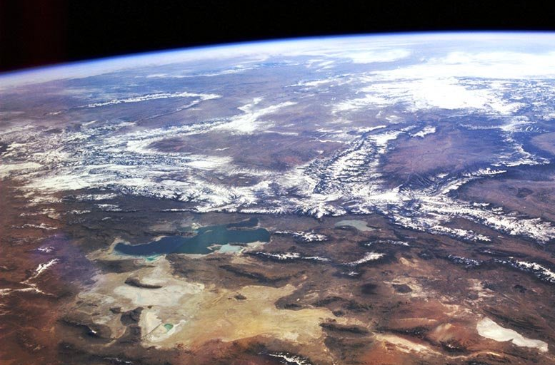
Great Salt Lake Basin Hydrologic Observatory
Strawberry
Bear
Weber
Jordan/Provo
West Desert
A Hydrologic Observatory to advance understanding of water resources in the modern west

Slide 3
A microcosm for many "western" water issues
Climate Gradients (Snow fed, Alpine to semi-arid), variability and vulnerability
Topographic and Land Use Gradients
Mountain Front / Valley groundwater dynamics and interactions
Geologic Diversity (Granite to Karst)
Closed basin for water and constituent balance closure
Development issues (local growth, SLC metropolitan area demands)
Policy Issues (3 states)
Agricultural issues (water supply, environmental compliance)
Environmental Issues (water quality, watershed management practices)
Ecological issues (Stream ecosystems, Bird refuge, GSL ecosystem)

Slide 4
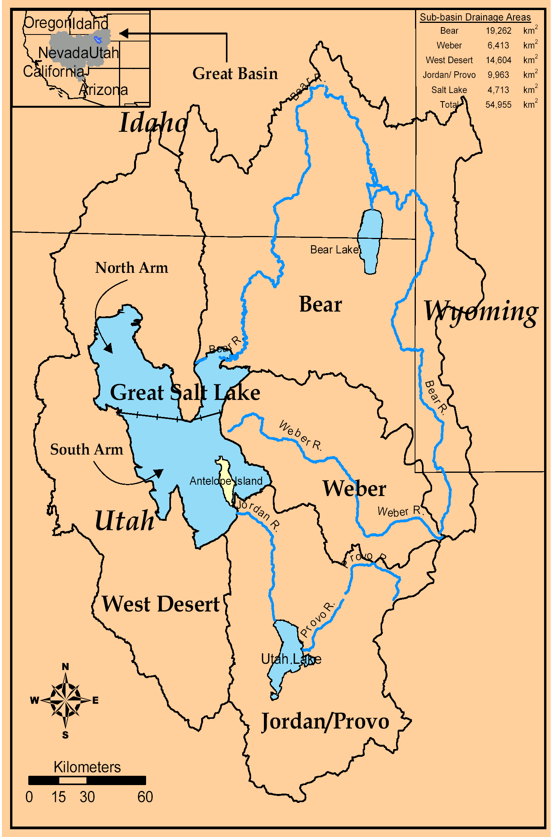
Great Salt Lake
The Great Salt Lake (latitude 40° to 42° N, longitude 112° to 113° W). The effective area of Great Salt Lake basin is about 55,000 km² .
The study area is divided into five geographic areas (Bear watershed, Weber watershed, Jordan/Provo watershed, West Desert watershed, and Great Salt Lake).
Fresh water inflow comes from Bear (19,262 km²), Weber (6,413 km²), and Jordan/ Provo (9,963 km²) Rivers.

Slide 5
Great Salt Lake Levels
(USGS data)
SLC Airport level
Feet
Meters
10/15/05 4195.4 ft 1278.8 m
The lake was divided into North and South arms by a railroad causeway in 1959. Separate records of level in the North Arm and South Arm are available from 1966.

Slide 6
Level-Area-Volume Relationships
(Loving et al., 2000)
Level (meter)
Level (meter)
Area (km²)
Volume (km³)
Area (km²)
Volume (km³)

Slide 7
Great Salt Lake Volumes
Acre-Feet × 10⁷
km³
GSL was at its lowest water-surface elevation in recent history at about 1,277.4 m (4,191 ft), it covered about 2,460.5 km² (950 mi²) and was about 7.6 m deep at its deepest point in 1963.
1987, when Great Salt Lake was at its highest water-surface elevation at about 1,283.8 m (4,212 ft) on April 1st, 1987, it covered about 6,216 km² (2,400 mi²) and was about 13.7 m at its deepest point.

Slide 8
Conceptual Model
Solar Radiation
Precipitation
Air Humidity
Air Temp.
Mountain Snowpack
Evaporation
GSL Level Volume Area
Soil Moisture And Groundwater
Salinity
Streamflow

Slide 9
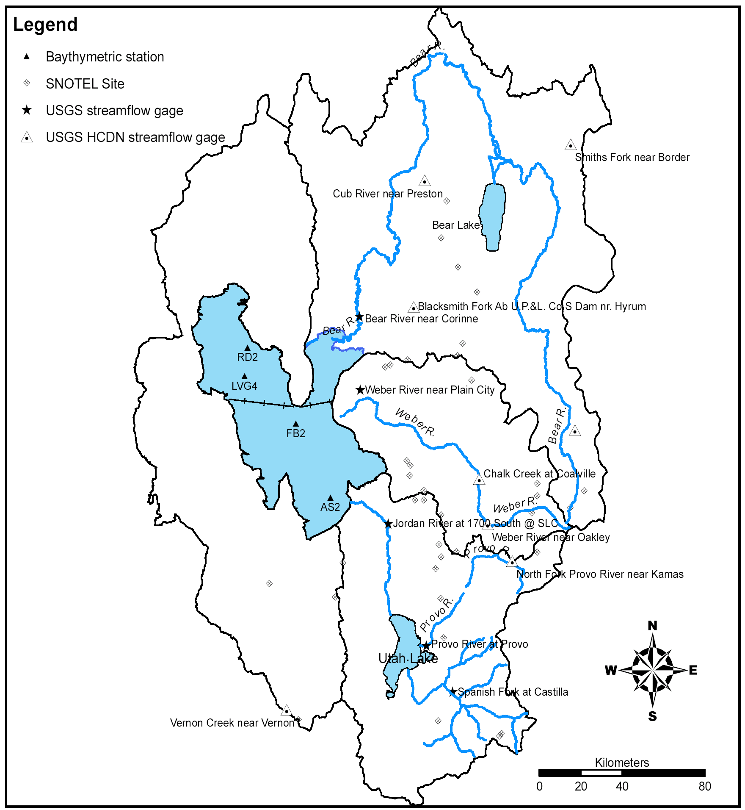
SLC, Jordan/Provo River Drainage area 8,904 km²
Corrine, Bear River
Drainage area 18,205 km²
Data
Provo, Provo River Drainage area 1,743 km²
Plain City, Weber River
Drainage area 5,390 km²
Spanish, Jordan River Drainage area 1,689 km²

Slide 10
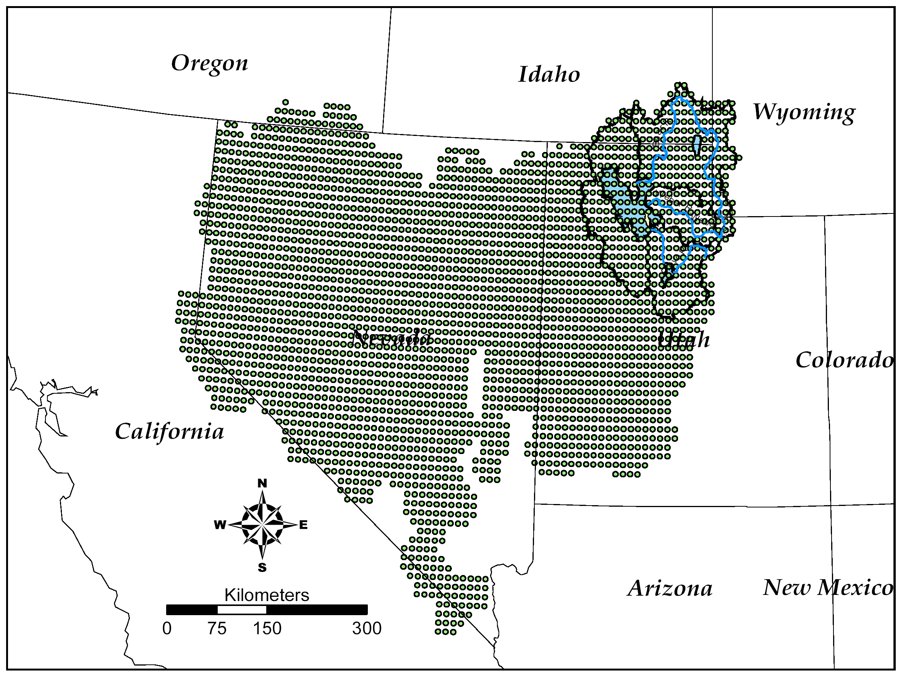
Monthly Gridded Precipitation, Air Temperature and Wind Speed over each region from University of Washington (Maurer, E. P., A. W. Wood, J. C. Adam, D. P. Lettenmaier and B. Nijssen, (2002), "A Long-Term Hydrologically Based Dataset of Land Surface Fluxes and States for the Conterminous United States," Journal of Climate, 15: 3237-3251.)
Precipitation, Air Temp., Wind speed

Slide 11
Spectral Analysis
Fourier Transform
Biweekly volume (1979-2000)
ΔV⁻
V km³
Log(|A|)
ΔV⁺
Reconstructed GSL Annual cycle - Peak June 15, Trough Nov 1.
June 15th
Nov. 1st
Month
Notes:
When we perform the whole time series we found that the dates are June15, November 15.

Slide 12
Annual Increase & Decrease
June 15 - Nov 1
Nov 1 - June 15
ΔV (+ or -) m³

Slide 13
Annual streamflows
m³

Slide 14
Nov 1 - June 15 lake volume increase
LOWESS (R defaults)
1:1 line
ΔV+ (m³) Nov 1 - June 15
Annual total streamflow, Q (m³)
Lake annual precipitation volume, P (m³)

Slide 15
Bear River Basin Macro-Hydrology
Streamflow response to basin and annual average forcing.
Runoff ratio = 0.18
Streamflow Q/A mm
Runoff ratio = 0.10
Precipitation mm
LOWESS (R defaults)
Temperature C

Slide 16
Bear River Basin Macro-Hydrology
LOWESS (R defaults)
Annual Streamflow Q/A mm
SNOTEL Max. SWE mm
SNOTEL Max. SWE mm (average of points)
Temperature C (basin average from gridded data)

Slide 17
Great Salt Lake Evaporation from annual mass balance E = P+Q-ΔV
LOWESS (R defaults)
E m³
Area m²

Slide 18
Annual Evaporation Loss E/A
LOWESS (R defaults)
Salinity decreases as volume increases. E increases as salinity decreases.
E/A m
Area m²

Slide 19
Volume decrease versus E (annual)
1:1 line
Significant E in excess of ΔV⁻. Evaporation not negligible when lake is rising (Nov 1 - June 15)
ΔV⁻ m³ June 15 -Nov 1
LOWESS (R defaults)
E m³
(from annual mass balance E = P+Q-ΔV)

Slide 20
Role of salinity (lake surface)
Pre 1986
Post 1987
North Arm
LOWESS
TDS g/l
South Arm
To a first approx is Salt Load Constant ?
Level m

Slide 21
Total Salt Load (Concentration x Volume)
North arm load.
Salinity inferred from level using LOWESS relationship
South arm load.
kg of TDS
Total Load. Sum of North and South arm load.
South arm observed
North arm observed

Slide 22
Evaporation vs Salinity
LOWESS (R defaults)
Salinity estimated from total load and volume related to decrease in E/A with decrease in lake volume and increase in C
E/A m
C = 3.5 x 10¹² kg/(Volume) g/l

Slide 23
Evaporation vs Temperature (Annual)
LOWESS (R defaults)
E/A m
Degrees C

Slide 24
Conclusions
Solar Radiation
Precipitation
Air Humidity
Air Temp.
Increases
Reduces
Mountain Snowpack
Evaporation
Area Control
GSL Level Volume Area
Supplies
Reduces
Soil Moisture And Groundwater
Contributes
Salinity
C≈L/V
Dominant
Streamflow

Slide 25
Future and Ongoing Work
Incorporate physical relationship between salinity and vapor pressure into evaporation.
Quantify climate inputs and hydrologic processes separately for the rise (Nov 1 - June 15) and fall (June 15 - Nov 1) periods to refine models.
Integrate the relationships identified into a system model to quantitatively understand the the large scale interactions involved in the dynamics of the Great Salt Lake basin system.
Develop and test predictive capability for quantifying the sensitivity of the GSL system to changes in forcing.

