Slide 1


HydroShare: Advancing Collaboration through Hydrologic Data and Model Sharing
David Tarboton
Utah State University
http://www.hydroshare.org
OCI-1148453
OCI-1148090

Slide 2

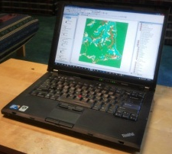
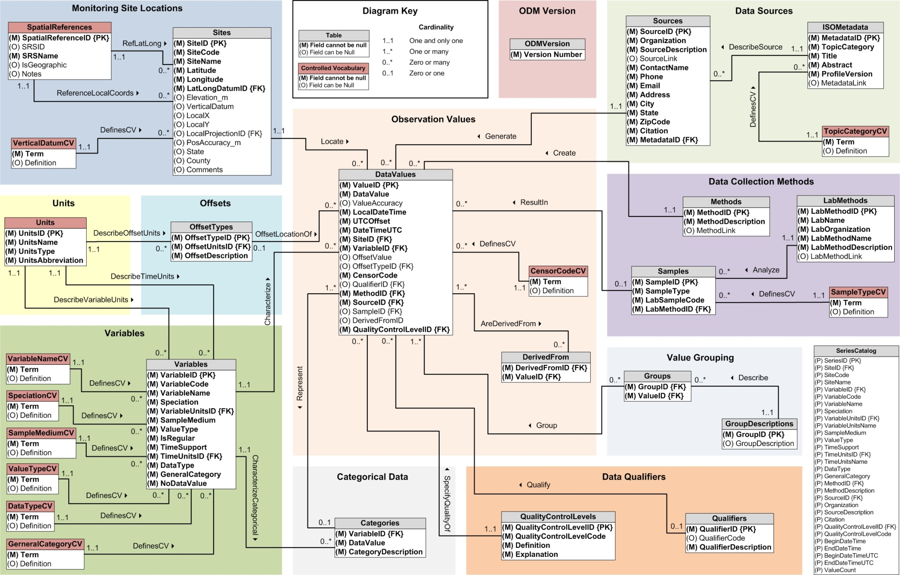
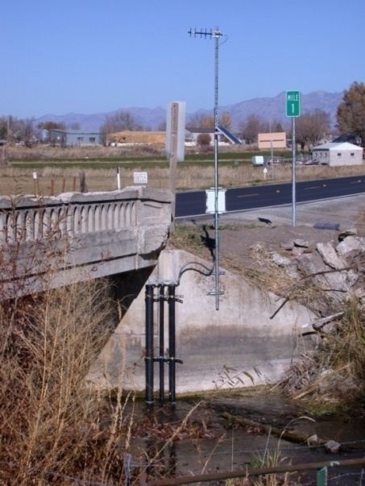
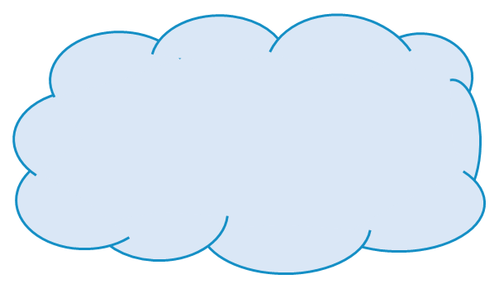
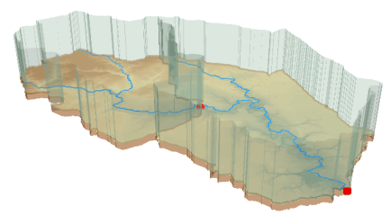



Outline
The CUAHSI HIS
  A Services-Oriented Architecture Based System for Sharing Hydrologic Data
HydroShare
  A Web-Based Collaborative Environment for the Sharing of Hydrologic Data and Models
CyberGIS connection
  Hydrologic Terrain Analysis
  River Geometry

Slide 3
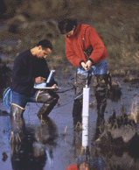


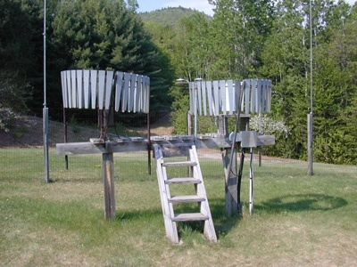
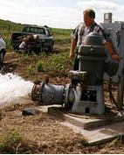
Hydrologic Data Challenges
Water quality
Water quantity
From dispersed federal agencies
From investigators collected for different purposes
Different formats
  Points
  Lines
  Polygons
  Fields
  Time Series
Rainfall and Meteorology
Soil water
Groundwater
GIS
Data Heterogeneity

Slide 4
What proportion of your research time do you spend on preparing or preprocessing data into appropriate forms needed for research purposes?
http://his.cuahsi.org/documents/HISStatusSept15.pdf
Notes:
Surveys of the hydrology community have indicated that data gathering and preprocessing is an inordinate fraction of the time required for modeling and analysis
In hydrology most of the easy single site, single variable, low hanging fruit research problems are solved and advances in understanding and better predictions require
combining information from multiple sources,
sharing and collaboration
Easier access to advanced computational capability
Sustainability and reliability in software

Slide 5
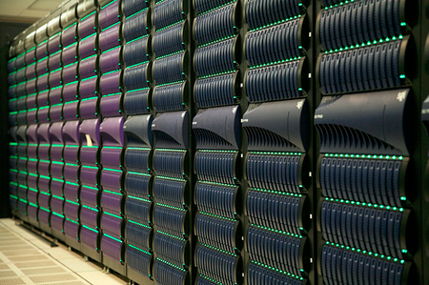
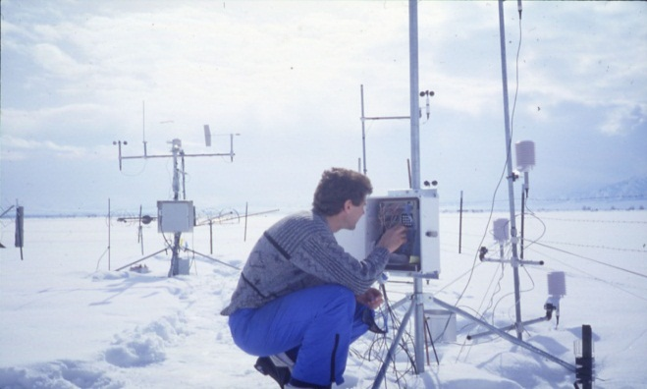
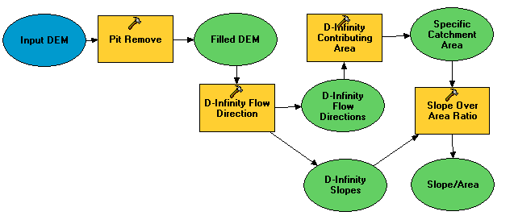

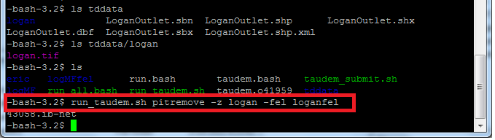
A digital divide
Researchers
Experimentalists
Modelers
Big Data and HPC
#!/bin/bash
vi
chmod
#PBS -l nodes=4:ppn=8
grep
awk
mpiexec
How can we best structure data and computer models to enable the use of high-performance and data-intensive computing by discipline scientists coming to this problem without extensive computational knowledge and algorithmic experience?
Gateways, Web Interfaces, CyberGIS

Slide 6
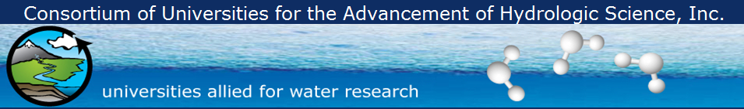
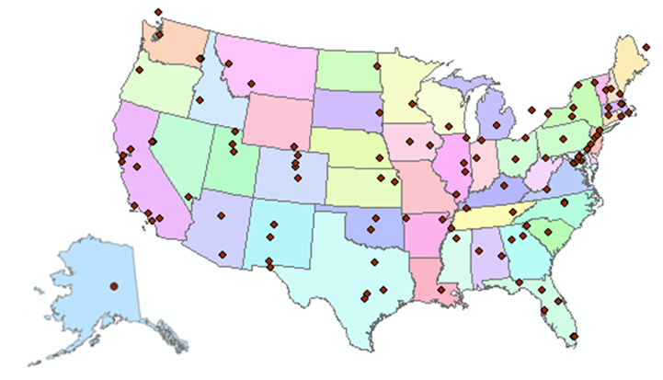
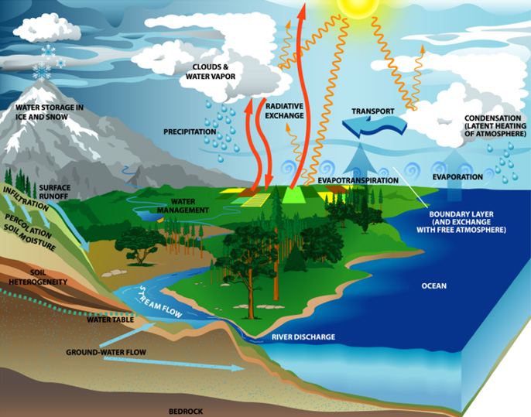
What is CUAHSI?
http://www.cuahsi.org
(as of January 2013)
109 US University members
7 affiliate members
20 International affiliate members
3 corporate members
provides community and research support services to advance water research
Support
EAR 0753521

Slide 7
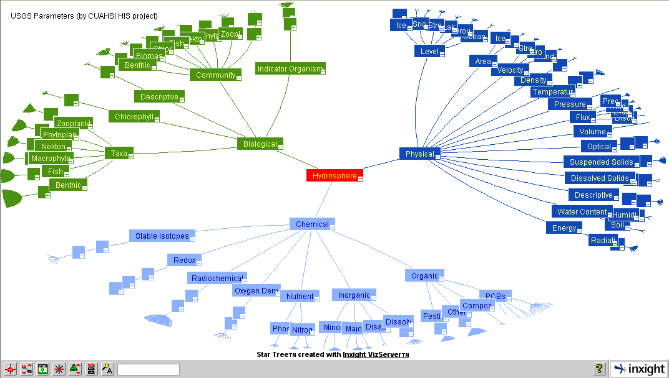
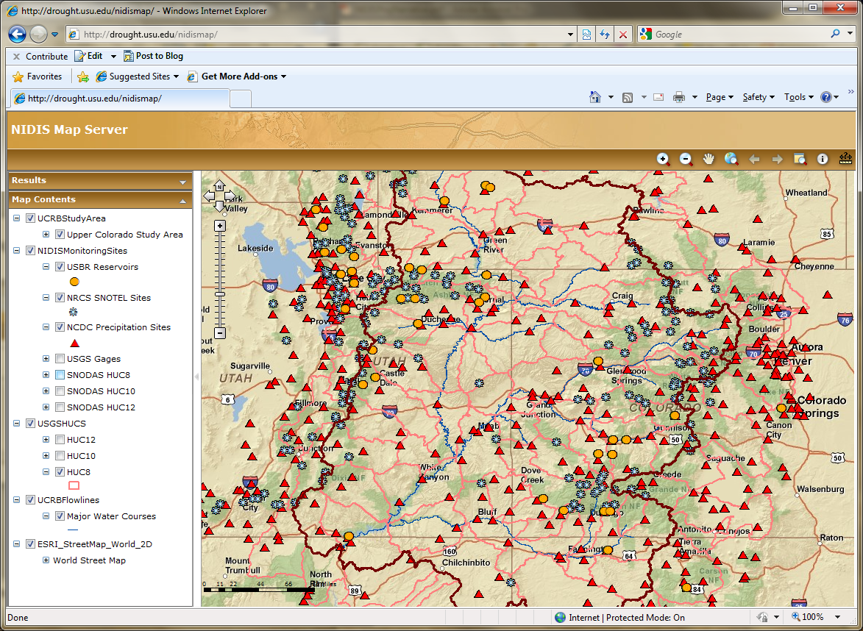
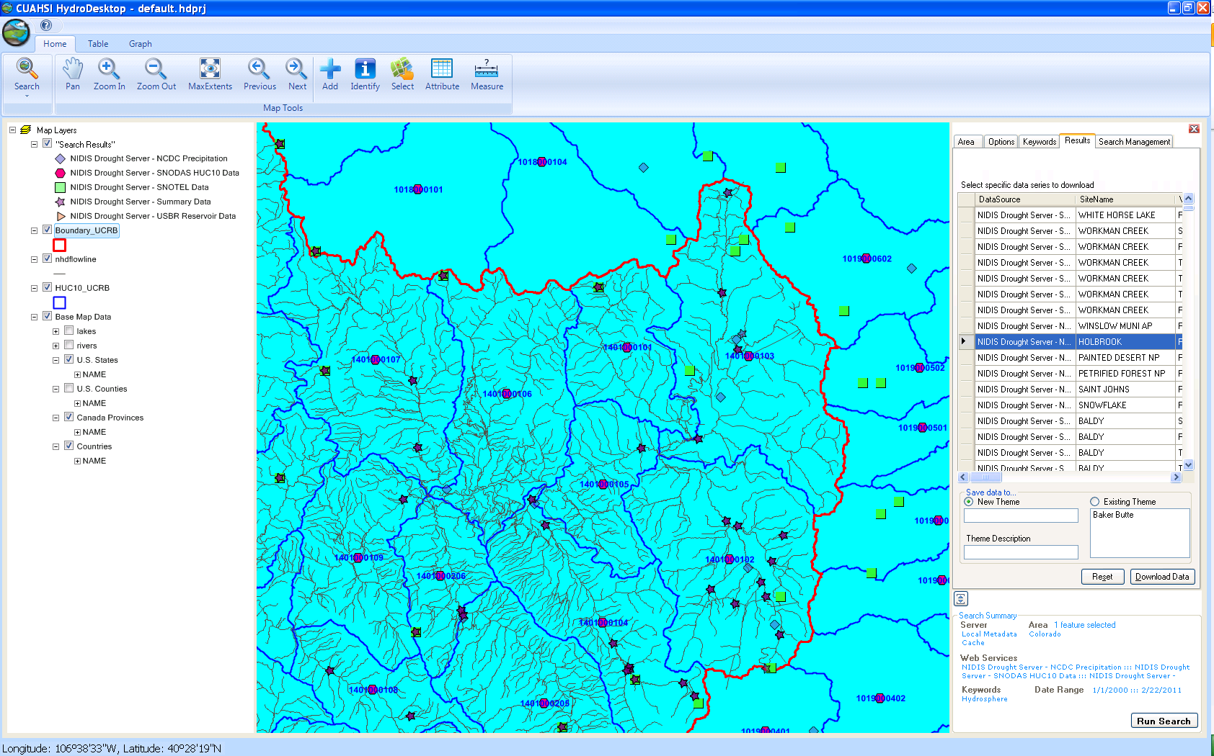
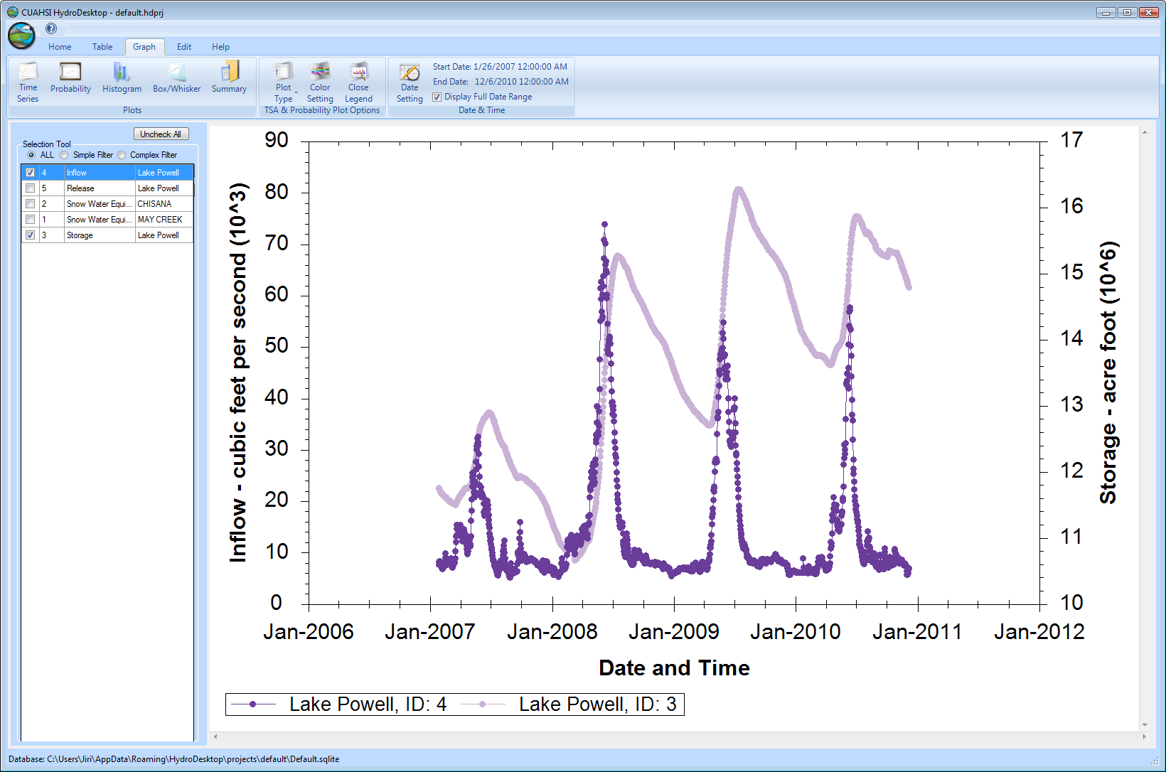
CUAHSI HIS
The CUAHSI Hydrologic Information System (HIS) is an internet based system to support the sharing of hydrologic data. It is comprised of hydrologic databases and servers connected through web services as well as software for data publication, discovery and access.
HydroServer – Data Publication
HydroCatalog
Data Discovery
Lake Powell Inflow and Storage
HydroDesktop – Data Access and Analysis
HydroDesktop – Combining multiple data sources

Slide 8
Services-Oriented Architecture Paradigm of the World Wide Web
Catalog
(Google)
Crawl and Catalog
Search
Web Server
(CNN.com)
Access
Browser
(Firefox)

Slide 9
CUAHSI Hydrologic Information System: A
Services-Oriented Architecture Based System for Sharing Hydrologic Data
HydroCatalog
Data Discovery and Integration
Metadata Services
WaterML, Other OGC Standards
Search Services
HydroServer
HydroDesktop
Data Publication
Data Services
Data Analysis and Synthesis

Slide 10










Data Searching – What we used to have to do
Searching each data source separately
NWIS
request
return
request
request
return
return
NAWQA
request
return
NAM-12
request
return
request
return
request
return
request
return
NARR
Slide: Michael Piasecki, Drexel University
Notes:
10

Slide 11

What CUAHSI HIS enables
Searching all data sources collectively
GetValues
GetValues
NWIS
GetValues
GetValues
generic
request
GetValues
GetValues
NAWQA
GetValues
NARR
GetValues
ODM
Slide: Michael Piasecki, Drexel University
Notes:
11

Slide 12
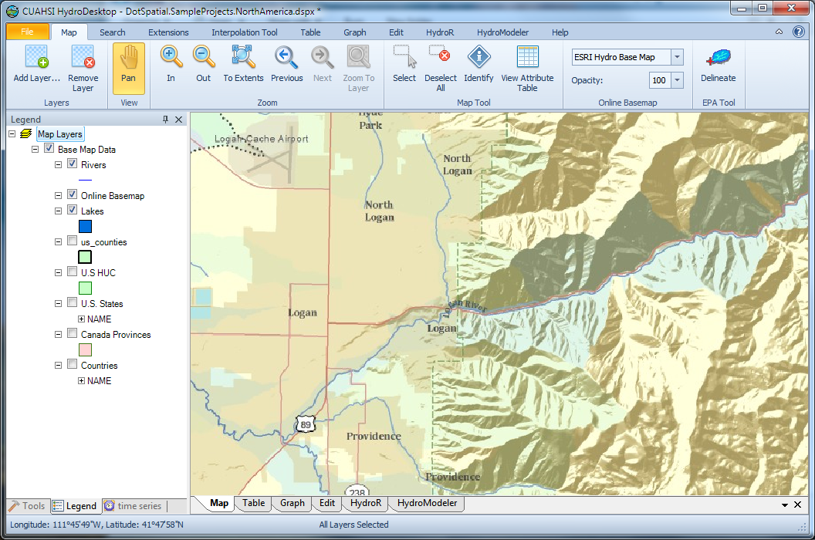
HydroDesktop
An open source
dotSpatial GIS based desktop client that supports discovery and analysis of hydrologic observations data
Uses EPA WATERS Web, Mapping, and Database Services at http://www.epa.gov/waters/geoservices/index.html to delineate Watersheds
Notes:
The service URLs that the HD tool uses are seen in http://hydrodesktop.codeplex.com/SourceControl/changeset/view/475b15a84bf4#Source%2fEPADelineation%2fCallWebService.cs The HD tool uses the Point Indexing Service to find the nearest NHD reach to where the user clicked. This returns a location on that reach. This point location is then used as input to the Navigation Delineation Service to get the watershed, and the Upstream/Downstream Service to get the river lines. The delineation service has two limitations: * It only works up to a certain distance upstream. I think we have it set to 100km. So for large watersheds (those with more than 100km of stream length upstream of where the user clicked), we don't get the most upstream portions of the watershed. * It doesn't delineate exactly to where the user clicked. It delineates to the endpoint of the NHD reach. (Can't remember if it is the clicked reach or the upstream reach -- try it and see.)

Slide 13
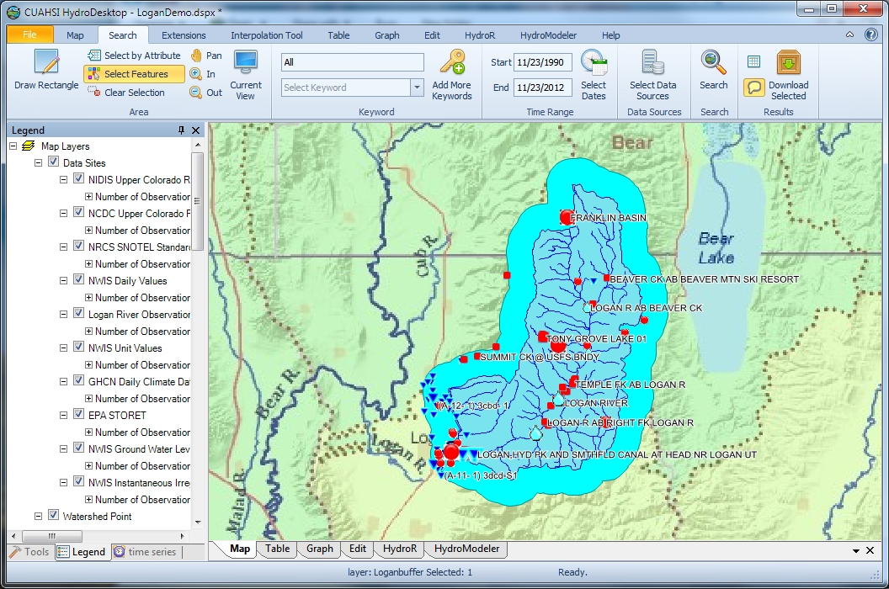
Search last 22 years for all data in buffer around watershed

Slide 14
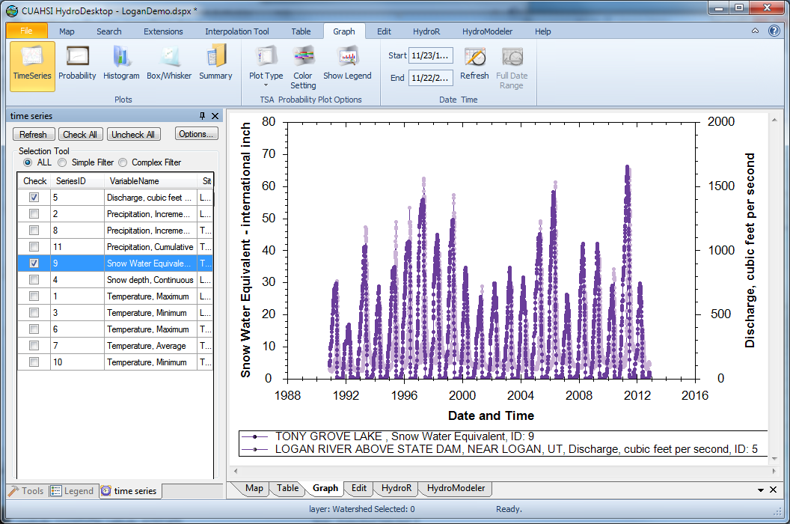
Download and Plot the Data
Combining information from multiple sources

Slide 15
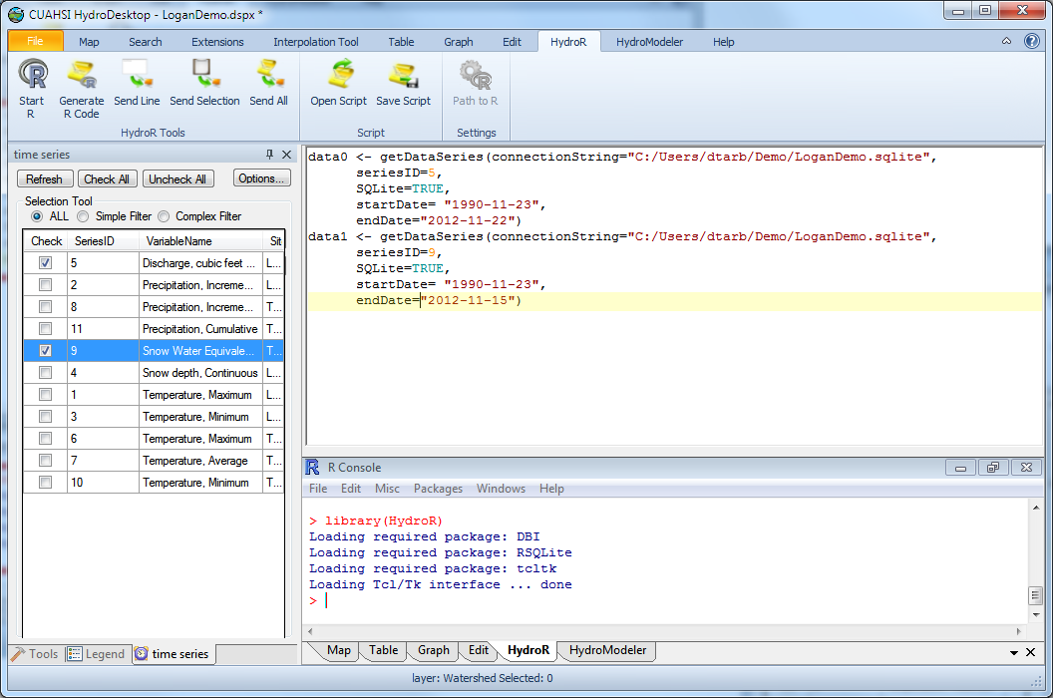
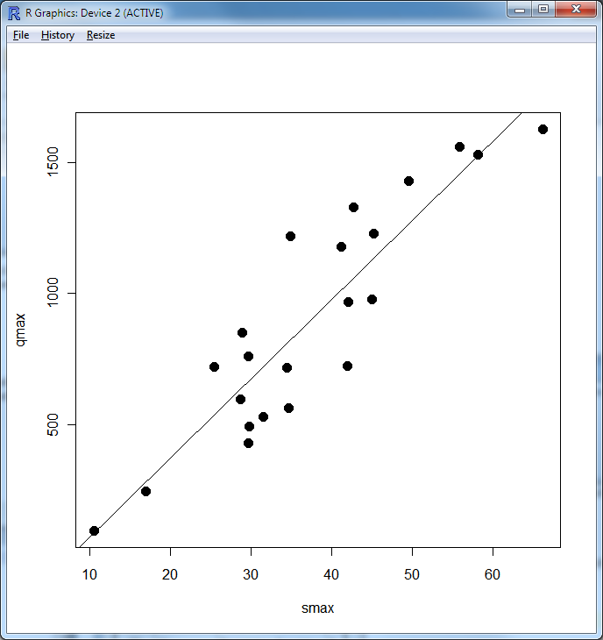
Perform an analysis using R
At your fingertips
the full analysis capability of R
data from multiple sources
accessed from distributed (cloud) resources.
importance of interoperability

Slide 16
CUAHSI HIS: A common window on water observations data for the United States unlike any that has existed before
Storage in a community data model
Publication from a server
Data access through internet-based services using consistent language and format
Tools for access and analysis
Discovery through thematic and geographic search functionality
Integrated modeling and analysis combining information from multiple sources
Desktop
Catalog
Server

Slide 17
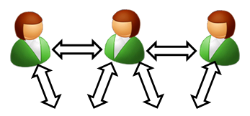

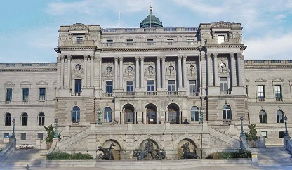
HydroShare is a web based collaborative system to support analysis, modeling and data publication
Collaboration
Analysis
Observers and instruments
Data
Models
Publication, Archival, Curation
Notes:
HydroShare will be a collaborative environment for sharing hydrologic data and models aimed at giving hydrologists the technology infrastructure they need to address critical issues related to water quantity, quality, accessibility, and management.
HydroShare will expand the data sharing capability of the CUAHSI Hydrologic Information System by broadening the classes of data accommodated, expanding capability to include the sharing of models and model components, and taking advantage of emerging social media functionality to enhance information about and collaboration around hydrologic data and models.
Functionality will include
A web portal for model and data sharing
Sharing features added to HydroDesktop client software
Access to more types of hydrologic data using standards compliant data formats and interfaces
Enhanced catalog functionality that broadens discovery functionality to different data types and models
New model sharing and discovery functionality
Enhanced easy to use access to high performance computing
Social media and collaboration functionality
Linkages to other data and modeling systems such as USGS and CUAHSI data services, NASA earth exchange and HPC resources e.g. at CSDMS

Slide 18
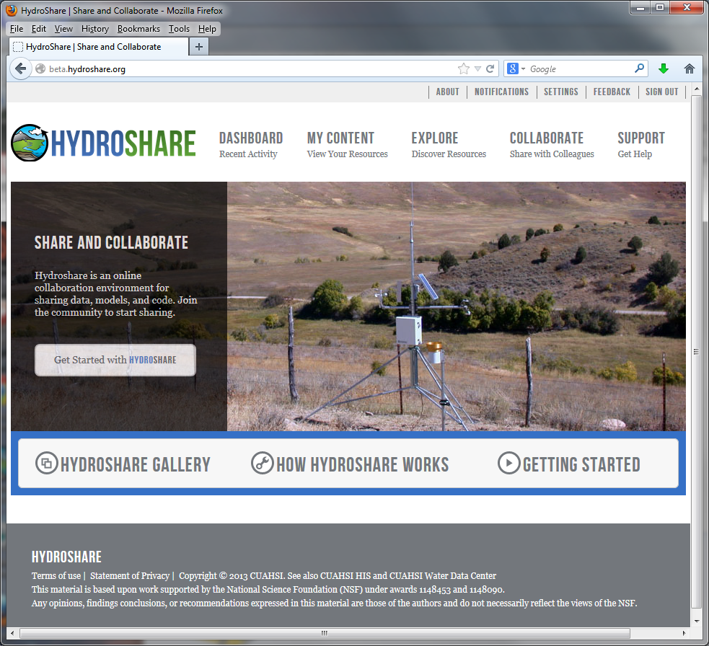
HydroShare - A web-based collaborative environment for the sharing of hydrologic data and models
beta.hydroshare.org
Can sharing data and models be as easy as sharing photos on Facebook or videos on YouTube?
Can finding data and models be as easy as shopping on Amazon?
Currently in beta testing. First release due November 2013
Notes:
HydroShare will be a collaborative environment for sharing hydrologic data and models aimed at giving hydrologists the technology infrastructure they need to address critical issues related to water quantity, quality, accessibility, and management.
HydroShare will expand the data sharing capability of the CUAHSI Hydrologic Information System by broadening the classes of data accommodated, expanding capability to include the sharing of models and model components, and taking advantage of emerging social media functionality to enhance information about and collaboration around hydrologic data and models.
Functionality will include
A web portal for model and data sharing
Sharing features added to HydroDesktop client software
Access to more types of hydrologic data using standards compliant data formats and interfaces
Enhanced catalog functionality that broadens discovery functionality to different data types and models
New model sharing and discovery functionality
Enhanced easy to use access to high performance computing
Social media and collaboration functionality
Linkages to other data and modeling systems such as USGS and CUAHSI data services, NASA earth exchange and HPC resources e.g. at CSDMS

Slide 19
HydroShare Functionality to be Developed
A new, web-based system for advancing model and data sharing
Sharing features to HydroDesktop
Access more types of hydrologic data using standards compliant data formats and interfaces
Enhance catalog functionality that broadens discovery functionality to different data types
New model sharing and discovery functionality
Facilitate and ease access to use of high performance computing
New social media and collaboration functionality
Links to other data and modeling systems

Slide 20
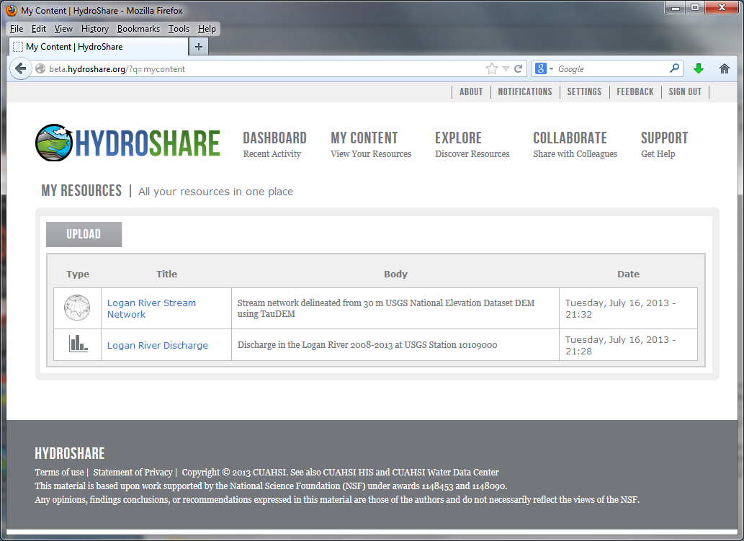

Slide 21
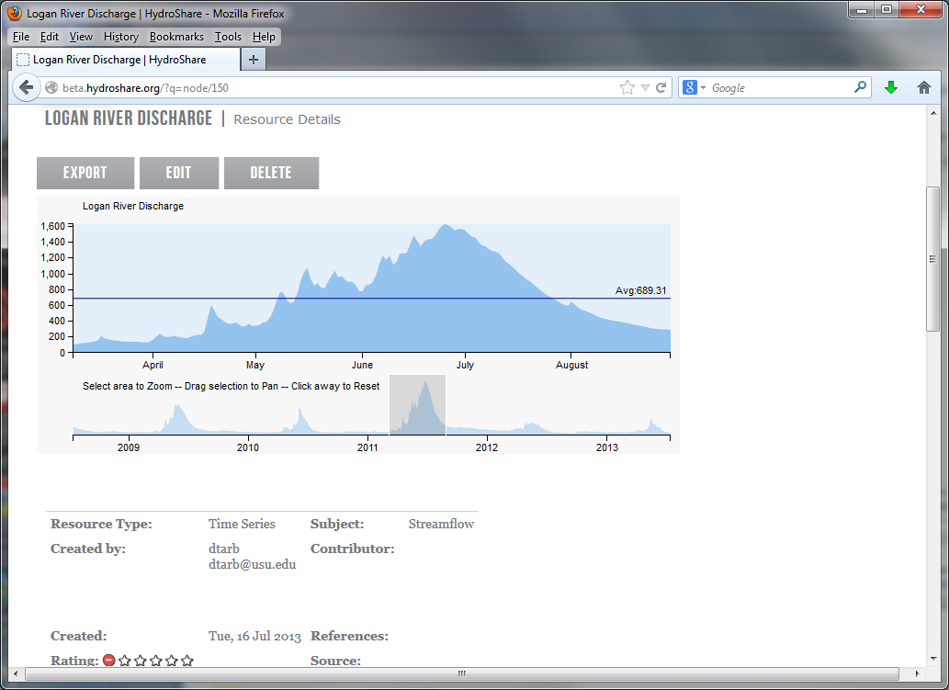

Slide 22
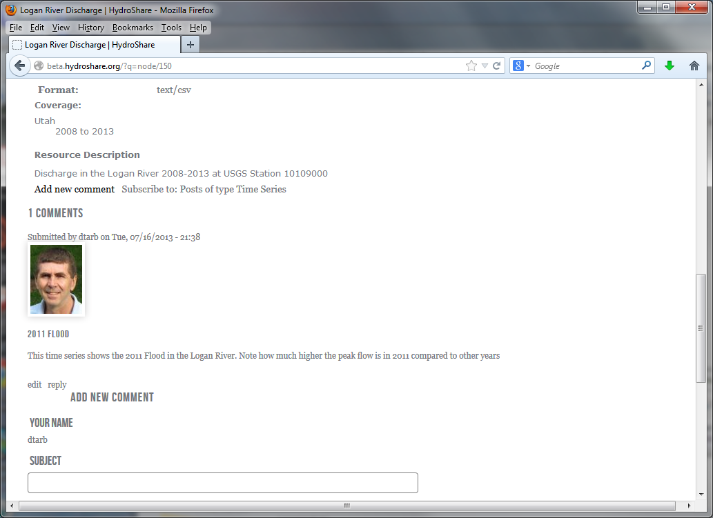

Slide 23
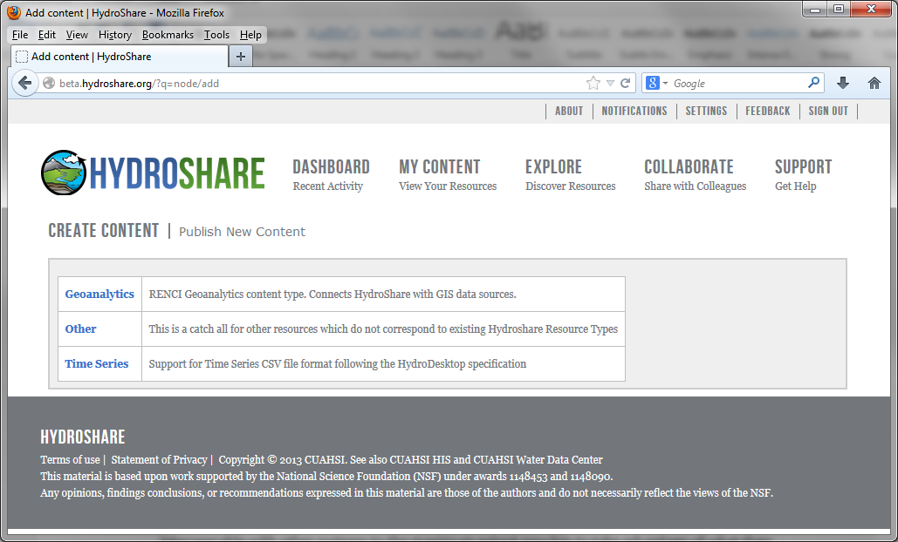
Upload

Slide 24
Additional Resource Functionality
Types
Time Series
Geographic feature set
Other
Referenced HIS time series
Geographic Raster
Multidimensional Space Time dataset
River geometry
Sample based observations (ODM2 and CZO)
Documents
Tabular objects
HydroDesktop Project package
Scripts
Models
Model Components
Referenced data sets from other (non HIS sources).
Tools
Uploaders to convert to facilitate loading of resource
Viewers to visualize the resource
Exporters to download the resource
Best practice tools for hydrologic data preprocessing and analysis

Slide 25

_{Imagine the Possibilities…}
Discover and Analyze/Model (in Desktop or Cloud)
Observe
Publish and Catalog
Collaboration
Analysis
3
Observers and instruments
HydroServer (ODM)
Data
Models
1
2
Publication, Archival, Curation
HydroShare to support integrated collaborative analysis, modeling and data publication

Slide 26
_{Imagine the Possibilities…}
Share the results (Data and Models)
Collaboration
Analysis
4
Observers and instruments
HydroShare resource
store
Data
Models
Publication, Archival, Curation
HydroShare to support integrated collaborative analysis, modeling and data publication

Slide 27

_{Imagine the Possibilities…}
Group Collaboration using HydroShare
Preparation of a paper
Collaboration
5
Analysis
6
Observers and instruments
Data
Models
Publication, Archival, Curation
HydroShare to support integrated collaborative analysis, modeling and data publication

Slide 28
_{Imagine the Possibilities…}
Submittal of paper, review, archival of electronic paper with data, methods and workflow
Collaboration
Analysis
7
Observers and instruments
Data
Models
Publication, Archival, Curation
HydroShare to support integrated collaborative analysis, modeling and data publication
DataOne, EarthCube, …

Slide 29

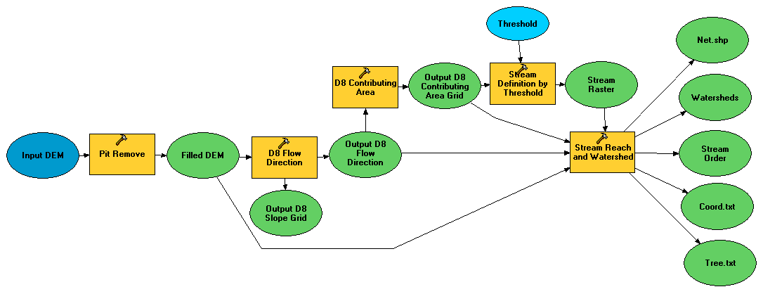

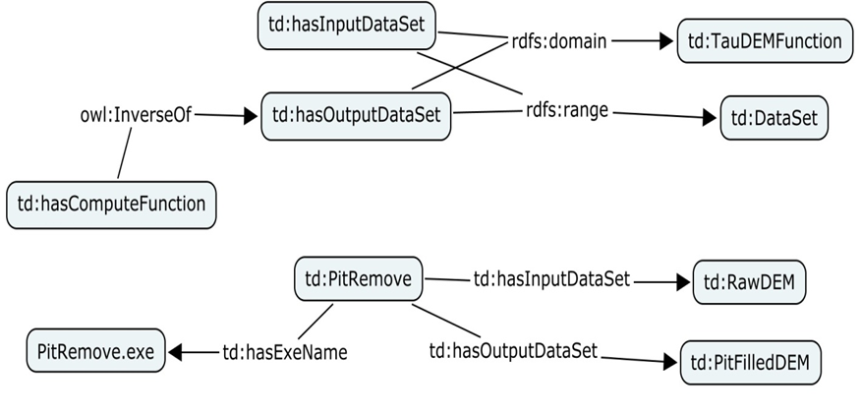
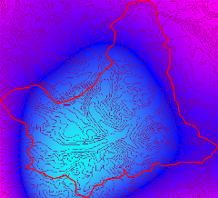

HydroShare Modeling
Flow
Time
t
y
x
Data: Links to national and global data sets of essential terrestrial variables (e.g. NASA NEX, HydroTerre)
Tools to preprocess and configure inputs (TauDEM + CyberGIS)
Preconfigured models and modeling systems as services (CI-WATER)
Standards for information exchange for interoperability (OpenMI, CSDMS BMI)
Tools for visualization and analysis
Automated reasoning to couple models based on purpose, context, data and resources (Aaron Byrd)
Notes:
Data: Links to national and global data sets of essential terrestrial variables (e.g. NASA NEX, HydroTerre)
Tools to preprocess and configure inputs
Preconfigured models and modeling systems as services
Standards for information exchange for interoperability (OpenMI, CSDMS BMI)
Tools for Visualization and Analysis
Automated reasoning to couple models based on purpose, context, data and resources

Slide 30
Resource Repository Centric Paradigm for Modeling and Analysis
Models
Visualization Tools
Analysis Tools
Resource Repository
Data Loaders
Data Discovery Tools
Enable multiple models to use common “best practice” tools

Slide 31
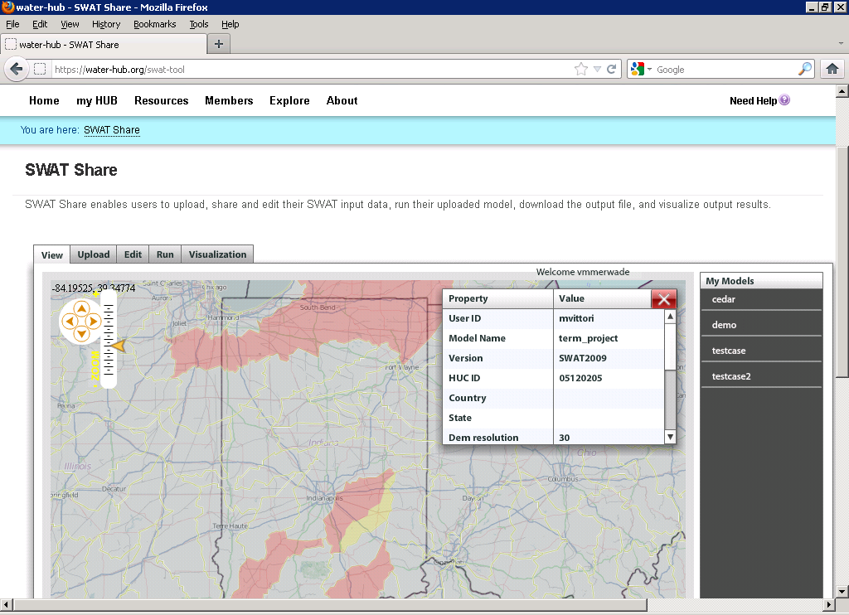
E.g. SWATShare
A web based tool for publishing, sharing, and accessing Soil Water Assessment Tool (SWAT)
www.water-hub.org/swat-tool
Notes:
You need to log-in to use the functions of SWAT share. On this slide, you see a map the watershed in red are the one for which SWAT models are available. Once you click a on one of the watersheds (highlighted in yellow), then you see then you see the associated metadata with the model. If the model is only published (and not shared), one cannot download or run the model. However, if the model is published and shared, any user can download, modify, and run the model on the SWATShare.

Slide 32
Model pre and post processing workflow
Model
Models
Visualization Tools
Analysis Tools
Input Files
Output Files
Resource Repository
Pre-Processing
Post -Processing
Data Loaders
Data Discovery Tools
Resource Repository
Each model interacts with information in the common data store
The modeler does not need to be concerned with and can take advantage of standardized analysis, visualization loading and discovery tools

Slide 33
Architecture and Implementation
Implemented
Web Browser
HydroDesktop
Coming Soon
RESTful Interface
Drupal
GeoAnalytics
Framework
RESTful Interface
E-iRODS
Workflow Structured
Objects
Policy Enforcement
Point
Indexing
Data Grid
Computation

Slide 34
Drupal – Content Management System
Extensible Open Source Content Management Framework for Publication written in PHP
Themed & Styled Presentation of HydroShare Resources with in page visualization
Off the shelf modules provide a Social Experience surrounding Hydrologic Data: Comments, Ratings, Group Behavior
Custom module development supports HydroShare Data Model & GeoAnalytics Integration

Slide 35
HydroShare Summary
A collaborative website for the sharing of hydrologic data and models
To expand data sharing capability of CUAHSI HIS
  Additional data classes
  Models, scripts, tools and workflows
Community Participation
Interoperability
Standards
Open Development

Slide 36

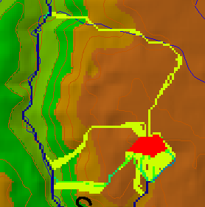
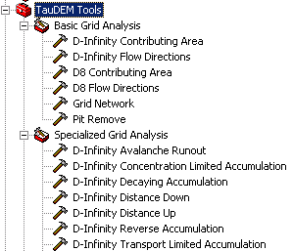

TauDEM
Stream and watershed delineation
Multiple flow direction flow field
Calculation of flow based derivative surfaces
MPI Parallel Implementation for speed up and large problems
Open source platform independent C++ command line executables for each function
Deployed as an ArcGIS Toolbox with python scripts that drive command line executables
CSDMS Cluster Implementation
Evaluating XSEDE implementation
http://hydrology.usu.edu/taudem/

Slide 37




The challenge of increasing Digital Elevation Model (DEM) resolution
1980’s DMA 90 m
10² cells/km²
1990’s USGS DEM 30 m
10³ cells/km²
2000’s NED 10-30 m
10⁴ cells/km²
2010’s LIDAR ~1 m
10⁶ cells/km²

Slide 38
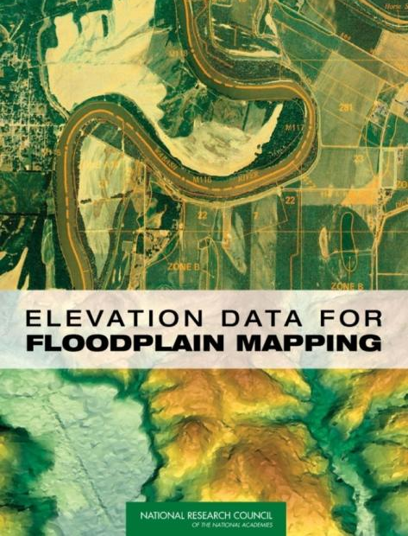
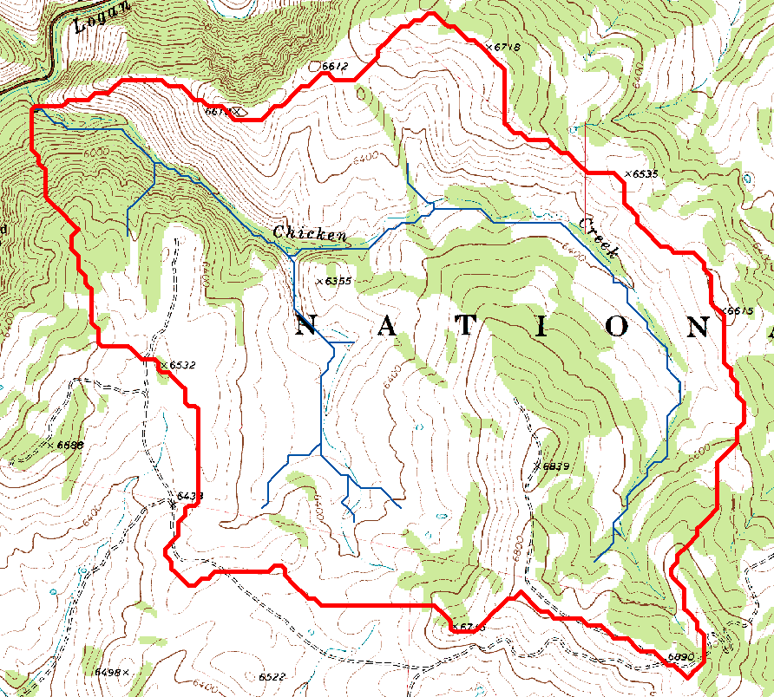
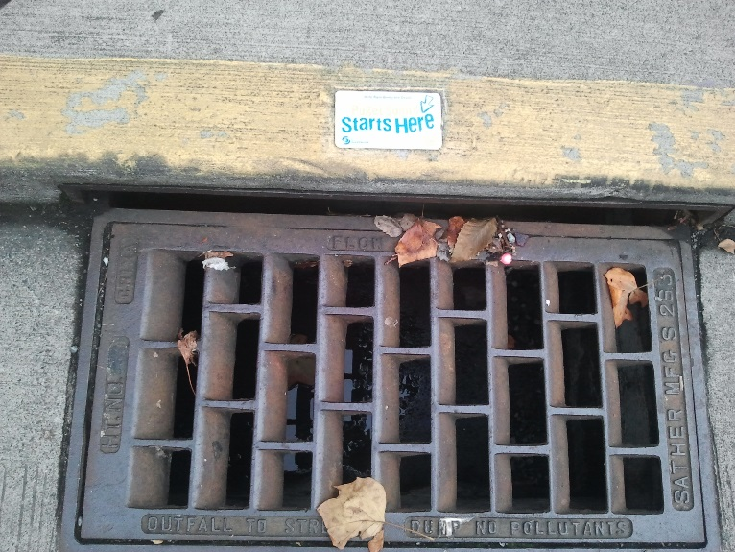
Topography defines watersheds which are fundamentally the most basic hydrologic landscape elements.
http://www.nap.edu/catalog/11829.html
Notes:
Topography defines watersheds which are the most basic hydrologic landscape elements
Almost all hydrologic research requires information about "the watershed". Knowing what is in a watershed, what its attributes are, what is upstream and what is downstream are fundamental to understanding and protecting our water resources
FEMA and other federal and state agencies are spending millions on improved flood plain mapping based on DEMs

Slide 39
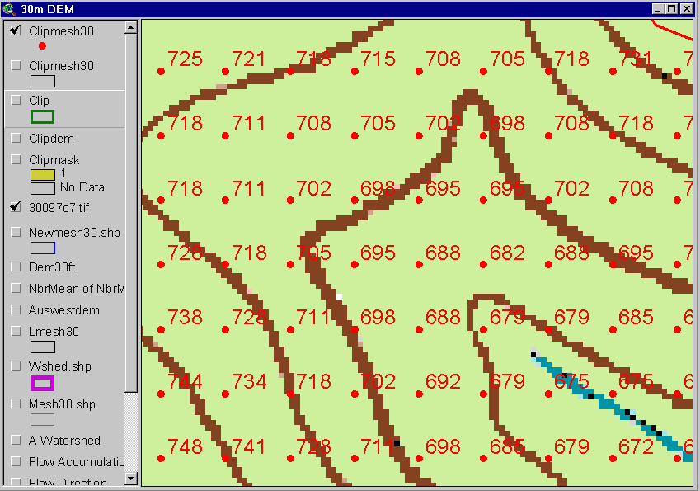
The starting point: A Grid Digital Elevation Model
Contours
740
720
700
680

Slide 40




Deriving Hydrologically Useful Information from Digital Elevation Models
Raw DEM
Pit Removal
Flow Field
Flow Related Terrain Information
Notes:
This slide shows the general model for deriving flow field related derivative surfaces from digital elevation data. The input is a raw digital elevation model, generally elevation values on a grid. This is basic information used to derive further hydrology related spatial fields that enrich the information content of this basic data. The first step is to remove sinks, either by filling, or carving. Then a flow field is defined. This enables the calculation of flow related terrain information. My focus has been on flow related information working within this framework. I try to leave other GIS functionality, like radiation exposure, line of sight analyses and visualization to others. I have distributed my software in ways that it easily plugs in to mainstream systems, such as ArcGIS to enhance ease of use.

Slide 41
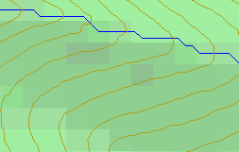
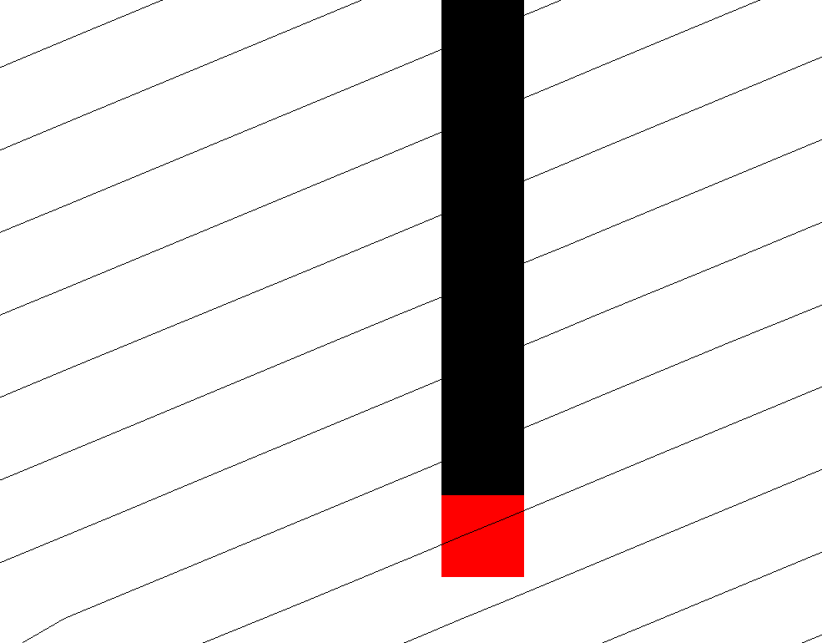
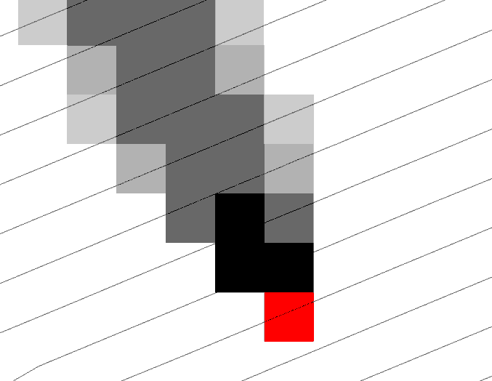
Representation of Flow Field
Steepest single direction
48
52
56
67
D8
D∞
Tarboton, D. G., (1997), "A New Method for the Determination of Flow Directions and Contributing Areas in Grid Digital Elevation Models," Water Resources Research, 33(2): 309-319.)
Notes:
This slide shows how the terrain flow field is represented. Early DEM work used a single flow direction model, D8. In 1997 I published the Dinfinity method that proportions flow from each grid cell among downslope neighbors. This, at the expense of some dispersion, allows a better approximation of flow across surfaces.

Slide 42
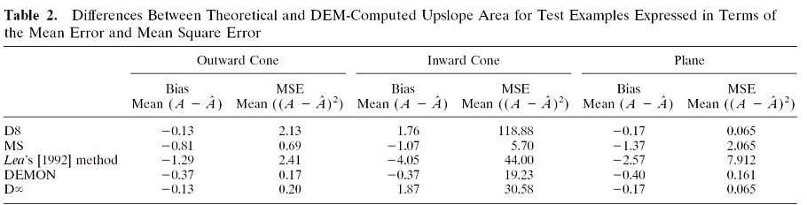
Contributing Area
D∞
D8
<1 ha
1-4 ha
4-8 ha
>8 ha

Slide 43
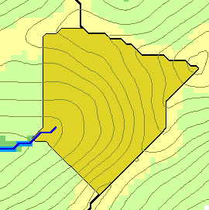
Flow Accumulation
w(x)
x

Slide 44
Generalization to Flow Algebra
Replace
P_{ki}
P_{ki}
P_{ki}
i
by general function

Slide 45
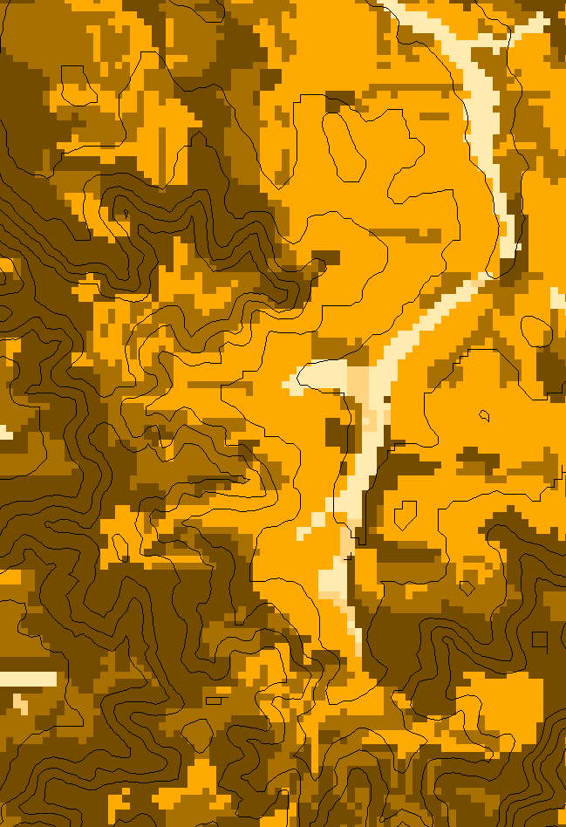
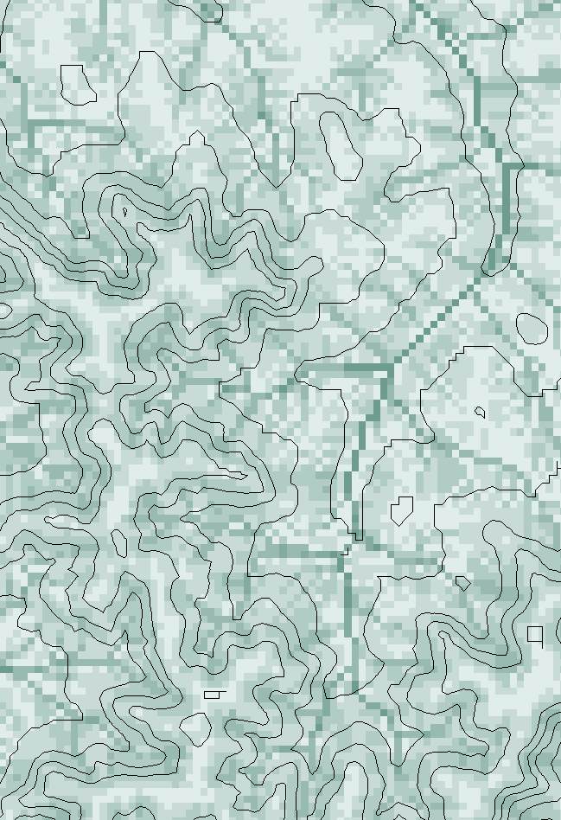
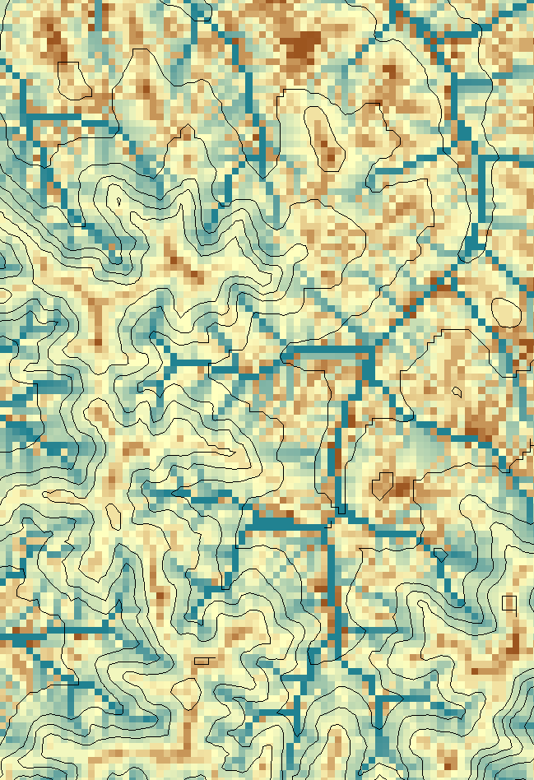
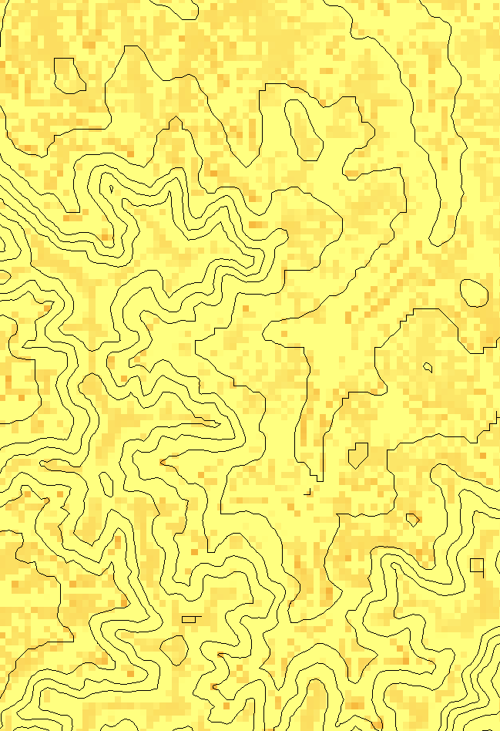
E.g. Transport limited accumulation
Supply
Capacity
Transport
Deposition
S
T
=
χa
2
tan(
b
)
2
T
=
min{
S
+
∑
T
,
T
}
D
=
S
+
∑
T
−
T
cap
out
in
cap
in
out
Useful for modeling erosion and sediment delivery, the spatial dependence of sediment delivery ratio and contaminant that adheres to sediment
Flow Algebra provides a general modeling framework for static flow field based geospatial concepts

Slide 46

TauDEM Parallel Approach
MPI, distributed memory paradigm
Row oriented slices
Each process includes one buffer row on either side
Each process does not change buffer row

Slide 47
Parallelization of Flow Algebra
1. Dependency grid
2. Flow algebra function
Executed by every process with grid flow field P, grid dependencies D initialized to 0 and an empty queue Q. FindDependencies(P,Q,D) for all i for all k neighbors of i if P_{ki}>0 D(i)=D(i)+1 if D(i)=0 add i to Q next
Executed by every process with D and Q initialized from FindDependencies. FlowAlgebra(P,Q,D,θ,γ) while Q isn’t empty get i from Q θ_{i} = FA(γ_{i}, P_{ki}, θ_{k}, γ_{k}) for each downslope neighbor n of i if P_{in}>0 D(n)=D(n)-1 if D(n)=0 add n to Q next n end while swap process buffers and repeat

Slide 48

Workflow to automatically generate stream network upstream of outlet

Slide 49


Catchments linked to Stream Network

Slide 50
Improved runtime efficiency
Parallel Pit Remove timing for NEDB test dataset (14849 x 27174 cells ≈ 1.6 GB).
8 processor PC
Dual quad-core Xeon E5405 2.0GHz PC with 16GB RAM
128 processor cluster
16 diskless Dell SC1435 compute nodes, each with 2.0GHz dual quad-core AMD Opteron 2350 processors with 8GB RAM

Slide 51
Scaling of run times to large grids
Owl is an 8 core PC (Dual quad-core Xeon E5405 2.0GHz) with 16GB RAM
Rex is a 128 core cluster of 16 diskless Dell SC1435 compute nodes, each with 2.0GHz dual quad-core AMD Opteron 2350 processors with 8GB RAM
VPC is a virtual PC resourced with 48 GB RAM and 4 Intel Xeon E5450 3 GHz processors

Slide 52

Capabilities Summary
Capability to run larger problems
 |  | Processors used | Grid size
 |  |  | Theoretcal limit | Largest run
2008 | TauDEM 4 | 1 | 0.22 GB | 0.22 GB
Sept 2009 | Partial implement-ation | 8 | 4 GB | 1.6 GB
June 2010 | TauDEM 5 | 8 | 4 GB | 4 GB
Sept 2010 | Multifile on 48 GB RAM PC | 4 | Hardware limits | 6 GB
Sept 2010 | Multifile on cluster with 128 GB RAM | 128 | Hardware limits | 11 GB
11 GB
6 GB
4 GB
1.6 GB
0.22 GB
Single file size limit 4GB
At 10 m grid cell size

Slide 53


XSEDE Extended Collaboration Support Services (ECSS) improvements
Reconfiguration of multiple file header reads to be broadcast from single node
Reconfiguration of output files to avoid spanning processors
Before
After

Slide 54

Open Topography
Teton Conservation District, Wyoming LIDAR Example

Slide 55

DEM derived from point cloud using TIN DEM Generation and output as GeoTIFF

Slide 56



Contributing area from D-Infinity
Notes:
Note the detail in the representation of flow paths at features such as roads

Slide 57

Contributing area from D-Infinity
Notes:
Note the detail in the representation of flow paths at features such as roads

Slide 58
TauDEM Summary
Parallelization speeds up processing and partitioned processing reduces size limitations
Parallel logic developed for general recursive flow accumulation methodology (flow algebra)
Documented ArcGIS Toolbox Graphical User Interface
32 and 64 bit versions (but 32 bit version limited by inherent 32 bit operating system memory limitations)
PC, Mac and Linux/Unix capability
Capability to process large grids efficiently increased from 0.22 GB upper limit pre-project to where < 4GB grids can be processed in the ArcGIS Toolbox version on a PC within a day and up to 11 GB has been processed on a distributed cluster (a 50 fold size increase)

Slide 59




Representing River Geometry in HydroShare
LiDAR
Cross Sections Attached to River Network
Cross Sections
Hydraulic Calculations

Slide 60

Modular design, linking river geometry, catchment geometry, network topology, and time series observations
  Data is linked by common reference points along the river, which can be represented as point or cross section shapefiles and shown on a map.
  Based on OGC HY_Features Model

Slide 61

Summary and Conclusions
CUAHSI HIS
  Enhanced Access to Hydrologic Data
  Combining information from multiple sources
HydroShare
  A collaborative website for the sharing of hydrologic data and models
  To expand data sharing capability of CUAHSI HIS
    Additional data classes
    Models, scripts, tools and workflows
TauDEM
  Parallel implementation of general watershed delineation tools
  Opportunities for server based cloud execution (as part of HydroShare, CyberGIS?)
River Geometry (RiverML)
  An XML based language to encode the elements of river geometry as a basis for storage, sharing and modeling with this data
To boldly go where no one has gone before

Slide 62

Thanks to a lot of people
  USU
  RENCI/UNC
  CUAHSI
  BYU
  Tufts
  USC
  Texas
  Purdue
  SDSC
HydroShare team: Ray Idaszak, Dan Ames, Jeff Horsburgh, Jon Goodall, Larry Band, Venkatesh Merwade, Carol Song, Alva Couch, David Valentine, Rick Hooper, Jennifer Arrigo, David Maidment, Tim Whiteaker, Alex Bedig, Jason Coposky, Pabitra Dash, Tian Gan, Karl Gustafson, Taehee Hwang, Stephen Jackson, Harry Johnson, Yuri Kim, Phyllis Mbewe, Brian Miles, Jon Pollak, Stephanie Reeder, Terrell Russell, Tom Whitenack, Ilya Zaslavsky, Lan Zhao
http://www.cuahsi.org/hydroshare.aspx
OCI-1148453
OCI-1148090
Notes:
The HydroShare project is part of a broad effort in CUAHSI in the area of Hydrologic Information Systems. We have a team of developers and domain scientists from eight universities working on HydroShare. This is part of the even broader focus in NSF on data management, Cyberinfrastructure and sustainable software.

Slide 63
Are there any questions ?
AREA 2
3
AREA 1
12

