Slide 1
Integrated Water Planning … at a University … in a State … in the Future.
Jump in! Get your feet wet! Make a splash!
Together we can make a difference

Slide 2
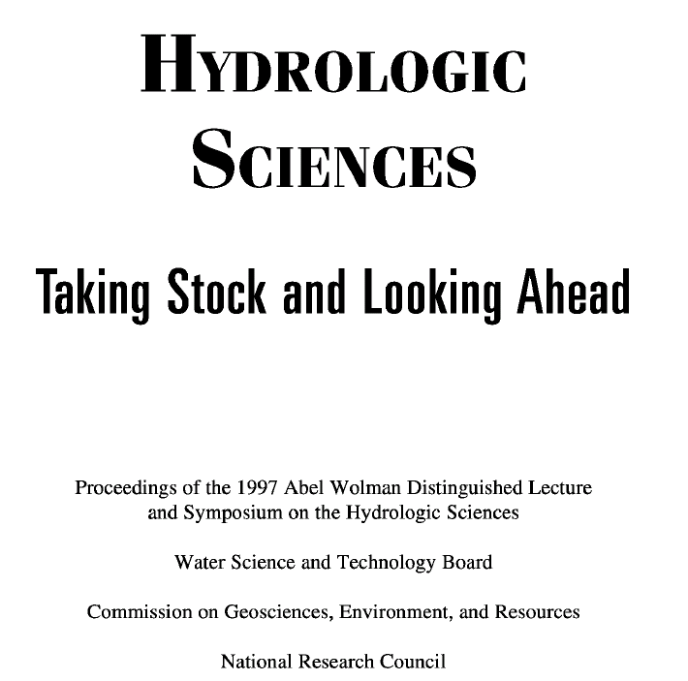
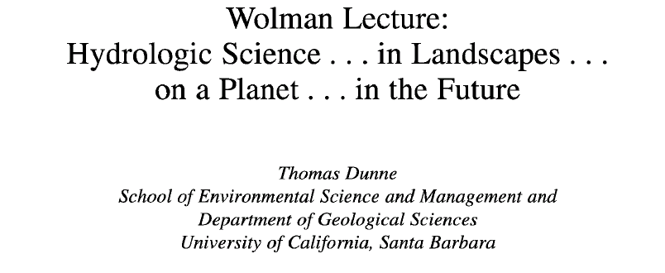

Slide 3
Utah State University Departments and Programs that contribute to the Interdisciplinary Water Sciences
Plants, Soils, and Biometeorology (PSB)
Geology
Civil and Environmental Engineering (CEE)
Utah Water Research Laboratory (UWRL)
Aquatic, Watershed, and Earth Resources (AWER)
Physical
Economics
Biological and Irrigation Engineering (BIE)
Environment and Society (ENVS)
Biological
Social
Water Dynamics Laboratory
Biology
Landscape Architecture and Environmental Planning (LAEP)
Natural Resource and Environmental Policy Program (NREPP)
Sociology, Social Work and Anthropology (SSWA)
Ecology Center (EC)
Notes:
The purpose of the Utah State University Water Initiative is to foster collaboration and interdisciplinary work across the multiple colleges and departments involved with Water Sciences at Utah State University. Water sciences span a broad range of programs at USU. The challenge that the USU Water Initiative seeks to address is to integrate and synthesize water-related science and engineering activities to focus education, research and outreach programs to meet the growing demands for integrated expertise. Regionally, the USU Water Initiative aims to focus the intellectual leadership of the university academic community on integrated water planning that is critical for society in the Intermountain West.

Slide 4
Utah State University Water Initiative Task Force
David G. Tarboton
Michelle A. Baker
David Chandler
Christopher A. Conte
Joanna Endter-Wada
Christopher Fawson
Terry F. Glover
Thomas B. Hardy
Paul M. Jakus
Scott B. Jones
Richard T. Koenig
Thomas E. Lachmar
Chris Luecke
Mac McKee
Nancy Mesner
Richard C. Peralta
Pamela J. Riley
John C. Schmidt
David K. Stevens
Wynn R. Walker

Slide 5
The Charge
Recommend ways to strengthen water programs at USU that take advantage of the existing diversity and breadth of faculty expertise in water-related issues in order to restore Utah State University to a position of prominence in the study of water.
  take stock of how USU performs relative to comparable peer institutions;
  address how USU should more appropriately fund and organize efforts in water-related programs;
  examine whether there is value in cross-disciplinary efforts in water-related programs;
  provide specific step-by-step recommendations as to how to strengthen water programs at USU as they involve graduate students, policy and research.

Slide 6
Process
Round table meetings in Salt Lake City with Utah Water Community
Meetings and interviews with campus visitors from agencies and Peer Institutions
On campus round table meetings
Task Force deliberation and debate

Slide 7
National and Worldwide Context
"We cannot build the necessary scientific understanding of hydrology at the global scale from the traditional research and education programs that have been designed to serve the pragmatic needs of the engineering community" National Research Council (1991)
National Research Council Committee on Opportunities in the Hydrologic Sciences (COHS), (1991), Opportunities in the Hydrologic Sciences, Editor, P. S. Eagleson, National Academy Press, Washington, D.C.

Slide 8
The Challenge
The challenge before USU as an academic institution is that it must integrate and synthesize water-related science and engineering activities across campus to focus its education, research, applied, and extension programs to meet the critical demand for integrated expertise.
The University should provide an environment for honest intellectual debate on all sides of water issues and provide intellectual leadership on water science in the state, the western U.S. region, nation, and world.

Slide 9
Findings Summary
Need for planning to address population growth related water needs
Deep rooted enthusiasm for interdisciplinary effort at USU
USU needs some form of overarching organizational entity to front and coordinate water activity

Slide 10
Specific Actions that are needed
Coordinated Synthesis and Integration Activities
Interdisciplinary Graduate Program in Integrative Water Sciences
Experimental Watershed Initiative

Slide 11
Organizational Models
Graduate School of Water Science and Management
Water Department
Water Center
Decentralized Coordinating Committee or Council

Slide 12
Recommendation
Establish a center whose mission is twofold
  to implement the specific actions
    and
  start the process of evolving and working towards the establishment of a School for Water Sciences and Management as an ultimate goal.

Slide 13
USU Water Initiative Action Plan
2003/2004
Seminar Series $ 23,000
First Annual Conference $ 20,000
Laboratory Watershed $ 97,000
Interdisciplinary Research Initiation $ 20,000
Interdisciplinary Graduate Program $ 15,000
Coordination and Administration $ 52,000
  $227,000

Slide 14
Other Speakers to be announced, and in Spring Semester
John Priscu, Montana State University, Antarctic research in biogeochemistry
Matt Kondolf, University of California - Berkeley, Stream Restoration
Jeff Chanton, Florida State University, Chemical cycling of major elements in the coastal zone and in wetlands

Slide 15
First Annual Conference
  Initiate an annual conference to be held at USU each spring, tentatively entitled "Spring Runoff Conference."
  The purposes of this conference will be to:
  1) provide a forum for students, faculty and the Utah Water Community to share current research in an on-campus venue.
  2) invite stakeholders in the management and development of water resources in the region, and especially in the Bear River Basin, to an open forum on the societal and technical needs that should be addressed by the USU Water Initiative.
  3) stimulate the development of interdisciplinary research on water-related issues in Utah.
  A possible theme for the first conference is: "Managing Utah's Water Resources in the Face of Drought and Growing Demand". Speakers would include faculty, students and regional agency representatives.

Slide 16
Laboratory Watershed
GSL Basin/Bear River Watershed
Broad physical setting (Snow melt water supply, climate variability vulnerability, Alpine to semi-arid, surface ground water interaction)
Development issues (local growth, SLC metropolitan area demands)
Policy Issues (3 states)
Agricultural issues (water supply, environmental compliance)
Environmental Issues (water quality, watershed management practices)
Ecological issues (Bird Refuge, GSL ecosystem)
A microcosm for many "western" water issues
CUAHSI "Hydrologic Observatory" and HELP opportunity

Slide 17
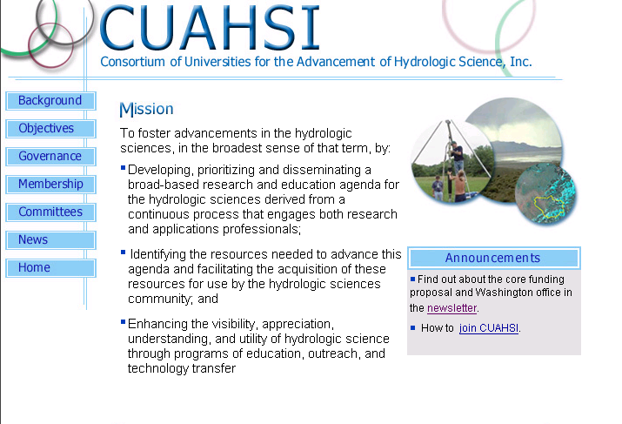
Interdisciplinary Research Opportunities
www.cuahsi.org

Slide 18
Consortium of Universities for the Advancement of Hydrologic Science (CUAHSI)
Hydrologic Observatories, Hydrologic Synthesis, Measurement Technology, and Hydrologic Information Systems
USU is a charter member of CUAHSI, and expertise exists at USU to host these opportunities, but to be competitive, we must be an established, unified front
www.cuahsi.org

Slide 19
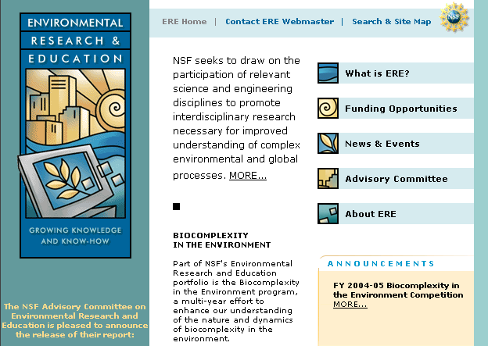
National Science Foundation – Biocomplexity in the Environment
http://www.nsf.gov/geo/ere/ereweb/index.cfm

Slide 20
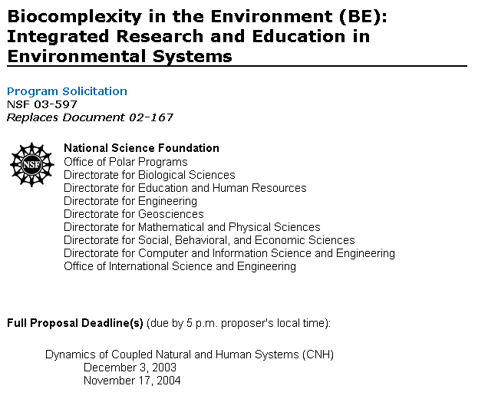
http://www.nsf.gov/pubs/2003/nsf03597/nsf03597.htm

Slide 21
Background on Emerging Issues from minutes of NSF Advisory Committee for Environmental Research and Education (AC-ERE)
April 16-17, 2003
http://www.nsf.gov/geo/ere/ereweb/meetingminutes/ac-ere_april_2003_minutes.doc
Inventory of NSF Programs on Water
NSF spends about $140 million per year on water research and new instrumentation. Topic areas that NSF is funding include aquatic ecosystems, water cycle, water quality management, the nature of water, manpower and infrastructure, and water facility engineering.
Nicholas Clesari, NSF, said that emerging issues in water resources research concern maintaining and improving water quality and in building new tools for large-scale water resource investigation, including a major infrastructure investment. The challenge is linking information about the fundamental properties of water. This requires large-data sets and appropriate systems to integrate the data. Currently, there are gaps in the collection of data to support the research. New strategies are needed for data collection in the field; new and improved instruments are needed for data acquisition, and effective data analysis is required.
NFS’s interest should include hydrological, geological, and biological issues of water and not just engineering
Plan for Identifying Priorities and Developing a Synthesis White Paper on “Water as a Complex Environmental System” Dr. Skole introduced “Water as a Complex Environmental System” as a possible initiative for the AC-ERE, since it is not included in NSF’s current water research.

Slide 22
National Science Foundation – Freshwater Initiative.
  Significant increases in research $ to be made available.
  Emerging issues: waters as biogeochemical hotspots, scaling, hydrogeomorphic landscape, global change, emerging technology.
  Success in attracting federal resources to address these challenges necessitates explicit integration of faculty expertise.

Slide 23
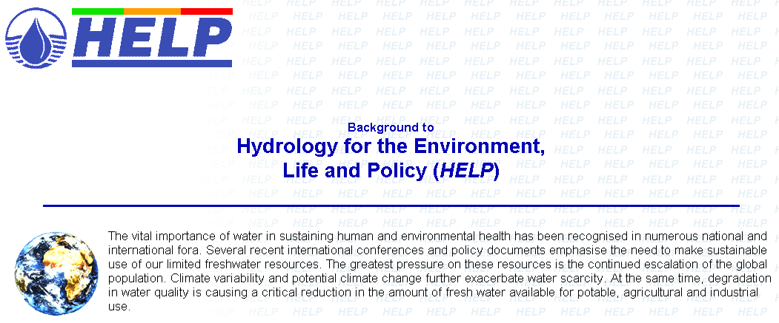
http://www.nwl.ac.uk/ih/help/index.html
UNESCO HELP. Address the policy and management issues that are most critical to water users in several drainage basins around the world through field-oriented watershed research to exploit advances in hydrologic and ecologic science within the societal context. USU needs an experimental watershed to be competitive.

Slide 24

http://www.inra.org/
INRA. a consortium of eight regional universities, funded by the US Department of Energy in collaboration with the Idaho National Engineering and Environmental Laboratory.
New INRA focus on water resources and drought.

Slide 25
Multi-Institutional Interdisciplinary Research and Education Program to
Understand and Manage Water Shortages—INRA White Paper July 2003
Summary
Water shortages destabilize economies and ecosystems. Water shortages are caused by complex interactions between climate variability, ecosystem processes, and increased demand from human activities. In the semi-arid region of the northwestern U.S., water availability during drought periods has already reached crisis levels. Many of the problems are critical to this region because hydropower, agriculture, navigation, fish and wildlife survival, water supply, tourism, environmental protection, and water-based recreation are vital to state economies and our way of life. Droughts that trigger drastic measures such as water rationing affect all of these uses, with significant impacts on State and regional economies.
We propose an Inland Northwest
Research Alliance (INRA) water
resources research initiative to
improve our ability to respond to
climate variability and improve our
ability to manage water resources
during the recurring drought cycles
that magnify water shortages within
our region.

Slide 26
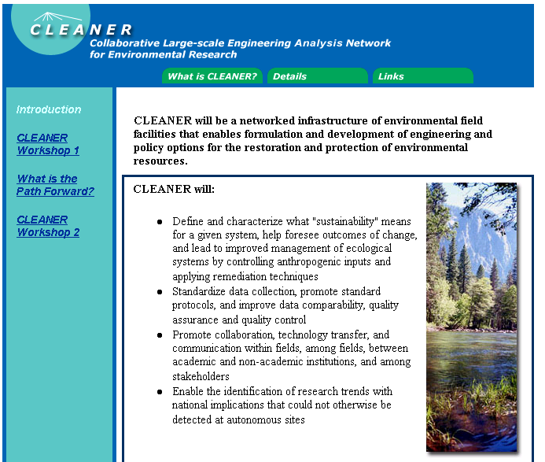
http://cleaner.ce.berkeley.edu/intro.php

Slide 27
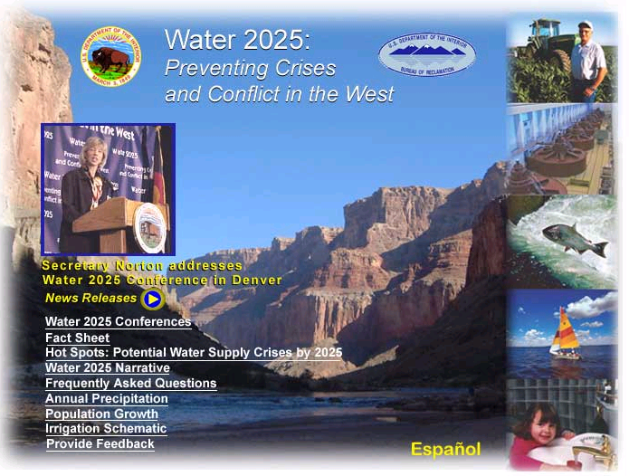
http://www.doi.gov/water2025/

Slide 28
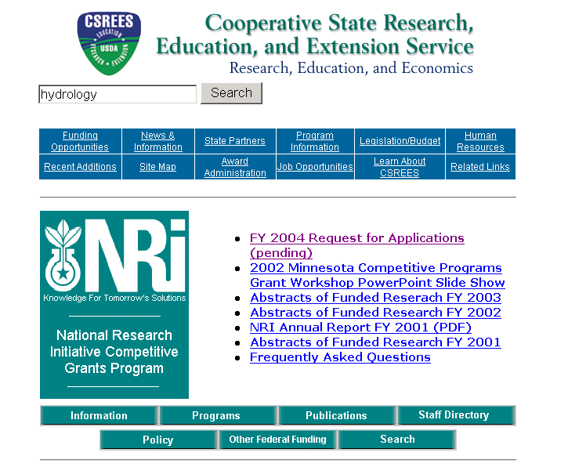
http://www.reeusda.gov/nri/

Slide 29
CRSP USAID. Supports collaborative research in developing countries so that they can solve problems of agricultural production and utilization over the long term.
NASA
NOAA
EPA
USGS
USDA NRI
…

Slide 30
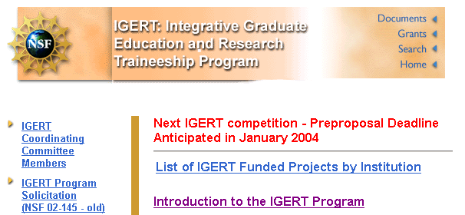
National Science Foundation – IGERT.
IGERT is NSF's flagship for graduate education. The ultimate goal is to graduate PhDs with experiences that both span boundaries and dig deeply in several areas. Integration and focus of interdisciplinary research efforts is required to be competitive.

Slide 31
Graduate Program in Integrative Water Sciences
Three research integration courses designed to engage students in interdisciplinary research involving problem based learning, proposal preparation, and contribution to an interdisciplinary original research paper.
A set of common foundation courses that cover the basic sciences, management and decision-making skills.
A three month agency, industry, or non-profit organization internship, nationally or abroad, for all students.
Service as teaching assistants for classes outside of students’ disciplines.

Slide 32
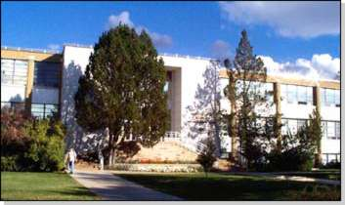
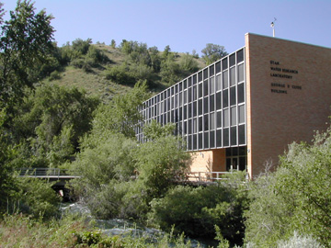
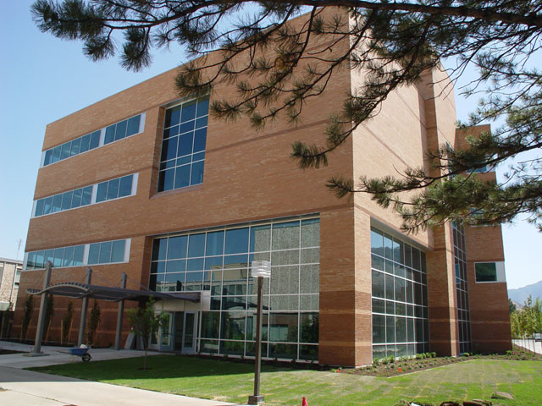
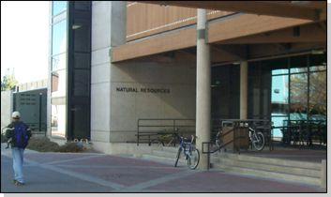
Utah State University
Water Initiative
Administration
Coordination
Organization

Slide 33
USU Water Initiative University Advisory Committee
on-campus committee to provide high level direction, advice and guidance on the activities and governance of the water initiative
meet monthly, provide overall policy oversight
responsible for overseeing the interdisciplinary research initiation
establish guidelines for the awarding of, and administer funds used for research initiation faculty support and, graduate fellowship funds.

Slide 34
Water Initiative External Advisory Board
6 to 15 people regional and national water community leaders selected to provide advice from an outside perspective.
provide guidance on national and regional water issues that should receive the attention and focus of the Water Initiative research and education programs.
meet once a year.

Slide 35
Seminar Committee
Charged with conducting the Water Initiative seminar series, scheduling, inviting and hosting speakers.
  Jack Schmidt,
  David Chandler
  Rick Krannich
  Luis Bastidas
  Phaedra Budy
  Keith Criddle
  Mac McKee
  Blake Tullis
  Jagath Kaluarachchi

Slide 36
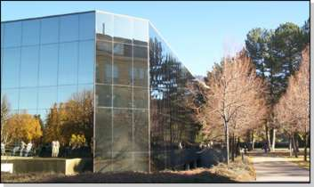
Annual Conference Committee
Charged with organizing and hosting the annual conference.

Slide 37
Laboratory Watershed design team.
Charged with developing the Laboratory Watershed design consistent with CUAHSI hydrologic observatory concept and writing and submitting proposals for establishing this Laboratory Watershed.

Slide 38
Interdisciplinary graduate program committee
Charged with developing the research integration course (outlined in the 2002 IGERT proposal) and getting necessary university approval and making plans for this course to be offered commencing Fall 2004.
Reviewing the entire curriculum of Water Sciences courses at USU and recommending ways to better coordinate offerings, articulate content and make the overall curriculum better and more consistent in support of the eventual goal of an interdisciplinary graduate program in integrative water sciences.

Slide 39
Questions?
AREA 2
3
AREA 1
12

