Slide 1


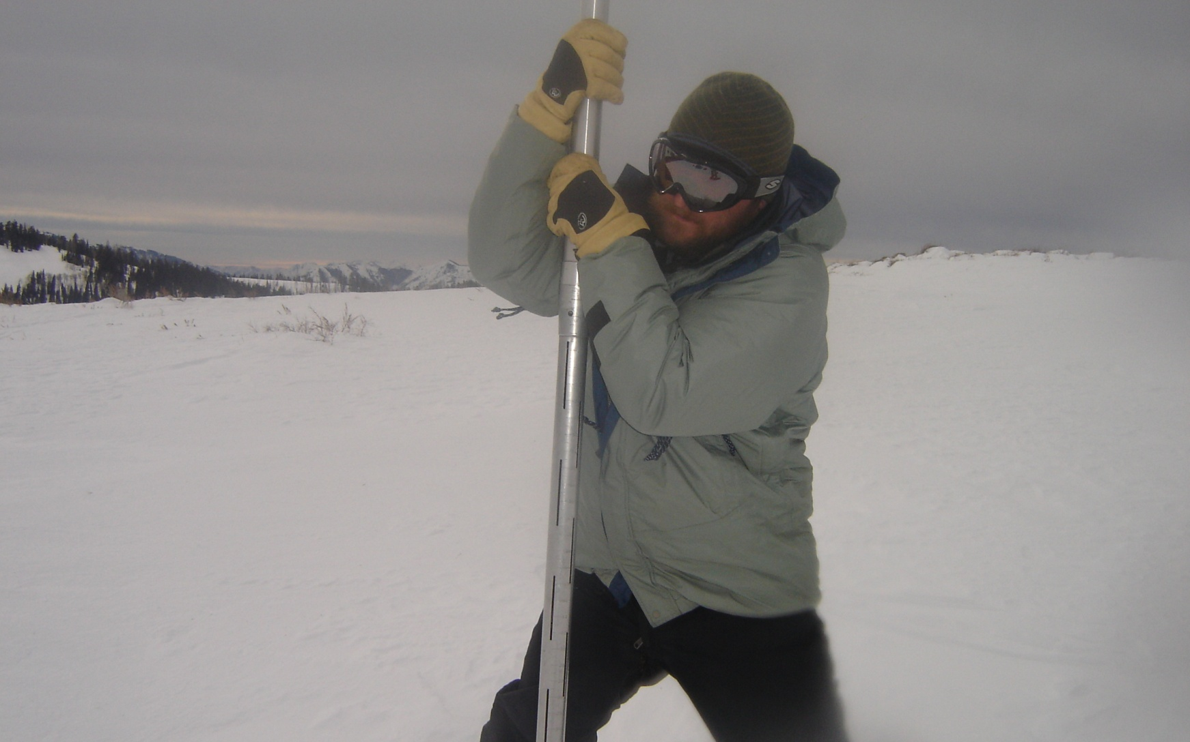
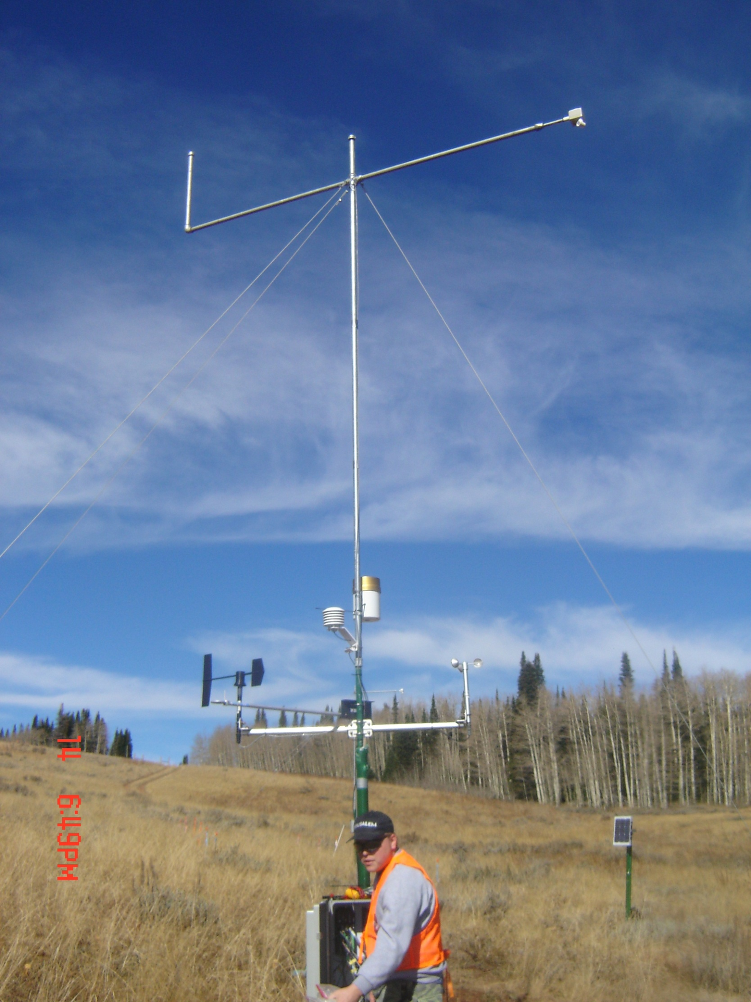
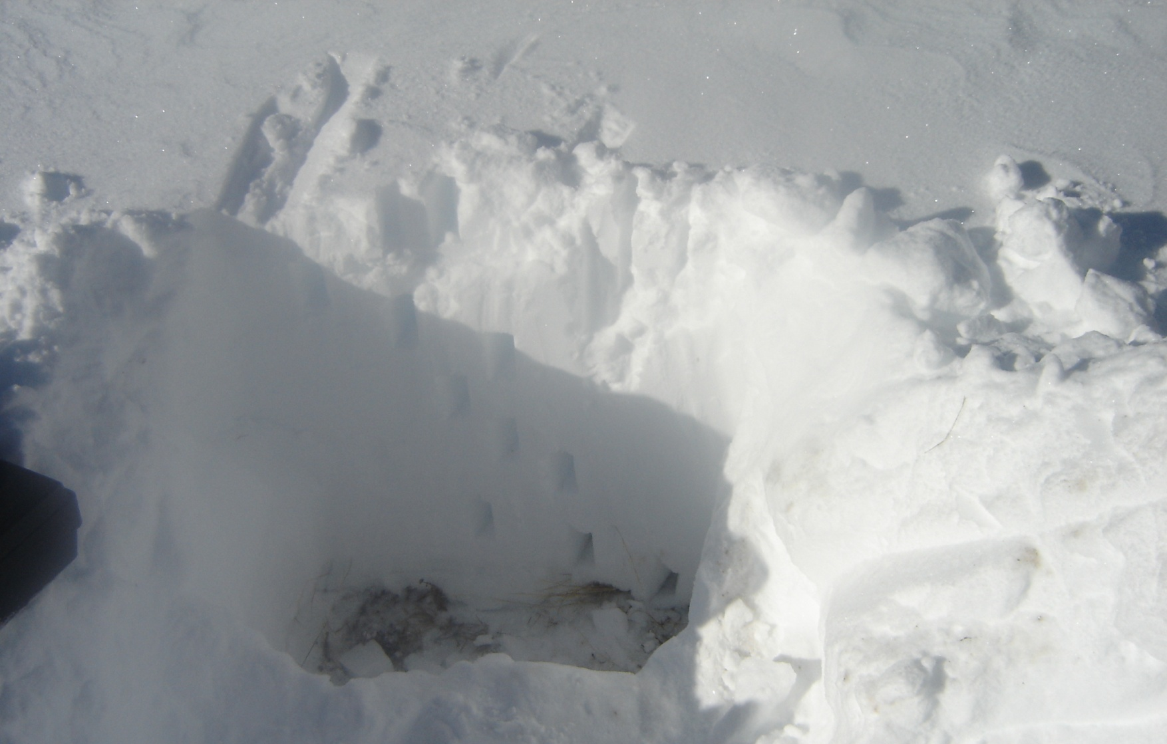
Modeling the Effect of Vegetation on the Accumulation and Melting of Snow
Vinod Mahat, David G. Tarboton
Department of Civil and Environmental Engineering, Utah State University, Logan, Utah
Abstract number: Pst-1
Contact: vinod.mahat@aggiemail.usu.edu
MOTIVATION
MODEL ENHANCEMENTS
RESULTS
Snow melt is an important component of western US water resources
Climate change is weakening the statistical basis for river forecasts that use empirical relationships, making it important to understand and be able to model snow melt from a physical basis
Our goal here is to improve the representation of vegetation in snow melt models and to thereby better quantify the impact of vegetation on the timing and partitioning of snow between melt and sublimation
Snow interception and unloading.
Transmission of radiation through the canopy.
Turbulent transport of heat and water vapor between the snow on the ground, in the canopy and the atmosphere above.
State Variables
Water equivalent of intercepted snow in the canopy, W_{c} (m)
Water equivalent of snow on the ground beneath the canopy, W_{s} (m)
Energy content of snow on the ground beneath the canopy, U_{s} (kJ m⁻²)
Mass and Energy Balance
SWE: Direct Observation
STUDY SITE
Net Radiation : Observed vs Modeled
Kj m⁻² day⁻¹
Open
Deciduous
Coniferous
Kj m⁻² day⁻¹
Assume zero energy storage in canopy
Kj m⁻² day⁻¹
Solar radiation
  Net solar radiation at canopy surface (Q_{snc})
  Net solar radiation on snow surface on ground (Q_{sns})
SWE: Observed vs Modeled
Deciduous
Coniferous
Open
MEASUREMENT DESIGN
Longwave radiation
  Net longwave radiation at canopy surface (Q_{lnc})
  Net longwave radiation on snow surface on ground (Q_{lns})
Continuous measurements of snow depth (Judd communications depth sensor) at each of the twelve stations.
Continuous measurements of weather: temperature (Vaisala HMP50); wind (Met One, 014A); net radiation, (Kipp & Zonin NR-Lite); humidity, (Vaisala HMP50) at one station in each vegetation class.
Four separate radiation components: downward and upward shortwave and long wave (Hukseflux, NR01 4-way radiometer) and snow surface temperature (Apogee Instrument, IRR-PN) at the centralized weather station with.
Precipitation at adjacent SNOTEL site.
Field surveys of snow depth (probe) and water equivalent (pit) during periodic visits
SWE: Across Different Vegetation
Turbulent fluxes
  Sensible heat flux(Q_{hc} ) and latent heat flux (Q_{ec} ) exchange between canopy and air around
  Sensible heat flux (Q_{hs} ) and latent heat flux (Q_{es} ) exchange between snow on ground and air above
CONCLUSIONS
Open (grass /sage) area accumulates 10 -20 % more snow than forested areas.
Higher rate of accumulation and ablation was found in aspen than in conifer.
The enhanced model is able to predict the snow accumulation, melt and sublimation in open(grass/sage) and forested (evergreen/deciduous) areas.
Interception, Unloading and Melt From the Canopy
  Interception rate
  The mass unloading (Hedstrom and Pomeroy, 1998)
  Melt water drip from the canopy
REFERENCES
Choudhury, B. J., and Monteith, J. L. (1988). "A four-layer model for the heat budget of homogeneous land surface." Quarterly Journal of the Royal Meteorological Society, 114(1988), 373-398.
Hedstrom, N. R., and Pomeroy, J. W. (1998). "Measurements and modeling of snow interception in the boreal forest." Hydrological Processes, 12(10-11), 1611-1625.
Nijssen, B., and Lettenmaier, D. P. (1999). "A simplified approach for predicting shortwave radiation transfer through boreal forest canopies." Journal of Geophysical Research, 104(D22), 27859-27868
Tarboton, D. G., and Luce, C. H. (1996). "Utah Energy Balance Snow Accumulation and Melt Model (UEB)." Computer model technical description and users guide, Utah Water Research Laboratory and USDA Forest Service Intermountain Research Station (http://www.engineering.usu.edu/dtarb/).
This research was supported by the USDA-CREES Utah drought management project award number 2008-34552-19042.

