Slide 1
Hydrology
A science dealing with the properties, distribution and circulation of water.
David Tarboton
http://www.engineering.usu.edu/dtarb/
dtarb@cc.usu.edu

Slide 2
Context for Hydrologic Science
Basic Sciences
Mathematics
Statistics
Physics
Chemistry
Biology
Geosciences
Geology
Soil Science
Atmospheric Science
Ocean Science
Glaciology
Geochemistry
Economics
Law
Sociology
Political Science
Engineering Hydrology
Agriculture
Forestry
Fluid Mechanics
Hydraulic Engineering
Meteorology
Hydrologic Science
Water Resources Management

Slide 3
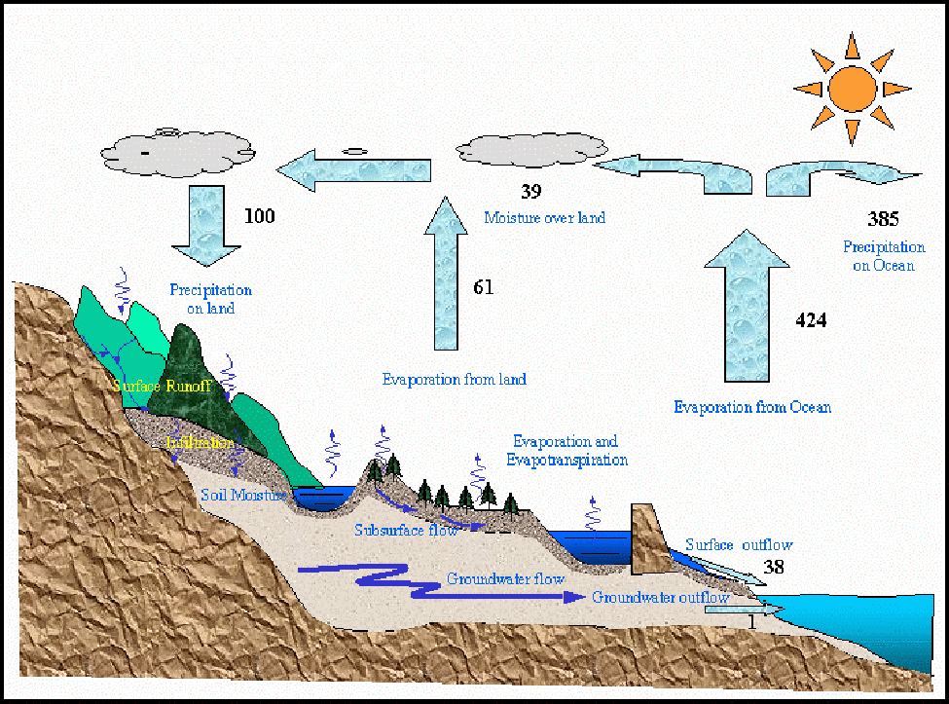
The Hydrologic Cycle

Slide 4
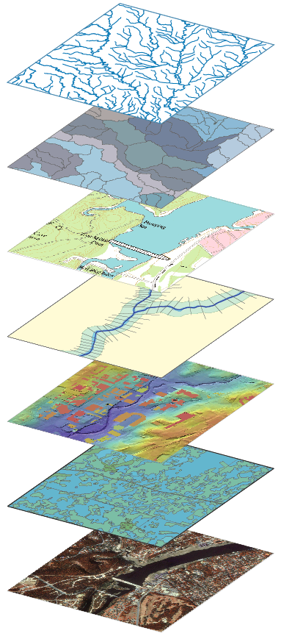
Hydrology Data Layers
Streams
Drainage Areas
Hydrography
Channels
Terrain Surfaces
Rainfall
Digital orthophotos

Slide 5
Water Balance
Atmospheric Water
Soil Water
Surface Water
Groundwater
Change of Storage
= Inflow - Outflow

Slide 6
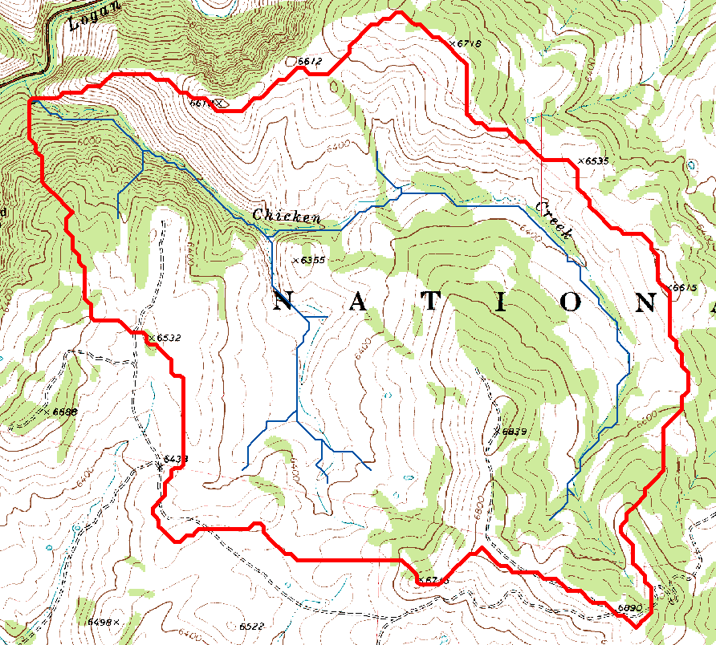
Watershed delineated on a topographic map

Slide 7
Drainage area can be concentrated or dispersed (specific catchment area) representing concentrated or dispersed flow.

Slide 8
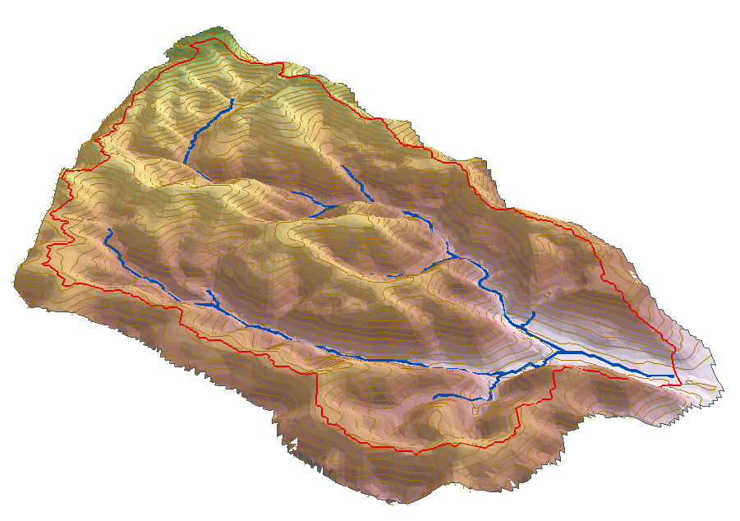
Watershed water balance
P
ET
G_{in}
Q
S
G_{out}

Slide 9
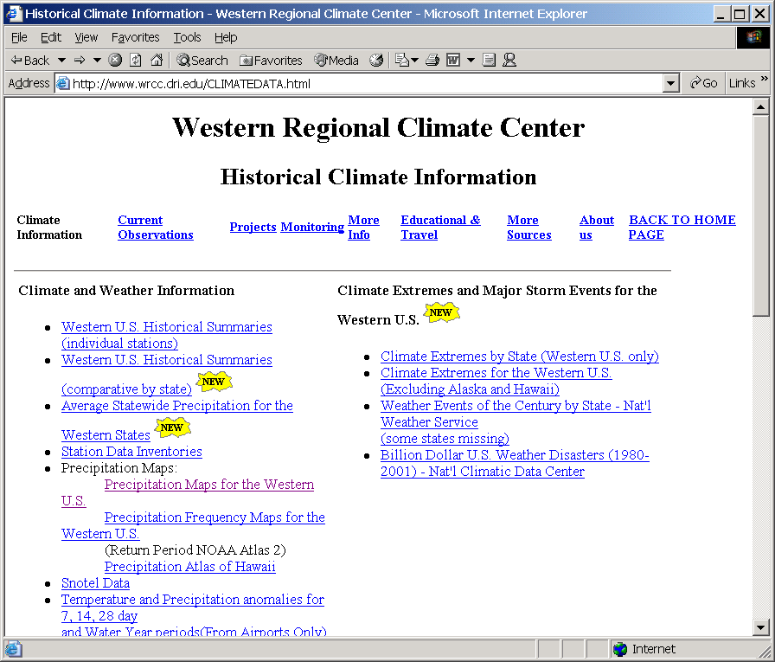

Slide 10
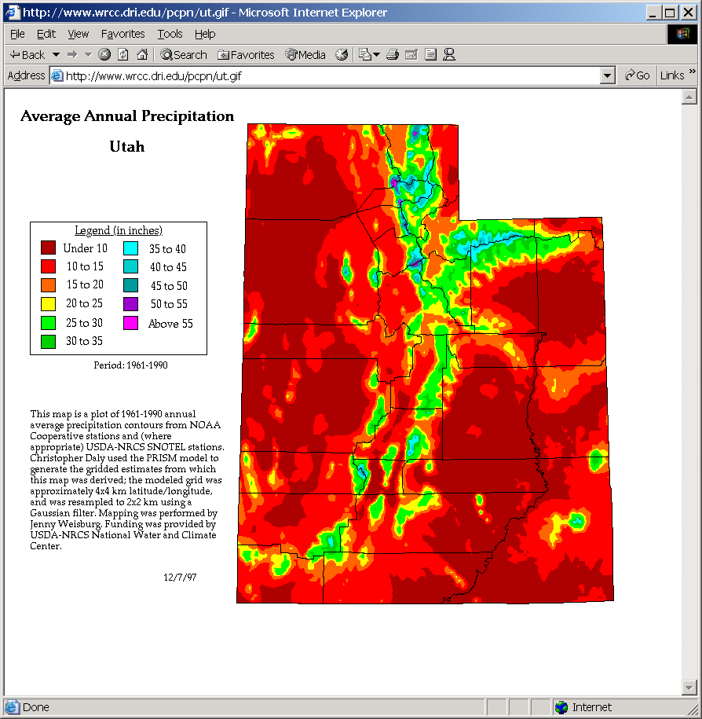

Slide 11
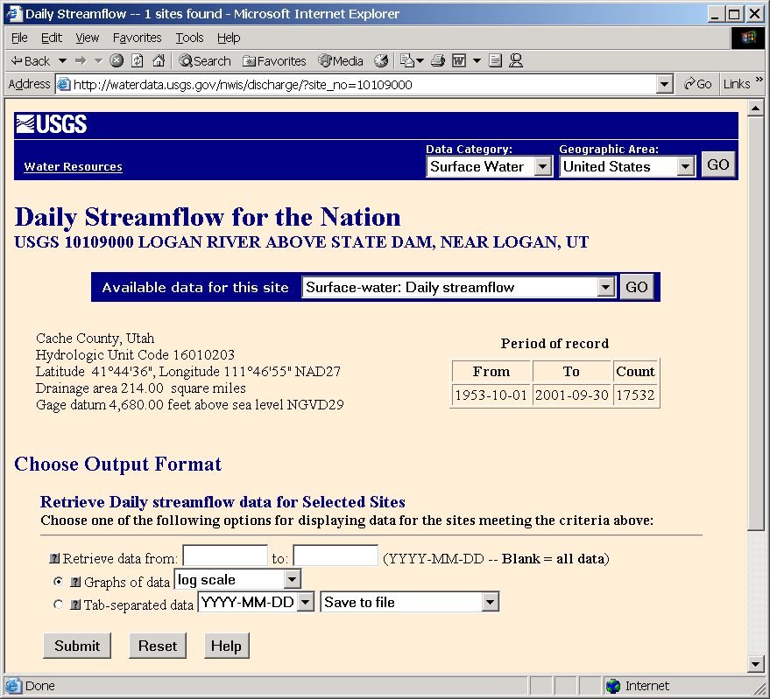

Slide 12
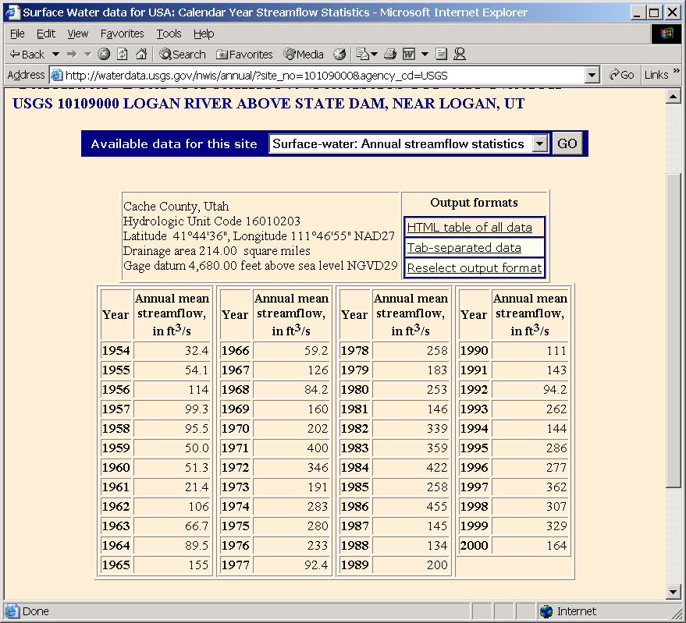

Slide 13
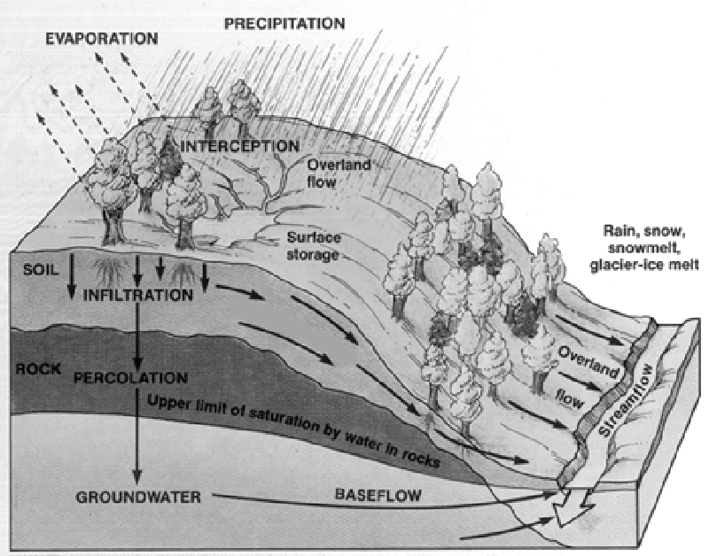
Physical Processes involved in Runoff Generation.
INTERFLOW
[Source http://snobear.colorado.edu/IntroHydro/geog_hydro.html]

Slide 14
Planning/Development issues
Flooding.
  What is upslope.
  Opportunities for drainage.
Impact on earth ecosystem
  Wetlands and their function
  Modifications to runoff/water balance

Slide 15
Questions?
AREA 2
3
AREA 1
12
Suggested reading: Dunne, T. and L. B. Leopold, (1978), Water in Environmental Planning, W H Freeman and Co, San Francisco, 818 p.

