Slide 1




Using GIS in Creating an End-to-End System for Publishing
Environmental Observations Data
Jeffery S. Horsburgh
David G. Tarboton, David R. Maidment, Ilya Zaslavsky
David Stevens, Amber Spackman
Support:
EAR 0622374
CBET 0610075

Slide 2
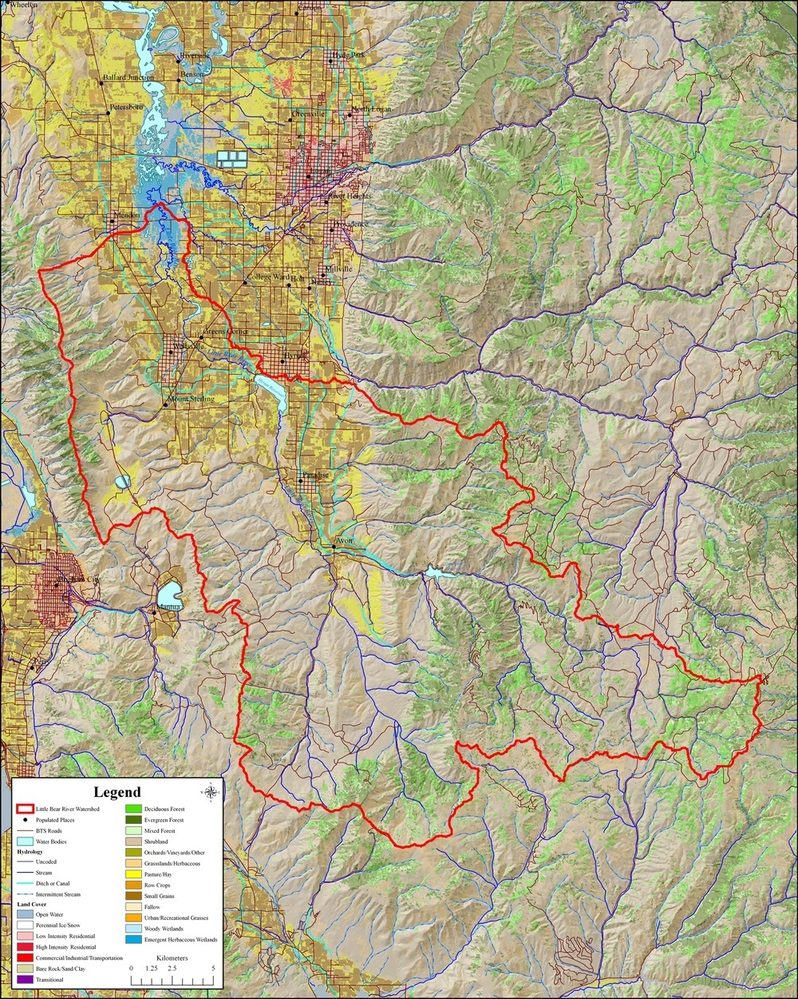
Little Bear River WATERS Test Bed
Observing infrastructure for high frequency estimation of total phosphorus fluxes
  High frequency surrogate measurements
  Turbidity -> TSS or TP

Slide 3
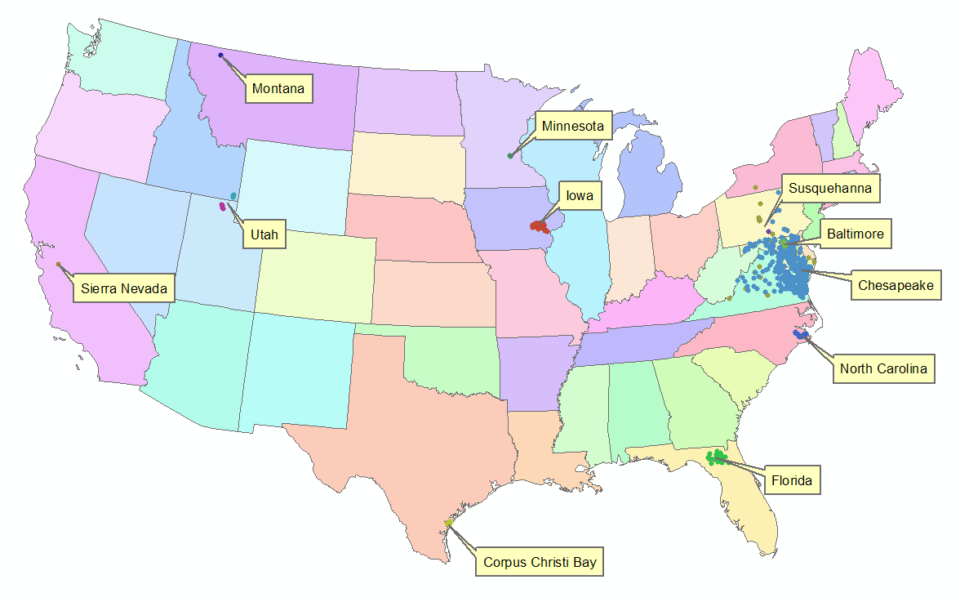





WATERS Network
11 Environmental Observatory Test Beds
Sensors and sensor networks
Cyberinfrastructure development
Data publication
National Hydrologic Information Server
San Diego Supercomputer Center
Demonstrating techniques and technologies for design and implementation of large-scale environmental observatories

Slide 4
The Challenge
Advance cyberinfrastructure for a network of environmental observatories
  Supporting sensor networks and observational data
  Publishing observational data
    Unambiguous interpretation (i.e., metadata)
    Overcome semantic and syntactic heterogeneity
Creating a national network of consistent data
  Community data resources
  Cross domain data integration and analysis
  Cross test bed data integration and analysis
Because results from local projects can be aggregated across sites and times, the potential exists to advance environmental and earth sciences significantly through the publication of research data.

Slide 5
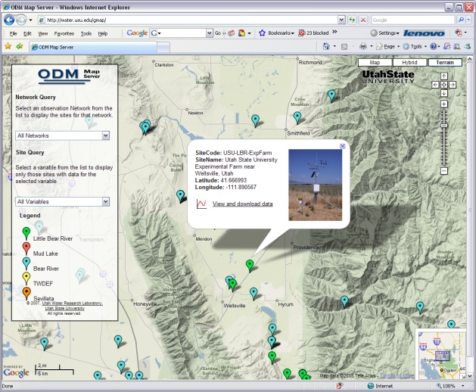
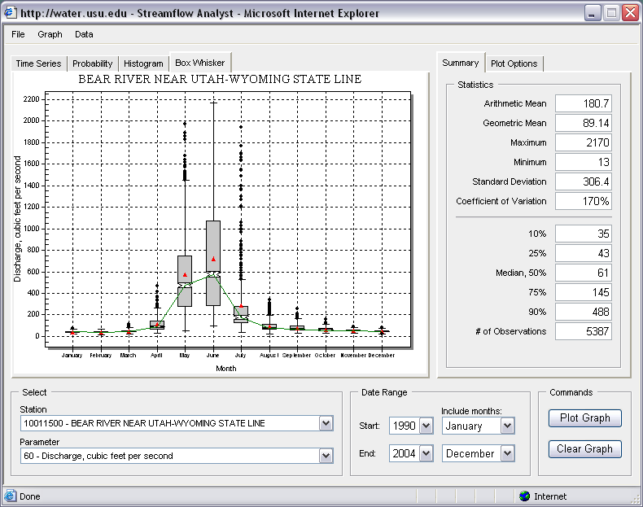
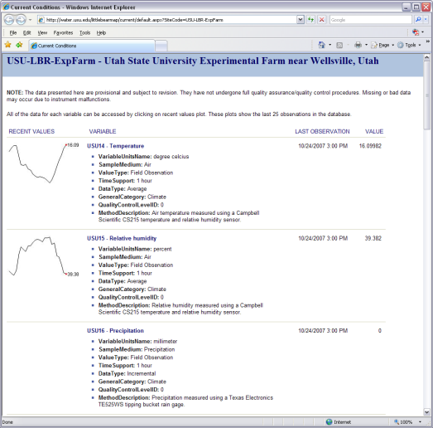

Sensor Network
Central Observations Database
Applications
Base Station
Computer
Observations
Database
(ODM)
Radio Repeaters
Internet
Internet
ODM Streaming
Data Loader
Data discovery, visualization,
and analysis through Internet enabled applications
Remote Monitoring Sites

Slide 6
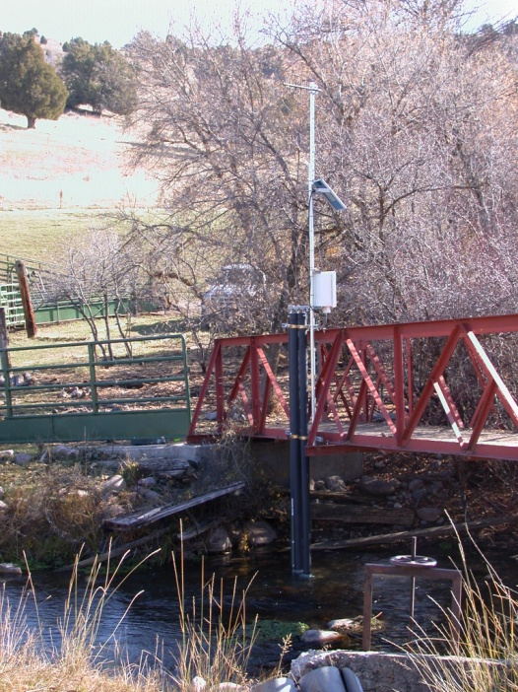
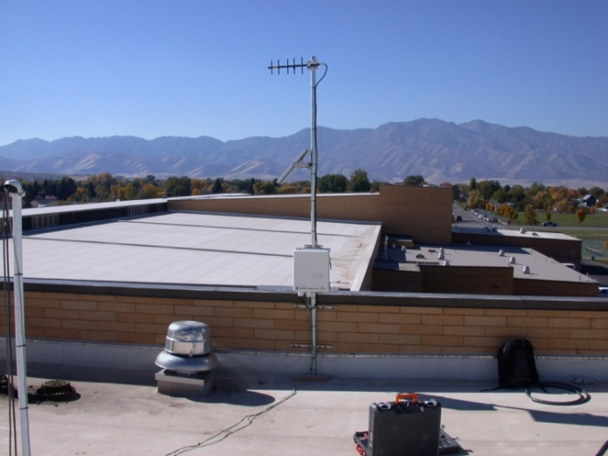
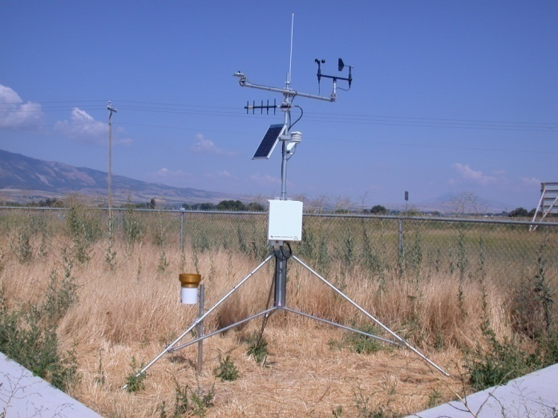
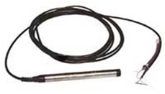
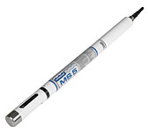
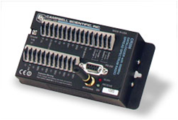

Little Bear River Sensor Network
7 water quality and streamflow monitoring sites
  Temperature
  Dissolved Oxygen
  pH
  Specific Conductance
  Turbidity
  Water level/discharge
2 weather stations
  Temperature
  Relative Humidity
  Solar radiation
  Precipitation
  Barometric Pressure
  Wind speed and direction
Spread spectrum radio telemetry network

Slide 7
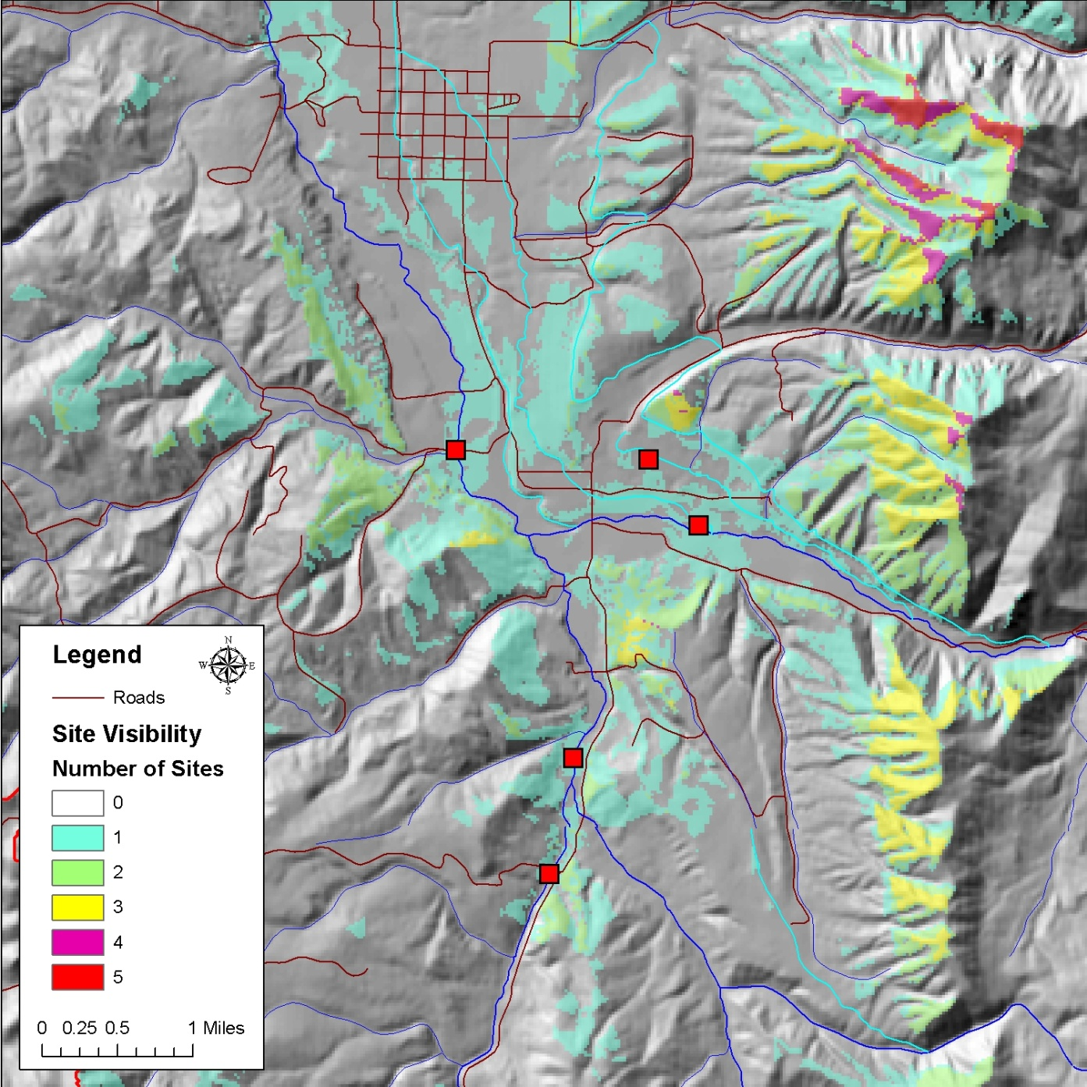
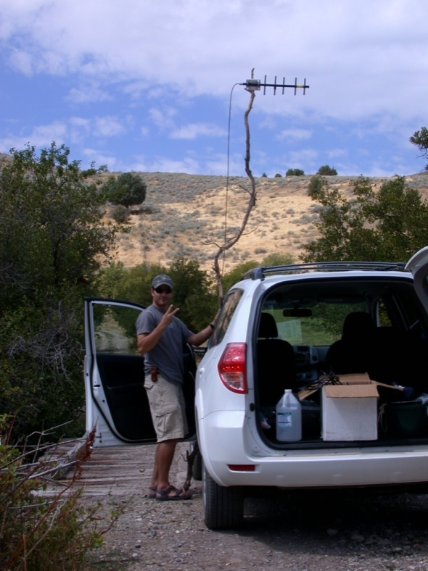
Viewshed Analysis
ArcGIS Spatial Analyst
Radio telemetry network setup
Optimal placement of radio repeaters given monitoring site locations

Slide 8
5.2
Mountain Crest High School
Remote Base Station
Paradise
Repeater
UWRL Base
Station Computer
1.3
2.9
1.9
Paradise
Site
C
East Fork
Weather Site
S
Confluence
Site
S
0.6
Lower East
Fork Site
Key
Lower South
Fork Site
S
2.9
Internet Link
Radio Link
S
Stream Monitoring Site
0.8
S
C
Climate Monitoring Site
Upper South
Fork Site
S

Slide 9
Sensor Network
Central Observations Database
Applications
Base Station
Computer
Observations
Database
(ODM)
Radio Repeaters
Internet
Internet
ODM Streaming
Data Loader
Data discovery, visualization,
and analysis through Internet enabled applications
Remote Monitoring Sites

Slide 10
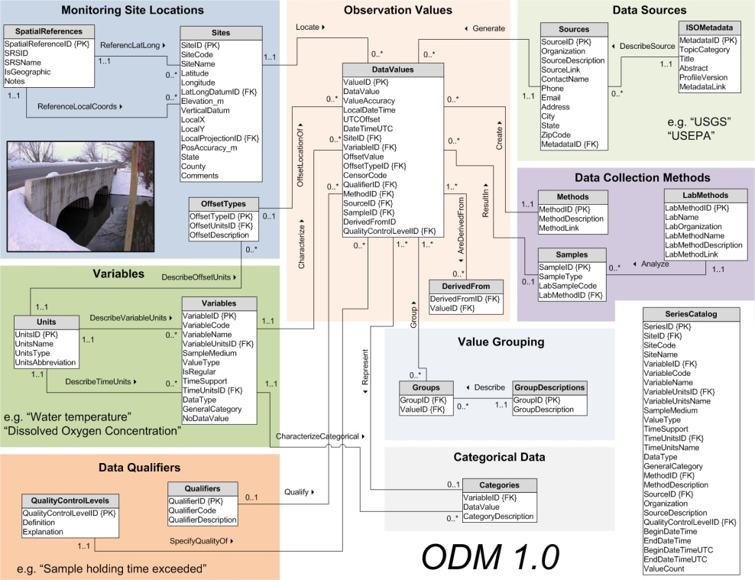
Central Observations Database
CUAHSI ODM
Implemented in Microsoft SQL Server
Overcome semantic and syntactic heterogeneity
Horsburgh, J. S., D. G. Tarboton, D. Maidment, and I. Zaslavsky (2008), A Relational Model for Environmental and Water Resources Data, Water Resources Research, In press. (accepted 13 February 2008), doi:10.1029/2007WR006392.

Slide 11

Syntactic Heterogeneity
Multiple Data Sources
With Multiple Formats
Excel
Files
Text
Files
Access
Files
Data Logger
Files
ODM Observations
Database

Slide 12
Semantic Heterogeneity
General Description of Attribute | USGS NWISª | EPA STORET^{b}
Structural Heterogeneity
Code for location at which data are collected | "site_no" | "Station ID"
Name of location at which data are collected | "Site" OR "Gage" | "Station Name"
Code for measured variable | "Parameter" | ?^{c}
Name of measured variable | "Description" | "Characteristic Name"
Time at which the observation was made | "datetime" | "Activity Start"
Code that identifies the agency that collected the data | "agency_cd" | "Org ID"
Contextual Semantic Heterogeneity
Name of measured variable | "Discharge" | "Flow"
Units of measured variable | "cubic feet per second" | "cfs"
Time at which the observation was made | "2008-01-01" | "2006-04-04 00:00:00"
Latitude of location at which data are collected | "41°44'36" | "41.7188889"
Type of monitoring site | "Spring, Estuary, Lake, Surface Water" | "River/Stream"
ª United States Geological Survey National Water Information System (http://waterdata.usgs.gov/nwis/).
^{b} United States Environmental Protection Agency Storage and Retrieval System (http://www.epa.gov/storet/).
^{c} An equivalent to the USGS parameter code does not exist in data retrieved from EPA STORET.

Slide 13
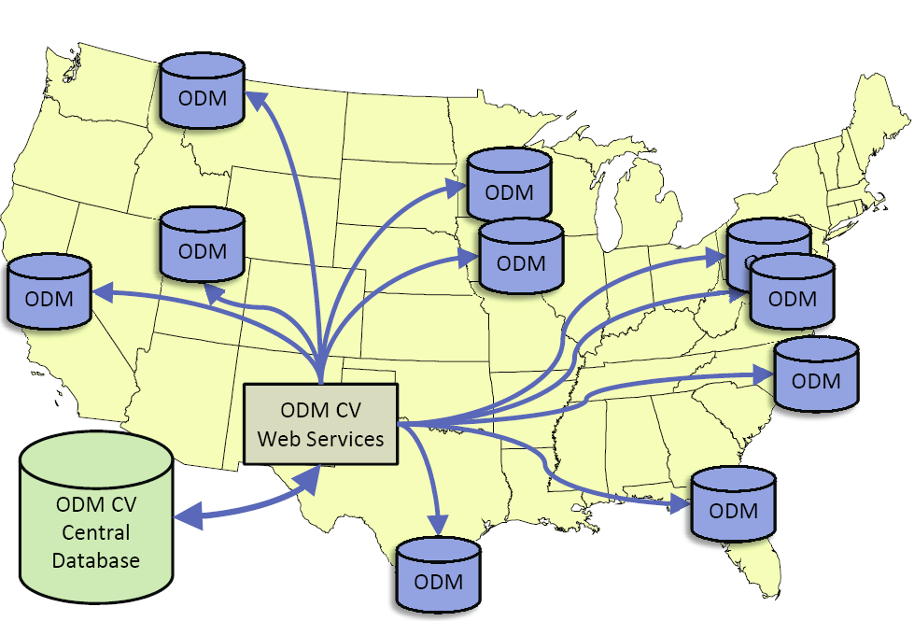
Overcoming Semantic Heterogeneity
http://water.usu.edu/cuahsi/odm/
ODM Controlled Vocabulary System
  ODM CV central database
  Online submission and editing of CV terms
  Web services for broadcasting CVs
ODM VariableNameCV
Variable Name
Term
…
Sunshine duration
Temperature
Turbidity
…
Investigator 1: | “Temperature, water”
Investigator 2: | “Water Temperature”
Investigator 3: | “Temperature”
Investigator 4: | “Temp.”

Slide 14

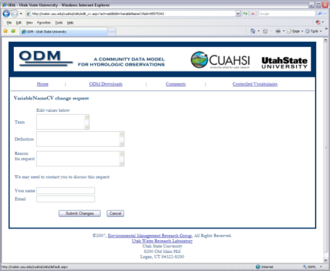

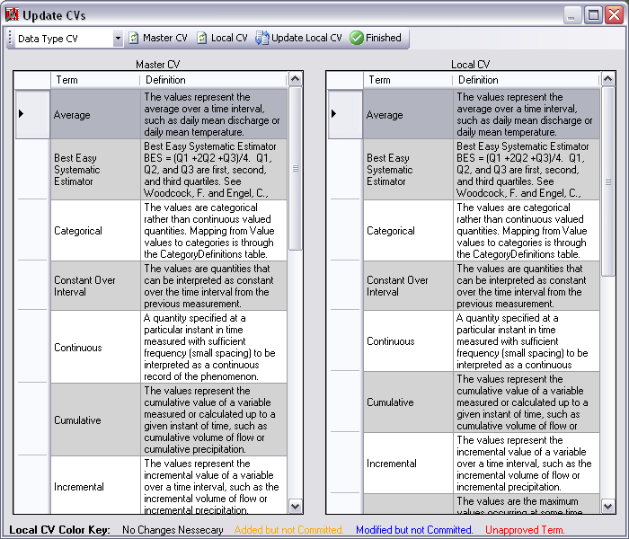
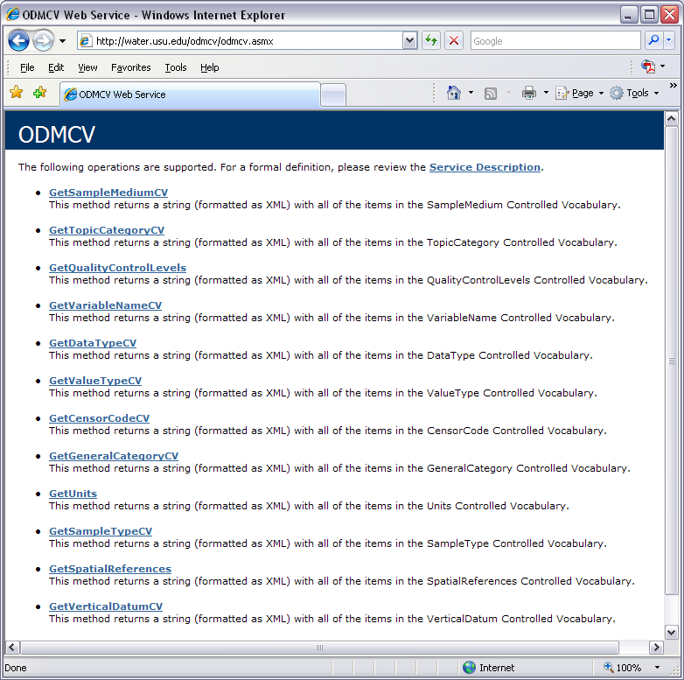
Dynamic Controlled Vocabulary Moderation System
ODM Website
ODM Data Manager
ODM
Tools
ODM Controlled
Vocabulary Moderator
XML
Master ODM Controlled Vocabulary
Local ODM
Database
ODM
Controlled Vocabulary
Web Services
Local
Server

Slide 15
Loading the
Little Bear
Sensor Data
Into ODM
ODM Streaming Data Loader
Streaming Data Text Files
ODM SDL Mapping Wizard
Automate the data loading process via scheduled updates
Map datalogger files to the ODM schema and controlled vocabularies
XML Config File
ODM SDL Import Application
ODM
ODM SDL manages the periodic insertion of the streaming data into the ODM database using the mappings stored in the XML configuration file.
Base Station
Computer(s)

Slide 16
Sensor Network
Central Observations Database
Applications
Base Station
Computer
Observations
Database
(ODM)
Radio Repeaters
Internet
Internet
ODM Streaming
Data Loader
Data discovery, visualization,
and analysis through Internet enabled applications
Remote Monitoring Sites

Slide 17
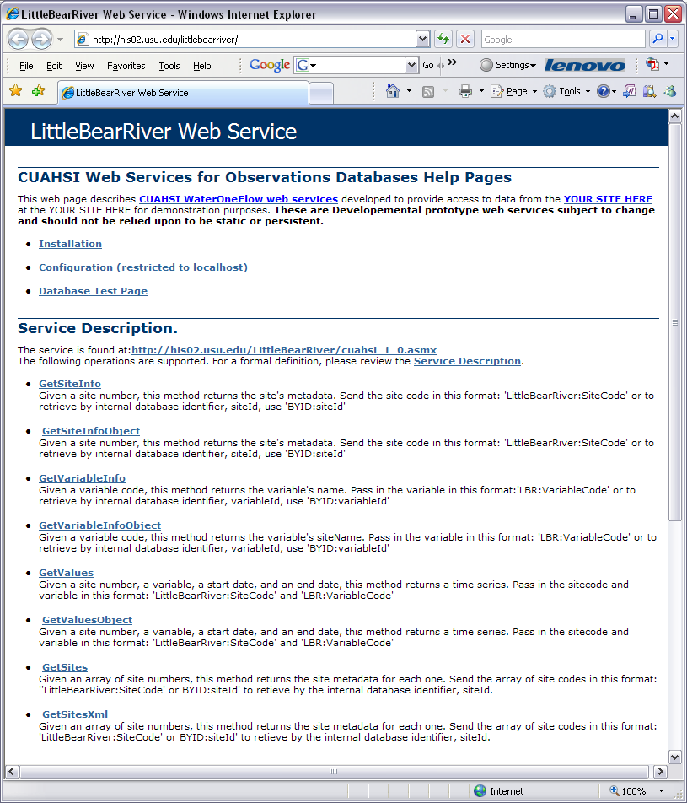
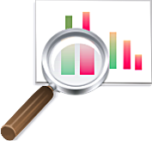
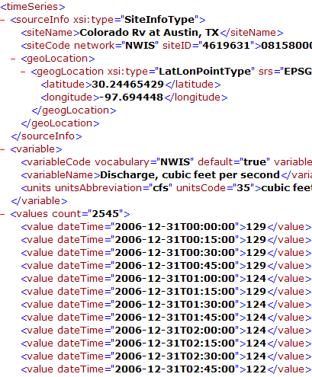
CUAHSI WaterOneFlow Web Services
“Getting the Browser Out of the Way”
GetSites
GetSiteInfo
GetVariableInfo
GetValues
Standard protocols provide platform independent data access
WaterML
SQL
Queries
Data Consumer
ODM
Database
Query
Response

Slide 18
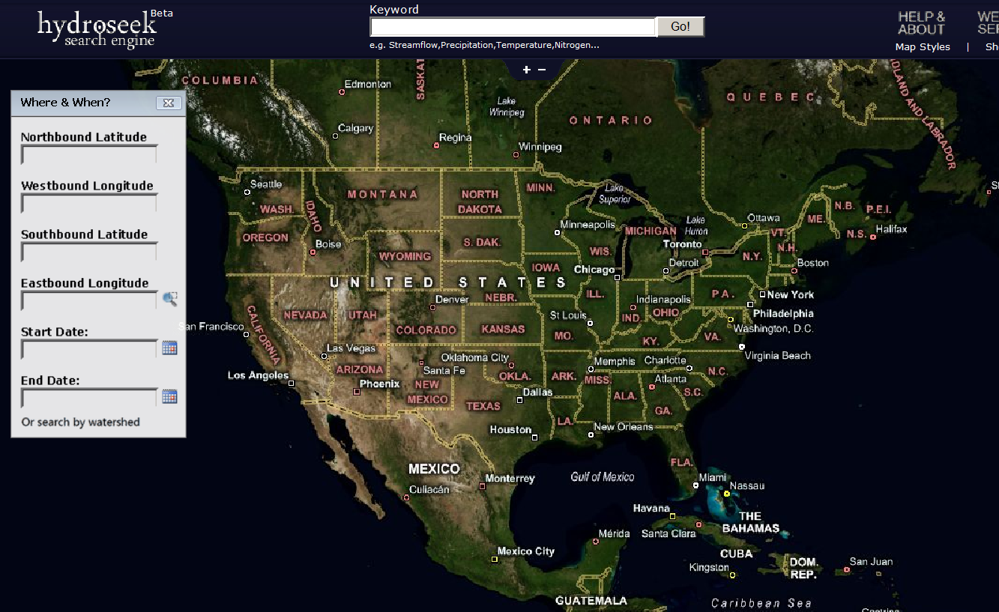
Hydroseek http://www.hydroseek.org
Supports search by location and type of data across multiple observation networks including NWIS, Storet, and university data

Slide 19
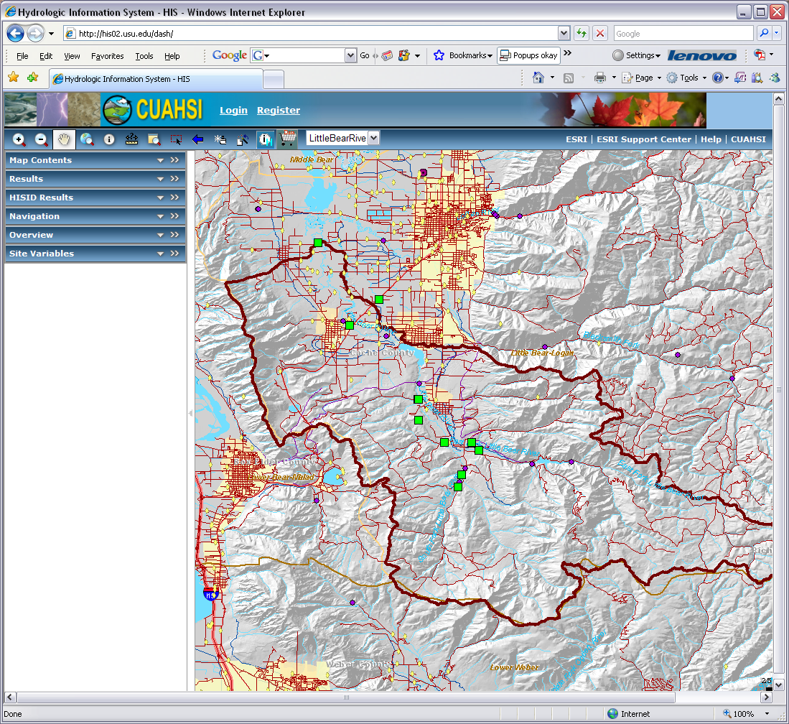
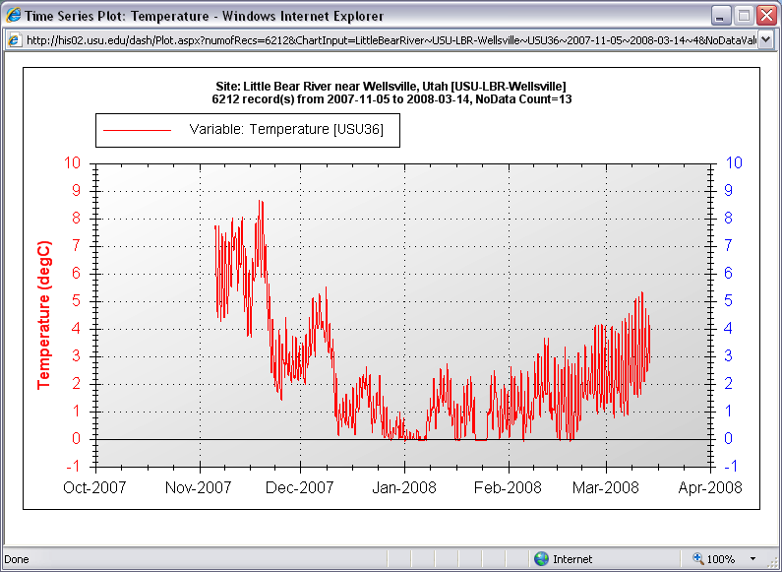
CUAHSI HIS Server DASH http://his02.usu.edu/dash/
Provides:
  Geographic context to monitoring sites
  Point and click access to data
ArcGIS Server - Newest ESRI Technology
Spatial data plus spatial analysis
Some overhead

Slide 20
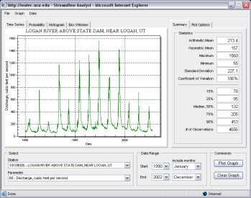
Google Map Server
http://water.usu.edu/gmap/
“HIS Server Light”
Similar functionality with less overhead
Sacrifices geoprocessing functionality

Slide 21
Summary
Generic method for publishing observational data
  Supports many types of point observational data
  Overcomes syntactic and semantic heterogeneity using a standard data model and controlled vocabularies
  Supports a national network of observatory test beds but can grow!
Web services provide programmatic machine access to data
  Work with the data in your data analysis software of choice
Internet-based applications provide user interfaces for the data and geographic context for monitoring sites

Slide 22
Questions?
Support:
EAR 0622374
CBET 0610075

