Slide 1

A Community Data Model for Hydrologic Information Systems
David G Tarboton
David R. Maidment (PI)
Ilya Zaslavsky
Michael Piasecki
Jon Goodall
Graduate students, programmers and collaborators: Jeff Horsburgh, David Valentine, Tim Whiteaker, Bora Beran, Ernest To, Tim Whitenack, Dean Djokic, Zhumei Qian
Support
EAR 0622374
EAR 0413265
http://www.cuahsi.org/his.html

Slide 2
Outline
A bit about me
The CUAHSI HIS
Web Services
Observations Data Model
Observatory Test Bed Implementation

Slide 3
My Teaching
Probabilistic and Statistical Methods in Engineering
GIS in Water Resources Online
A Virtual Course Presented On-Line by David Maidment at the University of Texas at Austin in partnership with Utah State University. Next offering Fall 2007. http://www.engineering.usu.edu/dtarb/giswr
[Physical Hydrology, Stochastic Hydrology]
Rainfall Runoff Processes
http://www.engineering.usu.edu/dtarb/rrp.html

Slide 4
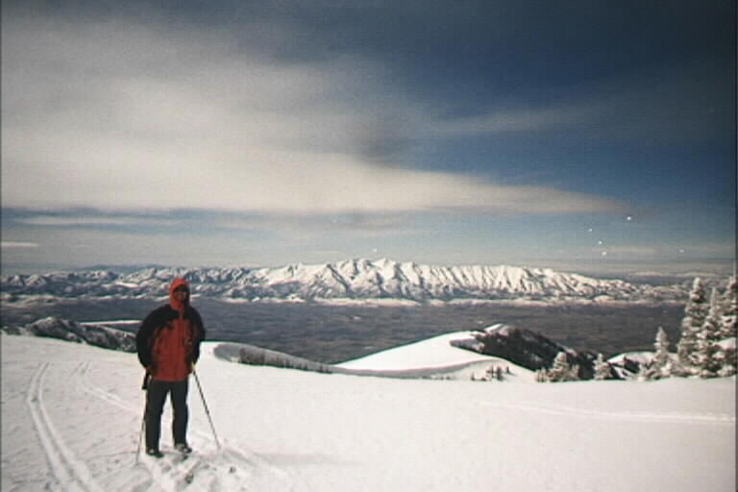
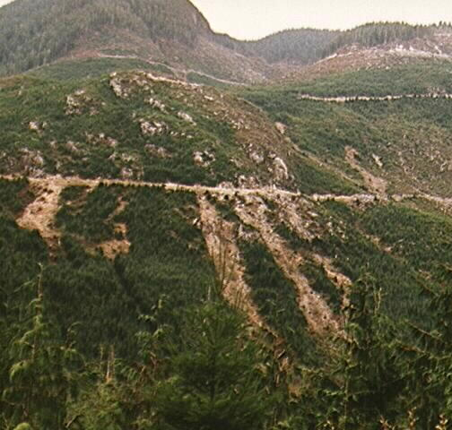
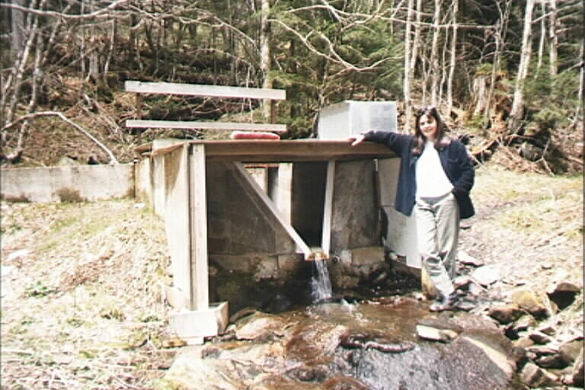
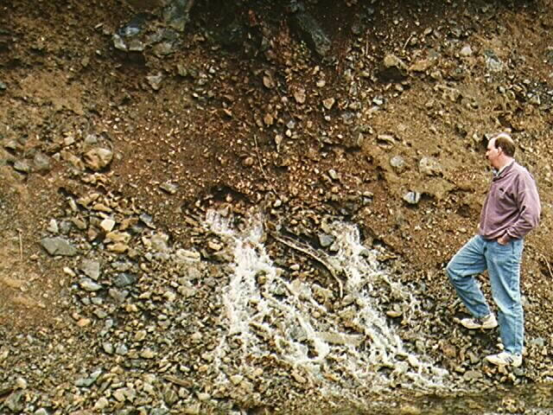
My Research
Spatially distributed hydrologic modeling.
Snow Hydrology.
Hydrologic Information Systems - Applying digital elevation data and GIS in hydrology.
Stochastic hydrology using nonparametric techniques.
Geomorphology.

Slide 5
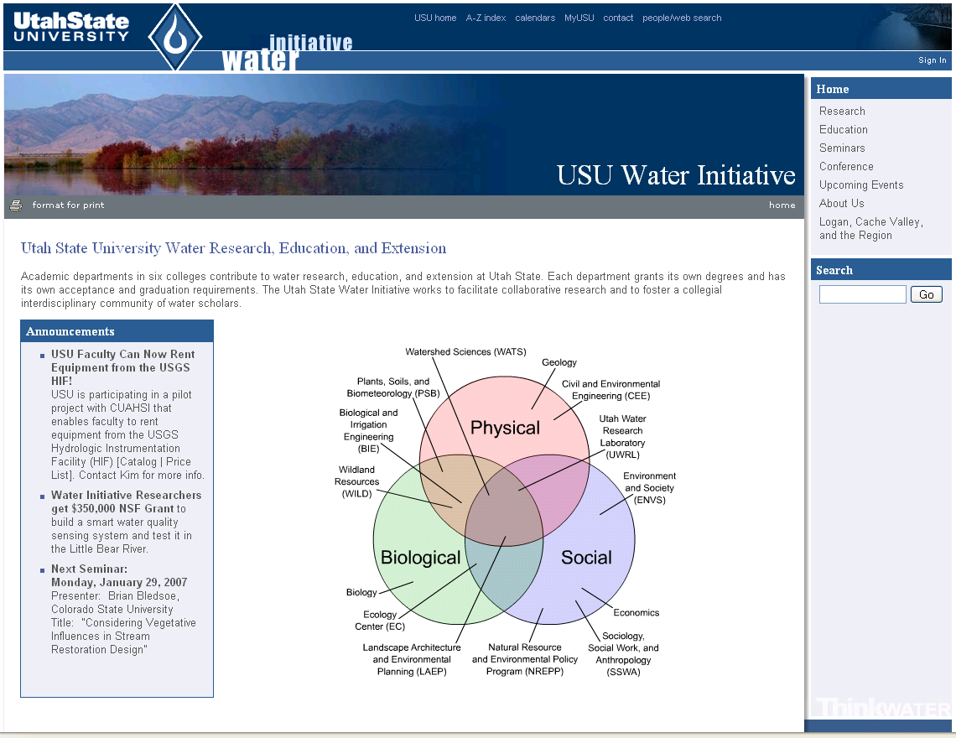
http://water.usu.edu

Slide 6
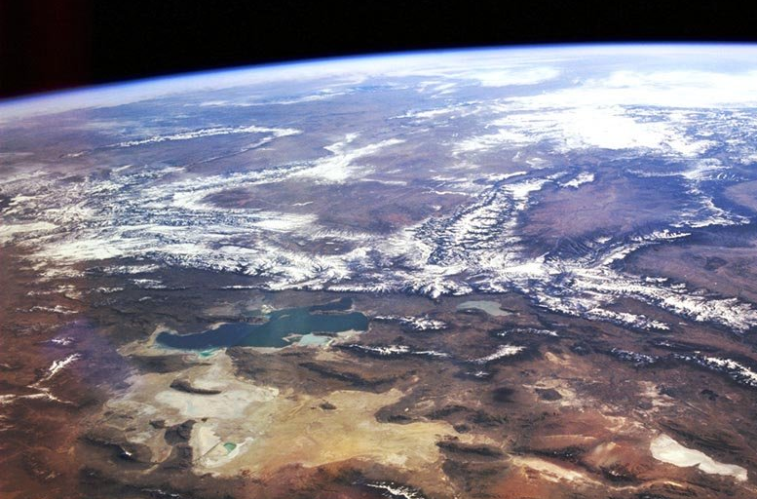
Great Salt Lake Basin Critical Zone Observatory
Strawberry
Bear
Weber
Jordan/Provo
West Desert
An observatory to study critical zone closed basin ecosystem dynamics

Slide 7
Conceptual Model
Solar Radiation
Precipitation
Air Humidity
Air Temp.
Increases
Reduces
Mountain Snowpack
Evaporation
Area Control
GSL Level Volume Area
Supplies
Reduces
Soil Moisture And Groundwater
Contributes
Salinity
C≈L/V
Dominant
Streamflow

Slide 8
Outline
A bit about me
The CUAHSI HIS
Web Services
Observations Data Model
Observatory Test Bed Implementation

Slide 9
CUAHSI HIS Goals
better Data Access
support for Hydrologic Observatories
advancement of Hydrologic Science
enabling Hydrologic Education
Time
Value
Space
Variables

Slide 10
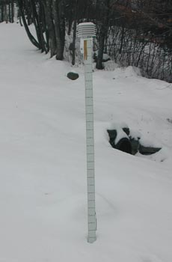


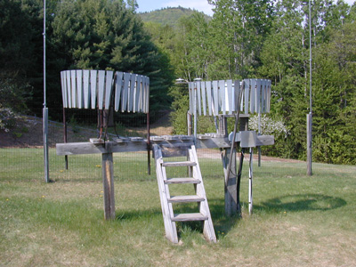
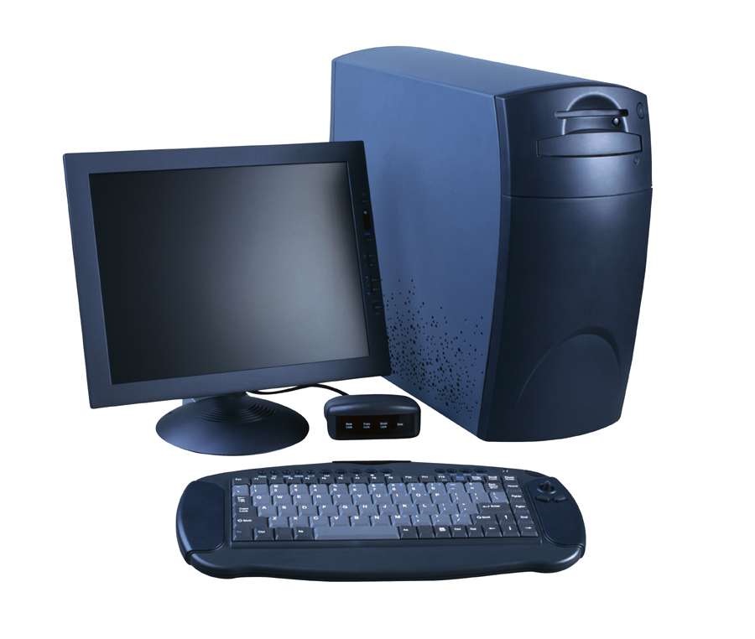
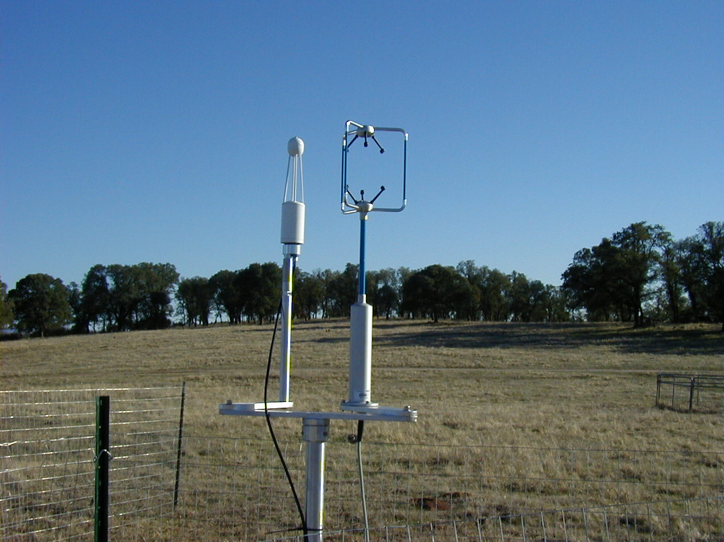
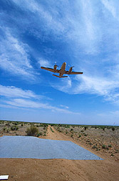
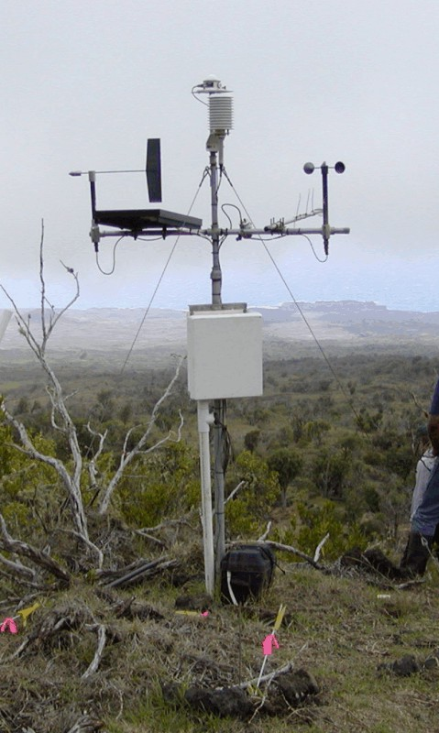
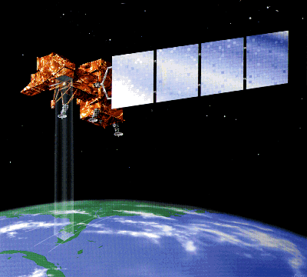
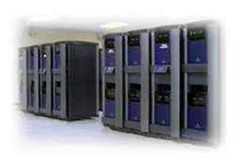
Water Data
Water quantity
and quality
Soil water
Rainfall & Snow
Modeling
Meteorology
Remote sensing

Slide 11



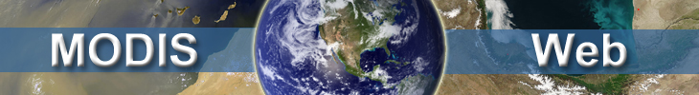






Objective
Provide access to multiple heterogeneous data sources simultaneously regardless of semantic or structural differences between them
What we are doing now …..
NWIS
request
return
request
request
return
return
NAWQA
request
return
NAM-12
request
return
request
return
request
return
request
return
NARR
Slide from Michael Piasecki, Drexel University

Slide 12

What we would like to do …..
GetValues
GetValues
NWIS
GetValues
GetValues
generic
request
GetValues
GetValues
NAWQA
GetValues
NARR
GetValues
ODM
Slide from Michael Piasecki, Drexel University

Slide 13


Hydrologic Data Access System Website Portal and Map Viewer
Information input, display, query and output services
Preliminary data exploration and discovery. See what is available and perform exploratory analyses
Downloads
Uploads
Web services interface
3rd party data servers
HTML -XML
Data access through web services
WaterOneFlow Web Services
WSDL - SOAP
Data storage through web services
GIS
e.g. USGS, NCDC
Matlab
IDL
Observatory data servers
CUAHSI HIS data servers
Splus, R
Excel
ODM
ODM
Programming (Fortran, C, VB)
Notes:
Hydrologic Information System Service Oriented Architecture

Slide 14
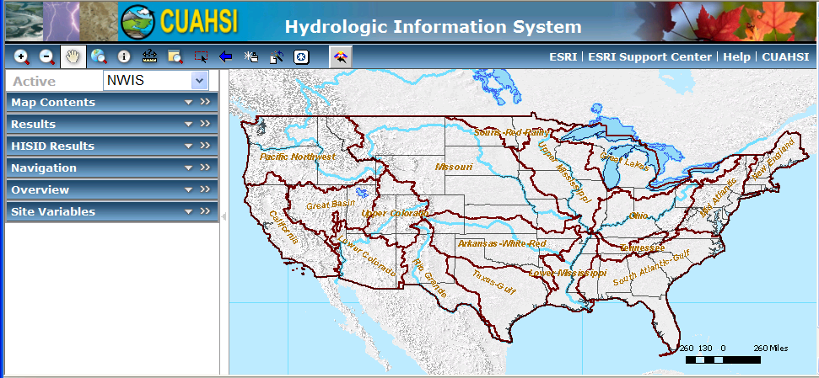
CUAHSI Hydrologic Data Access System
(HDAS)
EPA
NCDC
NASA
NWS
USGS
Observatory Data
A common data window for accessing, viewing and downloading hydrologic information

Slide 15
Outline
A bit about me
The CUAHSI HIS
Web Services
Observations Data Model
Observatory Test Bed Implementation

Slide 16
Data Sources
NASA
Storet
Ameriflux
Extract
NCDC
Unidata
NWIS
NCAR
Transform
CUAHSI Web Services
Excel
Visual Basic
ArcGIS
C/C++
Load
Matlab
Fortran
Access
Java
Applications
http://www.cuahsi.org/his.html
Some operational services

Slide 17
Example: Matlab use of CUAHSI Web Services
% create NWIS Class and an instance of the class
createClassFromWsdl('http://water.sdsc.edu/wateroneflow/NWIS/DailyValues.asmx?WSDL');
WS = NWISDailyValues;
% Site Info for Site of Interest
siteid='NWIS:02087500';
strSite=GetSiteInfoObject(WS,siteid,'');
strSite.site.siteInfo.siteName
ans =
NEUSE RIVER NEAR CLAYTON, NC
lat=strSite.site.siteInfo.geoLocation.geogLocation.lat itude
long=strSite.site.siteInfo.geoLocation.geogLocation.longitude
lat =
35.6472222
long =
-78.4052778

Slide 18
Variable and variableTimeInterval
strSite.site.seriesCatalog(1).series(:).variable
ans =
variableCode: '00065'
variableName: 'Gage height, feet'
units: 'international foot'
ans =
variableCode: '00060'
variableName: 'Discharge, cubic feet per second'
units: 'cubic feet per second'
strSite.site.seriesCatalog(1).series(:).variableTimeInterval
ans =
beginDateTime: '1927-08-01T00:00:00'
endDateTime: '2006-10-16T00:00:00'
ans =
beginDateTime: '1927-08-01T00:00:00'
endDateTime: '2006-10-16T00:00:00'

Slide 19
getVariableInfo
varcode='NWIS:00060';
varInfo=GetVariableInfoObject(WS,varcode,'')
varInfo =
variables: [1x1 struct]
varInfo.variables.variable
ans =
variableCode: '00060'
variableName: 'Discharge, cubic feet per second'
units: 'cubic feet per second'

Slide 20
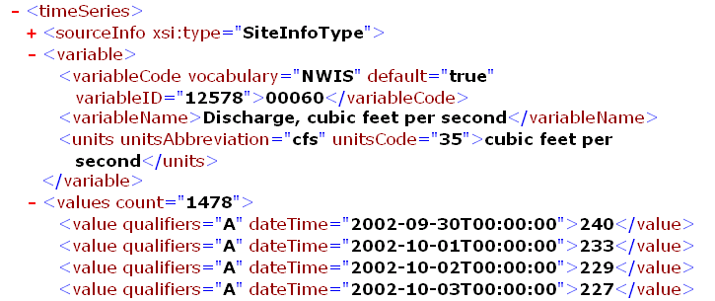
GetValues
% GetValues to get the data
siteid='NWIS:02087500';
bdate='2002-09-30T00:00:00';
edate='2006-10-16T00:00:00';
variable='NWIS:00060';
valuesxml=GetValues(WS,siteid,variable,bdate,edate,'');

Slide 21
Parse XML and Analyze
% Parse the XML into a Matlab object to work with
valuesobj=xml_parseany(valuesxml);
...
plot(date,flowval);datetick;

Slide 22
Outline
A bit about me
The CUAHSI HIS
Web Services
Observations Data Model
Observatory Test Bed Implementation

Slide 23
Hydrologic Science
It is as important to represent hydrologic environments precisely with
data as it is to represent hydrologic processes with equations
Physical laws and principles
(Mass, momentum, energy, chemistry)
Hydrologic Process Science
(Equations, simulation models, prediction)
Hydrologic conditions
(Fluxes, flows, concentrations)
Hydrologic Information Science
(Observations, data models, visualization
Hydrologic environment
(Dynamic earth)

Slide 24
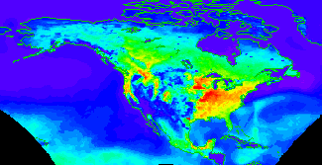

Continuous Space-Time Model – NetCDF (Unidata)
Time, T
Coordinate
dimensions
{X}
D
Space, L
Variable dimensions
{Y}
Variables, V

Slide 25
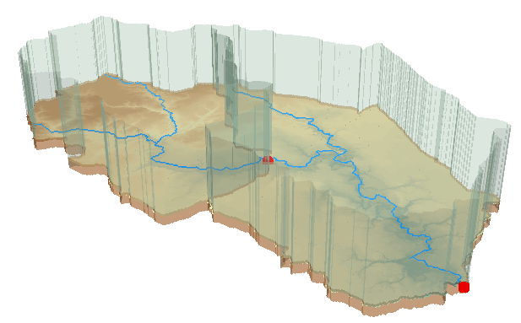
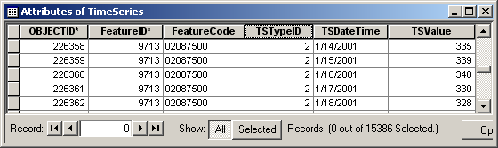
Discrete Space-Time Data Model
ArcHydro
Time, TSDateTime
TSValue
Space, FeatureID
Variables, TSTypeID

Slide 26

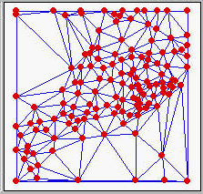
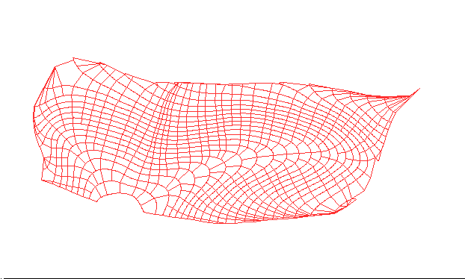

Terrain Data Models
Grid
TIN
Contour and flowline

Slide 27
CUAHSI Observations Data Model
A relational database at the single observation level (atomic model)
Stores observation data made at points
Metadata for unambiguous interpretation
Traceable heritage from raw measurements to usable information
Standard format for data sharing
Cross dimension retrieval and analysis
Streamflow
Groundwater
levels
Precipitation
& Climate
Soil
moisture
data
Water Quality
Flux tower
data

Slide 28
Scope
Focus on Hydrologic Observations made at a point
Exclude remote sensing or grid data. These are part of a digital watershed but not suitable for an atomic database model and individual value queries
Primarily store raw observations and simple derived information to get data into its most usable form.
Limit inclusion of extensively synthesized information and model outputs at this stage.

Slide 29
What are the basic attributes to be associated with each single data value and how can these best be organized?
Value
DateTime
Variable
Location
Units
Interval (support)
Accuracy
Offset
OffsetType/ Reference Point
Source/Organization
Censoring
Data Qualifying Comments
Method
Quality Control Level
Sample Medium
Value Type
Data Type

Slide 30
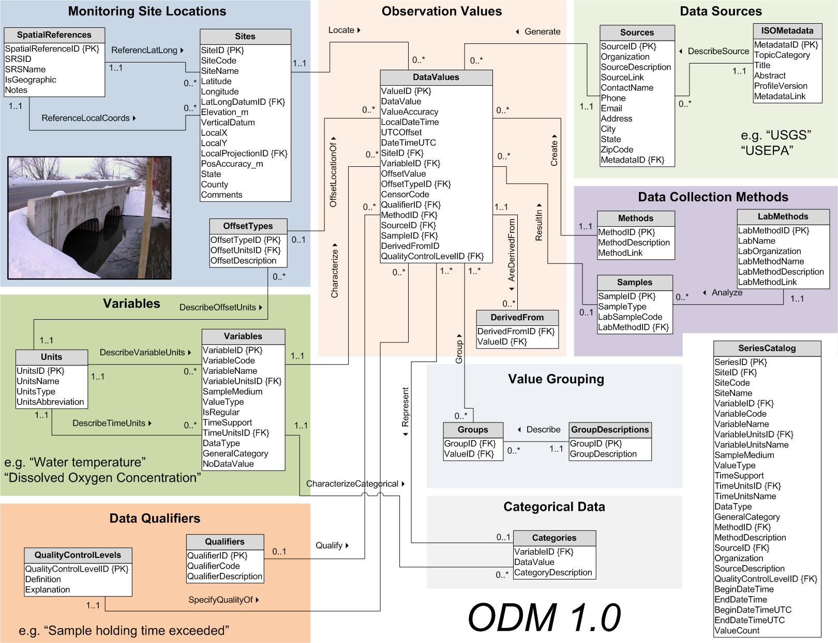

Slide 31
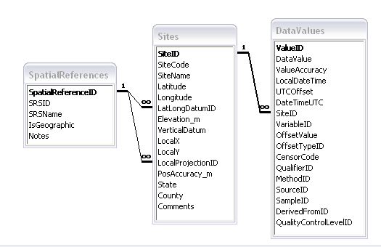
Site Attributes
SiteCode, e.g. NWIS:10109000
SiteName, e.g. Logan River Near Logan, UT
Latitude, Longitude Geographic coordinates of site
LatLongDatum Spatial reference system of latitude and longitude
Elevation_m Elevation of the site
VerticalDatum Datum of the site elevation
Local X, Local Y Local coordinates of site
LocalProjection Spatial reference system of local coordinates
PosAccuracy_m Positional Accuracy
State, e.g. Utah
County, e.g. Cache

Slide 32
Independent of, but can be coupled to Geographic Representation
ODM
Arc Hydro
Feature
Observations Data Model
1
HydroPoint
Waterbody
Watershed
Sites
1
HydroID
HydroID
HydroID
SiteID
HydroCode
*
HydroCode
HydroCode
SiteCode
FType
FType
DrainID
SiteName
OR
Name
Name
AreaSqKm
Latitude
JunctionID
AreaSqKm
JunctionID
Longitude
JunctionID
NextDownID
…
ComplexEdgeFeature
*
SimpleJunctionFeature
*
CouplingTable
1
SiteID
HydroID
1
HydroEdge
HydroJunction
HydroJunction
HydroID
1
HydroJunction
1
HydroID
HydroID
HydroCode
HydroID
HydroCode
HydroCode
ReachCode
HydroCode
NextDownID
NextDownID
Name
NextDownID
LengthDown
LengthDown
LengthKm
HydroNetwork
LengthDown
DrainArea
DrainArea
LengthDown
DrainArea
FType
FType
FlowDir
FType
Enabled
Enabled
FType
Enabled
AncillaryRole
AncillaryRole
EdgeType
AncillaryRole
Enabled
EdgeType
Flowline
Shoreline

Slide 33
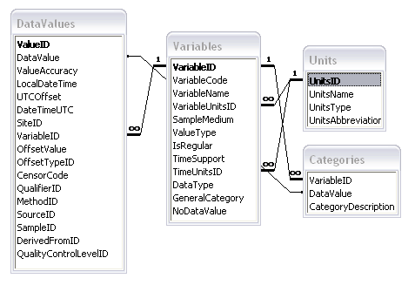
Variable attributes
Cubic meters per second
Flow
m³/s
VariableName, e.g. discharge
VariableCode, e.g. NWIS:0060
SampleMedium, e.g. water
ValueType, e.g. field observation, laboratory sample
IsRegular, e.g. Yes for regular or No for intermittent
TimeSupport (averaging interval for observation)
DataType, e.g. Continuous, Instantaneous, Categorical
GeneralCategory, e.g. Climate, Water Quality
NoDataValue, e.g. -9999

Slide 34
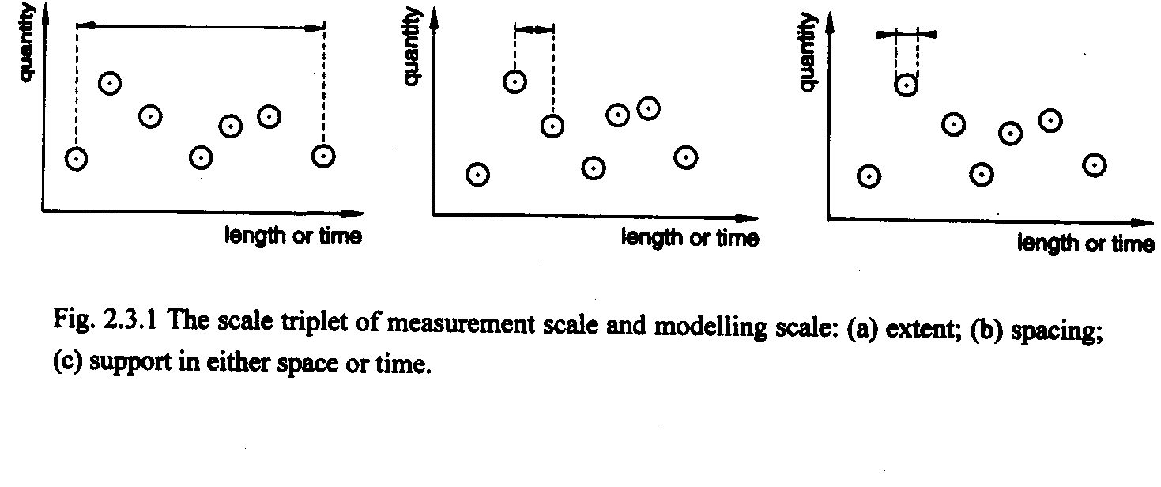
Scale issues in the interpretation of data
The scale triplet
a) Extent
b) Spacing
c) Support
From: Blöschl, G., (1996), Scale and Scaling in Hydrology, Habilitationsschrift, Weiner Mitteilungen Wasser Abwasser Gewasser, Wien, 346 p.

Slide 35
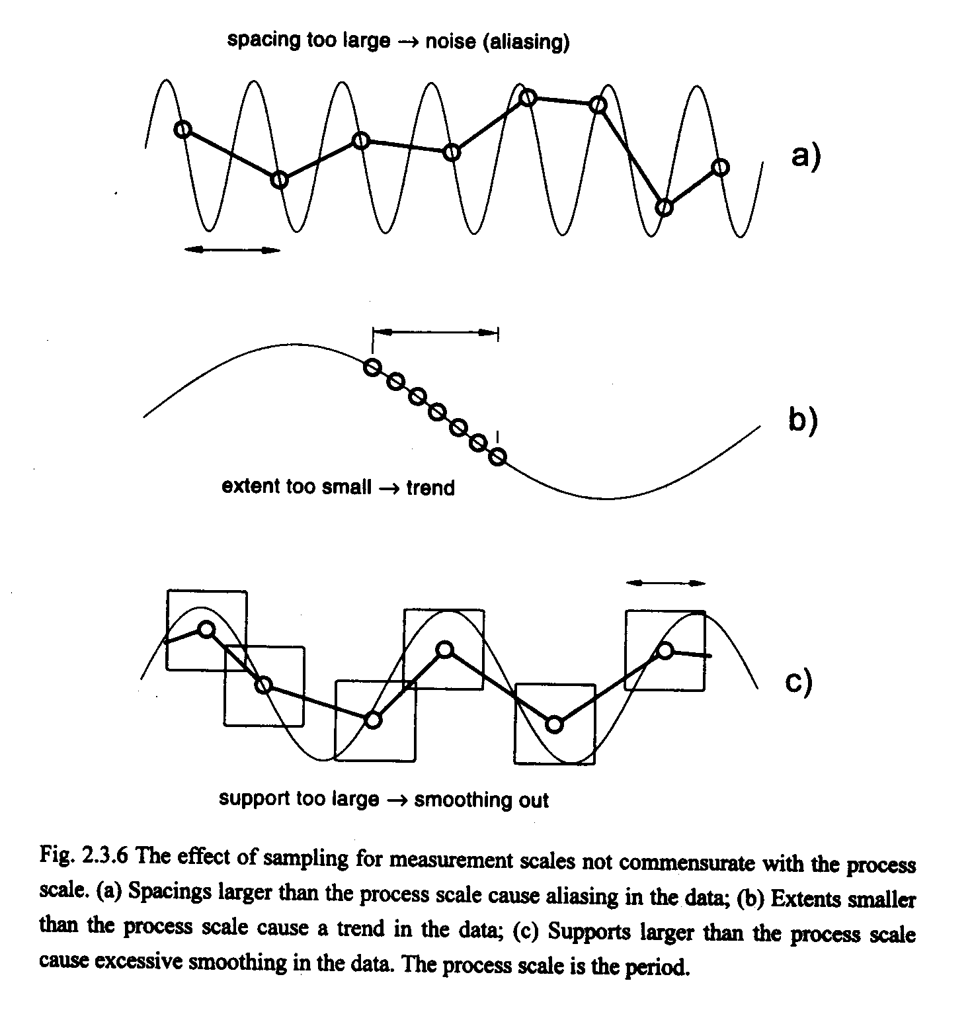
From: Blöschl, G., (1996), Scale and Scaling in Hydrology, Habilitationsschrift, Weiner Mitteilungen Wasser Abwasser Gewasser, Wien, 346 p.

Slide 36
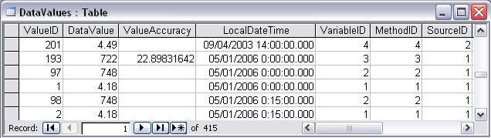
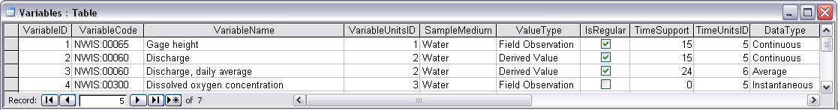
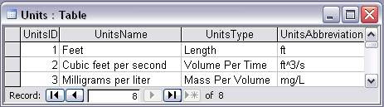
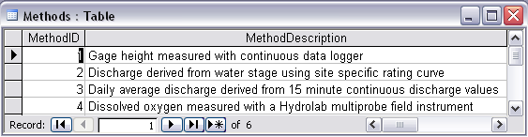
Discharge, Stage, Concentration and Daily Average Example

Slide 37
Data Types
Continuous (Frequent sampling - fine spacing)
Sporadic (Spot sampling - coarse spacing)
Cumulative
Incremental
Average
Maximum
Minimum
Constant over Interval
Categorical

Slide 38
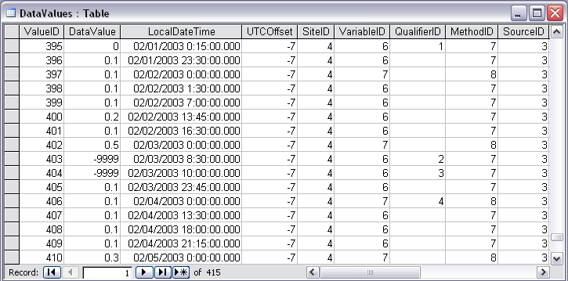
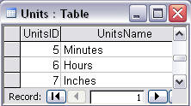
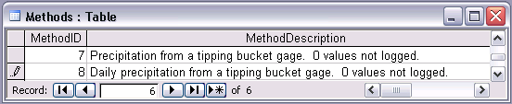
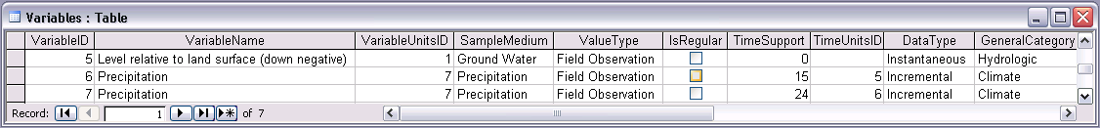
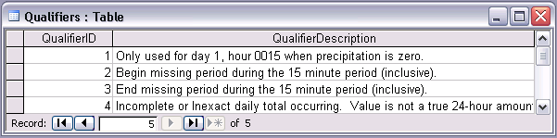
15 min Precipitation from NCDC
Incomplete or Inexact daily total occurring. Value is not a true 24-hour amount. One or more periods are missing and/or an accumulated amount has begun but not ended during the daily period.
Notes:
NCDC Precipitation Example
Concepts:
Use of nodata value in Value field of Values table (denotes beginning and ending of a no data period)
Multiple observations of multiple variables at a single site
Storage of incremental data with different time support (15 minute incremental vs. 24 hour incremental)
Use of data qualifying comments
Use of end of interval accumulation of data (the sum of precipitation for a day is reported at the end of the day – midnight of the next day)
Relationships:

Slide 39
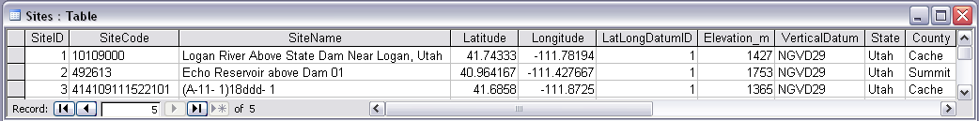
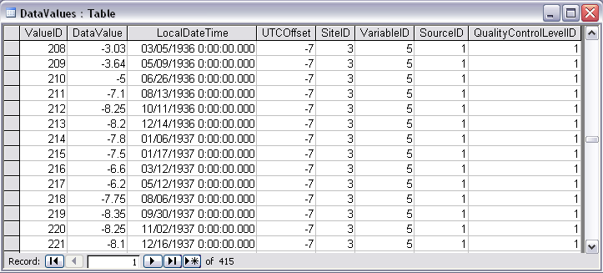
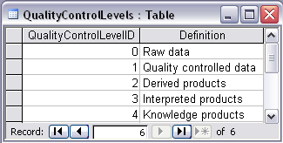
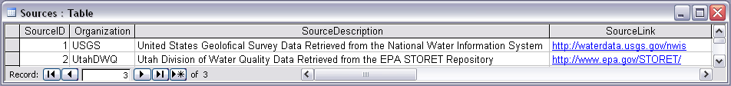
Irregularly sampled groundwater level
Notes:
Groundwater Level Example
Concepts:
Multiple observations of a single variable at a single site made by a single source
Use of a quality control level to qualify data
Relationships:
Relationship between the Sites table and the Values table on SiteID
Relationship between the Values table and the Variables table on VariableID
Relationship between the Values table and the Sources table on SourceID
Relationship between the Values table and the QualityControlLevelDefinitions table on QualityControlLevel

Slide 40
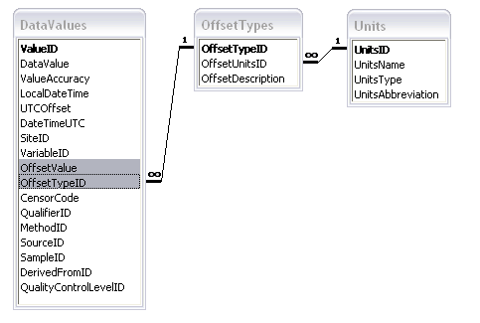
Offset
OffsetValue
Distance from a datum or control point at which an observation was made
OffsetType defines the type of offset, e.g. distance below water level, distance above ground surface, or distance from bank of river

Slide 41
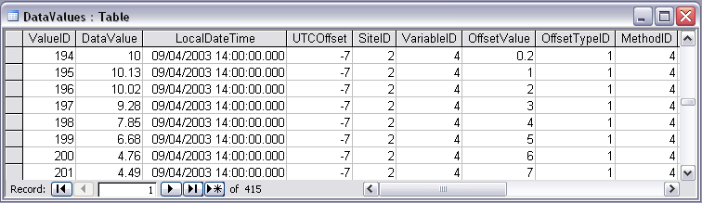

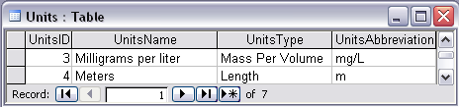
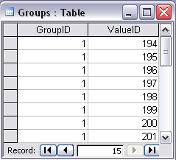


Water Chemistry from a profile in a lake
Notes:
Water Chemistry From a Lake Profile
Concepts:
Grouped observations (all observations in one reservoir profile)
Observations made using an offset (observations made at multiple depths below the surface of a reservoir)
Observations made using a specific method (observations made using a particular field instrument)
Relationships:
Relationship between Values table and the Variables table on VariableID
Relationship between Values table and OffestTypes table on OffsetTypeID
Relationship between Values table and Methods table on MethodID
Relationship between Variables table and Units table on UnitID
Relationship between GroupDescriptions table and Groups table on GroupID
Relationship between OffsetTypes table and Units table on UnitID and OffsetUnitID

Slide 42
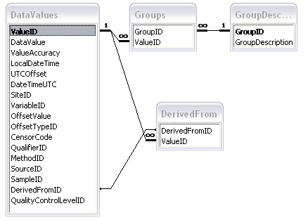
Groups and Derived From Associations

Slide 43
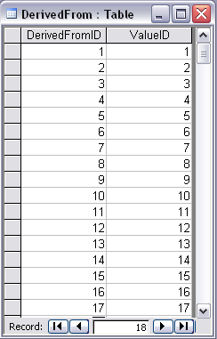
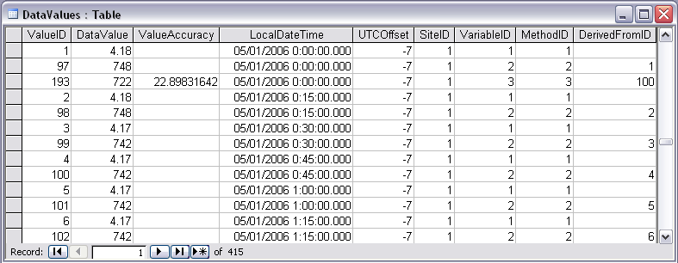
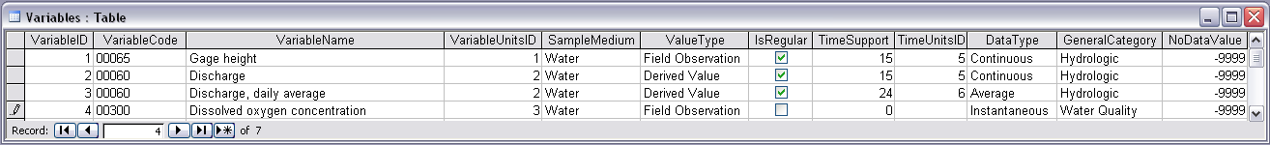
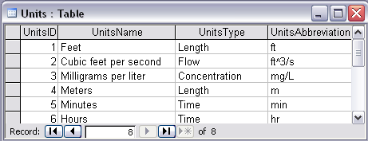
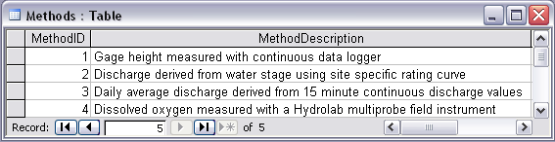
Stage and Streamflow Example
Notes:
Discharge Derived from Gage Height
Concepts:
Data derived from other data – single data point derived from a single observation (discharge from stage)
Data derived using a specific method (discharge from stage using rating curve)
Relationships:
Relationships between Values table and DerivedFrom table on DerivedFromID and ValueID
Relationship between Values table and Variables table on VariableID
Relationship between Values table and Methods table on MethodID
Relationship between Variables table and Units table on UnitID

Slide 44

Daily Average Discharge Example
Daily Average Discharge Derived from 15 Minute Discharge Data
Notes:
Daily Average Discharge Derived from 15 Minute Discharge Data
Concepts:
Data derived from other data – single data point derived from multiple observations (daily average from 15 minute instantaneous observations)
Data derived using a method (daily average by averaging 15 minute instantaneous observations)
Relationships:
Relationship between Values table and DerivedFrom table on DerivedFromID
Relationship between Values table and Methods table on MethodID
Relationship between Values table and Variables table on VariableID
Relationship between Variables table and Units table on UnitID

Slide 45

Methods and Samples
Method specifies the method whereby an observation is measured, e.g. Streamflow using a V notch weir, TDS using a Hydrolab, sample collected in auto-sampler
SampleID is used for observations based on the laboratory analysis of a physical sample and identifies the sample from which the observation was derived. This keys to a unique LabSampleID (e.g. bottle number) and name and description of the analytical method used by a processing lab.

Slide 46





Water Chemistry from Laboratory Sample

Slide 47

ValueAccuracy
A numeric value that quantifies measurement accuracy defined as the nearness of a measurement to the standard or true value. This may be quantified as an average or root mean square error relative to the true value. Since the true value is not known this may should be estimated based on knowledge of the method and measurement instrument. Accuracy is distinct from precision which quantifies reproducibility, but does not refer to the standard or true value.
ValueAccuracy
Bias
Accurate
Low Accuracy
Low Accuracy, but precise

Slide 48

Data Quality and Processing Levels
Qualifier Code and Description provides qualifying information about the observations, e.g. Estimated, Provisional, Derived, Holding time for analysis exceeded
QualityControlLevel records the level of quality control that the data has been subjected to.
- Level 0. Raw Data
- Level 1. Quality Controlled Data
- Level 2. Derived Products
- Level 3. Interpreted Products
- Level 4. Knowledge Products

Slide 49

Series of Observations
A “Data Series” is a set of all the observations of a particular variable at a site.
The SeriesCatalog is programmatically generated to provide users with the ability to do data discovery (i.e. what data is available and where) without formulating complex queries or hitting the DataValues table which can get very large.

Slide 50
Outline
A bit about me
The CUAHSI HIS
Web Services
Observations Data Model
Observatory Test Bed Implementation

Slide 51

Workgroup HIS Server

Slide 52

Automated Ingestion of Sensor Data into ODM
Data Processing
Applications
Challenges
Heterogeneity
Establishing standards
  Sensor/system descriptions Sensor ML
Base Station
Computer(s)
Observations
Database
(ODM)
Telemetry Network
Internet
Sensors

Slide 53


ODM and HIS in an Observatory Setting
Integration of Sensor Data With HIS
Data Processing
Applications
Internet
Base Station
Computer(s)
Observations
Database
(ODM)
Data discovery, visualization, analysis, and modeling through Internet enabled applications
Telemetry Network
Internet
Workgroup HIS
Server
Programmer interaction through web services
Sensors
Workgroup HIS Tools

Slide 54


Managing Data Within ODM - ODM Tools
Load – import existing data directly to ODM
Query and export – export data series and metadata
Visualize – plot and summarize data series
Edit – delete, modify, adjust, interpolate, average, etc.

Slide 55
Sensors, data collection, and telemetry network
Integrated Monitoring System
CUAHSI HIS ODM – central storage and management of observations data
Bayesian Networks to control monitoring system, triggering sampling for storm events and base flow
Bayesian Networks to construct water quality measures from surrogate sensor signals to provide high frequency estimates of water quality and loading
Site specific correlations
between sensor signals
and other water quality variables
End result: high frequency estimates of nutrient concentrations and loadings

Slide 56



Conclusion
Advancement of water science is critically dependent on integration of water information
Databases: Structured data sets to facilitate data integrity and effective sharing and analysis.
- Standards
- Metadata
- Unambiguous interpretation
Analysis: Tools to provide windows into the database to support visualization, queries, analysis, and data driven discovery.
Models: Numerical implementations of hydrologic theory to integrate process understanding, test hypotheses and provide hydrologic forecasts.
Models
ODM
Web Services
Databases
Analysis

Slide 57


Questions?
AREA 2
3
AREA 1
12

