Slide 1
HydroShare An online, collaborative environment for the sharing of hydrologic data and models
David Tarboton, Ray Idaszak, Dan Ames, Jeff Horsburgh, Jon Goodall, Larry Band, Venkatesh Merwade, Carol Song, Alva Couch, David Valentine, Rick Hooper, Jennifer Arrigo, David Maidment, Tim Whiteaker
dtarb@usu.edu
http://his.cuahsi.org
CUAHSI
HIS
Sharing hydrologic data
OCI-1148453
OCI-1148090
2012-2017

Slide 2
What proportion of your research time do you spend on preparing or preprocessing data into appropriate forms needed for research purposes?
http://his.cuahsi.org/documents/HISStatusSept15.pdf
Notes:
Surveys of the hydrology community have indicated that data gathering and preprocessing is an inordinate fraction of the time required for modeling and analysis
In hydrology most of the easy single site, single variable, low hanging fruit research problems are solved and advances in understanding and better predictions require
combining information from multiple sources,
sharing and collaboration
Easier access to advanced computational capability
Sustainability and reliability in software

Slide 3
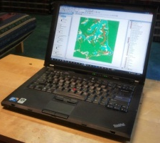
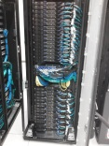
HydroShare
Collaboration
Create
Visualization
Social Media
Read
HydroDesktop
Update
Models
Delete
Data
WPS
Your favorite ...
Data.gov
Earth
Exchange
HPC
CSDMS
CUAHSI
HydroServer
Notes:
HydroShare is a system that we have proposed to address these issues. It will be an online collaborative environment for sharing hydrologic data and models aimed at giving hydrologist the technology infrastructure they need to address critical issues related to water quantity, quality, accessibility, and management. HydroShare will expand the data sharing capability of the CUAHSI Hydrologic Information System by broadening the classes of data accommodated, expanding capability to include the sharing of models and model components, and taking advantage of emerging social media functionality to enhance information about and collaboration around hydrologic data and models. We plan to develop sustainable cyberinfrastructure, basically a website, for better access to water-related data and models in the hydrologic sciences. Social media functionality will help users be better informed of the use and value of data and models so as to discover the information and tools most relevant to their needs as well as stimulate the combination of data and coupling of models from multiple sources and catalyze sharing and collaboration. We envisage that the system will help hydrologists more easily access water-related research data and models that are online, retrieve them to their desktops, and perform analyses that could include accessing other models or using computing systems in the cloud or in distributed grid infrastructures. This project is funded from 2012-2017.
I have worked for 20+ years on hydrologic modeling and have codes that are widely used as well as that have died of neglect. I have also had projects whose data is nicely organized in CUAHSI HIS and others where the data is buried in private files. I would like to develop this system to do better.
HydroShare will be a social media based web site that provides access to hydrologic data and models. It will contain its own resources as well as links to external resources, e.g. web services from the USGS or CUAHSI HydroServers. It will interact with other data and modeling systems such as NASA earth exchange and provide easy to use access to HPC resources e.g. at CSDMS.
HydroShare will be directly accessible to serve as a portal for collaboration among hydrologists. We recognize that there are a lot of collaboration websites being developed, so will focus on providing hydrology value added functionality in terms of access to data and models. HydroShare will also have a web services interface, building on CUAHSI HIS that provides access from desktop software such as HydroDesktop and R.

Slide 4
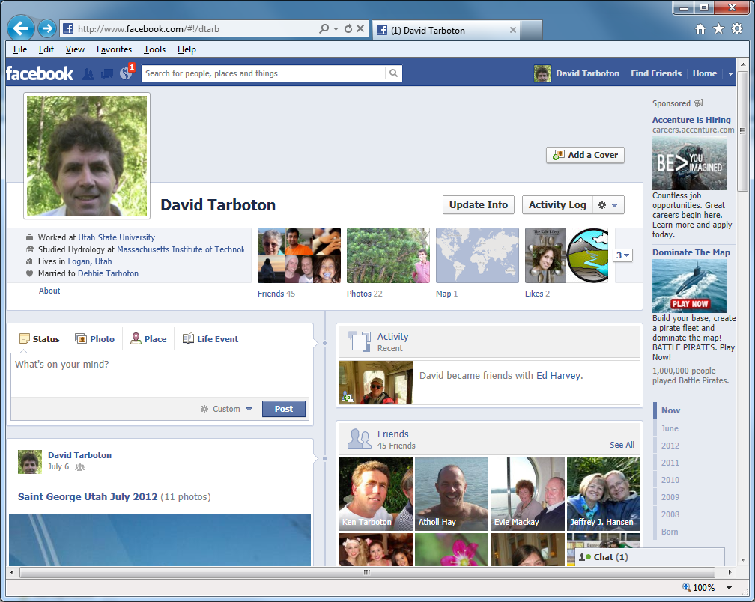
Can sharing data and models be as easy as sharing photos on Facebook or videos on YouTube?
Notes:
In short, we would like to see if sharing hydrologic data and models can be as easy as sharing photos on Facebook or videos on YouTube.

Slide 5
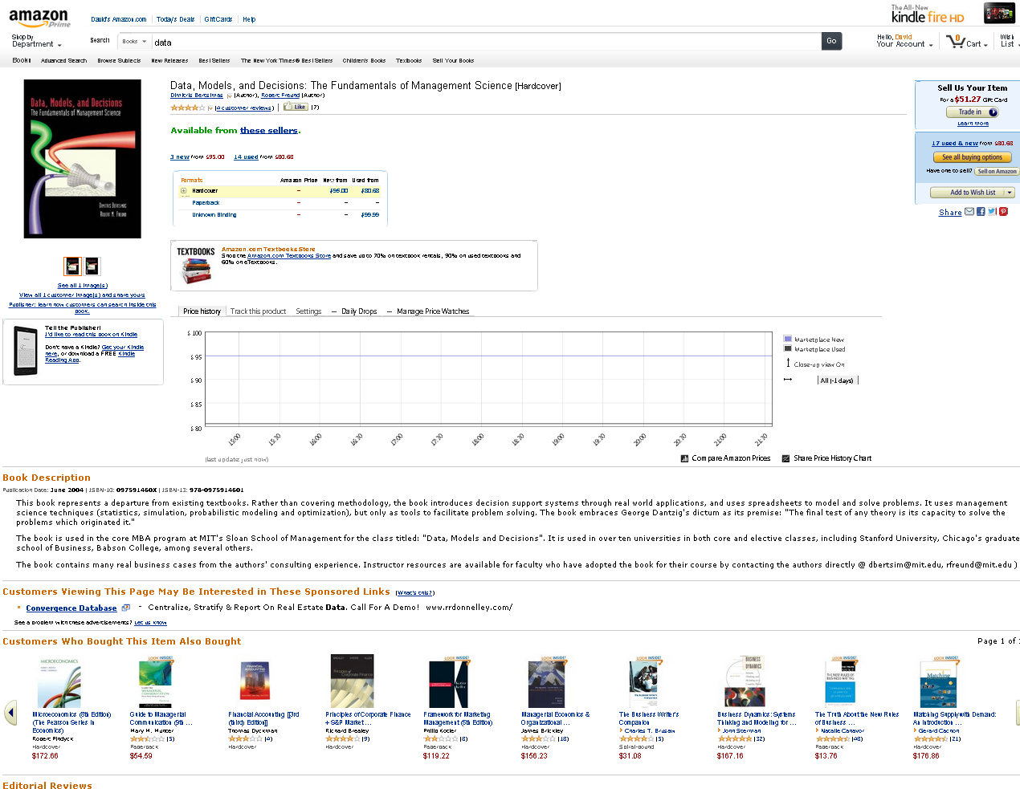
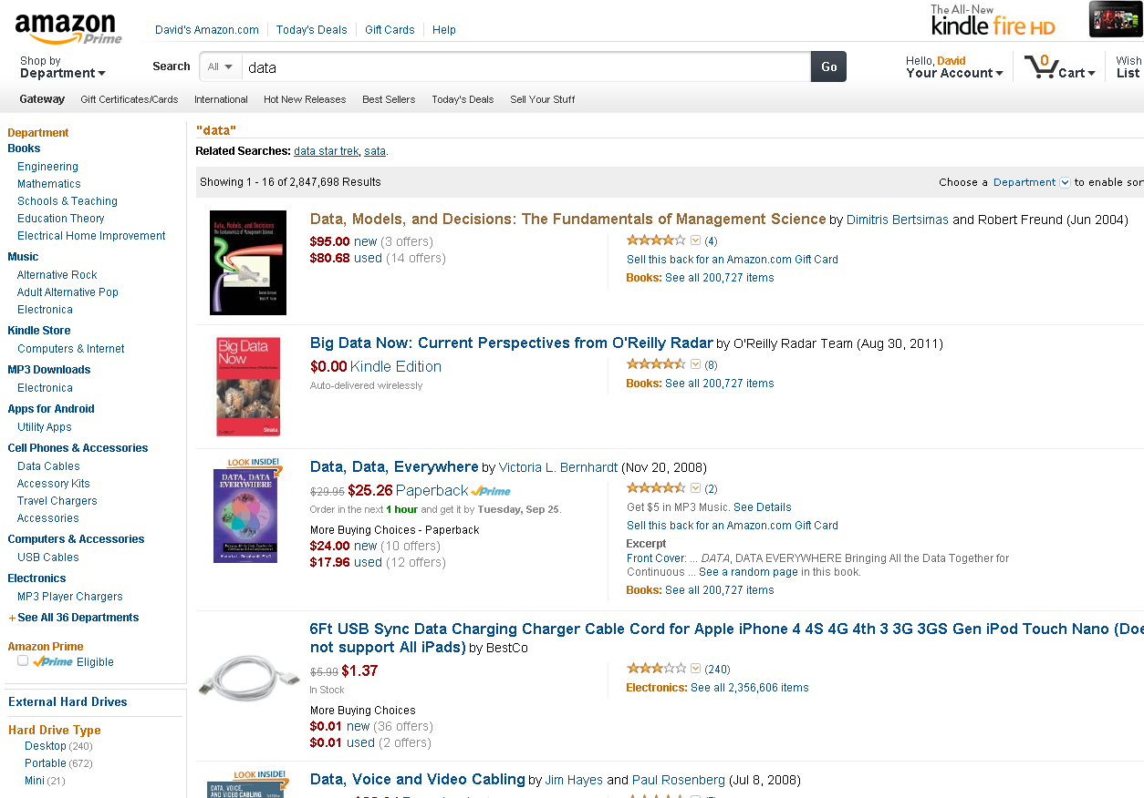
Can finding data and models be as easy as shopping on Amazon?
Possible Filters
Available Formats
Items
Recommendations
Prices (perhaps usage)
Notes:
Or whether finding data and models can be as easy as shopping on Amazon, and perhaps not as heavy on your credit card.
List of items also includes other providers, aka not shipped by amazon.
List of data shows ‘facets’
,
Items show formats recommendations. Add-in shows pricetracking

Slide 6
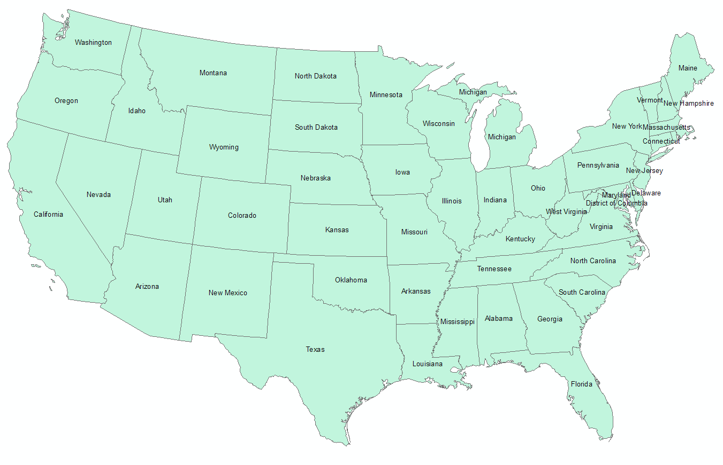
HydroShare project team
USU
RENCI/UNC
CUAHSI
ISU (BYU)
Tufts
USC
Texas
Purdue
SDSC
CUAHSI
HIS
Sharing hydrologic data
OCI-1148453
OCI-1148090
2012-2017
Notes:
The HydroShare project is part of a broad effort in CUAHSI in the area of Hydrologic Information Systems. We have a team of developers and domain scientists from eight universities working on HydroShare. This is part of the even broader focus in NSF on data management, Cyberinfrastructure and sustainable software.

Slide 7
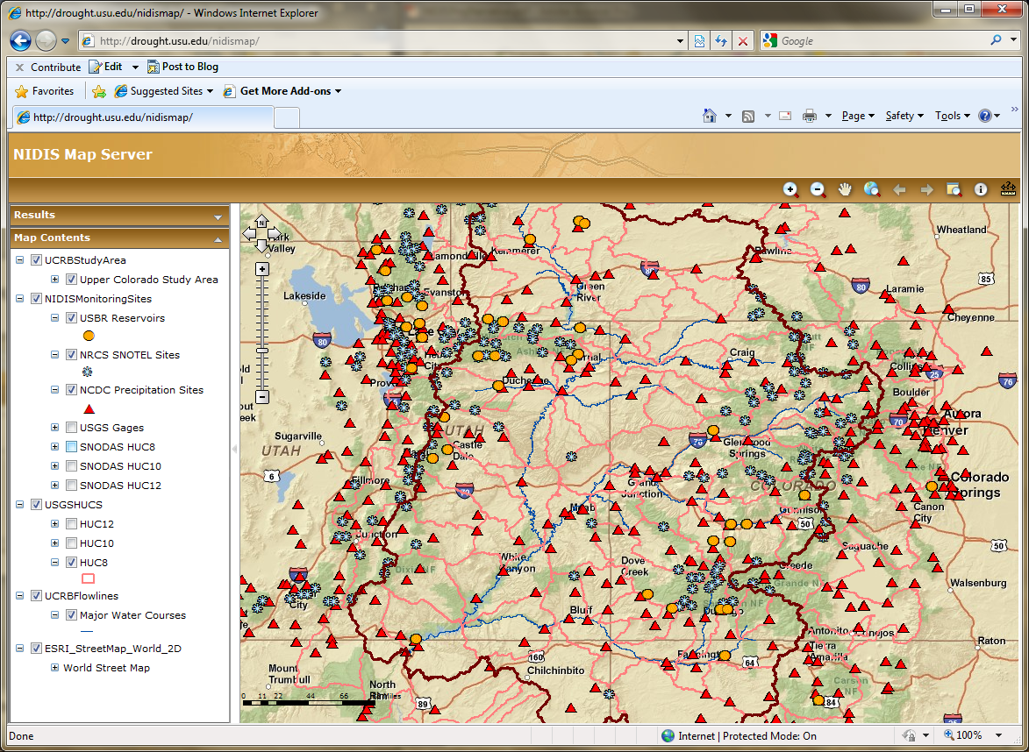
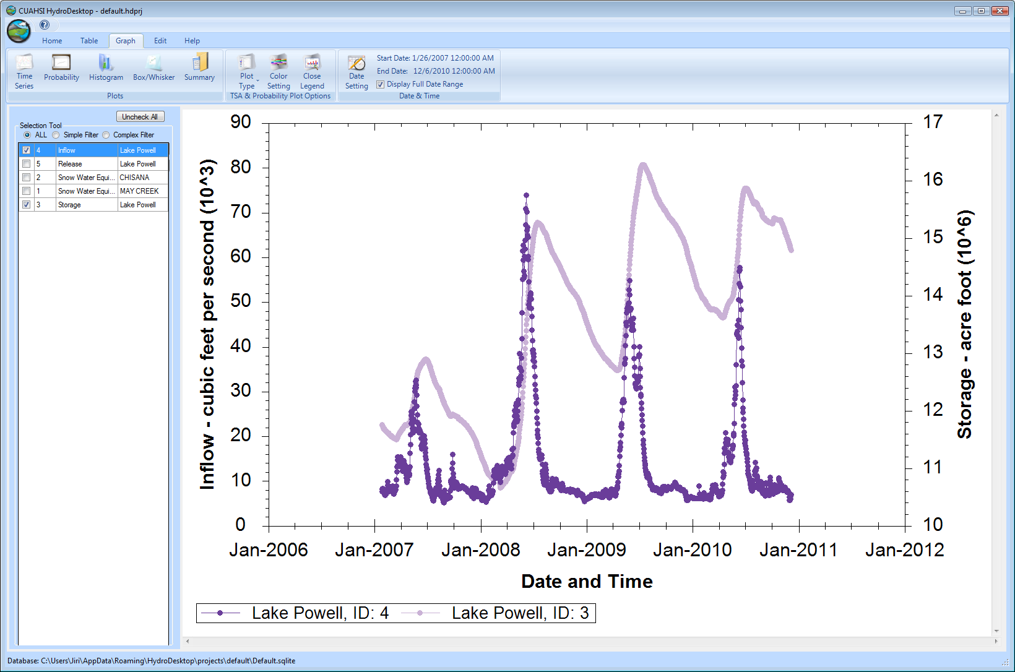
CUAHSI Hydrologic Information System
The CUAHSI Hydrologic Information System (HIS) is an internet based system to support the sharing of hydrologic data. It is comprised of hydrologic databases and servers connected through web services as well as software for data publication, discovery and access.
HydroServer – Data Publication
HydroCatalog
Data Discovery
Lake Powell Inflow and Storage
HydroDesktop – Data Access and Analysis
HydroDesktop – Combining multiple data sources

Slide 8
CUAHSI HIS Services-Oriented Architecture
Data Discovery and Integration
HydroCatalog
Metadata Services
WaterML, Other OGC Standards
Search Services
HydroServer
HydroDesktop
Data Publication
Data Services
Data Analysis and Synthesis
ODM
Geo Data
Information Model and Community Support Infrastructure
2004-2012, David Maidment PI, http://his.cuahsi.org

Slide 9
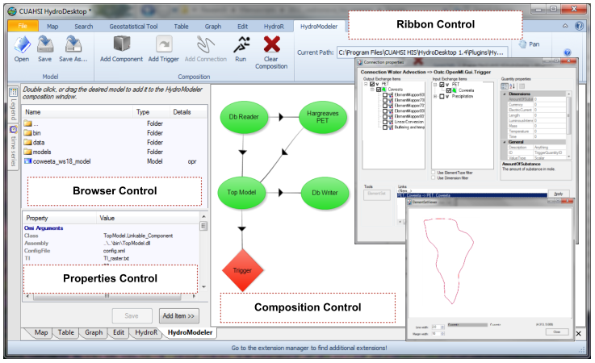
HydroDesktop and Modeling
An integrated modeling environment based on the Open Modeling Interface (OpenMI) standard and embedded within HydroDesktop
Integrated modeling within a Hydrologic Information System: An OpenMI based approach, Castronova, A.M., Goodall, J.L., Ercan, M,B. Environmental Modelling & Software, In Press. 10.1016/j.envsoft.2012.02.011.

Slide 10
CUAHSI HIS Key Aspects
Storage in a community data model
Publication from a server (92 registered to date)
Data access through internet-based services using consistent language and format
Tools for access and analysis
Discovery through thematic and geographic search functionality
Integrated modeling and analysis combining information from multiple sources
WaterML evolved into Open Geospatial Consortium Standard, being considered by WMO and used by USGS and EPA among others

Slide 11
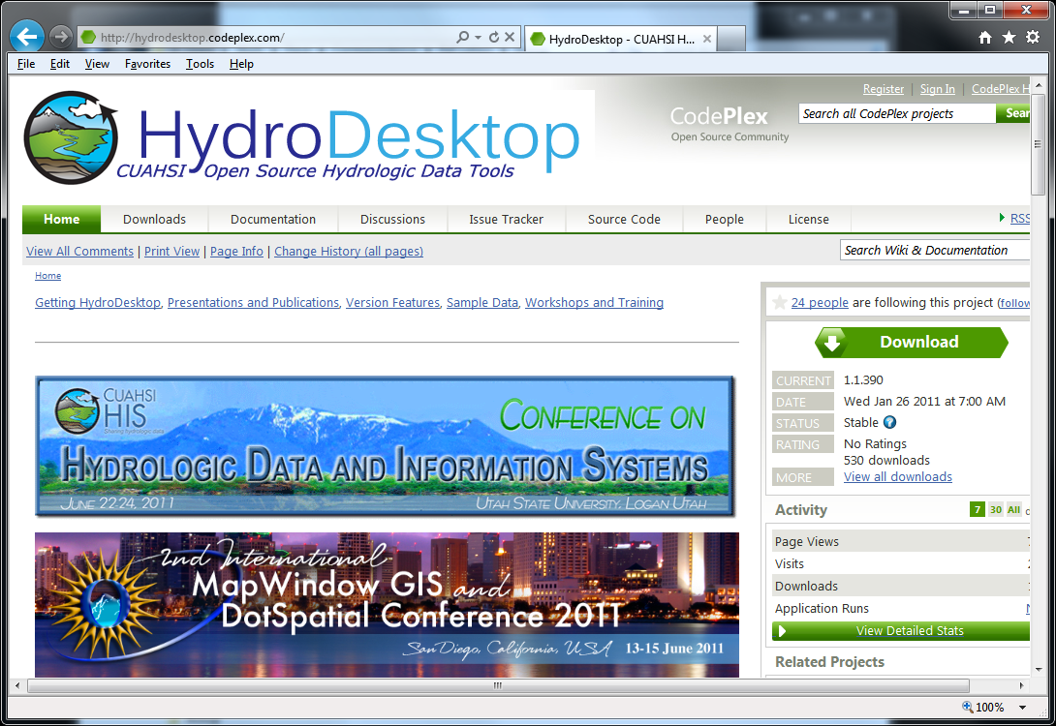
Open Development Model
http://his.cuahsi.org
http://hydrodesktop.codeplex.com
http://hydroserver.codeplex.com
http://hydrocatalog.codeplex.com
Notes:
All our HIS work is open source, but more importantly we use an open development model with open issue trackers, discussion forums and source code version control system. You can participate in these activities and we welcome your input and feedback. Together we can advance the art and practice of collaborative community modeling and data sharing.

Slide 12
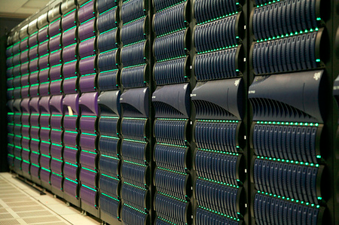
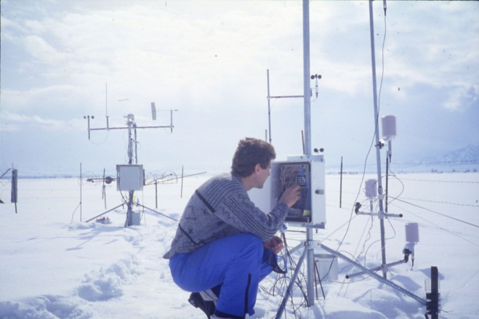
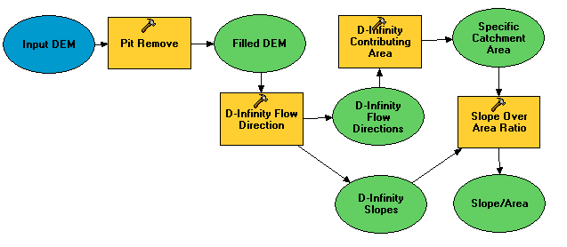
A Digital Divide
Researchers
Experimentalists
Modelers
Big Data and HPC
#!/bin/bash
vi
ontology
#PBS -l nodes=4:ppn=8
grep
mpiexec
awk
chmod
Notes:
Part of the challenge we want to address is the digital divide between hydrologic researchers concerned with instruments, analysis and models and big data and HPC where even grasping the terminology involved can be daunting

Slide 13
NSF vision
“enabling software systems are needed to create an environment in which the barrier to access is low for innovation and new discovery”
Data Management and Preservation
Software Sustainability
http://www.nsf.gov/pubs/2012/nsf12113/nsf12113.pdf
Notes:
This work is in the context of NSF’s CF 21 vision for enabling software systems where the barrier to access is low for innovation and discovery. Data management and software sustainability are key parts of this.
Part of software sustainability is the application of commercially-established software engineering techniques which we are employing in HydroShare; a very different model than how academic code has traditionally been developed.

Slide 14
Overlying Concepts
HydroShare must change the way we do science
HydroShare is a collaboration environment and social media site
HydroShare must appeal to the community
HydroShare is designed and governed to be responsive to community input
HydroShare has to be dead simple to use

Slide 15
Functionality to be developed
A new, web-based system for advancing model and data sharing
Sharing features to HydroDesktop
Access more types of hydrologic data using standards compliant data formats and interfaces
Enhance catalog functionality that broadens discovery functionality to different data types and models
New model sharing and discovery functionality
Facilitate and ease access to use of high performance computing
New social media and collaboration functionality

Slide 16
Extend HIS Data Formats
Point Observations (Time Series in ODM/WaterML)
Feature data set (Shapefile of points, lines or polygons and attribute tables)
Raster data set (GeoTIFF file)
Multidimensional space/time data set (NetCDF file)
Geochemistry (ODM2)
Generalize catalog to include these formats
Adopt or develop appropriate web services or data delivery mechanisms

Slide 17
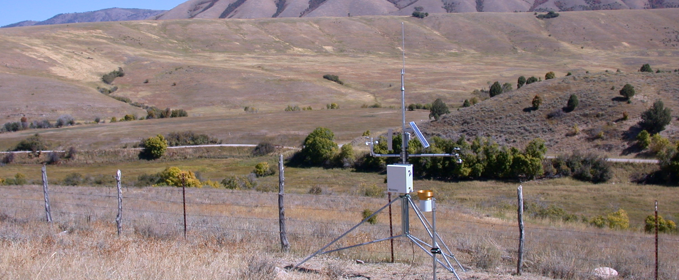
Sign In | Settings | Notifications | Feedback | Help
HydroShare
Dashboard
Recent Activity
My Content
View Your Resources
Explore
Discover Resources
Collaborate
Share with colleagues
Share your work with others
Share and Collaborate
HydroShare is an online collaboration environment for sharing data, models, and code. Join the community to start sharing.
HydroShare Gallery
How HydroShare Works
Getting Started
Getting Started
What’s New
Provide feedback
HydroShare Blog
Developers
Partners
CUAHSI
CUAHSI HIS
CUAHSI Water Data Center
Terms of Use | Statement of Privacy| Copyright © 2012 CUAHSI
This material is based upon work supported by the National Science Foundation (NSF) under Grants No. OCI-1148453, OCI-1148090
Any opinions, findings, conclusions, or recommendations expressed in this material are those of the authors and do not necessarily reflect the views of the NSF.
Notes:
Home Page
Gallery – shows featured, new, or highly rated resources (data, code, models, workflows, etc.)
Could have separate galleries for models, code, data, etc.
Top Bar Items
Sign in
Settings
Create a HydroShare profile
Choose display preferences
Choose default privacy (share everything or choose what to share)
Account information (password, etc.)
Notifications - messages from the HydroShare team (choose to receive notifications from HydroShare)
Help

Slide 18
You are signed in as Jeff Horsburgh | Settings | Notifications | Feedback | Help
HydroShare
Dashboard
Recent Activity
My Content
View Your Resources
Explore
Discover Resources
Collaborate
Share with colleagues
Share your work with others
Recent Activity
All activity | Only my activity
Profile
Little Bear River ODM
Database 6/6/2012
Jeff Horsburgh
Utah State University
jeff.horsburgh@usu.edu
Little Bear River Sites 6/6/2012
Little Bear River Excel File 6/6/2012
Resources You May Like
Little Bear River SWAT Model
Shared by: David Tarboton
Watershed delineation Workflow 6/6/2012
Abstract: Time series of water quality sensor data in the Little Bear River, Utah, USA
Keywords: Temperature, Dissolved Oxygen, pH, Specific Conductance, Turbidity
Little Bear River DEM
Shared by: David Tarboton
More
View Details
You Should Follow
People | Groups
Announcements
What’s New at HydroShare: Click here to visit the HydroShare blog to learn more about recent updates and new HydroShare features.
Jeff Horsburgh
Utah State University
David Tarboton
Utah State University
Terms of Use | Statement of Privacy| Copyright © 2012 CUAHSI
This material is based upon work supported by the National Science Foundation (NSF) under Grants No. OCI-1148453, OCI-1148090
Any opinions, findings, conclusions, or recommendations expressed in this material are those of the authors and do not necessarily reflect the views of the NSF.
Notes:
Dashboard
A user's home page
Shows user information/profile
Lists recent HydroShare activity in multiple categories (user's recent activity, all recent activity)
Announcements from HydroShare team
Suggests datasets the user might be interested in (geographic proximity, similar variables, similar time period, aggregations, keywords)
Suggests people that the user might want to "follow"
Suggests groups that the user might be interested in

Slide 19
You are signed in as Jeff Horsburgh | Settings | Notifications | Help
HydroShare
Dashboard
Recent Activity
My Content
View Your Resources
Explore
Discover Resources
Collaborate
Share with colleagues
Share your work with others
My Resources | All your resources in one place
Keyword:
Little Bear River
Search
Advanced
+ Upload
X Delete
Share
Export
 | Type | Title | Date | Abstract
 |  | Little Bear River ODM Database | 6/6/2012 | Utah State University is conducting continuous monitoring within the Little Bear River watershed of northern Utah, USA to investigate the use of surrogate ...
 |  | Little Bear River Sites | 6/6/2012 | Shapefile of monitoirng sites in the Little Bear River watershed.
 |  | Watershed Delineation Workflow | 6/6/2012 | TauDEM workflow to delineate watershed from DEM. Stream threshold is determined automatically to obtain objective drainage density estimate.
 |  | Little Bear River SWAT Model | 6/6/2012 | This is a Soil and Water Assessment Tool model package that is ready to execute. All inputs and outputs are included in the model package.
 |  | Little Bear River DEM | 6/6/2012 | 2 m resolution Digital Eleva6tion Model derived from LIDAR.
 |  | Stream Metabolism R Script | 6/6/2012 | This R script contains a set of functions that implement a one-station stream metabolism model
Results 1 – 10 of 100 << 1 2 3 4 5 6 7 8 9 10 >>
Terms of Use | Statement of Privacy| Copyright © 2012 CUAHSI
This material is based upon work supported by the National Science Foundation (NSF) under Grant No. XXXXXXXX.
Any opinions, findings, conclusions, or recommendations expressed in this material are those of the authors and do not necessarily reflect the views of the NSF.
Notes:
My Content
Tabular list of all resources that a user has submitted
Links to a details page for each resource
List may be organized into folders (as implemented in ArcGIS online, Dropbox, Google docs, etc.)
Thumbnail/icon previews of each resource where appropriate
Functionality on page applying to the list of resources
Add Item/Submit resources to HydroShare
Filter the list of submitted resources by category (data, models, documents, etc.), date, etc.
Sort the list of submitted resources by title, rating, views, date, etc.
Delete selected resources
Share selected resources
Create new folder for resources
Move resources from one folder to another folder
Search through my submitted resources
Export data resource (everything in the system should be portable!!!)
May want to support export in a number of different formats

Slide 20
You are signed in as Jeff Horsburgh | Settings | Notifications | Feedback | Help
HydroShare
Dashboard
Recent Activity
My Content
View Your Resources
Explore
Discover Resources
Collaborate
Share with colleagues
Share your work with others
Little Bear River Monitoring Sites | Resource Details
Open
Share
Export
Edit
Delete
Comments
Add Comment
Resource Type: ESRI Shapefile
Created by: Jeff Horsburgh
Created: 6/10/2012
Keywords: Observations Catalog, Data Cart, Little Bear River, Utah, CUAHSI, Water, Utah State University, Continuous Monitoring, Water Quality, Streamflow
Size: 250 KB
Extent: Left: -111.95 Right: -111.79
Top: 41.73 Bottom: 41.48
Jeff Horsburgh: This shapefile is really helpful if you want to know where my monitoring sites are located.
Shared With
Dan Ames
Brigham Young University
David Tarboton
Utah State University
Resource Description
Abstract: Utah State University is conducting continuous monitoring within the Little Bear River watershed of northern Utah, USA to investigate the use of surrogate measures such as turbidity in creating high frequency load estimates for constituents that cannot be measured continuously. This shapefile contains location of USU’s continuous monitoring sites.
Citation: Horsburgh, J. S., D. K. Stevens, D. G. Tarboton, N. O. Mesner, A. Spackman Jones, and S. Gurrero, (2009), Monitoring data collected within the Little Bear River Experimental Watershed, Utah, USA, Utah State University.
Similar Resources
Little Bear River Sites
Shared by: Jeff Horsburgh
Little Bear River ODM Database
Shared by: Jeff Horsburgh
Terms of Use | Statement of Privacy| Copyright © 2012 CUAHSI
This material is based upon work supported by the National Science Foundation (NSF) under Grants No. OCI-1148453, OCI-1148090
Any opinions, findings, conclusions, or recommendations expressed in this material are those of the authors and do not necessarily reflect the views of the NSF.
Notes:
Resource Details
Shows a preview of the resource if a viewer is available
Shows metadata details for a resource (need metadata standards for different resource types)
Metadata listed are context sensitive (related to the type of resource)
Shows comments, keywords/tags, and annotations for the resource
Shows who the resource is shared with
Listed functionality relevant to a dataset (actions are context sensitive to the type of resource)
Derive new dataset (e.g., time or space aggregation on existing datasets)
Download resource to local computer (resource + metadata)
Open resource in a viewer/visualization tool
Open resource in an appropriate analysis environment (e.g., R, SQLShare, ArcGIS Server JavaScript interface, HydroDesktop)
Edit dataset/dataset description
Export dataset
Delete dataset
Share dataset (May incur additional metadata requirements at the point of sharing)
Share Resources with a Group
Make Resources Public in HydroShare
Publish Resources to CUAHSI Data Center, DataONE, AGU, etc.
Choose who can access the resource
Choose who can view, edit, comment on, or annotate a resource

Slide 21
You are signed in as Jeff Horsburgh | Settings | Notifications | Feedback | Help
HydroShare
Dashboard
Recent Activity
My Content
View Your Resources
Explore
Discover Resources
Collaborate
Share with colleagues
Share your work with others
Little Bear River SWAT Model | Resource Details
Open
Execute
Share
Export
Edit
Delete
Comments
Add Comment
Resource Type: Model Package
Created by: Jeff Horsburgh
Created: 6/10/2012
Keywords: Little Bear River, Nutrients, Phosphorus, Water Quality, Model
Size: 100 MB
Jeff Horsburgh: This model package is ready to execute.
Shared With
Jon Goodall
University of South Carolina
Resource Description
Abstract: This is a Soil and Water Assessment Tool model package that is ready to execute. All inputs and outputs are included in the model package.
Required Inputs: High frequency (sub-daily) measurements of water temperature, dissolved oxygen, solar radiation, barometric pressure,
Outputs: Daily estimates of streamflow and water quality for subwatersheds in the Little Bear River.
Citation: Horsburgh, J. S. (2012), Little Bear River SWAT Model, Utah State University, Logan, UT.
Similar Resources
Neuse River SWAT Model
Shared by: Jon Goodall
Neuse River Rhessys Model
Shared by: Larry Band
Terms of Use | Statement of Privacy| Copyright © 2012 CUAHSI
This material is based upon work supported by the National Science Foundation (NSF) under Grants No. OCI-1148453, OCI-1148090
Any opinions, findings, conclusions, or recommendations expressed in this material are those of the authors and do not necessarily reflect the views of the NSF.
Notes:
For model or workflow packages that are complete and ready to execute
HydroShare may know how to send these to compute resources for execution directly
HydroShare may ask users to open the package in HydroDesktop for execution
HydroShare may open the package directly in a workflow software (e.g., Kepler, others)
Need to figure out how packages would be built (e.g., in HydroDesktop and then uploaded?)
Need to figure out how to manage results

Slide 22
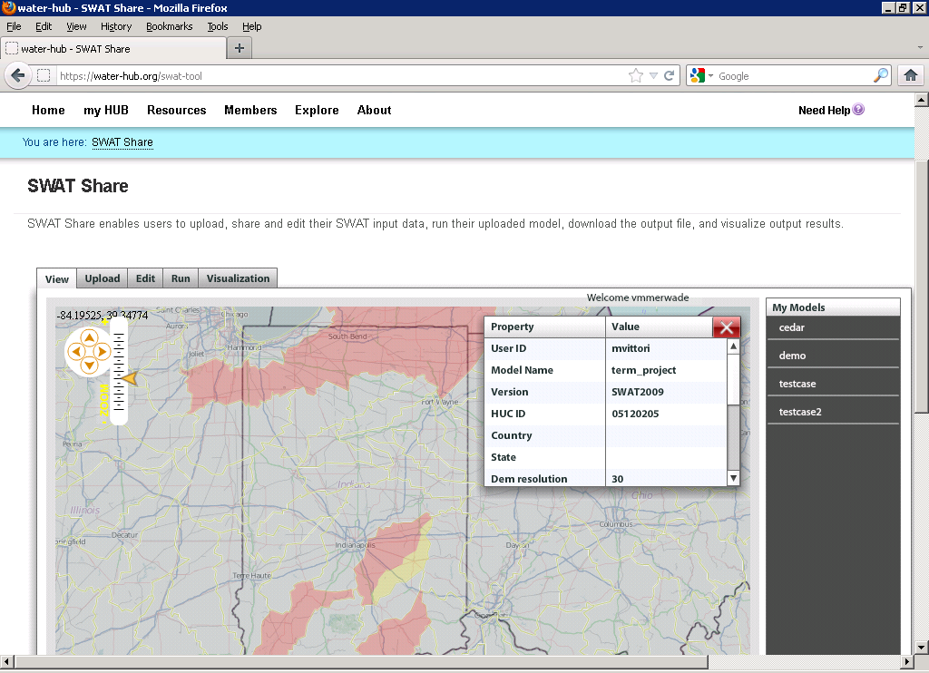
E.g. SWATShare
A HUBZero based tool for publishing, sharing, and accessing Soil Water Assessment Tool (SWAT)
www.water-hub.org/swat-tool
Notes:
You need to log-in to use the functions of SWAT share. On this slide, you see a map the watershed in red are the one for which SWAT models are available. Once you click a on one of the watersheds (highlighted in yellow), then you see then you see the associated metadata with the model. If the model is only published (and not shared), one cannot download or run the model. However, if the model is published and shared, any user can download, modify, and run the model on the SWATShare.

Slide 23
You are signed in as Jeff Horsburgh | Settings | Notifications | Feedback | Help
HydroShare
Dashboard
Recent Activity
My Content
View Your Resources
Explore
Discover Resources
Collaborate
Share with colleagues
Share your work with others
Explore | Discover and access resources published by others
Keyword:
Little Bear River
Search
Advanced
Resource Type:
Geospatial dataset
Date:
1/1/2012 – 6/12/2012
Sort by: Relevance Title Owner Rating Date
Title: Little Bear River Sites 6/6/2012
Shared by: Jeff Horsburgh
Title: Little Bear River DEM 6/10/2012
Shared by: David Tarboton
Title: National Land Cover Dataset 6/10/2012
Shared by: United States Geological Survey
Title: National Elevation Dataset 6/10/2012
Shared by: United States Geological Survey
Results 1 – 10 of 100 << 1 2 3 >>
Terms of Use | Statement of Privacy| Copyright © 2012 CUAHSI
This material is based upon work supported by the National Science Foundation (NSF) under Grants No. OCI-1148453, OCI-1148090
Any opinions, findings, conclusions, or recommendations expressed in this material are those of the authors and do not necessarily reflect the views of the NSF.
Notes:
Discover and access HydroShare resources shared by others
Discover data by metadata
Discover data by content?
Discover and access national datasets with access provided through HydroShare
National Elevation Dataset
National Land Cover Dataset
National Hydrography Dataset
Search HIS Central/CUAHSI Data Center and import from HydroServers
Discover and access models, scripts, and code
Comment on and/or rate datasets submitted by others
Discovered resources (or links to them) should be able to be added to a user’s resources.
Will require a HydroShare metadata catalog and federation with other catalogs such as the HIS Central/CUAHSI Data Center catalog

Slide 24
You are signed in as Jeff Horsburgh | Settings | Notifications | Feedback | Help
HydroShare
Dashboard
Recent Activity
My Content
View Your Resources
Explore
Discover Resources
Collaborate
Share with colleagues
Share your work with others
Collaborate | Build your research network
Create a Group
Keyword:
Search Groups
Groups You Might be Interested In
Show
All my groups
Owned by me
You are a member of 2 groups
Name: Little Bear River Research Group
Description: This group is studying water quality
in the Little Bear River, Utah, USA.
Created by: Jeff Horsburgh
Name: USU Hydrology Group
Created by: David Tarboton
Name: Little Bear River Junkies
Created by: Jeff Horsburgh
Name: CUAHSI
Description: This group shares resources related
to hydrologic science.
Created by: Rick Hooper
To what extent can we reuse capability and blend in with general purpose social networks like facebook, google+ or linkedin?
Terms of Use | Statement of Privacy| Copyright © 2012 CUAHSI
This material is based upon work supported by the National Science Foundation (NSF) under Grants No. OCI-1148453, OCI-1148090
Any opinions, findings, conclusions, or recommendations expressed in this material are those of the authors and do not necessarily reflect the views of the NSF.
Notes:
Collaborate
Create Groups
Search for Groups
List
All groups
Groups owned by user
Groups owned by others but that the user is a member of
Lists suggested groups for the user
Based on proximity, keywords, data types, variables, etc.
This begs metadata for groups, i.e. concepts like an owner, creator, administrator and the ability to change these. Also triggers of alerts when status is changed based on options

Slide 25
Interoperable data sharing
Tim Berners-Lee contends that the danger of social networking sites is that most are silos and do not allow users to port data from one site to another. He also cautions against social networks that grow too big and become a monopoly as this tends to limit innovation.
We need:
Well defined APIs for client application developers
Well defined data encoding and transfer formats to ensure that all data is portable
Standard CRUD interfaces
(http://www.scientificamerican.com/article.cfm?id=long-live-the-web)

Slide 26
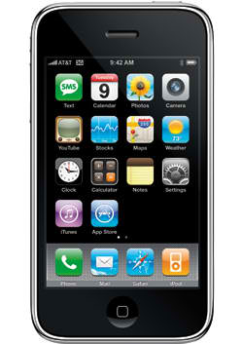
Support Client/App Functionality
Upload to HydroShare
Search HydroShare
Download from HydroShare
Download and execute model or workflow packages
Build and upload model or workflow packages
Submit HPC jobs?
Multiple clients (Desktop, iOS, Android)

Slide 27
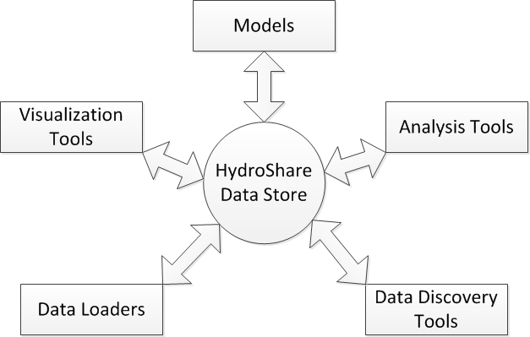
Using HydroShare for Modeling and Analysis

Slide 28
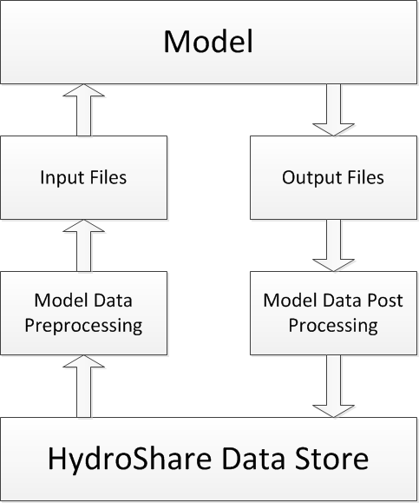
General Model Execution Paradigm

Slide 29
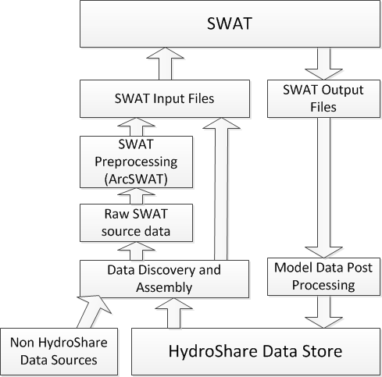
Examples
VIC, HSPF, Others ... You contribute your model

Slide 30
Levels of Model Integration
Model A
Model B
Model C
Data centric workflow
Data
Data
Data
Data
Data
Data
HydroShare Model & Data Store
Data Exchange during execution, e.g. using OpenMI
Model A
Data
Model B
Data
Model C
Loose coupling
Data
Data
Data
Data
Data
Data
HydroShare Model & Data Store
Code integrated and compiled together
Model A
Model B
Model C
Tight coupling
Data
Data
HydroShare Model & Data Store

Slide 31
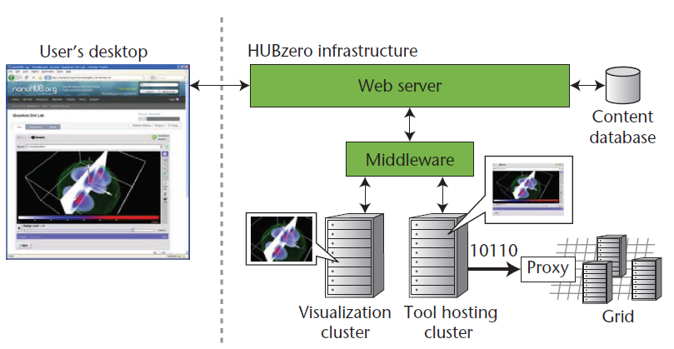
HUBzero Based Community Portal
Data & Model Resources
Discovery & access
Development
Execution on local VM
Execution on remote HPC
Publishing
Collaboration
Web Portal
Social networking
Community collaboration
Resource rating
Documents & videos
Learning modules
Architecture of HUBzero platform used to create dynamic web sites for scientific research and educational activities
http://dx.doi.org/10.1109/MCSE.2010.41
http://hubzero.org http://water-hub.org

Slide 32
Enterprise Integrated Rule-Oriented Data System
Open source middleware with pluggable architecture produced by UNC Chapel Hill (i.e. production quality iRODS)
Via microservices:
iRODS rules can automatically register available data
Programmatic capability to process data on upload/registration
Can automatically convert file formats (e.g. to create resources for visualization)
Can automatically assign unique and persistent identifiers
Can automatically parse metadata for semantic content and tag with additional semantic content
Can make metadata discoverable by other users/tools
Access control is enforced at the file level
Rules can be scheduled and run periodically
CORE
Auth
Database
Messaging
Microservices
Objects
Resources
RPC API
http://www.e-irods.org/
Notes:
Side note: “Enterprise” here means production quality and intended to operate in the enterprise, but E-iRODS is still free non-commercial code.

Slide 33
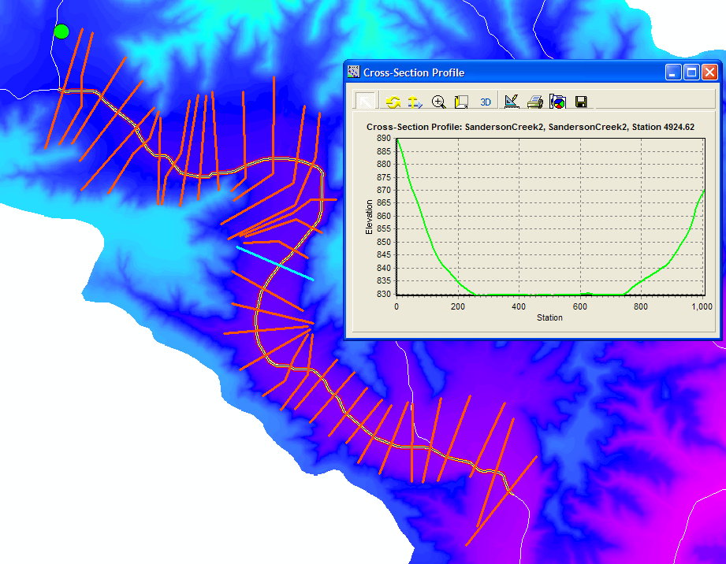
Facilitating Access to Critical National Datasets
NASA Earth Exchange
National River Morphology Dataset
Baltimore and Coweeta LTER
Already part of HIS
USGS Streamflow
EPA
Others

Slide 34
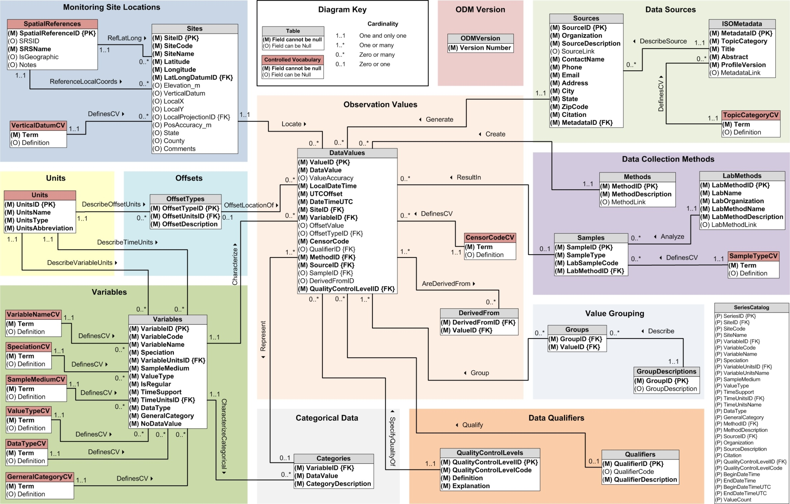
Questions ?
You are signed in as David Tarboton | Settings | Notifications | Feedback | Help
HydroShare
Share
Your Resources
Explore
Discover Resources
Collaborate
Interact with colleagues
Share your work with others
Summary
Simple and easy to use
Data and model sharing enabled by open standards based metadata
Find, create, share, connect, interact, work together online
Archive data collections accompanying research publications in easily accessible way
Integration and synthesis across data collections
To participate
See http://his.cuahsi.org
Join his@sdsc.edu
Write dtarb@usu.edu
Terms of Use | Statement of Privacy| Copyright © 2012 CUAHSI
This material is based upon work supported by the National Science Foundation (NSF) under Grants No. OCI-1148453, OCI-1148090
Any opinions, findings, conclusions, or recommendations expressed in this material are those of the authors and do not necessarily reflect the views of the NSF.

Slide 35
HydroShare
Collaboration
Create
Visualization
Social Media
Read
HydroDesktop
Update
Models
Delete
Data
WPS
Your favorite ...
Data.gov
Earth
Exchange
HPC
CSDMS
CUAHSI
HydroServer
Notes:
HydroShare is a system that we have proposed to address these issues. It will be an online collaborative environment for sharing hydrologic data and models aimed at giving hydrologist the technology infrastructure they need to address critical issues related to water quantity, quality, accessibility, and management. HydroShare will expand the data sharing capability of the CUAHSI Hydrologic Information System by broadening the classes of data accommodated, expanding capability to include the sharing of models and model components, and taking advantage of emerging social media functionality to enhance information about and collaboration around hydrologic data and models. We plan to develop sustainable cyberinfrastructure, basically a website, for better access to water-related data and models in the hydrologic sciences. Social media functionality will help users be better informed of the use and value of data and models so as to discover the information and tools most relevant to their needs as well as stimulate the combination of data and coupling of models from multiple sources and catalyze sharing and collaboration. We envisage that the system will help hydrologists more easily access water-related research data and models that are online, retrieve them to their desktops, and perform analyses that could include accessing other models or using computing systems in the cloud or in distributed grid infrastructures. This project is funded from 2012-2017.
I have worked for 20+ years on hydrologic modeling and have codes that are widely used as well as that have died of neglect. I have also had projects whose data is nicely organized in CUAHSI HIS and others where the data is buried in private files. I would like to develop this system to do better.
HydroShare will be a social media based web site that provides access to hydrologic data and models. It will contain its own resources as well as links to external resources, e.g. web services from the USGS or CUAHSI HydroServers. It will interact with other data and modeling systems such as NASA earth exchange and provide easy to use access to HPC resources e.g. at CSDMS.
HydroShare will be directly accessible to serve as a portal for collaboration among hydrologists. We recognize that there are a lot of collaboration websites being developed, so will focus on providing hydrology value added functionality in terms of access to data and models. HydroShare will also have a web services interface, building on CUAHSI HIS that provides access from desktop software such as HydroDesktop and R.

