Slide 1
HydroShare An online, collaborative environment for the sharing of hydrologic data and models
David Tarboton, Ray Idaszak, Dan Ames, Jon Goodall, Jeff Horsburgh, Larry Band, Venkatesh Merwade, Carol Song, Alva Couch, David Valentine, Rick Hooper, Jennifer Arrigo, David Maidment, Tim Whiteaker
CUAHSI
HIS
Sharing hydrologic data
Support
OCI-Forthcoming

Slide 2
What is HydroShare?
An online sustainable environment to be developed for the sharing of hydrologic data and models
To expand data sharing capability of CUAHSI HIS
Additional data classes
Models, scripts, tools and workflows
Collaboration/social networking

Slide 3
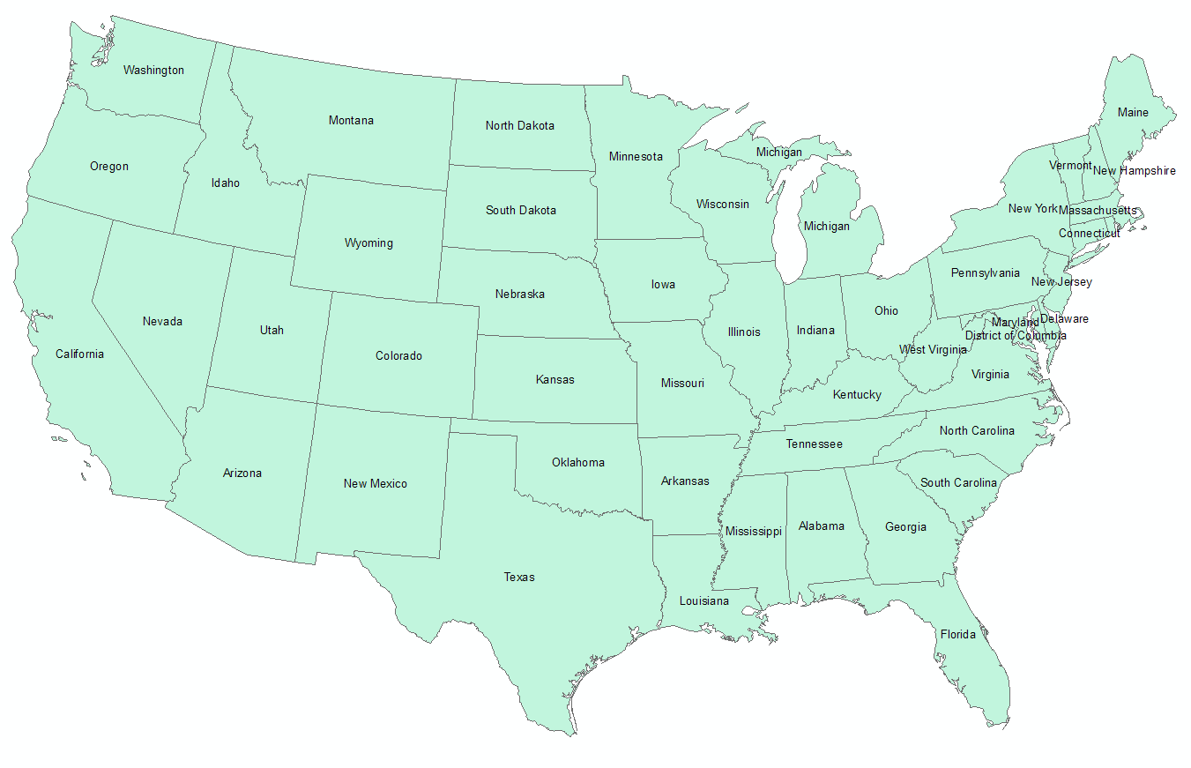
5-Year project ($4.5 million)
Proposal submitted 7/18/11 ($ 5 million)
Notified to be funded with reduced budget
Awaiting award
Collaborative project
USU
ISU (BYU), Tufts, CUAHSI, USC, Texas
RENCI/UNC
Purdue, SDSC

Slide 4
Collaborative research use case
Consumer
1
HydroDesktop
6
Web Gateway/Portal
11
Observer or instrument
5
4
10
Web Services
2
8
7
3
9
HydroServer
HydroCatalog
Data Storage
Present HIS
HydroShare
Much infrastructure online “in the Cloud”
Notes:
Data are observed and then loaded into HydroServer
HydroServer stores data in a relational database and publishes it using web services
Metadata is harvested at HydroCatalog into a global metadata repository that supports geographic and context based data discovery
A HydroDesktop user discovers the data using search services supported at HydroCatalog and
downloads the data from the HydroServer on which it is hosted into Hydrodesktop and performs his/her analysis
Presume that at this point in the HIS research cycle, a researcher selects data from HydroServers, filters the data in some way, and performs an analysis with a particular model resulting in some derived data or results – all of which need to be shared as part of a collaborative process. HIS was envisioned as a vehicle for capturing and publishing raw data, but does not have an easy way to facilitate sharing of models, or recording the metadata for model or analysis results placed in a HydroServer. HydroShare is envisioned as the solution.
(6) The user now posts the derived data and models to HydroShare using HydroDesktop. HydroDesktop ensures the data and models are in a format compliant with a community adopted standard, much of which HydroDesktop will have retained from the original data source and augmented based upon the analysis performed.
(7) Upon ingestion background actions parse the data,
(8) exposing the data and metadata through web services. Access control is set by the user
(9) Metadata pertaining to the data is harvested by HydroCatalog
(10) A collaborator discovers the derived data perhaps having been alerted to its presence through the collaboration forum functionality
(11) A collaborator downloads the data using HydroDesktop supported by new web services from HydroShare.
At this point steps (6) through (11) may iterate as a group of collaborators perform their analyses, create key graphics, discuss major conclusions and outline a paper. Once the work is complete, the paper may be submitted for publication describing the final resulting datasets, which are assigned a unique identifier (e.g., digital object identifier) and made immutable and open to the public.

Slide 5
Functionality to be developed
A new, web-based system for advancing model and data sharing
Sharing features to HydroDesktop
Access more types of hydrologic data using standards compliant data formats and interfaces
Enhance catalog functionality that broadens discovery functionality to different data types and models
New model sharing and discovery functionality
Facilitate and ease access to use of high performance computing
New social networking and collaboration functionality

Slide 6
Overlying Concepts
HydroShare must change the way we do science
HydroShare is a collaboration environment and social media site
HydroShare must appeal to the community
HydroShare is designed and governed to be responsive to community input
HydroShare has to be dead simple to use

Slide 7
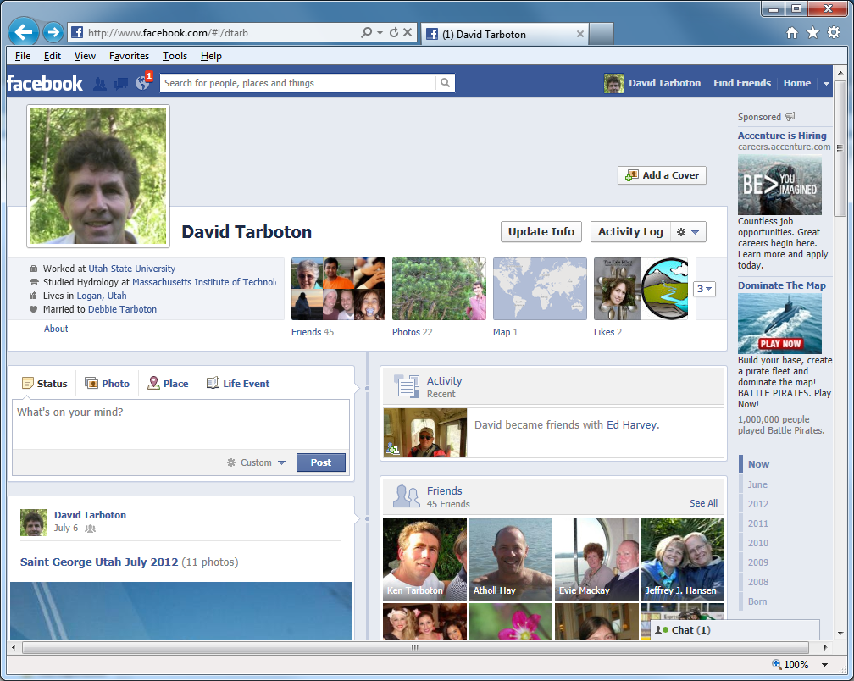
Can sharing data and models be as easy as sharing photos on Facebook or videos on YouTube?

Slide 8
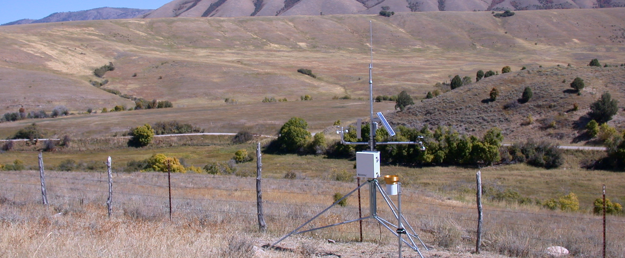
Sign In | Settings | Notifications | Help
Dashboard
Recent Activity
My Content
View Your Resources
Explore
Discover Resources
Collaborate
Share with colleagues
Support
Help/Feedback
Share and Collaborate
HydroShare is an online collaboration environment for sharing data, models, and code. Join the community to start sharing.
HydroShare Gallery
How HydroShare Works
Getting Started
Getting Started
What’s New
Provide feedback
HydroShare Blog
Developers
Partners
CUAHSI
CUAHSI HIS
CUAHSI Water Data Center
Terms of Use | Statement of Privacy| Copyright © 2012 CUAHSI
This material is based upon work supported by the National Science Foundation (NSF) under Grant No. XXXXXXXX.
Any opinions, findings, conclusions, or recommendations expressed in this material are those of the authors and do not necessarily reflect the views of the NSF.
Notes:
Home Page
Gallery – shows featured, new, or highly rated resources (data, code, models, workflows, etc.)
Could have separate galleries for models, code, data, etc.
Top Bar Items
Sign in
Settings
Create a HydroShare profile
Choose display preferences
Choose default privacy (share everything or choose what to share)
Account information (password, etc.)
Notifications - messages from the HydroShare team (choose to receive notifications from HydroShare)
Help

Slide 9
You are signed in as Jeff Horsburgh | Settings | Notifications | Help
Dashboard
Recent Activity
My Content
View Your Resources
Explore
Discover Resources
Collaborate
Share with colleagues
Support
Help/Feedback
Recent Activity
All activity | Only my activity
Profile
Little Bear River ODM
Database 6/6/2012
Jeff Horsburgh
Utah State University
jeff.horsburgh@usu.edu
Little Bear River Sites 6/6/2012
Little Bear River Excel File 6/6/2012
Resources You May Like
Little Bear River SWAT Model
Shared by: David Tarboton
Watershed delineation Workflow 6/6/2012
Abstract: Time series of water quality sensor data in the Little Bear River, Utah, USA
Keywords: Temperature, Dissolved Oxygen, pH, Specific Conductance, Turbidity
Little Bear River DEM
Shared by: David Tarboton
More
View Details
You Should Follow
People | Groups
Announcements
What’s New at HydroShare: Click here to visit the HydroShare blog to learn more about recent updates and new HydroShare features.
Jeff Horsburgh
Utah State University
David Tarboton
Utah State University
Terms of Use | Statement of Privacy| Copyright © 2012 CUAHSI
This material is based upon work supported by the National Science Foundation (NSF) under Grant No. XXXXXXXX.
Any opinions, findings, conclusions, or recommendations expressed in this material are those of the authors and do not necessarily reflect the views of the NSF.
Notes:
Dashboard
A user's home page
Shows user information/profile
Lists recent HydroShare activity in multiple categories (user's recent activity, all recent activity)
Announcements from HydroShare team
Suggests datasets the user might be interested in (geographic proximity, similar variables, similar time period, aggregations, keywords)
Suggests people that the user might want to "follow"
Suggests groups that the user might be interested in

Slide 10
You are signed in as Jeff Horsburgh | Settings | Notifications | Help
Dashboard
Recent Activity
My Content
View Your Resources
Explore
Discover Resources
Collaborate
Share with colleagues
Support
Help/Feedback
My Resources | All your resources in one place
Keyword:
Little Bear River
Search
Advanced
+ Upload
X Delete
Share
Export
 | Type | Title | Date | Abstract
 |  | Little Bear River ODM Database | 6/6/2012 | Utah State University is conducting continuous monitoring within the Little Bear River watershed of northern Utah, USA to investigate the use of surrogate ...
 |  | Little Bear River Sites | 6/6/2012 | Shapefile of monitoirng sites in the Little Bear River watershed.
 |  | Watershed Delineation Workflow | 6/6/2012 | TauDEM workflow to delineate watershed from DEM. Stream threshold is determined automatically to obtain objective drainage density estimate.
 |  | Little Bear River SWAT Model | 6/6/2012 | This is a Soil and Water Assessment Tool model package that is ready to execute. All inputs and outputs are included in the model package.
 |  | Little Bear River DEM | 6/6/2012 | 2 m resolution Digital Eleva6tion Model derived from LIDAR.
 |  | Stream Metabolism R Script | 6/6/2012 | This R script contains a set of functions that implement a one-station stream metabolism model
Results 1 – 10 of 100 << 1 2 3 4 5 6 7 8 9 10 >>
Terms of Use | Statement of Privacy| Copyright © 2012 CUAHSI
This material is based upon work supported by the National Science Foundation (NSF) under Grant No. XXXXXXXX.
Any opinions, findings, conclusions, or recommendations expressed in this material are those of the authors and do not necessarily reflect the views of the NSF.
Notes:
My Content
Tabular list of all resources that a user has submitted
Links to a details page for each resource
List may be organized into folders (as implemented in ArcGIS online, Dropbox, Google docs, etc.)
Thumbnail/icon previews of each resource where appropriate
Functionality on page applying to the list of resources
Add Item/Submit resources to HydroShare
Filter the list of submitted resources by category (data, models, documents, etc.), date, etc.
Sort the list of submitted resources by title, rating, views, date, etc.
Delete selected resources
Share selected resources
Create new folder for resources
Move resources from one folder to another folder
Search through my submitted resources
Export data resource (everything in the system should be portable!!!)
May want to support export in a number of different formats

Slide 11
You are signed in as Jeff Horsburgh | Settings | Notifications | Help
Dashboard
Recent Activity
My Content
View Your Resources
Explore
Discover Resources
Collaborate
Share with colleagues
Support
Help/Feedback
Little Bear River Monitoring Sites | Resource Details
Open
Share
Export
Edit
Delete
Comments
Add Comment
Resource Type: ESRI Shapefile
Created by: Jeff Horsburgh
Created: 6/10/2012
Keywords: Observations Catalog, Data Cart, Little Bear River, Utah, CUAHSI, Water, Utah State University, Continuous Monitoring, Water Quality, Streamflow
Size: 250 KB
Extent: Left: -111.95 Right: -111.79
Top: 41.73 Bottom: 41.48
Jeff Horsburgh: This shapefile is really helpful if you want to know where my monitoring sites are located.
Shared With
Dan Ames
Brigham Young University
David Tarboton
Utah State University
Resource Description
Abstract: Utah State University is conducting continuous monitoring within the Little Bear River watershed of northern Utah, USA to investigate the use of surrogate measures such as turbidity in creating high frequency load estimates for constituents that cannot be measured continuously. This shapefile contains location of USU’s continuous monitoring sites.
Citation: Horsburgh, J. S., D. K. Stevens, D. G. Tarboton, N. O. Mesner, A. Spackman Jones, and S. Gurrero, (2009), Monitoring data collected within the Little Bear River Experimental Watershed, Utah, USA, Utah State University.
Similar Resources
Little Bear River Sites
Shared by: Jeff Horsburgh
Little Bear River ODM Database
Shared by: Jeff Horsburgh
Terms of Use | Statement of Privacy| Copyright © 2012 CUAHSI
This material is based upon work supported by the National Science Foundation (NSF) under Grant No. XXXXXXXX.
Any opinions, findings, conclusions, or recommendations expressed in this material are those of the authors and do not necessarily reflect the views of the NSF.
Notes:
Resource Details
Shows a preview of the resource if a viewer is available
Shows metadata details for a resource (need metadata standards for different resource types)
Metadata listed are context sensitive (related to the type of resource)
Shows comments, keywords/tags, and annotations for the resource
Shows who the resource is shared with
Listed functionality relevant to a dataset (actions are context sensitive to the type of resource)
Derive new dataset (e.g., time or space aggregation on existing datasets)
Download resource to local computer (resource + metadata)
Open resource in a viewer/visualization tool
Open resource in an appropriate analysis environment (e.g., R, SQLShare, ArcGIS Server JavaScript interface, HydroDesktop)
Edit dataset/dataset description
Export dataset
Delete dataset
Share dataset (May incur additional metadata requirements at the point of sharing)
Share Resources with a Group
Make Resources Public in HydroShare
Publish Resources to CUAHSI Data Center, DataONE, AGU, etc.
Choose who can access the resource
Choose who can view, edit, comment on, or annotate a resource

Slide 12
You are signed in as Jeff Horsburgh | Settings | Notifications | Help
Dashboard
Recent Activity
My Content
View Your Resources
Explore
Discover Resources
Collaborate
Share with colleagues
Support
Help/Feedback
Little Bear River SWAT Model | Resource Details
Open
Execute
Share
Export
Edit
Delete
Comments
Add Comment
Resource Type: Model Package
Created by: Jeff Horsburgh
Created: 6/10/2012
Keywords: Little Bear River, Nutrients, Phosphorus, Water Quality, Model
Size: 100 MB
Jeff Horsburgh: This model package is ready to execute.
Shared With
Jon Goodall
University of South Carolina
Resource Description
Abstract: This is a Soil and Water Assessment Tool model package that is ready to execute. All inputs and outputs are included in the model package.
Required Inputs: High frequency (sub-daily) measurements of water temperature, dissolved oxygen, solar radiation, barometric pressure,
Outputs: Daily estimates of streamflow and water quality for subwatersheds in the Little Bear River.
Citation: Horsburgh, J. S. (2012), Little Bear River SWAT Model, Utah State University, Logan, UT.
Similar Resources
Neuse River SWAT Model
Shared by: Jon Goodall
Neuse River Rhessys Model
Shared by: Larry Band
Terms of Use | Statement of Privacy| Copyright © 2012 CUAHSI
This material is based upon work supported by the National Science Foundation (NSF) under Grant No. XXXXXXXX.
Any opinions, findings, conclusions, or recommendations expressed in this material are those of the authors and do not necessarily reflect the views of the NSF.
Notes:
For model or workflow packages that are complete and ready to execute
HydroShare may know how to send these to compute resources for execution directly
HydroShare may ask users to open the package in HydroDesktop for execution
HydroShare may open the package directly in a workflow software (e.g., Kepler, others)
Need to figure out how packages would be built (e.g., in HydroDesktop and then uploaded?)
Need to figure out how to manage results

Slide 13
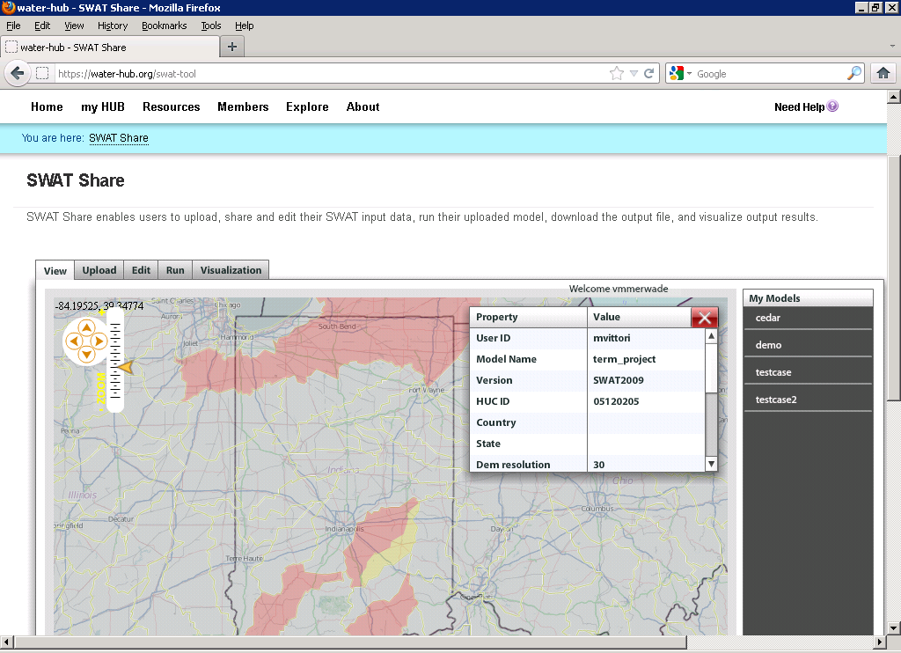
E.g. SWATShare
A HUBZero based tool for publishing, sharing, and accessing Soil Water Assessment Tool (SWAT)
www.water-hub.org/swat-tool
Notes:
You need to log-in to use the functions of SWAT share. On this slide, you see a map the watershed in red are the one for which SWAT models are available. Once you click a on one of the watersheds (highlighted in yellow), then you see then you see the associated metadata with the model. If the model is only published (and not shared), one cannot download or run the model. However, if the model is published and shared, any user can download, modify, and run the model on the SWATShare.

Slide 14
You are signed in as Jeff Horsburgh | Settings | Notifications | Help
Dashboard
Recent Activity
My Content
View Your Resources
Explore
Discover Resources
Collaborate
Share with colleagues
Support
Help/Feedback
Explore | Discover and access resources published by others
Keyword:
Little Bear River
Search
Advanced
Resource Type:
Geospatial dataset
Date:
1/1/2012 – 6/12/2012
Sort by: Relevance Title Owner Rating Date
Title: Little Bear River Sites 6/6/2012
Shared by: Jeff Horsburgh
Title: Little Bear River DEM 6/10/2012
Shared by: David Tarboton
Title: National Land Cover Dataset 6/10/2012
Shared by: United States Geological Survey
Title: National Elevation Dataset 6/10/2012
Shared by: United States Geological Survey
Results 1 – 10 of 100 << 1 2 3 >>
Terms of Use | Statement of Privacy| Copyright © 2012 CUAHSI
This material is based upon work supported by the National Science Foundation (NSF) under Grant No. XXXXXXXX.
Any opinions, findings, conclusions, or recommendations expressed in this material are those of the authors and do not necessarily reflect the views of the NSF.
Notes:
Discover and access HydroShare resources shared by others
Discover data by metadata
Discover data by content?
Discover and access national datasets with access provided through HydroShare
National Elevation Dataset
National Land Cover Dataset
National Hydrography Dataset
Search HIS Central/CUAHSI Data Center and import from HydroServers
Discover and access models, scripts, and code
Comment on and/or rate datasets submitted by others
Discovered resources (or links to them) should be able to be added to a user’s resources.
Will require a HydroShare metadata catalog and federation with other catalogs such as the HIS Central/CUAHSI Data Center catalog

Slide 15
You are signed in as Jeff Horsburgh | Settings | Notifications | Help
Dashboard
Recent Activity
My Content
View Your Resources
Explore
Discover Resources
Collaborate
Share with colleagues
Support
Help/Feedback
Collaborate | Build your research network
Create a Group
Keyword:
Search Groups
Groups You Might be Interested In
Show
All my groups
Owned by me
You are a member of 2 groups
Name: Little Bear River Research Group
Description: This group is studying water quality
in the Little Bear River, Utah, USA.
Created by: Jeff Horsburgh
Name: USU Hydrology Group
Created by: David Tarboton
Name: Little Bear River Junkies
Created by: Jeff Horsburgh
Name: CUAHSI
Description: This group shares resources related
to hydrologic science.
Created by: Rick Hooper
To what extent can we reuse capability and blend in with general purpose social networks like facebook, google+ or linkedin?
Terms of Use | Statement of Privacy| Copyright © 2012 CUAHSI
This material is based upon work supported by the National Science Foundation (NSF) under Grant No. XXXXXXXX.
Any opinions, findings, conclusions, or recommendations expressed in this material are those of the authors and do not necessarily reflect the views of the NSF.
Notes:
Collaborate
Create Groups
Search for Groups
List
All groups
Groups owned by user
Groups owned by others but that the user is a member of
Lists suggested groups for the user
Based on proximity, keywords, data types, variables, etc.
This begs metadata for groups, i.e. concepts like an owner, creator, administrator and the ability to change these. Also triggers of alerts when status is changed based on options

Slide 16
Interoperable data sharing
Tim Berners-Lee contends that the danger of social networking sites is that most are silos and do not allow users to port data from one site to another. He also cautions against social networks that grow too big and become a monopoly as this tends to limit innovation.
We need:
Well defined APIs for client application developers
Well defined data encoding and transfer formats to ensure that all data is portable
Standard CRUD interfaces
(http://www.scientificamerican.com/article.cfm?id=long-live-the-web)

Slide 17
Support Client/App Functionality
Upload to HydroShare
Search HydroShare
Download from HydroShare
Download and execute model or workflow packages
Build and upload model or workflow packages
Submit HPC jobs?

Slide 18
Use HydroDesktop to prototype and demonstrate Client Functionality

Slide 19
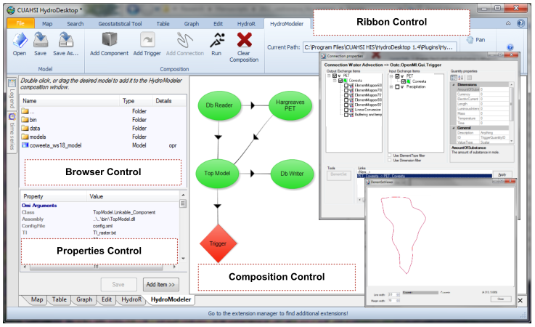
HydroDesktop and Modeling
An integrated modeling environment based on the Open Modeling Interface (OpenMI) standard and embedded within HydroDesktop
Integrated modeling within a Hydrologic Information System: An OpenMI based approach, Castronova, A.M., Goodall, J.L., Ercan, M,B. Environmental Modelling & Software, In Press. 10.1016/j.envsoft.2012.02.011.

Slide 20
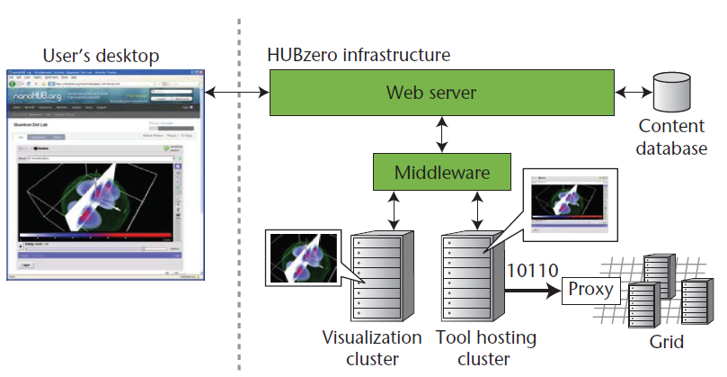
HUBzero Based Community Portal
Data & Model Resources
Discovery & access
Development
Execution on local VM
Execution on remote HPC
Publishing
Collaboration
Web Portal
Social networking
Community collaboration
Resource rating
Documents & videos
Learning modules
Architecture of HUBzero platform used to create dynamic web sites for scientific research and educational activities
http://dx.doi.org/10.1109/MCSE.2010.41
http://hubzero.org http://water-hub.org

Slide 21
integrated Rule-Oriented Data System
Micro-Services
Ability to look inside and program actions on uploaded files
Rules can tell iRODS to automatically register data into Metadata Catalog and write to Data Server
Users can search for, access, add/extract metadata, annotate, analyze & process, replicate, copy, share data, manage & track access, subscribe, and more
Access control model
E.g. Implement rules and micro-services to trigger processing necessary to automatically digest recognized resource to
Create resources for visualizing and manipulating data
Automatically parse and catalog metadata
Convert the data object to multiple formats
Automatically copy objects to secure storage for archival
Automatically assign unique and persistent identifiers
Automatically parse metadata for semantic content and to tag with additional semantic content
http://www.irods.org/

Slide 22
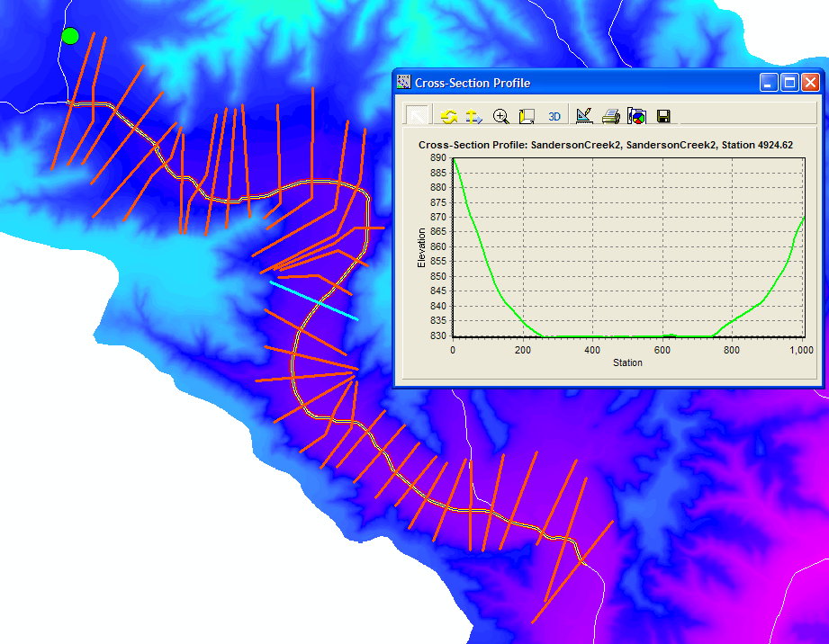
Facilitating Access to Critical National Datasets
NASA Earth Exchange
National River Morphology Dataset
Baltimore and Coweeta LTER

Slide 23
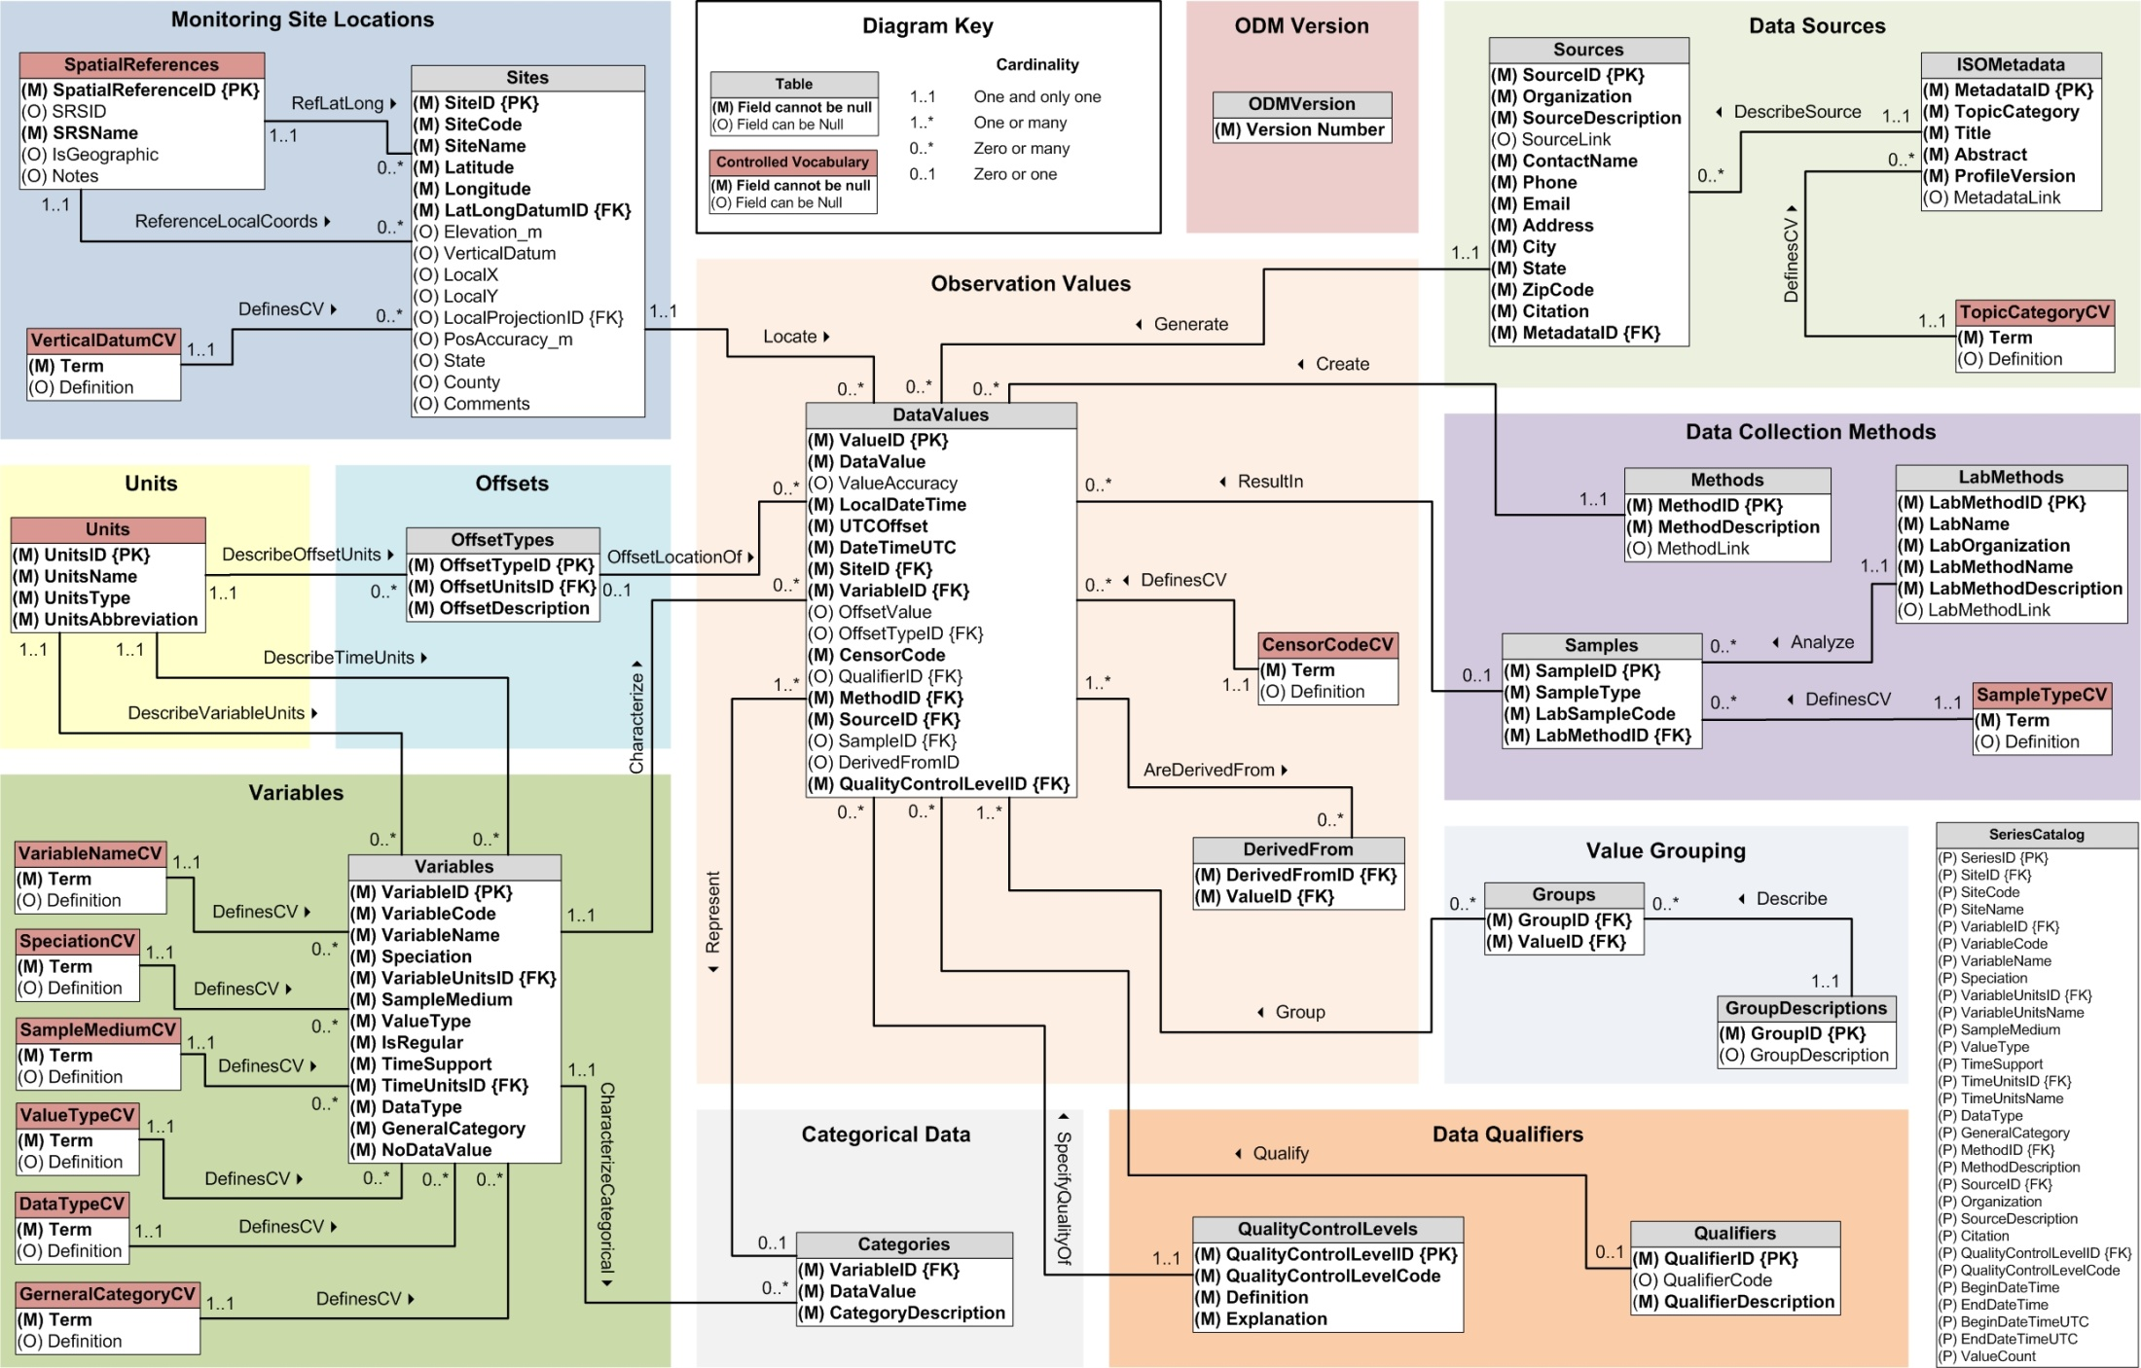
Questions ?
HydroShare
Share, Find, Create, Model, Innovate, Transform
Share your work with others
Summary
Simple and easy to use
Data and model sharing enabled by open standards based metadata
Find, create, share, connect, interact, work together online
Archive data collections accompanying research publications in easily accessible way
Integration and synthesis across data collections

