Slide 1
Digital Elevation Models and Hydrology
David G. Tarboton
dtarb@cc.usu.edu
http://www.engineering.usu.edu/dtarb

Slide 2
Overview
Hillslope and Channel processes
Digital elevation model derived flow networks
Objective drainage density estimation
Secondary DEM analysis functionality
  Influence
  Dependence
  Reverse accumulation
  Transport limited accumulation
Terrain Analysis Using Digital Elevation Models (TauDEM) in ArcGIS

Slide 3
Hydrologic processes are different on hillslopes and in channels. It is important to recognize this and delineate model elements that account for this.
Concentrated versus dispersed flow.
Objective delineation of channel networks using digital elevation models.

Slide 4
Drainage area can be concentrated or dispersed (specific catchment area)

Slide 5

Digital Elevation Model Based Flow Path Analysis
D∞
Eight direction pour point model D8
Grid network
4
3
2
5
1
6
7
8
Drainage Area
1
1
1
1
1
1
4
3
3
1
1
1
12
1
2
1
1
2
16
1
1
3
6
25
2

Slide 6
100 grid cell constant drainage area threshold stream delineation

Slide 7
200 grid cell constant drainage area based stream delineation

Slide 8
Grid Network Ordering Approach (Peckham, 1995)

Slide 9
Slope area threshold (Montgomery and Dietrich, 1992).

Slide 10
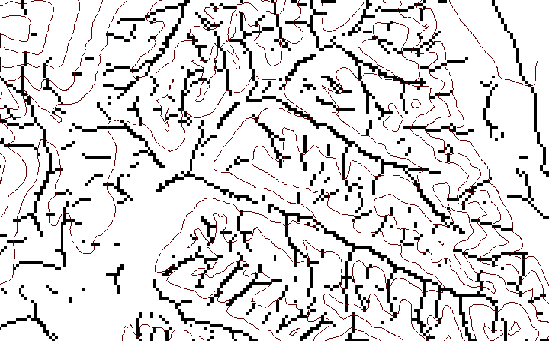
Local Curvature Computation
(Peuker and Douglas, 1975, Comput. Graphics Image Proc. 4:375)
43
48
48
51
51
56
41
47
47
54
54
58

Slide 11
Contributing area of upwards curved grid cells only

Slide 12
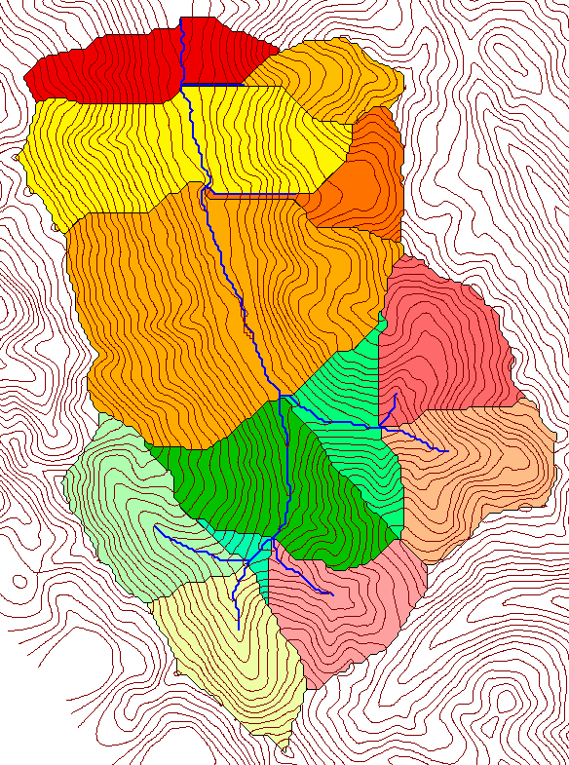
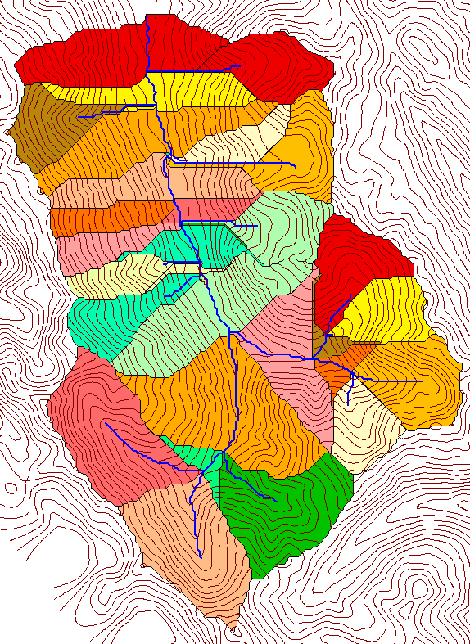
Subwatersheds (hydrologic model elements) with different support area thresholds.
500 cell theshold
1000 cell theshold

Slide 13
Topographic Texture and Drainage Density
Driftwood, PA
Same scale, 20 m contour interval
Sunland, CA

Slide 14
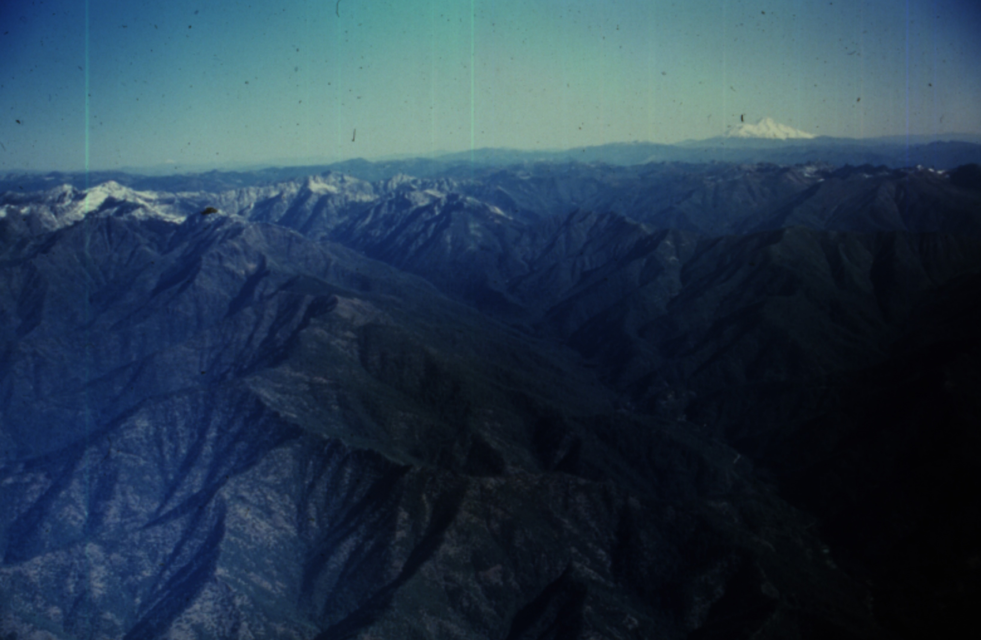
Canyon Creek, Trinity Alps, Northern California.
Photo D K Hagans

Slide 15
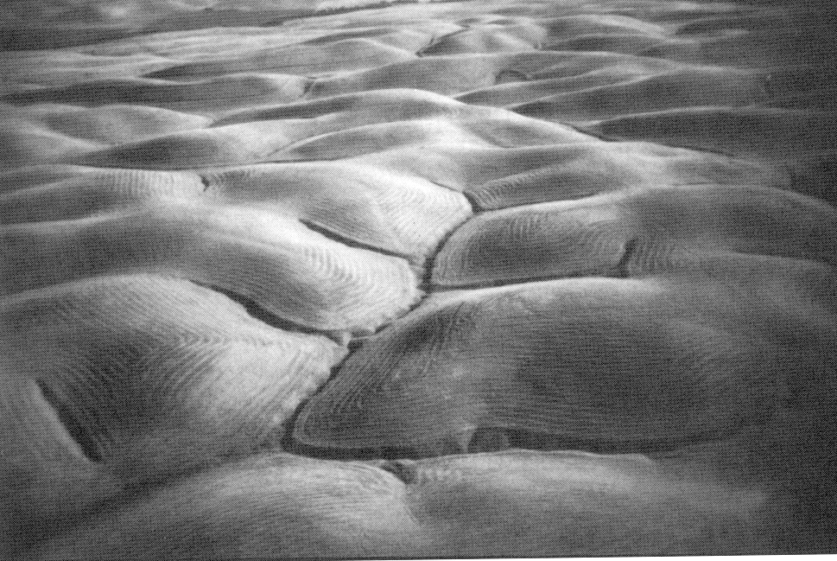
Gently Sloping Convex Landscape
From W. E. Dietrich

Slide 16
How to decide on drainage area threshold ?
AREA 2
3
AREA 1
12

Slide 17
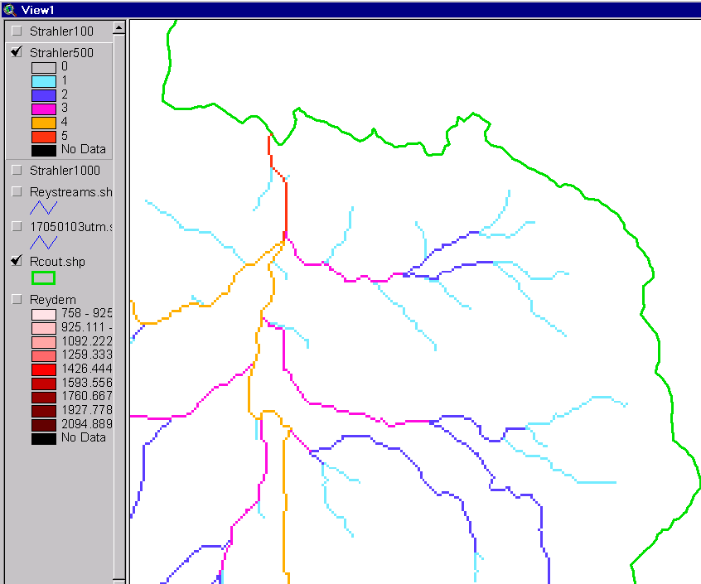
Strahler Stream Order
Order 5
Order 1
most upstream is order 1
when two streams of a order i join, a stream of order i+1 is created
when a stream of order i joins a stream of order i+1, stream order is unaltered
Order 3
Order 4
Order 2

Slide 18
Slope Law

Slide 19
Constant Stream Drops Law

Slide 20

Stream Drop
Elevation difference between ends of stream
Nodes
Links
Single Stream
Note that a “Strahler stream” comprises a sequence of links (reaches or segments) of the same order

Slide 21
Strahler Stream Order
Stream Drop: Elevation difference between ends of stream
most upstream is order 1
when two streams of a order i join, a stream of order i+1 is created
when a stream of order i joins a stream of order i+1, stream order is unaltered
Nodes
Links
Single Stream
Note that a “Strahler stream” comprises a sequence of links (reaches or segments) of the same order

Slide 22
Suggestion: Map channel networks from the DEM at the finest resolution consistent with observed channel network geomorphology ‘laws’.
Look for statistically significant break in constant stream drop property
Break in slope versus contributing area relationship
Physical basis in the form instability theory of Smith and Bretherton (1972), see Tarboton et al. 1992

Slide 23
Statistical Analysis of Stream Drops
Threshold = 10
Dd = 2.5
t = -3.5
Threshold = 15
Dd = 2.1
t = -2.08
Threshold = 20
Dd = 1.9
t = -1.03
Stream drop test for Mawheraiti River. For each upward curved support area threshold the stream drop for each stream is plotted against Strahler stream order. The large circles indicate mean stream drop for each order The weighted support area threshold, drainage density (in km⁻¹) and t statistic for the difference in means between lowest order and all higher order streams is given.

Slide 24
Curvature based stream delineation with threshold by constant drop analysis

Slide 25
Digital Elevation Model Analysis
Primary
  Flow directions and slopes
  Drainage area (specific catchment area)
Secondary
  Influence function
  Dependence function
  Reverse accumulation
  Transport limited accumulation

Slide 26
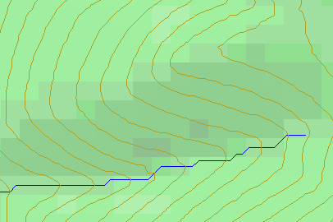
Topographic Slope
?
Topographic Definition Drop/Distance
Limitation imposed by 8 grid directions.
Flow Direction Field — if the elevation surface is differentiable (except perhaps for countable discontinuities) the horizontal component of the surface normal defines a flow direction field.

Slide 27
The D∞ Algorithm
D∞ Flow Direction Grid — A special case of a multiple flow direction grid in which the flow direction is represented by an angle stored in each grid cell
Tarboton, D. G., (1997), "A New Method for the Determination of Flow Directions and Contributing Areas in Grid Digital Elevation Models," Water Resources Research, 33(2): 309-319.) (http://www.engineering.usu.edu/cee/faculty/dtarb/dinf.pdf)

Slide 28
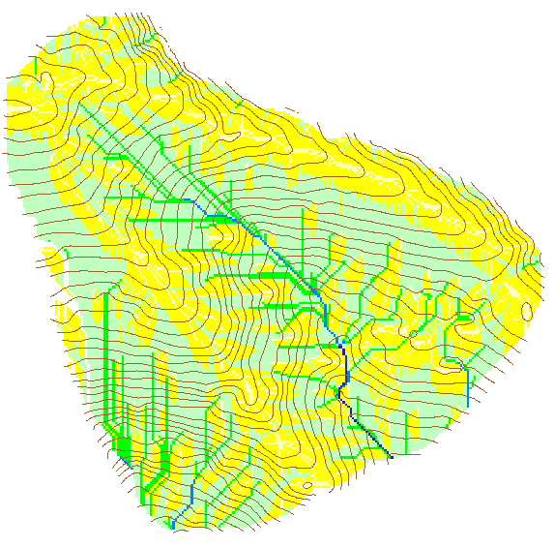

Contributing Area using D∞
Contributing Area using D8

Slide 30
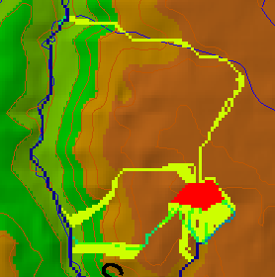
Useful for example to track where sediment or contaminant moves

Slide 31
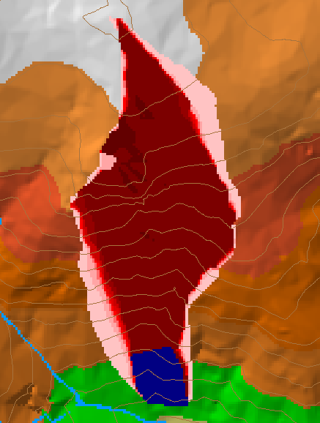
Useful for example to track where a contaminant may come from

Slide 32
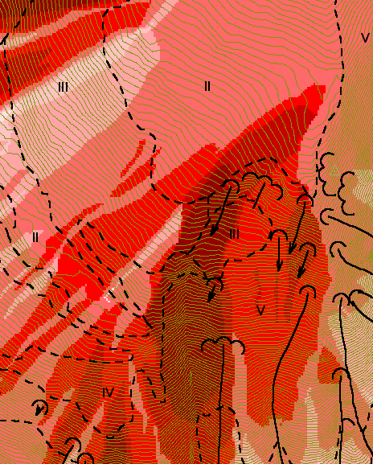
Reverse Accumulation
Useful for destabilization sensitivity in landslide hazard assessment

Slide 33
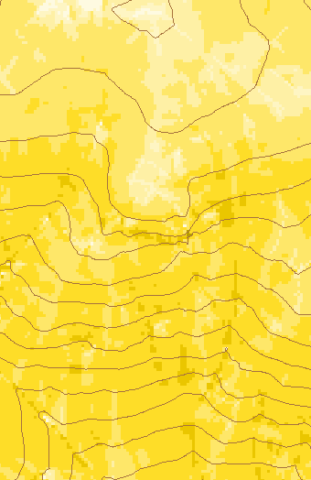
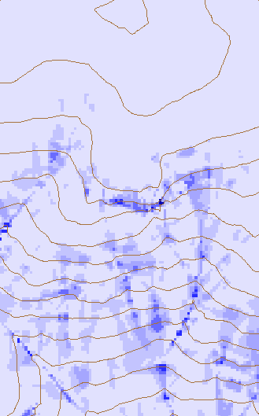
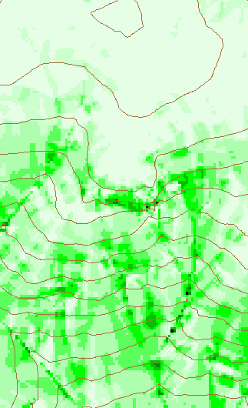
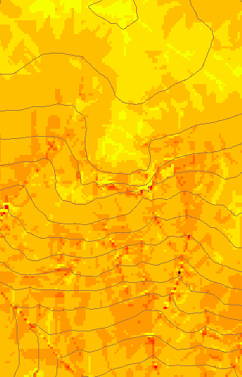
Transport limited accumulation
Useful for modeling erosion and sediment delivery, the spatial dependence of sediment delivery ratio and contaminant that adheres to sediment

Slide 34
TauDEM in ArcGIS
Visual Basic
ESRI ArcGIS 8.1
Toolbar
Visual Basic
GUI
application
Standalone
command line
applications
C++ COM DLL interface
Available from
TauDEM C++ library
Fortran (legacy)
components
http://www.engineering.usu.edu/dtarb/
USU TMDLtoolkit modules
(grid, shape, image, dbf, map, mapwin)
ESRI gridio API
(Spatial analyst)
Data
formats
Vector shape
files
ASCII text
grid
Binary direct
access grid
ESRI binary
grid

Slide 35
Implementation Details
Spatial Analyst includes a C programming API (Application Programming Interface) that allows you to read and write ESRI grid data sets directly.
Excerpt from gioapi.h
/ * GetWindowCell - Get a cell within the window for a layer,
* Client must interpret the type of the output 32 Bit Ptr
* to be the type of the layer being read from.
*
* PutWindowCell - Put a cell within the window for a layer.
* Client must ensure that the type of the input 32 Bit Ptr
* is the type of the layer being read from.
*
*/
int GetWindowCell(int channel, int rescol, int resrow, CELLTYPE *cell);
int PutWindowCell(int channel, int col, int row, CELLTYPE cell);

Slide 36
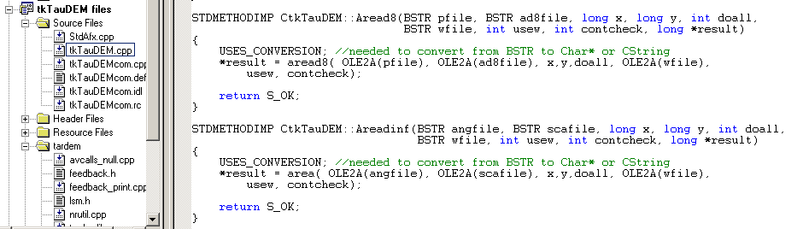
C++ COM Methods used to implement functionality using Microsoft Visual C++
STDMETHODIMP CtkTauDEM::Areadinf(BSTR angfile, BSTR scafile, long x, long y, int doall, BSTR wfile, int usew, int contcheck, long *result)
{
USES_CONVERSION; //needed to convert from BSTR to Char* or String
*result = area( OLE2A(angfile), OLE2A(scafile), x,y,doall, OLE2A(wfile),
usew, contcheck);
return S_OK;
}

Slide 37
Visual Basic for the GUI and ArcGIS linkage
Private TarDEM As New tkTauDEM
…
Private Function runareadinf(Optional toadd As Boolean = False) As Boolean
Dim i As Long
runareadinf = False
i = TarDEM.Areadinf(tdfiles.ang, tdfiles.sca, 0, 0, 1, "", 0, 1)
If TDerror(i) Then Exit Function
If toadd Then
AddMap tdfiles.sca, 8
End If
runareadinf = True
End Function

Slide 38
GIS in Water Resources Online
A Virtual Course Presented On-Line by David Maidment at the University of Texas at Austin in partnership with Utah State University. Next offering Fall 2002.
Goals:
  To teach the principles and operation of geographic information systems, focusing in particular on ArcView and its Spatial Analyst extension.
  To show how spatial hydrologic modeling can be done by developing a digital representation of the environment in the GIS, then adding functions simulating hydrologic processes.
  To develop individual experience in the use of GIS in Water Resources through execution of a term project, and presenting it both orally and written form in html on the world wide web.
http://moose.cee.usu.edu/giswr/

Slide 39
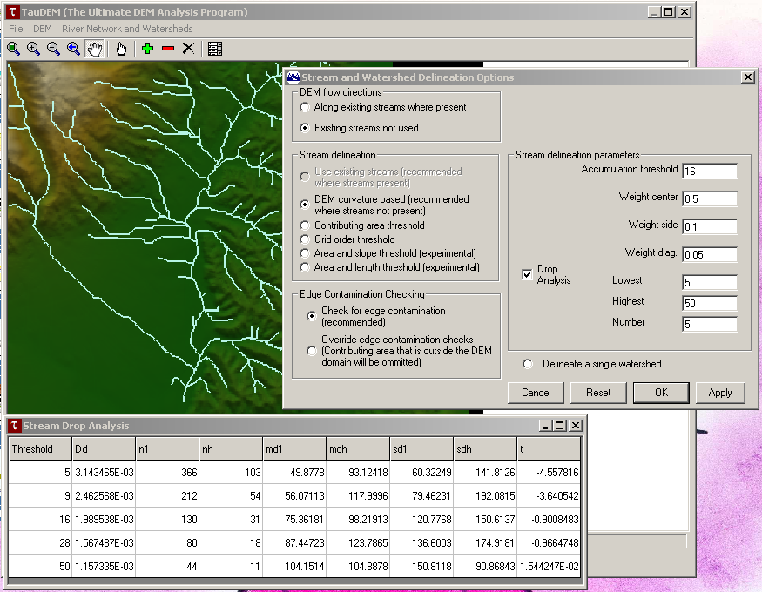
Demonstration

