Slide 1
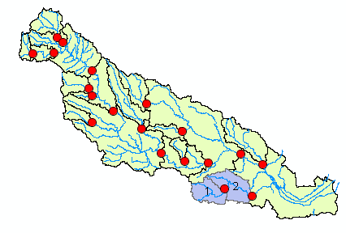
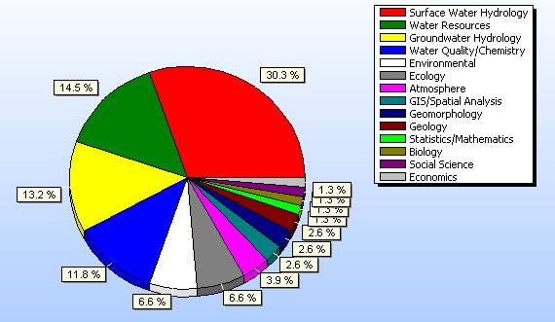
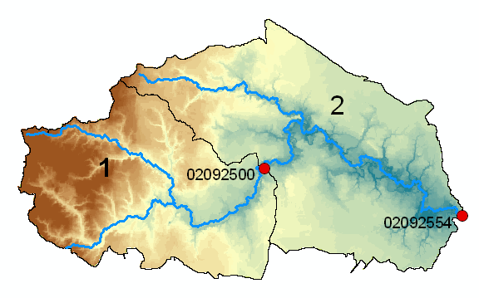
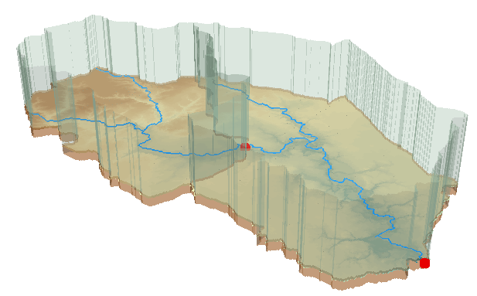
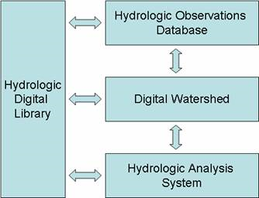
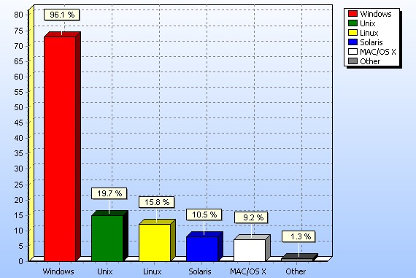
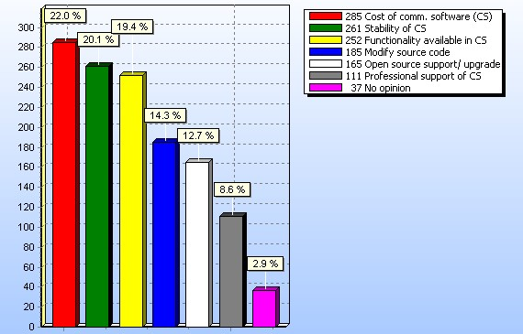
H23F-1498
Hydrology’s efforts toward the cyber-frontier:
The National Science Foundation is, as part of its "cyberinfrastructure“ initiative, supporting the Consortium of Universities for the Advancement of Hydrologic Science, Inc (CUAHSI), Hydrologic Information System (HIS) project.
Cyberinfrastructure is the use of high-speed telecommunications to integrate networks of computers and provide advanced data access and computational resources beyond what an individual scientist would normally have available.
The CUAHSI Hydrologic Information System has four components:
Respondents
1. Hydrologic Observations Database: observational data on streamflow, climate, water quality, groundwater levels, and other data measured at monitoring points
2. Digital Watershed: synthesizes the Hydrologic Observations Database with GIS data, weather and climate grids and remote sensing data to form a comprehensive depiction of the water environment of a hydrologic region
3. Hydrologic Analysis System: supports analysis of fluxes, flowpaths, residence times and mass balances
4. Hydrologic Digital Library: stores and provides internet access to digital products
Which of the following most closely describes your field of research?
The integration of multiple datasets over heterogeneous spatial and time scales with inconsistent metadata styles, into formats that can be easily used by researchers with varied software and operating system preferences, is a challenging task.
The CUAHSI HIS team undertook a user assessment to find out how hydrologic scientists are using information now, and to seek guidance from potential HIS users of how best to focus efforts to develop the CUAHSI Hydrologic Information System.
This paper reports these results. Further details are available in the CUAHSI Hydrologic Information System Status report available from http://www.cuahsi.org/
Software Used for Hydrologic Research.
Please rate each of the following software packages and programming languages with respect to how important they are for hydrologic analysis in your research. .
Platform
Which operating systems do you use for your research? If you use more than one operating system, select all that apply.
Results taken from preliminary survey at the CUAHSI HIS Symposium held in Austin, Texas, March 2005. Sample size n=39.
The HIS may include the capability to interact with other software. Please choose up to two software packages in each category that are most important for hydrologic analysis in your research.
Programming
Geographic Information Systems
Rank | Software | 1st Choice | 2nd Choice
1 | FORTRAN | 42.1% | 18.6%
2 | C/C++ | 19.7% | 27.1%
3 | Visual Basic | 18.4% | 23.7%
4 | not applicable to my research | 15.8% | 15.3%
Rank | Software | 1st Choice | 2nd Choice
1 | ArcGIS (ESRI ArcInfo, ArcView, etc) | 92.1% | 0.0%
2 | not applicable to my research | 6.6% | 43.3%
3 | IDRISI (Clark Labs) | 1.3% | 13.3%
4 | MapInfo | 0.0% | 30.0%
5 | GRASS | 0.0% | 13.3%
In considering the choice between the open source and commercial software model for the HIS, the following considerations arise. Please indicate and rank the three issues that are most important to you.
Other, Java, Python, PERL and AWK were also presented but received < 6% selections
Mathematics/Statistics
Data Management
Rank | Software | 1st Choice | 2nd Choice
1 | Matlab | 41.3% | 19.0%
2 | Excel | 24.0% | 25.4%
3 | SAS | 10.7% | 11.1%
4 | SPSS | 5.3% | 11.1%
5 | R | 2.7% | 14.3%
6 | Mathematica | 5.3% | 6.3%
7 | Minitab | 2.7% | 4.8%
8 | IDL | 2.7% | 3.2%
9 | Splus | 1.3% | 3.2%
10 | not applicable to my research | 2.7% | 1.6%
Rank | Software | 1st Choice | 2nd Choice
1 | Excel | 69.3% | 18.2%
2 | MS Access | 10.7% | 58.2%
3 | SQL/Server | 12.0% | 16.4%
4 | not applicable to my research | 5.3% | 7.3%
5 | PostgreSQL | 2.7% | 0.0%
Hydrologic Models
Please indicate your opinion in the selection of commercial/open source software platforms for the CUAHSI HIS.
Rank | Software | 1st Choice | 2nd Choice
1 | not applicable to my research | 21.9% | 15.3%
2 | Modflow/Visual Modflow | 19.2% | 16.9%
3 | U.S. Army Corps HEC models | 11.0% | 10.2%
4 | GMS Groundwater Modeling System | 8.2% | 11.9%
5 | TOPMODEL | 11.0% | 8.5%
6 | Sacramento/NWS/HSPF | 5.5% | 8.5%
7 | SMS Surface Water Modeling System | 2.7% | 6.8%
8 | SHE System Hydroligique European/Mike-SHE | 0.0% | 8.5%
9 | Groundwater Vistas | 4.1% | 5.1%
10 | TIN-based real time Integrated Basin Simulator (tRIBS) | 4.1% | 1.7%
11 | EPA Basins | 2.7% | 5.1%
12 | WMS Watershed Modeling System | 2.7% | 0.0%
13 | SWAT | 4.1% | 0.0%
14 | MMS/PRMS | 2.7% | 1.7%
 | Strongly Disagree | Disagree | Agree | Strongly Agree | No Opinion
HIS Client software should work on all computer operating systems | 2.7% | 10.7% | 49.3% | 30.7% | 6.7%
HIS Software should leverage commercial software systems | 2.7% | 9.3% | 40.0% | 22.7% | 25.3%
HIS Software should be open source | 1.3% | 8.0% | 29.3% | 42.7% | 18.7%

Slide 2
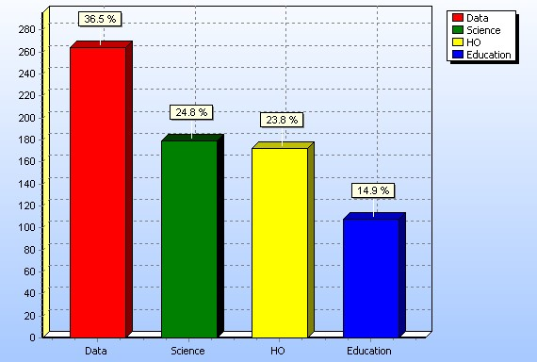
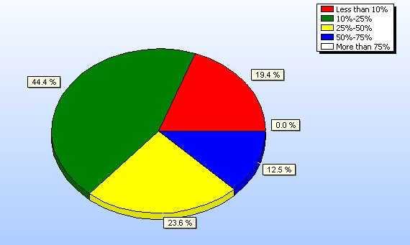
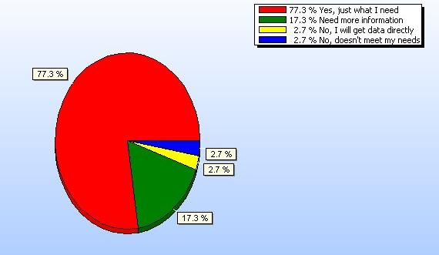
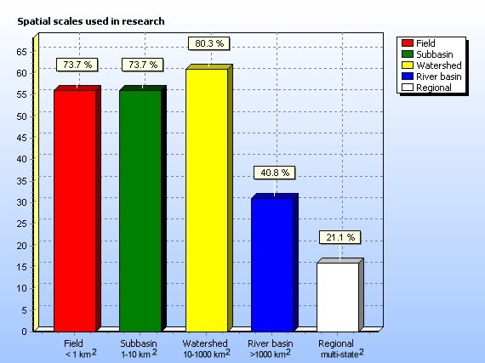
User Needs for a Community
Hydrologic Information System
HIS Services
Please rank these four HIS service categories for helping you.
David Tarboton dtarb@cc.usu.edu and Christina Bandaragoda, cmay@cc.usu.edu,
Utah Water Research Laboratory, Utah State University, Logan, UT 84322 United States David Maidment, maidment@mail.utexas.edu, Center for Research in Water Resources, University of Texas at Austin, Austin, TX 78712 United States
1. Data services –services that can be used by a hydrologic researchers or students obtain the hydrologic data quickly and easily, and in forms that they can readily use;
2. Observatory services – services that a CUAHSI Hydrologic Observatory will require to process, archive and display the data it collects;
3. Science services–services needed to build the complex digital representations of hydrologic environments to support advanced hydrologic modeling and hypothesis testing;
4. Education services – these are services needed to advance the use of hydrologic information in the classroom.
Hydrologic Data Acquisition and Preparation
Consider the following datasets that the CUAHSI HIS may incorporate. Please rate each dataset for its priority for inclusion in the HIS.
Rank |  | Essential to my research | Am likely to use in research | I am aware of this, but not likely to use | I have not heard of dataset | Weighted¹ Score
1 | USGS Streamflow | 60.8% | 27.0% | 9.5% | 2.7% | 49.5%
2 | NCDC Precipitation | 35.1% | 44.6% | 12.2% | 8.1% | 38.3%
3 | Remote Sensing data (e.g. LANDSAT, GOES, AVHRR) | 30.7% | 34.7% | 32.0% | 2.7% | 32.0%
4 | National Elevation Dataset and derivatives (EDNA) | 32.4% | 31.1% | 24.3% | 12.2% | 32.0%
5 | Other NCDC Weather and Climate Data | 22.5% | 47.9% | 21.1% | 8.5% | 31.0%
6 | USGS Groundwater levels | 25.7% | 39.2% | 28.4% | 6.8% | 30.2%
7 | National Land Cover dataset (NLCD) | 21.3% | 46.7% | 28.0% | 4.0% | 29.8%
8 | Soils Data (STATSGO/SSURGO) | 20.0% | 44.0% | 26.7% | 9.3% | 28.0%
9 | National Hydrography Dataset (NHD) | 25.3% | 32.0% | 22.7% | 20.0% | 27.5%
10 | USGS Water Chemistry (NASQAN, HBN, Cooperative data) | 20.0% | 38.7% | 32.0% | 9.3% | 26.2%
11 | NCDC Pan Evaporation | 18.7% | 41.3% | 29.3% | 10.7% | 26.2%
The Need
What proportion of your research time do you spend on preparing or preprocessing data into appropriate forms needed for research purposes?
¹ The weighted score is (“Essential”*2 + “Likely to Use”)/3
Some datasets used in your research may be difficult to access and use. Please indicate one dataset that you believe would most benefit from increased ease of access through a Hydrologic Information System (HIS).
If a CUAHSI HIS was developed with the priorities you have listed for a watershed where you conduct research, would you use it?
What spatial scales are most relevant to data resolution used in your research? Check all that apply.
Conclusions
Significant time spent on data preparation - the need is there
A general, simple, standard, and open interface that could connect with many systems is the only way to accommodate all of the models used
Data services are the most important services for the HIS to provide while addressing critical data use difficulties such as inconsistent data formats, the existence and consistency of metadata, and irregular time steps
Need better communication and articulation of the potential capabilities of HIS (17% need more information)
The HIS hopes to improve capability for integrating, analyzing, and synthesizing data from disparate sources. In your experience, which of the following difficulties are most important for HIS to address?
Acknowledgements
This work is supported by the National Science Foundation under grant #EAR-0413265 to CUAHSI and the University of Texas at Austin.

