Slide 1


The CUAHSI Hydrologic Information System
Spatial Data Publication Platform
David Tarboton, Jeff Horsburgh, David Maidment, Dan Ames, Jon Goodall, Richard Hooper, and Ilya Zaslavsky
CUAHSI
HIS
Sharing hydrologic data
http://his.cuahsi.org/
Support
EAR 0622374

Slide 2

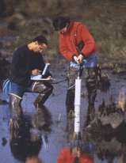
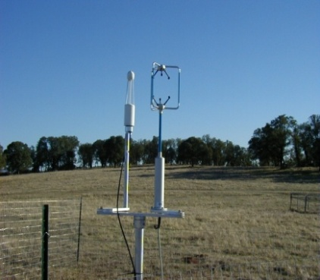
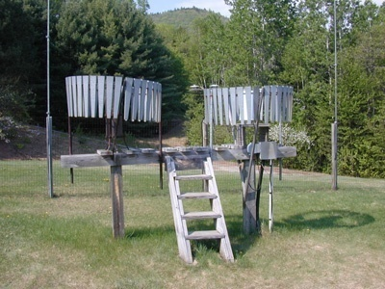
What is HIS
The CUAHSI Hydrologic Information System (HIS) provides web services, tools, standards and procedures that enhance access to more and better data for hydrologic analysis.
http://his.cuahsi.org
Water quantity
Water quality
Precipitation
Meteorology
Notes:
HIS helps you discover and access hydrologic data.

Slide 3
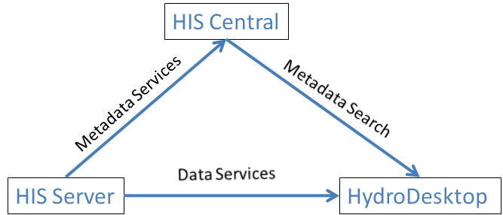
Services-Oriented Architecture for Water Data
Search engines
Google, Yahoo
Web servers
Browsers, Mosaic, Firefox

Slide 4
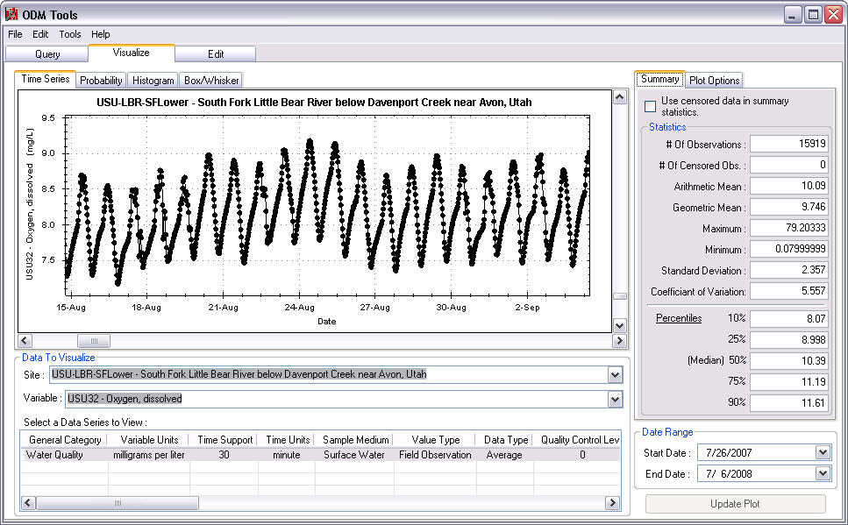

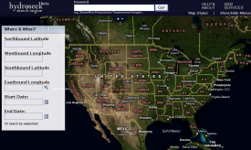
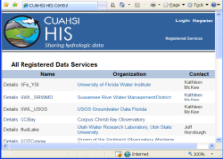
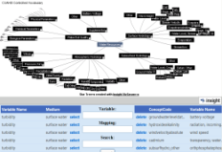


CUAHSI Water Data Services System
Query, Visualize, and Edit data using ODM Tools
Analysis
Access
Discovery
GIS
Matlab
Splus
R
IDL
Hydroseek
Java
C++
VB
HIS
Desktop
HydroExcel
ODM
Database
WaterML
Service Registry
Hydrotagger
Streaming Data Loader
GetSites
GetSiteInfo
GetVariableInfo
GetValues
Base Station
Computer(s)
Excel, text
Harvester
HIS Central
USGS NWIS
Water Metadata Catalog
Telemetry Network
WaterOneFlow
Web Service
ODM Data Loader
EPA STORET
NCDC
Others
Sensors

Slide 5

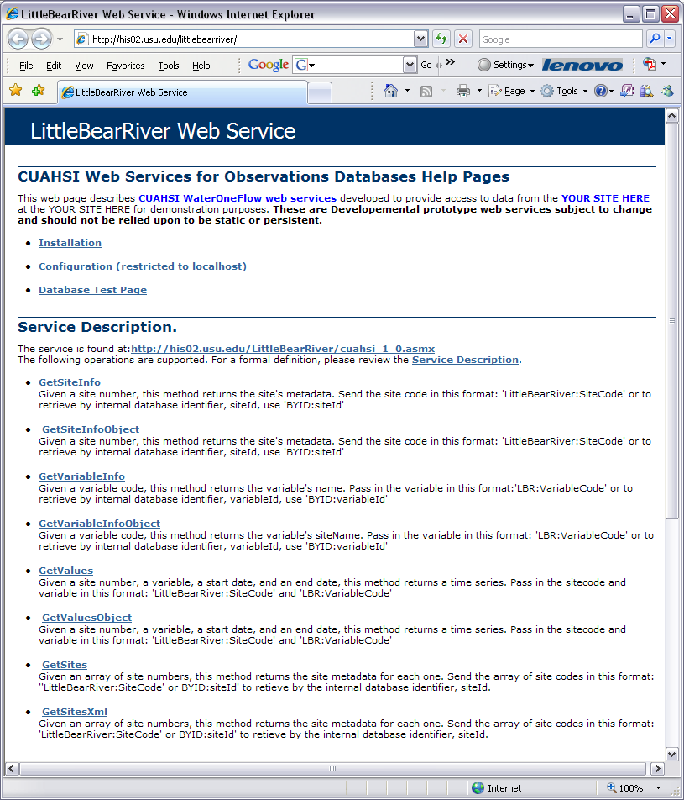

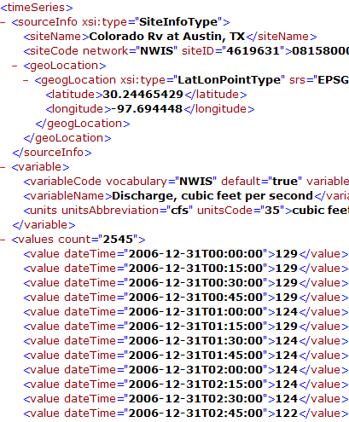
CUAHSI WaterOneFlow Web Services
“Getting the Browser Out of the Way”
GetSites
GetSiteInfo
GetVariableInfo
GetValues
Standard protocols provide platform independent data access
WaterML
SQL
Queries
Data Consumer
ODM
Database
Query
Response

Slide 6
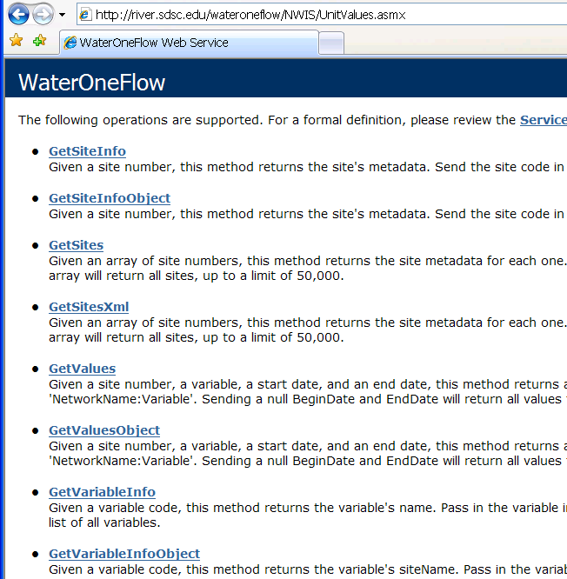
WaterML and WaterOneFlow
WaterML is an XML language for communicating water data
WaterOneFlow is a set of web services based on WaterML
Set of query functions
Returns data in WaterML
Slide from David Valentine
Notes:
6

Slide 7
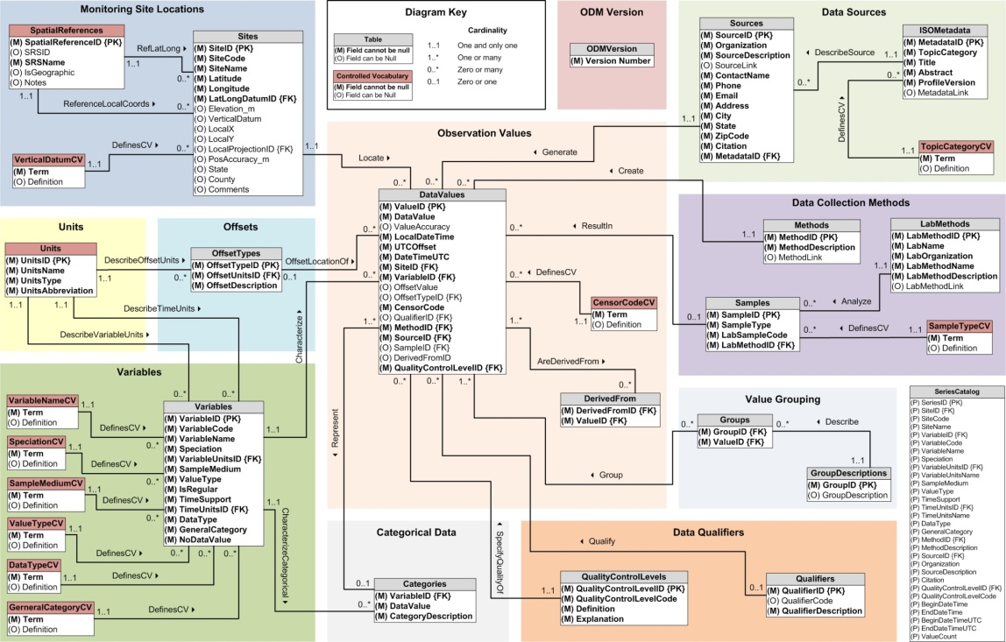
What are the basic attributes to be associated with each single data value and how can these best be organized?
“When”
Time, T
t
A data value
v_{i} (s,t)
s
“Where”
Space, S
V_{i}
“What”
Variables, V
Observations Data Model (ODM)
A relational database at the single observation level (atomic model)
Stores observation data made at points
Metadata for unambiguous interpretation
Traceable heritage from raw measurements to usable information
Standard format for data sharing
Cross dimension retrieval and analysis

Slide 8
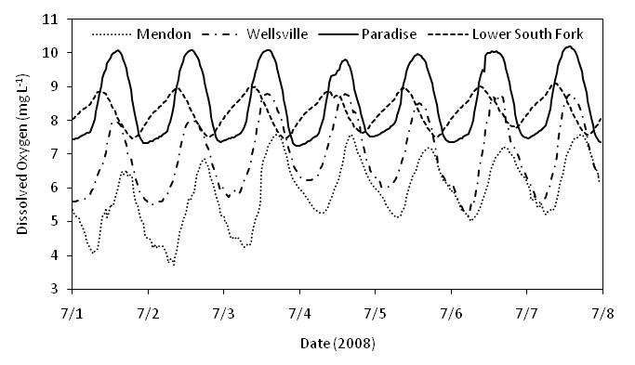
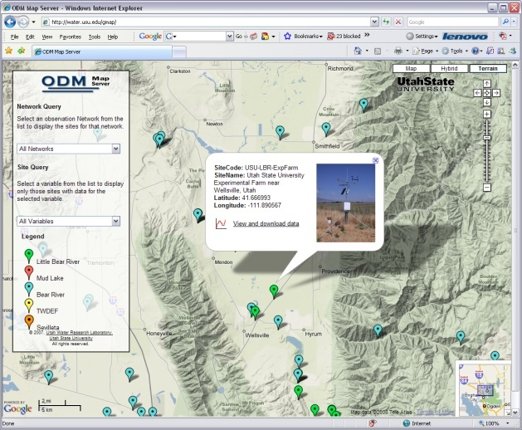

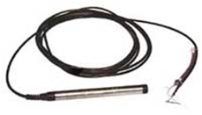
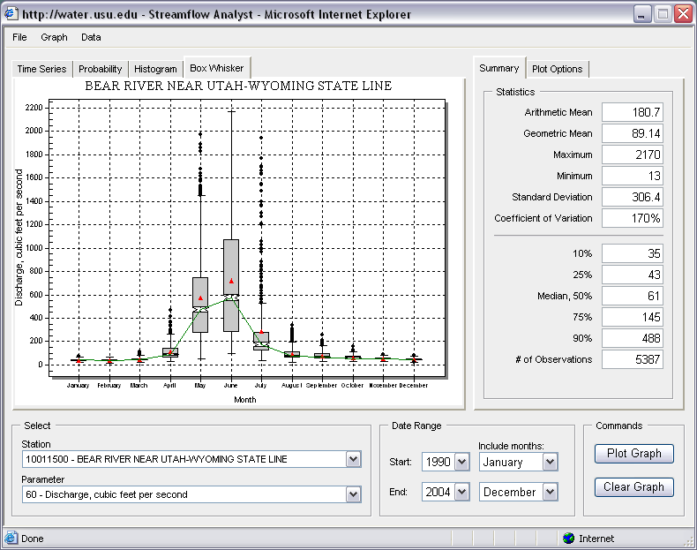
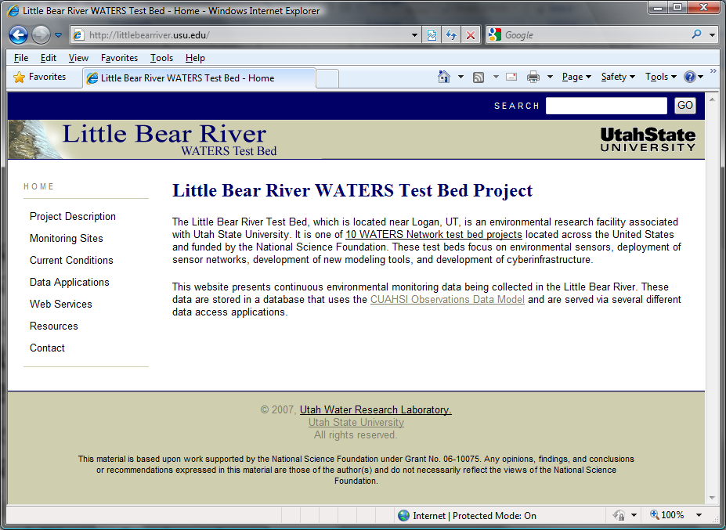

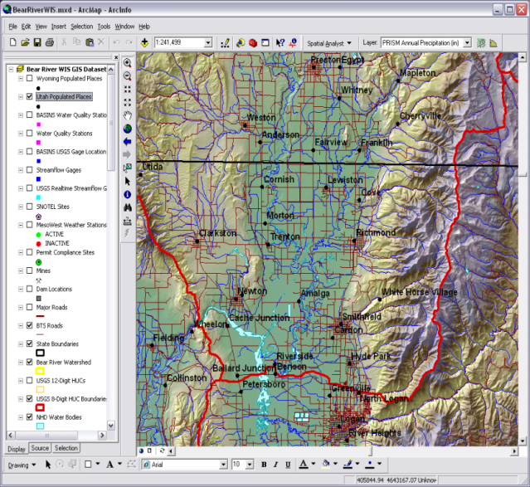

Point Observations Data
Internet Applications
Ongoing Data Collection
Historical Data Files
ODM Database
GetSites
GetSiteInfo
GetVariableInfo
GetValues
GIS Data
WaterML
WaterOneFlow
Web Service
Data presentation, visualization,
and analysis through Internet enabled applications
HIS Server

Slide 9
HIS Server
Point data, time series (ODM)
Map server (ArcGIS server)
  Spatial data services (grids, fields, features)
    OGC WFS, WCS, WMS
Data node capabilities web service
  ODM and map service catalogs
  service level metadata listings
WaterOneFlow web services
ODM Suite (Loader, SDL, Tools)
Time series analyst (web application)
HIS Server website
2008
New
Spatial data publication platform

Slide 10
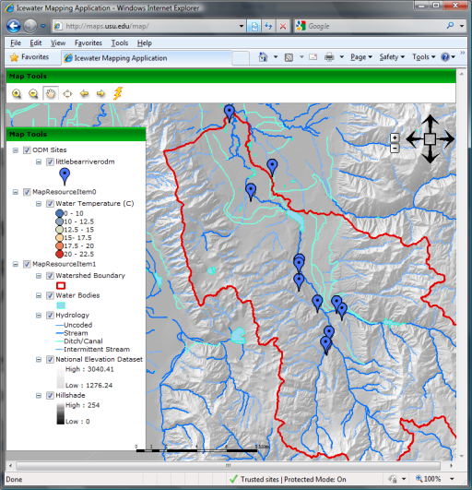
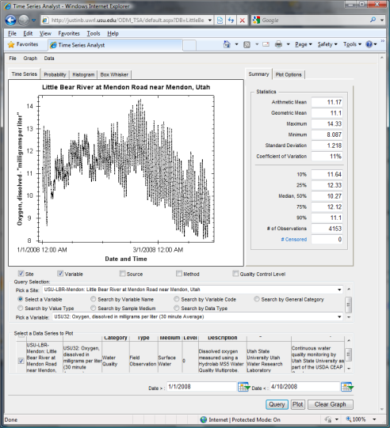
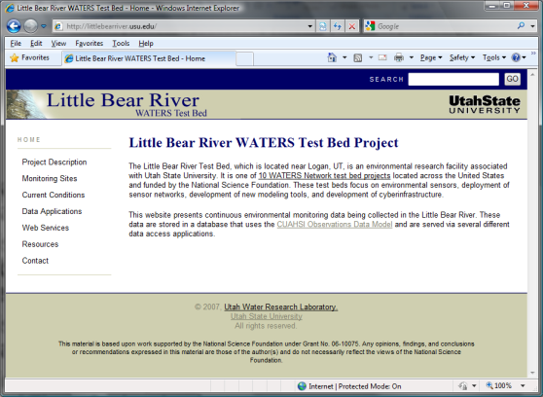
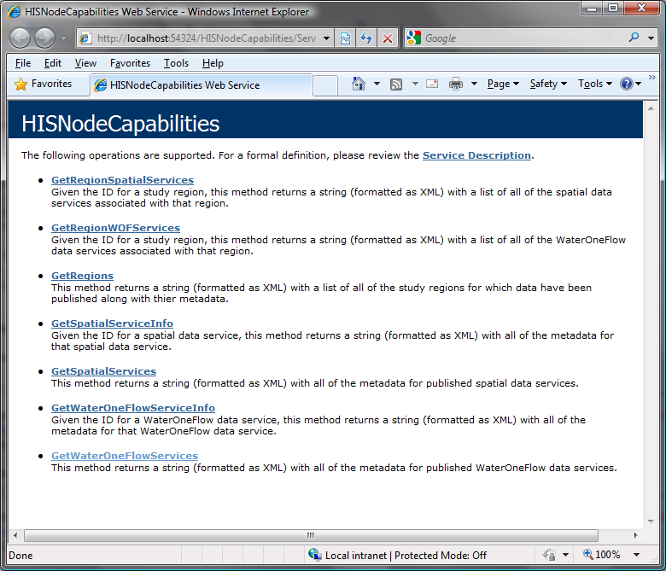
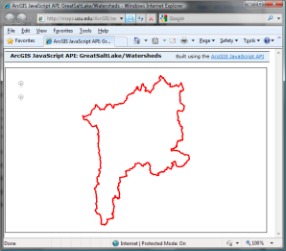
Map Server
Time Series Analyst
HIS Server Website
HIS Server Capabilities Web Service
HIS Server Database Configuration Tool
WaterOneFlow
Services
HIS Server
Database
Spatial
Services
WaterOneFlow
WaterOneFlow
WaterOneFlow
ODM
ODM
ODM
ODM Databases and WaterOneFlow Web Services
ArcGIS Server Spatial Data Services

Slide 11
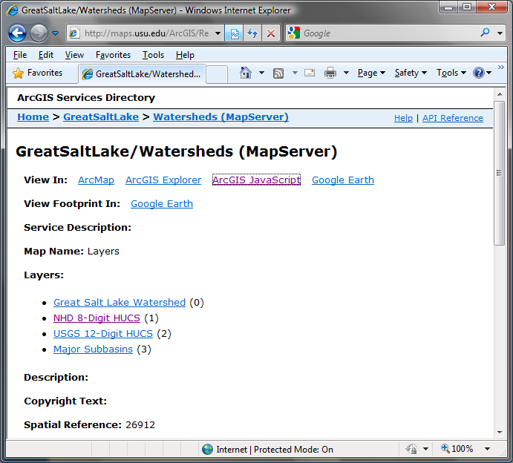
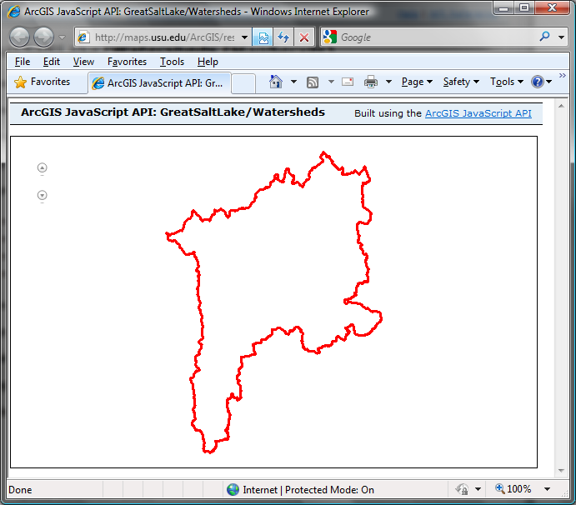
Publication of Spatial (GIS) Datasets
Publishing spatial datasets using ArcGIS Server
  Using OGC standards that can be consumed by a number of GIS clients
  WMS, WFS, WCS

Slide 12

Data Presentation Via a Map Interface
Internet Map Server built using ArcGIS
Web browser client
Combine spatial data and observational data
Launch data visualization tools
Based on a “Region”
http://maps.usu.edu/map/

Slide 13

Data Preview, Visualization, and Analysis
Time Series Analyst
Web Browser Client
Multiple ODM Database Support
Variety of plot types and descriptive statistics
Linked to the map server application
Enables data preview and download
http://tsa.usu.edu/odmanalyst/

Slide 14
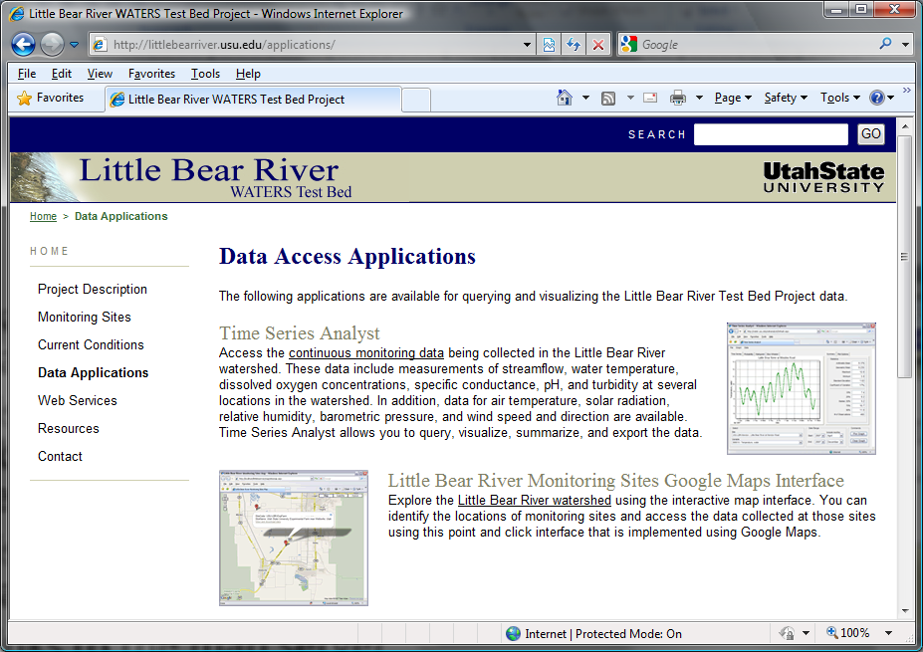
HIS Server
Website
HIS Server description page
Listing of published observational data services
Listing of published GIS data services
Links to the map server and Time Series Analyst
Data Query and Download Page
http://littlebearriver.usu.edu

Slide 15
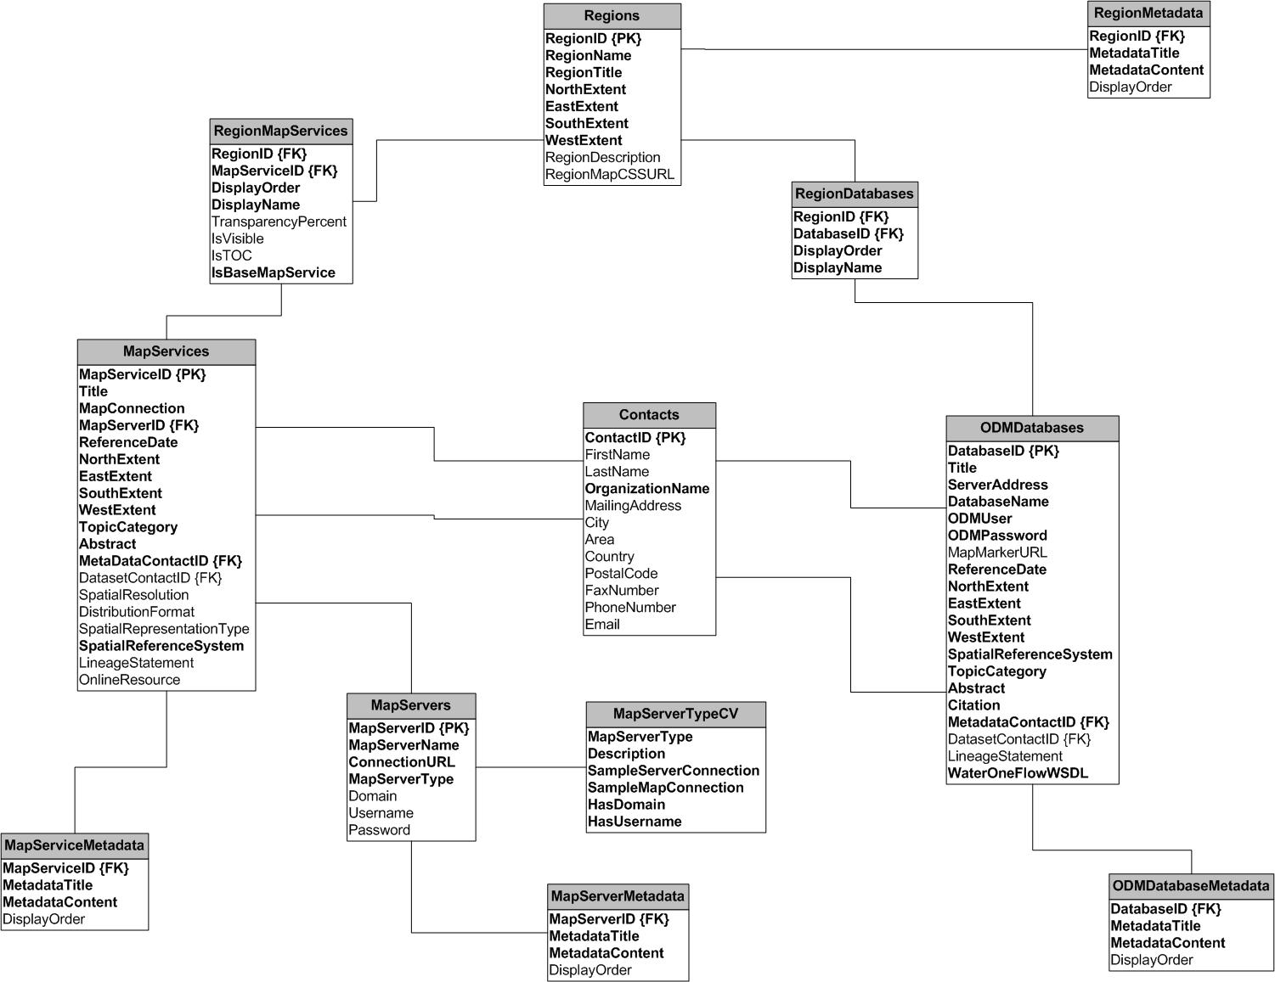
HydroServer Database

Slide 16
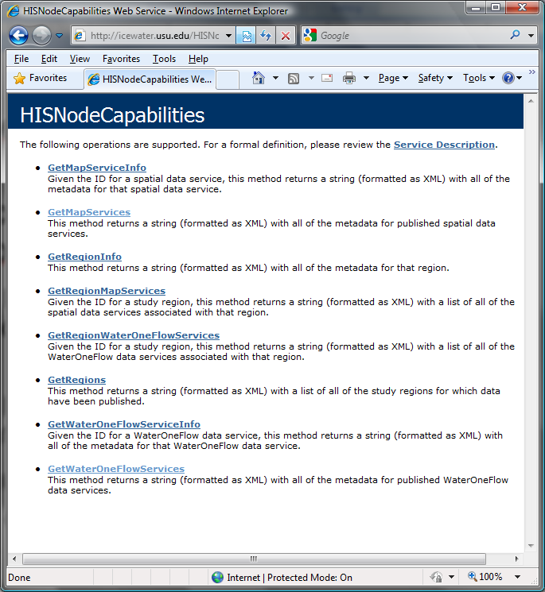
HydroServer Capabilities Web Service
Publish capabilities of each HydroServer
  Listing of published observational data services
  Listing of published spatial data services
Supports automatic cataloging of available services at HIS Central
Makes HydroServers self describing

Slide 17
Conclusions
HIS Server provides a self contained autonomous data publication system
Local control of data
Spatial and map data services (OGC via ArcGIS Server)
Downloadable user (data publisher) configurable software stack that contains:
  ODM and associated tools
  WaterOneFlow web services version 1.1
  Geographic data sharing using WFS, WCS from ArcGIS server
  Time series analyst
  Generic ArcGIS server based web map application
  Data node capabilities web services that publish metadata on time series and spatial data services

Slide 18
HIS Server Future Considerations
Security and authentication
More generic object structure
  Flexibility in attributes
  moving platforms
  Additional data types
Tighter integration with Ontology
Enhanced spatial data sharing
What features and functionality does HIS Server need to better serve the communities needs with respect to NEXRAD specifically, and for any other data?

Slide 19
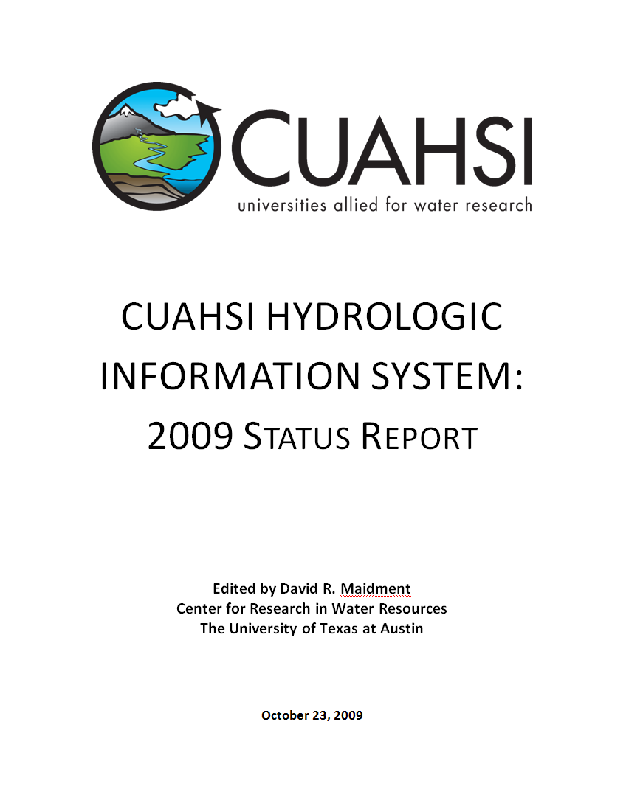
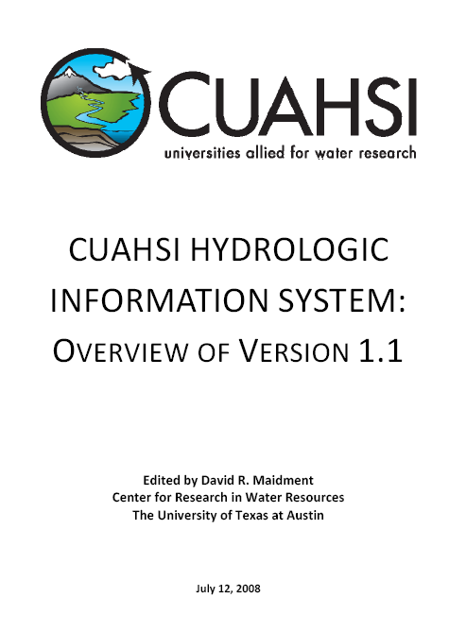
Reports
2008 status report summarizes the conceptual framework, methodology, and application tools for HIS
Shows how to develop and publish a CUAHSI Water Data Service
2009 status report details the expansions and updates
http://his.cuahsi.org/documents/HISOverview2009.pdf

Slide 20
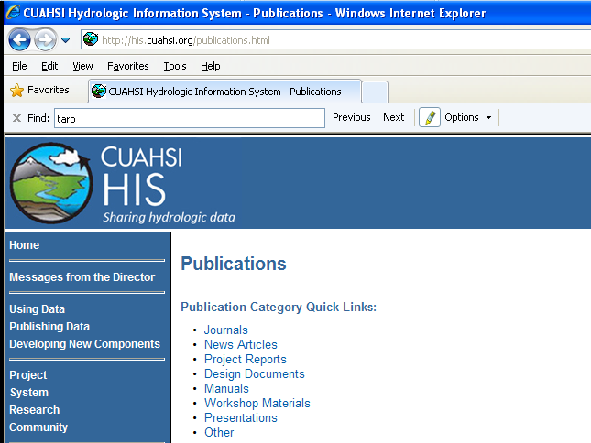
http://his.cuahsi.org

