Slide 1


Combining Data From Multiple Sources Using the CUAHSI Hydrologic Information
System
David Tarboton, Dan Ames, Jeffery S. Horsburgh, Jon Goodall
And the CUAHSI HIS development team
CUAHSI
HIS
Sharing hydrologic data
http://his.cuahsi.org/
Support
EAR 0622374

Slide 2
The CUAHSI Hydrologic Information System Team
University of Texas at Austin – David Maidment, Tim Whiteaker, James Seppi, Fernando Salas, Jingqi Dong, Harish Sangireddy
San Diego Supercomputer Center – Ilya Zaslavsky, David Valentine, Tom Whitenack, Matt Rodriguez
Utah State University – David Tarboton, Jeff Horsburgh, Kim Schreuders, Stephanie Reeder
University of South Carolina – Jon Goodall, Anthony Castronova
Idaho State University – Dan Ames, Ted Dunsford, Jiří Kadlec, Yang Cao, Dinesh Grover
Drexel University/CUNY – Michael Piasecki, Bora Beran
CUAHSI Program Office – Rick Hooper, Yoori Choi, Jennifer Arrigo, Jon Pollak
ESRI – Dean Djokic, Zichuan Ye
Users Committee – Kathleen McKee, Marian Muste, Lucy Marshall, Tim Whiteaker, Christina Bandaragoda, Luke Sheneman, Ben Crosby
CUAHSI
HIS
Sharing hydrologic data
http://his.cuahsi.org/
Support
EAR 0622374

Slide 3
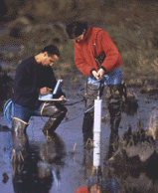


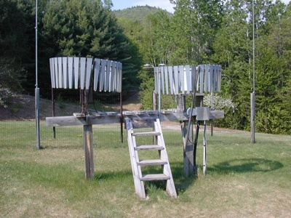
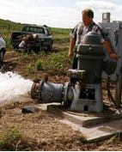
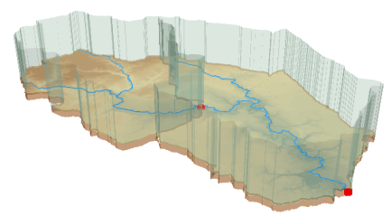
Hydrologic Data Challenges
Water quality
Water quantity
From dispersed federal agencies
From investigators collected for different purposes
Different formats
  Points
  Lines
  Polygons
  Fields
  Time Series
Rainfall and Meteorology
Soil water
Data Heterogeneity
Groundwater
The way that data is organized can enhance or inhibit the analysis that can be done
GIS

Slide 4










Data Searching – What we used to have to do
Searching each data source separately
NWIS
request
return
request
request
return
return
NAWQA
request
return
NAM-12
request
return
request
return
request
return
request
return
NARR
Michael Piasecki
Drexel University
Notes:
4

Slide 5

What CUAHSI HIS enables
Searching all data sources collectively
GetValues
GetValues
NWIS
GetValues
GetValues
generic
request
GetValues
GetValues
NAWQA
Michael Piasecki
Drexel University
GetValues
NARR
GetValues
ODM
Notes:
5

Slide 6
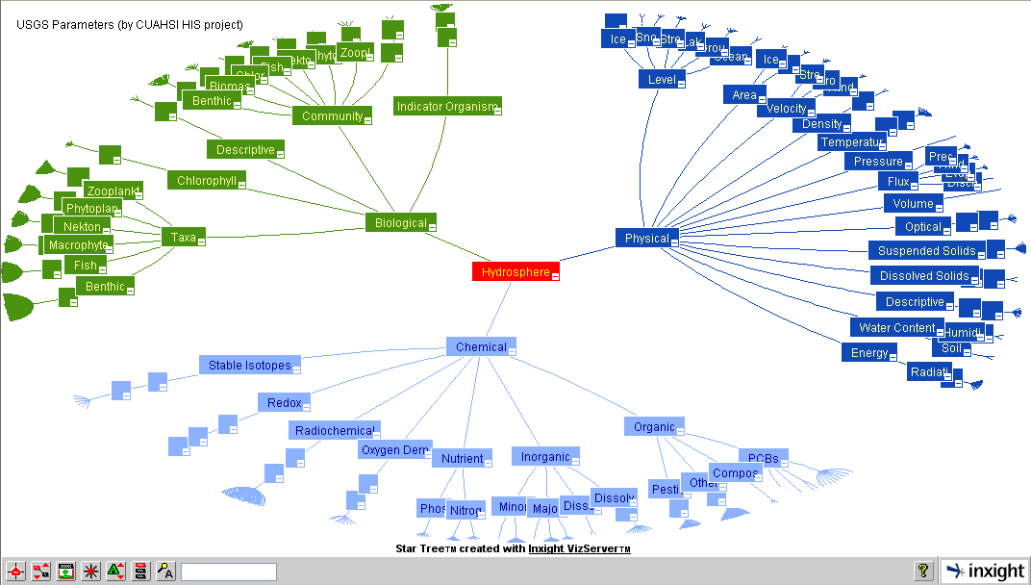
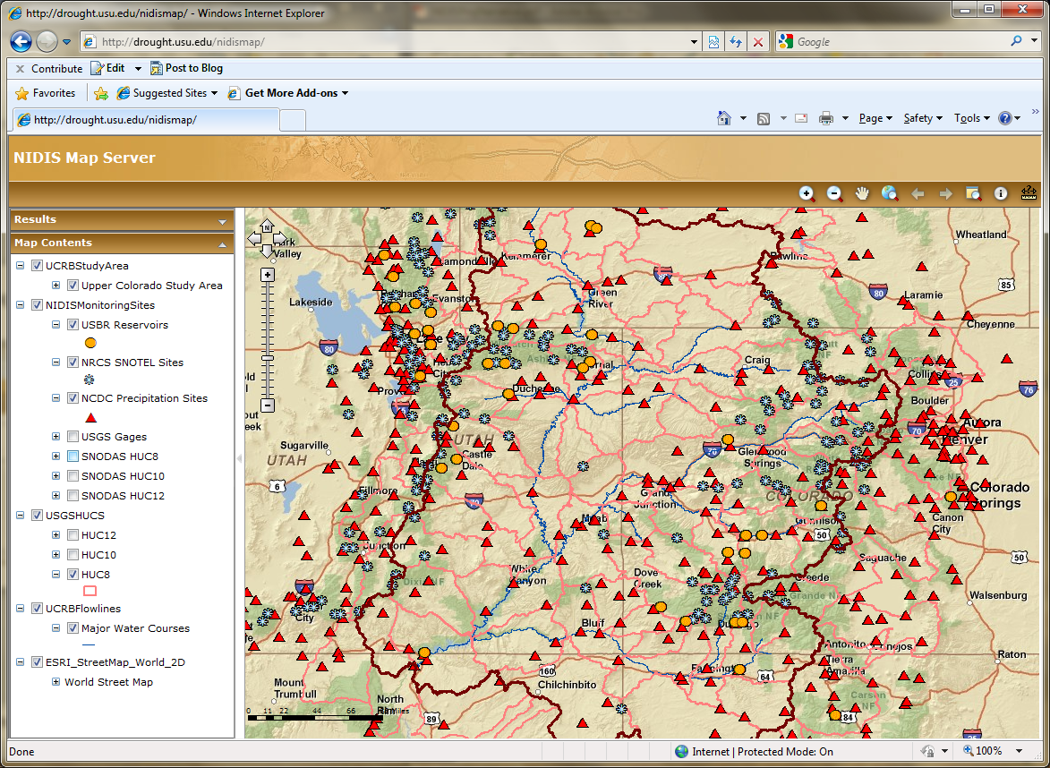
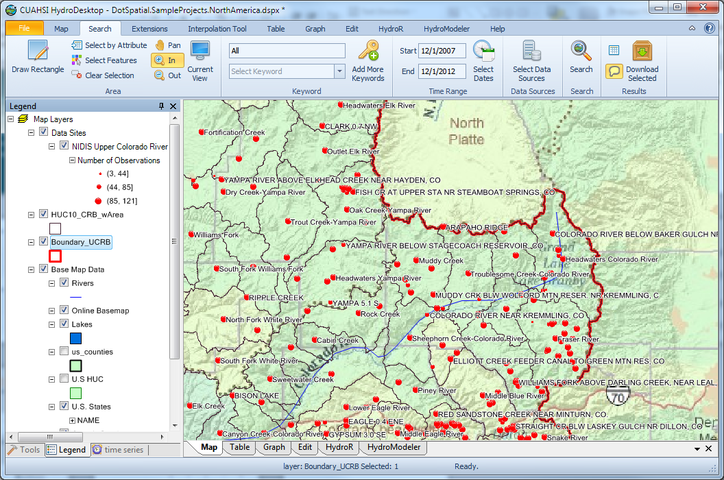
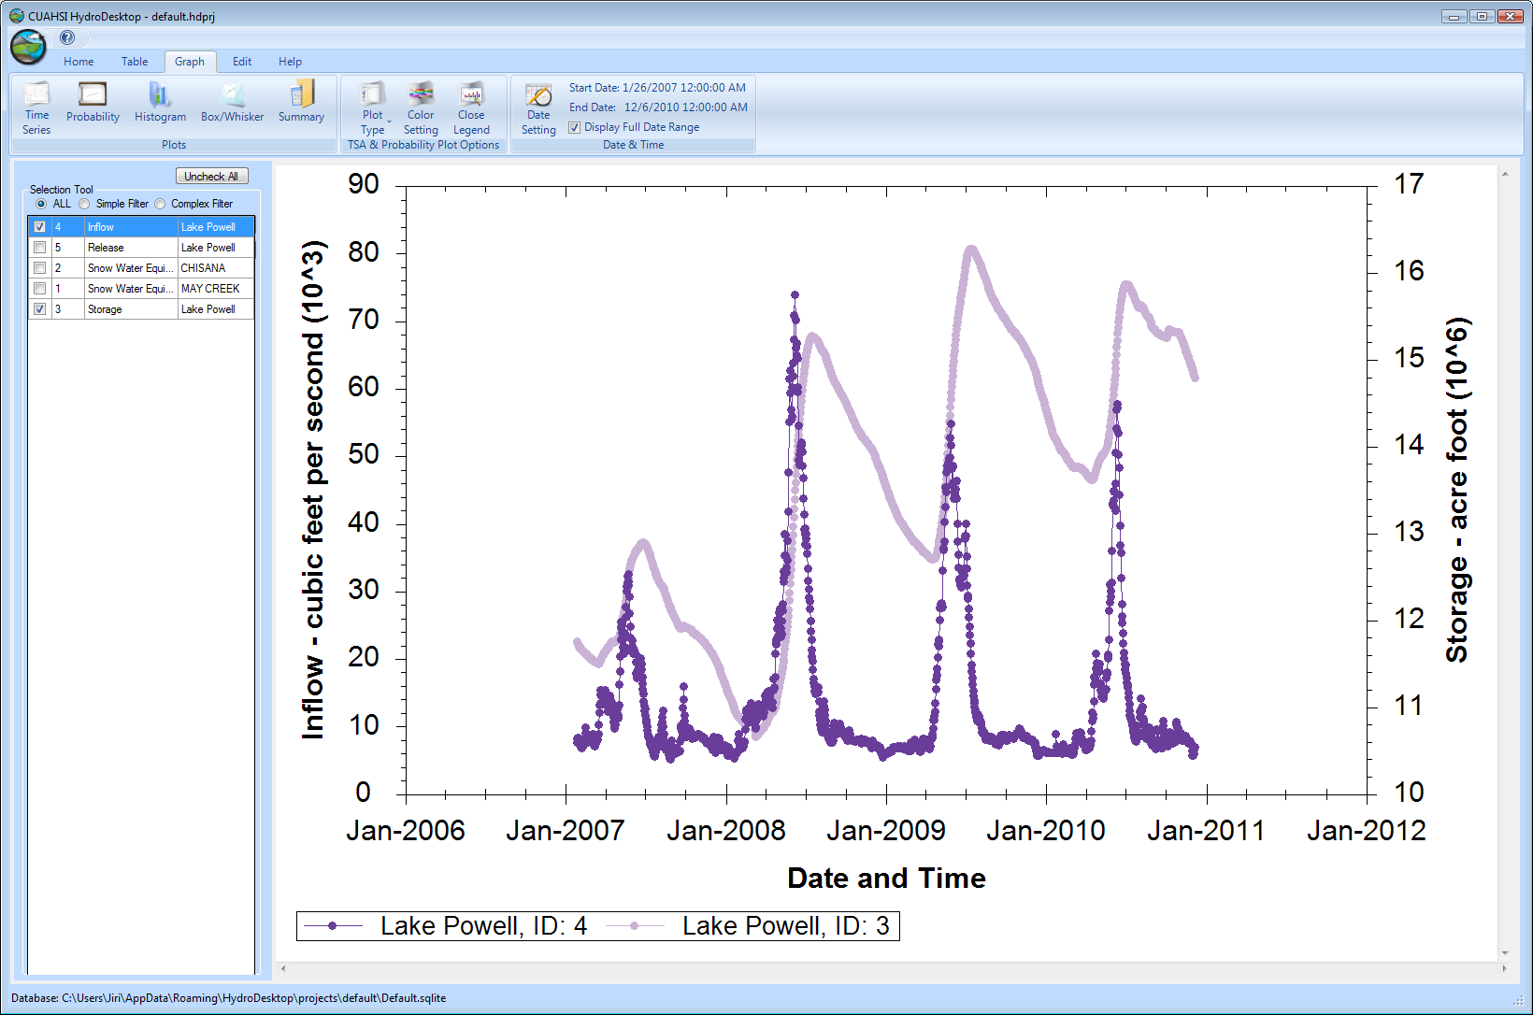
CUAHSI HIS
The CUAHSI Hydrologic Information System (HIS) is an internet based system to support the sharing of hydrologic data. It is comprised of hydrologic databases and servers connected through web services as well as software for data publication, discovery and access.
HydroServer – Data Publication
HydroCatalog
Data Discovery
Lake Powell Inflow and Storage
HydroDesktop – Data Access and Analysis
HydroDesktop – Combining multiple data sources

Slide 7
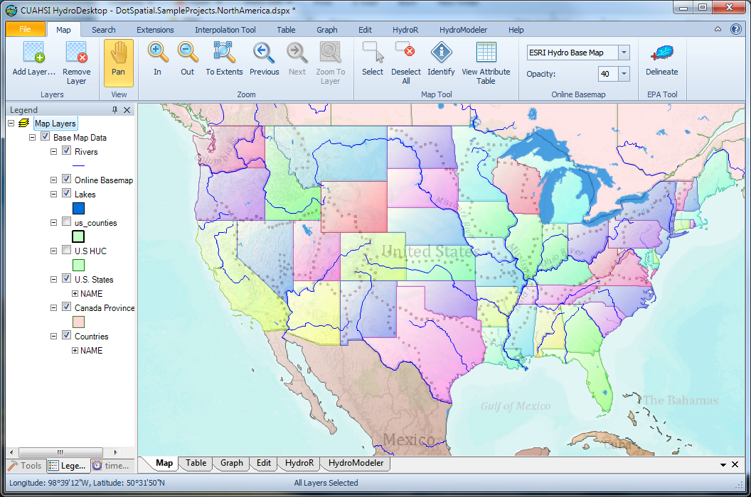
HydroDesktop Demo
An open source
dotSpatial GIS based desktop client that supports discovery and analysis of hydrologic observations data

Slide 8
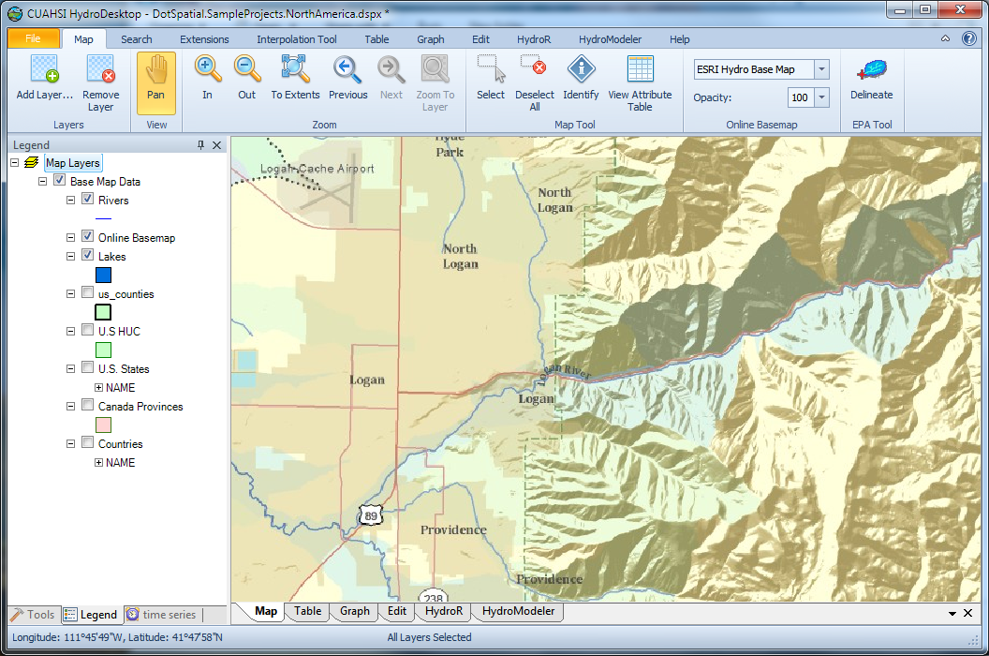
Delineate Watershed using EPA web services
Uses EPA WATERS Web, Mapping, and Database Services at http://www.epa.gov/waters/geoservices/index.html
Notes:
The service URLs that the HD tool uses are seen in http://hydrodesktop.codeplex.com/SourceControl/changeset/view/475b15a84bf4#Source%2fEPADelineation%2fCallWebService.cs The HD tool uses the Point Indexing Service to find the nearest NHD reach to where the user clicked. This returns a location on that reach. This point location is then used as input to the Navigation Delineation Service to get the watershed, and the Upstream/Downstream Service to get the river lines. The delineation service has two limitations: * It only works up to a certain distance upstream. I think we have it set to 100km. So for large watersheds (those with more than 100km of stream length upstream of where the user clicked), we don't get the most upstream portions of the watershed. * It doesn't delineate exactly to where the user clicked. It delineates to the endpoint of the NHD reach. (Can't remember if it is the clicked reach or the upstream reach -- try it and see.)

Slide 9
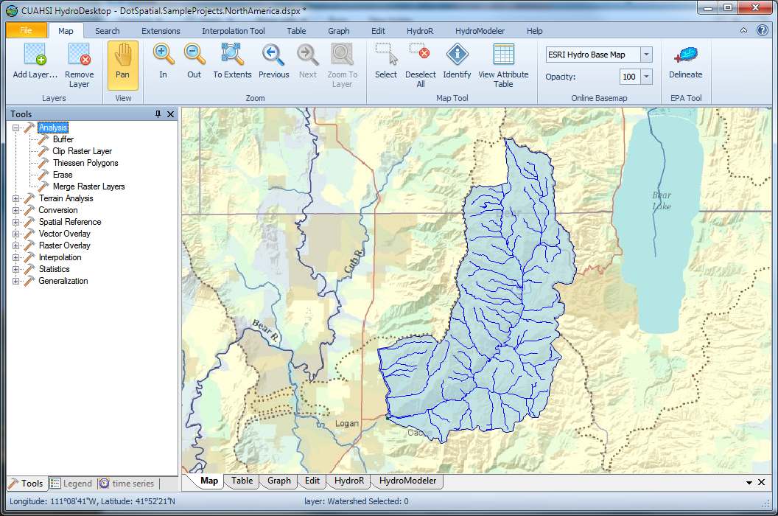
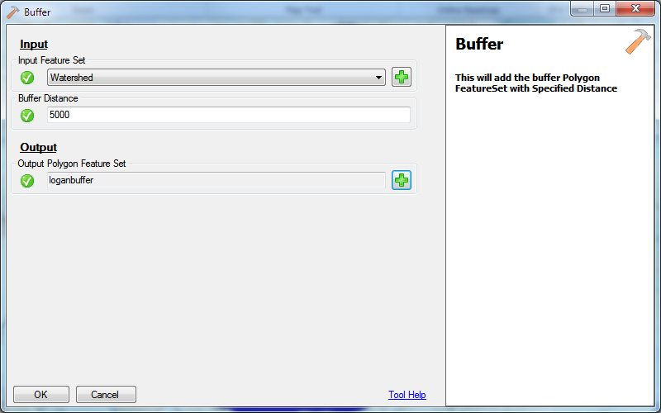
Find data in and near this watershed

Slide 10
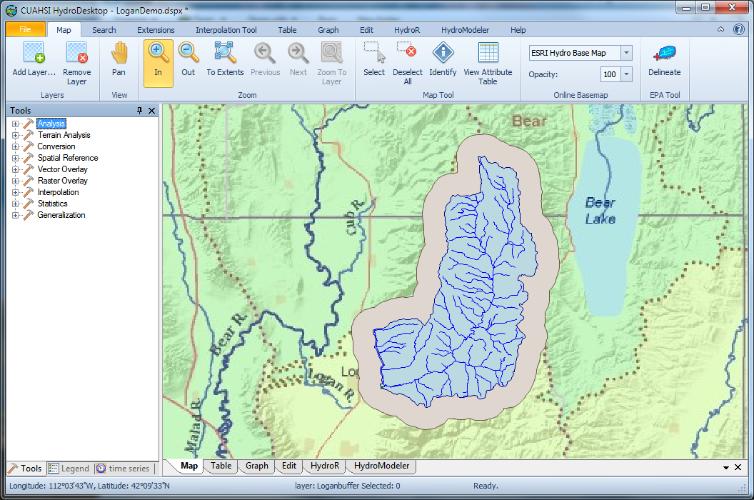
Resulting buffer around the watershed

Slide 11
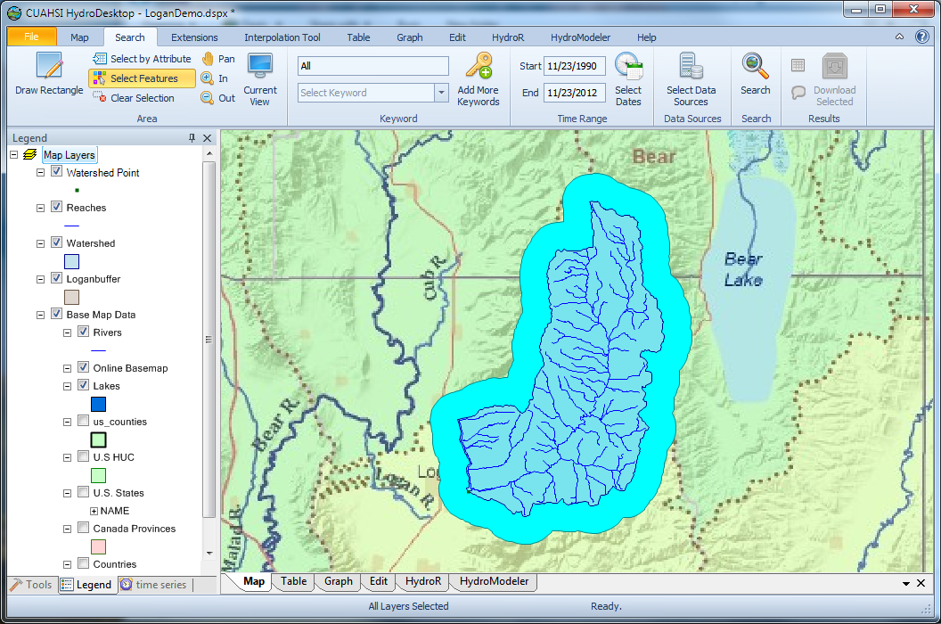
Search last 22 years for all data in buffer around watershed

Slide 12
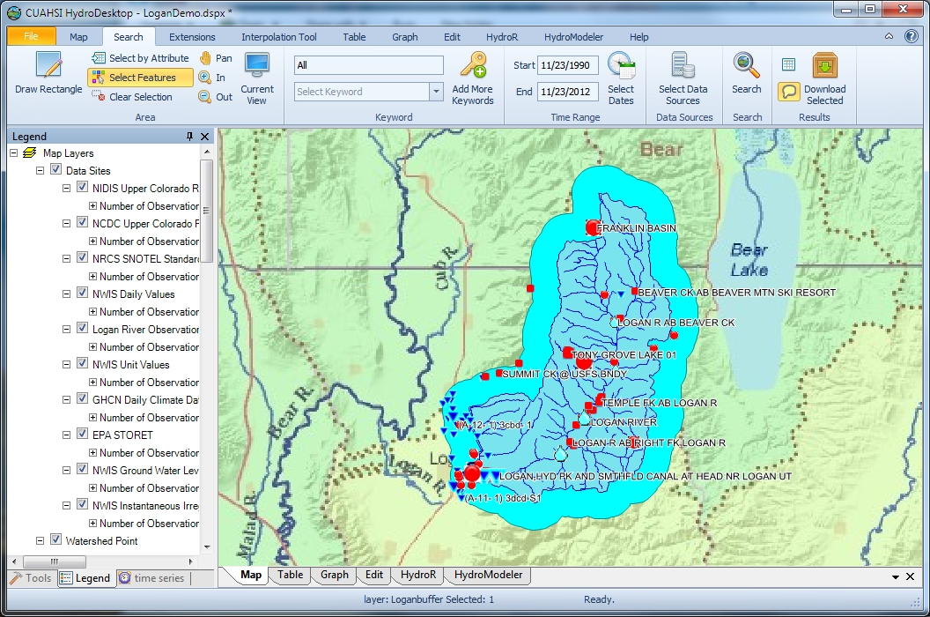
Data Discovered

Slide 13
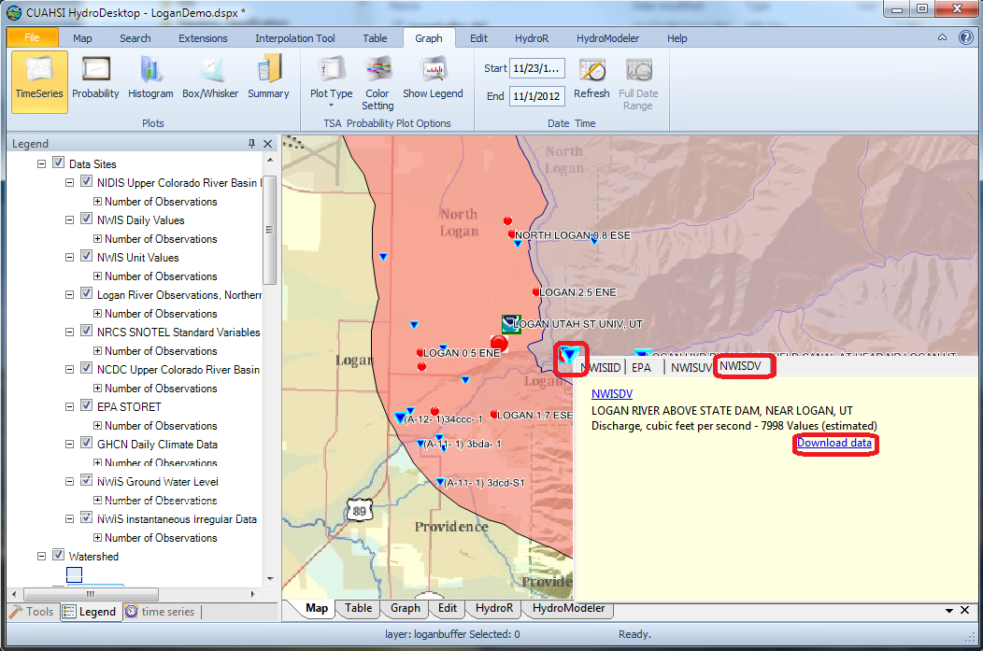
Download USGS Daily Value Streamflow Data

Slide 14
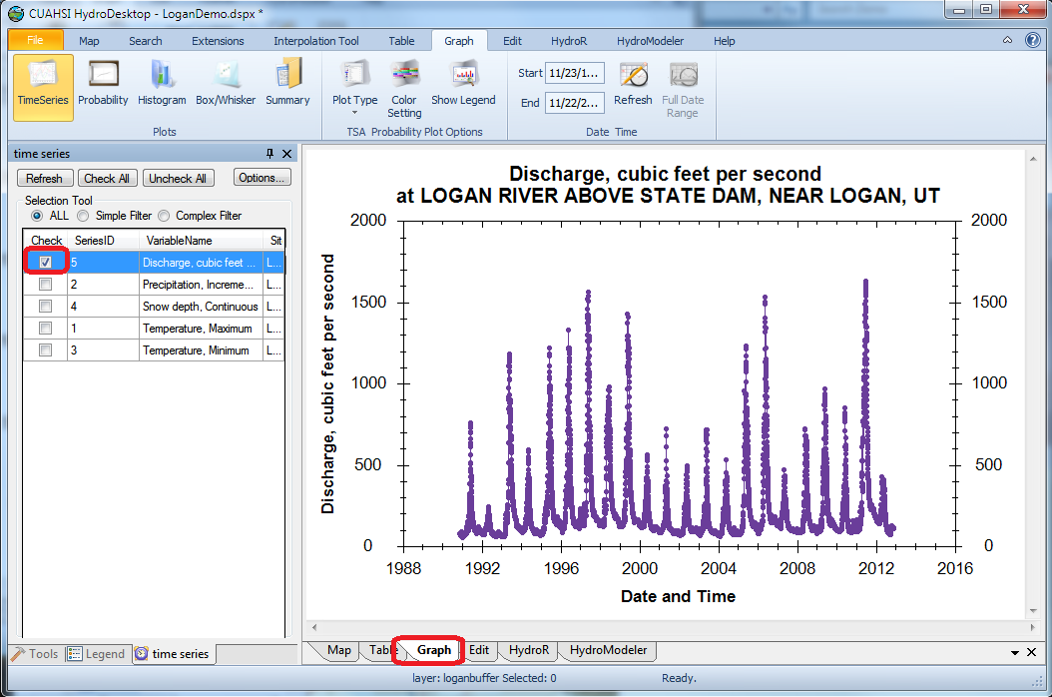
Plot the Data

Slide 15
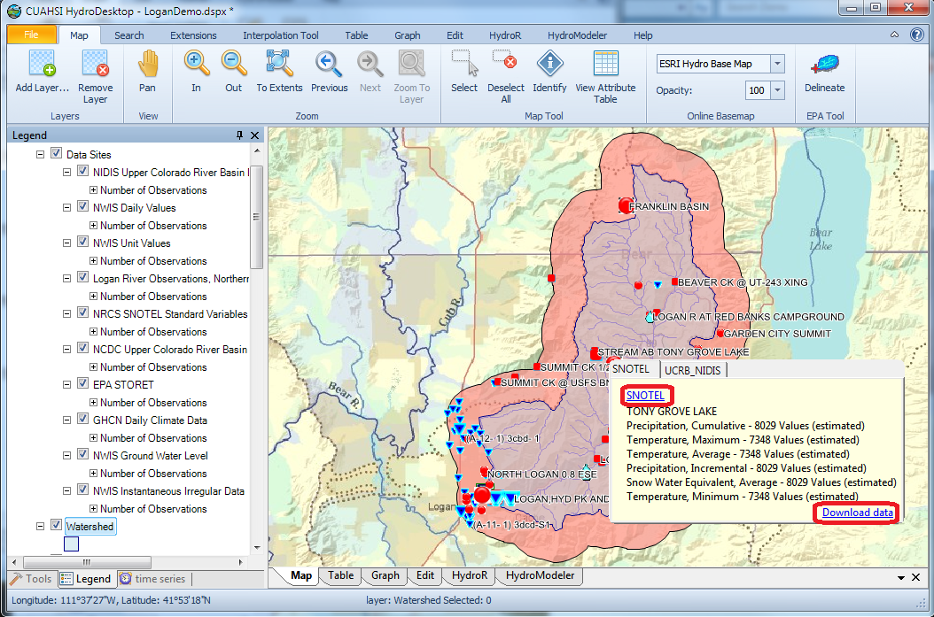
Download NRCS SNOTEL data

Slide 16
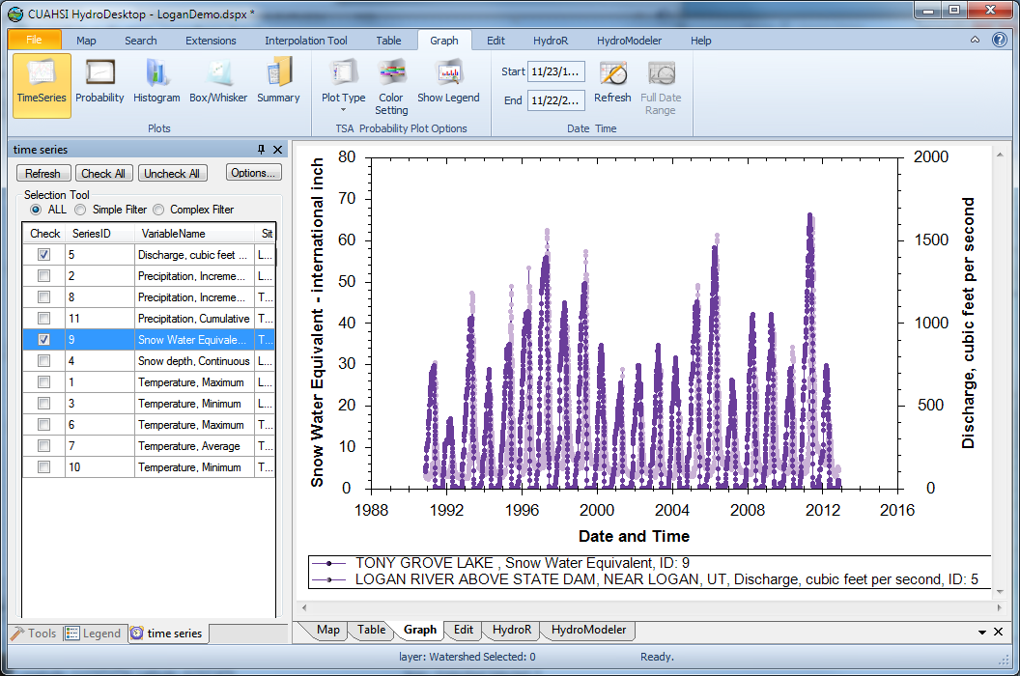
Combined plot

Slide 17
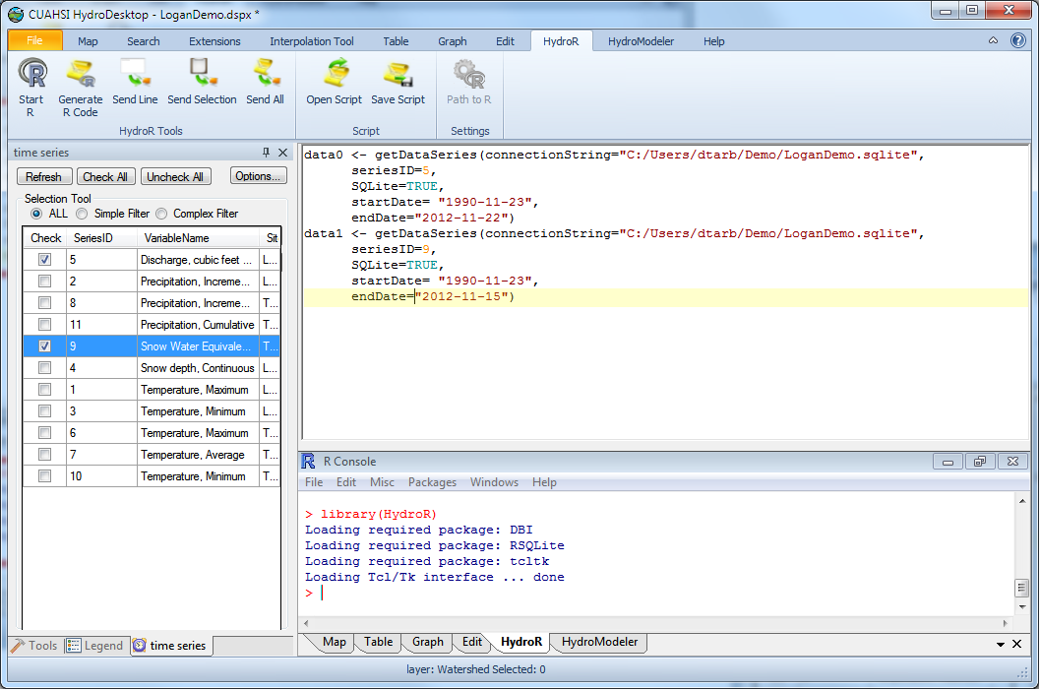
R Interoperability

Slide 18
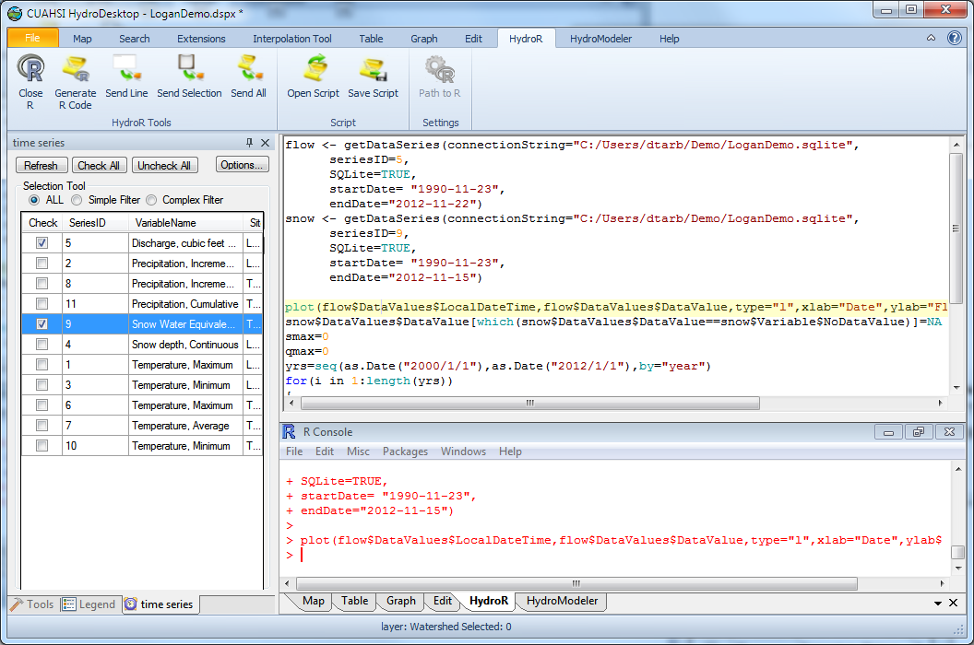
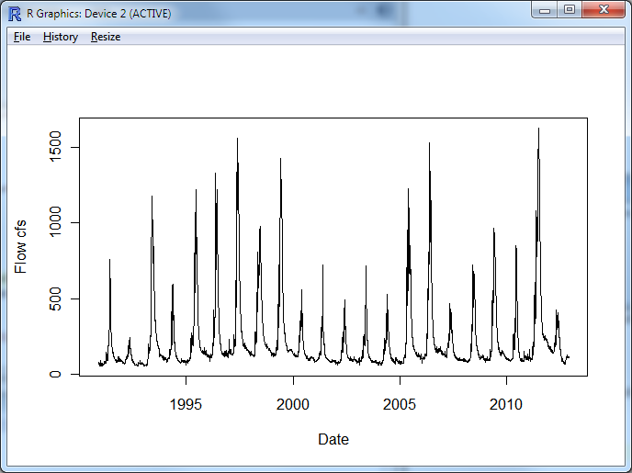
Plot the data using R

Slide 19
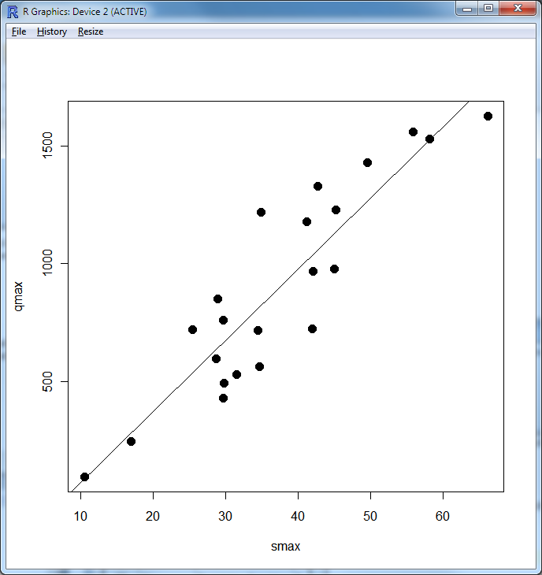
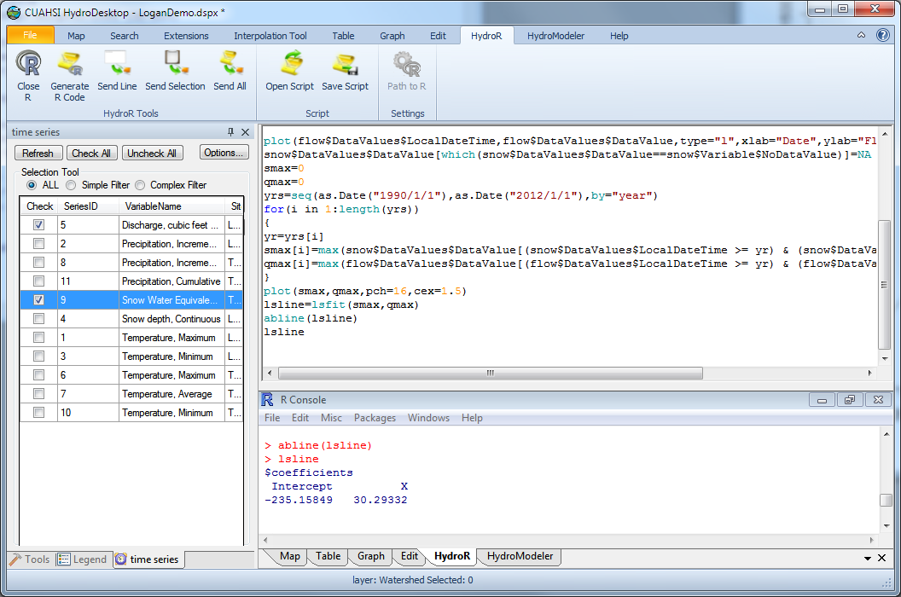
Use the analysis capability of R

Slide 20
Conclusions
Standards based architecture to enhance adoption and interoperability
Publication from distributed servers
Discovery through catalog search services
Integrated modeling and analysis combining information from multiple sources
Data sources include agencies and universities
Open source extensibility
CUAHSI governance
Services oriented Architecture
Discovery and Integration
HydroCatalog
Discoverability
Metadata Services
Search Services
Standards
WaterML
HydroServer
HydroDesktop
Publication
Synthesis and Research
Data Services
Accessibility
Consumability
Information Model and Community Support Infrastructure
The combination of these capabilities creates a common window on water observations data for the United States unlike any that has existed before.

Slide 21
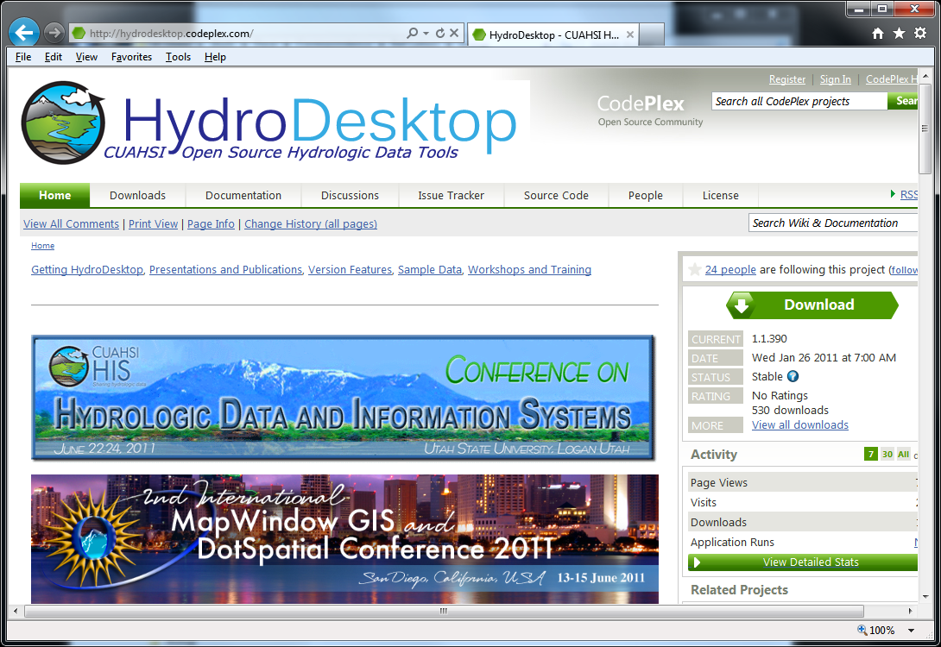


Open Development Model
http://his.cuahsi.org
http://hydrodesktop.codeplex.com
http://hydroserver.codeplex.com
http://hydrocatalog.codeplex.com
Notes:
All our HIS work is open source, but more importantly we use an open development model with open issue trackers, discussion forums and source code version control system. You can participate in these activities and we welcome your input and feedback. Together we can advance the art and practice of collaborative community modeling and data sharing.

