Slide 1
Terrain Analysis Using Digital Elevation Models
David G. Tarboton
Dan Ames
Utah State University
http://www.engineering.usu.edu/dtarb

Slide 2
Outline
Primary Digital Elevation Model (DEM) analysis
  Flow Directions
  Drainage Area
  Slope
  Channel network and watershed delineation
Secondary DEM analysis
  (Terrain stability mapping)
  Weighted drainage area accumulation (equivalent clearcut analysis)
Software
Notes:
Atlanta pre erosion

Slide 3
Related activities
Distributed hydrologic modeling.
Channel network geomorphology and mapping using digital elevation models.
Terrain stability mapping and GIS use in hydrologic modeling. (SINMAP)
Snowmelt processes and models.
GIS in Water Resources Online Course (with David Maidment, U. of Texas)
For more detail, papers and software see http://www.engineering.usu.edu/dtarb/

Slide 4
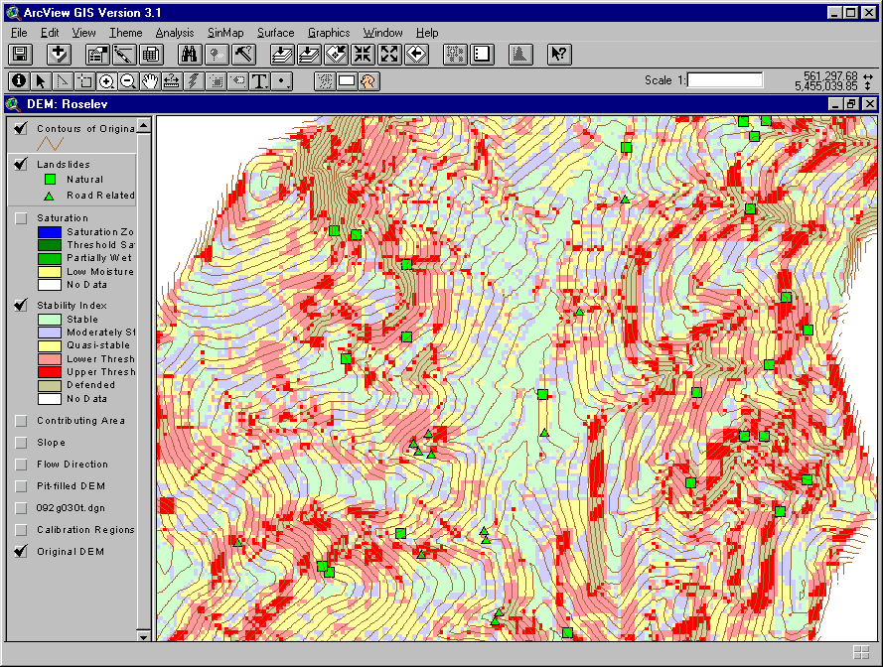
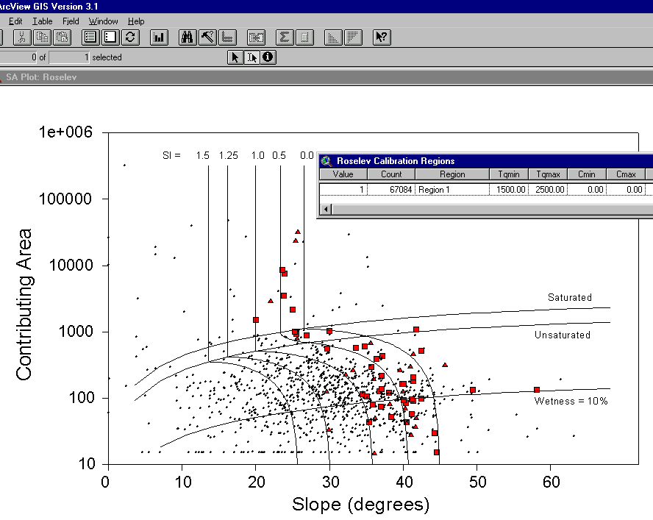
SINMAP
Terrain Stability Mapping
AREA 2
3
AREA 1
12

Slide 5
Elevation Surface — the ground surface elevation at each point
Digital Elevation Model — A digital representation of an elevation surface. Examples include a (square) digital elevation grid, triangular irregular network, set of digital line graph contours or random points.

Slide 6
Digital Elevation Model and Hydrology Data Sources
The USGS National Elevation Dataset (NED) http://edcnts12.cr.usgs.gov/ned/
  Highest-resolution, best-quality elevation data available across the United States merged into a seamless raster format. 1 arc-second cells (1:24,000 scale).
National Hydrography Dataset (NHD) http://nhd.usgs.gov/
  The stream network and water bodies of the United States organized by 8-digit hydrologic cataloging units.

Slide 7
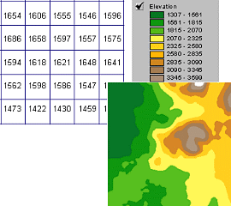
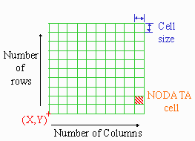
Digital Elevation Grid — a grid of cells (square or rectangular) in some coordinate system having land surface elevation as the value stored in each cell.
Square Digital Elevation Grid — a common special case of the digital elevation grid

Slide 8
Direction of Steepest Descent
30
30
67
56
49
67
56
49
52
48
37
52
48
37
58
55
22
58
55
22
Slope:

Slide 9
Digital Elevation Model Based Channel Network Delineation
Eight direction pour point model D8
Grid network
4
3
2
5
1
6
7
8
Drainage Area
1
1
1
1
1
1
4
3
3
1
1
1
12
1
2
1
1
2
16
1
1
3
6
25
2

Slide 10
Watershed Draining to This Outlet

Slide 11
Streams from 1:250,000 blue lines

Slide 12
100 grid cell constant support area threshold stream delineation

Slide 13
200 grid cell constant support area based stream delineation

Slide 14
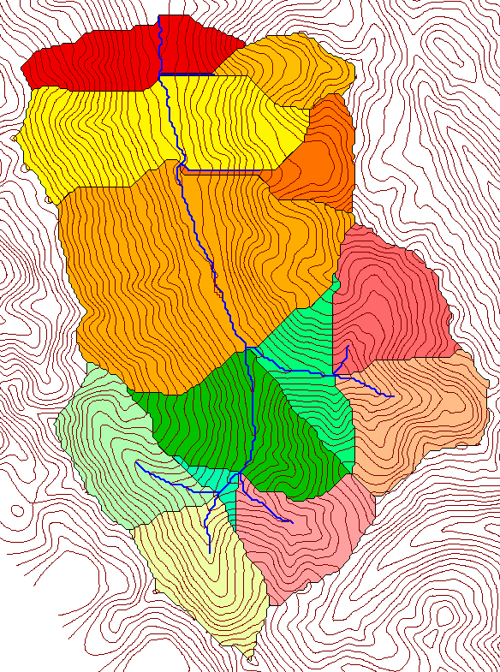
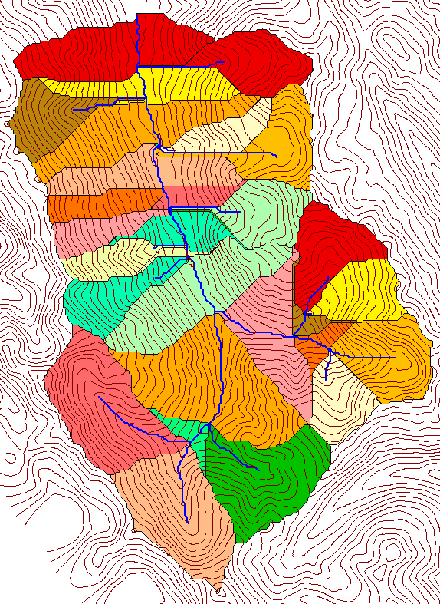
Delineation of Channel Networks and Subwatersheds
500 cell theshold
1000 cell theshold

Slide 15
How to decide on support area threshold ?
AREA 2
3
AREA 1
12

Slide 16
Curvature based stream delineation

Slide 17
Topographic Texture and Drainage Density
Driftwood, PA
Same scale, 20 m contour interval
Sunland, CA

Slide 18
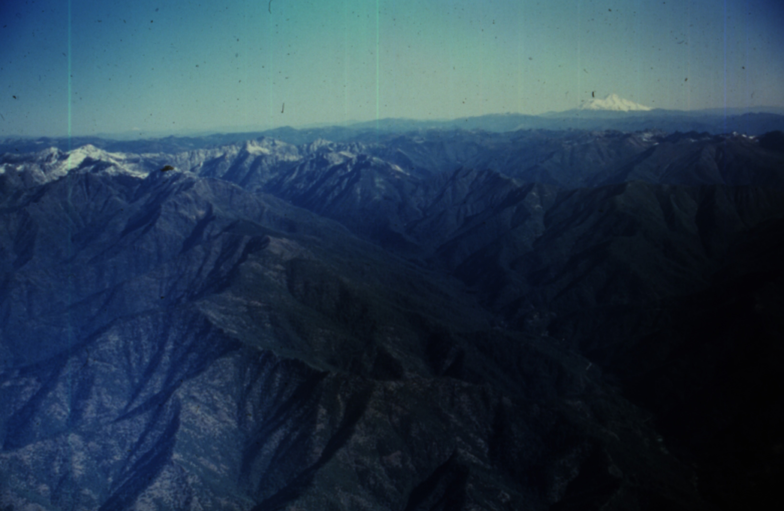
Canyon Creek, Trinity Alps, Northern California.
Photo D K Hagans

Slide 19
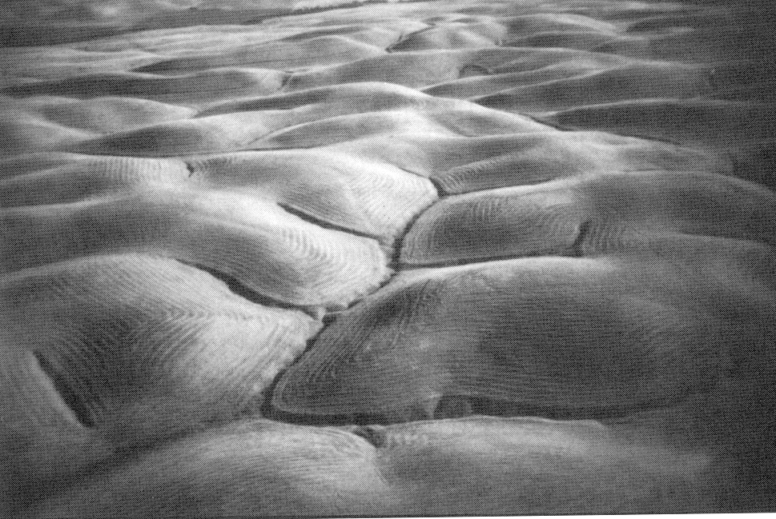
Gently Sloping Convex Landscape
From W. E. Dietrich

Slide 20
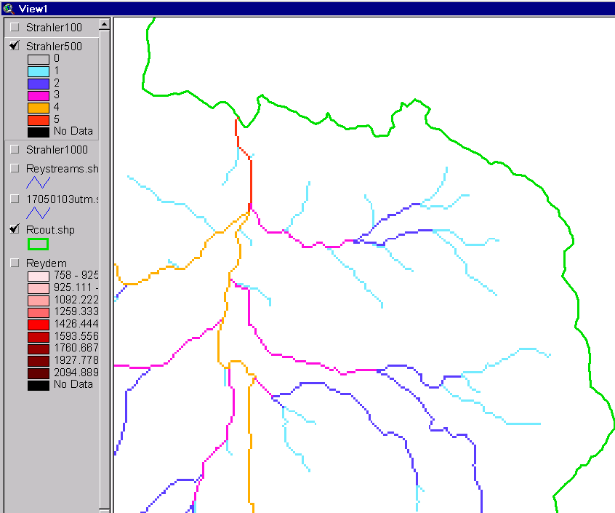
Strahler Stream Order
Order 5
Order 1
most upstream is order 1
when two streams of a order i join, a stream of order i+1 is created
when a stream of order i joins a stream of order i+1, stream order is unaltered
Order 3
Order 4
Order 2

Slide 21
Slope Law

Slide 22
Constant Stream Drops Law

Slide 23

Stream Drop
Elevation difference between ends of stream
Nodes
Links
Single Stream
Note that a “Strahler stream” comprises a sequence of links (reaches or segments) of the same order

Slide 24
Suggestion: Map channel networks from the DEM at the finest resolution consistent with observed channel network geomorphology ‘laws’.
Break in constant stream drop property
Break in slope versus contributing area relationship
Physical basis in the form instability theory of Smith and Bretherton (1972), see Tarboton et al. 1992

Slide 25
Statistical Analysis of Stream Drops

Slide 26
T-Test for Difference in Mean Values
0
72
130
T-test checks whether difference in means is large (> 2)
when compared to the spread of the data around the mean values

Slide 27
Constant Support Area Threshold

Slide 28
200 grid cell constant support area based stream delineation

Slide 29
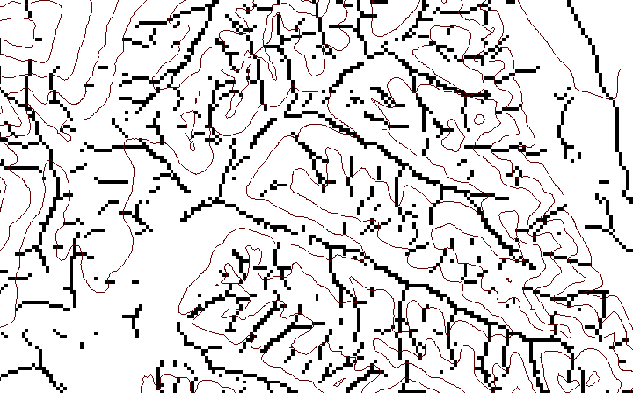
Local Curvature Computation
(Peuker and Douglas, 1975, Comput. Graphics Image Proc. 4:375)
43
48
48
51
51
56
41
47
47
54
54
58

Slide 30
Contributing area of upwards curved grid cells only

Slide 31
Upward Curved Contributing Area Threshold

Slide 32
Curvature based stream delineation

Slide 33
Equivalent Clearcut Analysis
Notes:
Green to Grey to Light pink to Dark Pink to Red as measure of disturbance by either fire, roads or clearcut. 0-1 Used as weighted accumulation.

Slide 34
Notes:
Equivalent Clearcut Area analysis
Weighted accumulation of disturbance normalized by area intersected with the stream. Gives relative amount of disturbance in upstream area.

Slide 39
Software (TauDEM)
Functionality
Pit removal (standard flooding approach)
Flow directions and slope
  D8 (standard)
  D∞ (Tarboton, 1997, WRR 33(2):309)
  Flat routing (Garbrecht and Martz, 1997, JOH 193:204)
Drainage area (D8 and D∞)
  Weighted drainage area accumulation (e.g. for ECA)
Network and watershed delineation
  Support area threshold/channel maintenance coefficient (Standard)
  Combined area-slope threshold (Montgomery and Dietrich, 1992, Science, 255:826)
  Local curvature based (using Peuker and Douglas, 1975, Comput. Graphics Image Proc. 4:375)
Threshold/drainage density selection by stream drop analysis (Tarboton et al., 1991, Hyd. Proc. 5(1):81)

Slide 40
TauDEM Software Architecture
ESRI ArcGIS 8.1
(Awaiting release)
(under Development
using beta)
VB GUI
applications
(under
development)
ArcView Extension
Avenue Scripts
(SINMAP)
Standalone
command line
applications
C++ COM interface
(under development)
DLL interface
Completed software
available from
TauDEM C++ library
Fortran (legacy)
components
http://www.engineering.usu.edu/dtarb/
Grid read/write interface
ESRI gridio API
(Spatial analyst)
Data
formats
Vector shape files
ASCII text grid files
ESRI Binary Grid Files

Slide 41
Conclusions
Terrain analysis using digital elevation models provides considerable capability useful in hydrologic analysis
In channel network delineation use consistency with geomorphology laws to adapt support area threshold and drainage density to the natural texture of the topography.
Use curvature based methods to allow channel network drainage density to be spatially variable to adapt to variable topographic texture.

Slide 42
Are there any questions ?
AREA 2
3
AREA 1
12

