Slide 1
Terrain Analysis Using Digital Elevation Models (TauDEM)
David G. Tarboton
http://www.engineering.usu.edu/dtarb

Slide 2
Overview
Terrain concepts useful in hydrology
Extending your GIS through programming
Demonstration

Slide 3
Elevation Surface — the ground surface elevation at each point
Digital Elevation Model — A digital representation of an elevation surface. Examples include a (square) digital elevation grid, triangular irregular network, set of digital line graph contours or random points.

Slide 4
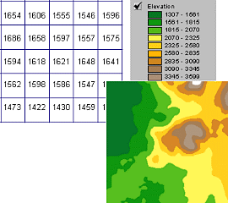
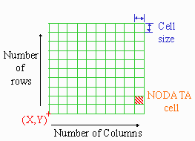
Digital Elevation Grid — a grid of cells (square or rectangular) in some coordinate system having land surface elevation as the value stored in each cell.
Square Digital Elevation Grid — a common special case of the digital elevation grid

Slide 5
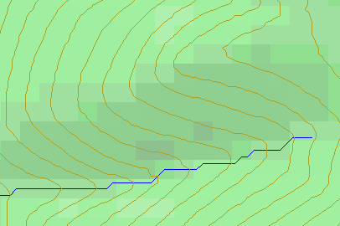
Topographic Slope
?
Topographic Definition Drop/Distance
Limitation imposed by 8 grid directions.
Flow Direction Field — if the elevation surface is differentiable (except perhaps for countable discontinuities) the horizontal component of the surface normal defines a flow direction field.

Slide 6
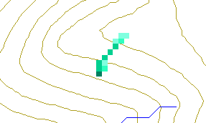
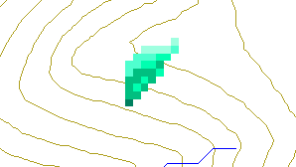
Single Flow Direction Grid — A numerical representation of the flow direction field in which each cell takes on one of eight values depending on which of its eight neighboring cells is in the direction of steepest descent
Multiple Flow Direction Grid — A numerical representation of the flow direction field in which flow is partitioned between one or more or the eight neighboring cells such that proportions add up to one

Slide 8
The D∞ Algorithm
D∞ Flow Direction Grid — A special case of a multiple flow direction grid in which the flow direction is represented by an angle stored in each grid cell
Tarboton, D. G., (1997), "A New Method for the Determination of Flow Directions and Contributing Areas in Grid Digital Elevation Models," Water Resources Research, 33(2): 309-319.) (http://www.engineering.usu.edu/cee/faculty/dtarb/dinf.pdf)

Slide 9
Drainage area can be concentrated or dispersed (specific catchment area)

Slide 10
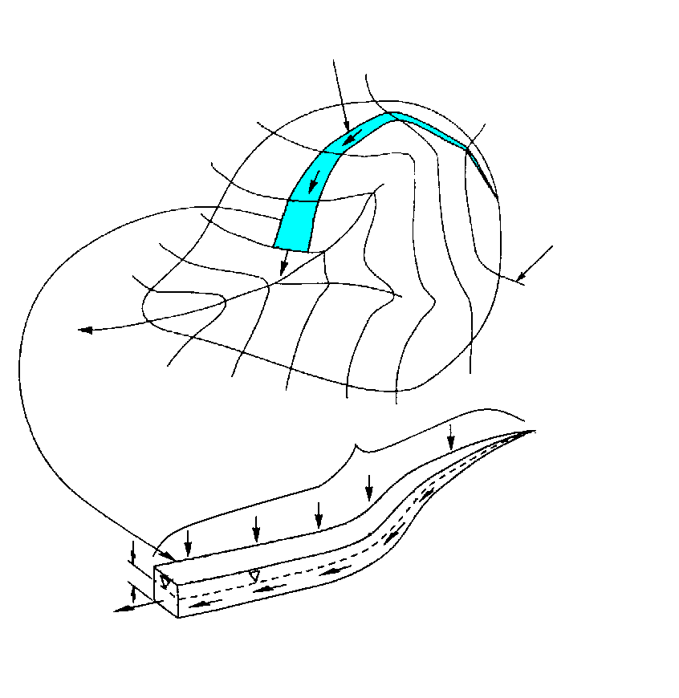
Specific catchment area a is the upslope area per unit contour length [m²/m ⇒ m]
Topographic Definition
Stream line
Contour line
Upslope contributing area a

Slide 11
Contributing Area — a field representing at each point the magnitude of the drainage area upslope of that point. Also called Catchment Area, Drainage Area or Flow Accumulation.
Specific Catchment Area — a field representing contributing area per unit contour width. Units are length.
Concentrated Contributing Area — the contributing area on a smooth surface or flow line where surface flow has concentrated and there is a measurable contributing area to a point. Units are area.
Contributing Area Grid — a grid derived from the flow direction grid, which counts in each cell the number of upstream cells draining through that cell.

Slide 12
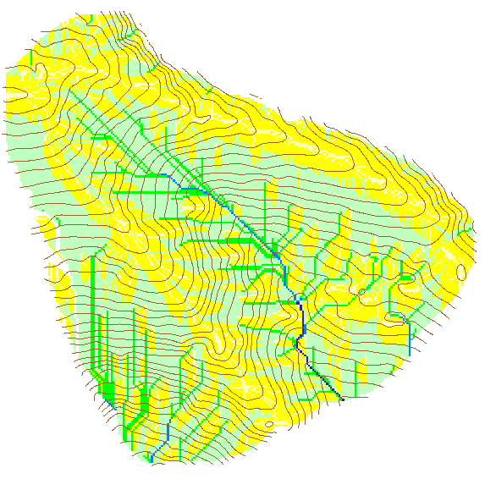

Contributing Area using D∞
Contributing Area using D8

Slide 14
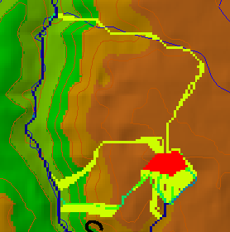
Useful for example to track where sediment or contaminant moves

Slide 15
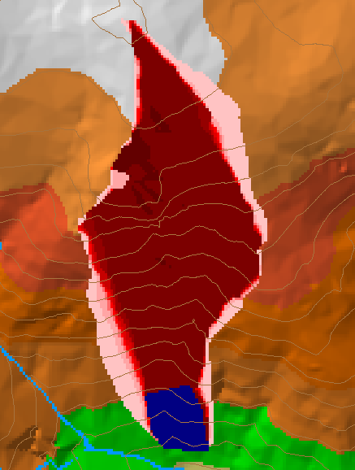
Useful for example to track where a contaminant may come from

Slide 16
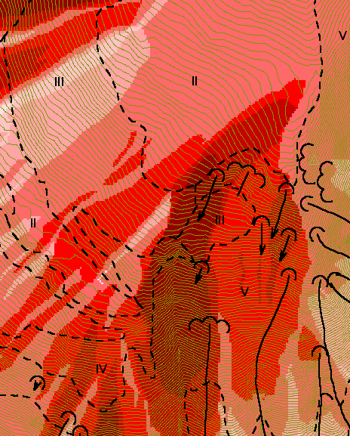
Downslope Accumulation
Useful for destabilization sensitivity in landslide hazard assessment

Slide 17
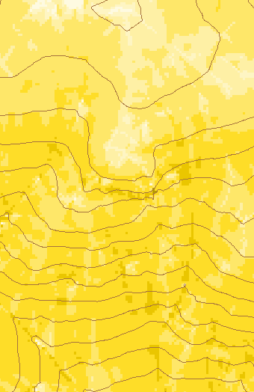
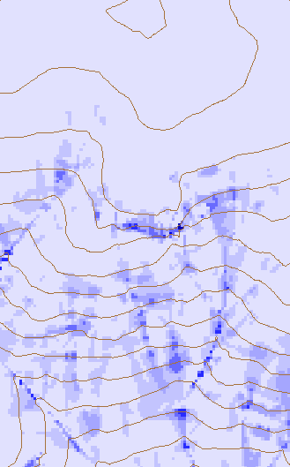
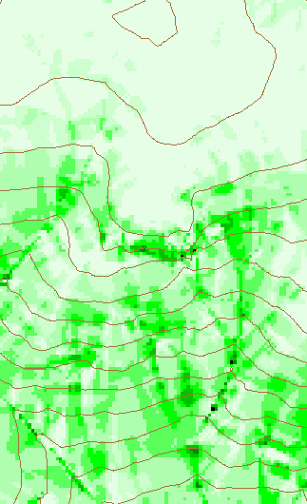
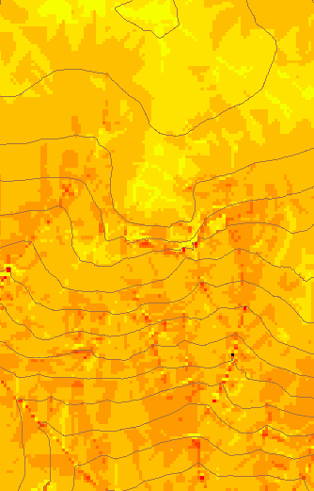
Transport limited accumulation
Useful for modeling erosion and sediment delivery, the spatial dependence of sediment delivery ratio and contaminant that adheres to sediment

Slide 18
Hydrologic processes are different on hillslopes and in channels. It is important to recognize this and delineate model elements that account for this.
Concentrated versus dispersed flow.
Objective delineation of channel networks using digital elevation models.

Slide 19
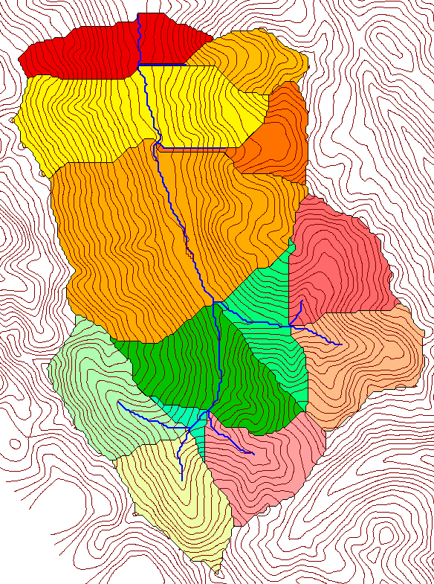
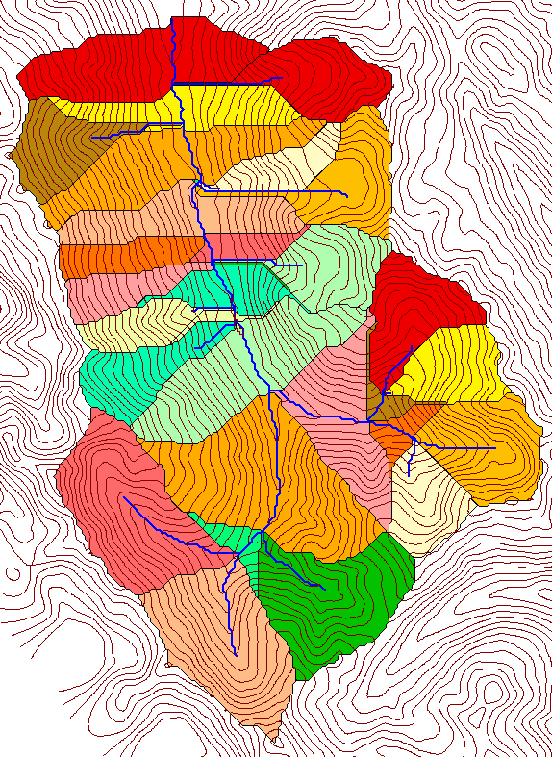
How to decide on drainage area threshold to determine channels and watershed model elements?
500 cell theshold
1000 cell theshold

Slide 20
Topographic Texture and Drainage Density
Driftwood, PA
Same scale, 20 m contour interval
Sunland, CA

Slide 21

Strahler Stream Order
Stream Drop: Elevation difference between ends of stream
most upstream is order 1
when two streams of a order i join, a stream of order i+1 is created
when a stream of order i joins a stream of order i+1, stream order is unaltered
Nodes
Links
Single Stream
Note that a “Strahler stream” comprises a sequence of links (reaches or segments) of the same order

Slide 22
Suggestion: Map channel networks from the DEM at the finest resolution consistent with observed channel network geomorphology ‘laws’.
Look for statistically significant break in constant stream drop property
Break in slope versus contributing area relationship
Physical basis in the form instability theory of Smith and Bretherton (1972), see Tarboton et al. 1992

Slide 23
Statistical Analysis of Stream Drops
Threshold = 10
Dd = 2.5
t = -3.5
Threshold = 15
Dd = 2.1
t = -2.08
Threshold = 20
Dd = 1.9
t = -1.03
Stream drop test for Mawheraiti River. For each upward curved support area threshold the stream drop for each stream is plotted against Strahler stream order. The large circles indicate mean stream drop for each order The weighted support area threshold, drainage density (in km⁻¹) and t statistic for the difference in means between lowest order and all higher order streams is given.

Slide 24
Curvature based stream delineation with threshold by constant drop analysis

Slide 25
Why Programming

Slide 26
TauDEM Software Functionality
Pit removal (standard flooding approach)
Flow directions and slope
  D8 (standard)
  D∞ (Tarboton, 1997, WRR 33(2):309)
  Flat routing (Garbrecht and Martz, 1997, JOH 193:204)
Drainage area (D8 and D∞)
Network and watershed delineation
  Support area threshold/channel maintenance coefficient (Standard)
  Combined area-slope threshold (Montgomery and Dietrich, 1992, Science, 255:826)
  Local curvature based (using Peuker and Douglas, 1975, Comput. Graphics Image Proc. 4:375)
Threshold/drainage density selection by stream drop analysis (Tarboton et al., 1991, Hyd. Proc. 5(1):81)
Wetness index and distance to streams

Slide 27
TauDEM Software Architecture
ESRI ArcGIS 8.1
(Toolbar under
development )
VB GUI
application
Standalone
command line
applications
C++ COM DLL interface
Available from
TauDEM C++ library
Fortran (legacy)
components
http://www.engineering.usu.edu/dtarb/
USU TMDLtoolkit modules
(grid, shape, image, dbf, map, mapwin)
ESRI gridio API
(Spatial analyst)
Data
formats
Vector shape
files
ASCII text
grid
Binary direct
access grid
ESRI binary
grid

Slide 28
Implementation Details
Spatial Analyst includes a C programming API (Application Programming Interface) that allows you to read and write ESRI grid data sets directly.
Excerpt from gioapi.h
/ * GetWindowCell - Get a cell within the window for a layer,
* Client must interpret the type of the output 32 Bit Ptr
* to be the type of the layer being read from.
*
* PutWindowCell - Put a cell within the window for a layer.
* Client must ensure that the type of the input 32 Bit Ptr
* is the type of the layer being read from.
*
*/
int GetWindowCell(int channel, int rescol, int resrow, CELLTYPE *cell);
int PutWindowCell(int channel, int col, int row, CELLTYPE cell);

Slide 29
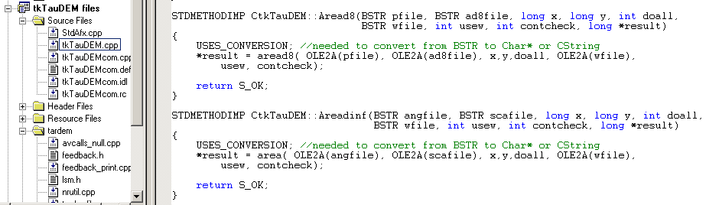
C++ COM Methods used to implement functionality using Microsoft Visual C++
STDMETHODIMP CtkTauDEM::Areadinf(BSTR angfile, BSTR scafile, long x, long y, int doall, BSTR wfile, int usew, int contcheck, long *result)
{
USES_CONVERSION; //needed to convert from BSTR to Char* or String
*result = area( OLE2A(angfile), OLE2A(scafile), x,y,doall, OLE2A(wfile),
usew, contcheck);
return S_OK;
}

Slide 30
Visual Basic for the GUI and ArcGIS linkage
Private TarDEM As New tkTauDEM
…
Private Function runareadinf(Optional toadd As Boolean = False) As Boolean
Dim i As Long
runareadinf = False
i = TarDEM.Areadinf(tdfiles.ang, tdfiles.sca, 0, 0, 1, "", 0, 1)
If TDerror(i) Then Exit Function
If toadd Then
AddMap tdfiles.sca, 8
End If
runareadinf = True
End Function

