Slide 1
Terrain Analysis Using Digital Elevation Models (TauDEM) in Hydrology
David G. Tarboton
dtarb@cc.usu.edu
http://www.engineering.usu.edu/dtarb

Slide 2
Overview
Review of digital elevation model grid based flow direction, accumulation and watershed delineation
Channel network delineation. Objective selection of channel delineation threshold and representation of variable drainage density.
Terrain flow fields and their numerical representation. Multiple flow direction approaches.
Specialized grid accumulation functions

Slide 3
Elevation Surface — the ground surface elevation at each point
Digital Elevation Model — A digital representation of an elevation surface. Examples include a (square) digital elevation grid, triangular irregular network, set of digital line graph contours or random points.

Slide 4
Digital Elevation Model Based Flow Path Analysis
Eight direction pour point model D8
Grid network
4
3
2
5
1
6
7
8
Drainage Area
Grid Order
1
1
1
1
1
1
1
1
1
1
1
4
3
3
1
1
2
2
2
1
1
1
12
1
2
1
1
3
1
1
1
1
2
16
1
1
1
1
3
1
1
3
6
25
2
1
2
2
3
1

Slide 5
100 grid cell constant support area threshold stream delineation

Slide 6
Grid network pruned to order 4 stream delineation

Slide 7
200 grid cell constant support area based stream delineation

Slide 8
How to decide on drainage area threshold ?
AREA 2
3
AREA 1
12
Why is it important?

Slide 9
Hydrologic processes are different on hillslopes and in channels. It is important to recognize this and account for this in models.
Drainage area can be concentrated or dispersed (specific catchment area) representing concentrated or dispersed flow.
Objective determination of channel network drainage density

Slide 10
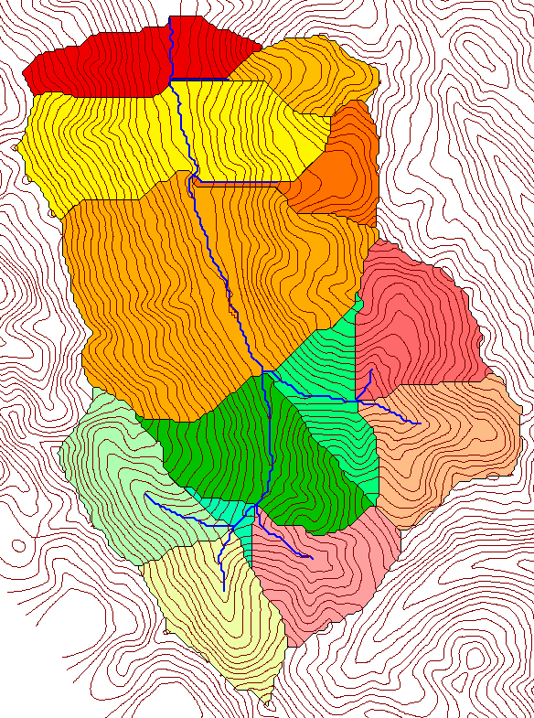
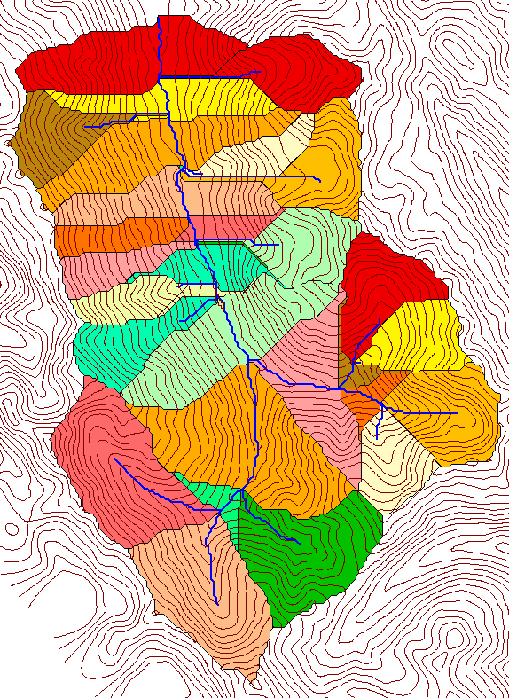
Delineation of Channel Networks and Subwatersheds
500 cell theshold
1000 cell theshold

Slide 11
Examples of differently textured topography
Driftwood, PA
Same scale, 20 m contour interval
Sunland, CA

Slide 12
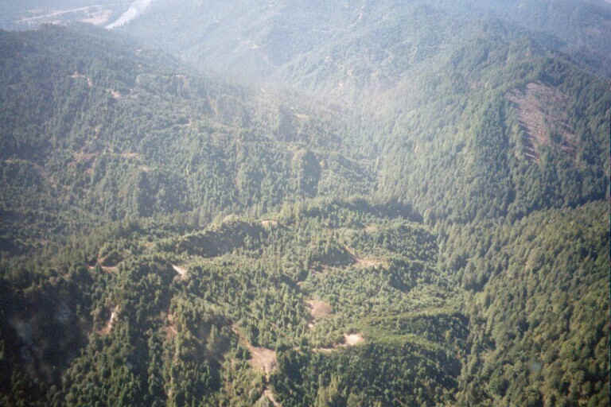
Logged Pacific Redwood Forest near Humboldt, California

Slide 13
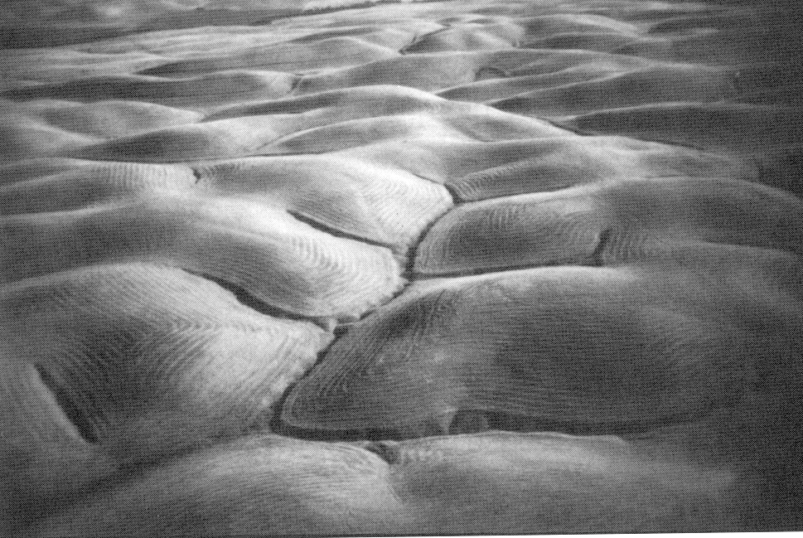
Gently Sloping Convex Landscape
From W. E. Dietrich

Slide 14
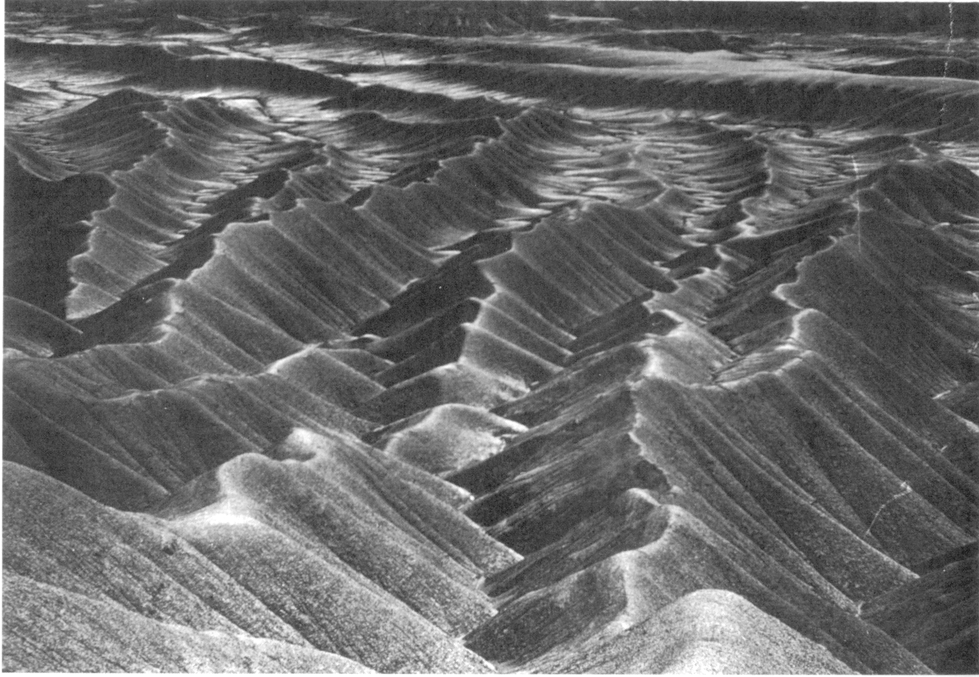
Mancos Shale badlands, Utah. From Howard, 1994.

Slide 15
“landscape dissection into distinct valleys is limited by a threshold of channelization that sets a finite scale to the landscape.” (Montgomery and Dietrich, 1992, Science, vol. 255 p. 826.)
One contributing area threshold does not fit all watersheds.
Suggestion: Map channel networks from the DEM at the finest resolution consistent with observed channel network geomorphology ‘laws’.

Slide 16
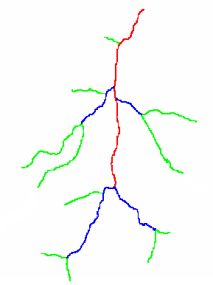
Constant Stream Drops Law based on Strahler Stream Ordering
1
3
1
2
1
2
1
1
1
2
1
1
2
1
1
1
1
Broscoe, A. J., (1959), "Quantitative analysis of longitudinal stream profiles of small watersheds," Office of Naval Research, Project NR 389-042, Technical Report No. 18, Department of Geology, Columbia University, New York.

Slide 17

Stream Drop
Elevation difference between ends of stream
Nodes
Links
Single Stream
Note that a “Strahler stream” comprises a sequence of links (reaches or segments) of the same order

Slide 18
Statistical Analysis of Stream Drops

Slide 19
Constant Support Area Threshold

Slide 20
200 grid cell constant support area based stream delineation

Slide 21
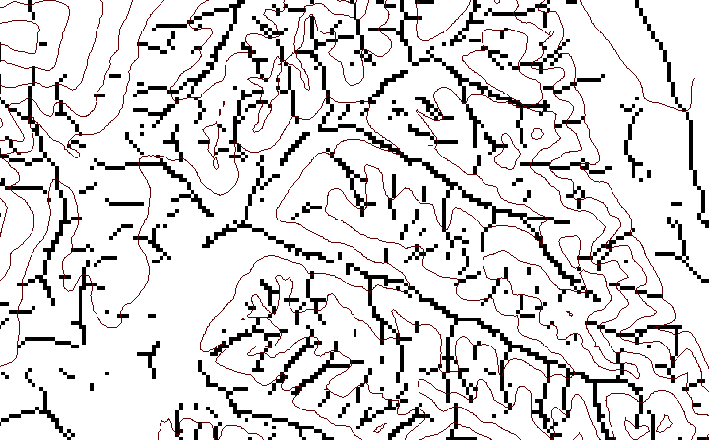
Local Curvature Computation
(Peuker and Douglas, 1975, Comput. Graphics Image Proc. 4:375)
43
48
48
51
51
56
41
47
47
54
54
58

Slide 22
Contributing area of upwards curved grid cells only

Slide 23
Upward Curved Contributing Area Threshold

Slide 24
Curvature based stream delineation

Slide 25
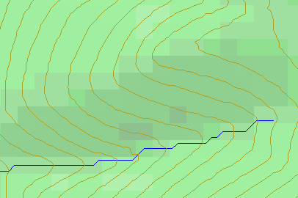
Topographic Slope
?
Topographic Definition Drop/Distance
Limitation imposed by 8 grid directions.

Slide 26

The D∞ Algorithm
Tarboton, D. G., (1997), "A New Method for the Determination of Flow Directions and Contributing Areas in Grid Digital Elevation Models," Water Resources Research, 33(2): 309-319.) (http://www.engineering.usu.edu/cee/faculty/dtarb/dinf.pdf)

Slide 27
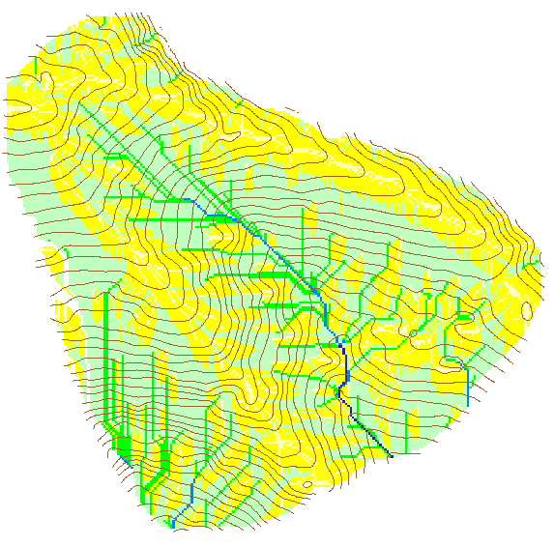

Contributing Area using D∞
Contributing Area using D8

Slide 29
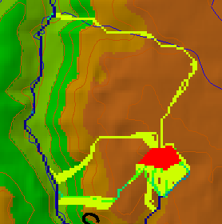
Useful for example to track where sediment or contaminant moves

Slide 30
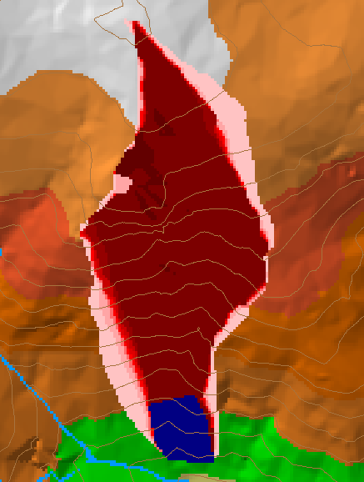
Useful for example to track where a contaminant may come from

Slide 31

Useful for a tracking contaminant or compound subject to decay or attenuation

Slide 32
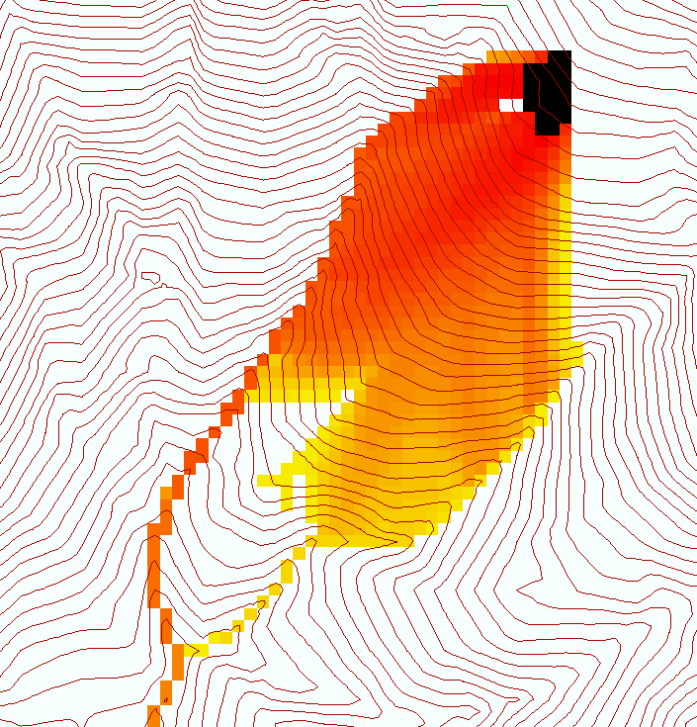
Useful for a tracking a contaminant released or partitioned to flow at a fixed threshold concentration

Slide 33
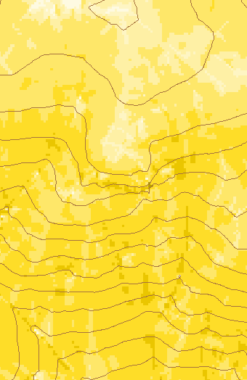
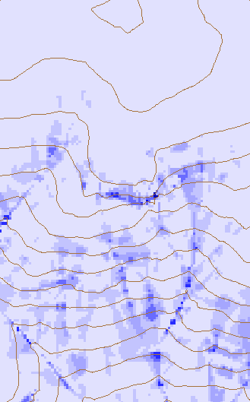
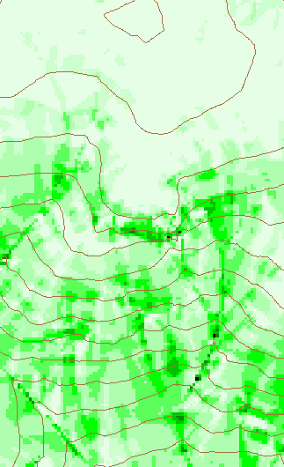
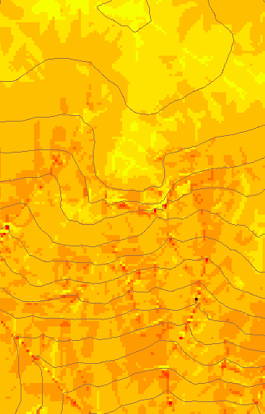
Transport limited accumulation
Useful for modeling erosion and sediment delivery, the spatial dependence of sediment delivery ratio and contaminant that adheres to sediment

Slide 34
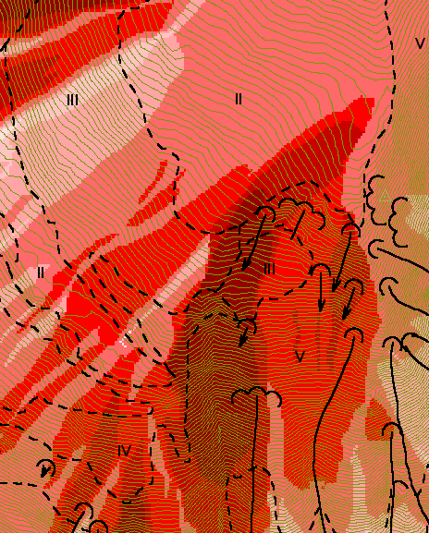
Reverse Accumulation
Useful for destabilization sensitivity in landslide hazard assessment
with Bob Pack

Slide 35
Why Programming

Slide 36
TauDEM Software Functionality
Pit removal (standard flooding approach)
Flow directions and slope
  D8 (standard)
  D∞ (Tarboton, 1997, WRR 33(2):309)
  Flat routing (Garbrecht and Martz, 1997, JOH 193:204)
Drainage area (D8 and D∞)
Network and watershed delineation
  Support area threshold/channel maintenance coefficient (Standard)
  Combined area-slope threshold (Montgomery and Dietrich, 1992, Science, 255:826)
  Local curvature based (using Peuker and Douglas, 1975, Comput. Graphics Image Proc. 4:375)
Threshold/drainage density selection by stream drop analysis (Tarboton et al., 1991, Hyd. Proc. 5(1):81)
Other Functions: Downslope Influence, Upslope Dependence, Wetness index, distance to streams, Transport limited accumulation

Slide 37
TauDEM in ArcGIS
Visual Basic
ESRI ArcGIS 8.x
Toolbar
Visual Basic
GUI
application
Standalone
command line
applications
C++ COM DLL interface
Available from
TauDEM C++ library
Fortran (legacy)
components
http://www.engineering.usu.edu/dtarb/
USU TMDLtoolkit modules
(grid, shape, image, dbf, map, mapwin)
ESRI gridio API
(Spatial analyst)
Data
formats
Vector shape
files
ASCII text
grid
Binary direct
access grid
ESRI binary
grid

Slide 38
Are there any questions ?
AREA 2
3
AREA 1
12
http://www.engineering.usu.edu/dtarb

