Slide 1
Hydrologic Terrain Analysis in ArcGIS
David G. Tarboton
dtarb@cc.usu.edu
http://www.engineering.usu.edu/dtarb

Slide 2
Outline
Grid based terrain flow data model
Objective stream threshold delineation
Variable drainage density
D∞ multiple flow direction model
Flow algebra
Terrain stability mapping (SINMAP)

Slide 3

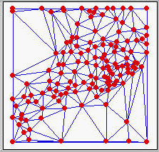
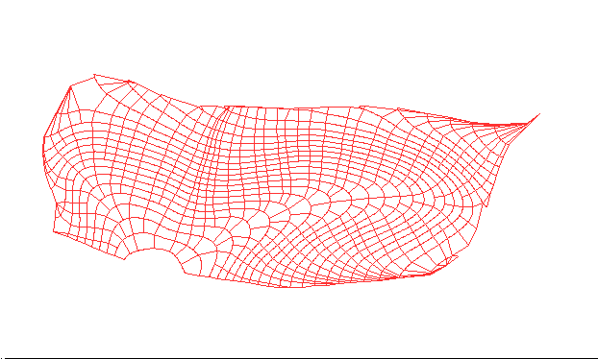

Terrain Data Models
Grid
TIN
Contour and flowline

Slide 4
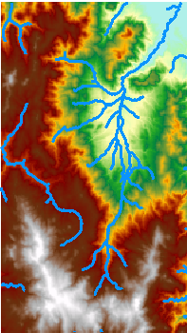
Duality between Terrain and Drainage Network
Flowing water erodes landscape and carries away sediment sculpting the topography
Topography defines drainage direction on the landscape and resultant runoff and streamflow accumulation processes

Slide 5
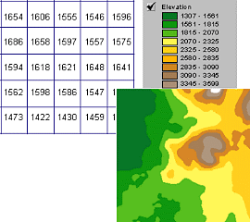
Grid based terrain flow data model
A grid defines geographic space as a matrix of identically-sized square cells. Each cell holds a numeric value that measures a geographic attribute (like elevation) for that unit of space.

Slide 6
Eight Direction Pour Point Model D8
30
4
3
2
67
56
49
5
1
52
48
37
6
7
8
58
55
22
Slope = Drop/Distance
Steepest down slope direction

Slide 7
Grid based terrain flow data model
Eight direction pour point model D8
Grid network
4
3
2
5
1
6
7
8
Drainage Area
1
1
1
1
1
1
4
3
3
1
1
1
12
1
2
1
1
2
16
1
1
3
6
25
2

Slide 8
Flow Accumulation Grid.
Area draining in to a grid cell
0
0
0
0
0
0
0
0
0
0
0
3
2
2
0
0
3
2
2
0
0
0
0
0
11
0
1
0
11
1
0
1
0
0
0
1
15
0
0
15
0
2
5
0
2
5
24
1
1
24
ArcHydro Page 72

Slide 9
Flow Accumulation > 5 Cell Threshold
Channel or Stream Raster
0
0
0
0
0
0
3
2
2
0
0
0
0
1
11
0
1
0
0
15
0
2
5
1
24

Slide 10
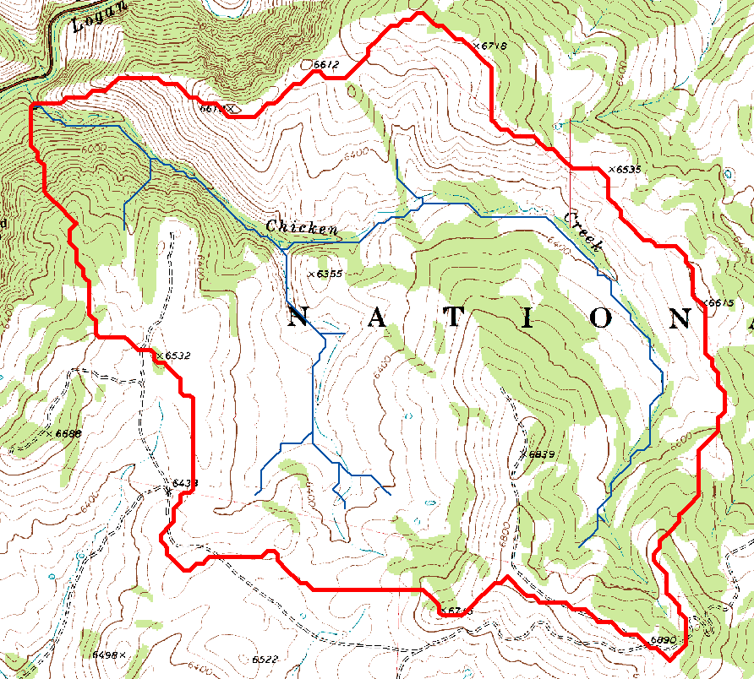
Watershed delineated on a topographic map

Slide 11
Stream Segments in a Grid Cell Network
1
1
2
1
2
5
3
5
3
5
4
4
4
3
5
4
4
6
6
6

Slide 12
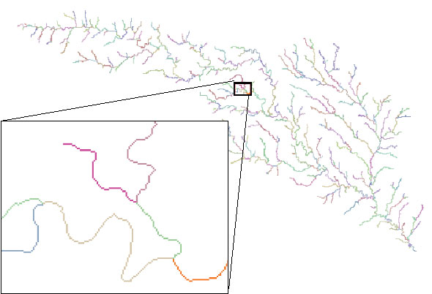
Stream links grid for the San Marcos subbasin
201
172
202
203
206
204
209
Each link has a unique identifying number
ArcHydro Page 74

Slide 13
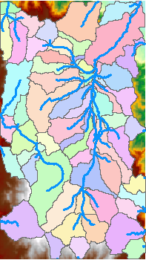
Catchments
For every stream segment, there is a corresponding catchment
Catchments are a tessellation of the landscape through a set of physical rules

Slide 14
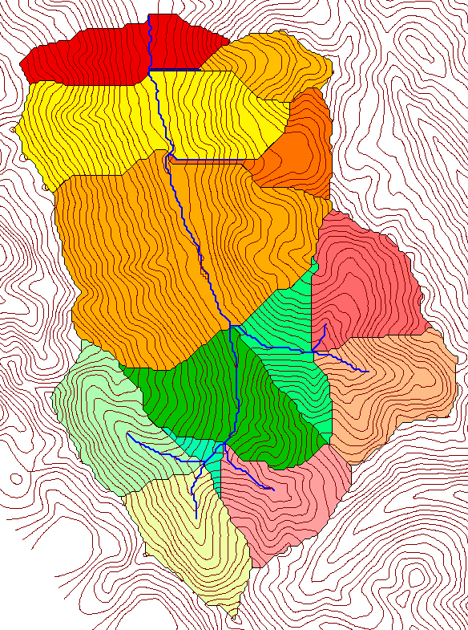
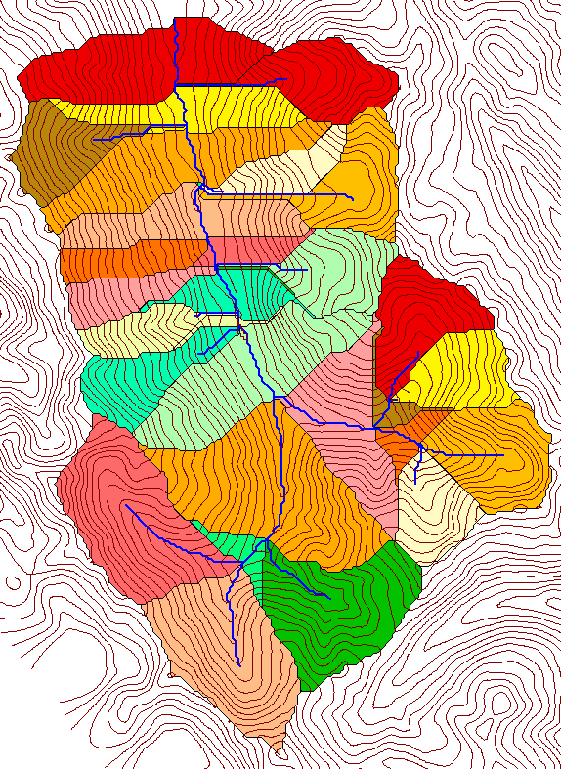
Delineation of Channel Networks and Catchments
500 cell theshold
1000 cell theshold

Slide 15
How to decide on stream delineation threshold ?
AREA 2
3
AREA 1
12
Why is it important?

Slide 16
Hydrologic processes are different on hillslopes and in channels. It is important to recognize this and account for this in models.
Drainage area can be concentrated or dispersed (specific catchment area) representing concentrated or dispersed flow.
Objective determination of channel network drainage density

Slide 17
“landscape dissection into distinct valleys is limited by a threshold of channelization that sets a finite scale to the landscape.” (Montgomery and Dietrich, 1992, Science, vol. 255 p. 826.)
One contributing area threshold does not fit all watersheds.
Map stream networks from the DEM at the finest resolution consistent with observed stream network geomorphology ‘laws’.

Slide 18
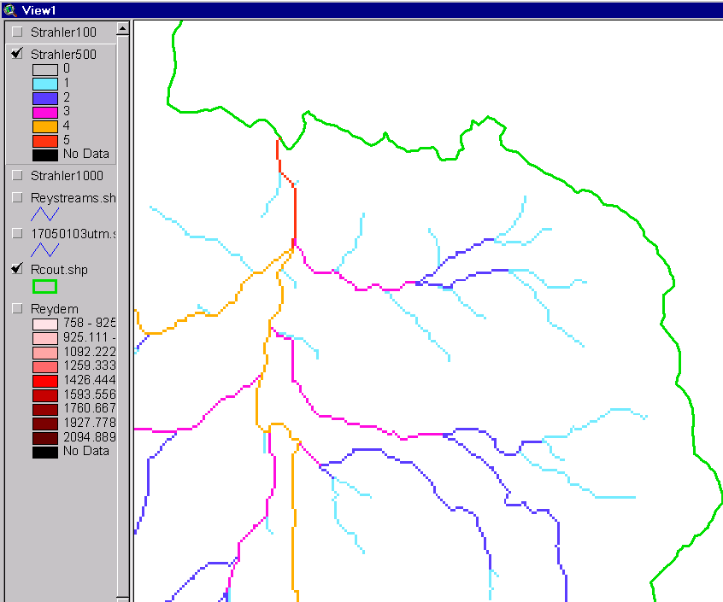
Strahler Stream Order
Order 5
Order 1
most upstream is order 1
when two streams of a order i join, a stream of order i+1 is created
when a stream of order i joins a stream of order i+1, stream order is unaltered
Order 3
Order 4
Order 2

Slide 19
Constant Stream Drops Law
Broscoe, A. J., (1959), "Quantitative analysis of longitudinal stream profiles of small watersheds," Office of Naval Research, Project NR 389-042, Technical Report No. 18, Department of Geology, Columbia University, New York.

Slide 20

Stream Drop
Elevation difference between ends of stream
Nodes
Links
Single Stream
Note that a “Strahler stream” comprises a sequence of links (reaches or segments) of the same order

Slide 21
Suggestion: Map channel networks from the DEM at the finest resolution consistent with observed channel network geomorphology ‘laws’.
Look for statistically significant break in constant stream drop property
Break in slope versus contributing area relationship
Physical basis in the form instability theory of Smith and Bretherton (1972), see Tarboton et al. 1992

Slide 22
Statistical Analysis of Stream Drops

Slide 23
T-Test for Difference in Mean Values
0
72
130
T-test checks whether difference in means is large (> 2)
when compared to the spread of the data around the mean values

Slide 24
Statistical Analysis of Stream Drops

Slide 25
200 grid cell constant drainage area based stream delineation

Slide 26
100 grid cell constant drainage area threshold stream delineation

Slide 27
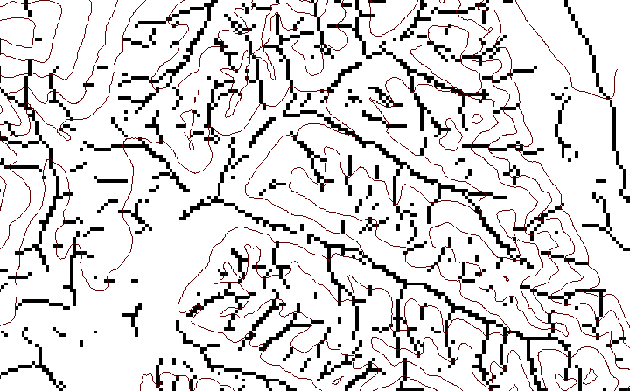
Local Curvature Computation
(Peuker and Douglas, 1975, Comput. Graphics Image Proc. 4:375)
43
48
48
51
51
56
41
47
47
54
54
58

Slide 28
Contributing area of upwards curved grid cells only

Slide 29
Upward Curved Contributing Area Threshold

Slide 30
Curvature based stream delineation with threshold by constant drop analysis

Slide 31
Channel network delineation, other options
4
3
2
5
1
6
7
8
Contributing Area
Grid Order
1
1
1
1
1
1
1
1
1
1
1
4
3
3
1
1
2
2
2
1
1
1
12
1
2
1
1
3
1
1
1
1
2
16
1
1
1
1
3
1
1
3
6
25
2
1
2
2
3
1

Slide 32
Grid Network Ordering Approach (Peckham, 1995)

Slide 33
Grid network pruned to order 4 stream delineation

Slide 34
Slope area threshold (Montgomery and Dietrich, 1992).

Slide 35
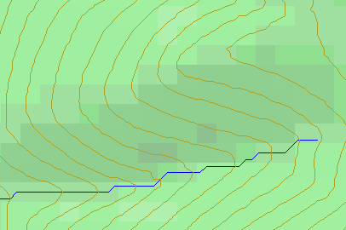
Limitation due to 8 grid directions.
?
Flow Direction Field — if the elevation surface is differentiable (except perhaps for countable discontinuities) the horizontal component of the surface normal defines a flow direction field.

Slide 36
D∞ Multiple flow direction model
Proportion flowing to neighboring grid cell 2 is α₁/(α₁ + α₂)
Proportion flowing to neighboring grid cell 1 is α₂/(α₁ + α₂)
Δ
Tarboton, D. G., (1997), "A New Method for the Determination of Flow Directions and Contributing Areas in Grid Digital Elevation Models," Water Resources Research, 33(2): 309-319.) (http://www.engineering.usu.edu/cee/faculty/dtarb/dinf.pdf)

Slide 37
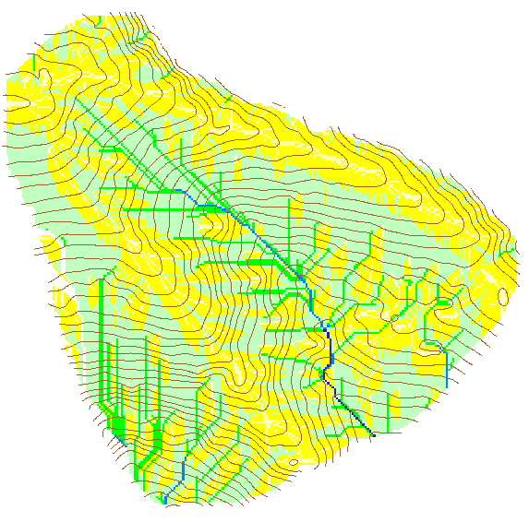

Contributing Area using D∞
Contributing Area using D8

Slide 38
Flow Algebra

Slide 39
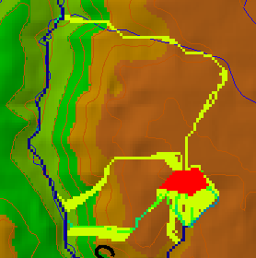
Useful for example to track where sediment or contaminant moves

Slide 40
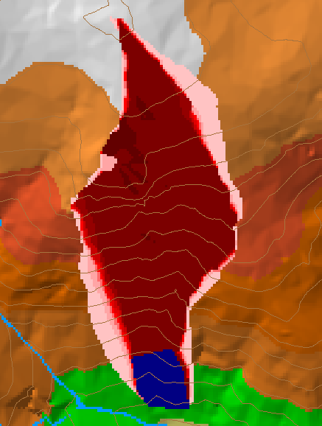
Useful for example to track where a contaminant may come from

Slide 41

Useful for a tracking contaminant or compound subject to decay or attenuation

Slide 42
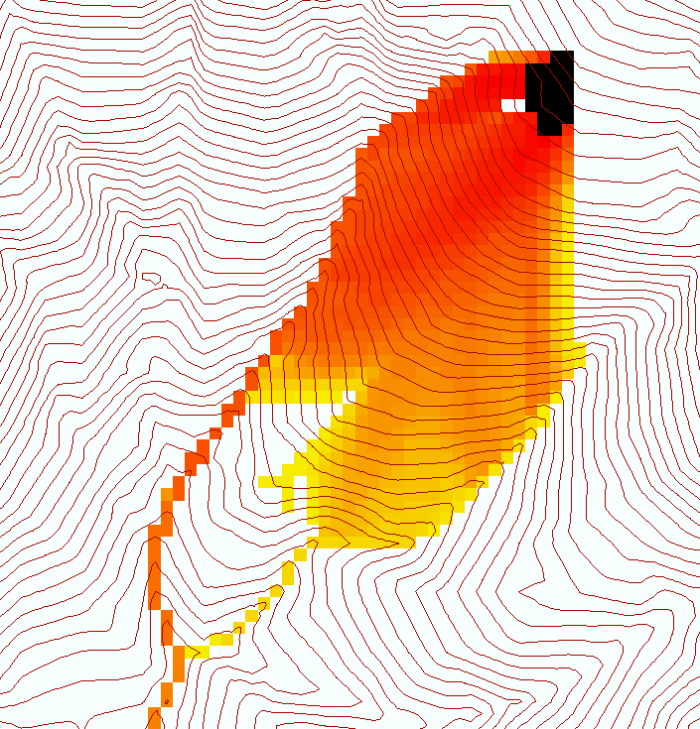
Useful for a tracking a contaminant released or partitioned to flow at a fixed threshold concentration

Slide 43
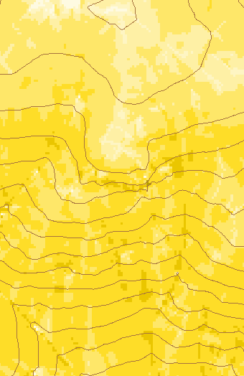
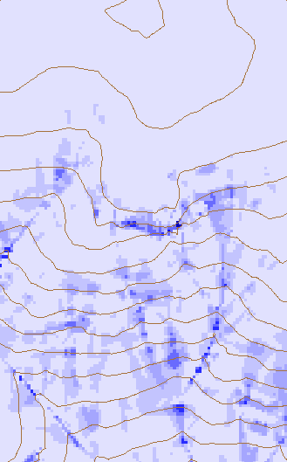
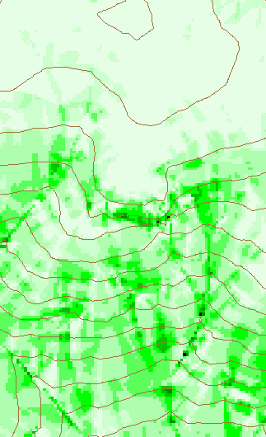
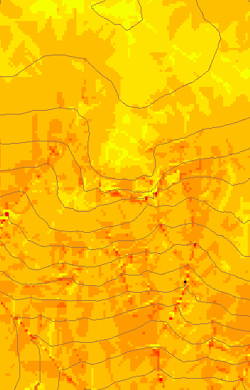
Transport limited accumulation
Useful for modeling erosion and sediment delivery, the spatial dependence of sediment delivery ratio and contaminant that adheres to sediment

Slide 44
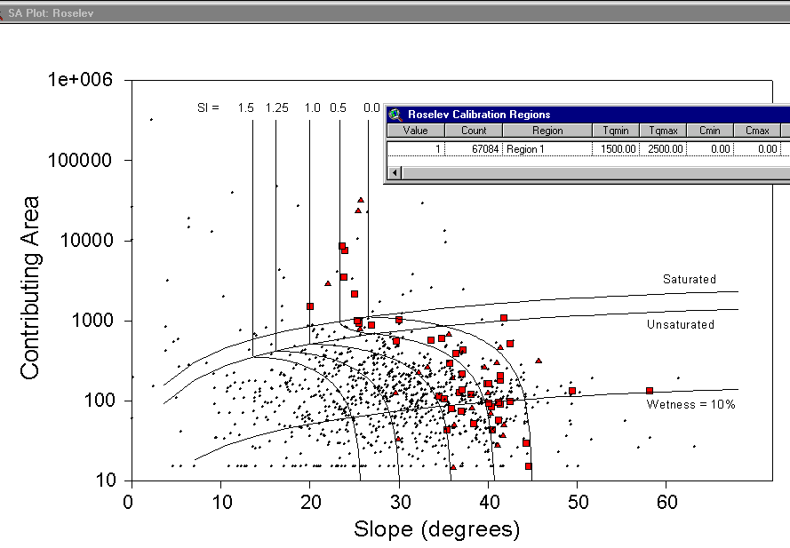
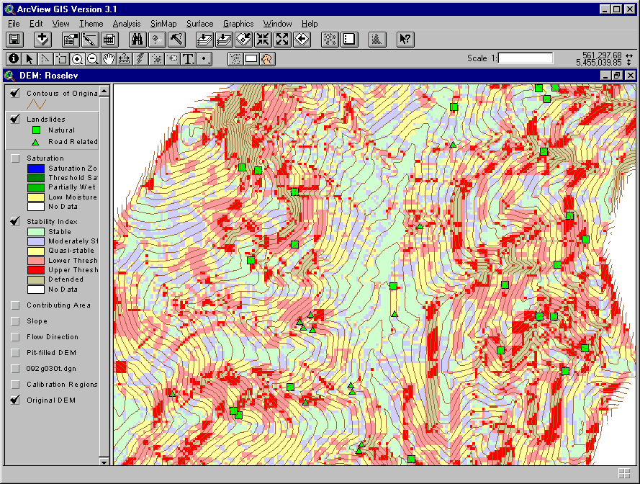
Terrain Stability Mapping
With Bob Pack. http://www.engineering.usu.edu/dtarb/sinmap.htm

Slide 45
SINMAP Theoretical Basis
Infinite Plane Slope Stability Model
h
D
D_{w}
FS=Factor of Safety
D
R
= DEM source
θ = slope
where
Relative Wetness
Density Ratio
Dimensionless Cohesion

Slide 46
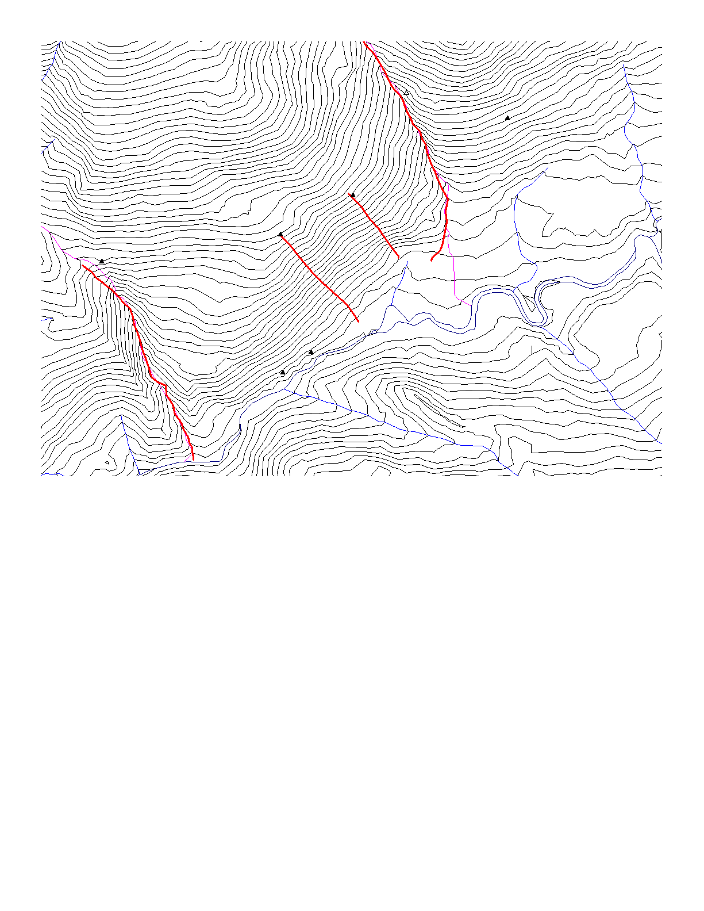
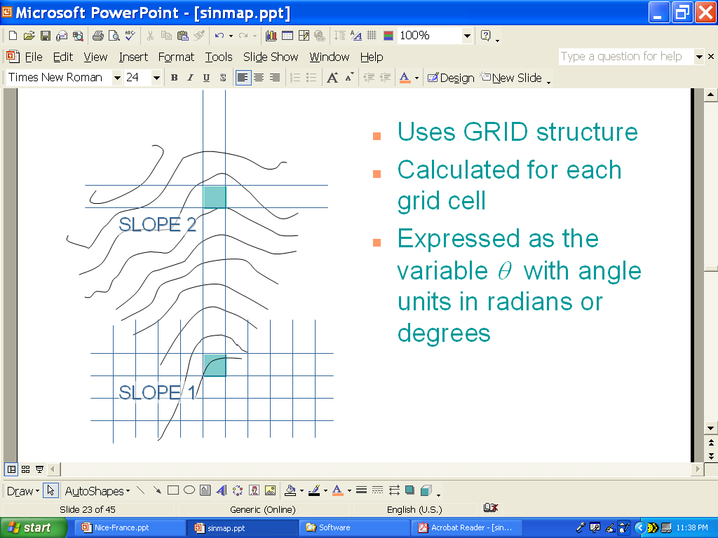
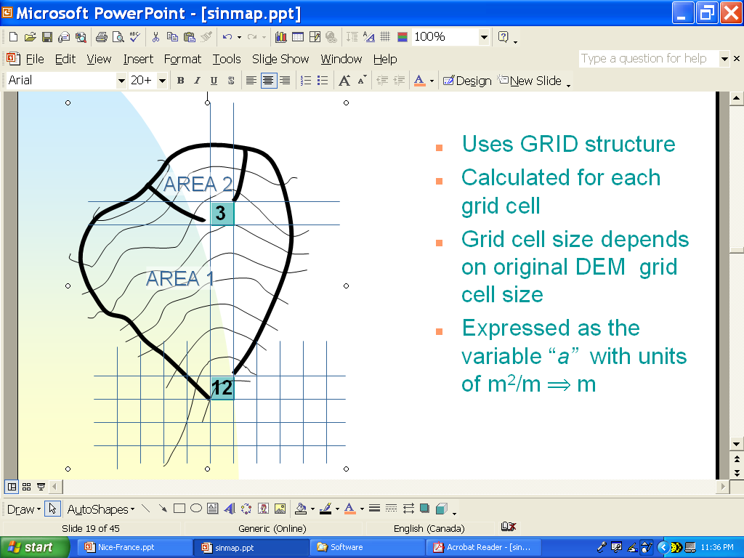
DEM Governs Slope & Flow Accumulation
Digital Terrain Model (DTM)
DTM Quality
Slope (θ)
Flow Accumulation (a)

Slide 47
Probabilistic Formulation
Shear Strength
Slope
Flow Accumulation
Wetness
MODEL
SI=FS &
P(FS>1)
Soil/Root Cohesion

Slide 48
Stability Class Definitions
1.0

Slide 49
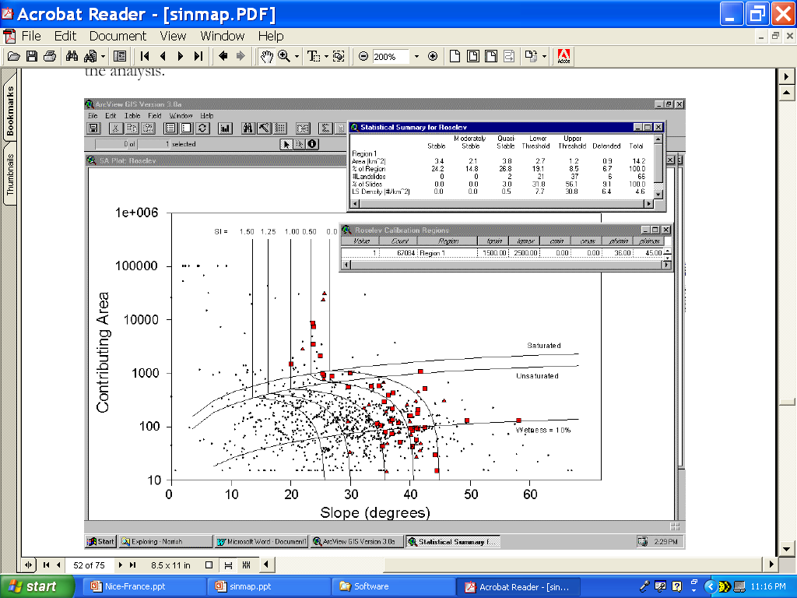
Interactive Calibration
Selection of ranges of Φ, R/T & c moves position of stability class breaks
Selection of range of R/T moves position of wetness class breaks

Slide 50
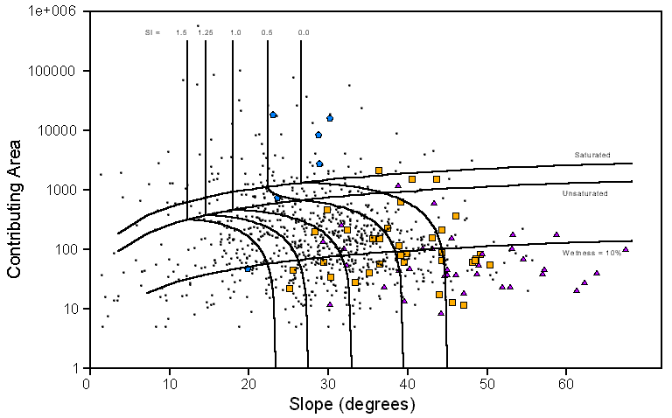
Example Result – Foster Ck
DRAINAGE AREA UPSLOPE
STABLE
UNSTABLE
SATURATED
UNSATURATED
Class 1
2
3
4
5
6
SLOPE

Slide 51
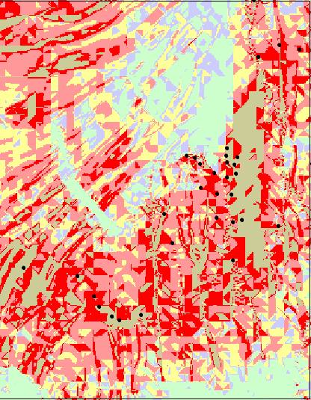
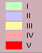
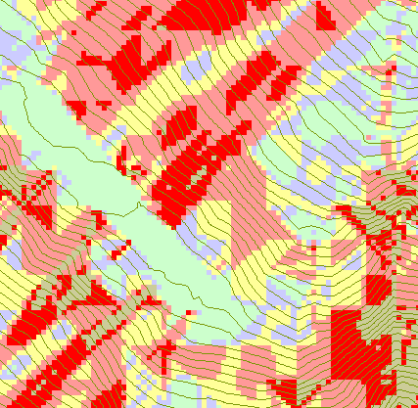
Foster Creek SI Map

Slide 52
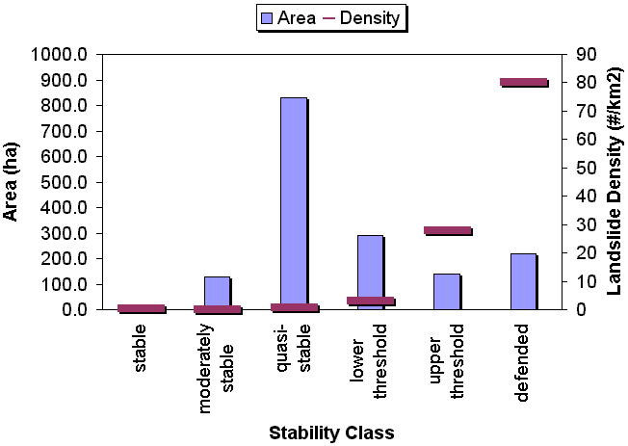
LANDSLIDE DENSITIES & AREAS FOR SI CLASSES

Slide 53
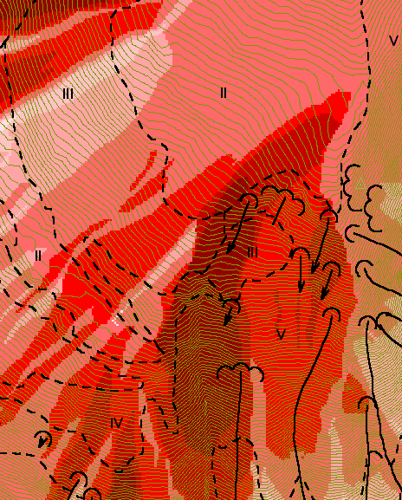
Reverse Accumulation
Useful for destabilization sensitivity in landslide hazard assessment
With Bob Pack

Slide 54
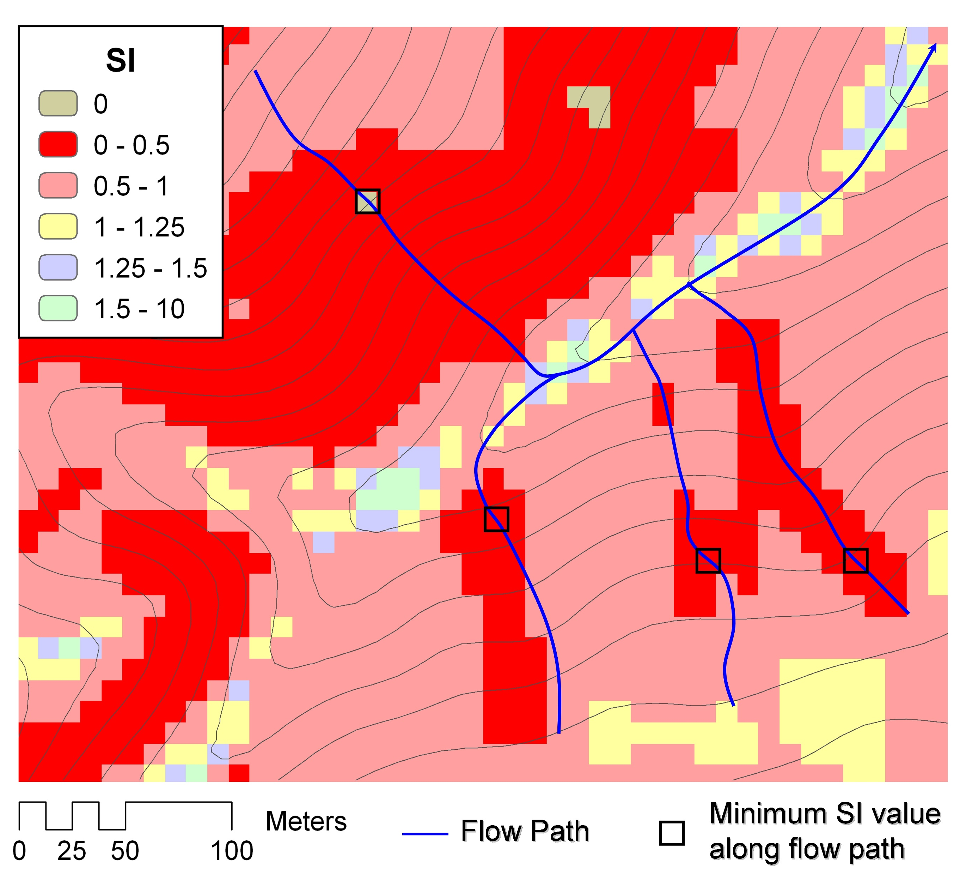
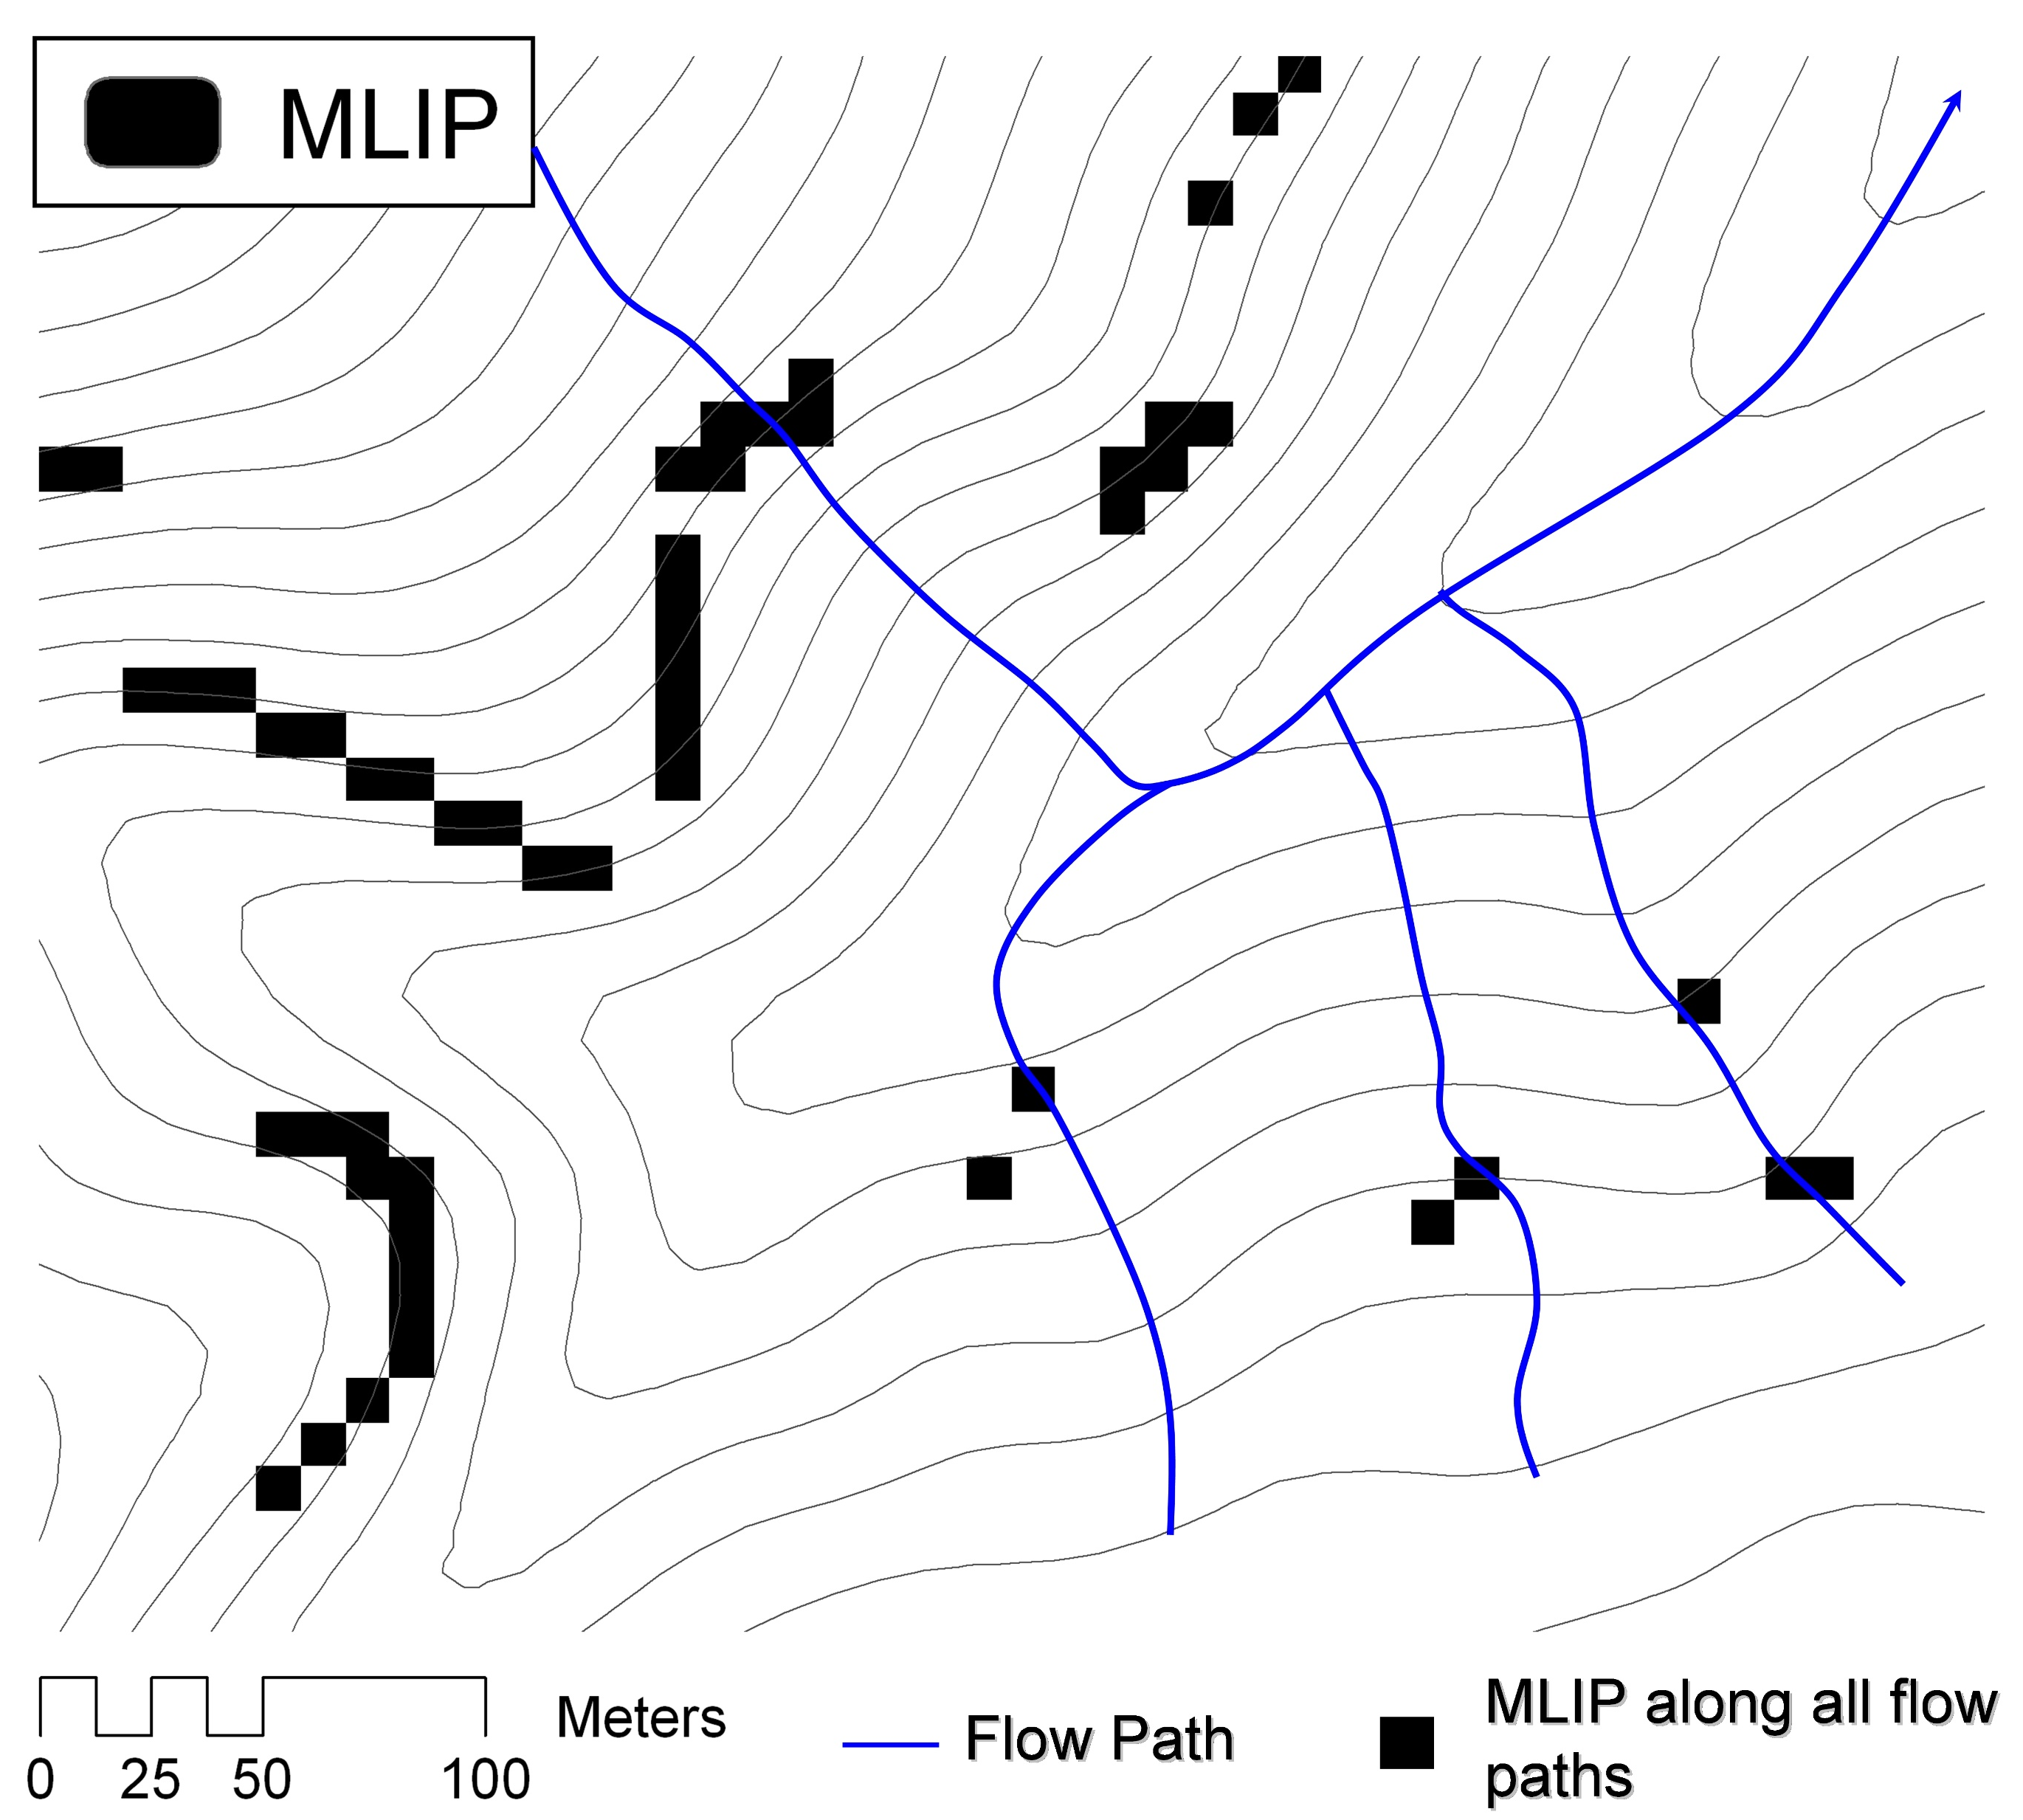
Most Likely Initiation Points
The location of the lowest SI value along a flow path
With Paolo Tarolli, University of Padova
http://www.copernicus.org/EGU/hess/hessd/3/395/hessd-3-395.pdf

Slide 55
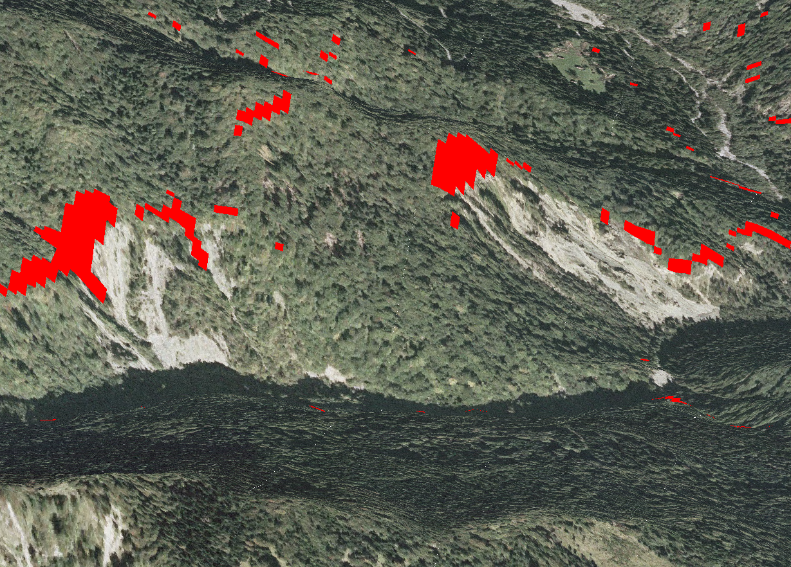

Slide 56
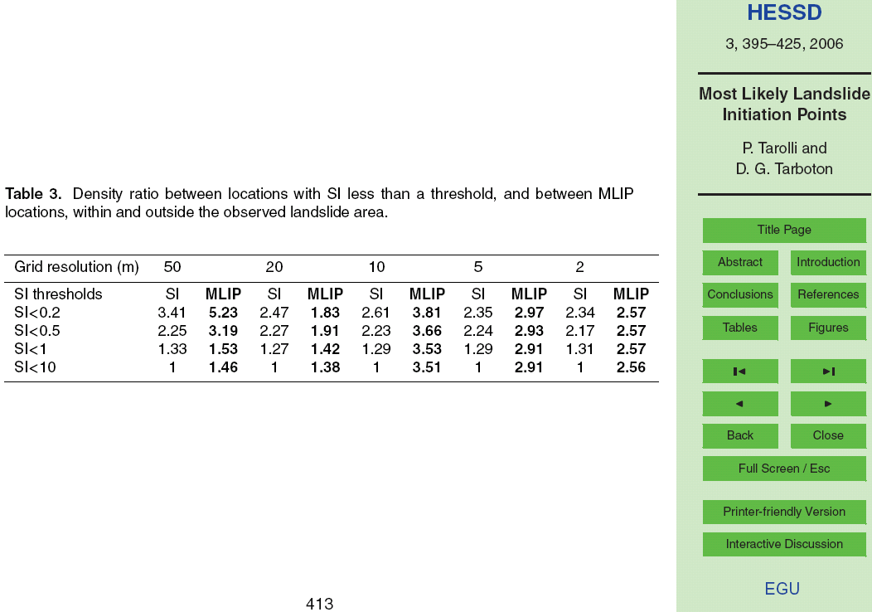
With Paolo Tarolli, University of Padova
http://www.copernicus.org/EGU/hess/hessd/3/395/hessd-3-395.pdf

Slide 57
Concluding Point
The GIS grid based terrain flow data model enables the representation of flow processes at and near the earth surface and derivation of a wide variety of information useful for the study of hydrologic processes.

Slide 58
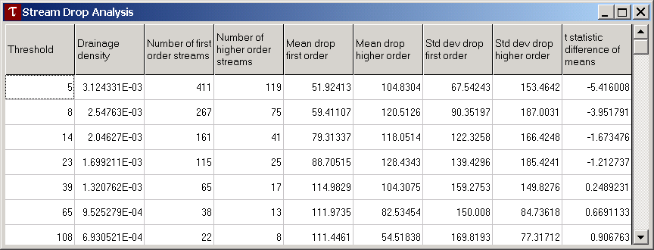
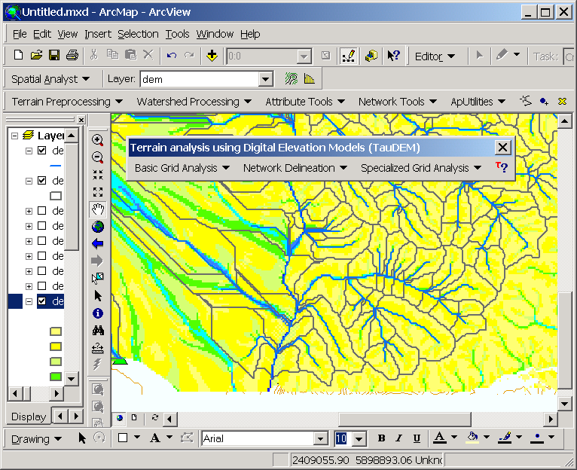
Questions?
AREA 2
3
AREA 1
12
TauDEM and SINMAP available at: http://www.engineering.usu.edu/dtarb

