Slide 1



Response of stream ecosystems to climate change (III): characterizing and predicting flow regimes
David Tarboton, Sulochan Dhungel, Charles P. Hawkins, Jacob J. Vander Laan, Ryan A. Hill and Jiming Jin

Slide 2
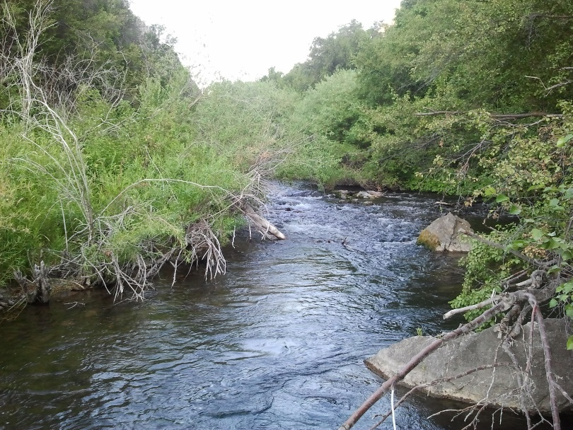
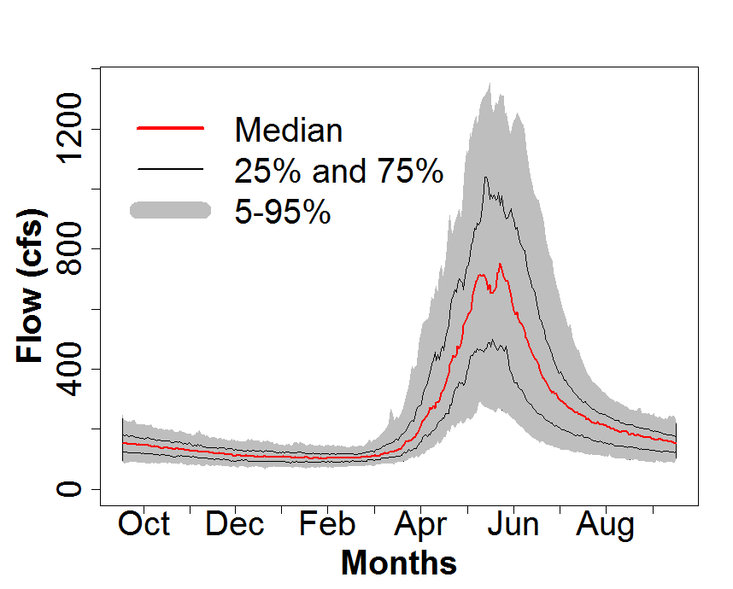
Objectives
Characterize current spatial patterns in ecologically important streamflow properties across the USA
Assess likely effects of climate change on streamflow regimes
Support stream biodiversity modeling
Notes:
My specific objectives were …

Slide 3
Outline
Selection of ecologically relevant streamflow properties (streamflow regime)
Data (USGS GAGES, Catchment Features, Climate)
Flow regime classification and prediction
Predicted climate-driven changes in flow regimes
Climate
Catchment
Features
Stream
Temperature
Streamflow Regime
Species Distributions

Slide 4
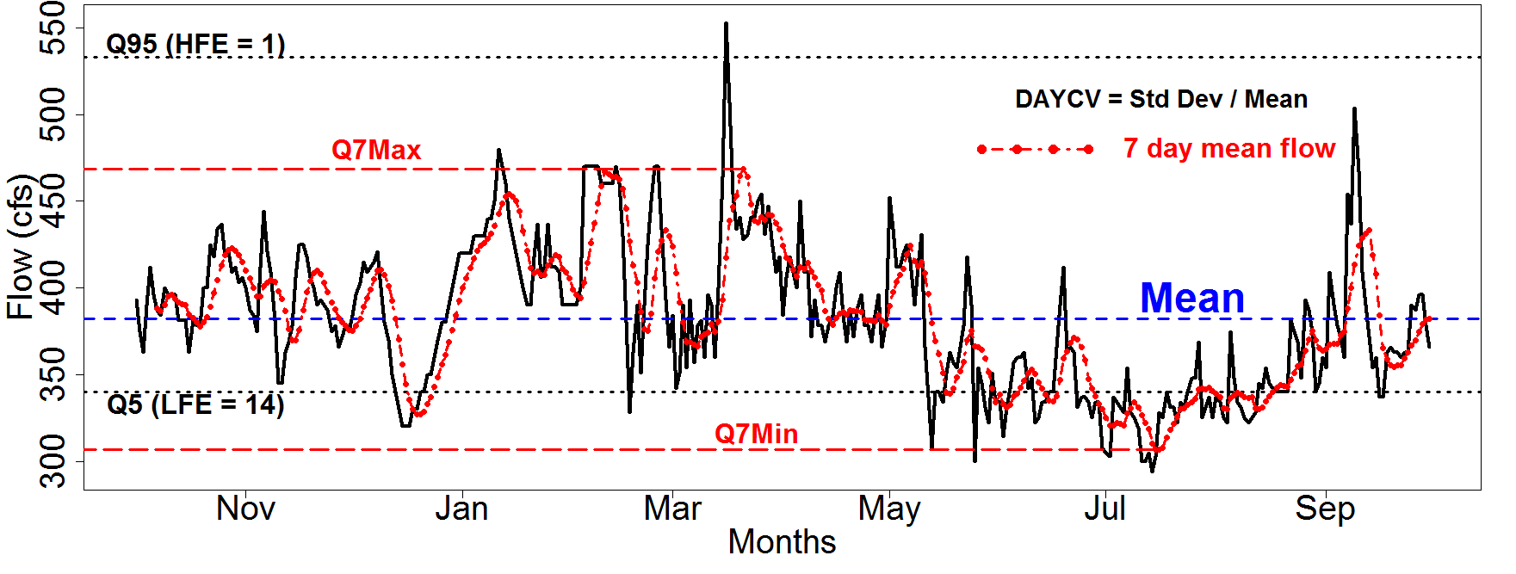
16 variables used to characterize 5 ecologically important aspects of streamflow
(Magnitude, Timing, Rate of Change, Duration, Frequency)
Extended Low Flow Index
Coefficient of Variation
Mean Daily Discharge
7 Day Minimum
7 Day Maximum
Bank Full Flow (Q167)
Flood Duration (Days > Q167)
Colwell’s Index of Predictability
Colwell’s Index of Constancy
Colwell’s Index of Contingency
Flow Reversals Per Year
50% Flow Date
Time of Peak
Number of High Flow Events (>Q95)
Number of Low Flow Events (<Q5)
Number of Zero Flow Events
High flow events > Q95
Coefficient of Variation = Std Dev / Mean
7 Day Maximum
7 Day Mean Flow
Mean
Low flow events < Q5
7 Day Minimum

Slide 5
Data
Daily streamflow USGS GAGES reference stations (Falcone et. al., 2010)
PRISM precipitation and temperature (Daly et al., 2008)
Downscaled Climate forecasts. CCSM A2 scenario -> WRF at 50 km scale downscaled statistically to 4 km based on PRISM
Active USGS GAGES reference stations
601 sites
90% complete record
1965-2010
Number
1965-2010
James A. Falcone, Daren M. Carlisle, David M. Wolock, and Michael R. Meador. 2010. GAGES: A stream gage database for evaluating natural and altered flow conditions in the conterminous United States. Ecology 91:621.
Daly, C., M. Halbleib, J. I. Smith, W. P. Gibson, M. K. Doggett, G. H. Taylor, J. Curtis and P. P. Pasteris. 2008. Physiographically sensitive mapping of climatological temperature and precipitation across the conterminous United States. International Journal of Climatology 28: 2031-2064.

Slide 6
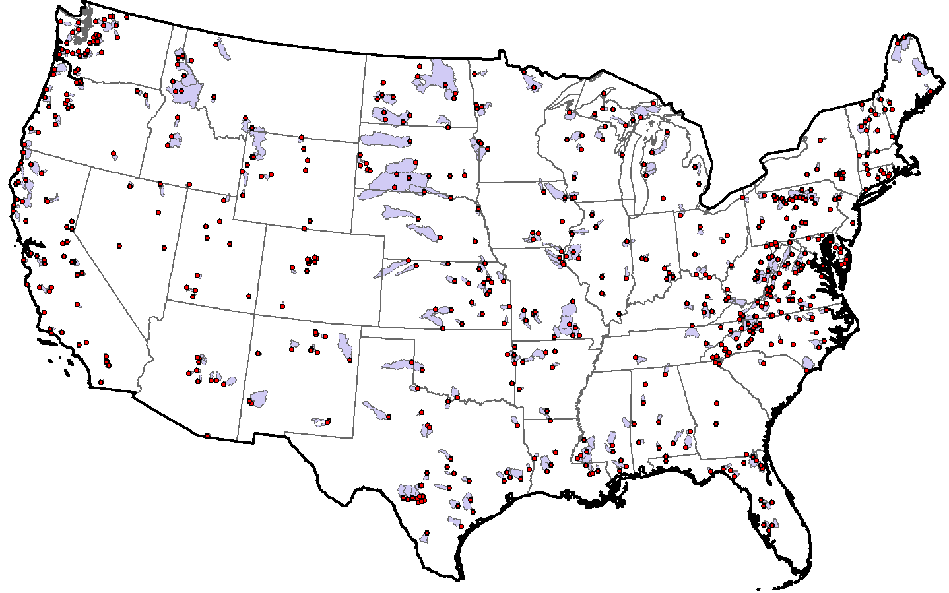
Reference-quality USGS GAGES Stations
Characterized each catchment with 34 climate, 7 soil, and 10 geomorphology variables
1. Freshwater Withdrawal (1995 to 2000)
5. Distance to nearest major NPDES site
2. Major Dam Density
6. Road Density (2000)
3. Change in reservoir storage ( 1950 to 2006)
7. Fragmentation Index of “undeveloped” land in watershed
4. Percent of stream as “Canal”, ”Pipeline”, “Ditch” or “Artificial Path”
Notes:
GAGES – Geospatial Attributes of Gages for Evaluating Streamflow
There are 6875 sites in this dataset which lists 1512 of its sites as reference quality sites not affected by humans.
Based on quantitative index of anthropogenic modification (calculated using GIS based variables), Visual inspection of site from high resolution imagery and information acquired from Annual water data reports, 1512 reference quality stream gage stations were chosen from the 6785 stations.
This is an index of anthropogenic modification (disturbance) calculated based on 6 variables:
1 Freshwater withdrawal (cubic meters per year per sq. km, from 1995-2000 county level estimates)
2 Major dam density (number per 100 km sq).
3 Change in dam (reservoir) storage, 1950 to 2006 (megalitres/sqkm)
4 Percentage of stream kilometers coded as “Canal”, ”Ditch”, ”Pipeline” or “Artificial Path” in NHDplus
5 Distance to the nearest major NPDES (National Pollutant Discharge Elimination System) site. These major NPDES sites are permitted for large discharges into the stream.
6 Road Density (km/sqkm) from 2000 census (used as a Urbanization Proxy)
7 Fragmentation Index of “undeveloped” land in watershed. High Values indicate “how anthropogenically disturbed” the natural land cover is in the basin).

Slide 7
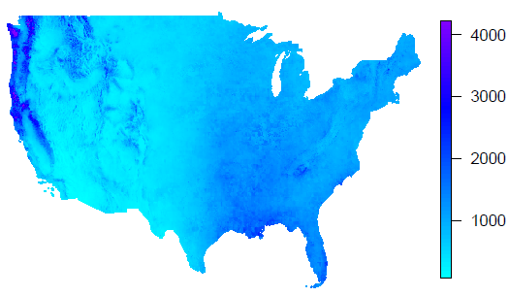
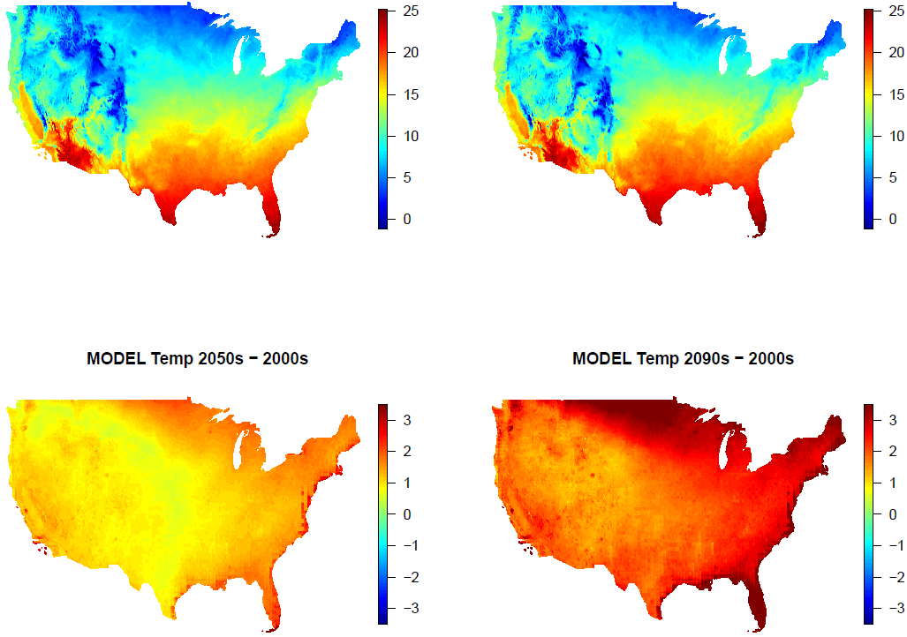
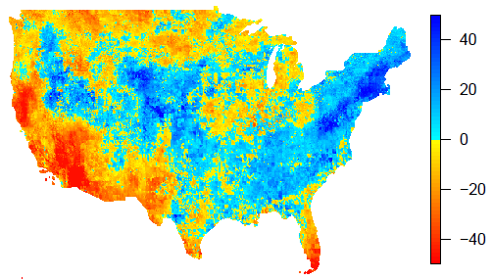
Climate Projections CCSM A2 + WRF
Precipitation 2001-2010
Temperature 2001-2010
Mean = 829 mm/yr
Mean = 11.4 ºC
Precipitation Percent Change from 2000-2010 to 2090-2099
Temperature Change from 2000-2010 to 2090-2099
%
%
%
%
%
Mean = 830 mm/yr
Mean = 14.2 ºC

Slide 8
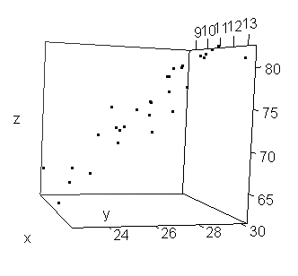
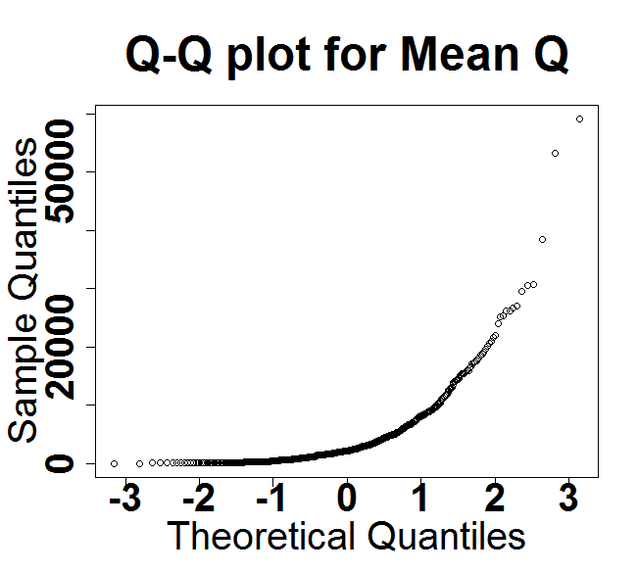
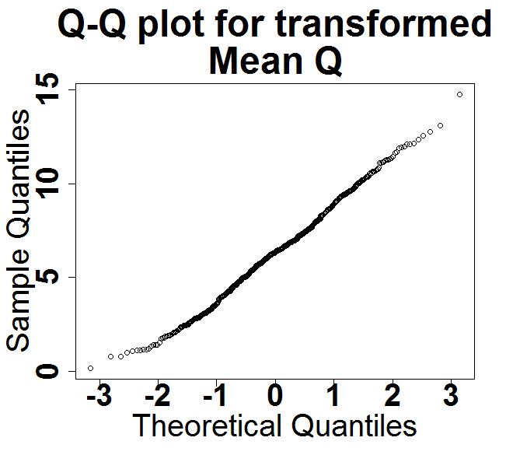
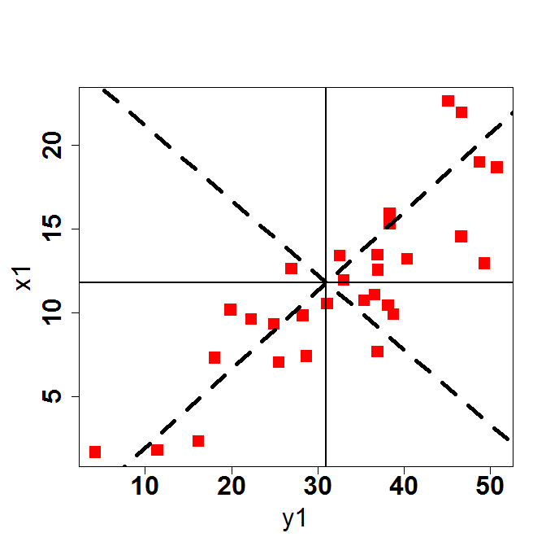
Analysis Steps
z₁
Normalize
PCA
y₁
x₁
Ward’s Clusters
Varimax Rotation
Classification
x
y
x1
Regime Class Change Due to Climate Change
y1

Slide 9
PCA (Loadings)
 | PC1 | PC2 | PC3 | PC4 | PC5
Extended Low Flow Index (ELFI) | 0.83 | 0.05 | 0.05 | 0.15 | -0.14
Coefficient of Variation of Daily Flows (DAYCV) | -0.82 | -0.07 | 0.07 | 0.04 | 0.36
Contingency (M) | 0.67 | -0.01 | -0.44 | -0.23 | 0.1
Low Flow Event (LFE) | 0.84 | 0.13 | 0.29 | 0.02 | -0.05
Zero Flow Event (ZFE) | -0.85 | -0.17 | -0.01 | 0.05 | 0.22
Average 7 day Minimum Flow (Qmin7) | 0.71 | 0.58 | 0.01 | 0.07 | -0.25
Mean daily discharge (QMEAN) | 0.31 | 0.93 | 0.03 | -0.08 | -0.14
Bank Full Flow (Q167) | 0.01 | 0.97 | 0.21 | -0.12 | 0
Average 7 day Maximum Flow (Qmax7) | 0.08 | 0.99 | 0.03 | -0.07 | -0.01
Flow Reversal(R) | 0.54 | 0.12 | 0.68 | 0 | -0.14
Flood Duration (FLDDUR) | 0.09 | -0.07 | -0.84 | 0.2 | 0.18
High Flow Event (HFE) | 0.02 | 0.1 | 0.91 | -0.22 | -0.07
50% timing of flow (T50) | 0.04 | -0.11 | -0.36 | 0.79 | 0.2
Time of Peak (Tp) | -0.02 | -0.09 | -0.08 | 0.89 | -0.01
Predictability (P) | -0.3 | -0.08 | -0.36 | 0.05 | 0.86
Constancy (C) | -0.56 | -0.11 | -0.1 | 0.2 | 0.73
Proportion of variance explained (cumulative) | 0.28 | 0.21 (0.49) | 0.16 (0.65) | 0.1 (0.75) | 0.11 (0.86)
Interpretation | Low Flow (L) | Magnitude (M) | Flashiness (F) | Timing (T) | Constancy (C)
(Magnitude, Timing, Rate of Change, Duration, Frequency)

Slide 10
Ward’s Hierarchical Cluster Analysis
(Euclidean Distance on Rotated PCAs)
A
B
C
C1
Distance
C21
C22
B1
A1
A2
B21
B22

Slide 11
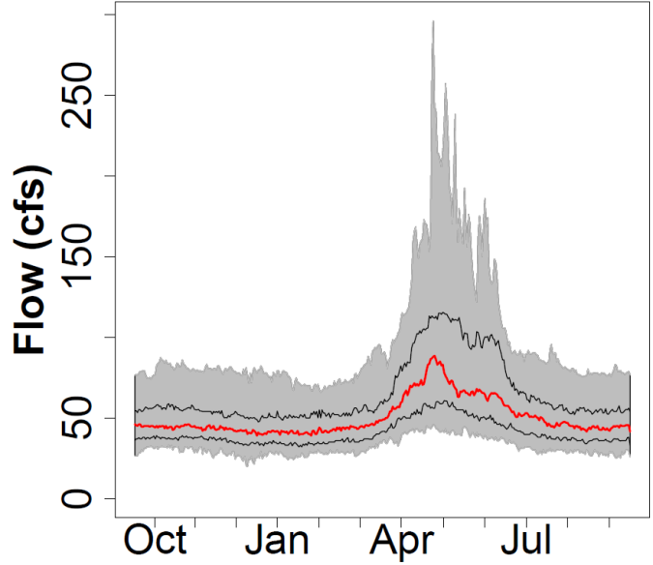
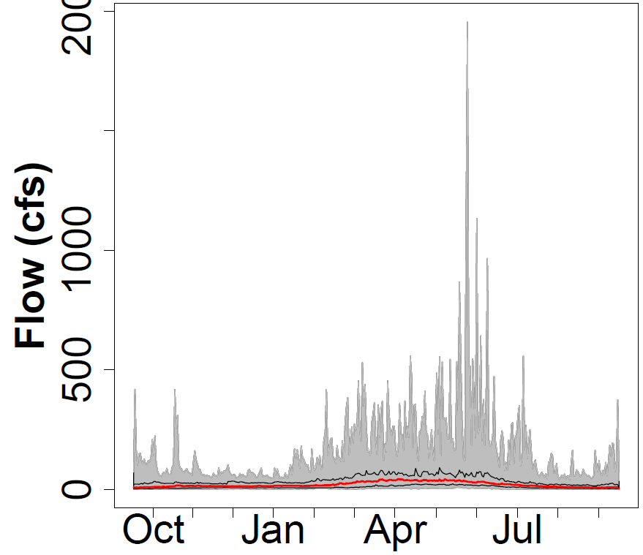
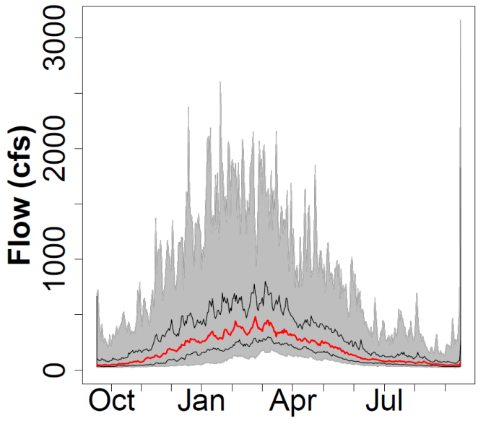
Characteristics of 3 Coarse Stream Classes
2000
A. Perennial with low flashiness and high low-flow factor (snow fed)
B. Intermittent (low
low flow factor and
higher flashiness)
C. Perennial with higher
flashiness and intermediate
low-flow factor (rain fed)
L = Low Flow F = Flashiness M = Magnitude T = Timing C = Constancy

Slide 12
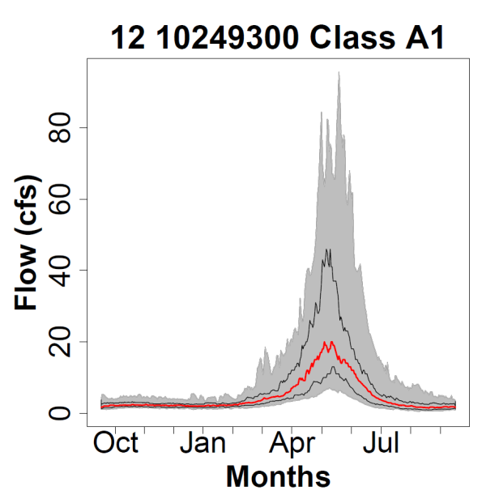
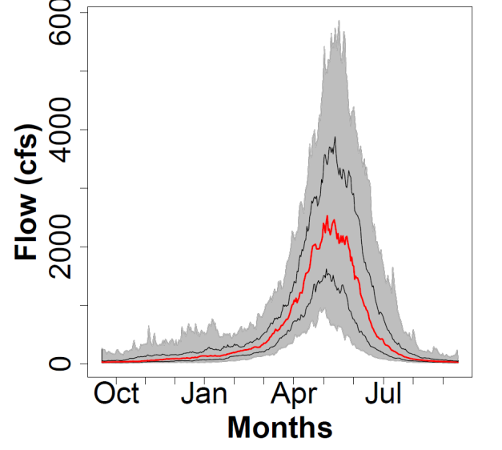
Characteristics of A-Type Streams
A1. Small perennial with low flashiness and high low-flow factor (snow fed)
A2. Large perennial with low flashiness and high low-flow factor (snow fed)
L = Low Flow F = Flashiness M = Magnitude T = Timing C = Constancy

Slide 13
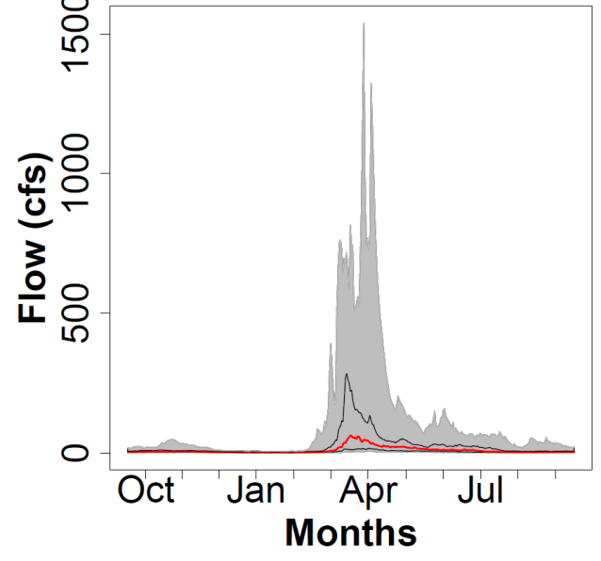
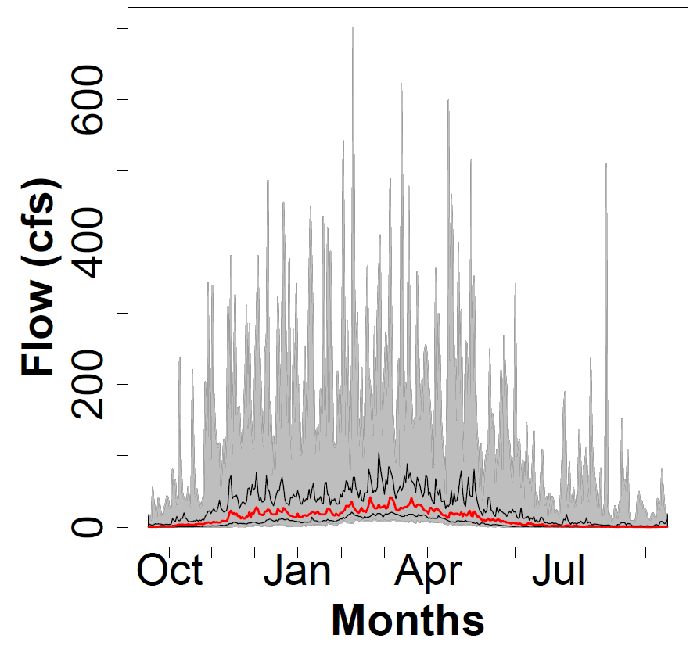
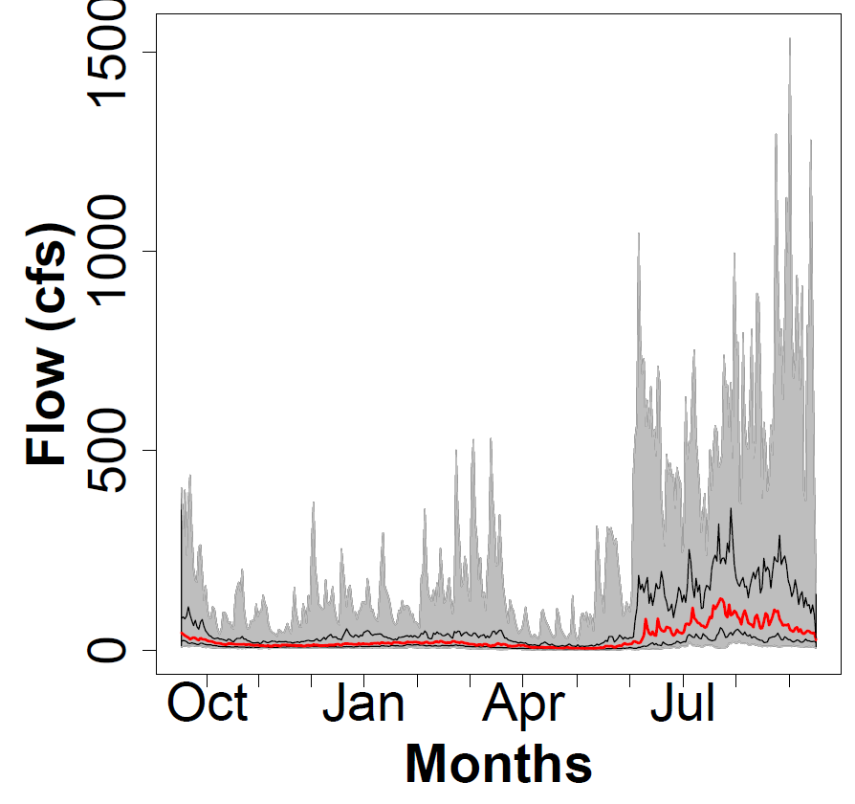
Characteristics of B-Type Streams
B1. Intermittent with low flashiness
B21. Intermittent with higher flashiness and early timing
B22. Intermittent with higher flashiness and later timing
L = Low Flow F = Flashiness M = Magnitude T = Timing C = Constancy

Slide 14
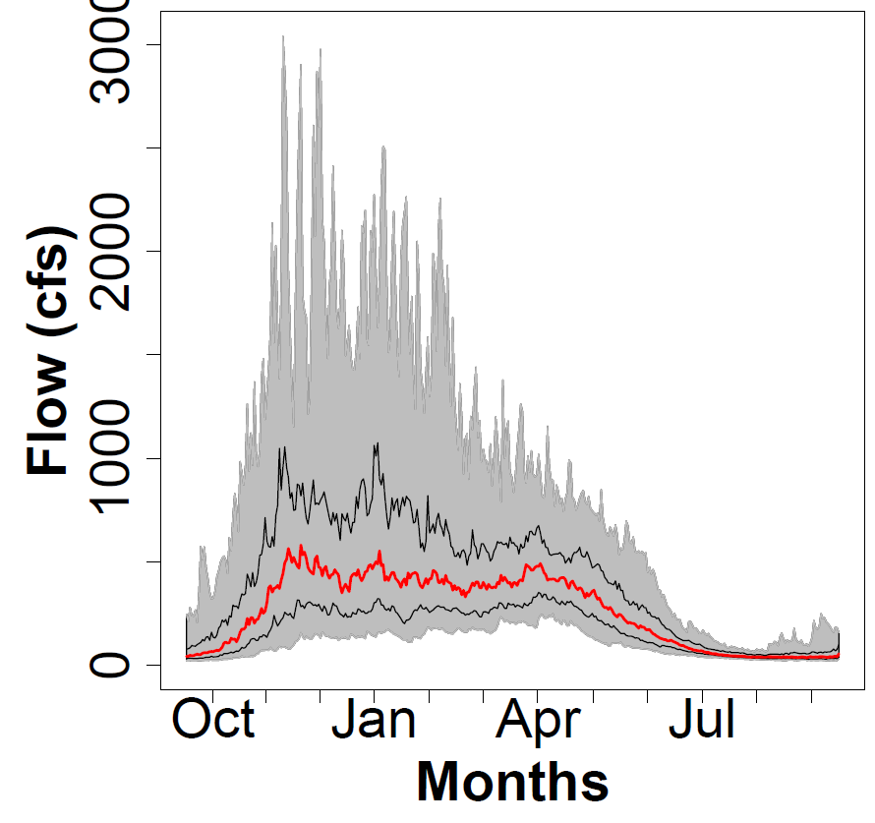
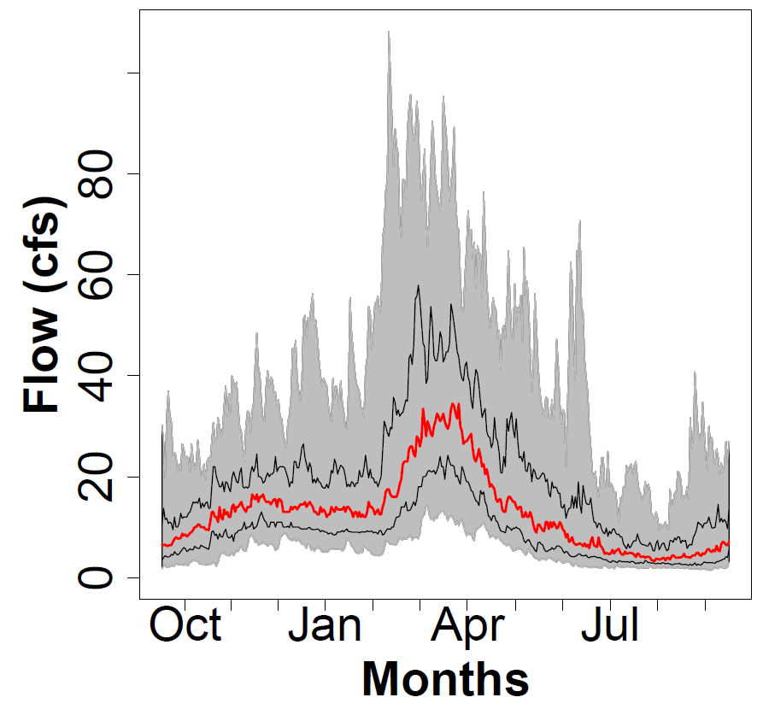
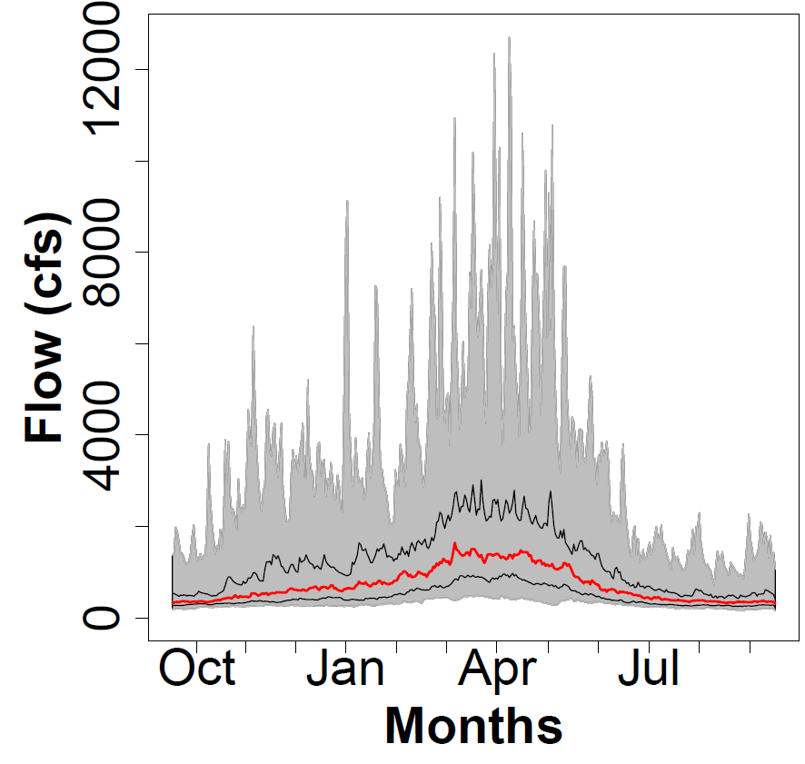
Characteristics of C-Type Streams
C21. Smaller perennial with later, more flashy flow
C22. Larger perennial with later, less-flashy flow
C1. Perennial with early flow
L = Low Flow F = Flashiness M = Magnitude T = Timing C = Constancy

Slide 15
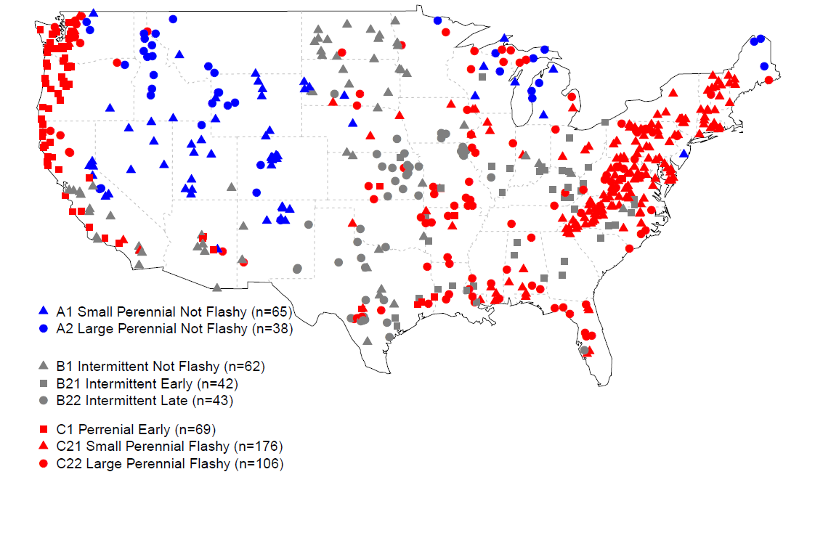
Geography of Stream Regime Classes
A
B
C1
C
B1
C21
C22
A1
A2
B21
B22

Slide 16
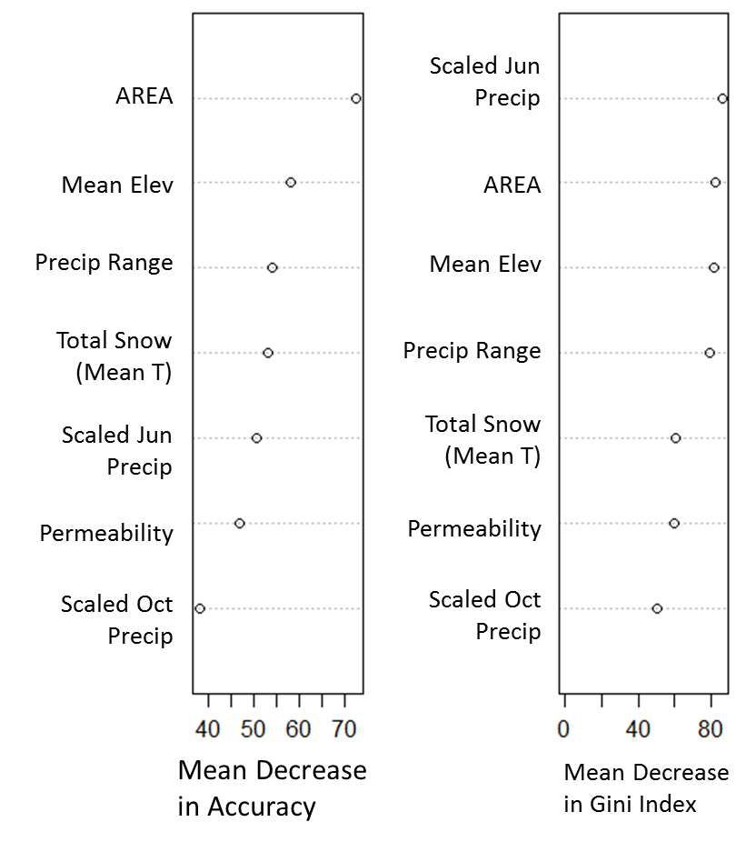
Random Forest Model Performance
Variable Importance
Classification error
June Precipitation
 |  | Predicted |  |  |  |  |  |  |  | Class Error
 |  | A1 | A2 | B1 | B21 | B22 | C1 | C21 | C22
Original | A1 | 54 |  | 2 |  |  | 1 | 7 | 1 | 17%
 | A2 | 4 | 28 |  |  |  |  |  | 6 | 26%
 | B1 | 3 |  | 36 | 3 | 8 | 4 | 5 | 3 | 42%
 | B21 |  |  | 1 | 24 | 3 | 1 | 11 | 2 | 43%
 | B22 |  |  | 1 | 1 | 33 |  | 2 | 6 | 23%
 | C1 |  |  | 6 | 1 |  | 54 | 3 | 5 | 22%
 | C21 |  |  | 5 | 4 | 1 | 2 | 151 | 13 | 14%
 | C22 | 4 | 3 | 5 | 2 | 3 | 5 | 14 | 70 | 34%
Area
Mean Elevation
Precipitation Range
Total Snow
Soil Permeability
October Precipitation
Mean Decrease in Gini Index

Slide 17
Predicted Climate-Driven Changes in Stream Classes (present to 2090s)
Confusion Matrix (2090-2099) |  | Predicted (2090 -2099) |  |  |  |  |  |  |  | Change %
 |  | A1 | A2 | B1 | B21 | B22 | C1 | C21 | C22
Model 2001 - 2010 | A1 | 56 | 1 | 1 |  |  |  |  | 1 | 5%
 | A2 |  | 29 |  |  |  |  |  |  | 0%
 | B1 |  |  | 45 |  | 3 | 2 | 2 | 9 | 26%
 | B21 |  |  | 1 | 8 | 5 | 3 | 9 | 1 | 70%
 | B22 |  |  | 5 | 1 | 22 | 9 | 3 | 13 | 58%
 | C1 | 1 |  | 2 | 1 | 2 | 75 | 7 | 5 | 19%
 | C21 |  | 1 | 10 | 12 |  | 35 | 104 | 9 | 39%
 | C22 |  | 3 | 2 | 1 |  | 10 | 2 | 90 | 17%
172/601 = 29% of the sites change class

Slide 18
Projected Changes to B21 Intermittent Early
Confusion Matrix |  | Predicted (2090_2099) |  |  |  |  |  |  |  | Change %
 |  | A1 | A2 | B1 | B21 | B22 | C1 | C21 | C22
Original (Model prediction 2001 - 2010) | A1 | 56 | 1 | 1 |  |  |  |  | 1 | 5%
 | A2 |  | 29 |  |  |  |  |  |  | 0%
 | B1 |  |  | 45 |  | 3 | 2 | 2 | 9 | 26%
 | B21 |  |  | 1 | 8 | 5 | 3 | 9 | 1 | 70%
 | B22 |  |  | 5 | 1 | 22 | 9 | 3 | 13 | 58%
 | C1 | 1 |  | 2 | 1 | 2 | 75 | 7 | 5 | 19%
 | C21 |  | 1 | 10 | 12 |  | 35 | 104 | 9 | 39%
 | C22 |  | 3 | 2 | 1 |  | 10 | 2 | 90 | 17%
Changing to perennial, rain-fed streams with later flow

Slide 19
Projected Changes to B22 Intermittent Late
Confusion Matrix |  | Predicted (2090_2099) |  |  |  |  |  |  |  | Change %
 |  | A1 | A2 | B1 | B21 | B22 | C1 | C21 | C22
Original (Model prediction 2001 - 2010) | A1 | 56 | 1 | 1 |  |  |  |  | 1 | 5%
 | A2 |  | 29 |  |  |  |  |  |  | 0%
 | B1 |  |  | 45 |  | 3 | 2 | 2 | 9 | 26%
 | B21 |  |  | 1 | 8 | 5 | 3 | 9 | 1 | 70%
 | B22 |  |  | 5 | 1 | 22 | 9 | 3 | 13 | 58%
 | C1 | 1 |  | 2 | 1 | 2 | 75 | 7 | 5 | 19%
 | C21 |  | 1 | 10 | 12 |  | 35 | 104 | 9 | 39%
 | C22 |  | 3 | 2 | 1 |  | 10 | 2 | 90 | 17%
Changing to perennial rain-fed streams

Slide 20
Projected Changes to C21 Small Perennial Flashy
Confusion Matrix |  | Predicted (2090_2099) |  |  |  |  |  |  |  | Change %
 |  | A1 | A2 | B1 | B21 | B22 | C1 | C21 | C22
Original (Model prediction 2001 - 2010) | A1 | 56 | 1 | 1 |  |  |  |  | 1 | 5%
 | A2 |  | 29 |  |  |  |  |  |  | 0%
 | B1 |  |  | 45 |  | 3 | 2 | 2 | 9 | 26%
 | B21 |  |  | 1 | 8 | 5 | 3 | 9 | 1 | 70%
 | B22 |  |  | 5 | 1 | 22 | 9 | 3 | 13 | 58%
 | C1 | 1 |  | 2 | 1 | 2 | 75 | 7 | 5 | 19%
 | C21 |  | 1 | 10 | 12 |  | 35 | 104 | 9 | 39%
 | C22 |  | 3 | 2 | 1 |  | 10 | 2 | 90 | 17%
Change to earlier and increased intermittency

Slide 21
Concluding Remarks
Did we adequately characterize ecological important aspects of flow?
Prediction to ungauged (or future) streams is a critical challenge. Low-flow is most problematic.
Will streams switch between perennial and intermittent? These types of changes have very different implications for stream biodiversity.

Slide 22
Questions?

Slide 23
Extra slides

Slide 24
Combined Fraction of Zero Flow Days (ZFD) and Baseflow Index (BFI) to characterize low flow
Extended Low Flow Index (ELFI)
1
1
Prob(BFI < x)
Cumulative Probability
Prob(ZFD > -x)
0
-1
0
1
ELFI = BFI - ZFD
Notes:
Necessity: For calculation of many statistical metrics, normality of the variable can be a problem when the variable is highly skewed. In this case, we found that as many stations had no zero flow days, ZD was highly skewed. Also, for a large portion of stations with positive ZD, BFI was zero and hence BFI was also highly skewed. Hence, BFI and ZD were combined for a new metric which was called Steadiness Index (SI).

Slide 25
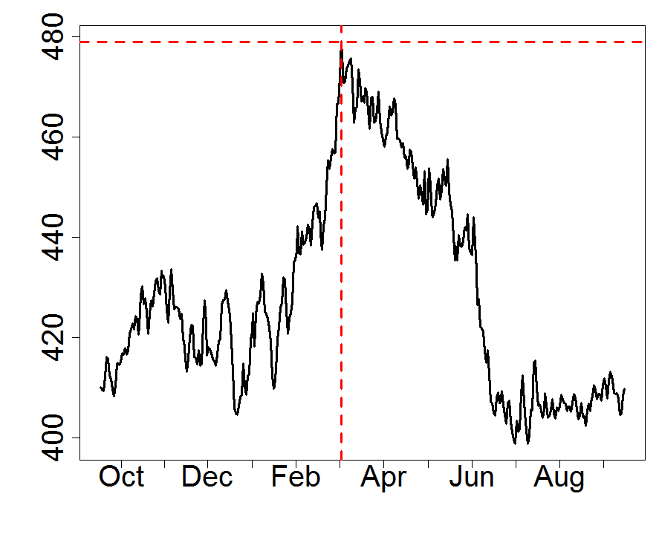
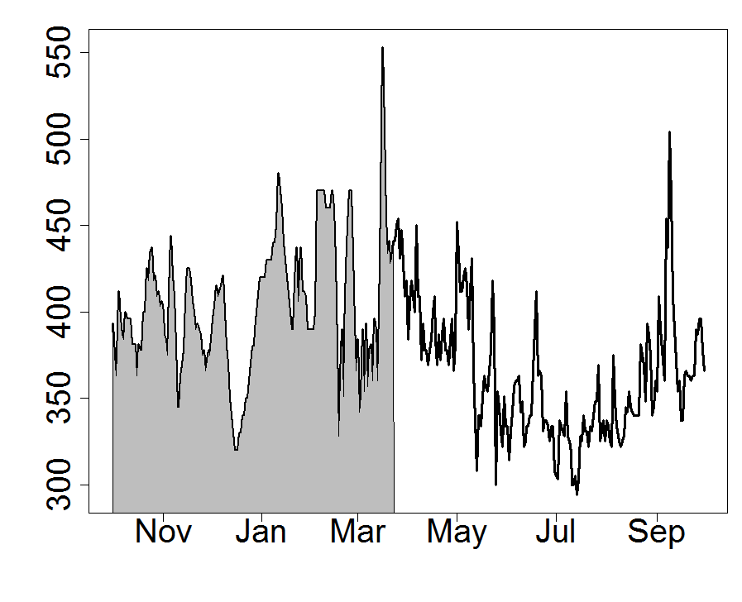
Timing variables
Time of Peak
50% Flow date
Flow (cfs)
Flow (cfs)
Average day of peak in water year
The day of water year by which
50% of total flow has occurred
All the streamflow variables were calculated based on water year (Oct – Sep)

Slide 26
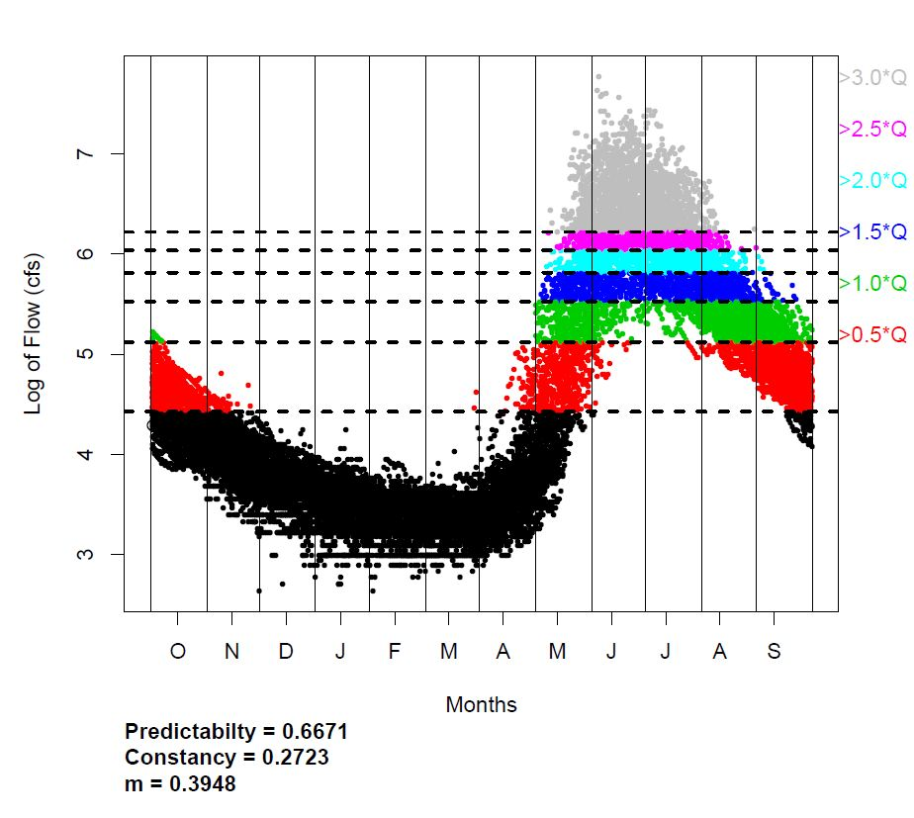
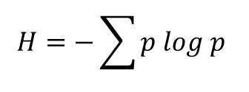
Streamflow Predictability (P), Constancy (C) and Contingency (M)
Colwell (Ecology 1974, 55:1148-1153)
Periods j
p_{ij} = proportion
Entropy measure of uncertainty
$$H=−\sum{p log p }$$
Predictability (P) is entropy measure of uncertainty scaled from 0 (uncertain) to 1 (certain)
Constancy (C) is entropy measure of uncertainty scaled from 0 to 1 without regard for period
Contingency (M=P-C) scales the mutual information of time and state from 0 (unrelated) to 1 (dependent)
Log of flow (cfs)
States i
C=0
P=1
M=1
C=1
P=1
M=0
C=0
P=0
M=0
Notes:
# Entropy Plots
x=(0:50)/50*2*pi
y=sin(x)
windows(width=4,height=3)
plot(x,y,type="l",xaxt="n",yaxt="n",lwd=3,xlab="",ylab="")
lines(x,rep(0,length(x)))
plot(x,rep(0,length(x)),type="l",xaxt="n",yaxt="n",lwd=3,xlab="",ylab="",ylim=c(-1,1))
plot(x,rep(0,length(x)),type="l",xaxt="n",yaxt="n",lwd=75,xlab="",ylab="",ylim=c(-1,1),col="gray")
lines(x,rep(0,length(x)))
lines(x,rep(0,length(x)))

Slide 27
Colwell’s Predictability (P), Constancy (C) and Contingency (M)
Periods / States | 1 | 2 | 3 | 4 | Total
> 3 * Qmean |  |  | 50 |  | 50
2 - 3 * Qmean | 50 |  |  |  | 50
1 - 2 * Qmean |  | 50 |  |  | 50
< Qmean |  |  |  | 50 | 50
P=1, C=0, M=1
P=C+M
Periods / States | 1 | 2 | 3 | 4 | Total
> 3 * Qmean
2 - 3 * Qmean
1 - 2 * Qmean | 50 | 50 | 50 | 50 | 200
< Qmean
P=1, C=1, M=0

Slide 28
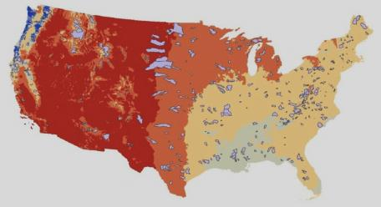
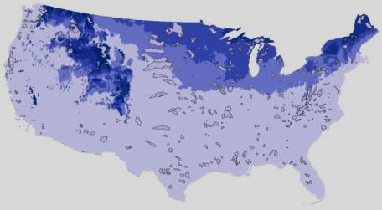
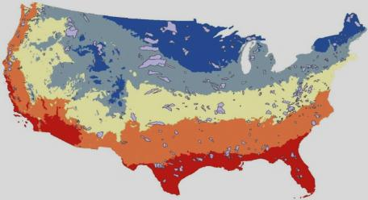
Climate, Soil and Geomorphological Properties Evaluated for each Watershed
Climate
Minimum Temp Maximum Temp
Diff in Temp
Amplitude of Temp
Standard Deviation of Max Temp
Standard Deviation of Min Temp
Potential Evapotranspiration
Dryness Index
Potential Evapotranspiration Amplitude
Seasonality
Total Snow (Mean T)
Mean Temp
Mean Precipitation
Minimum Precipitation
Maximum Precipitation
Precipitation Range
Amplitude of Precipitation
Timing of 50% Precipitation
Relative Humidity
Monthly scaled Precipitation (12 months)
Percent of Snow
Total Snow
Percent Snow (Mean T)
Soil
Available water capacity of soil
Soil Bulk Density
Soil organic matter content
Soil Permeability
Average Water table height
Depth to bedrock
Gleeson Permeability
.
.
.
Geomorphology
Minimum Elevation
Maximum Elevation
Elevation Range
Standard Deviation of Elevation
Hypsometric Convexity
Mean Slope
Standard Deviation of Slope
Area
Shape
Mean Elevation

Slide 29
Projected Changes to A1 Perennial Steady Small
Confusion Matrix |  | Predicted (2090_2099) |  |  |  |  |  |  |  | Change %
 |  | A1 | A2 | B1 | B21 | B22 | C1 | C21 | C22
Original (Model prediction 2001 - 2010) | A1 | 56 | 1 | 1 |  |  |  |  | 1 | 5%
 | A2 |  | 29 |  |  |  |  |  |  | 0%
 | B1 |  |  | 45 |  | 3 | 2 | 2 | 9 | 26%
 | B21 |  |  | 1 | 8 | 5 | 3 | 9 | 1 | 70%
 | B22 |  |  | 5 | 1 | 22 | 9 | 3 | 13 | 58%
 | C1 | 1 |  | 2 | 1 | 2 | 75 | 7 | 5 | 19%
 | C21 |  | 1 | 10 | 12 |  | 35 | 104 | 9 | 39%
 | C22 |  | 3 | 2 | 1 |  | 10 | 2 | 90 | 17%

Slide 30
Projected Changes to A2 Large Perennial not Flashy
Confusion Matrix |  | Predicted (2090_2099) |  |  |  |  |  |  |  | Change %
 |  | A1 | A2 | B1 | B21 | B22 | C1 | C21 | C22
Original (Model prediction 2001 - 2010) | A1 | 56 | 1 | 1 |  |  |  |  | 1 | 5%
 | A2 |  | 29 |  |  |  |  |  |  | 0%
 | B1 |  |  | 45 |  | 3 | 2 | 2 | 9 | 26%
 | B21 |  |  | 1 | 8 | 5 | 3 | 9 | 1 | 70%
 | B22 |  |  | 5 | 1 | 22 | 9 | 3 | 13 | 58%
 | C1 | 1 |  | 2 | 1 | 2 | 75 | 7 | 5 | 19%
 | C21 |  | 1 | 10 | 12 |  | 35 | 104 | 9 | 39%
 | C22 |  | 3 | 2 | 1 |  | 10 | 2 | 90 | 17%

Slide 31
Projected Changes to B1 Intermittent Not Flashy
Confusion Matrix |  | Predicted (2090_2099) |  |  |  |  |  |  |  | Change %
 |  | A1 | A2 | B1 | B21 | B22 | C1 | C21 | C22
Original (Model prediction 2001 - 2010) | A1 | 56 | 1 | 1 |  |  |  |  | 1 | 5%
 | A2 |  | 29 |  |  |  |  |  |  | 0%
 | B1 |  |  | 45 |  | 3 | 2 | 2 | 9 | 26%
 | B21 |  |  | 1 | 8 | 5 | 3 | 9 | 1 | 70%
 | B22 |  |  | 5 | 1 | 22 | 9 | 3 | 13 | 58%
 | C1 | 1 |  | 2 | 1 | 2 | 75 | 7 | 5 | 19%
 | C21 |  | 1 | 10 | 12 |  | 35 | 104 | 9 | 39%
 | C22 |  | 3 | 2 | 1 |  | 10 | 2 | 90 | 17%
Moving to Perrenial rain fed

Slide 32
Projected Changes to C1 Perrenial Early
Confusion Matrix |  | Predicted (2090_2099) |  |  |  |  |  |  |  | Change %
 |  | A1 | A2 | B1 | B21 | B22 | C1 | C21 | C22
Original (Model prediction 2001 - 2010) | A1 | 56 | 1 | 1 |  |  |  |  | 1 | 5%
 | A2 |  | 29 |  |  |  |  |  |  | 0%
 | B1 |  |  | 45 |  | 3 | 2 | 2 | 9 | 26%
 | B21 |  |  | 1 | 8 | 5 | 3 | 9 | 1 | 70%
 | B22 |  |  | 5 | 1 | 22 | 9 | 3 | 13 | 58%
 | C1 | 1 |  | 2 | 1 | 2 | 75 | 7 | 5 | 19%
 | C21 |  | 1 | 10 | 12 |  | 35 | 104 | 9 | 39%
 | C22 |  | 3 | 2 | 1 |  | 10 | 2 | 90 | 17%
Little change

Slide 33
Projected Changes to C22 Large Perennial Less Flashy
Confusion Matrix |  | Predicted (2090_2099) |  |  |  |  |  |  |  | Change %
 |  | A1 | A2 | B1 | B21 | B22 | C1 | C21 | C22
Original (Model prediction 2001 - 2010) | A1 | 56 | 1 | 1 |  |  |  |  | 1 | 5%
 | A2 |  | 29 |  |  |  |  |  |  | 0%
 | B1 |  |  | 45 |  | 3 | 2 | 2 | 9 | 26%
 | B21 |  |  | 1 | 8 | 5 | 3 | 9 | 1 | 70%
 | B22 |  |  | 5 | 1 | 22 | 9 | 3 | 13 | 58%
 | C1 | 1 |  | 2 | 1 | 2 | 75 | 7 | 5 | 19%
 | C21 |  | 1 | 10 | 12 |  | 35 | 104 | 9 | 39%
 | C22 |  | 3 | 2 | 1 |  | 10 | 2 | 90 | 17%
Some moving earlier

Slide 34
Characteristics of 3 Coarse Stream Classes
2000
GAGEID - 6431500
GAGEID - 7180500
GAGEID - 3488000
A. Perennial with low flashiness and high low-flow factor (snow fed)
B. Intermittent (low
low flow factor and
higher flashiness)
C. Perennial with higher
flashiness and intermediate
low-flow actor (rain fed)
L = Low Flow F = Flashiness M = Magnitude T = Timing C = Constancy

Slide 35
Characteristics of A-Type Streams
GAGEID - 10249300
GAGEID - 11266500
A1. Small perennial with Not Flashy (snow fed)
A2. Large perennial Not Flashy (snow fed)
L = Low Flow F = Flashiness M = Magnitude T = Timing C = Constancy

Slide 36
Characteristics of B-Type Streams
GAGEID - 5057200
GAGEID - 3291780
GAGEID - 2299950
B1. Intermittent Not Flashy
B21. Intermittent early
B22. Intermittent late
L = Low Flow F = Flashiness M = Magnitude T = Timing C = Constancy

Slide 37
Characteristics of C-Type Streams
GAGEID - 12083000
GAGEID - 4161580
GAGEID - 7014500
C21. Small perennial Flashy
C22. Large perennial Less Flashy
C1. Perennial Early
L = Low Flow F = Flashiness M = Magnitude T = Timing C = Constancy

