Slide 1
The Parameterization of Subgrid Variability in Snowpack Accumulation and Melt Models
Charles H. Luce
USFS Rocky Mtn. Res. Sta., Boise, ID
David G. Tarboton
Utah State University, Logan, UT
http://www.engineering.usu.edu/dtarb

Slide 2
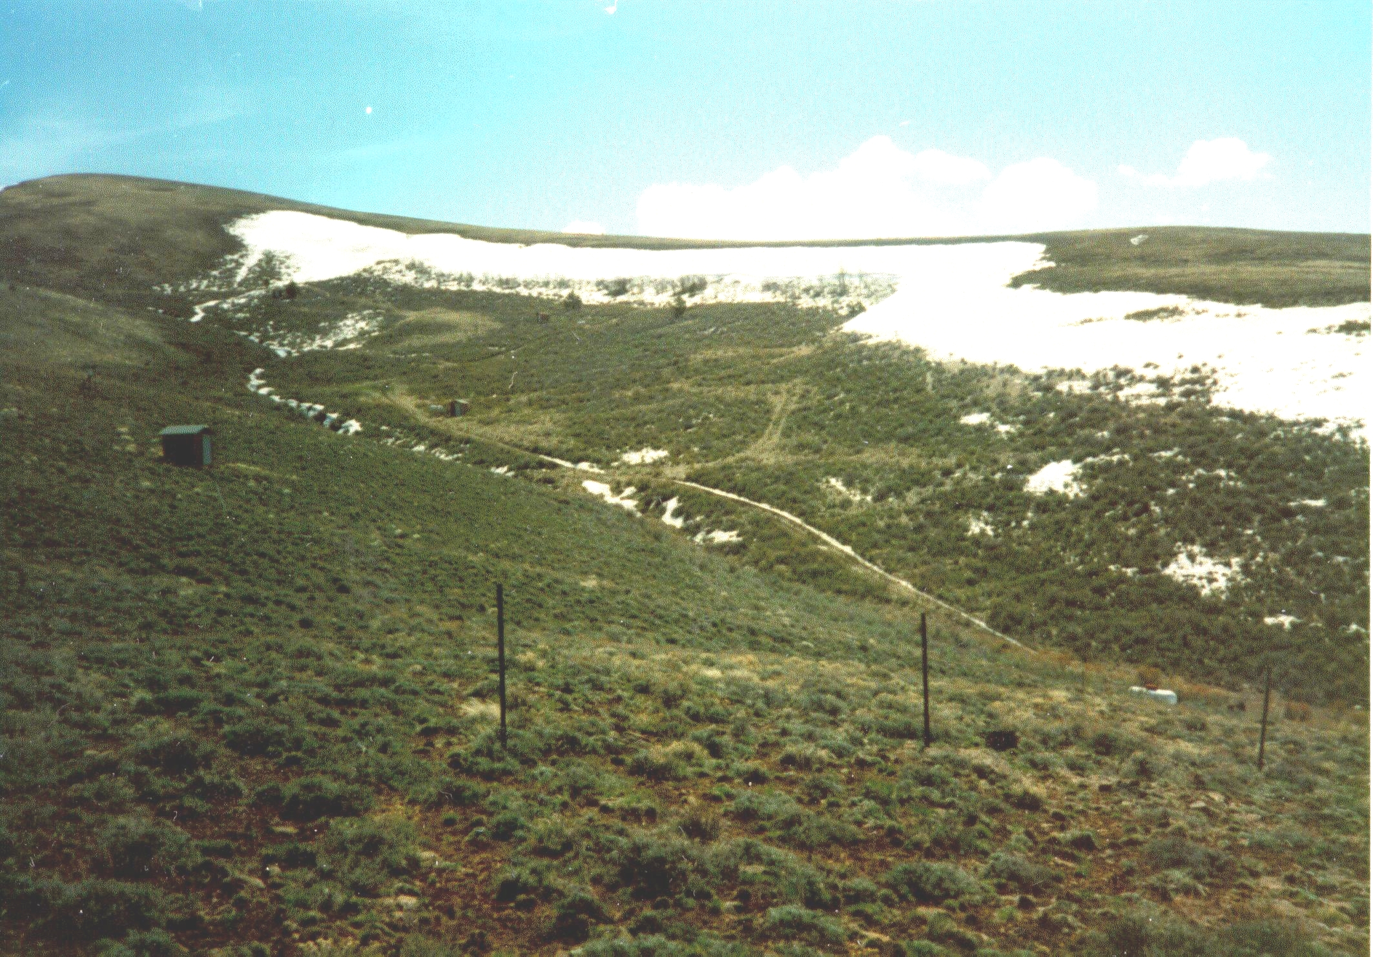
S
W
E
(
m
)
0
0
.
1
0
.
8
1
.
5
3
Notes:
If process fluxes have a linear dependence on parameters and states, one can use the “effective parameters” approach.
We tested the idea on this heterogeneous basin. The snow depth at peak accumulation varied from 0 to 3 m.

Slide 3
Notes:
Here we see that the effective parameter approach cannot remotely approach providing the appropriate snowpack evolution. The snow melts too fast in the model. The basin’s snowmelt extends over a two month period. The only way for a 1-D model to simulate such a long melt is to give it a deep snowpack.
Snow energy fluxes nearly linear with respect to snow surface temperature state variable, some non-linearity for the slope-aspect, but relatively minor, there briefly existing nonlinearity on snow water equivalence as meltwater is stored in the snowpack, but the whopper is that once an area is clear of snow, there is no further melt.
The basin has many places that accumulate a little snow and a few places that accumulate a lot of snow. Once the shallow accumulation sites have melted they no longer contribute to the decline in the basin average melt. So as a first cut we might guess that snow covered area would be an important state variable to track in a model depicting a heterogeneous area.

Slide 4
Point Model
Area Model
Notes:
For larger support areas, Af is required as a state variable. As snow accumulates and melts the snow covered area changes. Patches become snow free as snow melts. This is handy since for climate modeling the amount of snowcover is important for partitioning incoming solar radiation.

Slide 6
Depletion curves from several years of data at Upper Sheep Creek (data collected by Keith Cooley)
Notes:
This set of observations from many sample dates show that for drifting processes, the relationship is surprisingly consistent from year to year in spite of significantly varying peak accumulations.
The variation in the far right of the graph is from shallowly covered areas.

Slide 7
Upper Sheep Creek, 1992-1993.
Notes:
As the upshot to the methods I will present today, this figure shows the performance of a parameterization allowing substitution of a single ¼ sq. km element for 255 square elements 30-m on a side.
The area is not uniform, but has strong drifting, with snow water equivalence ranging from 10 cm to 3 m at peak accumulation.
Simplification is achieved by describing the area based only on the pdf of snow accumulation, not on the spatially explicit distribution of snow.
The parameterization has successfully described within-element variability based on area average inputs and state variables.

Slide 8
Describing Spatial Variability using Probability Distributions that evolve in time
f
W
Notes:
To describe within element variability, we must understand the sources of variability.
Variability in snow water equivalence comes about through both differential accumulation and differential melt.
These two cartoons show two simplified cases:
One with differential accumulation with uniform melt: During accumulation, the mean and variance increase, and during melt the mean decreases.
The other depicts uniform accumulation and differential melt, showing an increase in variance as the mean decreases.

Slide 9
Differential Accumulation
Notes:
To describe within element variability, we must understand the sources of variability.
Variability in snow water equivalence comes about through both differential accumulation and differential melt.
These two cartoons show two simplified cases:
One with differential accumulation with uniform melt: During accumulation, the mean and variance increase, and during melt the mean decreases.

Slide 10
Notes:
top figure shows a generic pdf of spatially sampled snow water equivalence at peak accumulation.
When melt of depth M occurs, areas with less snow than M will become snow free and the basin average snow water equivalence decreases.

Slide 11
Lumped Model output using depletion curve for Upper Sheep Creek, 1993 derived from PDF of snow water equivalent on Mar 3 compared to distributed model and observations.
Notes:
The heart of the parameterization is a relationship between the area average snow water equivalence and the fractional snow covered area, a so-called “depletion curve.”
The relationship shows hysteresis. Area increases rapidly with initial snowfall, but a more gradual decay with melt.
With this relationship, we can use the area average snow water equivalence state variable and basin average energy inputs to model the evolution of the snowpack with time by noting that the basin average inputs only melt snow in the snow covered areas.
I will demonstrate that all that is needed to derive this curve is the pdf of snow water equivalence spatially sampled at peak accumulation. By peak accumulation, most of the variability caused by differential accumulation is complete.

Slide 12
But – Now for the Fun stuff.
There is variability due to accumulation AND melt
f
W
Notes:
To describe within element variability, we must understand the sources of variability.
Variability in snow water equivalence comes about through both differential accumulation and differential melt.
These two cartoons show two simplified cases:
One with differential accumulation with uniform melt: During accumulation, the mean and variance increase, and during melt the mean decreases.
The other depicts uniform accumulation and differential melt, showing an increase in variance as the mean decreases.

Slide 13
Perturbation Analysis
Change
In Variance
Accumulation
dependence
Melt
dependence
Independent
innovations
Notes:
We can describe this mathematically using a perturbation approach.
Begin by decomposing the spatially distributed snow water equivalance into a spatial average (denoted by angular brackets) and the residual (denoted as w prime).
On the left, is a simple derivative
And it can be shown that the spatial average of that derivative is as it appears on the right.
Recognizing the definition of variance and covariance and that dw’/dt is melt or precipitation (ignoring evaporation for simplicity).
Gives us the same answer, variability increases when areas with deep snow preferentially get more snow or when areas with shallow snow melt more quickly than the average. So if your shallowest accumulations are on south facing slopes and your deep drifts are on north facing slopes, variance will increase with melt.

Slide 14
Relative Direct Beam Radiation Exposure
E_{r} = E_{l}/E_{ba} where
E_{l} is the local solar radiation exposure
E_{ba} is the basin average solar radiation exposure

Slide 15
Derivation of depletion curve adjusting for radiation exposure
Define radiation/energy adusted snow water equivalence at each point
W_{e} = W/E_{r}
Use the spatial distribution of this in the procedure to derive a depletion curve
Notes:
We begin by normalizing the snow water equivalence at each point by the amount of energy available for melt at that point relative to the average energy over the basin.
Thus, snow on a north facing slope would be effectively deeper than snow on a south facing slope when considering melt based on basin average energy inputs.

Slide 16
Notes:
Using the snow water equivalence normalized by solar radiation, we can calculate a depletion curve, Area vs. area average snow water equivalence.
Note that this depletion curve more closely follows the observations and the depletion curve from the distributed model.
Spatial variability in solar radiation is now accounted for in both the parameterization and the distributed model.
Neither accounts form spatial variability in exposure to turbulent fluxes nor lateral wind transport of snow.

Slide 17
Fractional Solar Radiation
Notes:
Once we recognize that differential melt exists we become more interested in the fact that the fractional area remaining does not receive the “basin average energy flux” but receives the “snow covered area energy flux”
So we define Sf as the ratio between total inputs over the snow covered area to the total inputs over the basin.
Sf is identical to Af if the energy inputs are uniform.

Slide 18
Hiding Function: Relative direct radiation exposure of remaining snow used to adjust energy inputs to lumped model as a function of A_{f}*(W/W_{max})
Notes:
In a basin with topography the story is different.
When the basin is snow covered, Sf is the same as Af.
As the snow cover recedes, the deeper, less sunlit, north-facing drifts remain and Sf can be as low as 80% of Af.
Note that this basin has relatively low relief, with the steeper slopes being around 30%. Easy spring telemarking.
If estimated heat fluxes to the snowpack are based on fractional snow covered area, there may be a substantial overestimate of melt.
This relationship may also be important when interpreting remote sensing images. In this case, snow covered areas receive less radiation relative to soil and vegetation as the snow melt.

Slide 19
Conclusions
Snow covered area depletion curves are used as a parameterization of subgrid variability in the lumped modeling of watershed snow accumulation and melt
Fractional snow covered area depletion curve derived from snow distribution function
Consistency in depletion curves over years attributable to causative processes being related to topography

Slide 20
Conclusions …
Depletion curves closer to data when adjusted for radiation exposure patterns
Hiding function parameterization suggested to relate solar exposure to snow depletion
Progress towards ultimate goal of being able to parameterize the subgrid variability anywhere based primarily on DEM data
  DEM determines radiation exposure
  DEM determination of wind blown snow drift accumulation distributions, from other related work [Prasad et al., WRR in press, available at http://www.engineering.usu.edu/dtarb]

