Slide 1

Application of TopNet to DMIP
Christina J. Bandaragoda¹
David G. Tarboton¹
Ross Woods²
1. Utah State University, Civil & Environmental Engineering Department, Logan, UT
2. National Institute of Water and Atmospheric Research, NIWA, Christchurch, New Zealand

Slide 2




TOPNET
Enhanced TOPMODEL (Beven and Kirkby, 1979 and later) applied to each subwatershed model element.
Kinematic wave routing of subwatershed inputs through stream channel network.
Vegetation based interception component.
Modified soil zone
Infiltration excess
GIS based parameterization
(TOPSETUP)
Reference ET demand
Priestly-Taylor
temp. and radiation based
Interception Store
Canopy Capacity CC (m)
Canopy Storage CV (m)
Throughfall
Snow (in progress)
Precipitation
Infiltration capacity
z_{r}
Soil Store
SR(m) =Soil Zone water content
Infiltration Excess Runoff
Z_{r}=depth of root zone
Precipitation
z
Soil Zone Drainage
Saturated Zone State Variable
Saturation Excess Runoff
Local soil moisture enhancement
Soil moisture deficit/depth to water table from wetness index determines saturated area
Baseflow response from average soil moisture deficit
If z < z_{r} SR is enhanced locally to
Streamflow
Baseflow

Slide 3
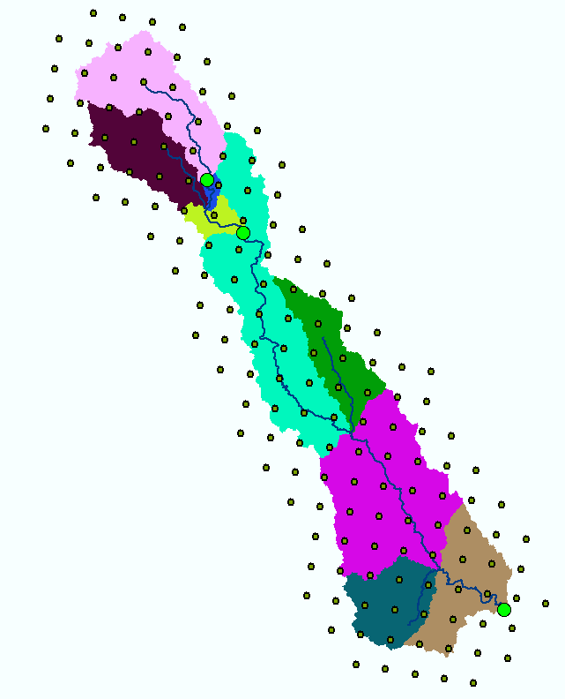
Spatial Representation
6
28
Subwatershed and channel reach model elements
Model is lumped at the scale of each subwatershed
Binary topological linkage with internal reaches split into two logical reaches with flow from reach watershed entering at midpoint
7
27
5
29
26
25
24
4
23
8
3
22
30
21
2
20
9
31
19
1
1
Subwatershed
18
18
Channel reach
Flow recorder
Logical Topology
Physical layout

Slide 4
Some model details
Assumption 1.
Hydraulic conductivity decreasing with depth - sensitivity parameter f
Assumption 2.
Saturated lateral flow driven by topographic gradient and controlled by depth to water table (soil moisture deficit).
Assumption 3.
Steady state. Saturated lateral flow related to equilibrium recharge rate.
Determines depth to water table and
saturation excess runoff generation
when z < 0

Slide 5
Additions and Modifications

Slide 6
Potential Evapotranspiration (following Maidment D. R. (editor), 1993, Handbook of Hydrology, Chapter 4 on Evaporation by W J Shuttleworth.)
A = Available energy = (1-α)T_{f} S_{o} - f ε’ σ T⁴
f = T_{f}/a Cloudiness factor
Δ = gradient of saturated vapor pressure - temperature curve at air temperature
γ = psychometric constant at air temperature and pressure
ε’ = net emmissivity based upon dew point
a_{e} = 0.34 b_{e} = -0.14 kPa^{-1/2}
Temperature and dew point lapsed from measurements at measurement location
Notes:
Could reduce PET for non growing season

Slide 7
Interception (adapted following Ibbitt, 1971)
1
Throughfall f(CV)
1
Relative intercepted storage CV/CC

Slide 8
Soil Zone
ET/PET
1
Green-Ampt like infiltration
excess rate formulation
Plant
Available
Drainable
z_{r}
Δθ₁
Δθ₂
Soil Drainage
SOILC = z_{r} (Δθ₁+ Δθ₂)
Drainage/Recharge r

Slide 9
Inputs Forcing
Precipitation at each radar grid location. Subwatershed precipitation by Delauney triangle weighted averaging over each subwatershed.
Air Temperature, Dew Point at single location, adjusted to center of each subwatershed using lapse rate.

Slide 10
Outputs
Streamflow for designated reaches
Diagnostic output for each subwatershed
  Total runoff
  Infiltration excess runoff component
  Saturation excess runoff component
  Baseflow component
  Drainage from soil to saturated zone (Recharge)
  Saturated area
  Potential evapotranspiration
  Actual evapotranspiration
Time series of model state variables
  Mean water table depth
  Soil zone storage
  Canopy storage

Slide 11
Objective delineation of channel networks using digital elevation models
Drainage area can be concentrated or dispersed (specific catchment area) representing concentrated or dispersed flow.
Hydrologic processes are different on hillslopes and in channels. It is important to recognize this and delineate model elements that account for this.

Slide 12
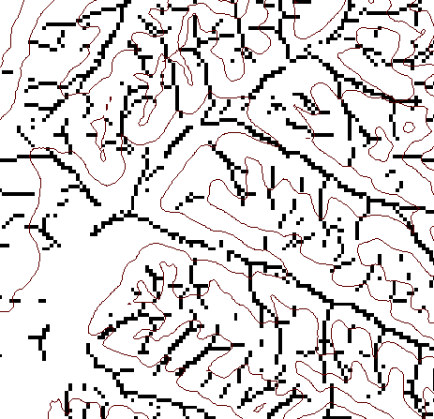
DEM based channel network delineation using local curvature and constant drop analysis to have objective and spatially variable drainage density
Eight direction pour point model D8
Flow direction network
Accumulation of "valley" cells
4
3
2
1
1
1
1
5
1
3
1
6
7
8
4
16
Local Valley Computation
(Peuker and Douglas, 1975, Comput. Graphics Image Proc. 4:375)
4
43
48
48
51
51
56
Threshold = 10
Dd = 2.5 km⁻¹
t = -3.5
Threshold = 20
Dd = 1.9 km⁻¹
t = -1.03
41
47
47
54
54
58
Stream drop test for highest resolution network (smallest threshold) with constant drop property satisfied, i.e. t test indicates no statistically significant difference in mean drop between first order and all higher order streams.

Slide 13
Curvature based stream delineation with threshold by constant drop analysis

Slide 14
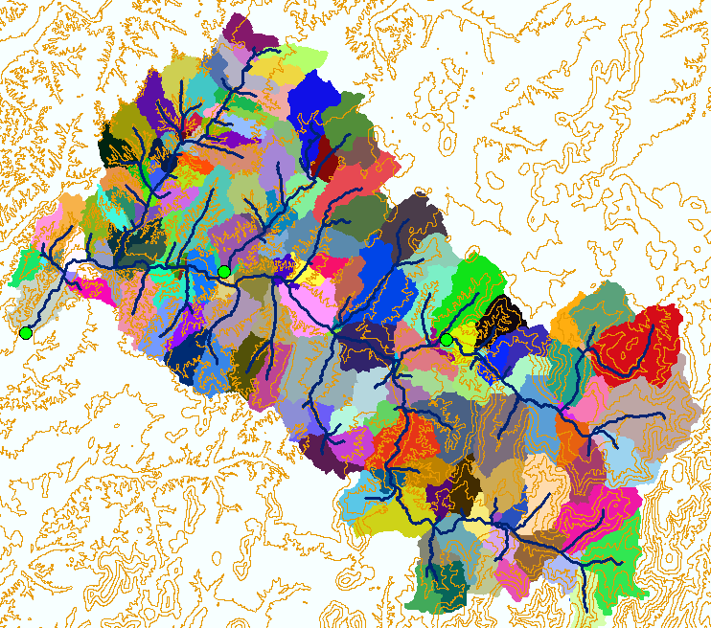
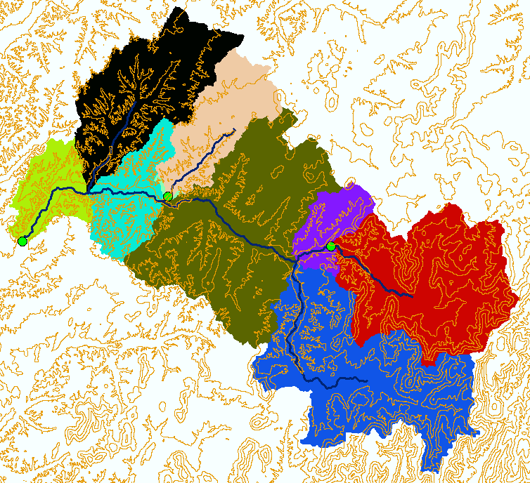
Control of Spatial Resolution
Baron subwatersheds from streams delineated using objectively estimated drainage density from constant drop analysis.
Baron subwatersheds generalized based on third order streams. For results generated to date 3rd order generalization has been used.

Slide 15
Parameters

Slide 16
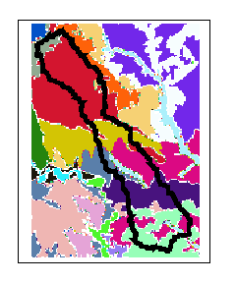
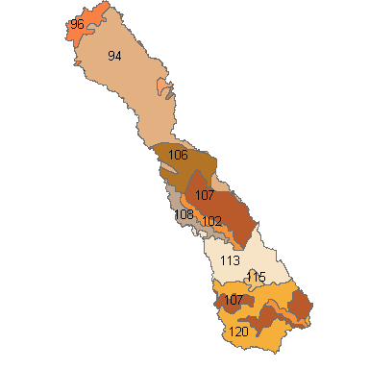
STATSGO Soil derived parameters
Soil texture for each of the 11 standard soil depth grid layers from PSU gridding of NRCS STATSGO data.
Zone Code Polygon Layer
Depth weighted average
θ₁ ,, θ₂ , & ψ_{φ}
Soil Grid Layers
Joined to Polygon Layer
f & K
Exponential decrease with depth
Table of Soil Hydraulic Properties – Clapp Hornberger 1978
Soil parameter look up by zone code
…

Slide 17
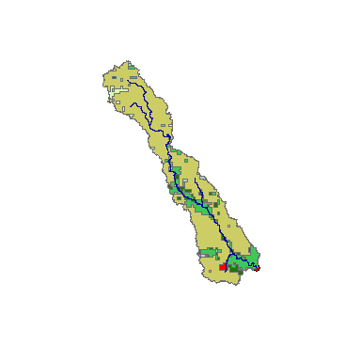
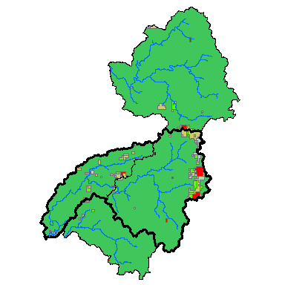
Vegetation derived parameters
NASA LDAS vegetation database
IGBP Classification
1-km AVHRR imagery

Slide 18

Digital Elevation Model Derived Parameters
Specific catchment area using D∞ algorithm used to compute wetness index
Tarboton, D. G., (1997), "A New Method for the Determination of Flow Directions and Contributing Areas in Grid Digital Elevation Models," Water Resources Research, 33(2): 309-319.) (http://www.engineering.usu.edu/cee/faculty/dtarb/dinf.pdf)

Slide 19
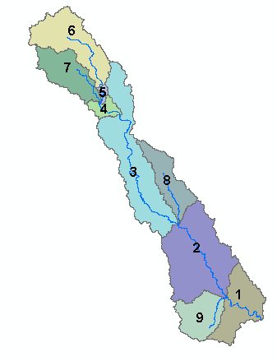
Wetness index histogram for each subwatershed used to parameterize subgrid variability of soil moisture
Basin 7
Basin 6
0.20
Proportion of area
0.20
0.10
Proportion of area
0.10
0.00
0
5
10
15
20
Basin 3
ln(a/S) (a in meter units)
0.00
0
5
10
15
20
Basin 4
ln(a/S) (a in meter units)
0.20
0.30
Proportion of area
0.20
0.10
Proportion of area
0.10
0.00
0
5
10
15
20
0.00
0
5
10
15
20
ln(a/S) (a in meter units)
ln(a/S) (a in meter units)
Basin 2
Basin 8
0.20
0.20
Proportion of area
Proportion of area
0.10
0.10
0.00
0.00
0
5
10
15
20
0
5
10
15
20
25
ln(a/S) (a in meter units)
ln(a/S) (a in meter units)
Basin 9
0.20
Basin 1
0.15
0.20
Proportion of area
0.15
0.10
0.10
0.05
Proportion of area
0.00
0.05
0
5
10
15
20
0.00
ln(a/S) (a in meter units)
0
5
10
15
20
ln(a/S) (a in meter units)

Slide 20
Calibration
Global probabilistic search using Shuffled Complex Evolution algorithm implemented in NLFIT (Kuczera, 1994, 1997)
Parameter multipliers to K, f, n, Cr, v
Calibration period 971001-990531
~ 1 graduate student week on calibration – essentially just letting the algorithm run till minimal improvement for each watershed
Kuczera, G., (1994), "NLFIT, A Bayesian Nonlinear Regression Program Suite," Version 1.00g, Department of Civil Engineering and Surveying, University of Newcastle, NSW, 2308, Australia.
Kuczera, G., (1997), "Efficient Subspace Probabilistic Parameter Optimization for Catchment Models," Water Resources Research, 33(1): 177-185.

Slide 21
"Uncalibrated" parameter multipliers
Parameter multiplier results after optimization
Notes:
Parameter constraints - Min then Max
0 1.e+20 Area (not a var1able parameter)
1.0 15.0 f
0.001 150. k
0.01 0.4 dtheta1
0.05 0.4 dtheta2
0.005 2.00 soilmc
0.0 20.0 exp c
0.0 0.5 psif
1. 10000. Overland flow velocity
0.0 0.005 Canopy capacity
0.0 2.0 Evap enhancement factor,cr
0.0 1.0 Albedo
0.0 1.0 Lapse rate (not a var1able parameter)
0.0 1.e+5 Sub-basin elevation (not a var1able parameter)
Initial condition constraints - Min then Max
0.0 2.0 Initial soil moisture
-0.5 5.0 Initial depth to WT
0.0 0.005 Initial canopy storage
Reach parameter constraints - Min then Max
0.0001 1.0 Channel slope (not a var1able parameter)
0.001 2.0 Manning's 'n'
0.1 1.e+07 Channel width (not a var1able parameter)
10000. 1.e+10 Channel length (not a var1able parameter)

Slide 22
Run time issues:
System: AMD Athlon XP 1900+
512 MB RAM
Platform: Windows 2000
Run-time for one model run
63000 timesteps: 4-9 minutes
Model elements: 9-21
Parameter Calibration by SCE
Five parameters: 6-9+ hours

Slide 23
Some Results
Baron Cumulative Water Balance

Slide 24
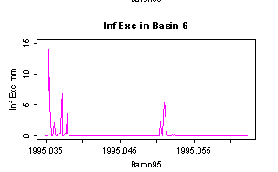
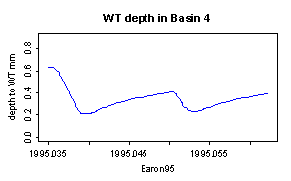
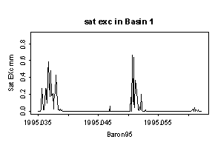
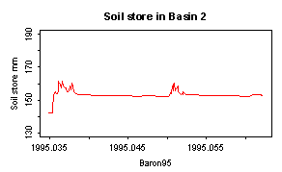
Basin specific Model Outputs for two Baron 1995 events
Infiltration excess runoff
Depth to water table
Unsat.
soil zone store
Saturation excess runoff

Slide 25
Modeling results

Slide 28
0.48
0.46
0.44
0.20
Oct,1,1999
0.50
0.25
Oct,1,1993
0.50
0.26
0.14
0.42
0.48
Changes in the slope of the cumulative runoff/cumulative rainfall ratio
used to diagnose biases either in streamflow
or precipitation measurement, most likely precipitation.

Slide 30
DMIP Annual Runoff Ratios

Slide 31
Lessons Learned
DMIP Data
Data exhibits changing annual runoff ratio with relatively higher observed flow in years with smaller precipitation and visa versa. We believe this is most likely due to biases in the precipitation input. Calibration to attempt to match this is unreasonable.
Our model
A simple exponential functional form of baseflow response, , limits the capability of the model to match recessions in both low and high flow conditions.
Fitting to mse doesn’t help with cumulative mass balance. Need to consider use of cumulative time series in calibration.
Future work
Model element scale questions
Connections between calibrated parameters and soil and veg attributes
Alternative generalized baseflow storage – discharge functions
Decouple K in soil and saturated store
Add impervious areas
Add snow

