Slide 1
Terrain Analysis and Hydrologic Modeling using Digital Elevation Models and GIS
David G. Tarboton
dtarb@cc.usu.edu
http://www.engineering.usu.edu/dtarb

Slide 2
Purpose
To discuss some of the methods and capabilities for using terrain analysis to enhance hydrologic modeling

Slide 3
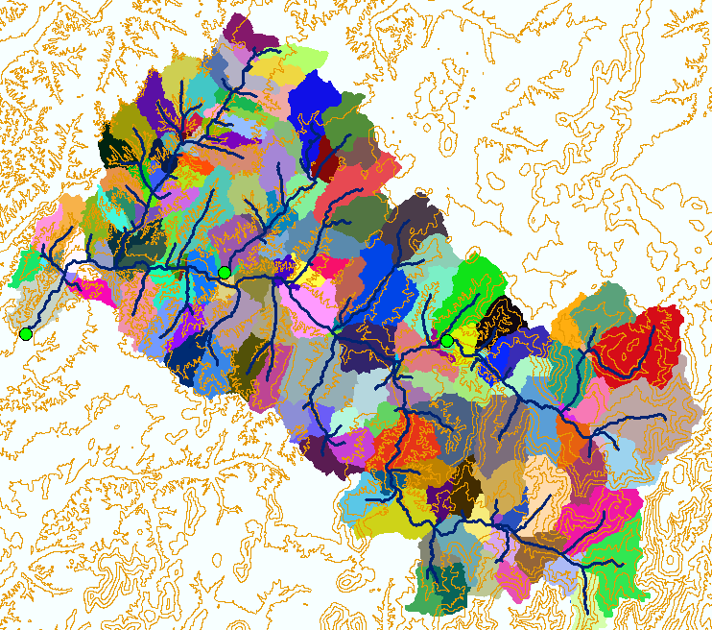
GIS and DEM Analysis is used in Hydrology to…
Delineate model elements
Baron subbasins, DMIP project

Slide 4
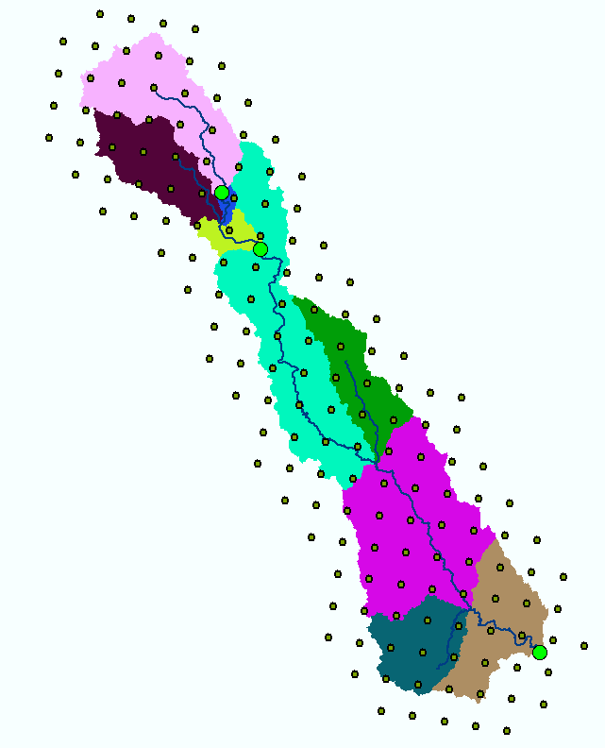
GIS and DEM Analysis is used in Hydrology to…
6
Interconnect model elements and stream reaches
Estimate rainfall Inputs
28
7
27
5
29
26
25
24
4
23
8
3
22
30
21
2
20
9
31
19
1
18
Blue River Basin, DMIP project

Slide 5
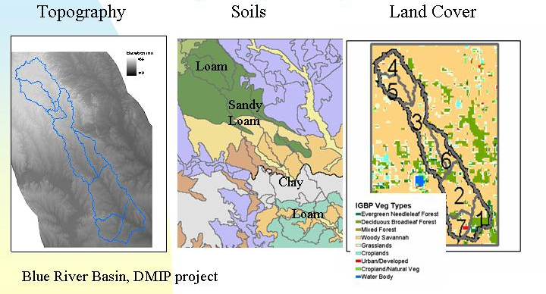
GIS and DEM Analysis is used in Hydrology to…
Integrate Spatial Inputs
Blue River Basin, DMIP project

Slide 6
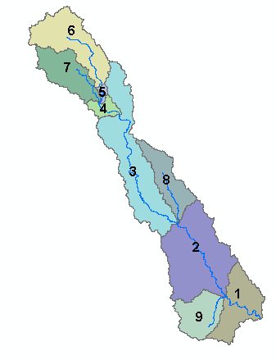
GIS and DEM Analysis is used in Hydrology to…
Determine parameters, like topographic wetness index distribution
Proportion of area
Basin 7
Basin 6
0.20
Proportion of area
0.10
0.20
0.00
0.10
0
5
10
15
20
0.00
ln(a/S) (a in meter units)
0
5
10
15
20
ln(a/S) (a in meter units)
0.20
Basin 3
0.30
Basin 4
Proportion of area
Proportion of area
0.10
0.20
0.00
0.10
0
5
10
15
20
0.00
ln(a/S) (a in meter units)
0
5
10
15
20
ln(a/S) (a in meter units)
Basin 2
0.20
Basin 8
0.20
Proportion of area
Proportion of area
0.10
0.10
0.00
0.00
0
5
10
15
20
0
5
10
15
20
25
ln(a/S) (a in meter units)
ln(a/S) (a in meter units)
Basin 9
0.20
0.15
Proportion of area
0.10
0.20
Basin 1
0.15
0.05
Proportion of area
0.00
0.10
Blue River Basin, DMIP project
0
5
10
15
20
0.05
ln(a/S) (a in meter units)
0.00
0
5
10
15
20
ln(a/S) (a in meter units)

Slide 7
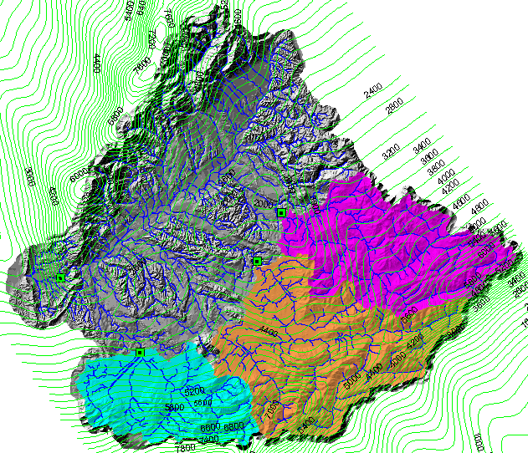
GIS and DEM Analysis is used in Hydrology to…
Synthesize Results
Grey River Basin, New Zealand

Slide 8
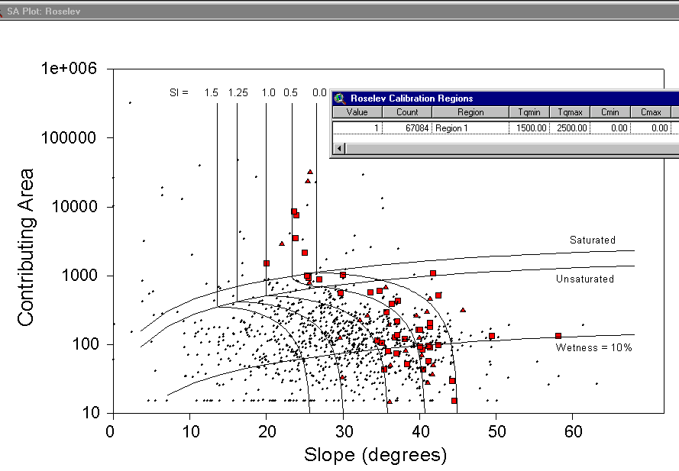
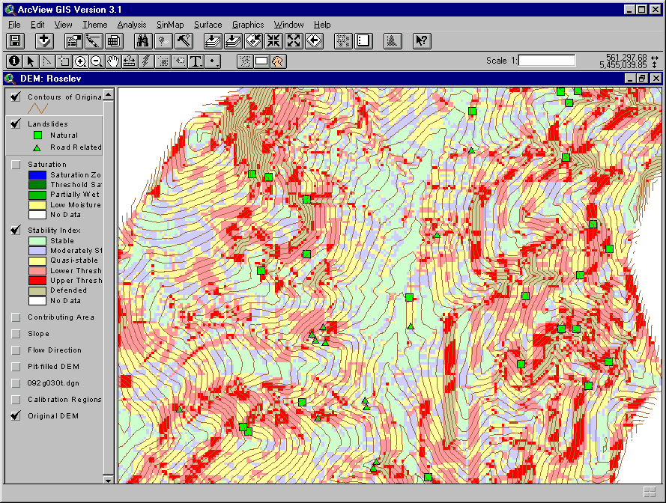
GIS and DEM Analysis is used in Hydrology to…
Examine Terrain Stability

Slide 9
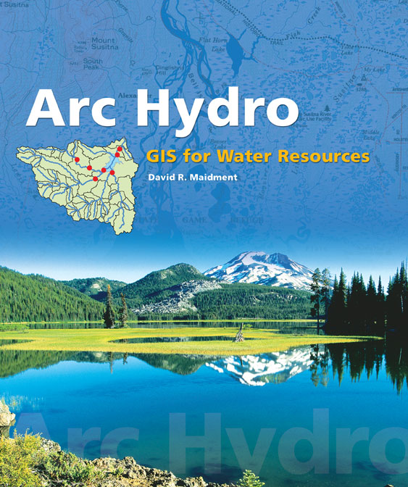
GIS and DEM Analysis is used in Hydrology to…
Standard Data Model for Water Resources to serve as basis for Hydrologic Information Systems
Drainage System
Hydro Network
Flow
Time
Time Series
Hydrography
Channel System

Slide 10
Outline
Digital elevation model based flow direction, contributing area and watershed delineation
Channel network delineation. Objective selection of stream delineation threshold and representation of variable drainage density.
Terrain flow fields and their numerical representation. Multiple flow direction approaches.
Specialized grid accumulation functions

Slide 11

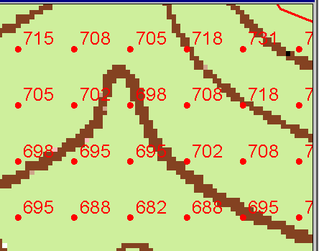
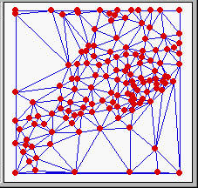
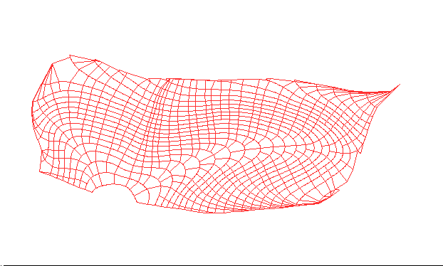
Numerical representation of a spatial surface (field)
Grid
TIN
Contour and flowline

Slide 12
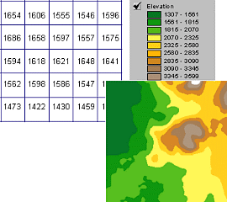
A grid defines geographic space as a matrix of identically-sized square cells. Each cell holds a numeric value that measures a geographic attribute (like elevation) for that unit of space.

Slide 13
Digital Elevation Model Based Flow Path Analysis
Eight direction pour point model D8
Grid network
4
3
2
5
1
6
7
8
Drainage Area
Grid Order
1
1
1
1
1
1
1
1
1
1
1
4
3
3
1
1
2
2
2
1
1
1
12
1
2
1
1
3
1
1
1
1
2
16
1
1
1
1
3
1
1
3
6
25
2
1
2
2
3
1

Slide 14
100 grid cell constant support area stream delineation threshold

Slide 15
200 grid cell constant support area stream delineation threshold

Slide 16
Grid Network Ordering Approach (Peckham, 1995)

Slide 17
Grid network pruned to order 4 stream delineation

Slide 18
Slope area threshold (Montgomery and Dietrich, 1992).

Slide 19
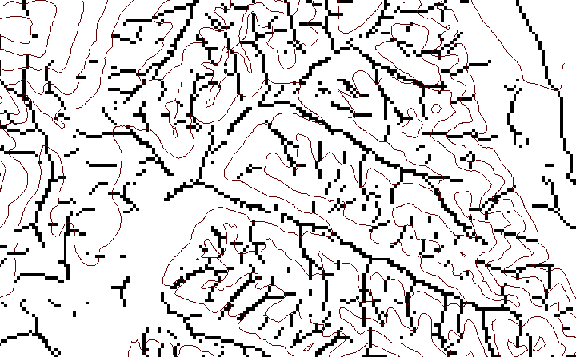
Local Curvature Computation
(Peuker and Douglas, 1975, Comput. Graphics Image Proc. 4:375)
43
48
48
51
51
56
41
47
47
54
54
58

Slide 20
Contributing area of upwards curved grid cells only

Slide 21
Curvature based stream delineation

Slide 22
How to decide on stream delineation threshold ?
AREA 2
3
AREA 1
12

Slide 23
How to decide on stream delineation threshold ?
AREA 2
3
AREA 1
12
Why is it important?

Slide 24
Hydrologic processes are different on hillslopes and in streams. It is important to recognize this and account for this in models.
Drainage area can be concentrated or dispersed (specific catchment area) representing concentrated or dispersed flow.
Objective determination of stream network drainage density

Slide 25
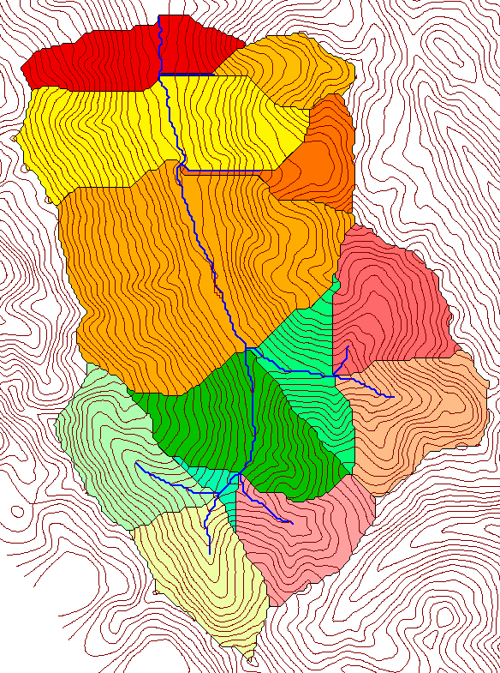
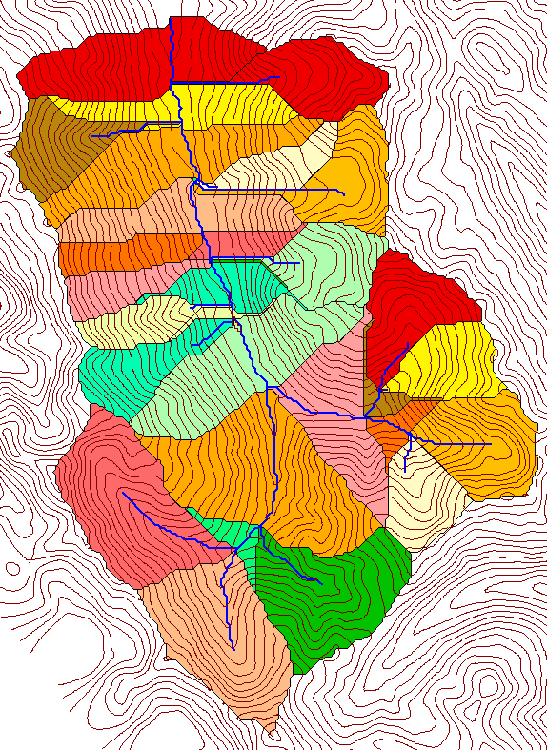
Delineation of Stream Networks and Subwatersheds
500 cell theshold
1000 cell theshold

Slide 26
Examples of differently textured topography
Driftwood, PA
Same scale, 20 m contour interval
Sunland, CA

Slide 27
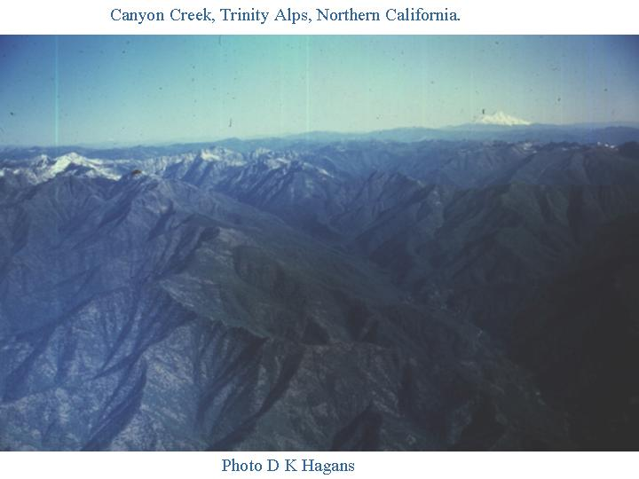

Slide 28
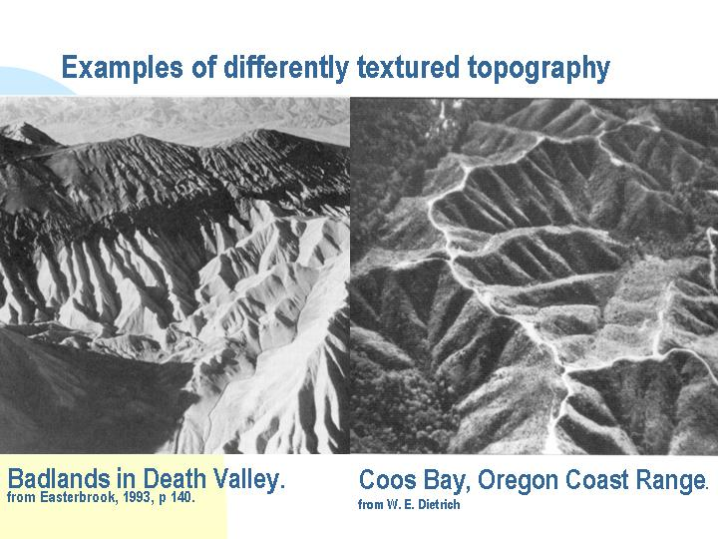

Slide 29
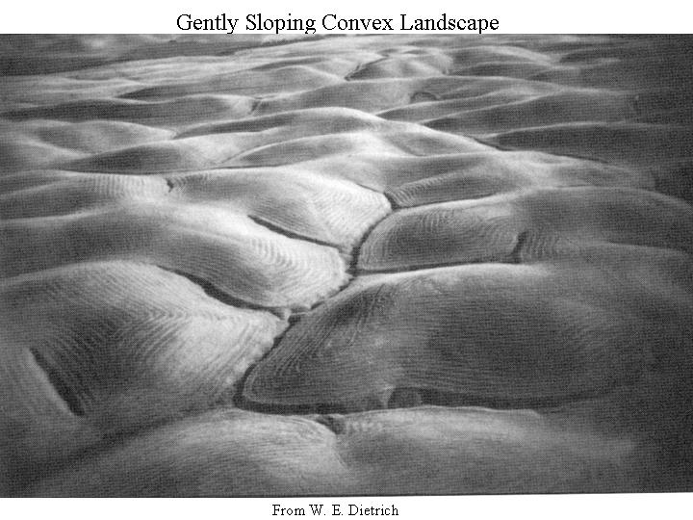

Slide 30
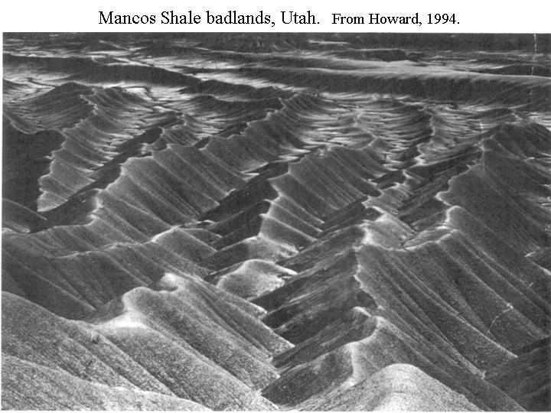

Slide 31
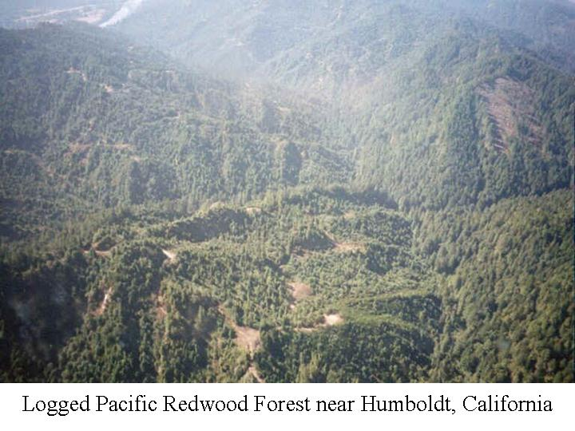

Slide 32
“landscape dissection into distinct valleys is limited by a threshold of channelization that sets a finite scale to the landscape.” (Montgomery and Dietrich, 1992, Science, vol. 255 p. 826.)

Slide 33
“landscape dissection into distinct valleys is limited by a threshold of channelization that sets a finite scale to the landscape.” (Montgomery and Dietrich, 1992, Science, vol. 255 p. 826.)
Suggestion: One contributing area threshold does not fit all watersheds.

Slide 34
“landscape dissection into distinct valleys is limited by a threshold of channelization that sets a finite scale to the landscape.” (Montgomery and Dietrich, 1992, Science, vol. 255 p. 826.)
Suggestion: One contributing area threshold does not fit all watersheds.
Lets look at some geomorphology.
    Drainage Density
    Horton’s Laws
    Slope – Area scaling
    Stream Drops

Slide 35
Drainage Density
D_{d} = L/A
Hillslope length ≈ 1/2D_{d}
B
B
Hillslope length = B
A = 2B L
D_{d} = L/A = 1/2B
∴ B= 1/2D_{d}
L

Slide 36
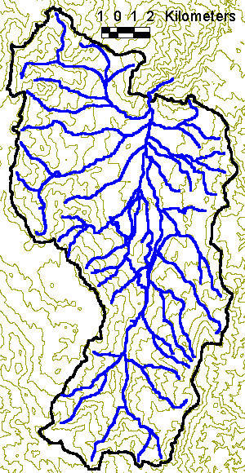
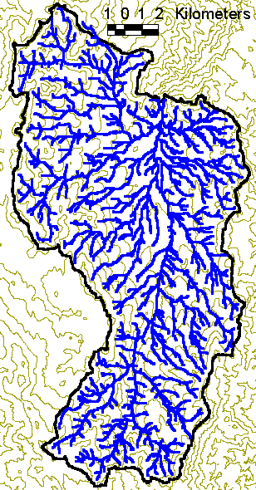
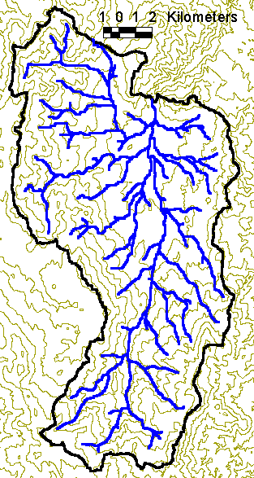
Drainage density for different stream delineation thresholds
EPA Reach Files
100 grid cell threshold
1000 grid cell threshold

Slide 37
Drainage Density Versus Contributing Area Threshold

Slide 38
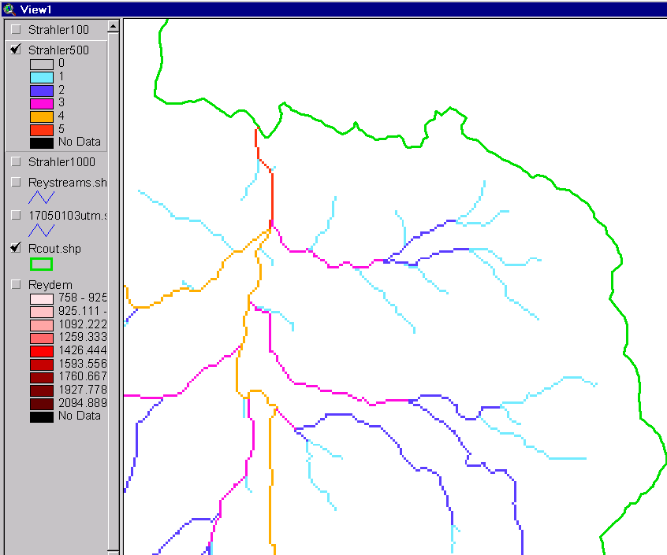
Strahler Stream Order
Order 5
Order 1
most upstream is order 1
when two streams of a order i join, a stream of order i+1 is created
when a stream of order i joins a stream of order i+1, stream order is unaltered
Order 3
Order 4
Order 2

Slide 39
Bifurcation Law

Slide 40
Area Law

Slide 41
Slope Law

Slide 42
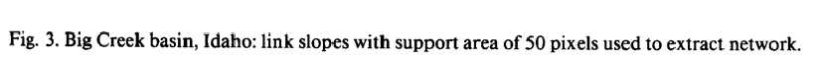
Slope-Area scaling
S~A^{-0.5}
From Tarboton, D. G., R. L. Bras and I. Rodriguez-Iturbe, (1992), "A Physical Basis for Drainage Density," Geomorphology, 5(1/2):

Slide 43
Constant Stream Drops Law
Broscoe, A. J., (1959), "Quantitative analysis of longitudinal stream profiles of small watersheds," Office of Naval Research, Project NR 389-042, Technical Report No. 18, Department of Geology, Columbia University, New York.

Slide 44

Stream Drop
Elevation difference between ends of stream
Nodes
Links
Single Stream
Note that a “Strahler stream” comprises a sequence of links (reaches or segments) of the same order

Slide 45
Suggestion: Map stream networks from the DEM at the finest resolution consistent with observed stream network geomorphology ‘laws’.
Look for statistically significant break in constant stream drop property
Break in slope versus contributing area relationship
Physical basis in the form instability theory of Smith and Bretherton (1972), see Tarboton et al. 1992

Slide 46
Statistical Analysis of Stream Drops

Slide 47
T-Test for Difference in Mean Values
0
72
130
T-test checks whether difference in means is large (> 2)
when compared to the spread of the data around the mean values

Slide 48
Constant Support Area Threshold

Slide 49
200 grid cell constant support area stream delineation threshold

Slide 50
Upward Curved Contributing Area Threshold

Slide 51
Curvature based stream delineation with threshold by constant drop analysis

Slide 52
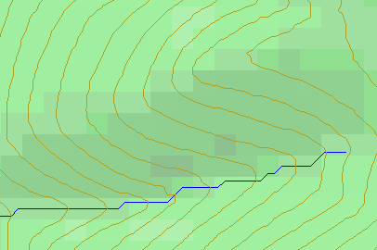
Topographic Slope
?
Topographic Definition Drop/Distance
Limitation imposed by 8 grid directions.
Flow Direction Field — if the elevation surface is differentiable (except perhaps for countable discontinuities) the horizontal component of the surface normal defines a flow direction field.

Slide 53
Eight Direction Pour Point Model D8
30
4
3
2
67
56
49
5
1
52
48
37
6
7
8
58
55
22
Slope = Drop/Distance
Steepest down slope direction

Slide 54

D∞ Multiple flow direction model
Proportion flowing to neighboring grid cell 2 is α₁/(α₁ + α₂)
Proportion flowing to neighboring grid cell 1 is α₂/(α₁ + α₂)
Δ
Tarboton, D. G., (1997), "A New Method for the Determination of Flow Directions and Contributing Areas in Grid Digital Elevation Models," Water Resources Research, 33(2): 309-319.) (http://www.engineering.usu.edu/cee/faculty/dtarb/dinf.pdf)

Slide 55
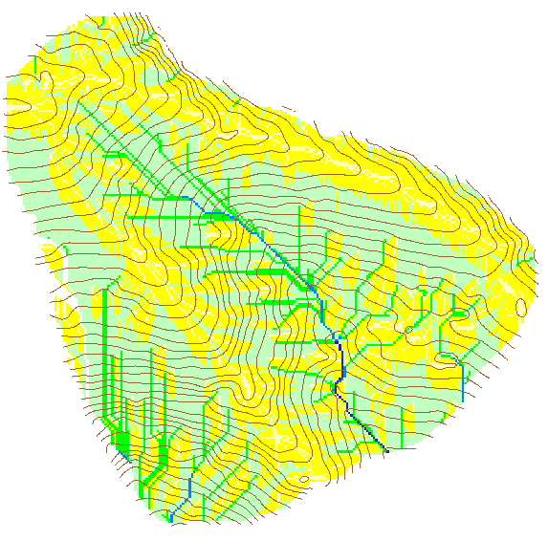

Contributing Area using D∞
Contributing Area using D8

Slide 56
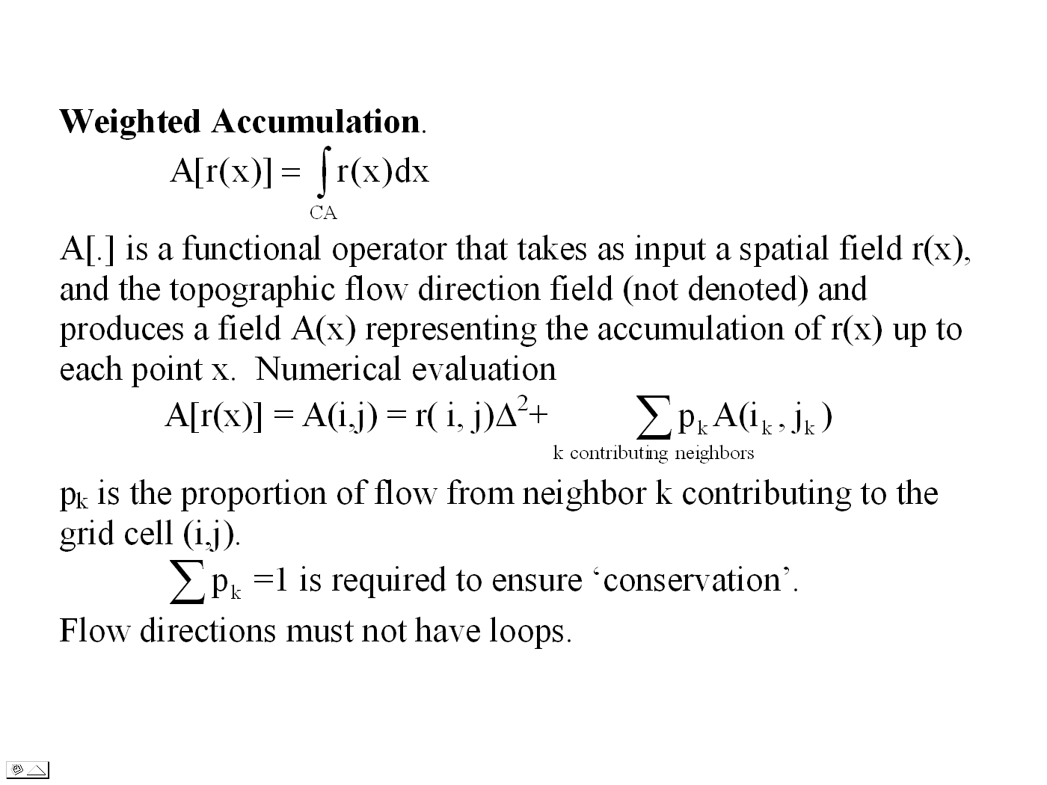

Slide 57
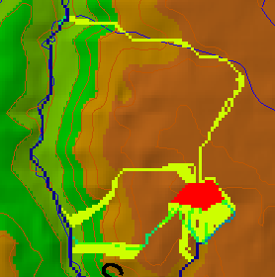
Useful for example to track where sediment or contaminant moves

Slide 58
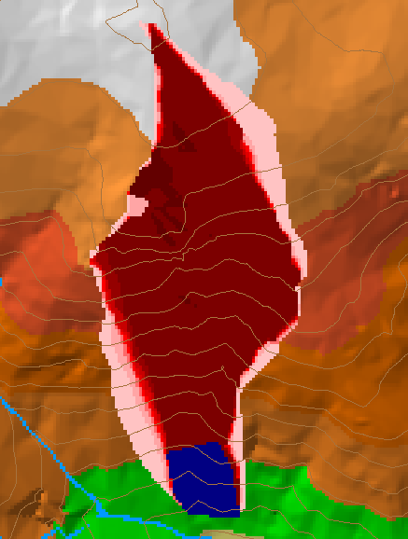
Useful for example to track where a contaminant may come from

Slide 59
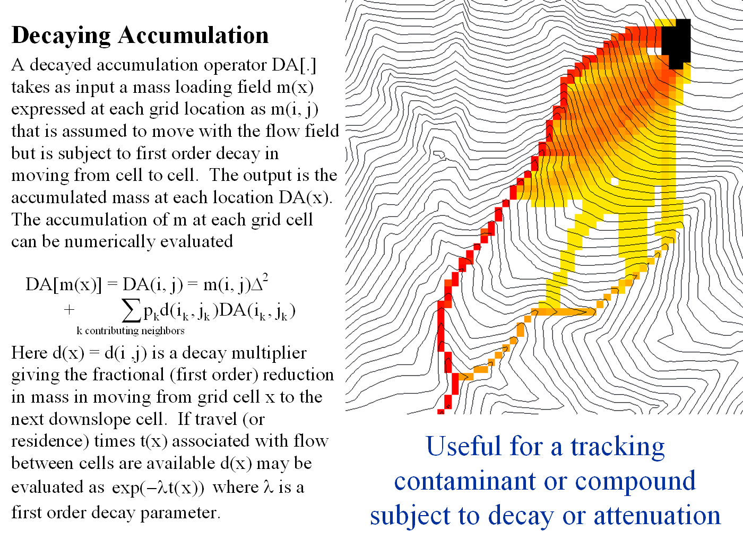

Slide 60
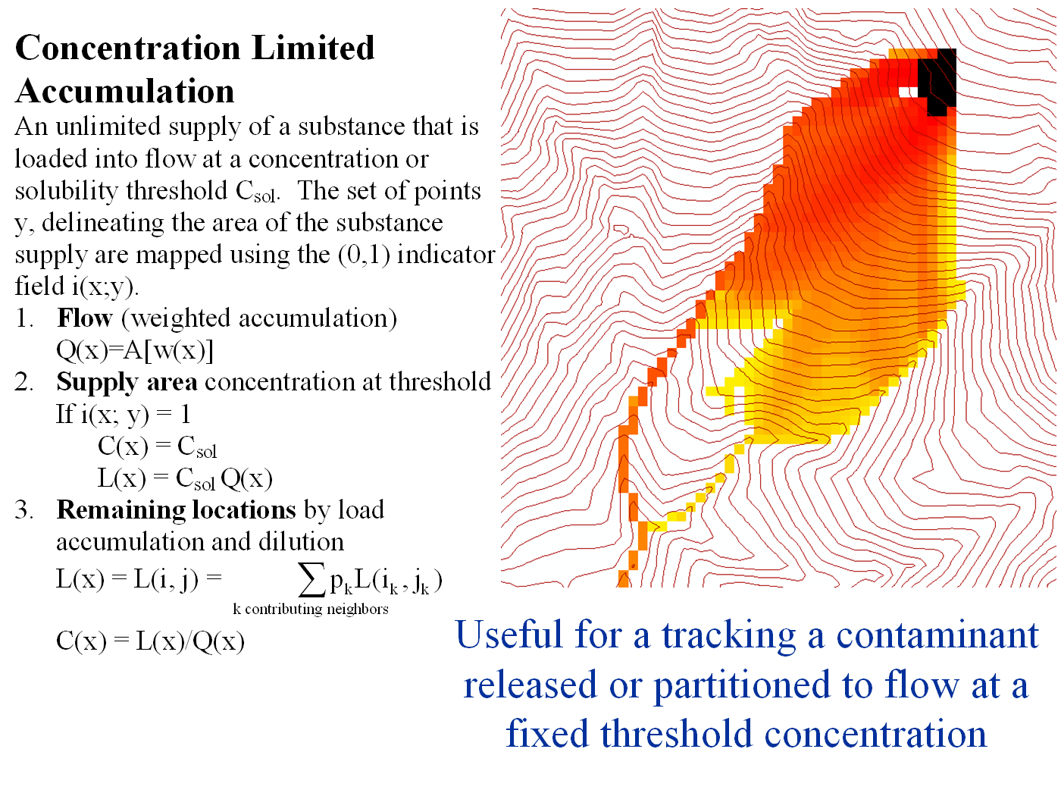

Slide 61
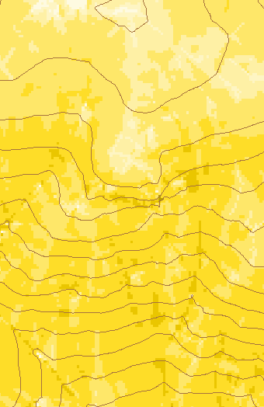
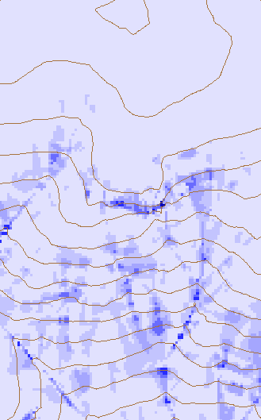
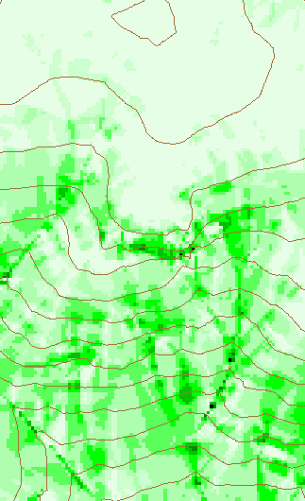
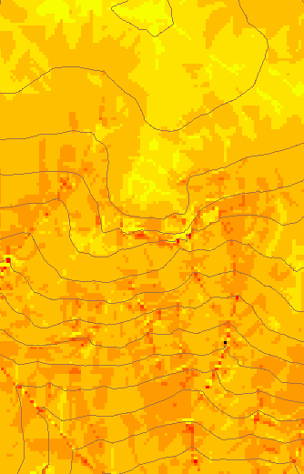
Transport limited accumulation
Useful for modeling erosion and sediment delivery, the spatial dependence of sediment delivery ratio and contaminant that adheres to sediment

Slide 62
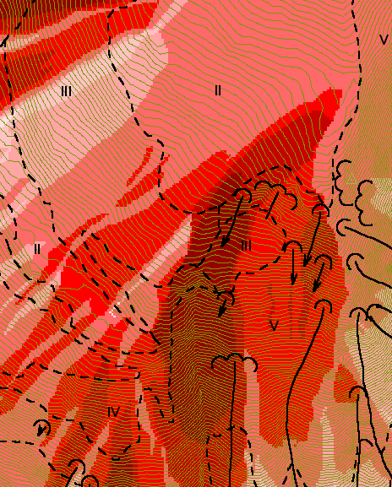
Reverse Accumulation
Useful for destabilization sensitivity in landslide hazard assessment

Slide 63
TauDEM Software
Pit removal (standard flooding approach)
Flow directions and slope
  D8 (standard)
  D∞ (Tarboton, 1997, WRR 33(2):309)
  Flat routing (Garbrecht and Martz, 1997, JOH 193:204)
Drainage area (D8 and D∞)
Network and watershed delineation
  Support area threshold/channel maintenance coefficient (Standard)
  Combined area-slope threshold (Montgomery and Dietrich, 1992, Science, 255:826)
  Local curvature based (using Peuker and Douglas, 1975, Comput. Graphics Image Proc. 4:375)
Threshold/drainage density selection by stream drop analysis (Tarboton et al., 1991, Hyd. Proc. 5(1):81)
Other Functions: Downslope Influence, Upslope Dependence, Wetness index, distance to streams, Transport limited accumulation
Available from http://www.engineering.usu.edu/dtarb/

Slide 64
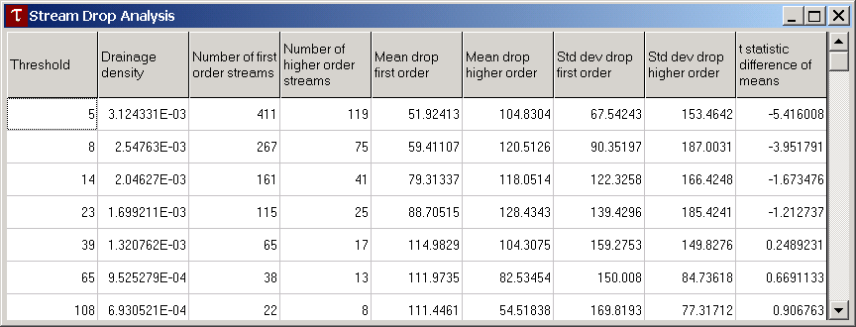
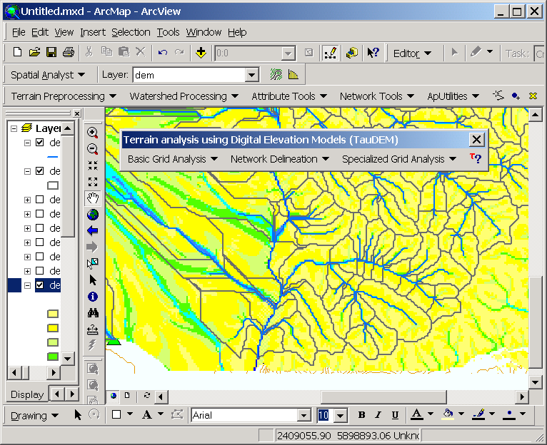
Questions?
Demonstration
AREA 2
3
AREA 1
12

Slide 65
References
Broscoe, A. J., (1959), "Quantitative Analysis of Longitudinal Stream Profiles of Small Watersheds," Office of Naval Research, Project NR 389-042, Technical Report No. 18, Department of Geology, Columbia University, New York.
Garbrecht, J. and L. W. Martz, (1997), "The Assignment of Drainage Direction over Flat Surfaces in Raster Digital Elevation Models," Journal of Hydrology, 193: 204-213.
Montgomery, D. R. and W. E. Dietrich, (1992), "Channel Initiation and the Problem of Landscape Scale," Science, 255: 826-830.
Peckham, S. D., (1995), "Self-Similarity in the Three-Dimensional Geometry and Dynamics of Large River Basins," PhD Thesis, Program in Geophysics, University of Colorado.
Peuker, T. K. and D. H. Douglas, (1975), "Detection of Surface-Specific Points by Local Parallel Processing of Discrete Terrain Elevation Data," Comput. Graphics Image Process., 4: 375-387.
Smith, T. R. and F. P. Bretherton, (1972), "Stability and the Conservation of Mass in Drainage Basin Evolution," Water Resources Research, 8(6): 1506-1529.

Slide 66
References
Tarboton, D. G., (2003), "Terrain Analysis Using Digital Elevation Models in Hydrology," ESRI Users Conference, San Deigo, July 7-11.
Tarboton, D. G. and D. P. Ames, (2001),"Advances in the mapping of flow networks from digital elevation data," in World Water and Environmental Resources Congress, Orlando, Florida, May 20-24, ASCE.
Tarboton, D. G., (1997), "A New Method for the Determination of Flow Directions and Contributing Areas in Grid Digital Elevation Models," Water Resources Research, 33(2): 309-319.
Tarboton, D. G., R. L. Bras and I. Rodriguez-Iturbe, (1992), "A physical basis for drainage density," Geomorphology, 5(1/2): 59-76.
Tarboton, D. G., R. L. Bras and I. Rodriguez-Iturbe, (1991), "On the Extraction of Channel Networks from Digital Elevation Data," Hydrologic Processes, 5(1): 81-100.
Available from http://www.engineering.usu.edu/dtarb/

