Slide 1


The CUAHSI Hydrologic Information System and NHD Plus
A Services Oriented Architecture for Water Resources Data
David G Tarboton
David R. Maidment (PI)
Ilya Zaslavsky
Michael Piasecki
Jon Goodall
Support
EAR 0622374
http://www.cuahsi.org/his.html

Slide 2
What is CUAHSI?
CUAHSI – Consortium of Universities for the Advancement of Hydrologic Science, Inc
Formed in 2001 as a legal entity. 115+ US Universities
Program office in Washington (5 staff)
NSF supports CUAHSI to develop infrastructure and services to advance hydrologic science in US universities

Slide 3
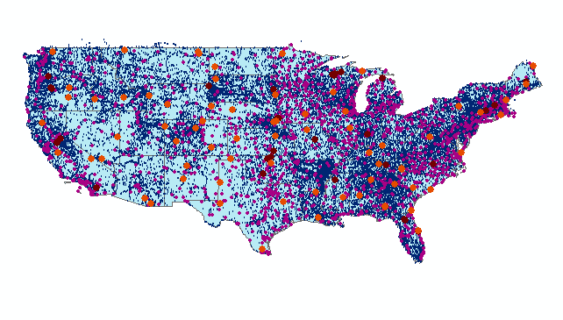
CUAHSI HIS
The CUAHSI Hydrologic Information System (HIS) is a geographically distributed network of data sources and functions that are integrated using web services oriented architecture so that they operate as a connected whole.

Slide 4
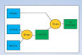
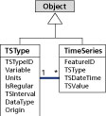
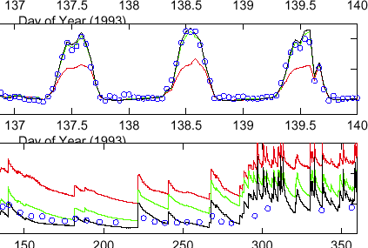

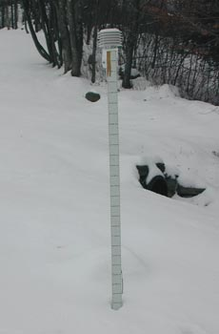

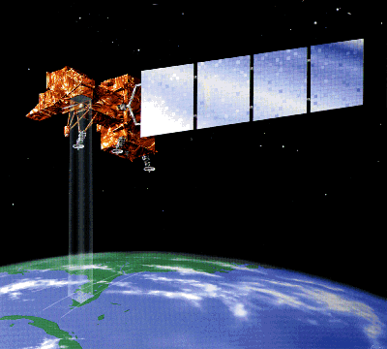
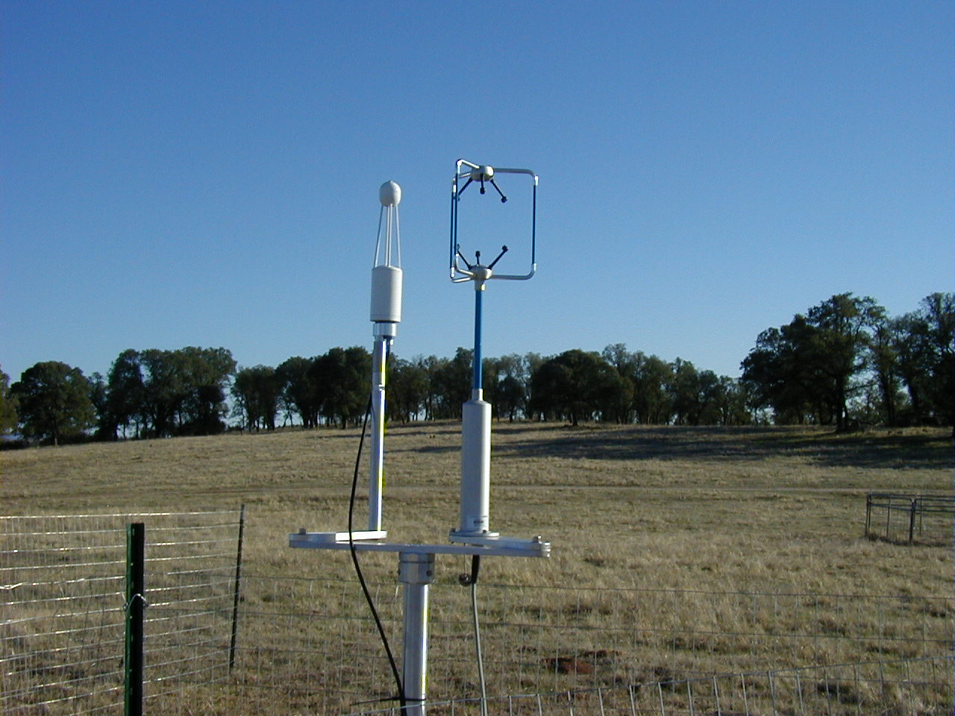
CUAHSI Hydrologic Information System
Goal: Enhance hydrologic science by facilitating user access to more and better data for testing hypotheses and analyzing processes
Models
Advancement of water science is critically dependent on integration of water information
It is as important to represent hydrologic environments precisely with data as it is to represent hydrologic processes with equations
Databases
Analysis
Water quantity
and quality
Rainfall & Snow
Remote sensing
Meteorology
Soil water

Slide 5

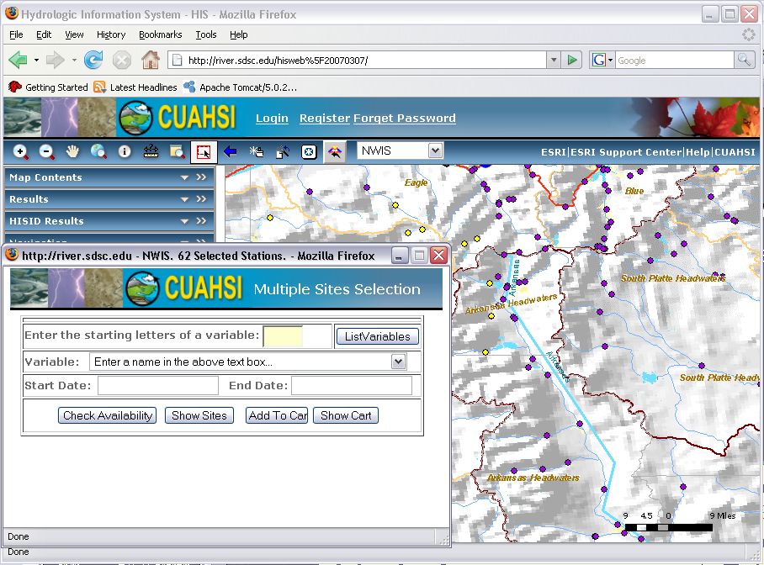
Service Oriented Architecture for Water Resources Data
Data Access System for Hydrology (DASH)
Website Portal and Map Viewer
Preliminary data exploration and discovery. See what is available and perform exploratory analyses
Downloads
Uploads
Analysis and Modeling applications
3rd party data servers
HTML -XML
Data access through web services
GIS
WaterOneFlow Web Services
Matlab
WSDL - SOAP
IDL
Data storage through web services
Splus, R
e.g. USGS, NCDC
Excel
Programming (Fortran, C, VB)
Observatory data servers
CUAHSI HIS data servers
Internet
ODM
ODM
WaterML
Notes:
Hydrologic Information System Service Oriented Architecture

Slide 6
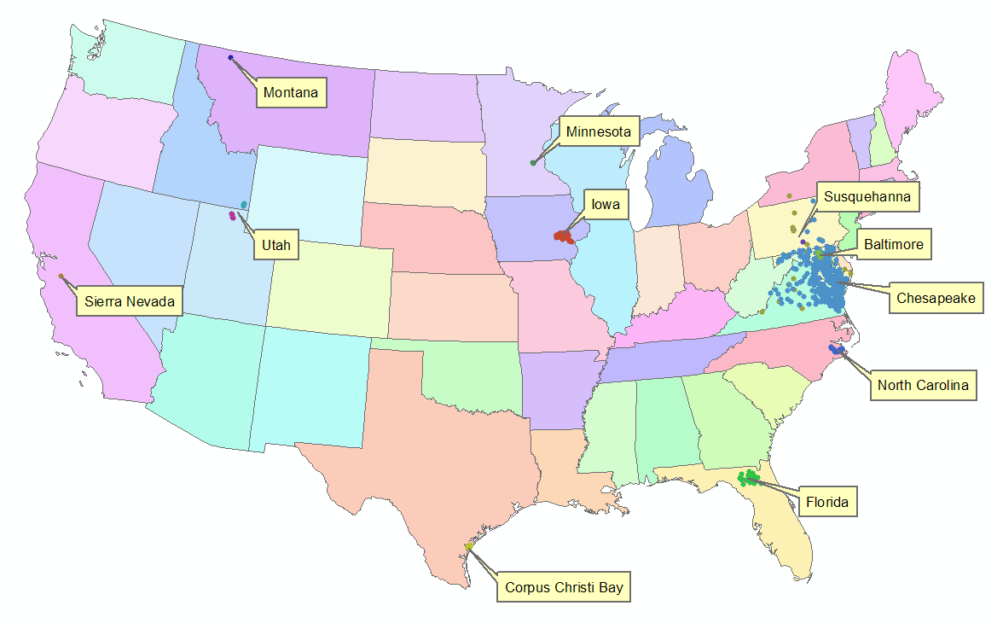
HIS Implementation in WATERS Network Information System
National Hydrologic Information Server
San Diego Supercomputer Center
11 WATERS Network test bed projects
16 ODM instances (some test beds have more than one ODM instance)
Data from 1246 sites, of these, 167 sites are operated by WATERS investigators

Slide 7
CUAHSI Observations Data Model
A relational database at the single observation level (atomic model)
Stores observation data made at points
Metadata for unambiguous interpretation
Traceable heritage from raw measurements to usable information
Standard format for data sharing
Cross dimension retrieval and analysis
Streamflow
Groundwater
levels
Precipitation
& Climate
Soil
moisture
data
Water Quality
Flux tower
data
Time
Space
Variables

Slide 8
Point Observations Information Model
http://www.cuahsi.org/his/webservices.html
Utah State
Univ
Data Source
Little Bear River
Network
GetSites
GetSiteInfo
Little Bear River at Mendon Rd
Sites
GetVariables
Dissolved Oxygen
Variables
GetVariableInfo
GetValues
9.78 mg/L, 1 October 2007, 6PM
Values
{Value, Time, Qualifier, Offset}
A data source operates an observation network
A network is a set of observation sites
A site is a point location where one or more variables are measured
A variable is a property describing the flow or quality of water
A value is an observation of a variable at a particular time
A qualifier is a symbol that provides additional information about the value
An offset allows specification of measurements at various depths in water
Horsburgh, J. S., D. G. Tarboton, D. R. Maidment and I. Zaslavsky, (2008), "A Relational Model for Environmental and Water Resources Data," Water Resources Research (in press).

Slide 9
We are at a tipping point ….
Web pages
Web services
Internet
Internet
Computer
Person
Computer
Computer
People interact with a
remote information server
Networks of information servers
provide services to one another

Slide 10
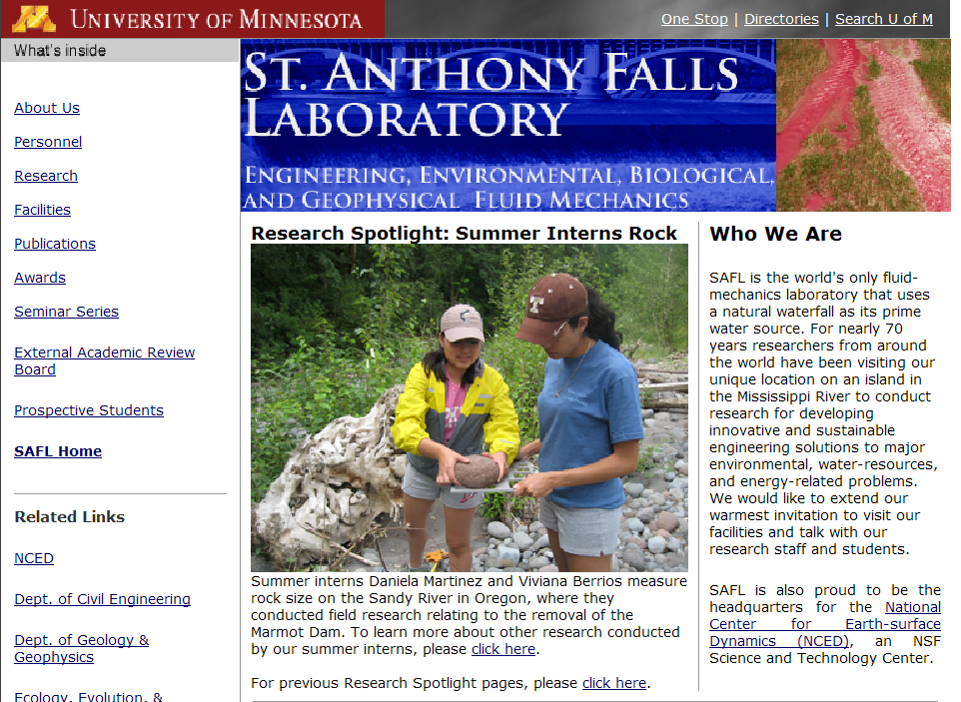

Information communication
Water web pages
Water web services
Water Markup Language (WaterML)
HyperText Markup Language (HTML)

Slide 11
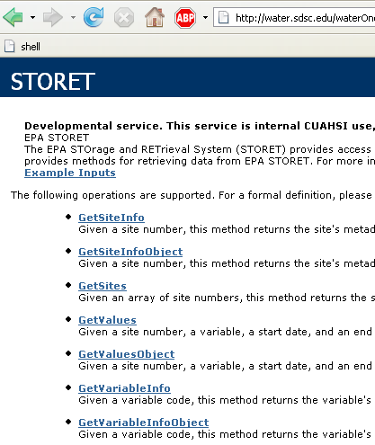
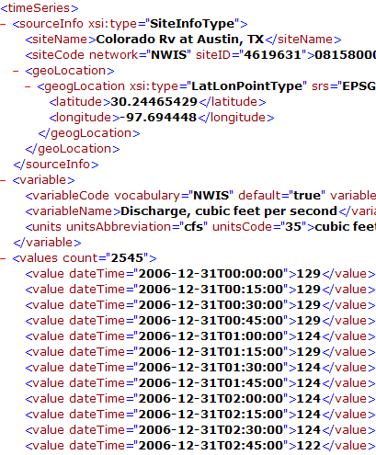
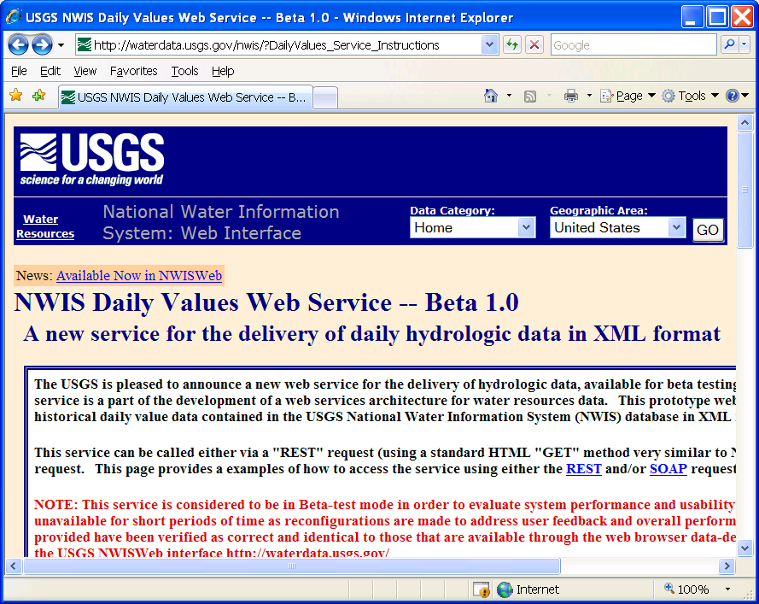
WaterOneFlow
Set of query functions
Return data in WaterML
http://river.sdsc.edu/wateroneflow/
Open Geospatial Consortium, Inc. (2007), CUAHSI WaterML, OGC Discussion Paper, OGC 07-041r1, Version 0.3.0, Zaslavsky, I., D. Valentine, and T. Whiteaker Editors, http://www.opengeospatial.org/standards/dp,

Slide 12
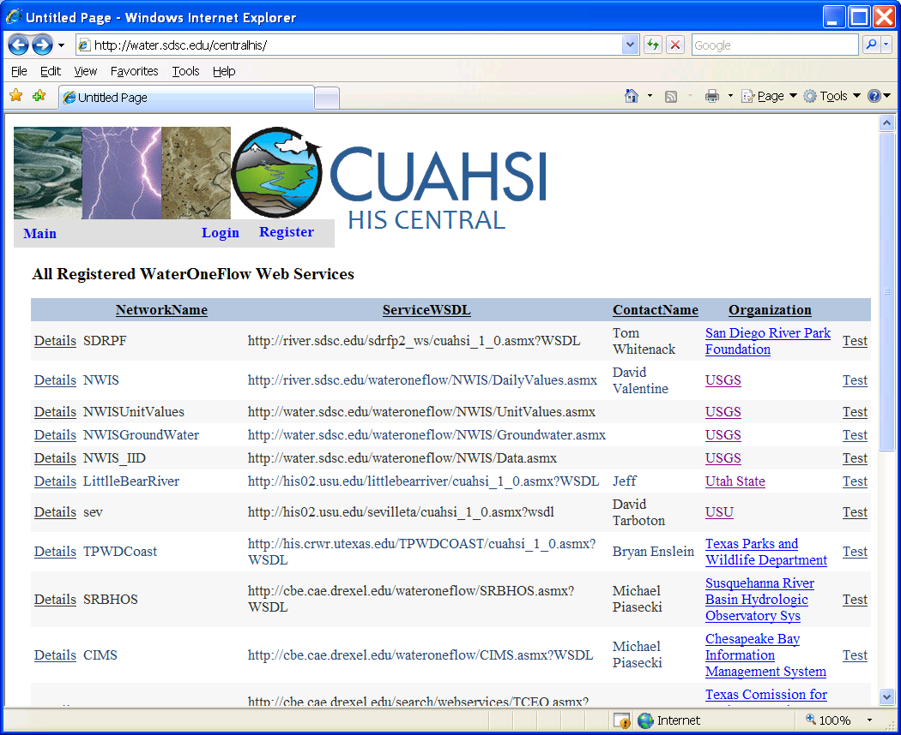

Slide 13
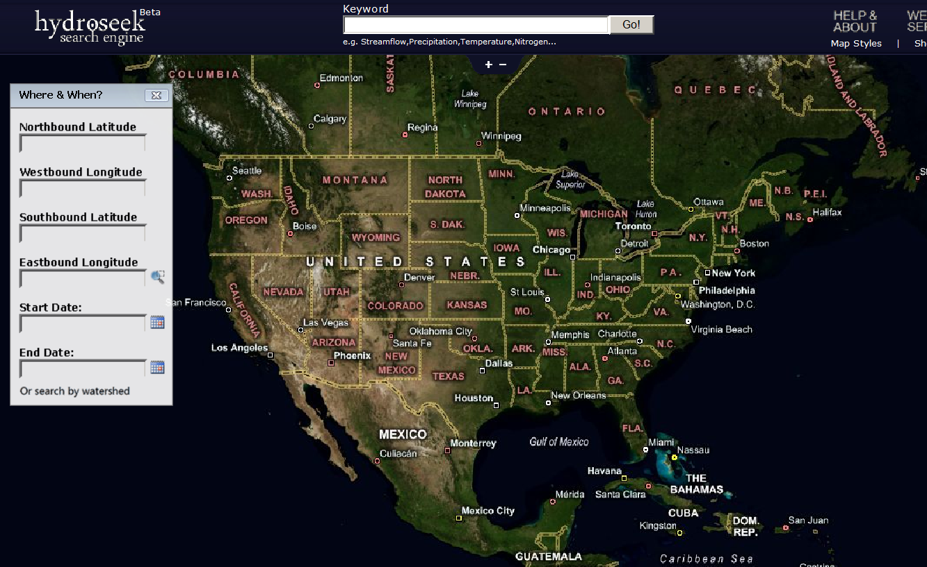
Hydroseek http://www.hydroseek.org
Supports search by location and type of data across multiple observation networks including NWIS, Storet, and university data

Slide 14
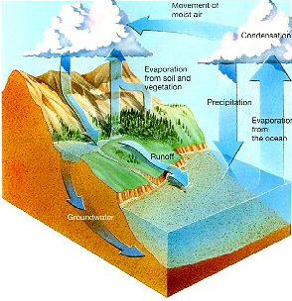
Digital Watersheds
A digital watershed is a structured collection of digital representations of inter-related hydrologic objects and measurements that facilitates integrated modeling and analysis.

Slide 15
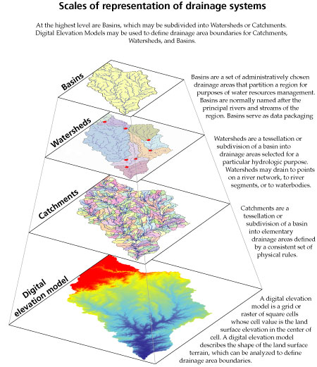
NHDPlus as a foundation for Digital Watersheds
Basins: Administratively chosen
drainage areas
Watersheds: A tesselation of
a basin for a particular purpose
Catchments: A tesselation of
a basin using physical rules
NHDPlus
Digital Elevation Model: a representation of the land surface as a spatial continuum

Slide 16
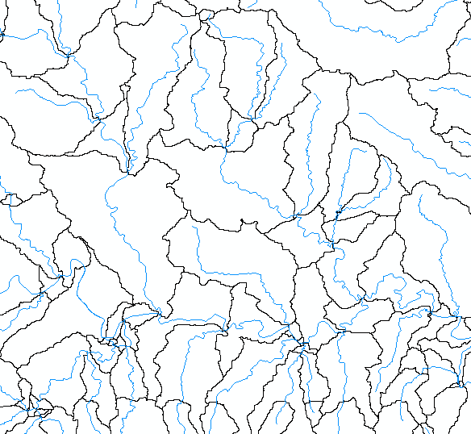
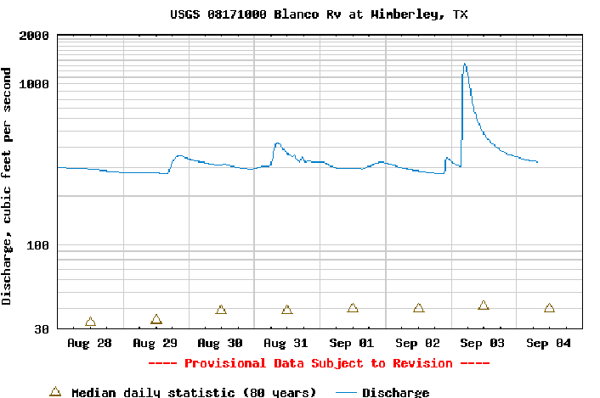
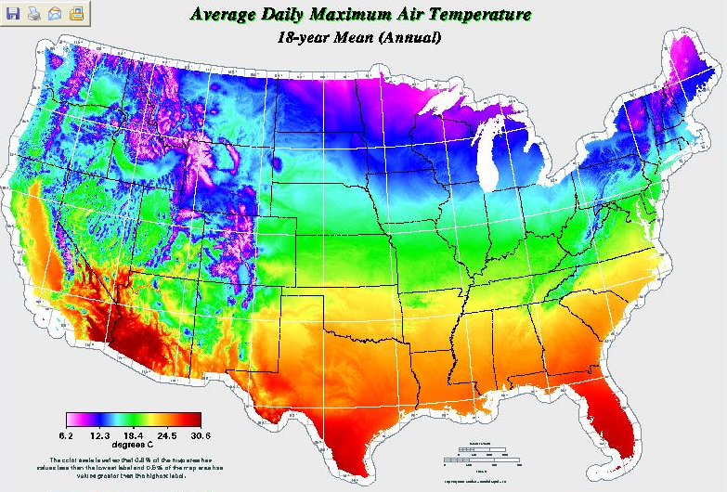
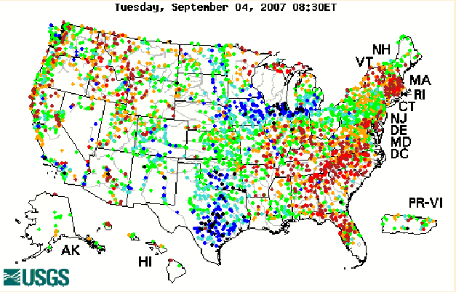
A Digital Watershed connects geospatial and temporal water resources data
Streamflow
Digital Watershed
NHDPlus
Weather

Slide 17
Summary
CUAHSI Hydrologic Information Server is functioning at all WATERS Network testbed sites
Academic Investigator and water agency (USGS) data are published in a consistent format (WaterML)
Hydroseek thematically synthesizes registered sources of WaterML data
Applications and analyses can operate seamlessly over the WATERS Network data services
A lot more to be done – GIS, weather and climate, remote sensing, simulation modeling, interpretive analysis, ….. Digital Watershed development!

Slide 18
Getting your own HIS Server
Platform
  PC, Windows 2003 Server, IIS 6.0, SQL Server 2005, .Net Framework 2.0, ASP .Net 2.0, ArcGIS Server 9.2 (for DASH)
HIS Software
  ODM (+Tools and Data Loaders)
  WaterOneFlow Web Services
  DASH
http://river.sdsc.edu/Wiki/HISServer.ashx
http://river.sdsc.edu/Wiki/HIS light.ashx
For more information contact:
Ilya Zaslavsky zaslavsk@sdsc.edu.

Slide 19
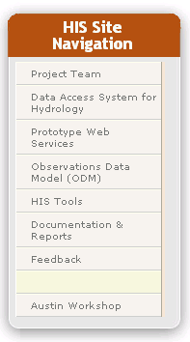
HIS Website http://www.cuahsi.org/his.html
Project Team – Introduces members of the HIS Team
Data Access System for Hydrology – Web map interface supporting data discovery and retrieval
Prototype Web Services – WaterOneFlow web services facilitating downlad of time series data from numerous national repositories of hydrologic data
Observations Data Model – Relational database schema for hydrologic observations
HIS Tools – Links to end-user applications developed to support HIS
Documentation and Reports – Status reports, specifications, workbooks and links related to HIS
Feedback – Let us know what you think
Austin Workshop – Material from WATERS workshop in Austin

