Slide 1


The CUAHSI Community Hydrologic Information System
David Tarboton, David Maidment, Ilya Zaslavsky, Dan Ames, Jon Goodall, Jeffery Horsburgh, Kim Schreuders
CUAHSI
HIS
Sharing hydrologic data
http://his.cuahsi.org/
Support
EAR 0622374

Slide 2
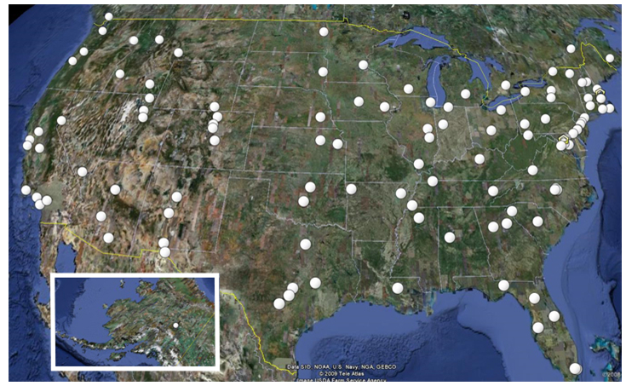
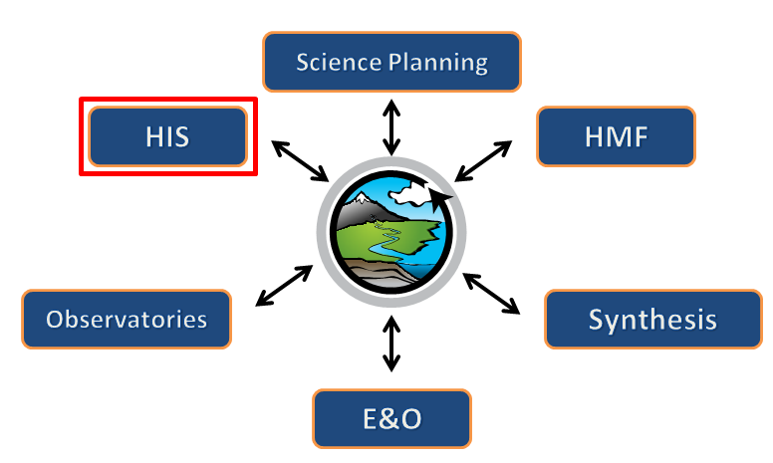

What is CUAHSI?
Consortium of Universities for the Advancement of Hydrologic Science, Inc.
110 US University members
6 affiliate members
12 International affiliate members
(as of March 2009)
Infrastructure and services for the advancement of hydrologic science and education in the U.S.
Support
EAR 0753521
http://www.cuahsi.org/

Slide 3
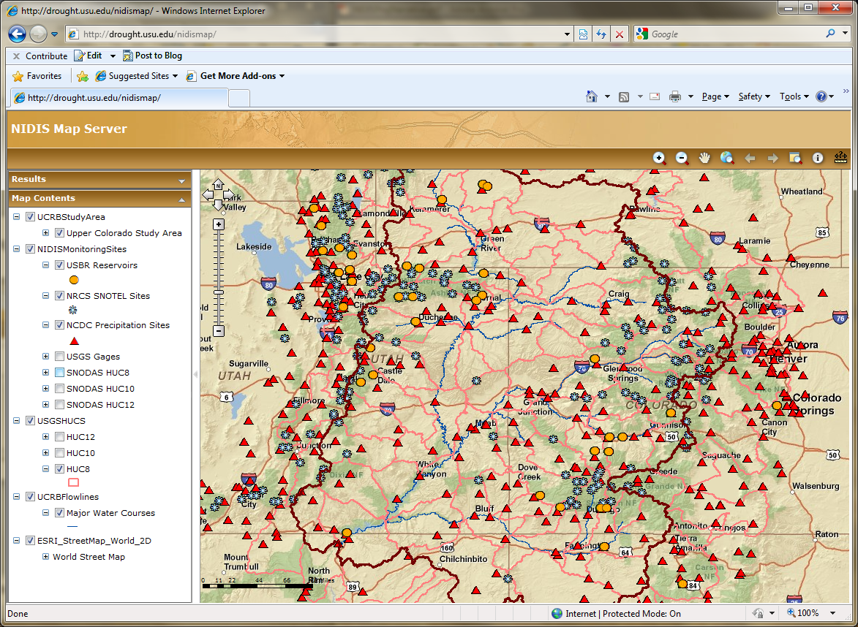
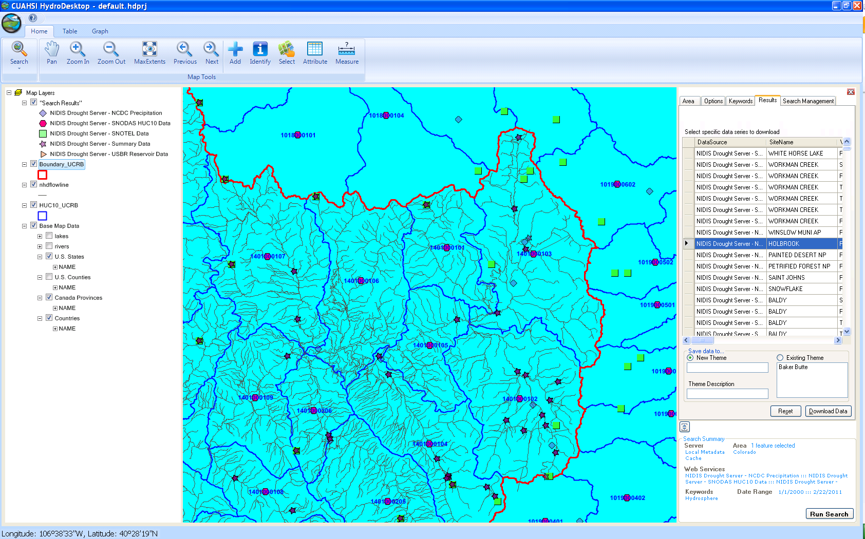
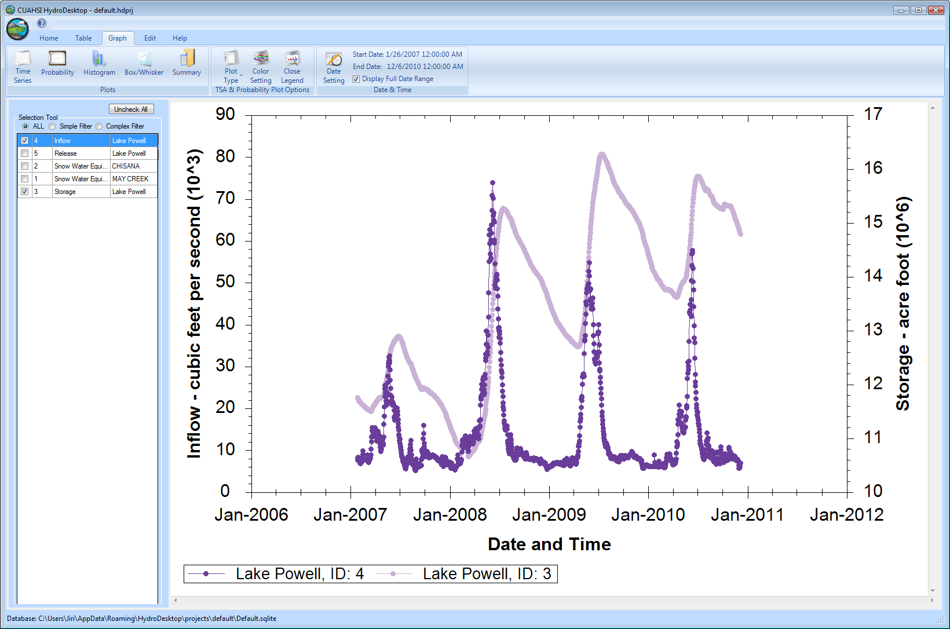
CUAHSI HIS
The CUAHSI Hydrologic Information System (HIS) is an internet based system to support the sharing of hydrologic data. It is comprised of hydrologic databases and servers connected through web services as well as software for data publication, discovery and access.
CUAHSI HydroServer – Data Publication
Lake Powell Inflow and Storage
CUAHSI HydroDesktop – Data Access and Analysis

Slide 4
Web Paradigm
Catalog
(Google)
Catalog harvest
Search
Web Server
(CNN.com)
Access
Browser
(Firefox)

Slide 5


CUAHSI Hydrologic Information System
Services-Oriented Architecture
Data Discovery and Integration
HydroCatalog
Metadata Services
WaterML, Other OGC Standards
Search Services
HydroServer
HydroDesktop
Data Publication
Data Services
Data Analysis and Synthesis
ODM
Geo Data
Information Model and Community Support Infrastructure

Slide 6
Let’s see some of it
http://icewater.usu.edu/
http://hydroserver.codeplex.com
http://hydrodesktop.codeplex.com

Slide 7
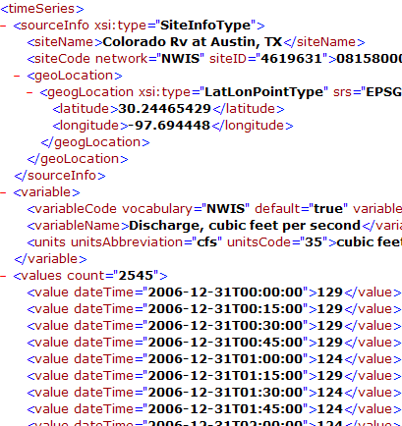
WaterML and WaterOneFlow
WaterML is an XML language for communicating water data
WaterOneFlow is a set of web services based on WaterML
Set of query functions
Returns data in WaterML
GetSites
GetSiteInfo
GetVariableInfo
GetValues
WaterOneFlow
Web Service
Notes:
7

Slide 8
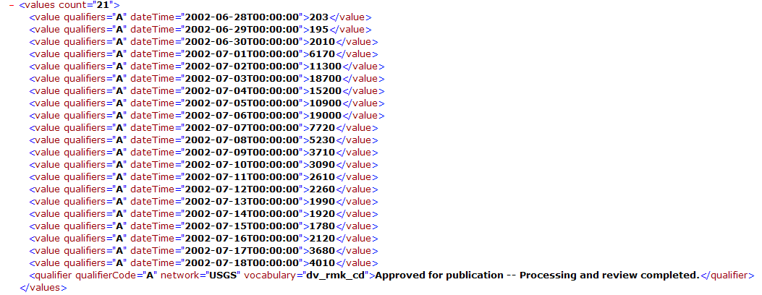
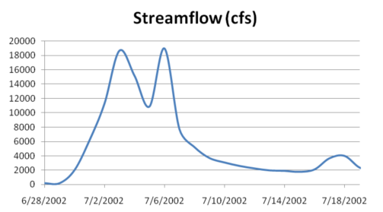
WaterML as a Web Language
Discharge of the San Marcos River at Luling, TX June 28 - July 18, 2002
USGS Streamflow data in WaterML language
This is the WaterML GetValues response from NWIS Daily Values

Slide 9
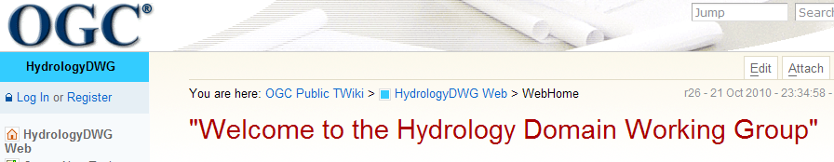
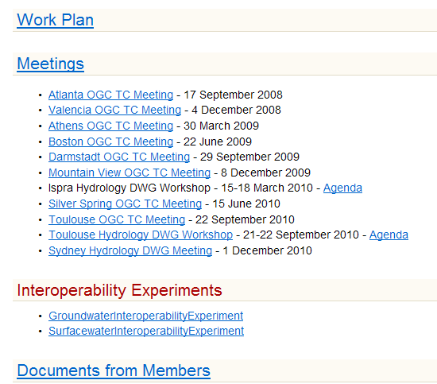
Jointly with World Meteorological Organization
Evolving WaterML into an International Standard
Meets every 3 months
Teleconferences most weeks
WaterML Version 2 standard being proposed
Vote for adoption 3-6 months later
To be open for public comment April to May 2011
http://www.opengeospatial.org/projects/groups/waterml2.0swg
Notes:
The Hydrology Domain Working Group was initiated by the Open Geospatial Consortium in September 2008. The OGC has about 400 companies and agencies that have developed the most widely used standards for conveying geospatial information on the internet (Web Mapping Service, Web Feature Service, Web Coverage Service, Catalog Services for the Web, Sensor Observation Service). In November 2009, OGC and WMO agreed to collaborate to provide information data exchange standards in hydrology, climatology, oceanography and meteorology – there are now two working groups – the OGC/WMO Joint Hydrology Domain Working Group and a similar Met-Oceans Working Group. HDWG is proposing a new standard for WaterML in December 2010 that is a customization of the OGC Sensor Observation Services’ Get Observations function adapted for conveying time series through the internet (WaterML2). The technical specification for the “service stack” will be presented and peer-reviewed through the Hydrology Domain Working Group.

Slide 10
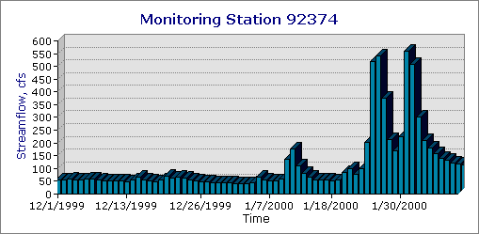
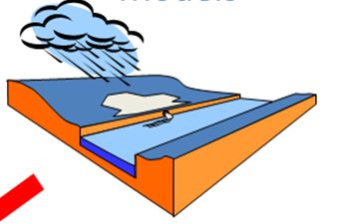
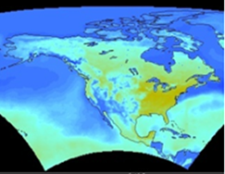

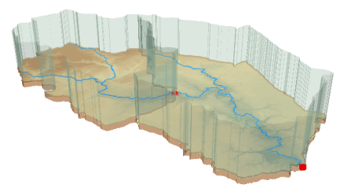
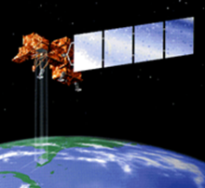
HydroDesktop
Desktop Hydrologic Information System
Observations
Weather and Climate
Modeling
GIS
Remote Sensing

Slide 11

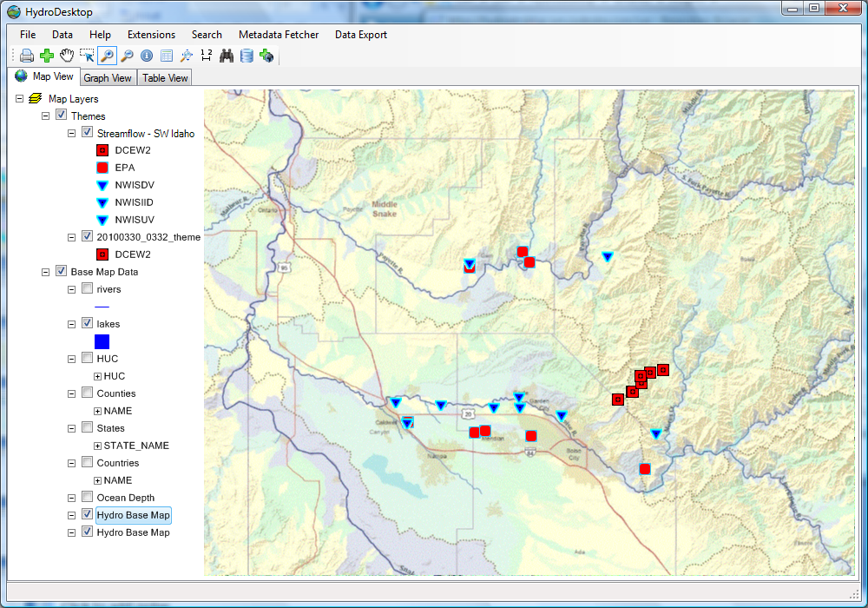
Hydrology
Search for data
Download data
Display time series
Export data
GIS
Add shapefiles to map
Change symbology and labels
Print and export map
GIS toolbox
http://hydrodesktop.codeplex.com
Notes:
HydroDesktop is a desktop based software application that serves as a client for HIS Services. This project is being supported by CUAHSI, Idaho EPSCoR and the Inland Northwest Research Alliance.

Slide 12

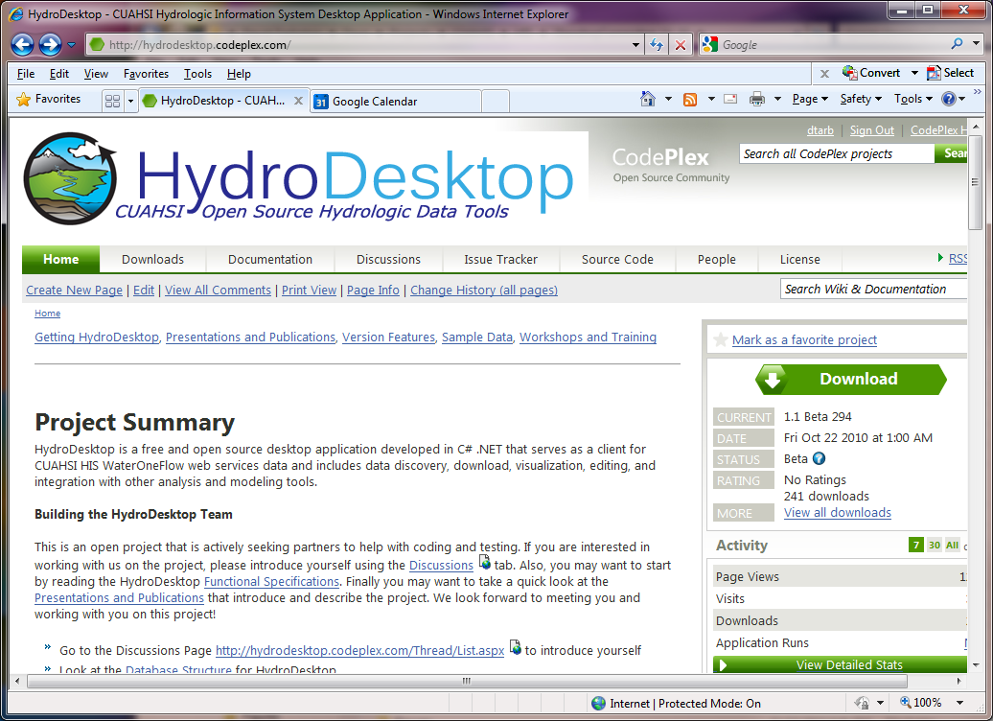
http://hydrodesktop.codeplex.com
12800 total downloads
2000 code commits
25 registered developers
Notes:
HydroDesktop is a desktop based software application that serves as a client for HIS Services. This project is being supported by CUAHSI, Idaho EPSCoR and the Inland Northwest Research Alliance.

Slide 13
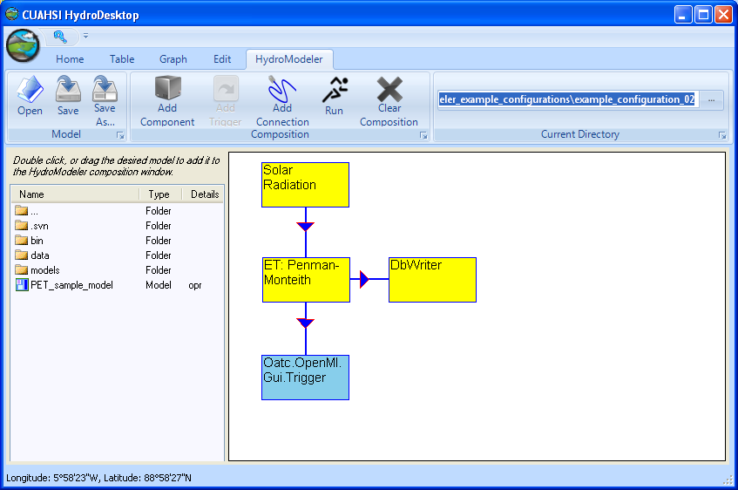
HydroModeler
An integrated modeling environment based on the Open Modeling Interface (OpenMI) standard and embedded within HydroDesktop
Allows for the linking of data and models as “plug-and-play” components
In development at the University of South Carolina by Jon Goodall, Tony Castronova, Mehmet Ercan, Mostafa Elag, and Shirani Fuller

Slide 14
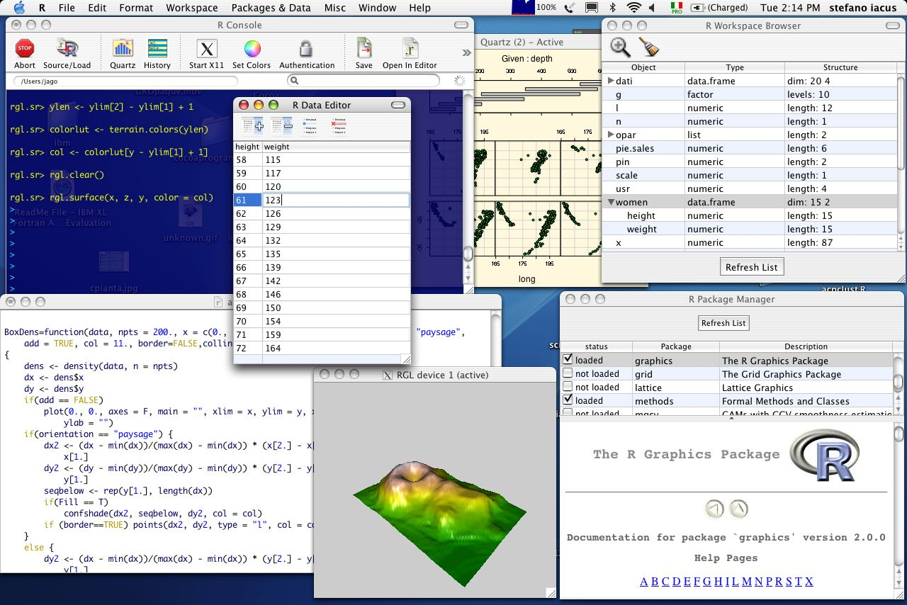
Integration with “R” Statistics Package

Slide 15
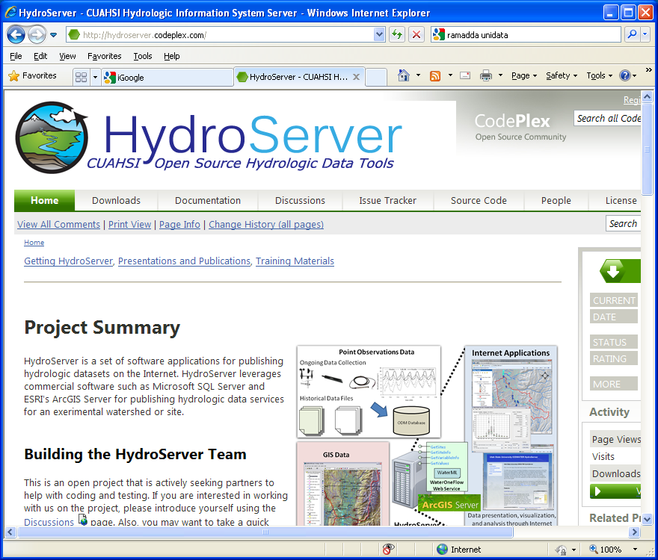
http://hydroserver.codeplex.com
A platform for publishing space-time hydrologic datasets that:
  Autonomous with local control of data
  Part of a distributed system that makes data universally available
Basis for Experimental Watershed or Observatory data management system
Standards based approach to data publication
  Accepted and emerging standards for data storage and transfer (OGC, WaterML)
Built on established software
  MS SQL Server, ArcGIS server
Open Source Community Code Repository
  Sustainability

Slide 16
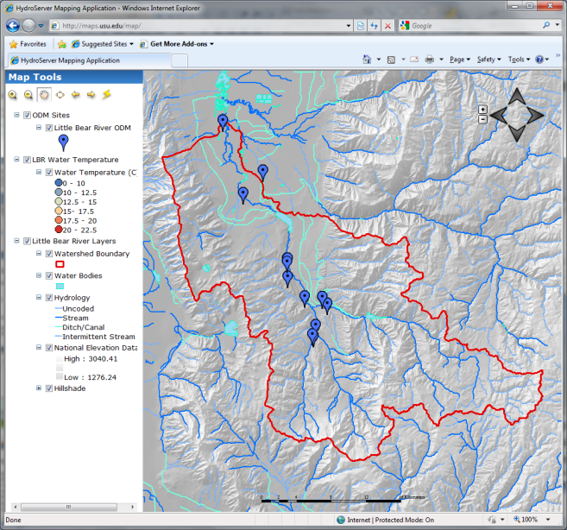

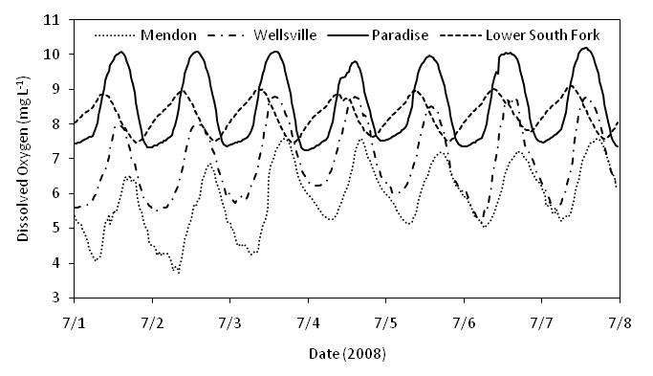

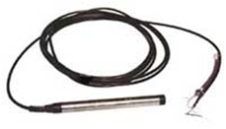
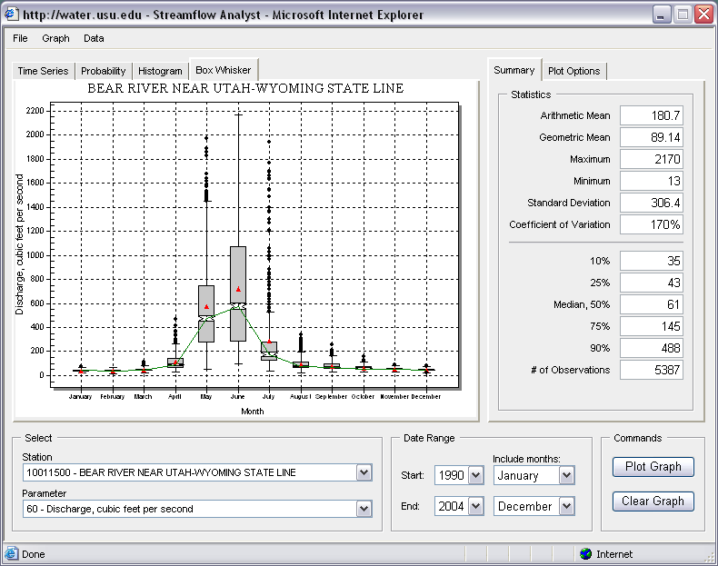
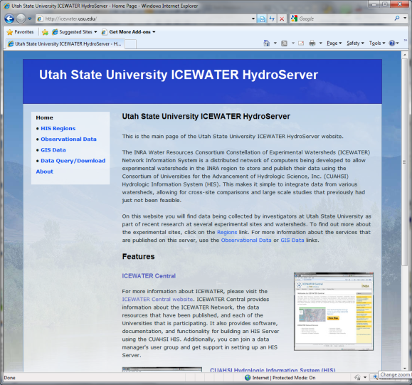

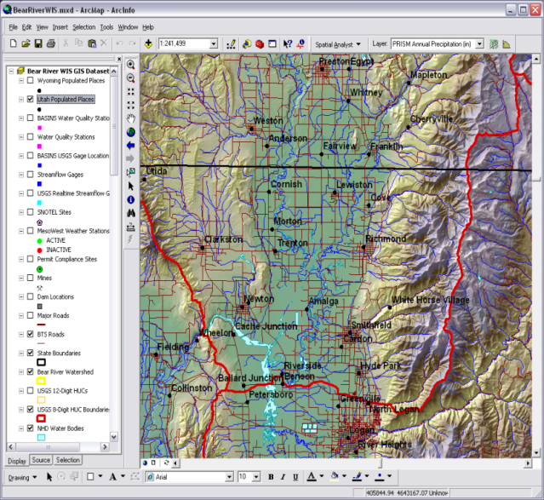
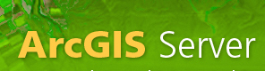
Point Observations Data
Internet Applications
Ongoing Data Collection
Historical Data Files
ODM Database
GetSites
GetSiteInfo
GetVariableInfo
GetValues
GIS Data
WaterML
WaterOneFlow
Web Service
Data presentation, visualization,
and analysis through Internet enabled applications
HydroServer

Slide 17

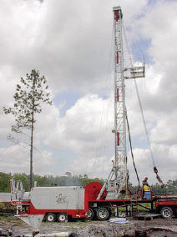
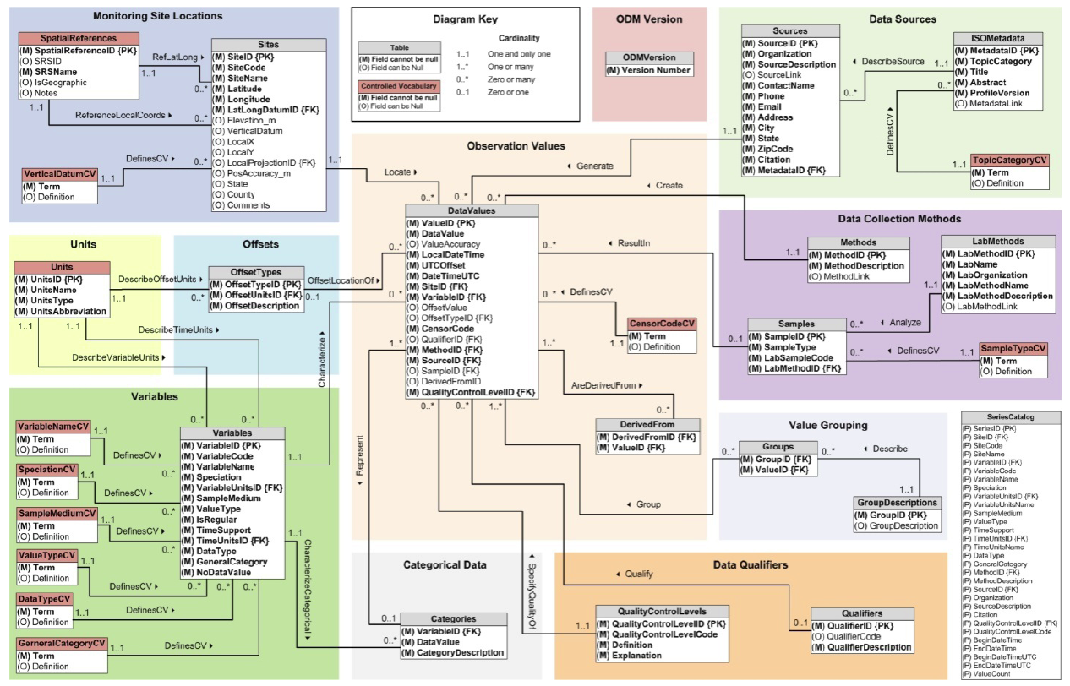
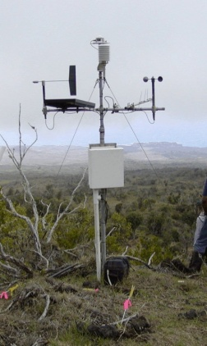

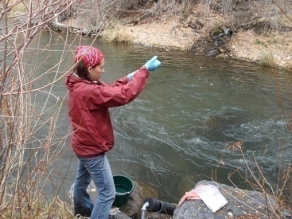
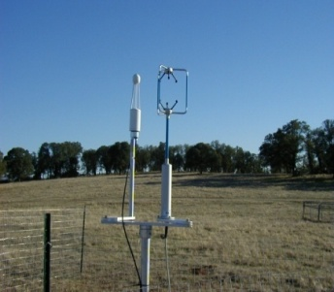
Observation Data Model for hydrologic and environmental measurements
The way that data is organized can enhance or inhibit the analysis that can be done
Groundwater
levels
Streamflow
Precipitation
& Climate
Soil
moisture
data
Water Quality
Flux tower data

Slide 18
Why an Observations Data Model
Provides a common persistence model for observations data
Syntactic heterogeneity (File types and formats)
Semantic heterogeneity
  Language for observation attributes (structural)
  Language to encode observation attribute values (contextual)
Publishing and sharing research data
Metadata to facilitate unambiguous interpretation
Enhance analysis capability

Slide 19
Scope
Focus on Hydrologic Observations made at a point
Exclude Remote sensing or grid data.
Primarily store raw observations and simple derived information to get data into its most usable form.
Limit inclusion of extensively synthesized information and model outputs at this stage.

Slide 20
What are the basic attributes to be associated with each single data value and how can these best be organized?
Value
DateTime
Variable
Location
Units
Interval (support)
Accuracy
Offset
OffsetType/ Reference Point
Source/Organization
Censoring
Data Qualifying Comments
Method
Quality Control Level
Sample Medium
Value Type
Data Type

Slide 21
CUAHSI Observations Data Model
Streamflow
Groundwater
levels
A relational database at the single observation level (atomic model)
Stores observation data made at points
Metadata for unambiguous interpretation
Traceable heritage from raw measurements to usable information
Standard format for data sharing
Cross dimension retrieval and analysis
Precipitation
& Climate
Soil
moisture
data
Water Quality
Flux tower
data
“When”
Time, T
t
A data value
v_{i} (s,t)
s
“Where”
Space, S
V_{i}
“What”
Variables, V

Slide 22
Data Storage – Relational Database
Values
Sites
Value
Date
Site
Variable
Site
Name
Latitude
Longitude
Value | Date | Site | Variable
4.5 | 3/3/2007 | 1 | Streamflow
4.2 | 3/4/2007 | 1 | Streamflow
33 | 3/3/2007 | 2 | Temperature
34 | 3/4/2007 | 2 | Temperature
Name | Latitude | Longitude
Cane Creek | 41.1 | -103.2
Cane Creek | 41.1 | -103.2
Town Lake | 40.3 | -103.3
Town Lake | 40.3 | -103.3
Site | Name | Latitude | Longitude
1 | Cane Creek | 41.1 | -103.2
2 | Town Lake | 40.3 | -103.3
Notes:
HIS uses a relational database for data storage. If you’re unfamiliar with databases, here’s a quick intro. Suppose I have time series values for streamflow and temperature. I can store these in a table where I record the value, the date, the site where the measurement occurred, and the variable being measured. Now suppose I want to store more information about the site, such as its name and location. I could add some fields to the Values table, but if I have a million values, then I’m storing that same site information over and over again. A more efficient approach is to create a separate table with the site info, and relate one table to the other based on the Site number. A relational database is a set of tables with relationships like this.

Slide 23
Why Use a RDBMS
Mature and stable technology
Structured Query Language (SQL)
Sharing of data among multiple applications
  Data integrity and security
  Access by multiple users at the same time
  Tools for backup and recovery
Reduced application development time

Slide 24
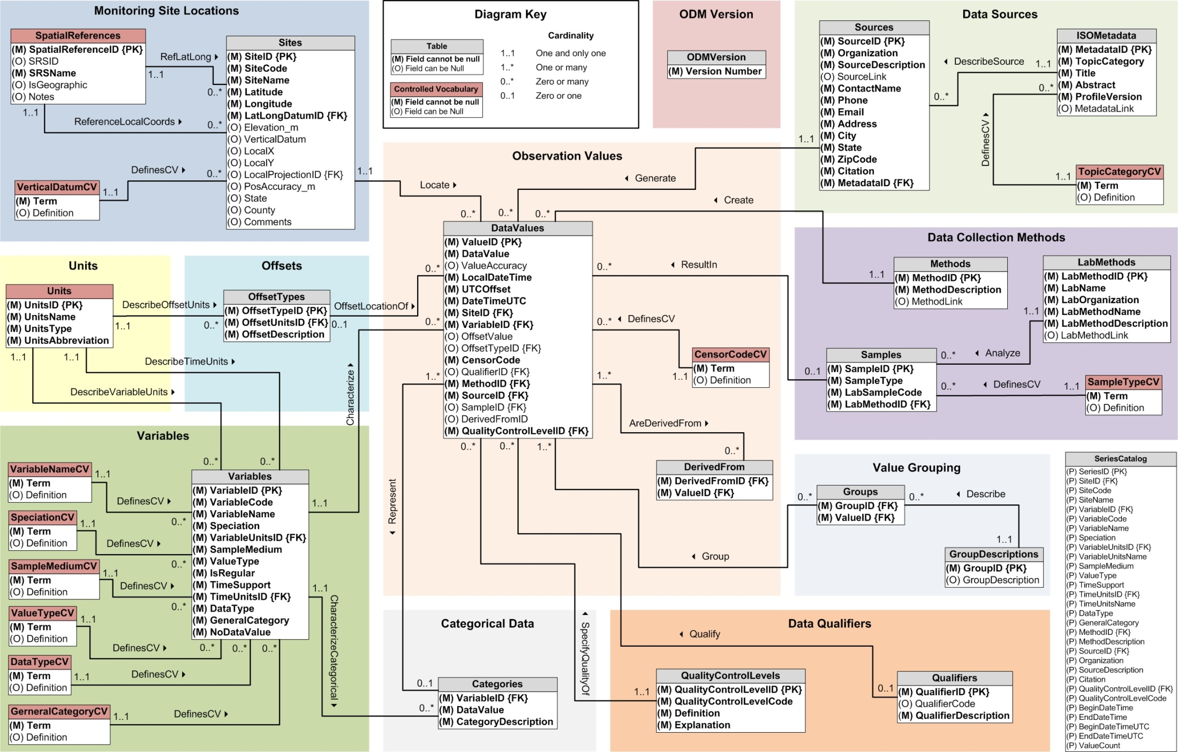
CUAHSI Observations Data Model http://his.cuahsi.org/odmdatabases.html
Horsburgh, J. S., D. G. Tarboton, D. R. Maidment and I. Zaslavsky, (2008), A Relational Model for Environmental and Water Resources Data, Water Resour. Res., 44: W05406, doi:10.1029/2007WR006392.
Notes:
In designing ODM we asked: What are the basic attributes to be associated with each single data value and how can these best be organized? This involved community survey at a workshop and by email and based on the feedback received we came up with the ODM schema illustrated, published last year in WRR
This is quite a detailed slide, but it is the entire schema. Few database designs are simple enough to fit the entire schema on one slide. This shows at the center the data values table and off to the sides, the ancillary or metadata tables that record.

Slide 25
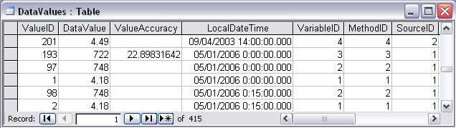
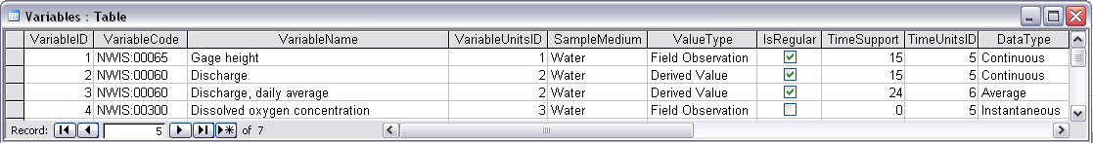
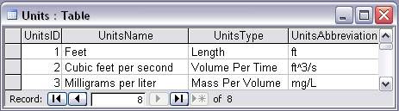
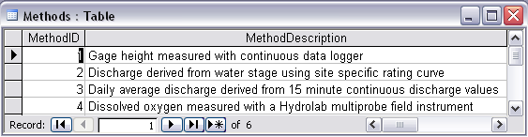
Discharge, Stage, Concentration and Daily Average Example

Slide 26
Independent of, but can be coupled to Geographic Representation
ODM
e.g. Arc Hydro
Feature
Observations Data Model
1
HydroPoint
Waterbody
Watershed
Sites
1
HydroID
HydroID
HydroID
SiteID
HydroCode
*
HydroCode
HydroCode
SiteCode
FType
FType
DrainID
SiteName
OR
Name
Name
AreaSqKm
Latitude
JunctionID
AreaSqKm
JunctionID
Longitude
JunctionID
NextDownID
…
ComplexEdgeFeature
*
SimpleJunctionFeature
*
CouplingTable
1
SiteID
HydroID
1
HydroEdge
HydroJunction
HydroJunction
HydroID
1
HydroJunction
1
HydroID
HydroID
HydroCode
HydroID
HydroCode
HydroCode
ReachCode
HydroCode
NextDownID
NextDownID
Name
NextDownID
LengthDown
LengthDown
LengthKm
HydroNetwork
LengthDown
DrainArea
DrainArea
LengthDown
DrainArea
FType
FType
FlowDir
FType
Enabled
Enabled
FType
Enabled
AncillaryRole
AncillaryRole
EdgeType
AncillaryRole
Enabled
EdgeType
Flowline
Shoreline

Slide 27
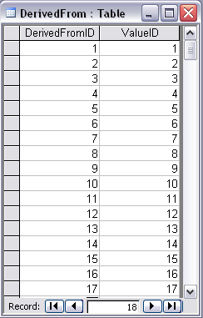
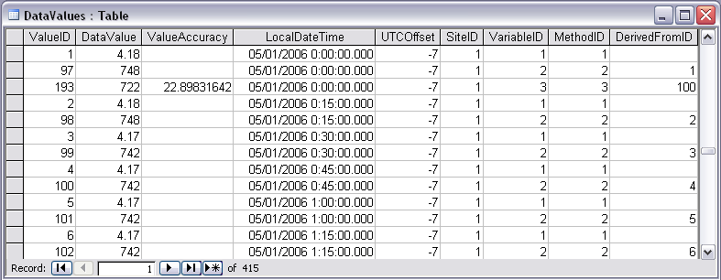
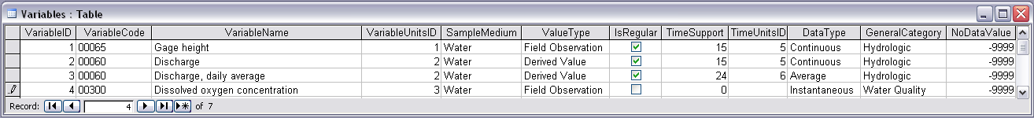
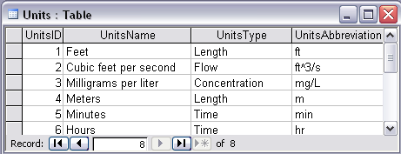
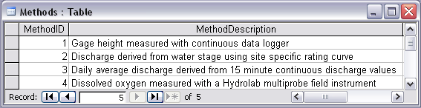
Stage and Streamflow Example
Notes:
Discharge Derived from Gage Height
Concepts:
Data derived from other data – single data point derived from a single observation (discharge from stage)
Data derived using a specific method (discharge from stage using rating curve)
Relationships:
Relationships between Values table and DerivedFrom table on DerivedFromID and ValueID
Relationship between Values table and Variables table on VariableID
Relationship between Values table and Methods table on MethodID
Relationship between Variables table and Units table on UnitID

Slide 28
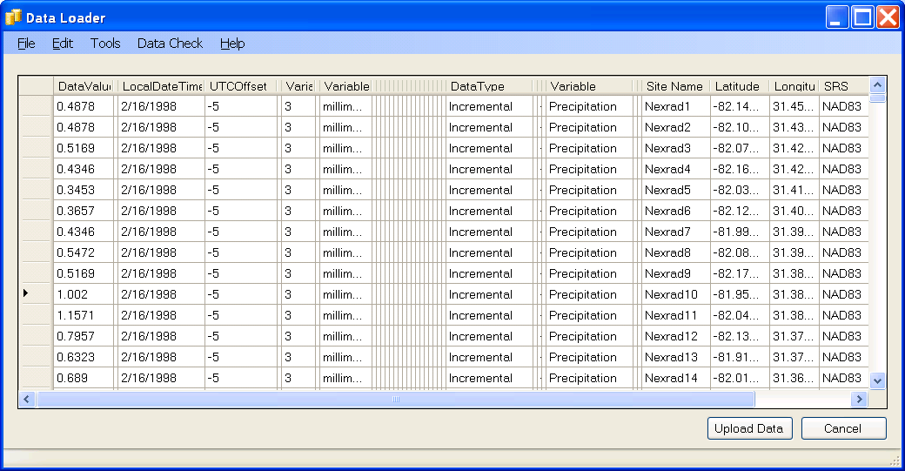
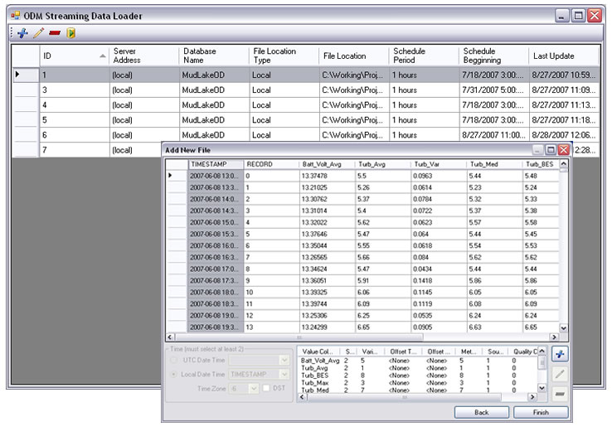
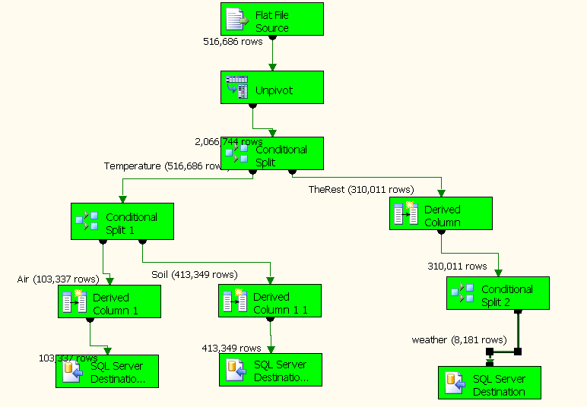
Loading data into ODM
OD Data Loader
Interactive OD Data Loader (OD Loader)
  Loads data from spreadsheets and comma separated tables in simple format
Scheduled Data Loader (SDL)
  Loads data from datalogger files on a prescribed schedule.
  Interactive configuration
SQL Server Integration Services (SSIS)
  Microsoft application accompanying SQL Server useful for programming complex loading or data management functions
SDL
SSIS

Slide 29
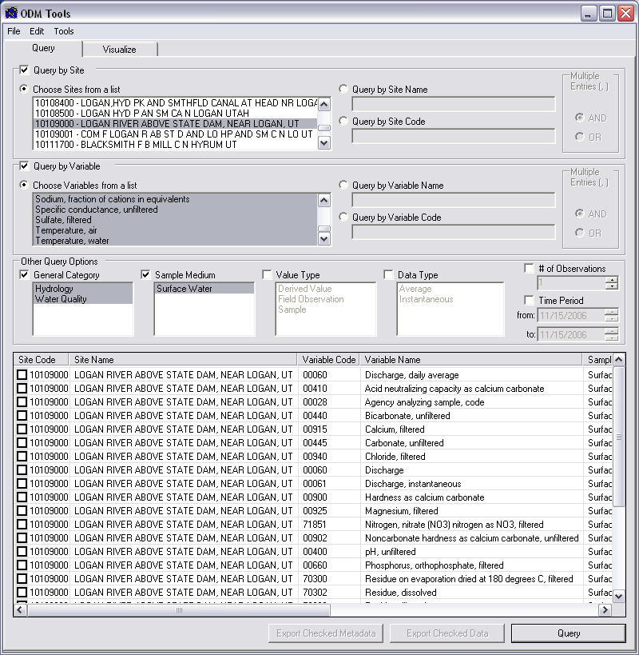
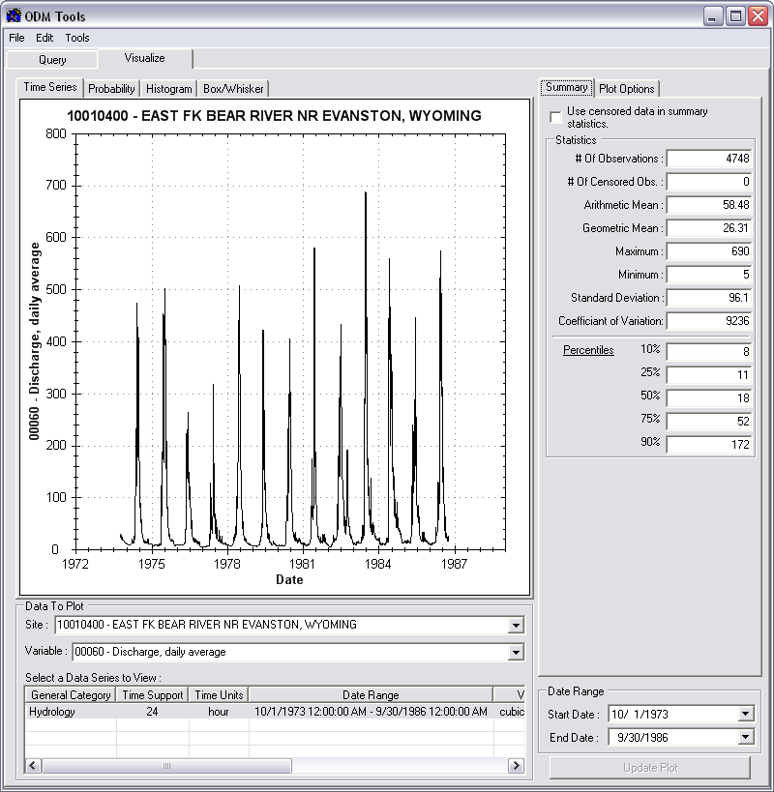
Managing Data Within ODM
ODM Tools
Query and export – export data series and metadata
Visualize – plot and summarize data series
Edit – delete, modify, adjust, interpolate, average, etc.

Slide 30
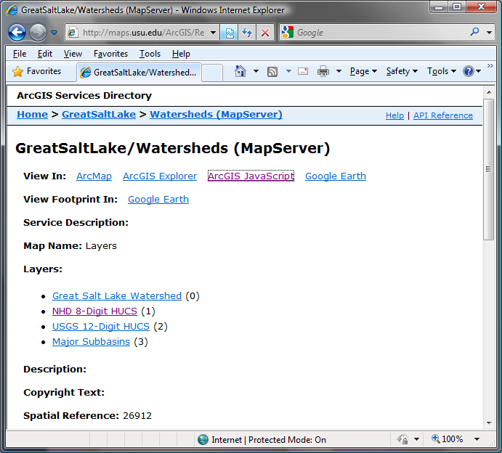
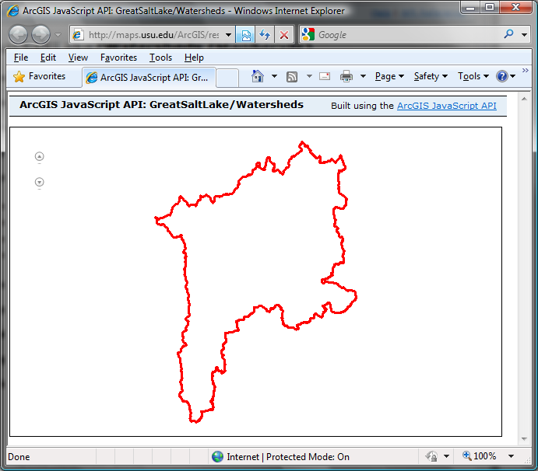
Publication of Spatial (GIS) Datasets
Publishing spatial datasets using ArcGIS Server
  Using OGC standards that can be consumed by a number of GIS clients
  WMS, WFS, WCS

Slide 31
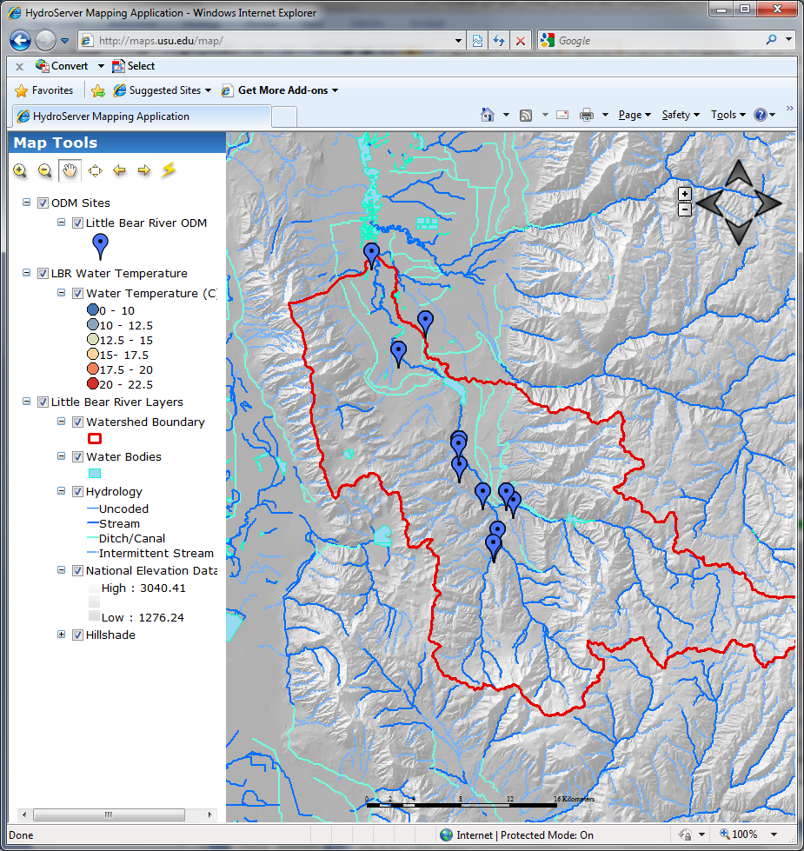
Data Presentation Via a Map Interface
Internet Map Server built using ArcGIS
Web browser client
Combine spatial data and observational data
Launch data visualization tools
Based on a “Region”
http://icewater.usu.edu/map/

Slide 32

Data Preview, Visualization, and Analysis
Time Series Analyst
Web Browser Client
Multiple ODM Database Support
Variety of plot types
Descriptive statistics
Linked to the map application
Data preview and download
http://icewater.usu.edu/tsa/

Slide 33

HydroServer Capabilities Web Service
Publish capabilities of each HydroServer
  Listing of published observational data services
  Listing of published spatial data services
Supports automatic cataloging of available services at HIS Central
Makes HydroServers self describing
Catalog
Metadata Services
Catalog Services
Server
Data Services
Desktop

Slide 34

Overcoming Semantic Heterogeneity
ODM Controlled Vocabulary System
  ODM CV central database
  Online submission and editing of CV terms
  Web services for broadcasting CVs
ODM VariableNameCV
Variable Name
Term
…
Sunshine duration
Temperature
Turbidity
…
Investigator 1: | “Temperature, water”
Investigator 2: | “Water Temperature”
Investigator 3: | “Temperature”
Investigator 4: | “Temp.”
From Jeff Horsburgh

Slide 35





Dynamic controlled vocabulary moderation system
ODM Data Manager
ODM Website
ODM
Tools
ODM Controlled
Vocabulary Moderator
XML
Master ODM Controlled Vocabulary
Local ODM
Database
ODM
Controlled Vocabulary
Web Services
Local
Server
http://his.cuahsi.org/mastercvreg.html
From Jeff Horsburgh

Slide 36

37 Water Data Services on HIS Central from 12 Universities
University of Maryland, Baltimore County
Montana State University
University of Texas at Austin
University of Iowa
Utah State University
University of Florida
University of New Mexico
University of Idaho
Boise State University
University of Texas at Arlington
University of California, San Diego
Idaho State University
Dry Creek Experimental Watershed (DCEW)
(28 km² semi-arid steep topography, Boise Front)
68 Sites
24 Variables
4,700,000+ values
Published by Jim McNamara, Boise State University

Slide 37




Water Agencies and Industry
USGS, NCDC , Corps of Engineers publishing data using HIS WaterML
OGC Hydrology Domain Working Group evaluating WaterML as OGC standard
ESRI using CUAHSI model in ArcGIS.com GIS data collaboration portal
Kisters WISKI support for WaterML data publication
Australian Water Resources Information System Water Accounting System has adopted aspects of HIS
NWS West Gulf River Forecast Center Multi-sensor Precipitation Estimate published from ODM using WaterML

Slide 38
Federal Agency Water Data Services at HISCentral (10/2010)
Network Name | Site Count | Value Count | Earliest Observation | Notes
NWISDV | 31,800 | 304,000,000 | 01/01/1861 | WaterML-compliant GetValues service from NWIS, catalog ingested
EPA | 236,000 | 78,000,000 | 01/11/1900 | SOAP wrapper over WQX services, catalog ingested
NWISUV | 11,800 | 84,500,000 | 60 DAYS | WaterML-compliant GetValues Service, catalog ingested
NCDC ISH | 11,600 | 3,000,000* | 1/1/2005 | WaterML-compliant GetValues service from NCDC
NCDC ISD | 24,800 | 18,200,000 | 1/1/1892 | WaterML-compliant GetValues service from NCDC
NWISIID | 376,000 | 86500,000 | 9/1/1867 | SOAP wrapper over NWIS web site, catalog ingested
NWISGW | 834,000 | 8,490,000 | 1/1/1800 | SOAP wrapper over NWIS web site, catalog ingested
RIVERGAGES | 1,300 | 264,000,000 | 1/1/2000 | WaterML compliant REST services from Army Corps of Engineers
* Estimated

Slide 39


USGS Unit Values Data
Real time streamflow data over the last 60 days
11188 sites, nationally for the US
Published by USGS National Water Information System

Slide 40

HISCentral Content (11/2010)
Map integrating NWIS, STORET, & Climatic Sites
58 public services
18,000+ variables
1.96+ million sites
23.3 million series
Referencing 5.1 billion data values
Available via HISCentral
discovery services
Available via GetValues requests

Slide 41
Summary
Data Storage in an Observations Data Model (ODM) and publication through HydroServer
Data Access through internet-based Water Data Services using a consistent data language, called WaterML from HydroDesktop
Data Discovery through a National Water Metadata Catalog and thematic keyword search system at HIS Central
Integrated Modeling and Analysis within HydroDesktop
The combination of these capabilities creates a common window on water observations data for the United States unlike any that has existed before.

Slide 42

Learn about the CUAHSI-HIS System
Share your work with information systems and large scale datasets
Share your use of hydrologic data for teaching
Interact with other users
Share your work linking data and modeling
Show science enabled by HIS
Hands-on workshops
Contribute to the future of HIS
For information on presenting or attending see:
http://his.cuahsi.org/conference2011
Contact: David.Tarboton@usu.edu

Slide 43
Thanks! HIS Project Team and Sponsors
University of Texas at Austin – David Maidment, Tim Whiteaker, James Seppi, Fernando Salas, Jingqi Dong, Harish Sangireddy
San Diego Supercomputer Center – Ilya Zaslavsky, David Valentine, Tom Whitenack, Matt Rodriguez
Utah State University – Jeff Horsburgh, Kim Schreuders, Stephanie Reeder, Edward Wai Tsui, Ravichand Vegiraju, Ketan Patil
University of South Carolina – Jon Goodall, Anthony Castronova
Idaho State University – Dan Ames, Ted Dunsford, Jiří Kadlec, Yang Cao, Dinesh Grover
Drexel University/CUNY – Michael Piasecki
WATERS Network – Testbed Data Managers
CUAHSI Program Office – Rick Hooper, Yoori Choi, Conrad Matiuk
ESRI – Dean Djokic, Zichuan Ye
CUAHSI
HIS
Sharing hydrologic data
http://his.cuahsi.org/
Support
EAR 0622374

