Slide 1


Developing a community hydrologic information system
David G Tarboton
David R. Maidment (PI)
Ilya Zaslavsky
Michael Piasecki
Jon Goodall
Support
EAR 0622374
http://www.cuahsi.org/his.html

Slide 2
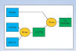
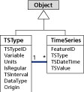
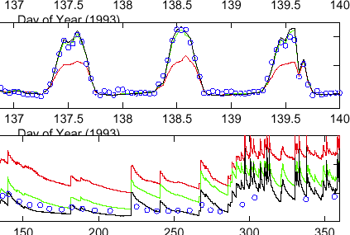

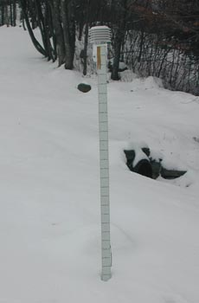

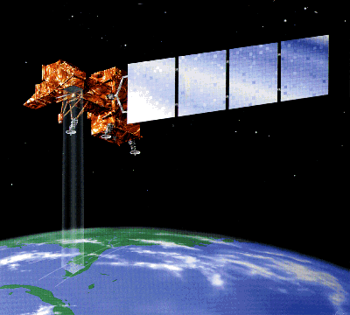
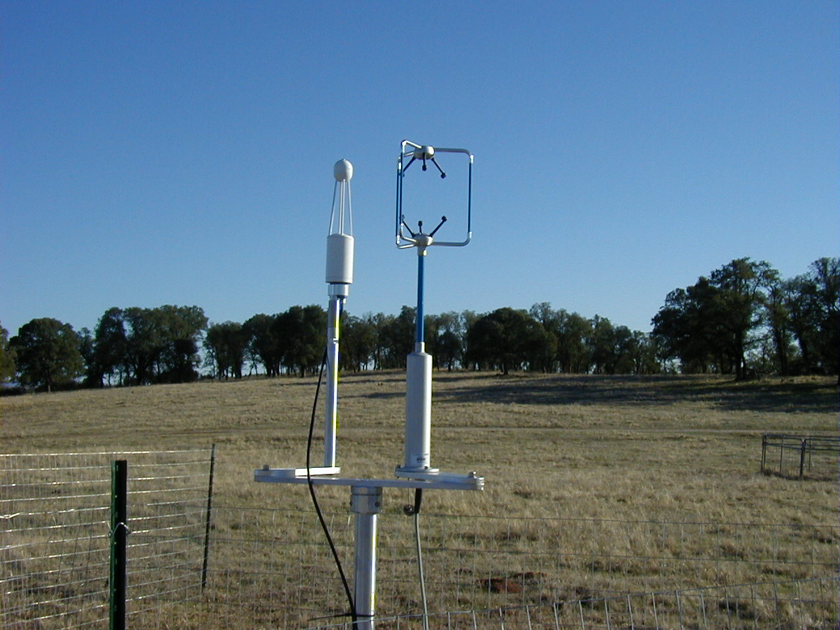
CUAHSI Hydrologic Information System
Goal: Enhance hydrologic science by facilitating user access to more and better data for testing hypotheses and analyzing processes
Models
Advancement of water science is critically dependent on integration of water information
It is as important to represent hydrologic environments precisely with data as it is to represent hydrologic processes with equations
Databases
Analysis
Water quantity
and quality
Rainfall & Snow
Remote sensing
Meteorology
Soil water

Slide 3

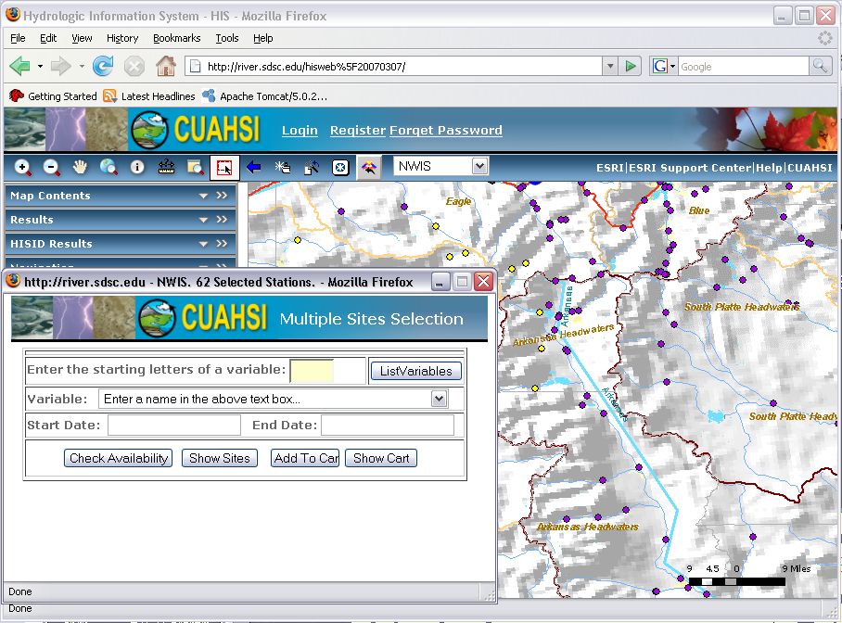
Service Oriented Architecture for Water Resources Data
Data Access System for Hydrology (DASH)
Website Portal and Map Viewer
Preliminary data exploration and discovery. See what is available and perform exploratory analyses
Downloads
Uploads
Analysis and Modeling applications
3rd party data servers
HTML -XML
Data access through web services
GIS
WaterOneFlow Web Services
Matlab
WSDL - SOAP
IDL
Data storage through web services
Splus, R
e.g. USGS, NCDC
Excel
Programming (Fortran, C, VB)
Observatory data servers
CUAHSI HIS data servers
Internet
ODM
ODM
WaterML
Notes:
Hydrologic Information System Service Oriented Architecture

Slide 4
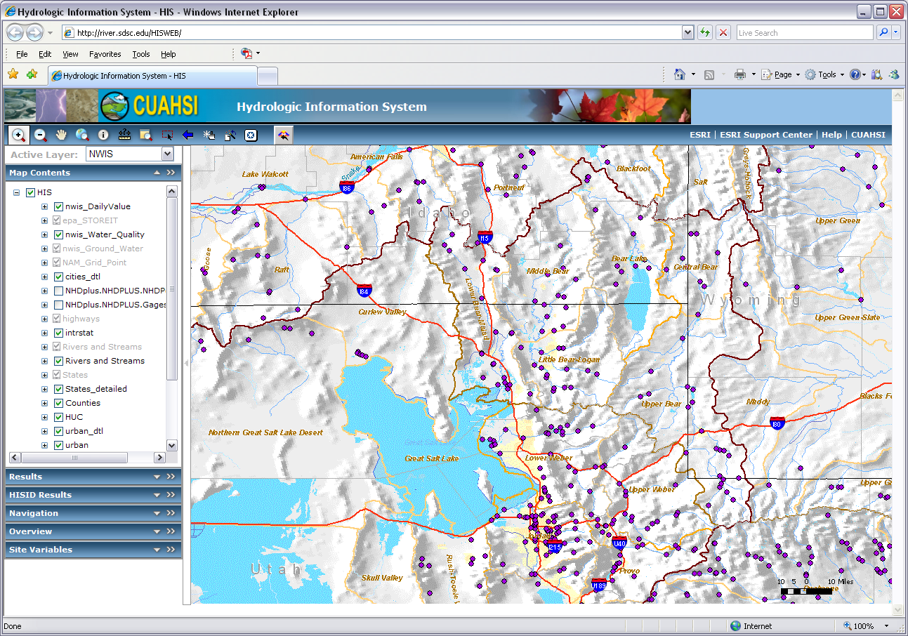
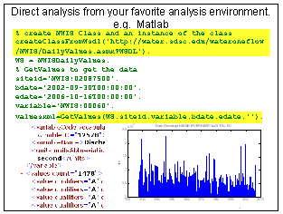
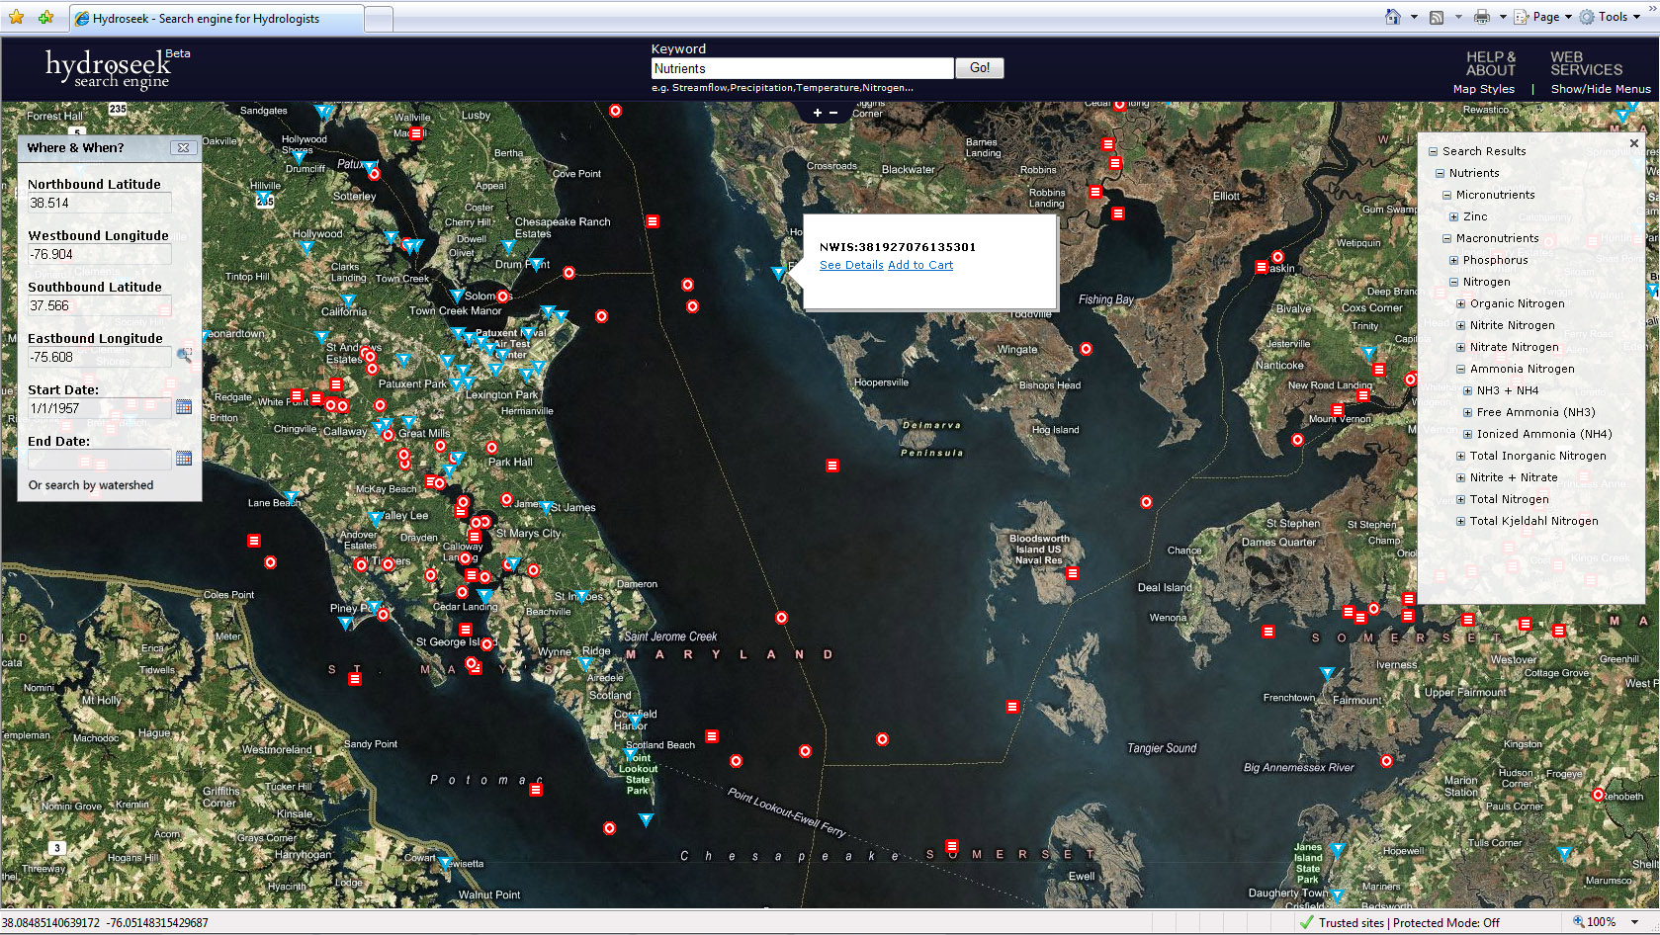
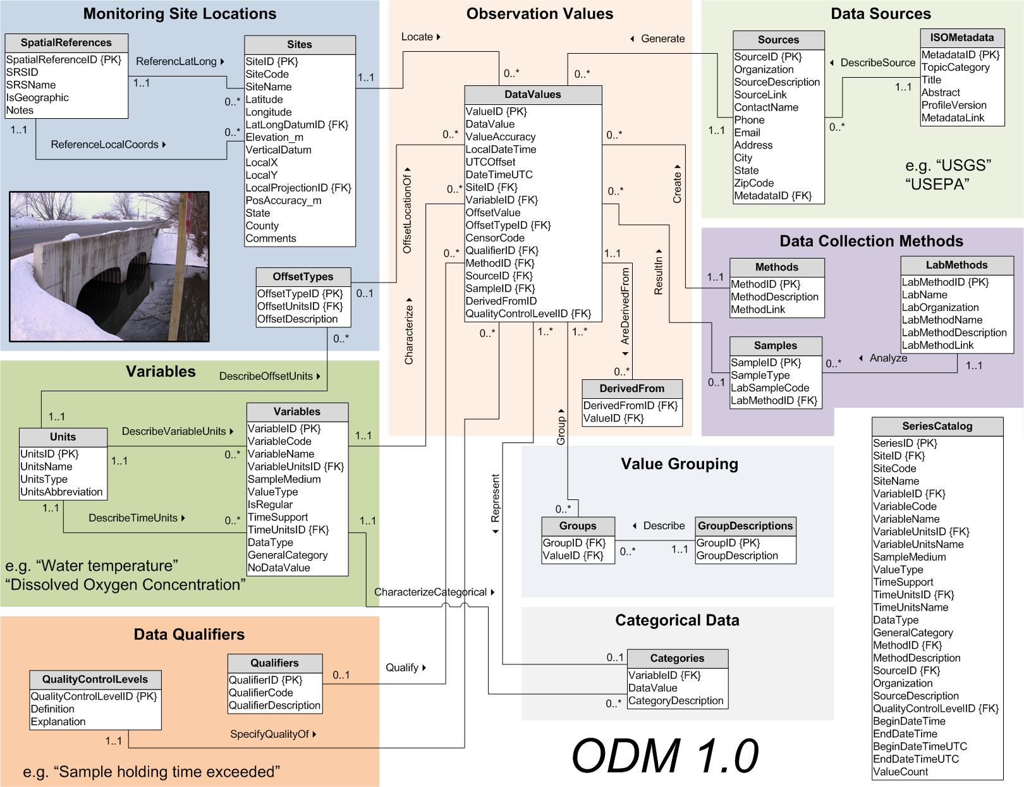

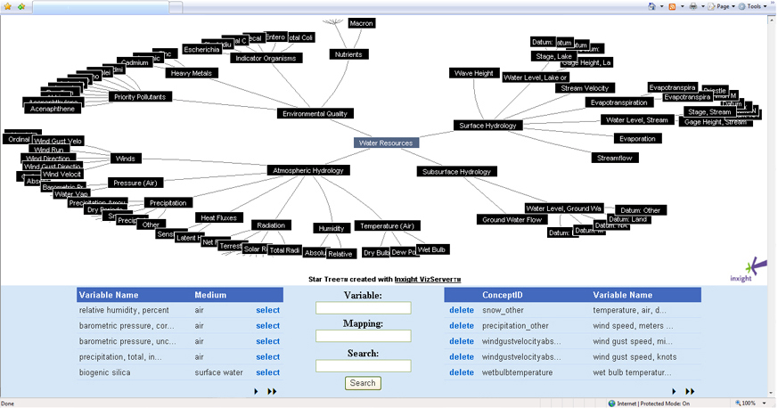
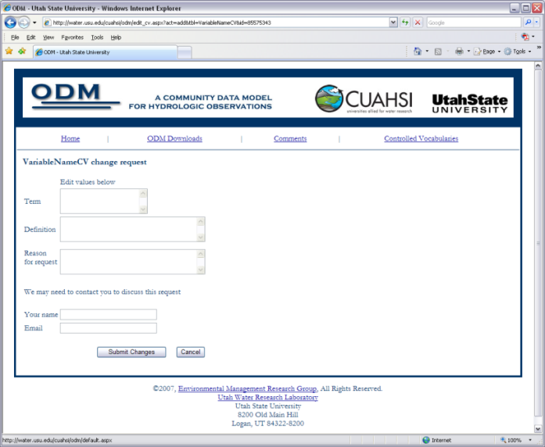
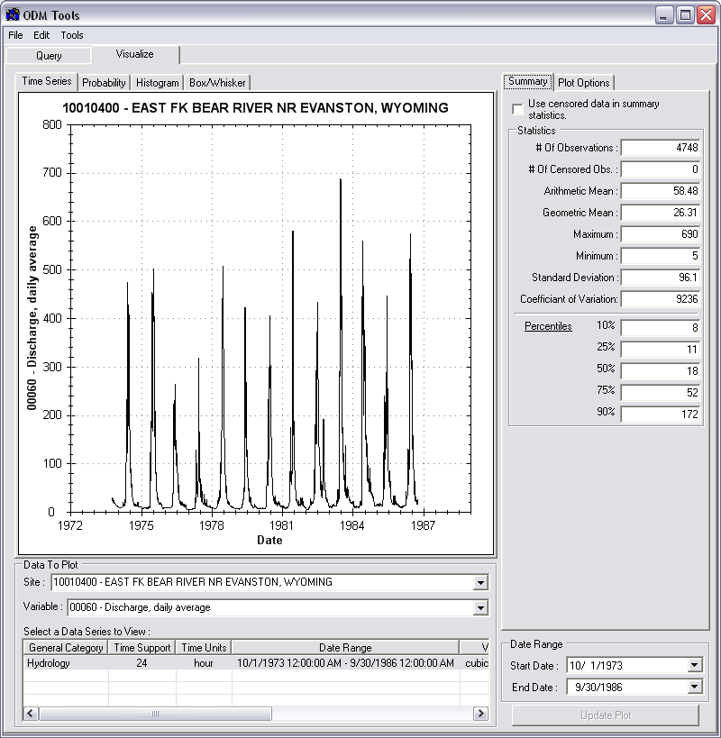
CUAHSI HIS on one slide
DASH
HydroSeek
Matlab
ODM
Ontology
WSDL Registry
  http://cbe.cae.drexel.edu/wateroneflow/CIMS.asmx?WSDL
  http://ccbay.tamucc.edu/CCBayODWS/cuahsi_1_0.asmx?WSDL
  http://ees-his06.ad.ufl.edu/santafe-srgwl/cuahsi_1_0.asmx?WSDL
  http://ferry.ims.unc.edu/modmon/cuahsi_1_0.asmx?WSDL
  http://his02.usu.edu/littlebearriver/cuahsi_1_0.asmx?WSDL
CV Services
ODM Tools

Slide 5
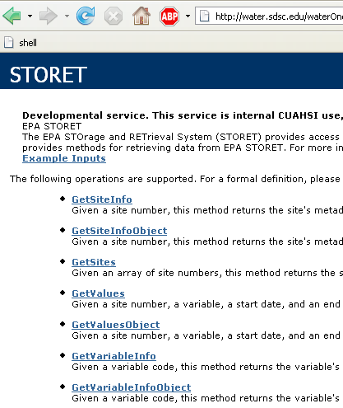
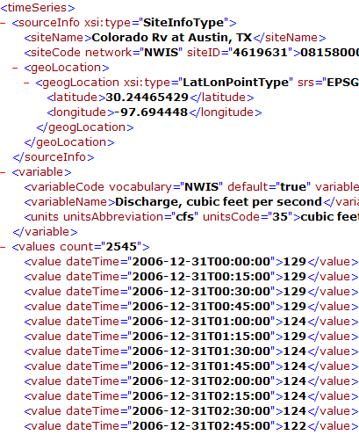
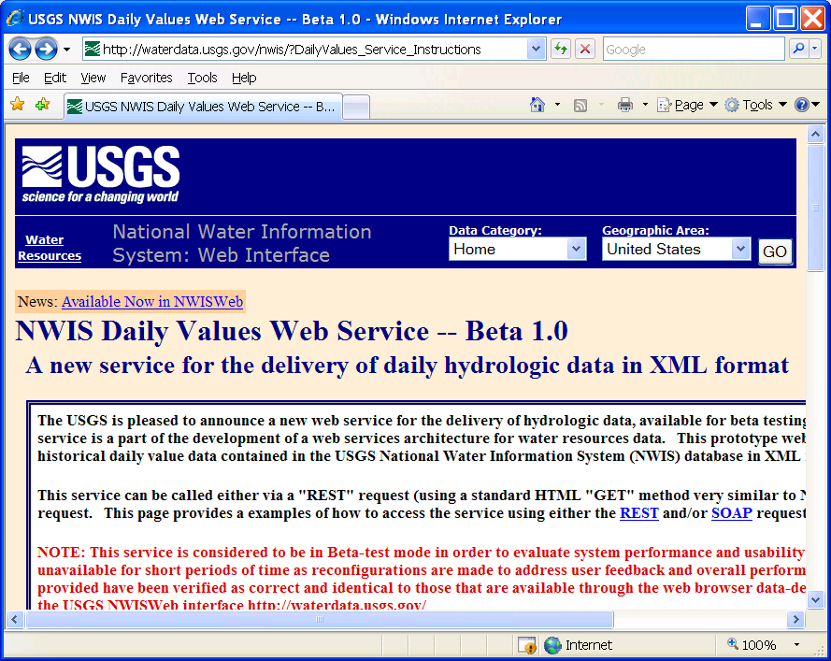
WaterOneFlow
Set of query functions
Return data in WaterML
http://river.sdsc.edu/wateroneflow/
Open Geospatial Consortium, Inc. (2007), CUAHSI WaterML, OGC Discussion Paper, OGC 07-041r1, Version 0.3.0, Zaslavsky, I., D. Valentine, and T. Whiteaker Editors, http://www.opengeospatial.org/standards/dp,

Slide 6
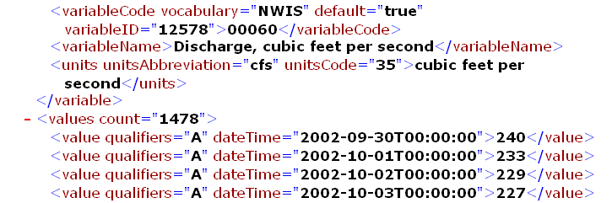
Direct analysis from your favorite analysis environment. e.g. Matlab
% create NWIS Class and an instance of the class
createClassFromWsdl('http://water.sdsc.edu/wateroneflow/NWIS/DailyValues.asmx?WSDL');
WS = NWISDailyValues;
% GetValues to get the data
siteid='NWIS:02087500';
bdate='2002-09-30T00:00:00';
edate='2006-10-16T00:00:00';
variable='NWIS:00060';
valuesxml=GetValues(WS,siteid,variable,bdate,edate,'');

Slide 7
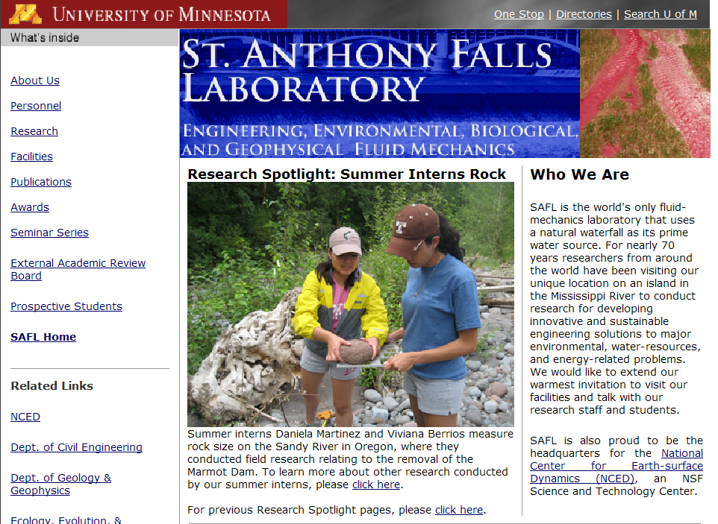
Information communication
Water web pages
Water web services
Water Markup Language (WaterML)
HyperText Markup Language (HTML)

Slide 8
CUAHSI Observations Data Model
A relational database at the single observation level (atomic model)
Stores observation data made at points
Metadata for unambiguous interpretation
Traceable heritage from raw measurements to usable information
Standard format for data sharing
Cross dimension retrieval and analysis
Streamflow
Groundwater
levels
Precipitation
& Climate
Soil
moisture
data
Water Quality
Flux tower
data
Time
Space
Variables
Horsburgh, J. S., D. G. Tarboton, D. R. Maidment and I. Zaslavsky, (2008), "A Relational Model for Environmental and Water Resources Data," Water Resources Research (in press).

Slide 9
CUAHSI Observations Data Model
http://www.cuahsi.org/his/odm.html

Slide 10
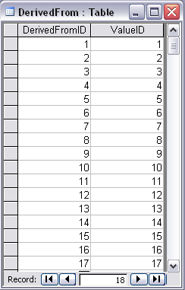
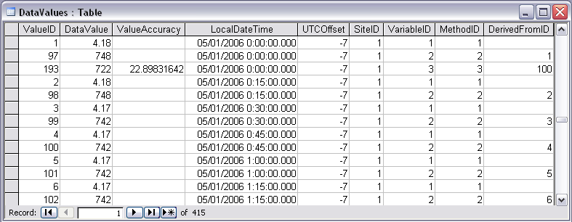
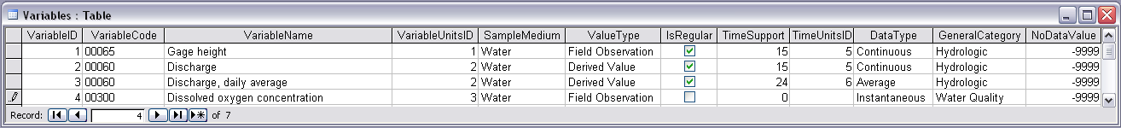
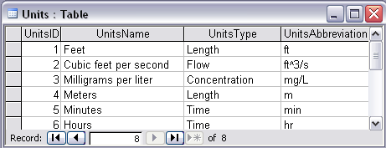
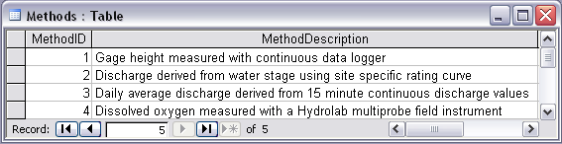
Stage and Streamflow Example
Notes:
Discharge Derived from Gage Height
Concepts:
Data derived from other data – single data point derived from a single observation (discharge from stage)
Data derived using a specific method (discharge from stage using rating curve)
Relationships:
Relationships between Values table and DerivedFrom table on DerivedFromID and ValueID
Relationship between Values table and Variables table on VariableID
Relationship between Values table and Methods table on MethodID
Relationship between Variables table and Units table on UnitID

Slide 11
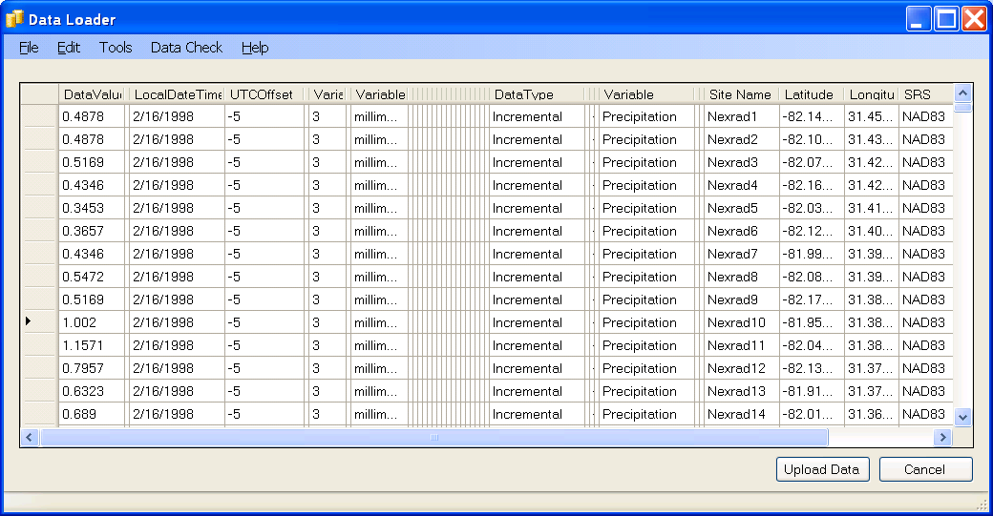
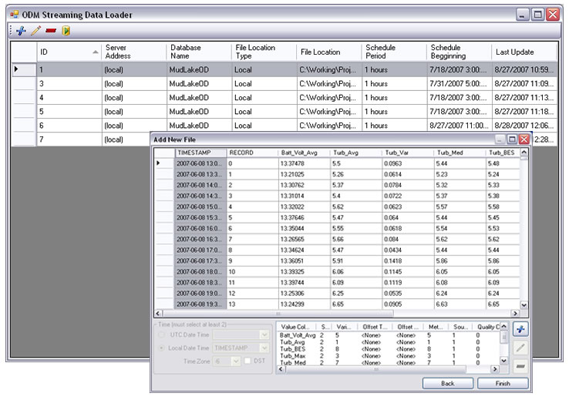
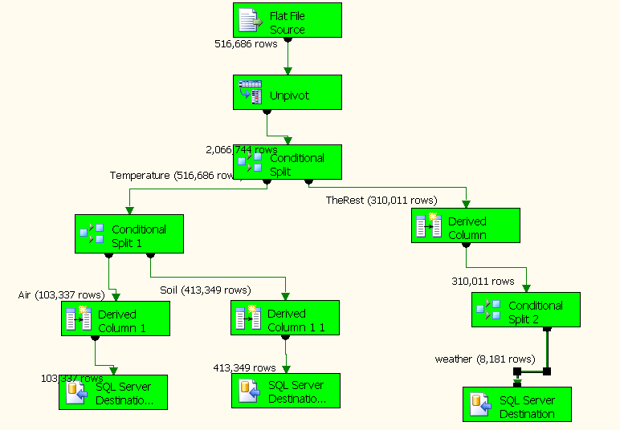
Loading and working with data in ODM
Interactive OD Data Loader (OD Loader)
Scheduled Data Loader (SDL)
SQL Server Integration Services (SSIS)
ODM Tools
OD Data Loader
SDL
SSIS
ODM Tools

Slide 12


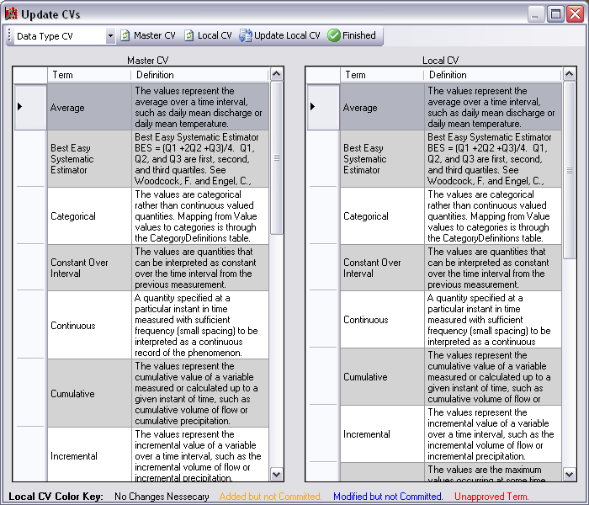
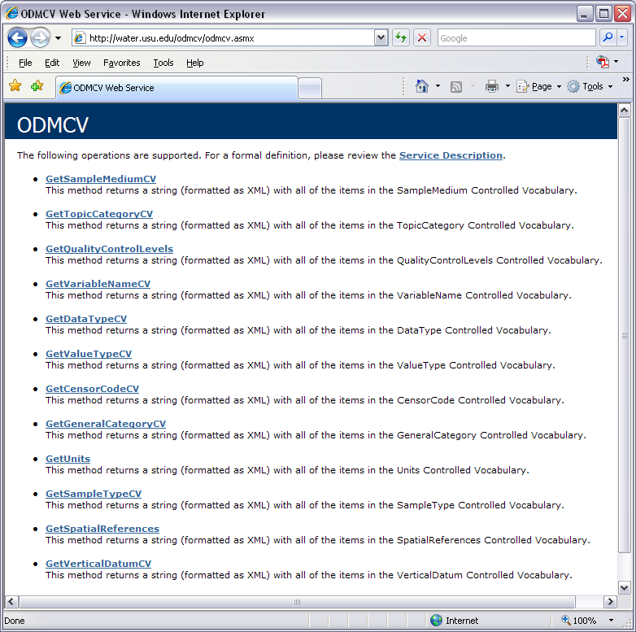
Dynamic controlled vocabulary moderation system
ODM Data Manager
ODM Website
ODM
Tools
ODM Controlled
Vocabulary Moderator
XML
Master ODM Controlled Vocabulary
Local ODM
Database
ODM
Controlled Vocabulary
Web Services
Local
Server
http://water.usu.edu/cuahsi/odm/cv.aspx

Slide 13
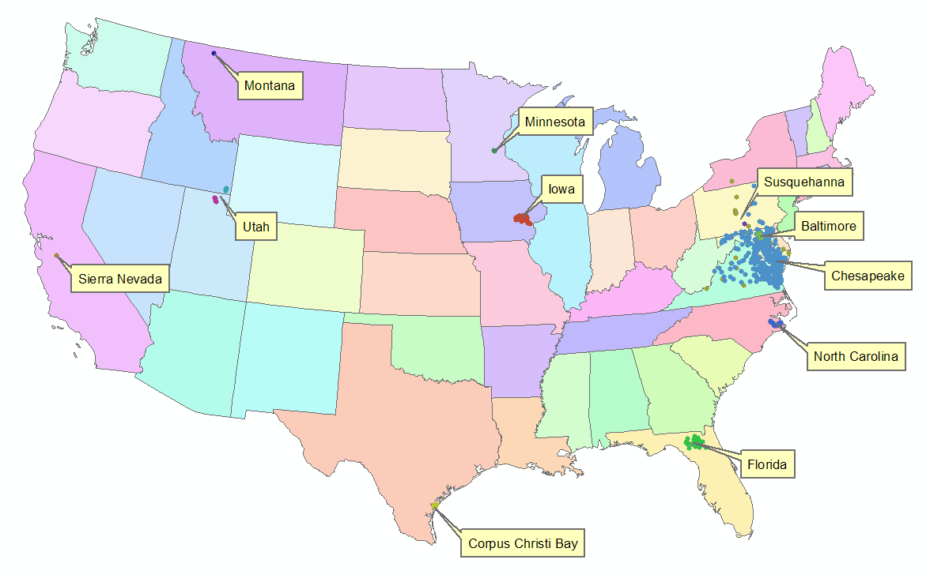
HIS Implementation in WATERS Network Information System
National Hydrologic Information Server
San Diego Supercomputer Center
11 WATERS Network test bed projects
16 ODM instances (some test beds have more than one ODM instance)
Data from 1246 sites, of these, 167 sites are operated by WATERS investigators

Slide 14
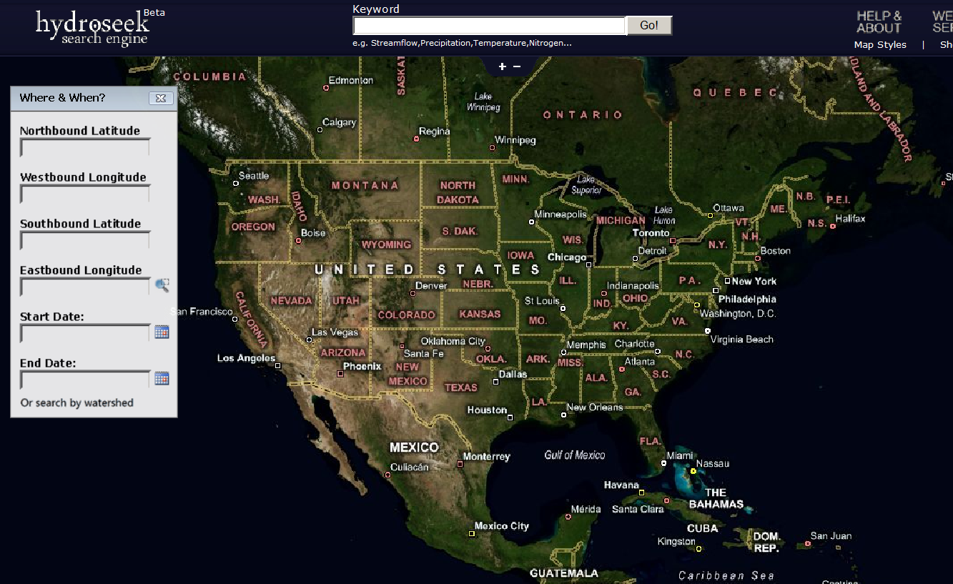
Hydroseek http://www.hydroseek.org
Supports search by location and type of data across multiple observation networks including NWIS, Storet, and university data

Slide 15
Conclusions
Point Observations Data from Agencies and Academic Investigators can be consistently communicated using web services
Point Observations Data can be archived in a relational database
Maps of point observation locations from different sources can be federated using a map server
Map server + relational database + web services = Integrated hydrologic data access system

Slide 16
Future Considerations
Support infrastructure to sustain HIS
Harmonization of WaterML with OGC Specifications
Support for modeling
Extended data model (vectors, rasters, images)
Additional ODM catalog sets to enhance discovery
Data Protection, Ownership and Authentication
Give substance to the concept of a digital watershed as a structured collection of digital representations of inter-related hydrologic objects and measurements that facilitates integrated modeling and analysis.

Slide 17
Getting your own HIS Server
Platform
  PC, Windows 2003 Server, IIS 6.0, SQL Server 2005, .Net Framework 2.0, ASP .Net 2.0, ArcGIS Server 9.2 (for DASH)
HIS Software
  ODM (+Tools and Data Loaders)
  WaterOneFlow Web Services
  DASH
http://river.sdsc.edu/Wiki/HISServer.ashx
http://river.sdsc.edu/Wiki/HIS light.ashx

Slide 18
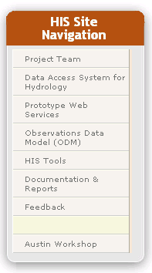
HIS Website http://www.cuahsi.org/his.html
Project Team – Introduces members of the HIS Team
Data Access System for Hydrology – Web map interface supporting data discovery and retrieval
Prototype Web Services – WaterOneFlow web services facilitating downlad of time series data from numerous national repositories of hydrologic data
Observations Data Model – Relational database schema for hydrologic observations
HIS Tools – Links to end-user applications developed to support HIS
Documentation and Reports – Status reports, specifications, workbooks and links related to HIS
Feedback – Let us know what you think
Austin Workshop – Material from WATERS workshop in Austin, TX, Nov 14-17, 2006

