Slide 1
Managing Hydrologic Data, Observations and Terrain Analysis
David Tarboton
Utah State University
http://www.engineering.usu.edu/dtarb/

Slide 2



Outline
The CUAHSI Hydrologic Information System
Terrain Analysis Using Digital Elevation Models
CUAHSI
HIS
Sharing hydrologic data
http://his.cuahsi.org/
http://hydrology.usu.edu/taudem

Slide 3
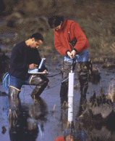


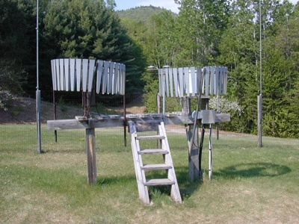
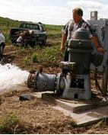
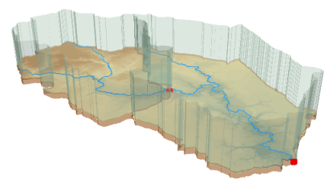
Hydrologic Data Challenges
Water quality
Water quantity
From dispersed federal agencies
From investigators collected for different purposes
Different formats
  Points
  Lines
  Polygons
  Fields
Rainfall and Meteorology
Soil water
Groundwater
GIS
Data Heterogeneity

Slide 4

The way that data is organized can enhance or inhibit the analysis that can be done
I have your information right here …
Picture from: http://initsspace.com/

Slide 5
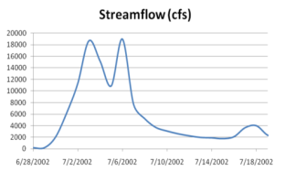
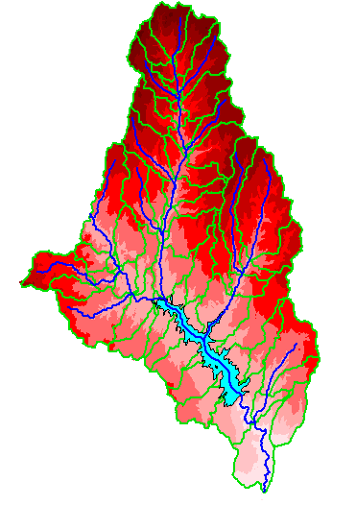
Hydrologic Science
It is as important to represent hydrologic environments precisely with
data as it is to represent hydrologic processes with equations
Physical laws and principles
(Mass, momentum, energy, chemistry)
Hydrologic Process Science
(Equations, simulation models, prediction)
Hydrologic conditions
(Fluxes, flows, concentrations)
Hydrologic Information Science
(Observations, data models, visualization
Hydrologic environment
(Physical earth)

Slide 6
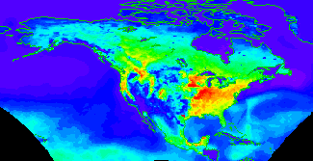


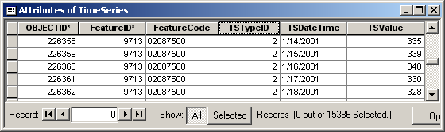

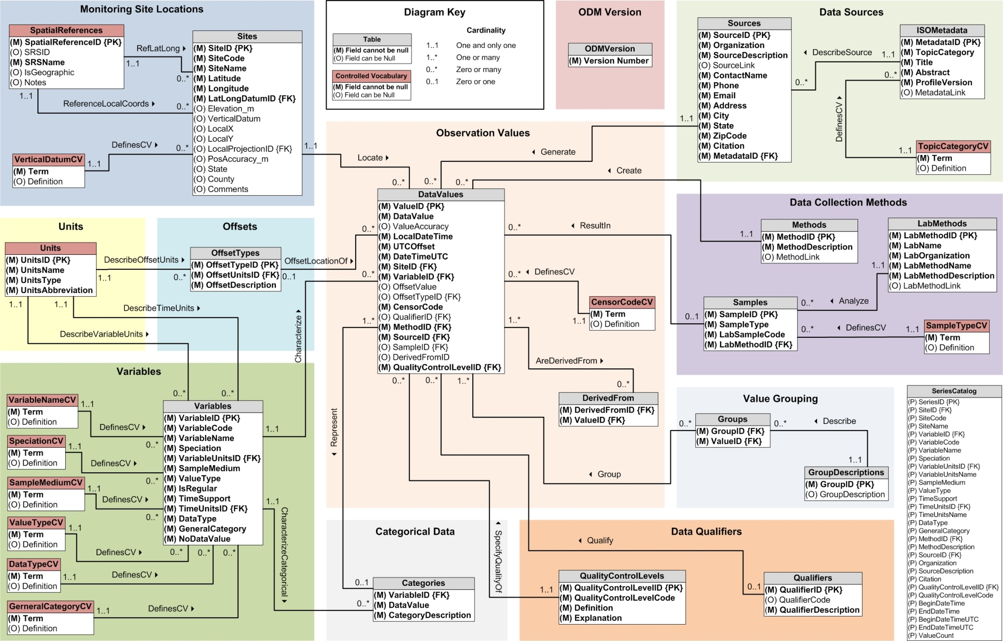
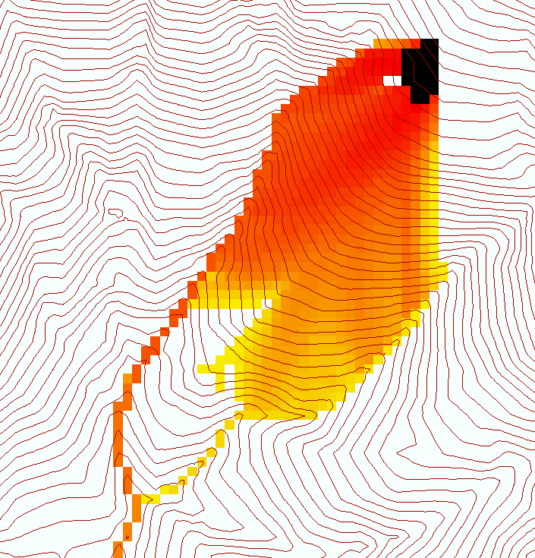
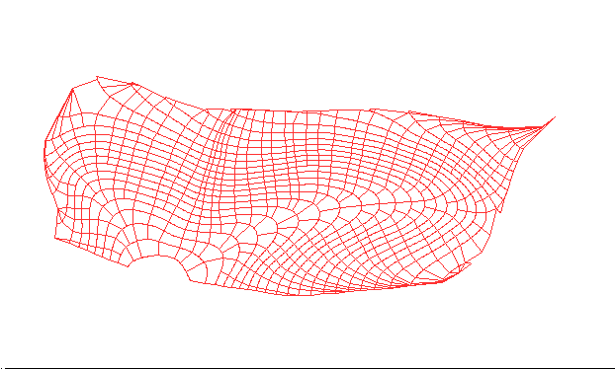

Data models capture the complexity of natural systems
NetCDF (Unidata) - A model for Continuous Space-Time data
ArcHydro – A model for Discrete Space-Time Data
Time, TSDateTime
Time, T
Coordinate
dimensions
{X}
TSValue
D
Space, FeatureID
Space, L
CUAHSI Observations Data Model: What are the basic attributes to be associated with each single data value and how can these best be organized?
Variables, TSTypeID
Variables, V
Variable dimensions
{Y}
Terrain Flow Data Model used to enrich the information content of a digital elevation model

Slide 7
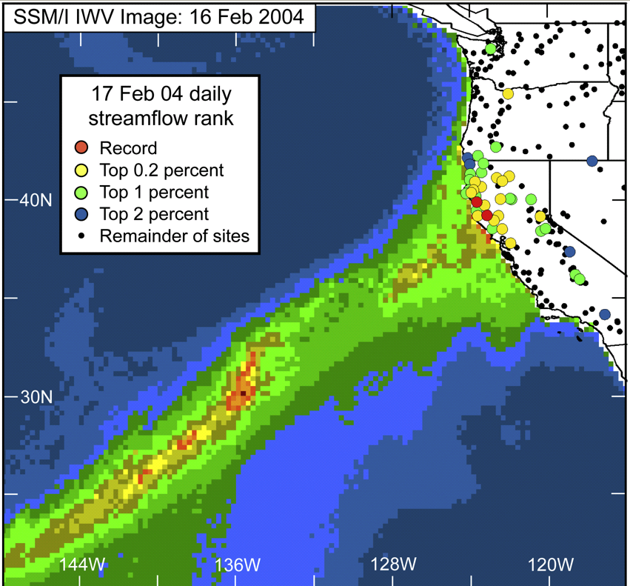
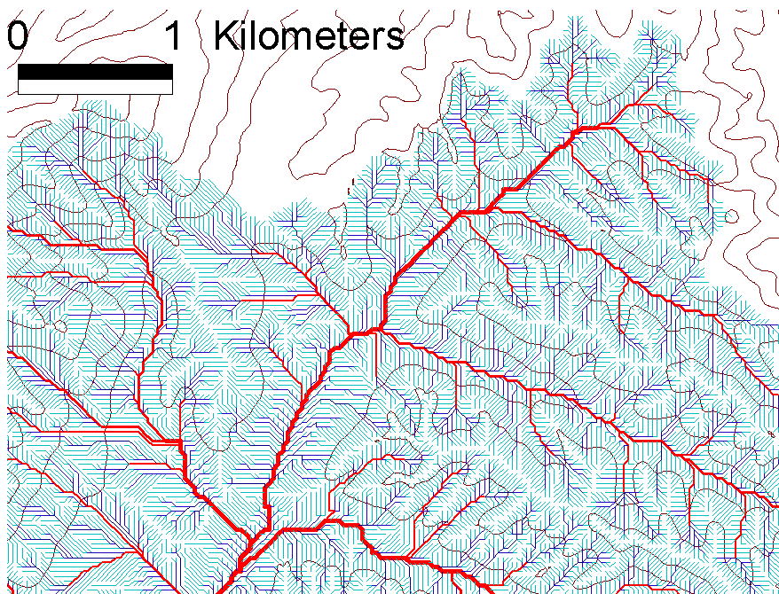
Data intensive science synthesizes large quantities of information (Hey et al., 2009).
exploiting advanced computational capability for the analysis and integration of large new datasets to elucidate complex and emergent behavior
In hydrology, the image at left (Ralph et al., 2006) illustrates connection between extreme floods recorded in USGS stream gages and atmospheric water vapor from space based sensors
Satellite remote sensing and massive datasets enhance understanding of multi-scale complexity in processes such as rainfall and river networks

Slide 8
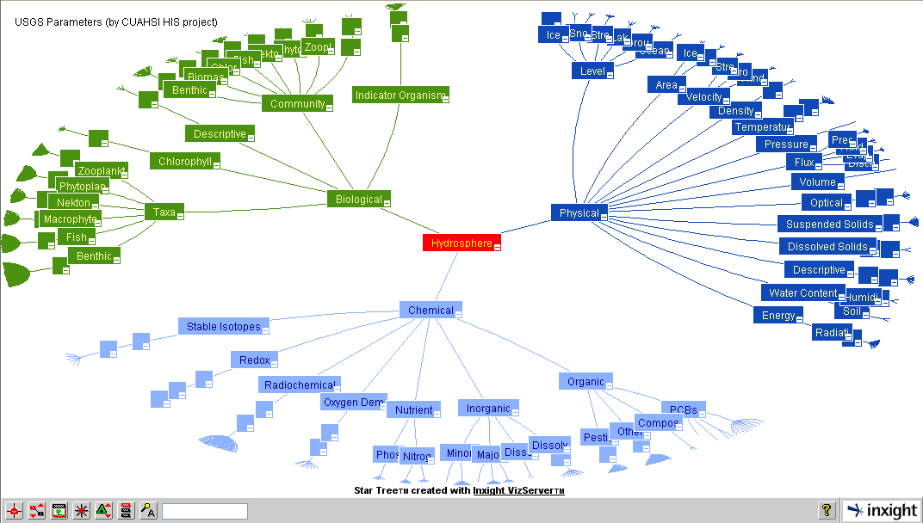
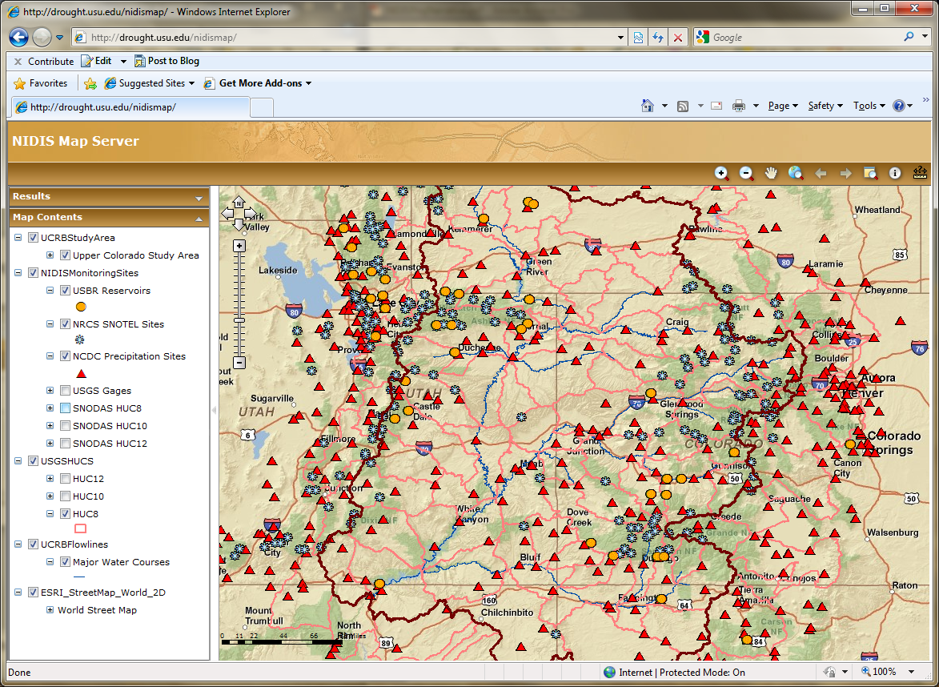
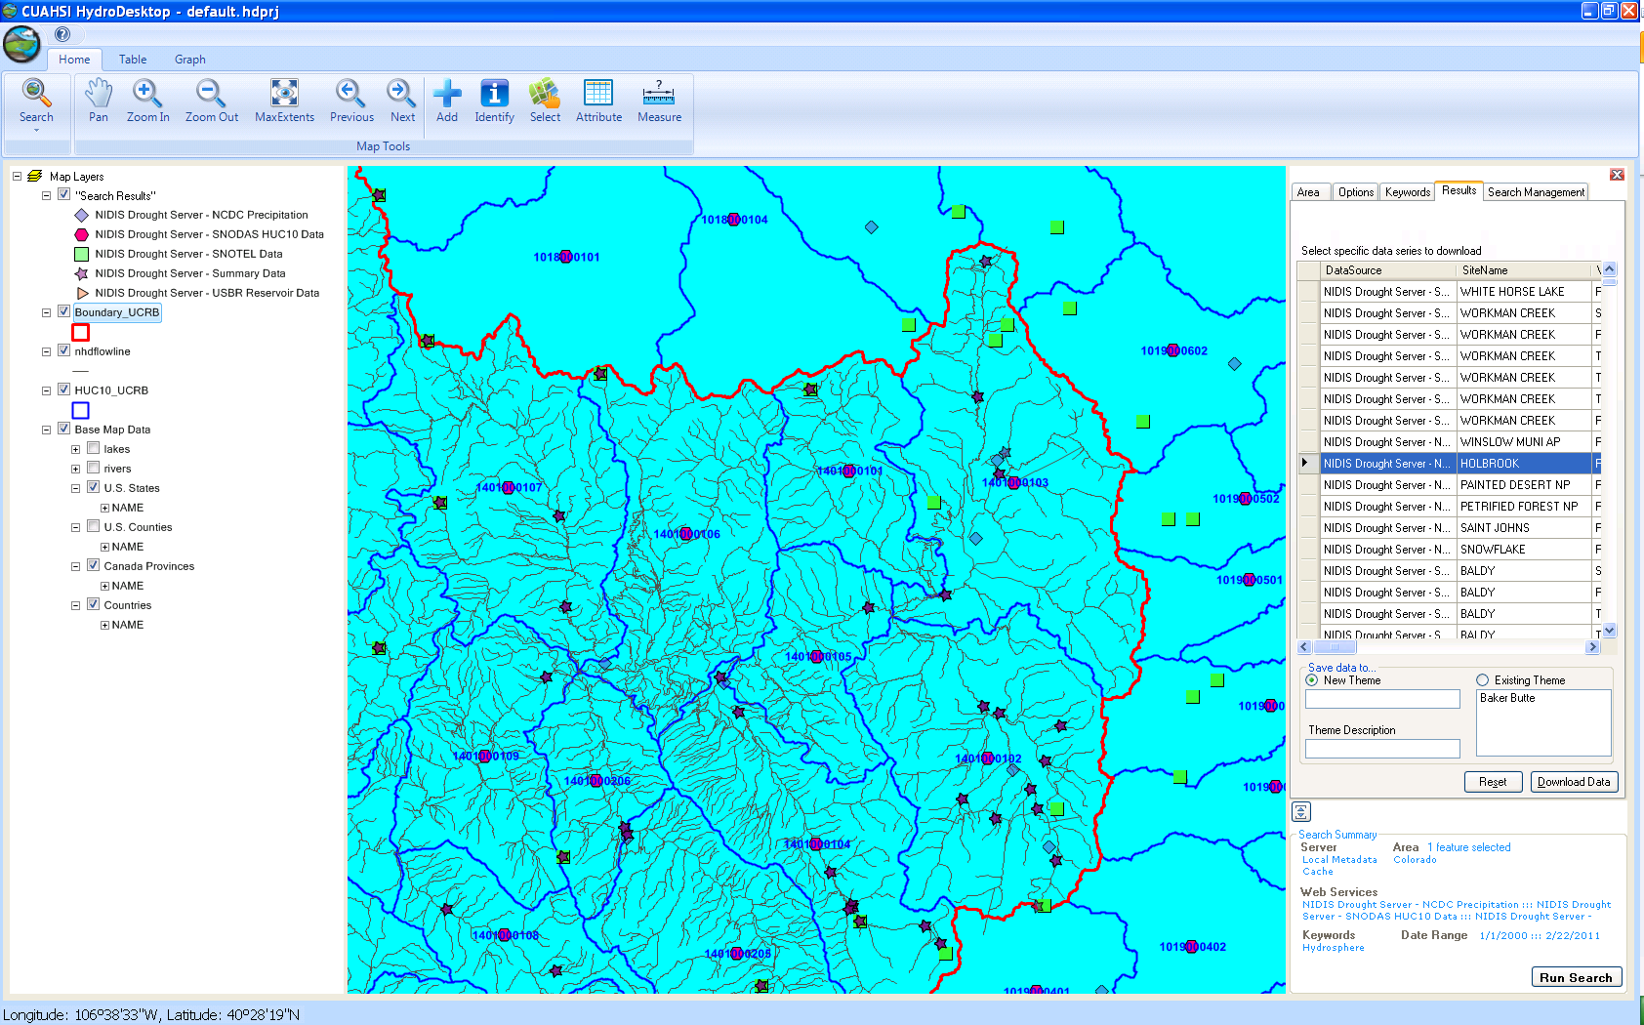
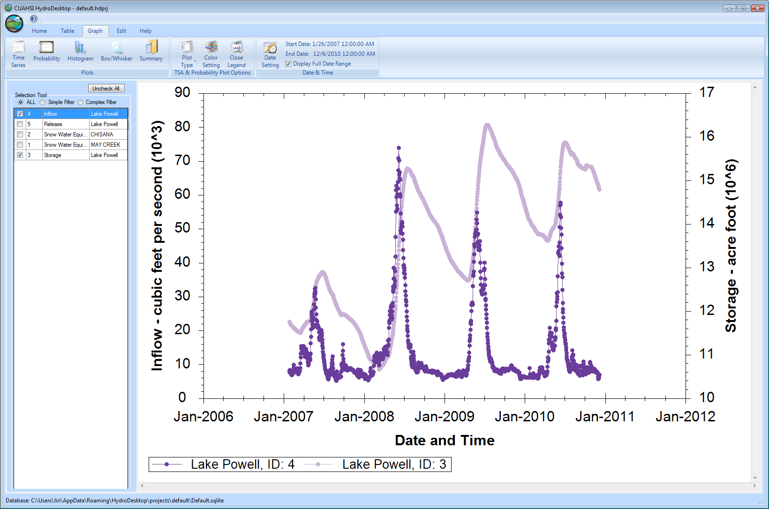
CUAHSI HIS
The CUAHSI Hydrologic Information System (HIS) is an internet based system to support the sharing of hydrologic data. It is comprised of hydrologic databases and servers connected through web services as well as software for data publication, discovery and access.
HydroServer – Data Publication
HydroCatalog
Data Discovery
Lake Powell Inflow and Storage
HydroDesktop – Data Access and Analysis
HydroDesktop – Combining multiple data sources

Slide 9

The CUAHSI Community Hydrologic Information System
University of Texas at Austin – David Maidment, Tim Whiteaker, James Seppi, Fernando Salas, Jingqi Dong, Harish Sangireddy
San Diego Supercomputer Center – Ilya Zaslavsky, David Valentine, Tom Whitenack, Matt Rodriguez
Utah State University – Jeff Horsburgh, Kim Schreuders, Stephanie Reeder, Edward Wai Tsui, Ravichand Vegiraju, Ketan Patil
University of South Carolina – Jon Goodall, Anthony Castronova
Idaho State University – Dan Ames, Ted Dunsford, Jiří Kadlec, Yang Cao, Dinesh Grover
Drexel University/CUNY – Michael Piasecki
WATERS Network – Testbed Data Managers
CUAHSI Program Office – Rick Hooper, Yoori Choi, Conrad Matiuk
ESRI – Dean Djokic, Zichuan Ye
CUAHSI
HIS
Sharing hydrologic data
http://his.cuahsi.org/
Support
EAR 0622374

Slide 10
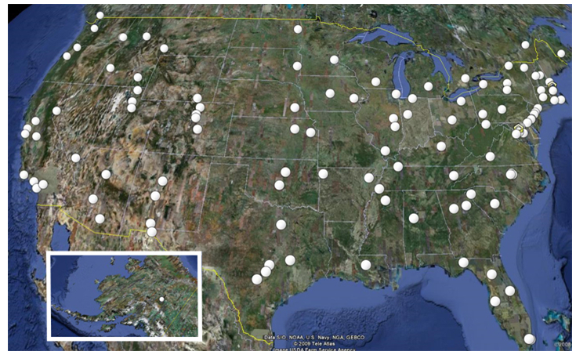
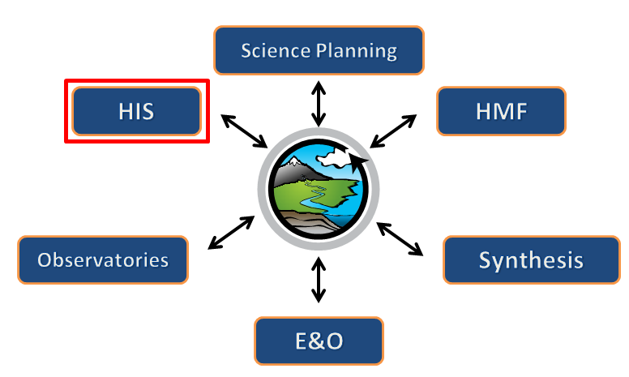

What is CUAHSI?
Consortium of Universities for the Advancement of Hydrologic Science, Inc.
110 US University members
6 affiliate members
12 International affiliate members
(as of March 2009)
Infrastructure and services for the advancement of hydrologic science and education in the U.S.
Support
EAR 0753521
http://www.cuahsi.org/

Slide 11










Data Searching – What we used to have to do
Searching each data source separately
NWIS
request
return
request
request
return
return
NAWQA
request
return
NAM-12
request
return
request
return
request
return
request
return
NARR
Michael Piasecki
Drexel University
Notes:
11

Slide 12

What HIS enables
Searching all data sources collectively
GetValues
GetValues
NWIS
GetValues
GetValues
generic
request
GetValues
GetValues
NAWQA
Michael Piasecki
Drexel University
GetValues
NARR
GetValues
ODM
Notes:
12

Slide 13
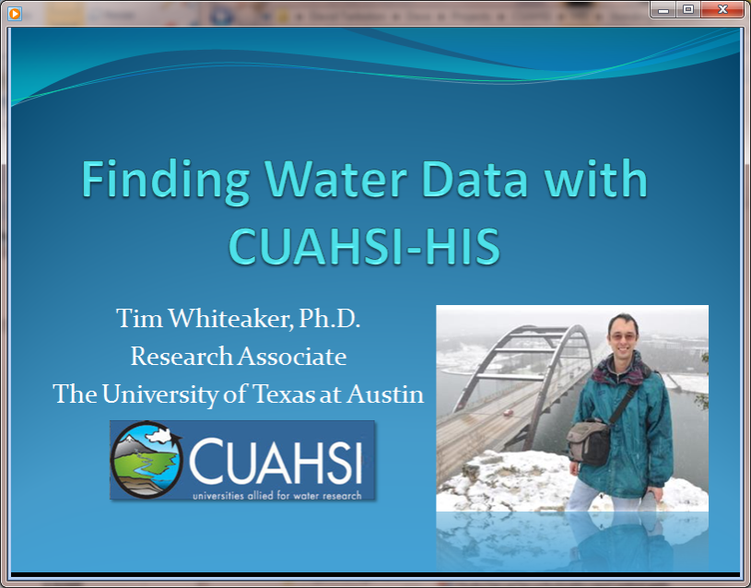
Video Demo
http://his.cuahsi.org/movies/JacobsWellSpring/JacobsWellSpring.html

Slide 14
Web Paradigm
Catalog
(Google)
Catalog harvest
Search
Web Server
(CNN.com)
Access
Browser
(Firefox)

Slide 15


CUAHSI Hydrologic Information System
Services-Oriented Architecture
Data Discovery and Integration
HydroCatalog
Metadata Services
WaterML, Other OGC Standards
Search Services
HydroServer
HydroDesktop
Data Publication
Data Services
Data Analysis and Synthesis
ODM
Geo Data
Information Model and Community Support Infrastructure

Slide 16
What are the basic attributes to be associated with each single data value and how can these best be organized?
Value
DateTime
Variable
Location
Units
Interval (support)
Accuracy
Offset
OffsetType/ Reference Point
Source/Organization
Censoring
Data Qualifying Comments
Method
Quality Control Level
Sample Medium
Value Type
Data Type

Slide 17
CUAHSI Observations Data Model
Streamflow
Groundwater
levels
A relational database at the single observation level (atomic model)
Stores observation data made at points
Metadata for unambiguous interpretation
Traceable heritage from raw measurements to usable information
Standard format for data sharing
Cross dimension retrieval and analysis
Precipitation
& Climate
Soil
moisture
data
Water Quality
Flux tower
data
“When”
Time, T
t
A data value
v_{i} (s,t)
s
“Where”
Space, S
V_{i}
“What”
Variables, V

Slide 18
CUAHSI Observations Data Model http://his.cuahsi.org/odmdatabases.html
Horsburgh, J. S., D. G. Tarboton, D. R. Maidment and I. Zaslavsky, (2008), A Relational Model for Environmental and Water Resources Data, Water Resour. Res., 44: W05406, doi:10.1029/2007WR006392.
Notes:
In designing ODM we asked: What are the basic attributes to be associated with each single data value and how can these best be organized? This involved community survey at a workshop and by email and based on the feedback received we came up with the ODM schema illustrated, published last year in WRR
This is quite a detailed slide, but it is the entire schema. Few database designs are simple enough to fit the entire schema on one slide. This shows at the center the data values table and off to the sides, the ancillary or metadata tables that record.

Slide 19
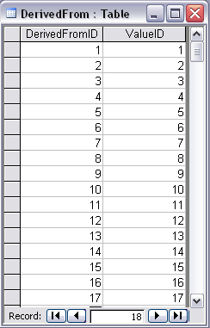
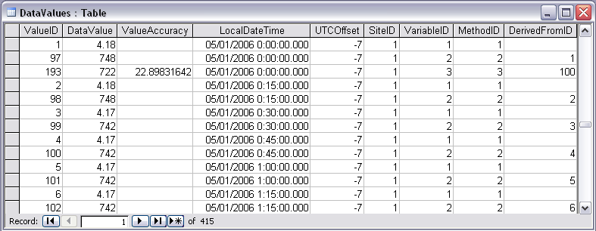
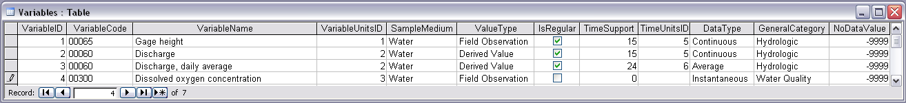
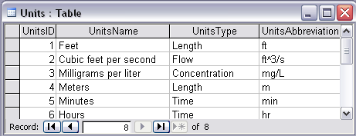
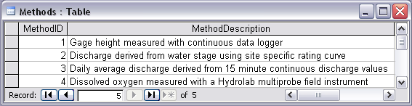
Stage and Streamflow Example
Notes:
Discharge Derived from Gage Height
Concepts:
Data derived from other data – single data point derived from a single observation (discharge from stage)
Data derived using a specific method (discharge from stage using rating curve)
Relationships:
Relationships between Values table and DerivedFrom table on DerivedFromID and ValueID
Relationship between Values table and Variables table on VariableID
Relationship between Values table and Methods table on MethodID
Relationship between Variables table and Units table on UnitID

Slide 20
Independent of, but can be coupled to Geographic Representation
ODM
e.g. Arc Hydro
Feature
Observations Data Model
1
HydroPoint
Waterbody
Watershed
Sites
1
HydroID
HydroID
HydroID
SiteID
HydroCode
*
HydroCode
HydroCode
SiteCode
FType
FType
DrainID
SiteName
OR
Name
Name
AreaSqKm
Latitude
JunctionID
AreaSqKm
JunctionID
Longitude
JunctionID
NextDownID
…
ComplexEdgeFeature
*
SimpleJunctionFeature
*
CouplingTable
1
SiteID
HydroID
1
HydroEdge
HydroJunction
HydroJunction
HydroID
1
HydroJunction
1
HydroID
HydroID
HydroCode
HydroID
HydroCode
HydroCode
ReachCode
HydroCode
NextDownID
NextDownID
Name
NextDownID
LengthDown
LengthDown
LengthKm
HydroNetwork
LengthDown
DrainArea
DrainArea
LengthDown
DrainArea
FType
FType
FlowDir
FType
Enabled
Enabled
FType
Enabled
AncillaryRole
AncillaryRole
EdgeType
AncillaryRole
Enabled
EdgeType
Flowline
Shoreline

Slide 21
Importance of the Observations Data Model
Provides a common persistence model for observations data
Syntactic heterogeneity (File types and formats)
Semantic heterogeneity
  Language for observation attributes (structural)
  Language to encode observation attribute values (contextual)
Publishing and sharing research data
Metadata to facilitate unambiguous interpretation
Enhance analysis capability

Slide 22
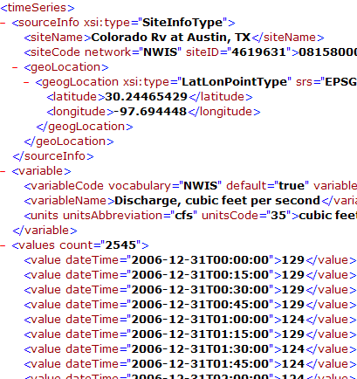
WaterML and WaterOneFlow
WaterML is an XML language for communicating water data
WaterOneFlow is a set of web services based on WaterML
Set of query functions
Returns data in WaterML
GetSites
GetSiteInfo
GetVariableInfo
GetValues
WaterOneFlow
Web Service
Notes:
22

Slide 23
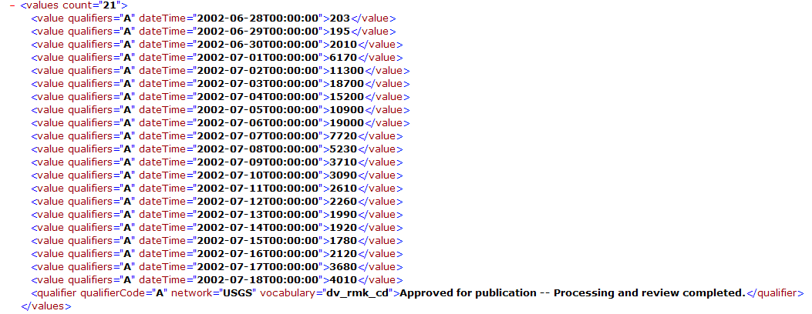
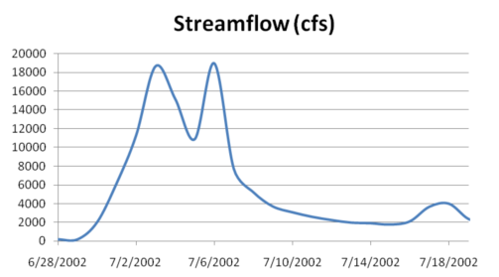
WaterML as a Web Language
Discharge of the San Marcos River at Luling, TX June 28 - July 18, 2002
USGS Streamflow data in WaterML language
This is the WaterML GetValues response from NWIS Daily Values

Slide 24
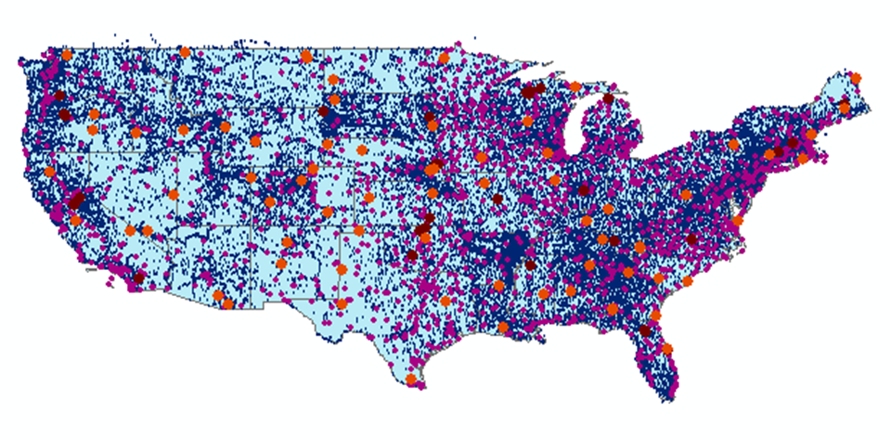
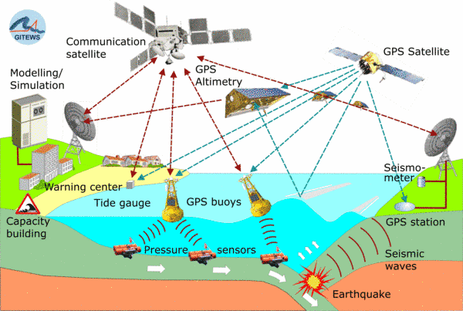
Open Geospatial Consortium
Web Service Standards
These standards have been developed over the past 10 years ….
…. by 400 companies and agencies working within the OGC
Map Services
Web Map Service (WMS)
Web Feature Service (WFS)
Web Coverage Service
(WCS)
Catalog Services for the Web (CS/W)
Observation Services
Observations and Measurements Model
Sensor Web Enablement (SWE)
Sensor Observation Service (SOS)
OGC Hydrology Domain Working Group evolving WaterML into an International Standard
http://www.opengeospatial.org/projects/groups/waterml2.0swg

Slide 25
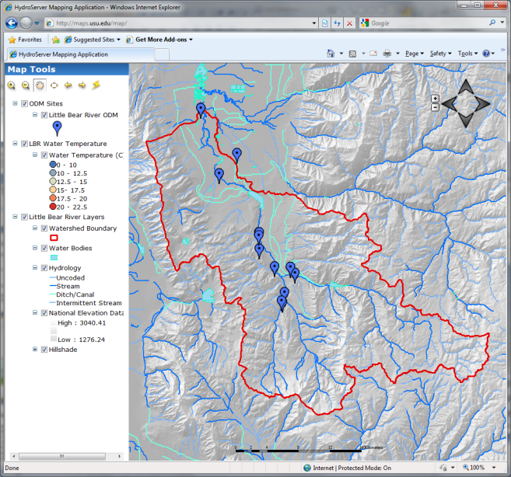

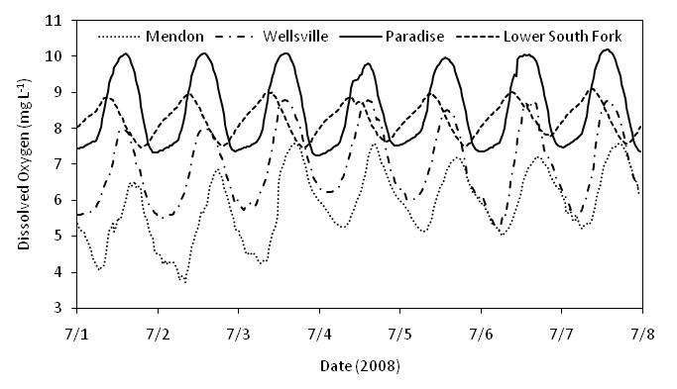

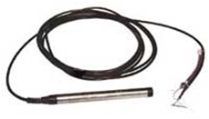
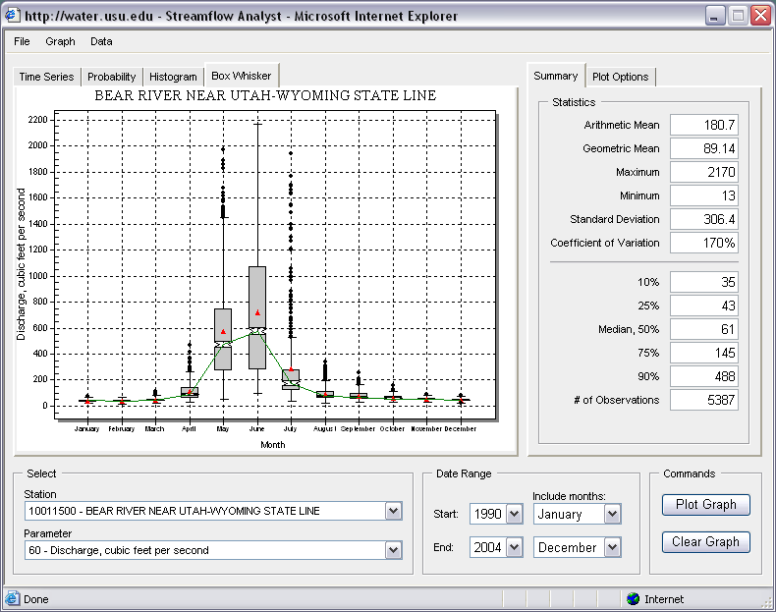
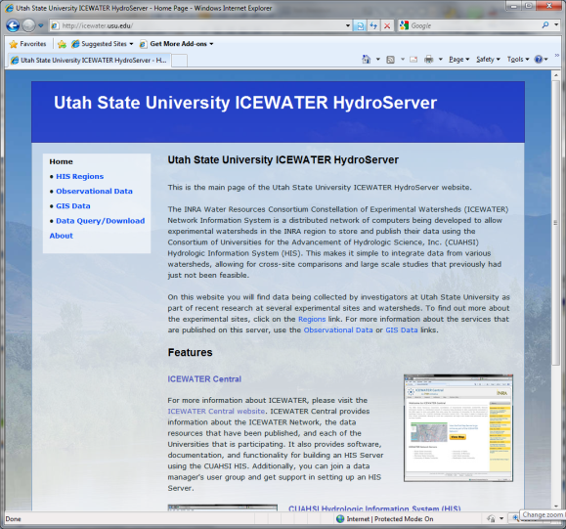

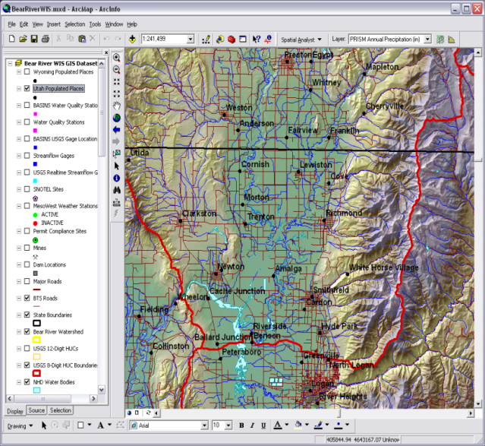
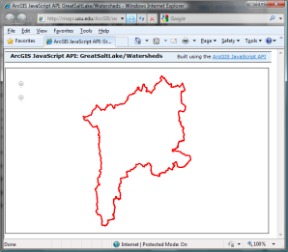
HydroServer – Data Publication
Point Observations Data
Internet Applications
Ongoing Data Collection
Historical Data Files
ODM Database
GetSites
GetSiteInfo
GetVariableInfo
GetValues
GIS Data
WaterML
WaterOneFlow
Web Service
OGC Spatial Data Service from ArcGIS Server
Data presentation, visualization,
and analysis through Internet enabled applications
Notes:
A platform for publishing space-time hydrologic datasets that:
Autonomous with local control of data
Part of a distributed system that makes data universally available
Basis for Experimental Watershed or Observatory data management system
Standards based approach to data publication
Accepted and emerging standards for data storage and transfer (OGC, WaterML)
Built on established software
MS SQL Server, ArcGIS server
Open Source Community Code Repository
Sustainability

Slide 26
HydroServer
Service Interface
Publish point data
Publish metadata
Publish spatial data
Manager Interface
Browser Interface
HydroServer
WaterOneFlow Web Service
Capabilities Web Service
Spatial Data Services
HydroServer Website
View server portal
WaterOneFlow Web Service
WaterOneFlow Web Service
Load and Edit data
ODM Tools and Data Loaders
Observation
Data Model
Geo Spatial
Database
Map
Website
View spatial data
Observation
Data Model
Observation
Data Model
Spatial Data File
Configure server
Capabilities Configuration Tool
HydroServer Capabilities Database
Time Series Analyst Website
View point data

Slide 27
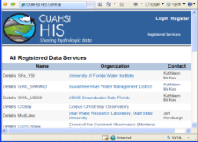
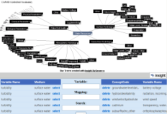


HydroCatalog
Service Registry
Hydrotagger
Search over data services from multiple sources
Supports concept based data discovery
WaterML
Harvester
Water Metadata Catalog
GetSites
GetSiteInfo
GetVariableInfo
GetValues
WaterOneFlow
Web Service
Search Services
CUAHSI Data Server
3rd Party Server
e.g. USGS
Discovery and Access
Hydro
Desktop
http://hiscentral.cuahsi.org

Slide 28
HydroCatalog
Data Publisher Interface
Interactively test WaterOneflow Services
Register, View and Manage Services
View and Manage Ontology Mappings
Data Service Interface
Search Client Interface
Validate WaterOneFlow Services
Validation Services
Web Service Registry Website
Semantic Annotation
Website
Collect Metadata
Metadata Harvester
Metadata catalog database
Provide Client Search over Services and Observation Metadata
Search Web Service
Log service use
Logging Service
Hydrologic Ontology
Monitor Service
Monitoring Services
Ontology Web Service
Get Concepts and Mappings
HydroCatalog

Slide 29
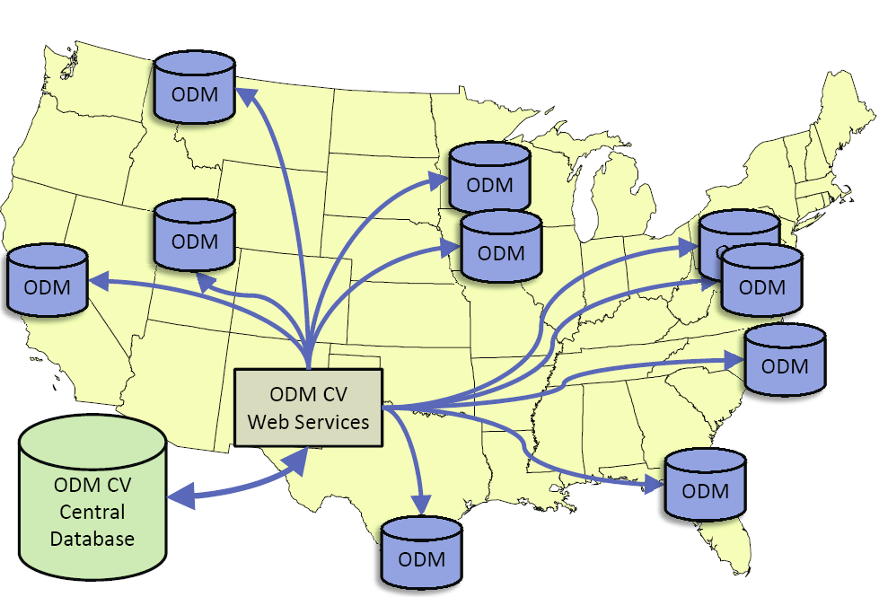
Overcoming Semantic Heterogeneity
ODM Controlled Vocabulary System
  ODM CV central database
  Online submission and editing of CV terms
  Web services for broadcasting CVs
ODM VariableNameCV
Variable Name
Term
…
Sunshine duration
Temperature
Turbidity
…
Investigator 1: | “Temperature, water”
Investigator 2: | “Water Temperature”
Investigator 3: | “Temperature”
Investigator 4: | “Temp.”
From Jeff Horsburgh

Slide 30

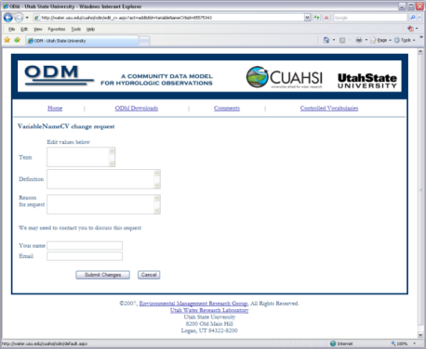

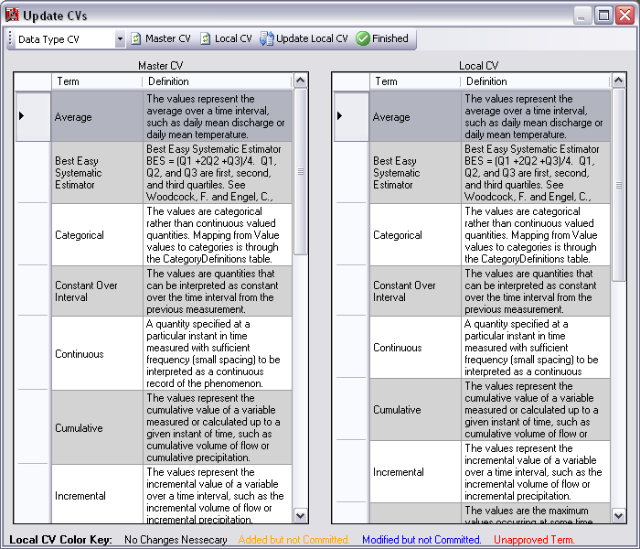
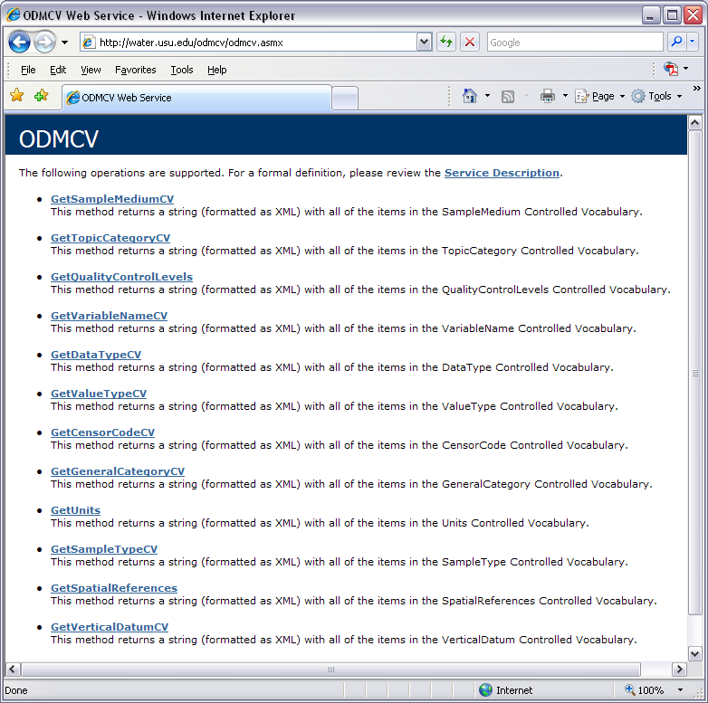
Dynamic controlled vocabulary moderation system
ODM Data Manager
ODM Website
ODM
Tools
ODM Controlled
Vocabulary Moderator
XML
Master ODM Controlled Vocabulary
Local ODM
Database
ODM
Controlled Vocabulary
Web Services
Local
Server
http://his.cuahsi.org/mastercvreg.html
From Jeff Horsburgh

Slide 31
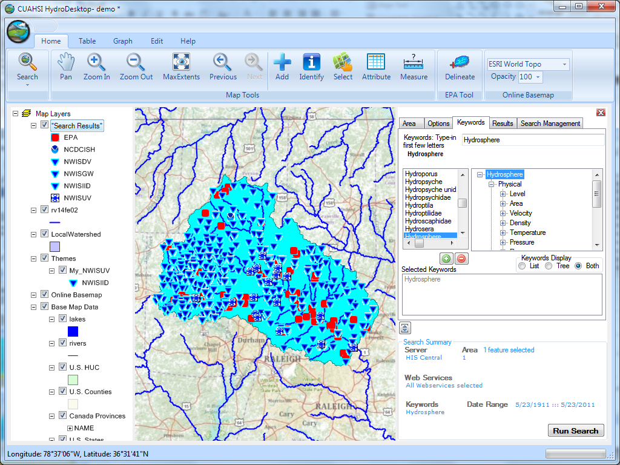
Thematic keyword search
HydroDesktop – Data Access and Analysis
Integration from multiple sources
Search on space and time domain

Slide 32
HydroDesktop
HydroDesktop
Core & Shared Libraries
Plugins
Export to CSV
Graph View
Interact with user
Interact with other programs
Object Model
User
Interface
Site
Variable
Series
Method
Theme
DataValue
…
HydroR
Interact with user
Hydro Modeler
Help
Table View
Fetch Basemap
Get from/ save to disk
DotSpatial
Library
Database Abstraction Layer
Search
Metadata Cache Manager
Data Repository Manager
Other
Libraries
XML
HydroCatalog
Search & Ontology Web Service
Search
Project File
Metadata Cache DB
Data Repository DB
WaterML
1.0
1.1
Application Settings
XML
Project File
Metadata Cache DB
Data Repository DB
WaterOneFlow
Web Service
Project File
Metadata Cache DB
Data Repository DB

Slide 33
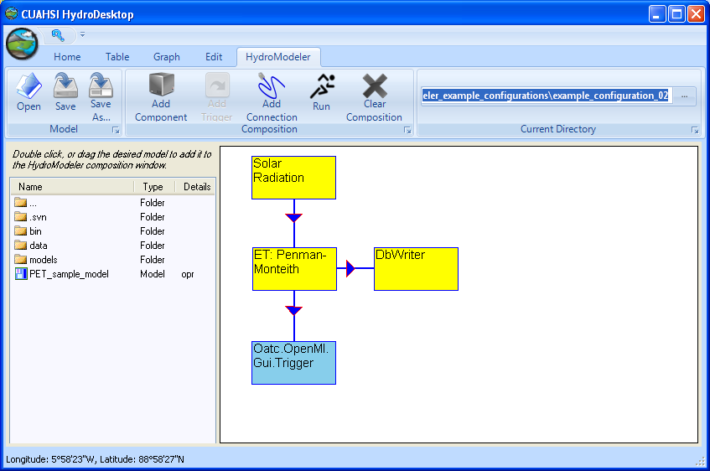
HydroModeler
An integrated modeling environment based on the Open Modeling Interface (OpenMI) standard and embedded within HydroDesktop
Allows for the linking of data and models as “plug-and-play” components
In development at the University of South Carolina by Jon Goodall, Tony Castronova, Mehmet Ercan, Mostafa Elag, and Shirani Fuller

Slide 34
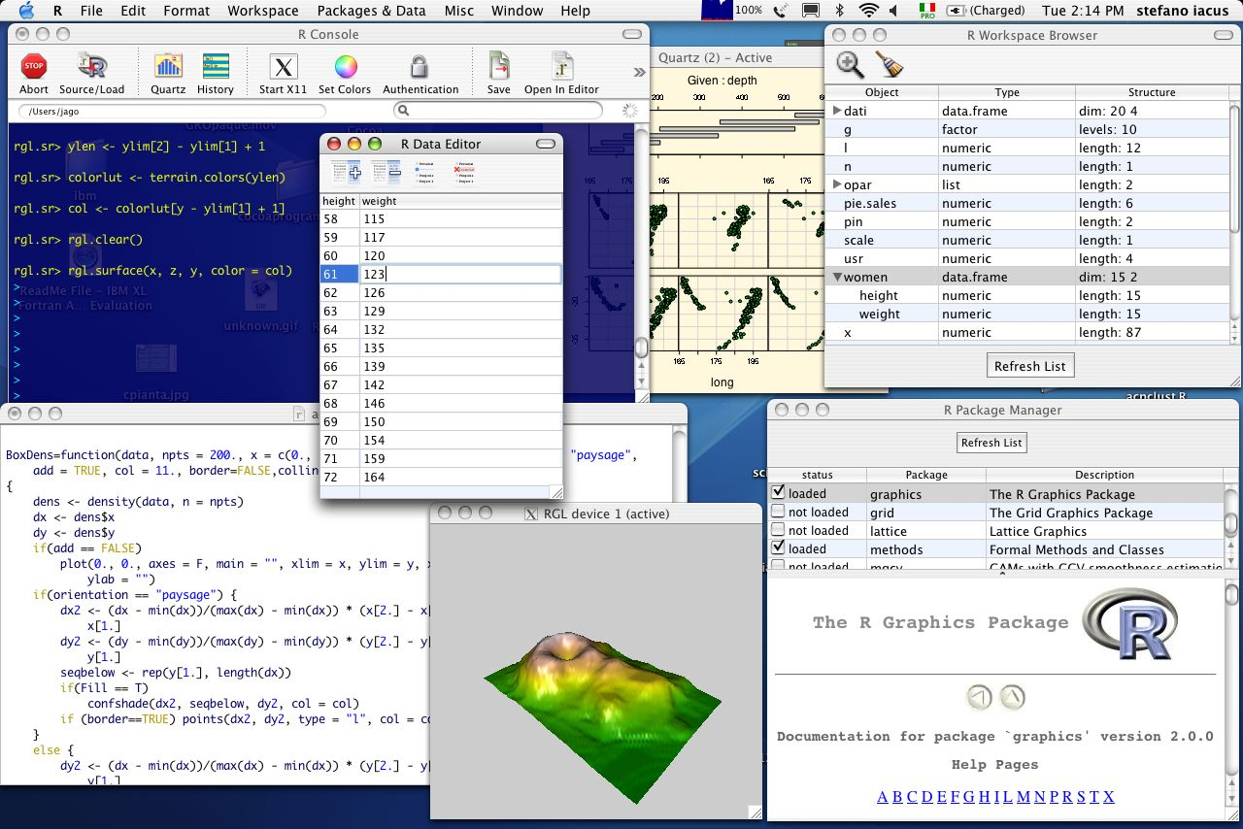
Integration with “R” Statistics Package

Slide 35
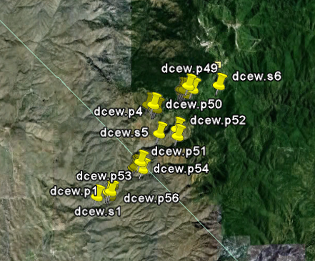
37 Water Data Services on HIS Central from 12 Universities
University of Maryland, Baltimore County
Montana State University
University of Texas at Austin
University of Iowa
Utah State University
University of Florida
University of New Mexico
University of Idaho
Boise State University
University of Texas at Arlington
University of California, San Diego
Idaho State University
Dry Creek Experimental Watershed (DCEW)
(28 km² semi-arid steep topography, Boise Front)
68 Sites
24 Variables
4,700,000+ values
Published by Jim McNamara, Boise State University

Slide 36




Water Agencies and Industry
USGS, NCDC , Corps of Engineers publishing data using HIS WaterML
OGC Hydrology Domain Working Group evaluating WaterML as OGC standard
ESRI using CUAHSI model in ArcGIS.com GIS data collaboration portal
Kisters WISKI support for WaterML data publication
Australian Water Resources Information System Water Accounting System has adopted aspects of HIS
NWS West Gulf River Forecast Center Multi-sensor Precipitation Estimate published from ODM using WaterML

Slide 37
CUAHSI Water Data Services Catalog
69 public services
18,000 variables
1.9 million sites
23 million series
5.1 billion data values
(as of June 2011)
The largest water data
catalog in the world
maintained at the San Diego Supercomputer Center

Slide 38
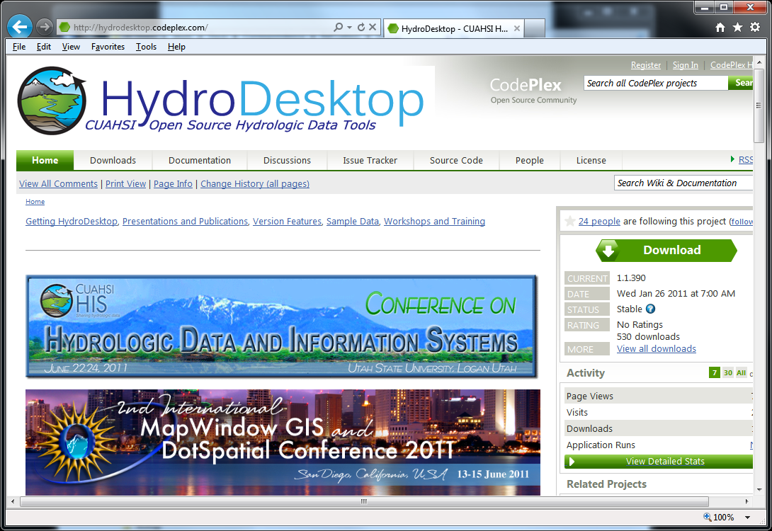
Open Development Model
http://hydrodesktop.codeplex.com
http://hydroserver.codeplex.com
http://hydrocatalog.codeplex.com

Slide 39
Summary
Data Storage in an Observations Data Model (ODM) and publication through HydroServer
Data Access through internet-based Water Data Services using a consistent data language, called WaterML from HydroDesktop
Data Discovery through a National Water Metadata Catalog and thematic keyword search system at Central HydroCatalog (SDSC)
Integrated Modeling and Analysis within HydroDesktop
The combination of these capabilities creates a common window on water observations data for the United States unlike any that has existed before.

Slide 40


Terrain Analysis Using Digital Elevation Models (TauDEM)
David Tarboton¹, Dan Watson², Rob Wallace,³ Kim Schreuders¹, Jeremy Neff¹
¹Utah Water Research Laboratory, Utah State University, Logan, Utah
²Computer Science, Utah State University, Logan, Utah
³US Army Engineer Research and Development Center, Information Technology Lab, Vicksburg, Mississippi
This research was funded by the US Army Research and Development Center under contract number W9124Z-08-P-0420

Slide 41



Deriving hydrologically useful information from Digital Elevation Models
Raw DEM
Pit Removal (Filling)
Flow Field
Flow Related Terrain Information
Notes:
This slide shows the general model for deriving flow field related derivative surfaces from digital elevation data. The input is a raw digital elevation model, generally elevation values on a grid. This is basic information used to derive further hydrology related spatial fields that enrich the information content of this basic data. The first step is to remove sinks, either by filling, or carving. Then a flow field is defined. This enables the calculation of flow related terrain information. My focus has been on flow related information working within this framework. I try to leave other GIS functionality, like radiation exposure, line of sight analyses and visualization to others. I have distributed my software in ways that it easily plugs in to mainstream systems, such as ArcGIS to enhance ease of use.

Slide 42
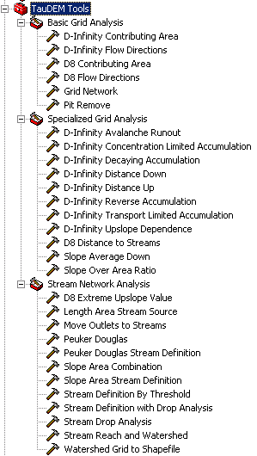

A parallel version of the TauDEM Software Tools
Improved runtime efficiency
Capability to run larger problems
Platform independence of core functionality
Deployed as an ArcGIS Toolbox with tools that drive accompanying command line executables, available from http://hydrology.usu.edu/taudem/

Slide 43




The challenge of increasing Digital Elevation Model (DEM) resolution
1980’s DMA 90 m
10² cells/km²
1990’s USGS DEM 30 m
10³ cells/km²
2000’s NED 10-30 m
10⁴ cells/km²
2010’s LIDAR ~1 m
10⁶ cells/km²

Slide 44
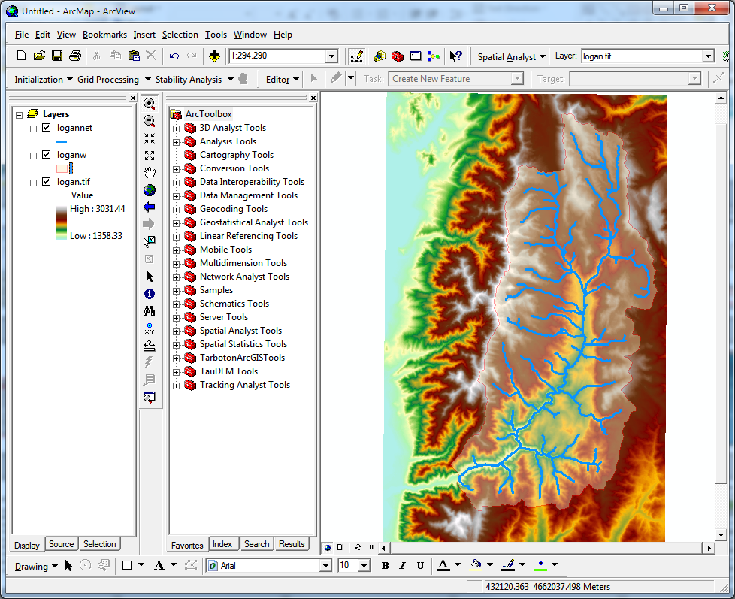
Website and Demo
http://hydrology.usu.edu/taudem

Slide 45

Grid Data Format Assumptions
Input and output grids are uncompressed GeoTIFF
Maximum size 4 GB
GDAL Nodata tag preferred (if not present, a missing value is assumed)
Grids are square (Δx= Δy)
Grids have identical extents, cell size and spatial reference
Spatial reference information is not used (no projection on the fly)

Slide 46



Representation of Flow Field
Steepest single direction
48
52
56
67
D8
D∞
Tarboton, D. G., (1997), "A New Method for the Determination of Flow Directions and Contributing Areas in Grid Digital Elevation Models," Water Resources Research, 33(2): 309-319.)
Notes:
This slide shows how the terrain flow field is represented. Early DEM work used a single flow direction model, D8. In 1997 I published the Dinfinity method that proportions flow from each grid cell among downslope neighbors. This, at the expense of some dispersion, allows a better approximation of flow across surfaces.

Slide 47

Parallel Approach
MPI, distributed memory paradigm
Row oriented slices
Each process includes one buffer row on either side
Each process does not change buffer row

Slide 48

Illustrative Use Case: Delineation of channels and watersheds using a constant support area threshold
Steps
Pit Remove
D8 Flow Directions
D8 Contributing Area
Stream Definition by Threshold
Stream Reach and Watershed

Slide 49



Pit Remove

Slide 50







D8 Flow Direction (and Slope)

Slide 51


D8 Contributing Area

Slide 52


Stream Definition by Threshold

Slide 53


Stream Reach and Watershed

Slide 54
Some Algorithm Details
Pit Removal: Planchon Fill Algorithm
Initialization
1st Pass
2nd Pass
Planchon, O., and F. Darboux (2001), A fast, simple and versatile algorithm to fill the depressions of digital elevation models, Catena(46), 159-176.

Slide 55
Parallel Scheme
Communicate
Initialize( Z,F) Do for all grid cells i if Z(i) > n F(i) ← Z(i) Else F(i) ← n i on stack for next pass endfor Send( topRow, rank-1 ) Send( bottomRow, rank+1 ) Recv( rowBelow, rank+1 ) Recv( rowAbove, rank-1 ) Until F is not modified
Z denotes the original elevation.
F denotes the pit filled elevation.
n denotes lowest neighboring elevation
i denotes the cell being evaluated
Iterate only over stack of changeable cells

Slide 56
Parallelization of Contributing Area/Flow Algebra
1. Dependency grid
and so on until completion
resulting in new D=0 cells on queue
Queue’s empty so exchange border info.
Decrease cross partition dependency
Executed by every process with grid flow field P, grid dependencies D initialized to 0 and an empty queue Q. FindDependencies(P,Q,D) for all i for all k neighbors of i if P_{ki}>0 D(i)=D(i)+1 if D(i)=0 add i to Q next
A=1
A=1
A=1
A=1
A=1
A=1
A=1
A=1
D=0
A=1
A=1
A=1
A=1
D=0
D=0
A=1
A=1
A=1
D=0
D=0
A=1
D=0
A=1
A=1
A=1
A=1
A=1
A=1.5
A=1.5
A=3
D=0
A=1.5
A=1.5
D=1
D=0
D=1
D=0
D=0
A=3
D=0
D=3
D=2
D=1
D=0
D=0
D=1
D=1
A=1.5
D=1
A=1.5
A=3
A=3
A=1.5
A=1.5
2. Flow algebra function
B=-2
B=-1
Executed by every process with D and Q initialized from FindDependencies. FlowAlgebra(P,Q,D,θ,γ) while Q isn’t empty get i from Q θ_{i} = FA(γ_{i}, P_{ki}, θ_{k}, γ_{k}) for each downslope neighbor n of i if P_{in}>0 D(n)=D(n)-1 if D(n)=0 add n to Q next n end while swap process buffers and repeat
B=-2
B=-1
A=1
A=1
D=2
D=2
D=1
A=1
D=1
A=1
D=0
A=1
A=1
D=2
D=2
D=2
D=2
D=2
D=1
D=1
D=1
D=1
A=1
D=1
A=1
A=5.5
D=0
A=2.5
D=0
A=1
A=1
D=1
D=1
D=1
A=1
D=1
A=1
D=0
D=0
A=1
D=1
D=1
D=3
D=2
D=1
D=1
D=1
D=1
D=1
A=1
D=1
A=1
D=1
A=6
A=3.5
D=1

Slide 57



Illustration of some other functions
D-Infinity Slope and Contributing Area

Slide 58




Transport limited accumulation
Supply
Capacity
Transport
Deposition
S
T
=
χa
2
tan(
b
)
2
T
=
min{
S
+
∑
T
,
T
}
D
=
S
+
∑
T
−
T
cap
out
in
cap
in
out
Useful for modeling erosion and sediment delivery, the spatial dependence of sediment delivery ratio and contaminant that adheres to sediment

Slide 59
Useful for a tracking contaminant or compound subject to decay or attenuation

Slide 60

Capabilities Summary
Capability to run larger problems
 |  | Processors used | Grid size
 |  |  | Theoretcal limit | Largest run
2008 | TauDEM 4 | 1 | 0.22 GB | 0.22 GB
Sept 2009 | Partial implement-ation | 8 | 4 GB | 1.6 GB
June 2010 | TauDEM 5 | 8 | 4 GB | 4 GB
Sept 2010 | Multifile on 48 GB RAM PC | 4 | Hardware limits | 6 GB
Sept 2010 | Multifile on cluster with 128 GB RAM | 128 | Hardware limits | 11 GB
11 GB
6 GB
4 GB
1.6 GB
0.22 GB
Single file size limit 4GB
At 10 m grid cell size

Slide 61
Improved runtime efficiency
Parallel Pit Remove timing for NEDB test dataset (14849 x 27174 cells ≈ 1.6 GB).
8 processor PC
Dual quad-core Xeon E5405 2.0GHz PC with 16GB RAM
128 processor cluster
16 diskless Dell SC1435 compute nodes, each with 2.0GHz dual quad-core AMD Opteron 2350 processors with 8GB RAM

Slide 62
Improved runtime efficiency
Parallel D-Infinity Contributing Area Timing for Boise River dataset (24856 x 24000 cells ~ 2.4 GB)
8 processor PC
Dual quad-core Xeon E5405 2.0GHz PC with 16GB RAM
128 processor cluster
16 diskless Dell SC1435 compute nodes, each with 2.0GHz dual quad-core AMD Opteron 2350 processors with 8GB RAM

Slide 63
Scaling of run times to large grids
Dataset | Size | Hardware | Number of Processors | PitRemove (run time seconds) |  | D8FlowDir (run time seconds)
 | (GB) |  |  | Compute | Total | Compute | Total
GSL100 | 0.12 | Owl (PC) | 8 | 10 | 12 | 356 | 358
GSL100 | 0.12 | Rex (Cluster) | 8 | 28 | 360 | 1075 | 1323
GSL100 | 0.12 | Rex (Cluster) | 64 | 10 | 256 | 198 | 430
GSL100 | 0.12 | Mac | 8 | 20 | 20 | 803 | 806
YellowStone | 2.14 | Owl (PC) | 8 | 529 | 681 | 4363 | 4571
YellowStone | 2.14 | Rex (Cluster) | 64 | 140 | 3759 | 2855 | 11385
Boise River | 4 | Owl (PC) | 8 | 4818 | 6225 | 10558 | 11599
Boise River | 4 | Virtual (PC) | 4 | 1502 | 2120 | 10658 | 11191
Bear/Jordan/Weber | 6 | Virtual (PC) | 4 | 4780 | 5695 | 36569 | 37098
Chesapeake | 11.3 | Rex (Cluster) | 64 | 702 | 24045
Owl is an 8 core PC (Dual quad-core Xeon E5405 2.0GHz) with 16GB RAM
Rex is a 128 core cluster of 16 diskless Dell SC1435 compute nodes, each with 2.0GHz dual quad-core AMD Opteron 2350 processors with 8GB RAM
Virtual is a virtual PC resourced with 48 GB RAM and 4 Intel Xeon E5450 3 GHz processors
Mac is an 8 core (Dual quad-core Intel Xeon E5620 2.26 GHz) with 16GB RAM

Slide 64
Scaling of run times to large grids
Owl is an 8 core PC (Dual quad-core Xeon E5405 2.0GHz) with 16GB RAM
Rex is a 128 core cluster of 16 diskless Dell SC1435 compute nodes, each with 2.0GHz dual quad-core AMD Opteron 2350 processors with 8GB RAM
Virtual is a virtual PC resourced with 48 GB RAM and 4 Intel Xeon E5450 3 GHz processors

Slide 65
Summary and Conclusions
Parallelization speeds up processing and partitioned processing reduces size limitations
Parallel logic developed for general recursive flow accumulation methodology (flow algebra)
Documented ArcGIS Toolbox Graphical User Interface
32 and 64 bit versions (but 32 bit version limited by inherent 32 bit operating system memory limitations)
PC, Mac and Linux/Unix capability
Capability to process large grids efficiently increased from 0.22 GB upper limit pre-project to where < 4GB grids can be processed in the ArcGIS Toolbox version on a PC within a day and up to 11 GB has been processed on a distributed cluster (a 50 fold size increase)

Slide 66
Limitations and Dependencies
Uses MPICH2 library from Argonne National Laboratory http://www.mcs.anl.gov/research/projects/mpich2/
TIFF (GeoTIFF) 4 GB file size (for single file version)
Capability to use multiple files to cover domain not yet on web site
Processor memory
Toolbox user interface only for ArcGIS 9.3.1

Slide 67
Are there any questions ?
AREA 2
3
AREA 1
12

