Slide 1
Geographic Information System Based Hydrology in Ecology and Natural Resources Management
David G. Tarboton
dtarb@cc.usu.edu
http://www.engineering.usu.edu/dtarb

Slide 2
Overview
Channel and watershed delineation
Hydrologic modeling (Bandaragoda)
Terrain stability mapping and erosion (Goodwin, Pack, Istanbulluoglu)
Dryland vegetation, a moisture limited ecological continuum (Goodwin)
Vegetation disturbance sediment model (Istanbulluoglu)

Slide 3
Objective delineation of channel networks using digital elevation models
Hydrologic processes are different on hillslopes and in channels. It is important to recognize this and account for this in models.
Drainage area can be concentrated or dispersed (specific catchment area) representing concentrated or dispersed flow.

Slide 4
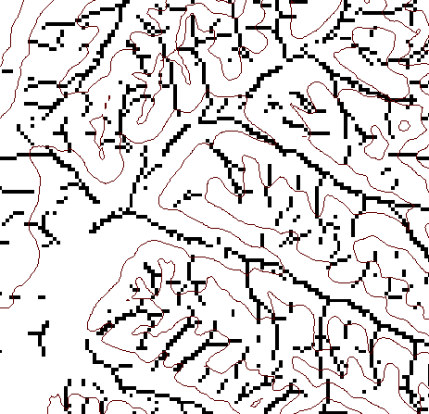
DEM based channel network delineation using local curvature and constant drop analysis to have objective and spatially variable drainage density
Eight direction pour point model D8
Flow direction network
Accumulation of "valley" cells
4
3
2
1
1
1
1
5
1
3
1
6
7
8
4
16
Local Valley Computation
(Peuker and Douglas, 1975, Comput. Graphics Image Proc. 4:375)
4
43
48
48
51
51
56
Threshold = 10
Dd = 2.5 km⁻¹
t = -3.5
Threshold = 20
Dd = 1.9 km⁻¹
t = -1.03
41
47
47
54
54
58
Stream drop test for highest resolution network (smallest threshold) with constant drop property satisfied, i.e. t test indicates no statistically significant difference in mean drop between first order and all higher order streams.

Slide 5
Curvature based stream delineation with threshold by constant drop analysis

Slide 6
100 grid cell constant drainage area threshold stream delineation

Slide 7
200 grid cell constant drainage area based stream delineation

Slide 8
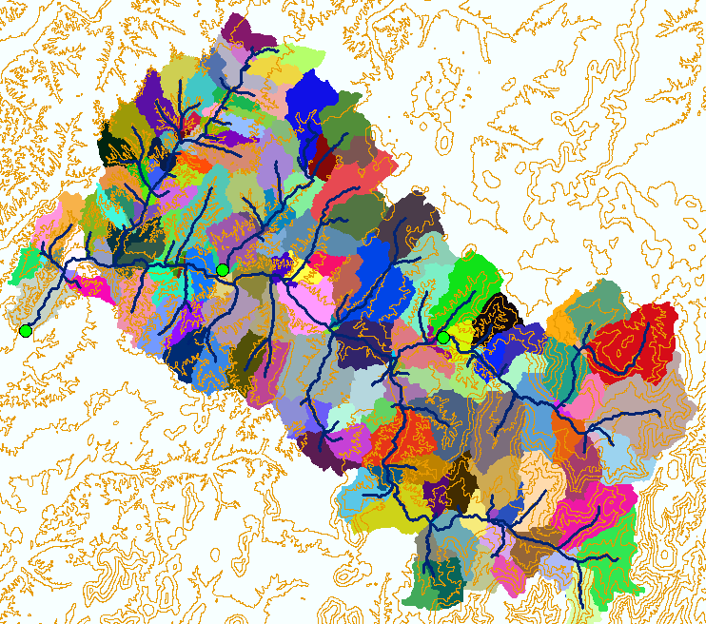
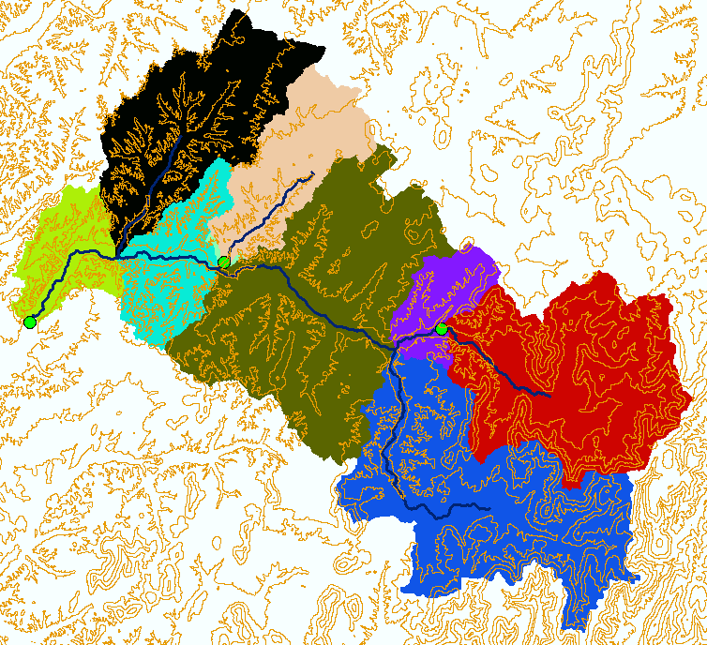
Model Element Spatial Resolution
Baron subwatersheds from streams delineated using objectively estimated drainage density from constant drop analysis.
Baron subwatersheds generalized based on third order streams.

Slide 9
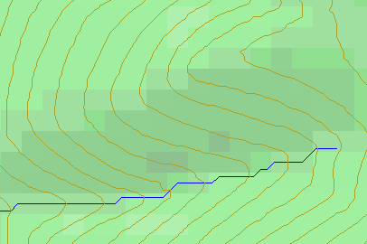
Topographic Slope
?
Topographic Definition Drop/Distance
Limitation imposed by 8 grid directions.
Flow Direction Field — if the elevation surface is differentiable (except perhaps for countable discontinuities) the horizontal component of the surface normal defines a flow direction field.

Slide 10

The D∞ Algorithm
Tarboton, D. G., (1997), "A New Method for the Determination of Flow Directions and Contributing Areas in Grid Digital Elevation Models," Water Resources Research, 33(2): 309-319.) (http://www.engineering.usu.edu/cee/faculty/dtarb/dinf.pdf)

Slide 11
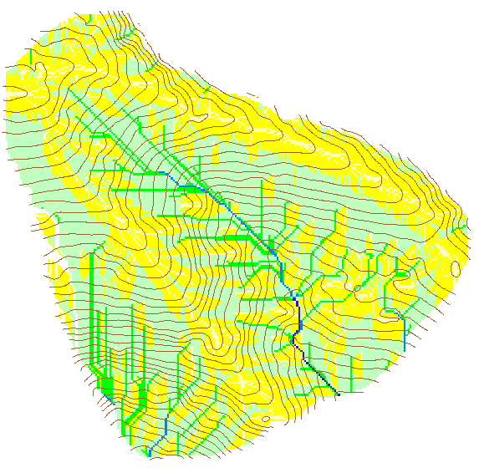

Contributing Area using D∞
Contributing Area using D8

Slide 12
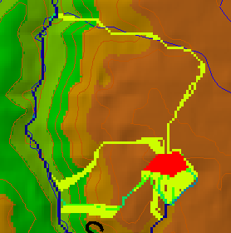
Useful for example to track where sediment or contaminant moves

Slide 13
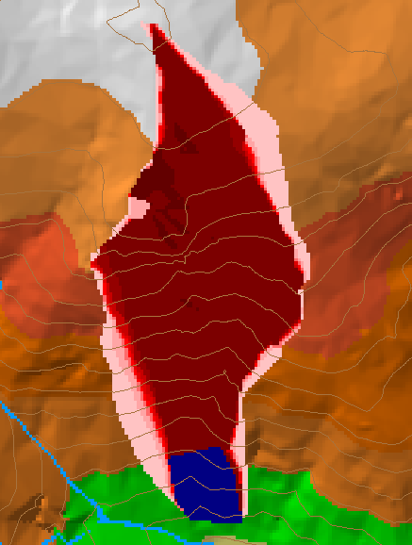
Useful for example to track where a contaminant may come from

Slide 14

Useful for a tracking contaminant or compound subject to decay or attenuation

Slide 15
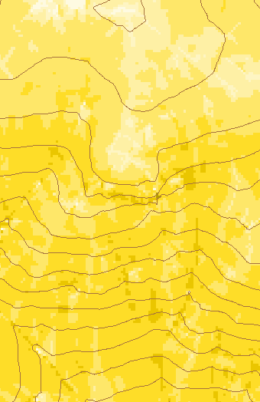
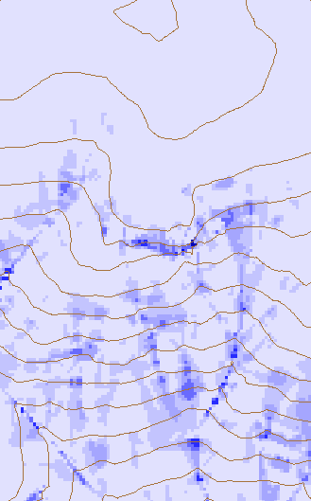
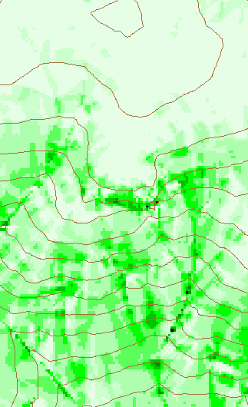
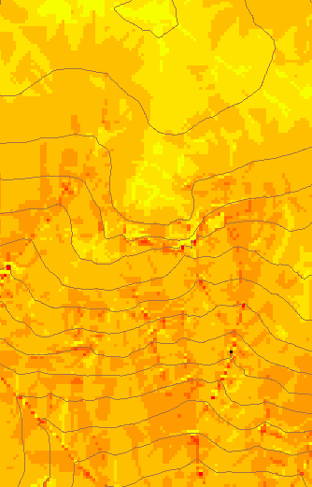
Transport limited accumulation
Useful for modeling erosion and sediment delivery, the spatial dependence of sediment delivery ratio and contaminant that adheres to sediment

Slide 16
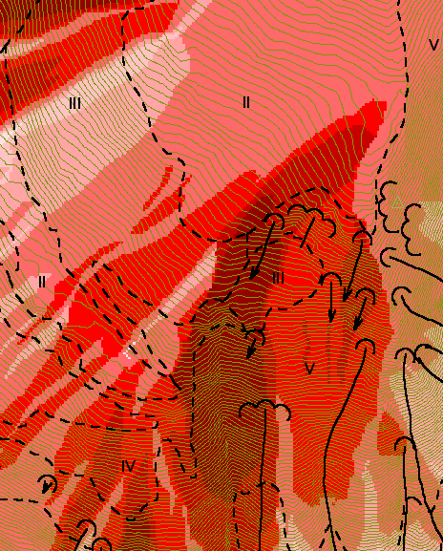
Reverse Accumulation
Useful for destabilization sensitivity in landslide hazard assessment
with Bob Pack

Slide 17
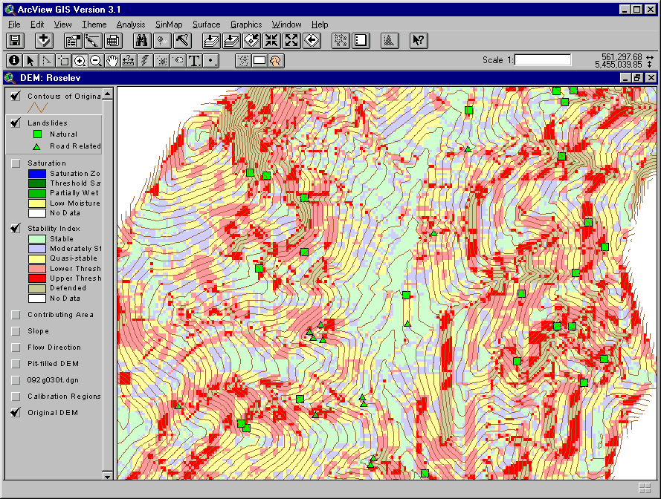
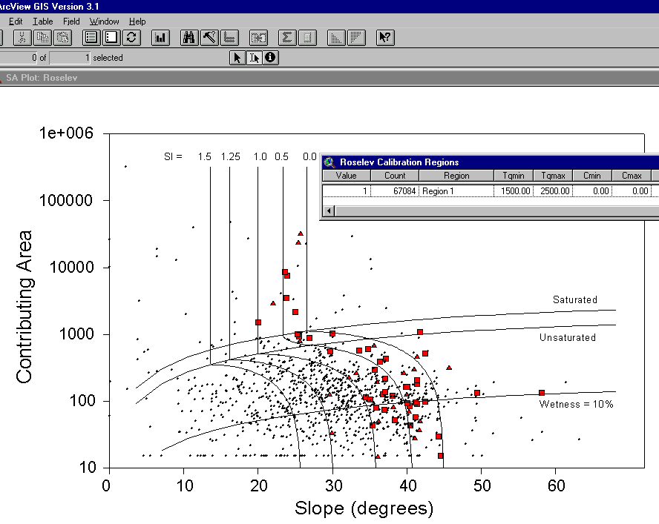
SINMAP
Terrain Stability Mapping
ArcView 3.x Extension
(Bob Pack, Craig Goodwin)

Slide 18




TOPNET
Enhanced TOPMODEL (Beven and Kirkby, 1979 and later) applied to each subwatershed model element.
Kinematic wave routing of subwatershed inputs through stream channel network.
Vegetation based interception component.
Modified soil zone
Infiltration excess
GIS based parameterization
(TOPSETUP)
Reference ET demand
Priestly-Taylor
temp. and radiation based
Interception Store
Canopy Capacity CC (m)
Canopy Storage CV (m)
Throughfall
Snow (in progress)
Precipitation
Infiltration capacity
z_{r}
Soil Store
SR(m) =Soil Zone water content
Infiltration Excess Runoff
Z_{r}=depth of root zone
Precipitation
z
Soil Zone Drainage
Saturated Zone State Variable
Saturation Excess Runoff
Local soil moisture enhancement
Soil moisture deficit/depth to water table from wetness index determines saturated area
Baseflow response from average soil moisture deficit
If z < z_{r} SR is enhanced locally to
Streamflow
Baseflow
With Christina Bandaragoda

Slide 19
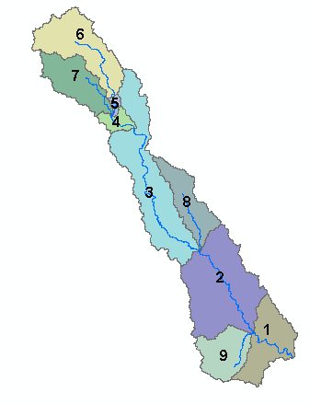
Wetness index histogram for each subwatershed used to parameterize subgrid variability of soil moisture
Basin 7
Basin 6
0.20
Proportion of area
0.20
0.10
Proportion of area
0.10
0.00
0
5
10
15
20
Basin 3
ln(a/S) (a in meter units)
0.00
0
5
10
15
20
Basin 4
ln(a/S) (a in meter units)
0.20
0.30
Proportion of area
0.20
0.10
Proportion of area
0.10
0.00
0
5
10
15
20
0.00
0
5
10
15
20
ln(a/S) (a in meter units)
ln(a/S) (a in meter units)
Basin 2
Basin 8
0.20
0.20
Proportion of area
Proportion of area
0.10
0.10
0.00
0.00
0
5
10
15
20
0
5
10
15
20
25
ln(a/S) (a in meter units)
ln(a/S) (a in meter units)
Basin 9
0.20
Basin 1
0.15
0.20
Proportion of area
0.15
0.10
0.10
0.05
Proportion of area
0.00
0.05
0
5
10
15
20
0.00
With Christina Bandaragoda
ln(a/S) (a in meter units)
0
5
10
15
20
ln(a/S) (a in meter units)

Slide 20
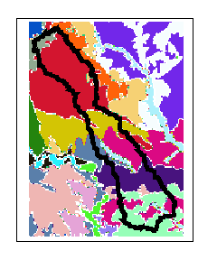
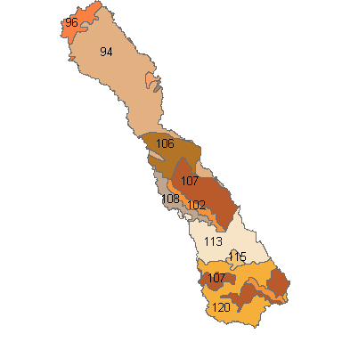
STATSGO Soil derived parameters
Soil texture for each of the 11 standard soil depth grid layers from PSU gridding of NRCS STATSGO data.
Zone Code Polygon Layer
Depth weighted average
θ₁ ,, θ₂ , & ψ_{φ}
Soil Grid Layers
Joined to Polygon Layer
f & K
Exponential decrease with depth
Table of Soil Hydraulic Properties – Clapp Hornberger 1978
Soil parameter look up by zone code
…
With Christina Bandaragoda

Slide 21
Basin average precipitation
Streamflow at outlet
Cumulative
water balance

Slide 22
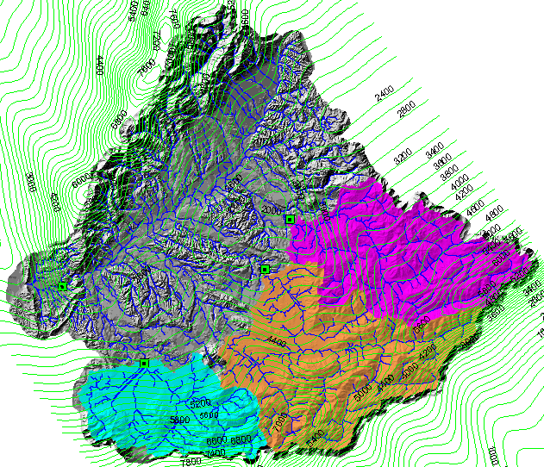
“White space” is the Grey at Dobson minus Ahaura, Arnold and Grey at Waipuna

Slide 23
Shear Stress Threshold Model for Channel Initiation
Channels incise when;
τ_{f}≥τ_{c}
τ_{f}: Effective Shear Stress Overland Flow;
  Overland flow, q_{o};
    Contributing area, a
    Excess rainfall rate, r
  Roughness, n;
    Bare soil, or grains, n_{b}(d₅₀)
    Additional roughness, n_{a}
  Slope, S
τ_{c} :Critical Shear Stress
  -Sediment Size, d₅₀
  -Dimensionless Critical Shear Stress, τ∗
With Erkan Istanbulluoglu, Bob Pack, Charlie Luce

Slide 24
The PCI Theory
Hydraulic and hydrologic hillslope properties are treated as random variables with spatially homogenous probability distributions.
With Erkan Istanbulluoglu, Bob Pack, Charlie Luce

Slide 25
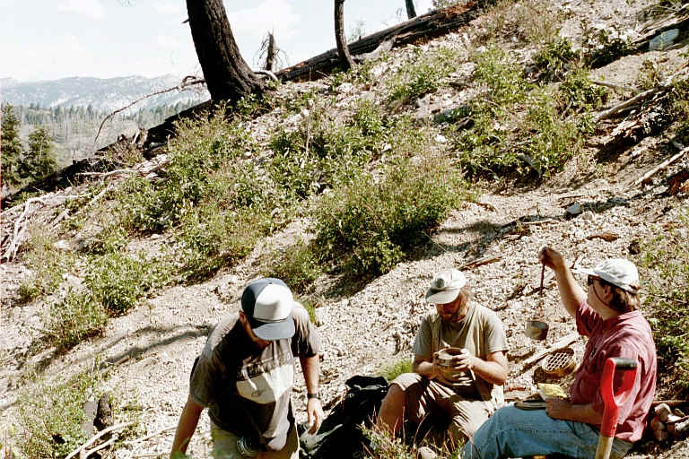
Field observations
Channel head locations identified
Local slopes estimated in the field.
Contributing areas were derived from the DEM.
Sediment size samples were collected just above the headcuts.
Gully cross-section areas measured.
With Erkan Istanbulluoglu, Bob Pack, Charlie Luce

Slide 26
With Erkan Istanbulluoglu, Bob Pack, Charlie Luce

Slide 27
Point-wise Comparison of the Observed aS^{α} and Calculated C at Channel Heads
The theory developed suggested that variation in d₅₀, n_{a} and r is responsible for the variation in aS^{α} at channel heads. We used the measured values of d₅₀ to test the contribution of d₅₀ to this variability. We set α=1.167, r = 35 mm/h, n_{a}= 0.052.
The regression R² and Nash-Sutcliff (NS) error measure indicate that about 40% of the variability in observed aS^{α} may be attributed to d₅₀.
R²=0.387
NS=0.377
With Erkan Istanbulluoglu, Bob Pack, Charlie Luce

Slide 28
Comparison of Channel Initiation Probability Distributions
Trapper Creek Data
With Erkan Istanbulluoglu, Bob Pack, Charlie Luce

Slide 29
PCI in Slope-Area Diagrams
With Erkan Istanbulluoglu, Bob Pack, Charlie Luce

Slide 30
Comparison of Channel Initiation Probability Distributions
Tennessee valley data set (Montgomery and Dietrich, 1989;1992).
With Erkan Istanbulluoglu, Bob Pack, Charlie Luce

Slide 31
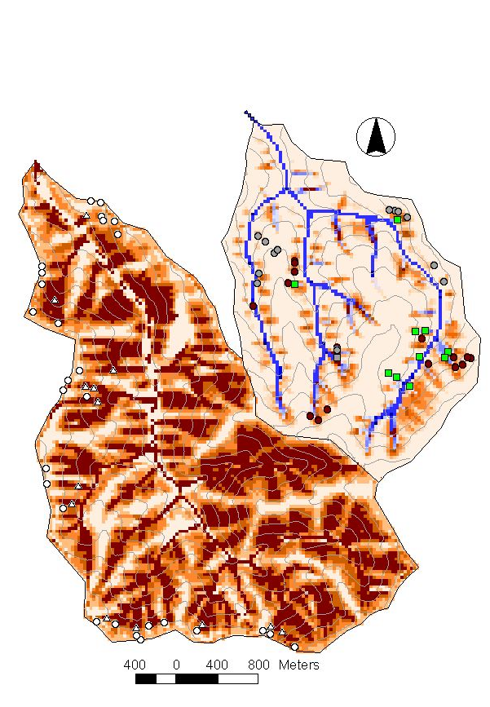
PCI Maps of the Study Watersheds
With Erkan Istanbulluoglu, Bob Pack, Charlie Luce

Slide 32
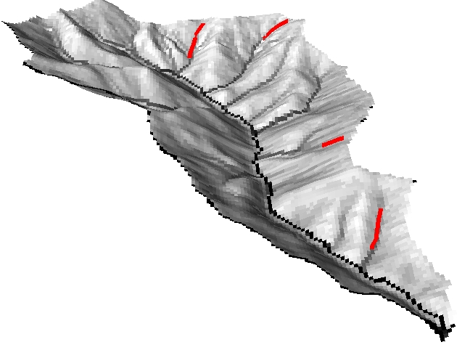
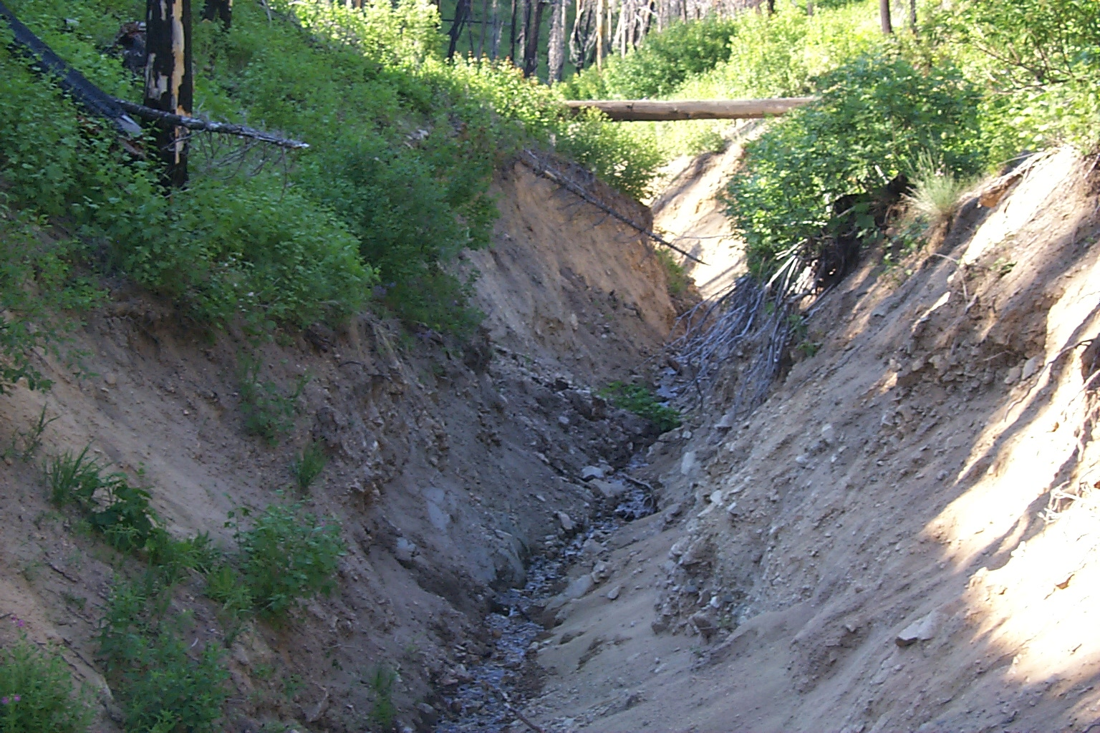
Field Estimates of Transport Capacity
Gully cross-sections are surveyed at
20-30 m spacing.
Slope of each segment is measured.
Sediment volumes are accumulated
downslope.
Tr. 18
Tr. 15
Tr. 5
Tr. 19
With Erkan Istanbulluoglu, Bob Pack, Charlie Luce

Slide 33
Field Data;
With Erkan Istanbulluoglu, Bob Pack, Charlie Luce

Slide 34
as a function of
With Erkan Istanbulluoglu, Bob Pack, Charlie Luce

Slide 35

Dryland Vegetation Distribution
Craig Goodwin
Basic Premises
Moisture is the most significant resource limitation in drylands
Topography is a major factor regulating landscape moisture by:
  Redistribution of moisture by overland flow
    No subsurface lateral flow
  Solar radiation exposure
    South slope versus north slope

Slide 36
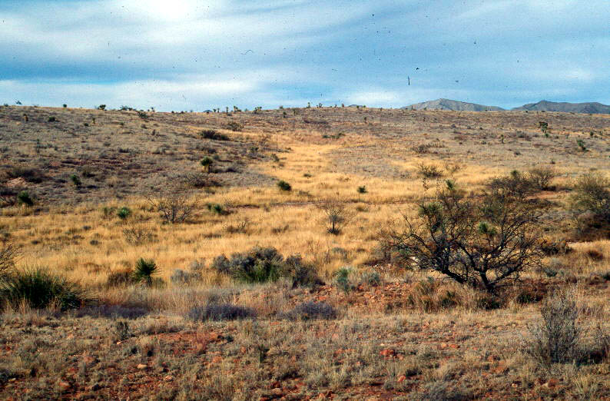
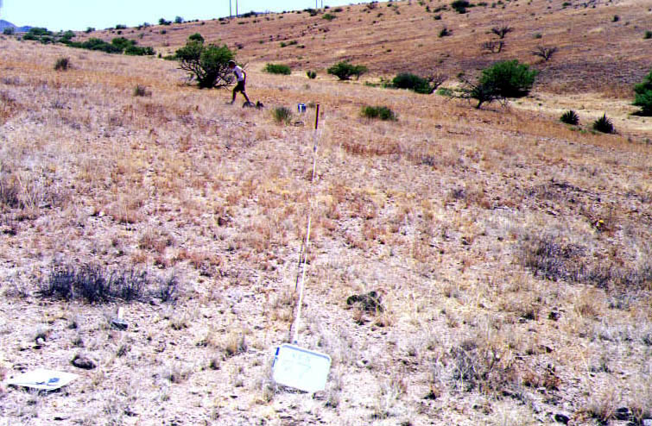
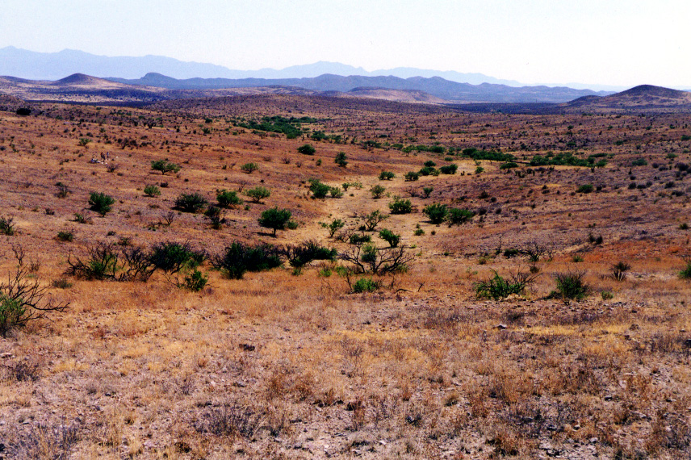
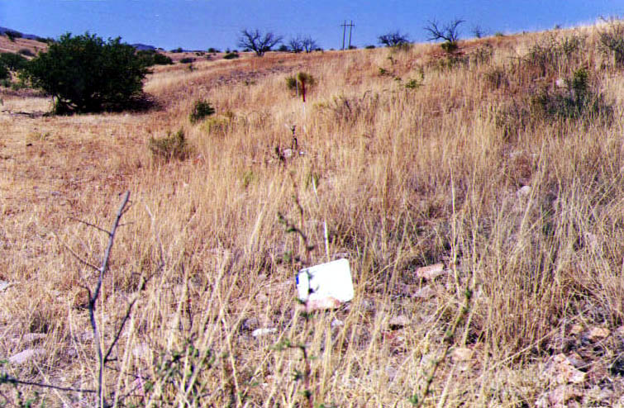
Craig Goodwin
Topographic Factors
Moisture Redistribution
Solar Radiation Exposure
South-facing Hillslope
North-facing Hillslope

Slide 37
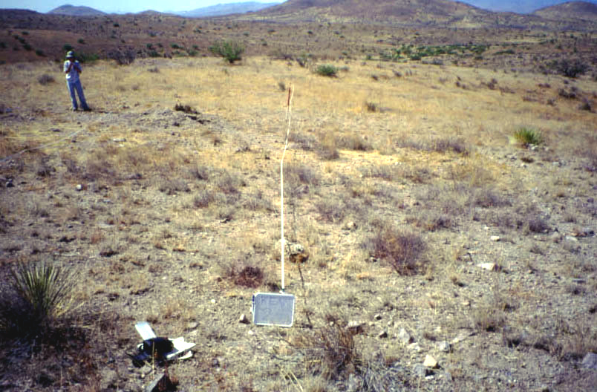
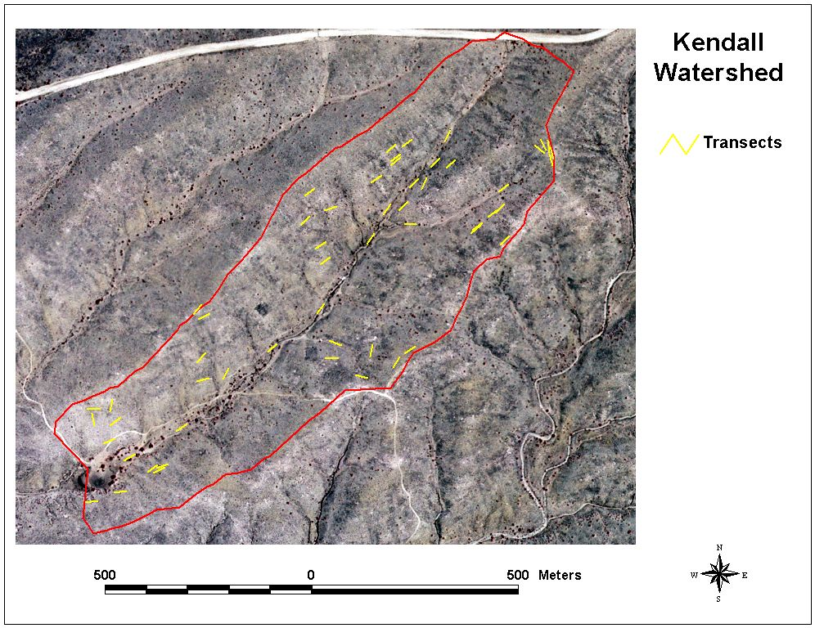
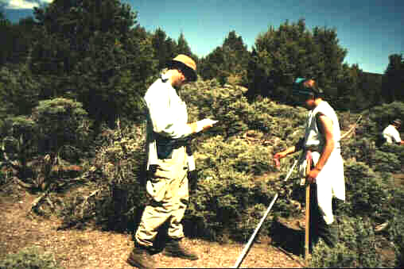
Ecological field data collection
Craig Goodwin
Cover data collected at approximately 60 transects (30 m long) per watershed.
Cover data collected for 100 points per transect, by species, using the “point intercept on a transect method.”

Slide 38
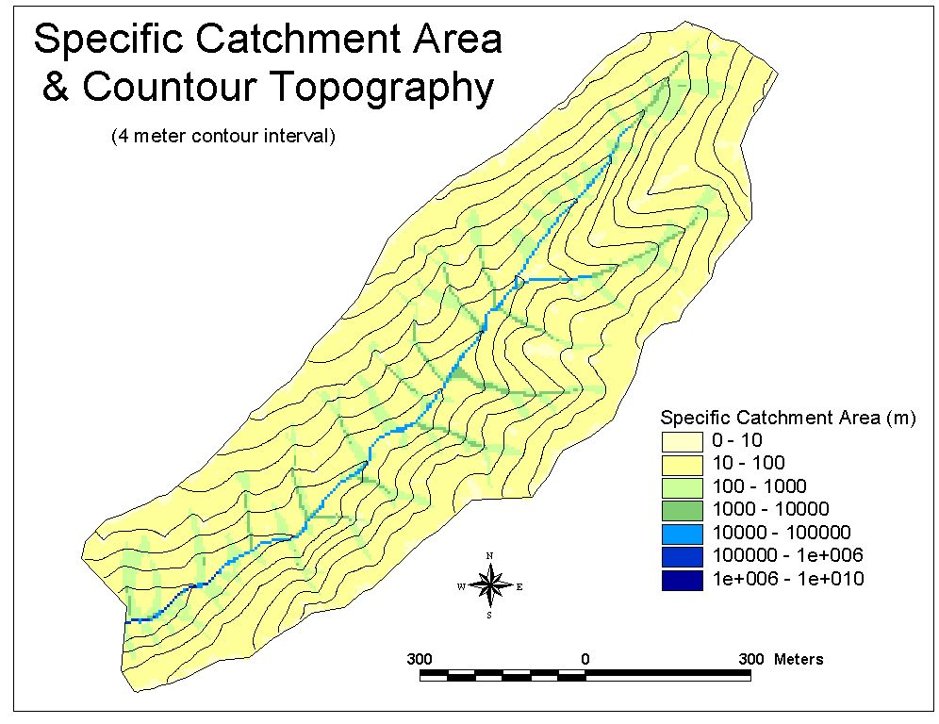
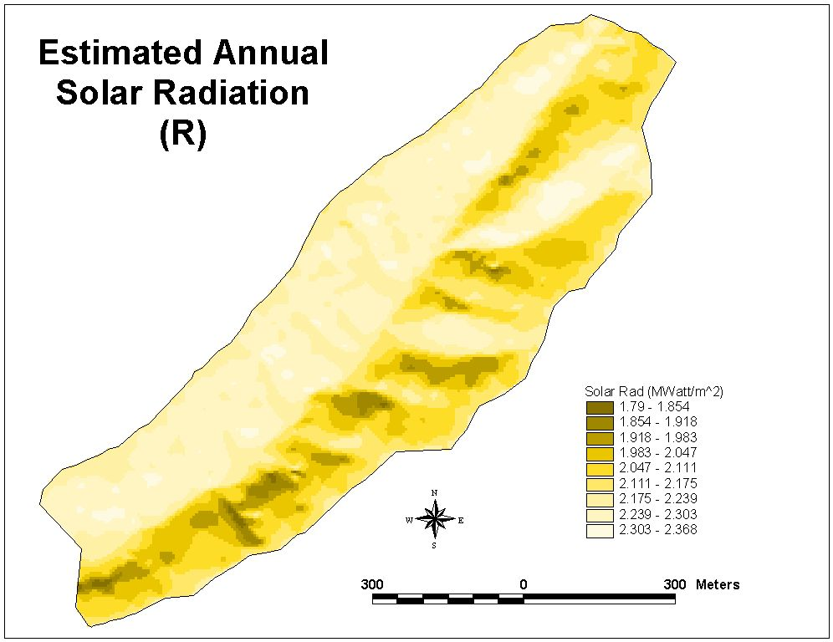
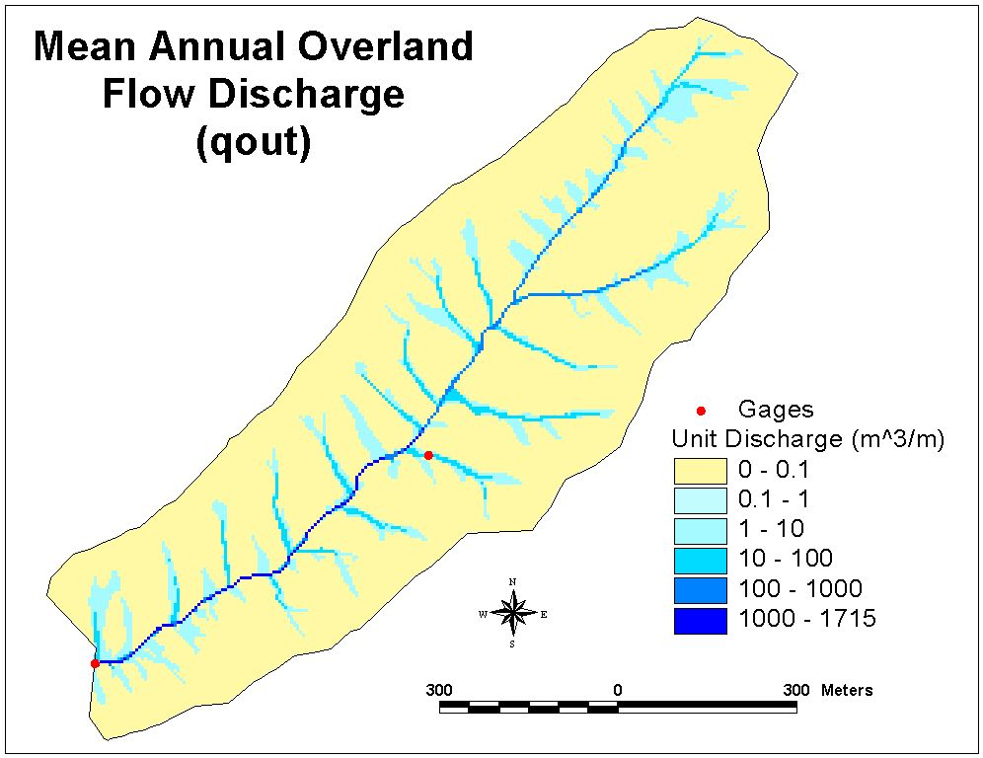
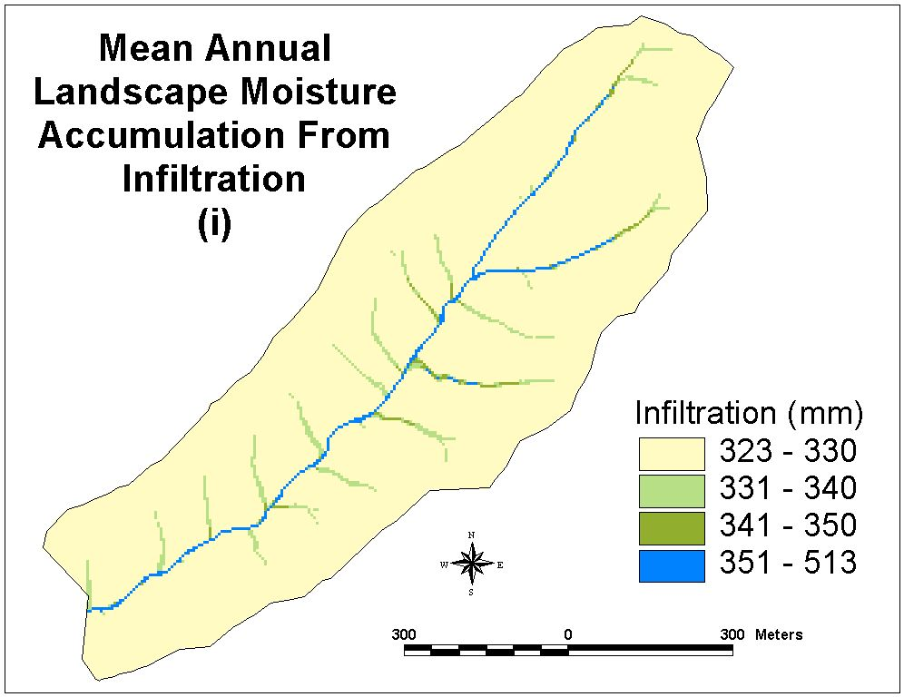
Craig Goodwin

Slide 39
Hydrology Component: Basis
Craig Goodwin
Landscape moisture in drylands is derived from infiltration of precipitation (i_{p}) and overland flow runon (i_{q}).
Infiltration and runoff (q) are partitioned using a storage threshold (h) concept. Daily (storm) rainfalls (p) are derived from an exponential distribution. Total average annual runoff at a point (q_{a}) is obtained by summing over the distribution of precipitation days. [Kirkby, 1994]
A fraction of runon (q_{in}) infiltrates at a point. The fraction that infiltrates is a function of discharge and surface characteristics (k_{s}), which control time of overland flow occurrence at that point.
Large bare ground expanses reduce soil moisture through evaporation. Currently, evaporation is estimated by a simple expression involving climate (k_{c}) and solar radiation (R) parameters (k_{r}), but more robust methods could be used.
A landscape moisture index (LMI), which is spatially distributed across a dryland landscape, is the end product of the hydrology component.

Slide 40
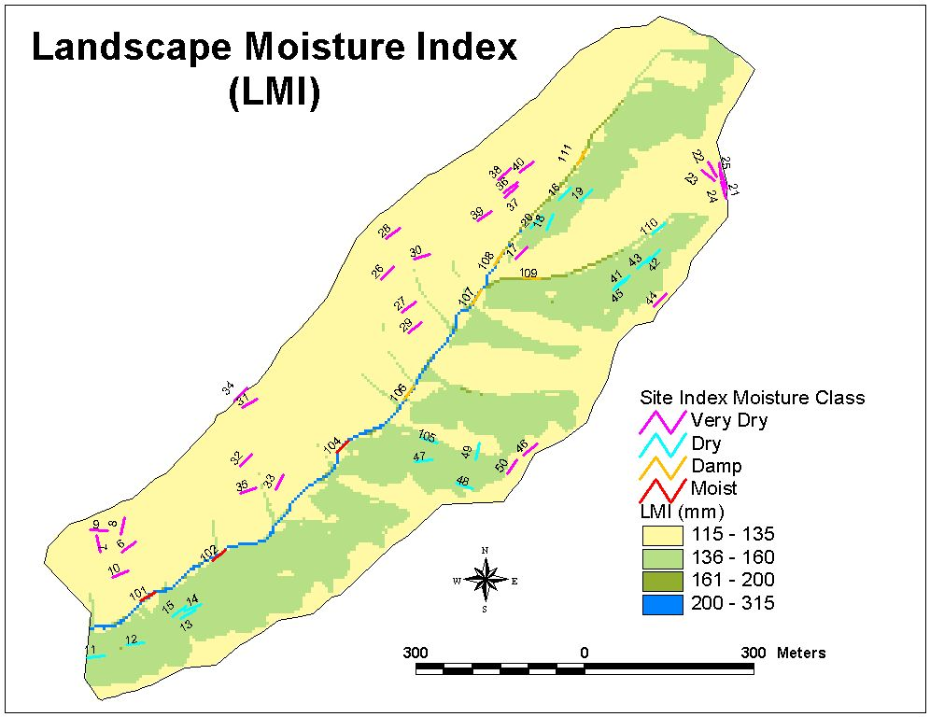
Landscape Moisture Index
Craig Goodwin
Distribution of the landscape moisture index (LMI) across Kendall watershed. Transects average the LMI cell values of cells that they intersect, and are binned into four categories that match the LMI categories. The very dry sites are on the south facing slopes, whereas dry sites occur on north facing slopes. The damp and moist categories occur along the mainstem valley and the two major tributary valleys. Note how the LMI incorporates characteristics of solar radiation and overland flow discharge (and specific catchment area). In the table to the right, vegetation cover data are ordered by LMI and binned using the same categories as shown on the map above.
Cover and LMI data for 4 Species at 55 transects. Cover is number of species hits out of a possible 100.

Slide 41
Cover Frequency Chart
Craig Goodwin
This graph illustrates the binned field data presented in the table on the previous slide. Only four of the 20 species in the watershed are illustrated. These data were used to predict species distribution across the landscape. Distribution of black gramma and velvet mesquite are illustrated on the next slide.

Slide 42
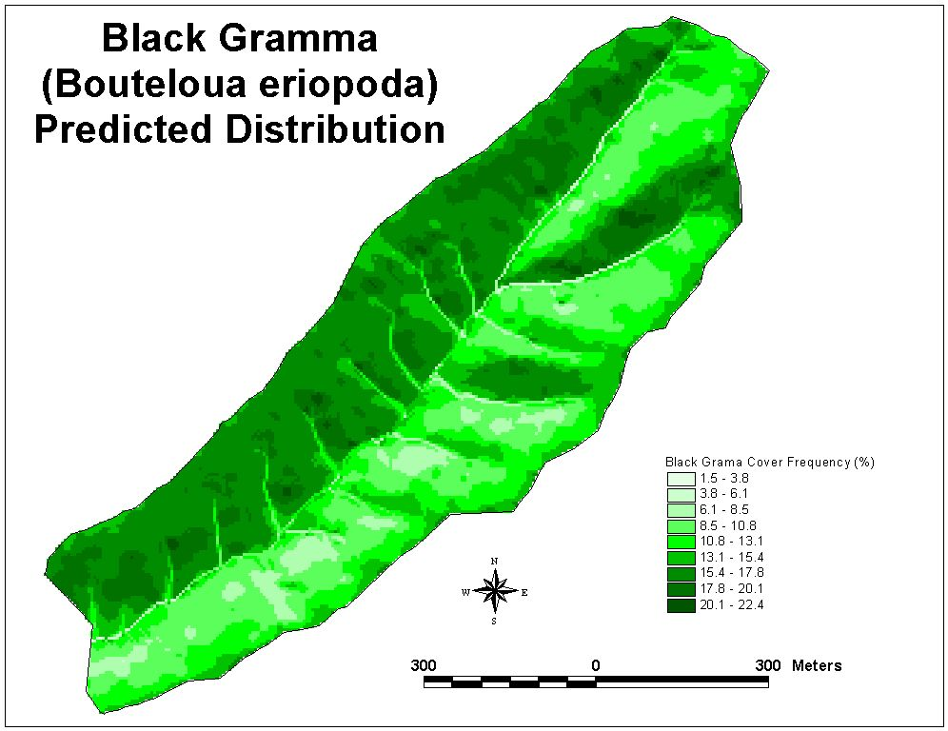
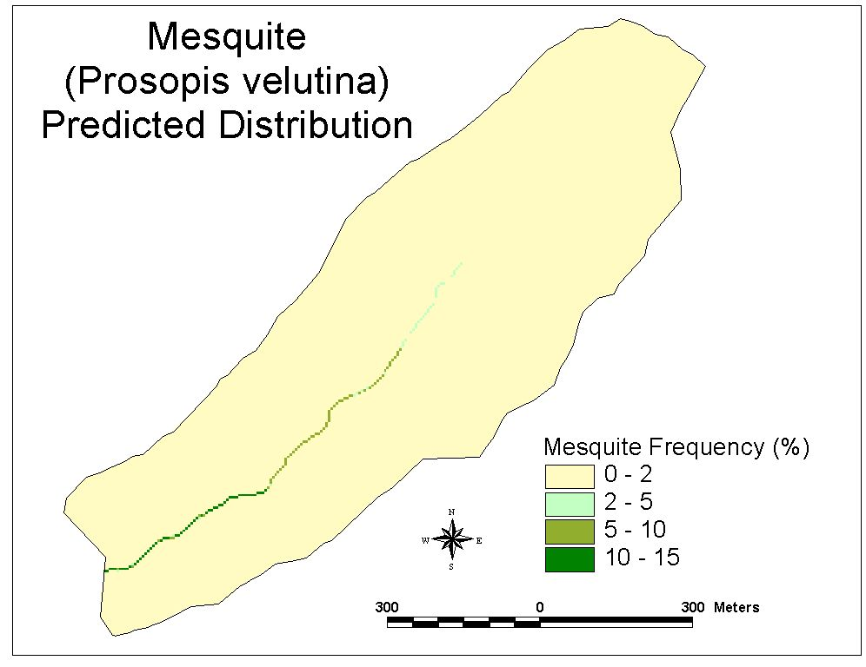
Species Distribution
Craig Goodwin
Black gramma distribution based upon LMI.
Mesquite distribution based upon LMI.

Slide 43
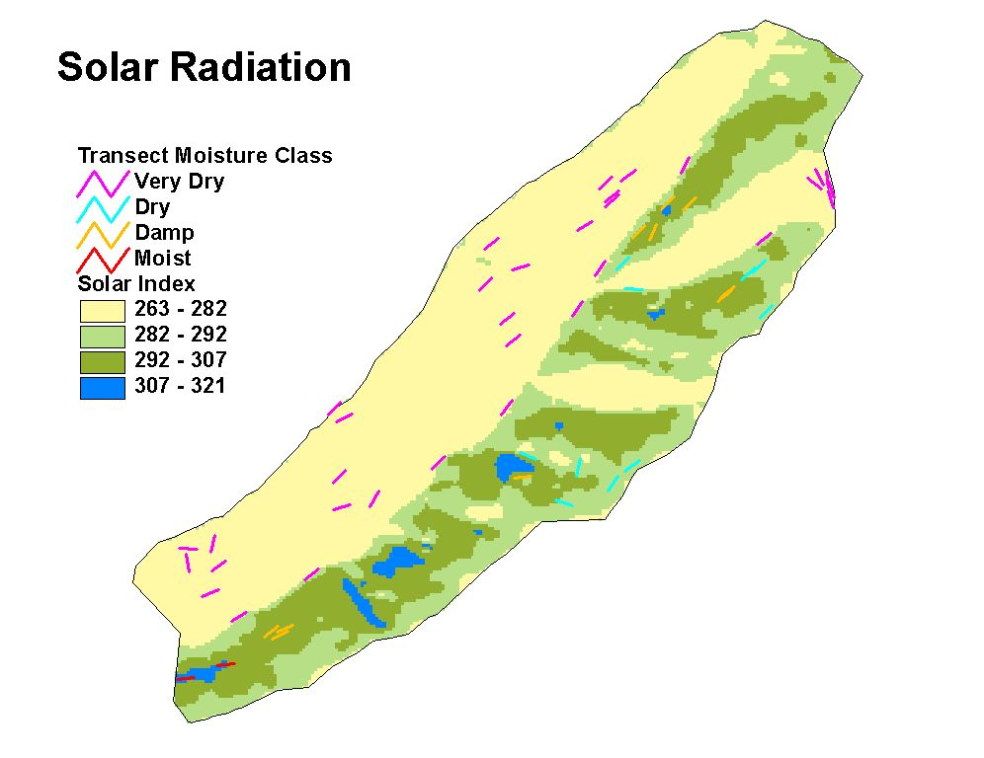
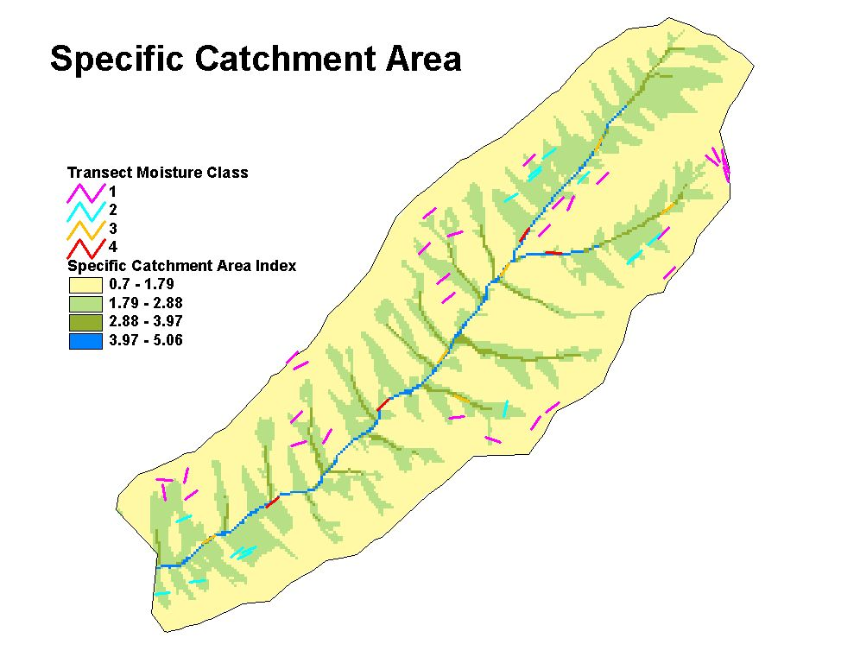
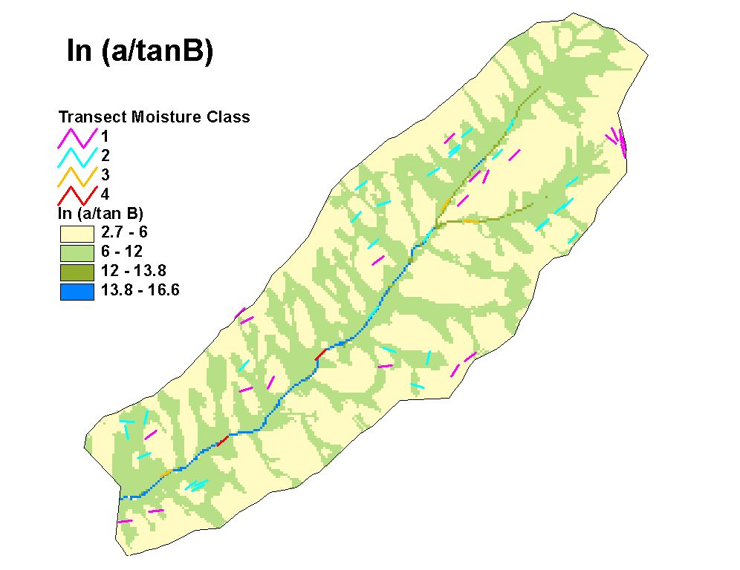
Other Potential Indices:
Do They Work As Well?
Craig Goodwin

Slide 44
Erkan Istanbulluoglu
Vegetation Disturbance Sediment Model
Purposes
How do forest cover conditions influence the frequency and magnitude of stream sediment inputs.
How do natural and human disturbances alter these frequencies and magnitudes.
Motivated by biologic and aquatic community dependence on sediment input regime.

Slide 45
MODELING APPROACH
Erkan Istanbulluoglu

Slide 46
Erkan Istanbulluoglu
Recovery Following Wildfires
In the first few years following vegetation loss fluvial erosion is often observed during thunderstorms.
Following the initial significant increase erosion is suppressed by the growth of under-story vegetation and recovery of the infiltration rates (in 3 to 5 yrs)
Root-strength reduces to minimum values usually after 10 – 15 years and increases landslide susceptibility during this period.

Slide 47
FOREST FIRES
Sampled Annual Maximum Rainfall
Runoff Response
Vegetation Response
10000 years simulation
Erosive Response
Erkan Istanbulluoglu

Slide 48

Erkan Istanbulluoglu
CONSTANT ROOT COHESION (No Vegetation Disturbance)
Soil depth at a point
Summary of the simulations

Slide 49
95% Quantile
Modeled Event S.Y.
Event S.Y. (Observed)
8% Quantile
Modeled LASY
LASY (Observed)
SASY (Observed)

Slide 50
Conclusion
Spatial hydrologic processes play a key role in integrating hydrology with to other fields including Geomorphology, Ecology, and Environmental Policy and Management
Are there any questions ?
AREA 2
3
AREA 1
12
http://www.engineering.usu.edu/dtarb

