Slide 1

Developing a Community Hydrologic Information System
David G Tarboton
David R. Maidment (PI)
Ilya Zaslavsky
Michael Piasecki
Jon Goodall
Graduate students, programmers and collaborators: Jeff Horsburgh, David Valentine, Tim Whiteaker, Bora Beran, Ernest To, Tim Whitenack, Dean Djokic, Zhumei Qian
Support
EAR 0622374
EAR 0413265
http://www.cuahsi.org/his.html

Slide 2
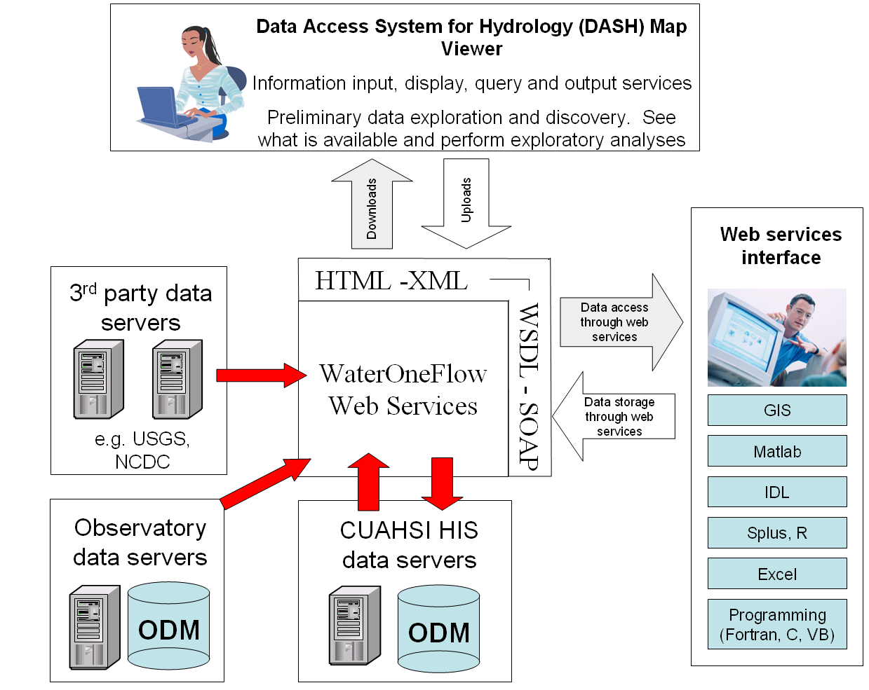
A Services Oriented Architecture for Water Resources Data
Notes:
Hydrologic Information System Service Oriented Architecture

Slide 3
A Services Oriented Architecture for Water Resources Data
Waters Network Information System
Observations Data Model
Web Services

Slide 4
A Services Oriented Architecture for Water Resources Data
Waters Network Information System
Observations Data Model
Web Services

Slide 5
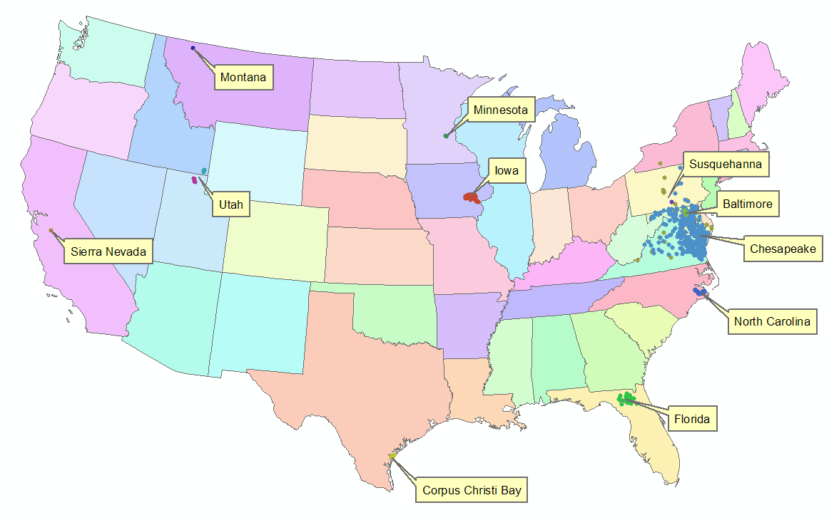
Waters Network Information System

Slide 6
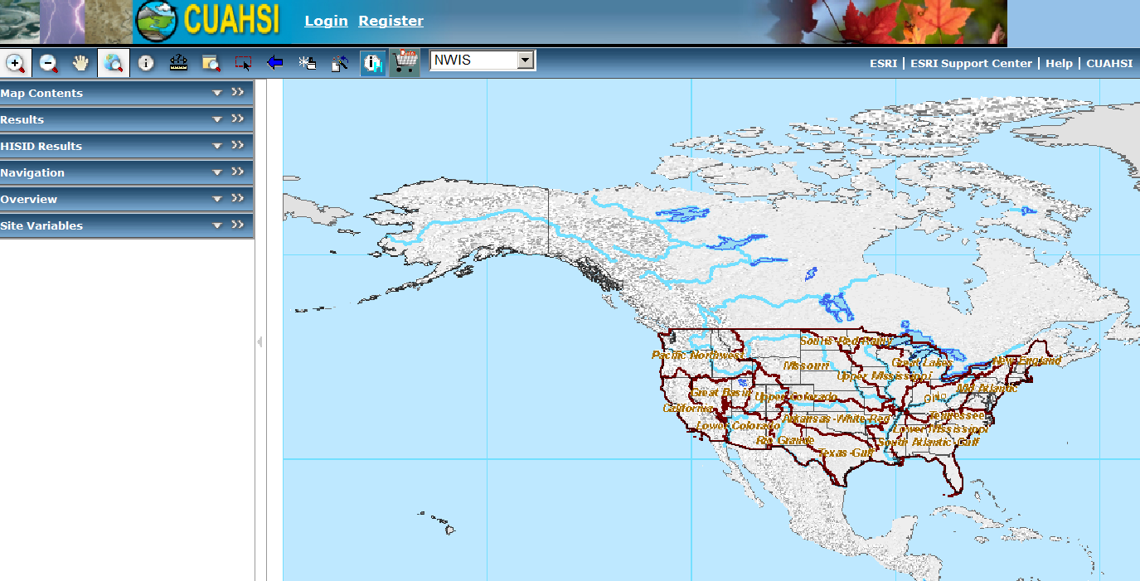
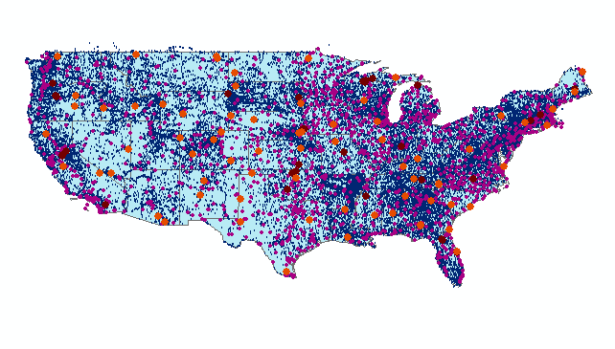
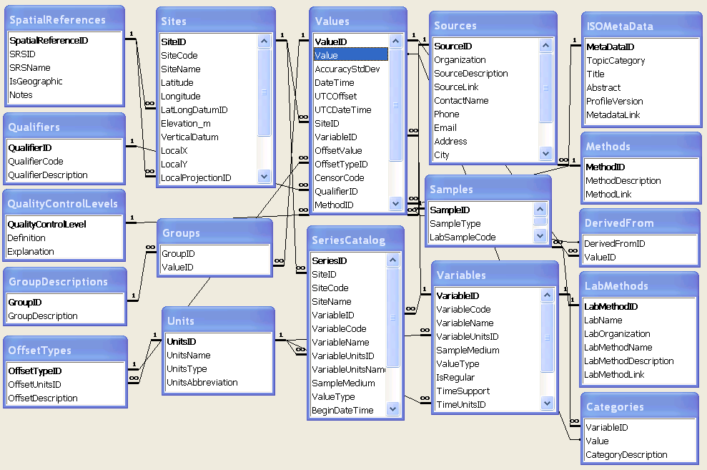
Hydrologic Information Server
WaterOneFlow services
DASH – data access system for hydrology
GetSites
GetSiteInfo
GetVariables
GetVariableInfo
GetValues
ArcGIS Server
Observations Data
Geospatial Data
Microsoft SQLServer Relational Database

Slide 7
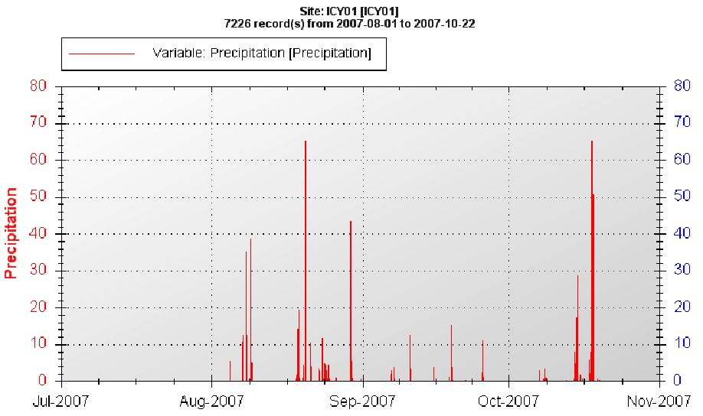
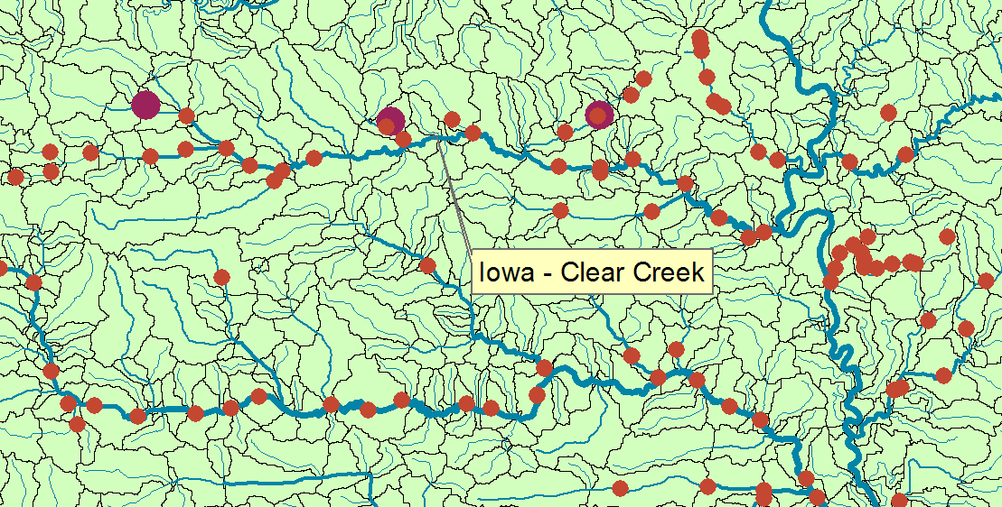
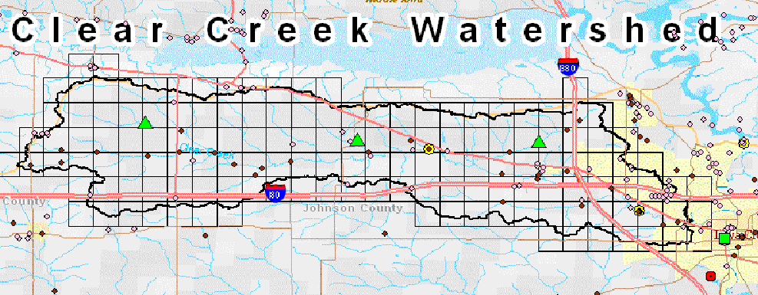
Iowa – Clear Creek Watershed
Uses streaming data loader
Precipitation
PI: Craig Just, Marian Muste, Anton Kruger; DM: Marian Muste, Dong Su Kim, Nick Arnold

Slide 8
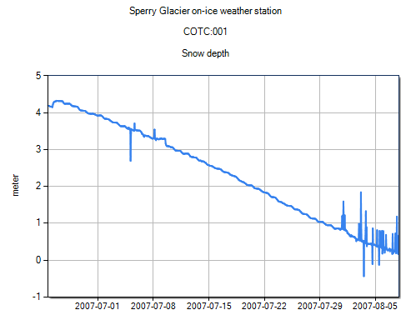
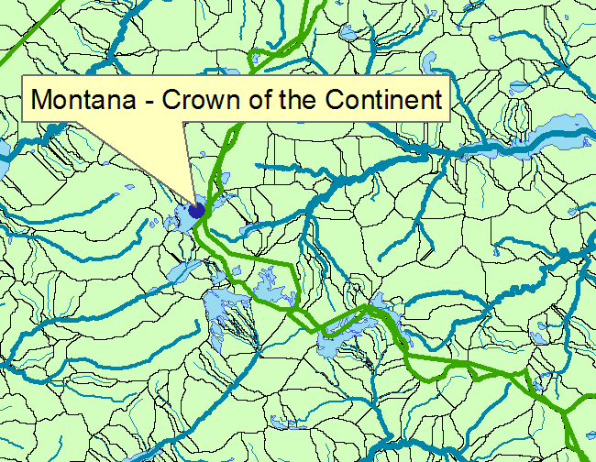
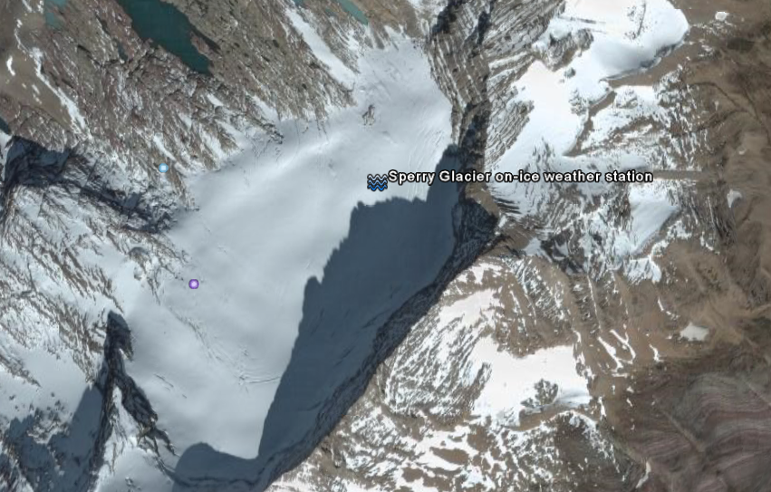
Montana – Crown of the Continent
Snow Depth (m)
Glacier on ice
weather station
4
0
2007: July August
PI: Johnnie Moore, … DM: Toby Meierbachotol, Aaron Deskins

Slide 9
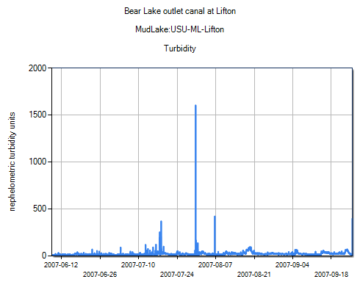
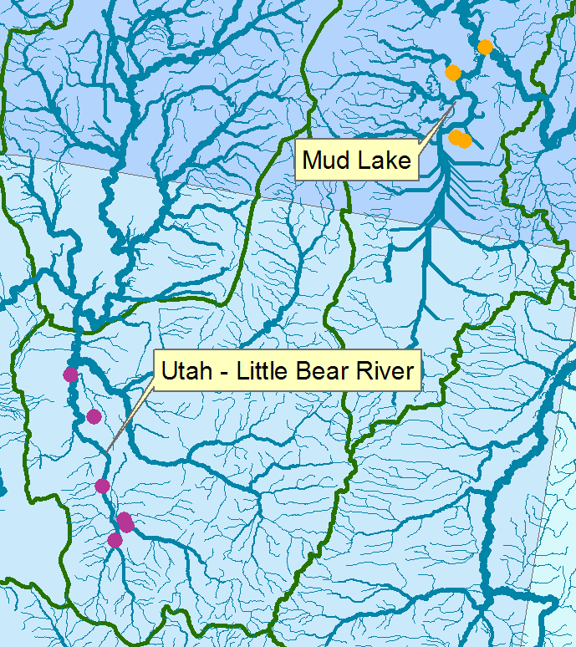
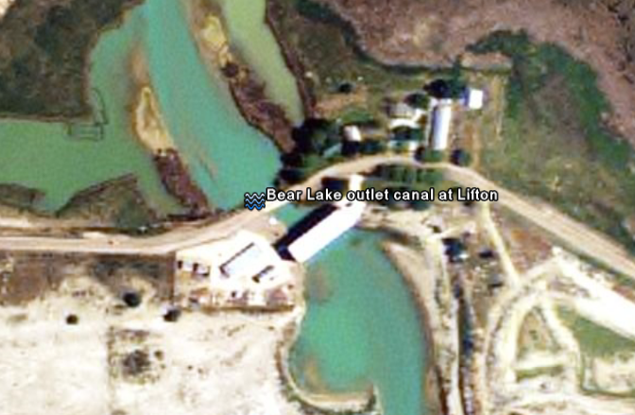
Utah – Little Bear River and Mud Lake
Turbidity
David Stevens, Jeff Horsburgh, David Tarboton, Nancy Mesner, Kim Schreuders

Slide 10
A Services Oriented Architecture for Water Resources Data
Waters Network Information System
Observations Data Model
Web Services

Slide 11
What are the basic attributes to be associated with each single data value and how can these best be organized?
Value
DateTime
Variable
Location
Units
Interval (support)
Accuracy
Offset
OffsetType/ Reference Point
Source/Organization
Censoring
Data Qualifying Comments
Method
Quality Control Level
Sample Medium
Value Type
Data Type

Slide 12
Point Observations Information Model
http://www.cuahsi.org/his/webservices.html
Utah State
Univ
Data Source
Little Bear River
Network
GetSites
GetSiteInfo
Little Bear River at Mendon Rd
Sites
GetVariables
Dissolved Oxygen
Variables
GetVariableInfo
GetValues
9.78 mg/L, 1 October 2007, 6PM
Values
{Value, Time, Qualifier, Offset}
A data source operates an observation network
A network is a set of observation sites
A site is a point location where one or more variables are measured
A variable is a property describing the flow or quality of water
A value is an observation of a variable at a particular time
A qualifier is a symbol that provides additional information about the value
An offset allows specification of measurements at various depths in water

Slide 13
CUAHSI Observations Data Model
A relational database at the single observation level (atomic model)
Stores observation data made at points
Metadata for unambiguous interpretation
Traceable heritage from raw measurements to usable information
Standard format for data sharing
Cross dimension retrieval and analysis
Streamflow
Groundwater
levels
Precipitation
& Climate
Soil
moisture
data
Water Quality
Flux tower
data

Slide 14
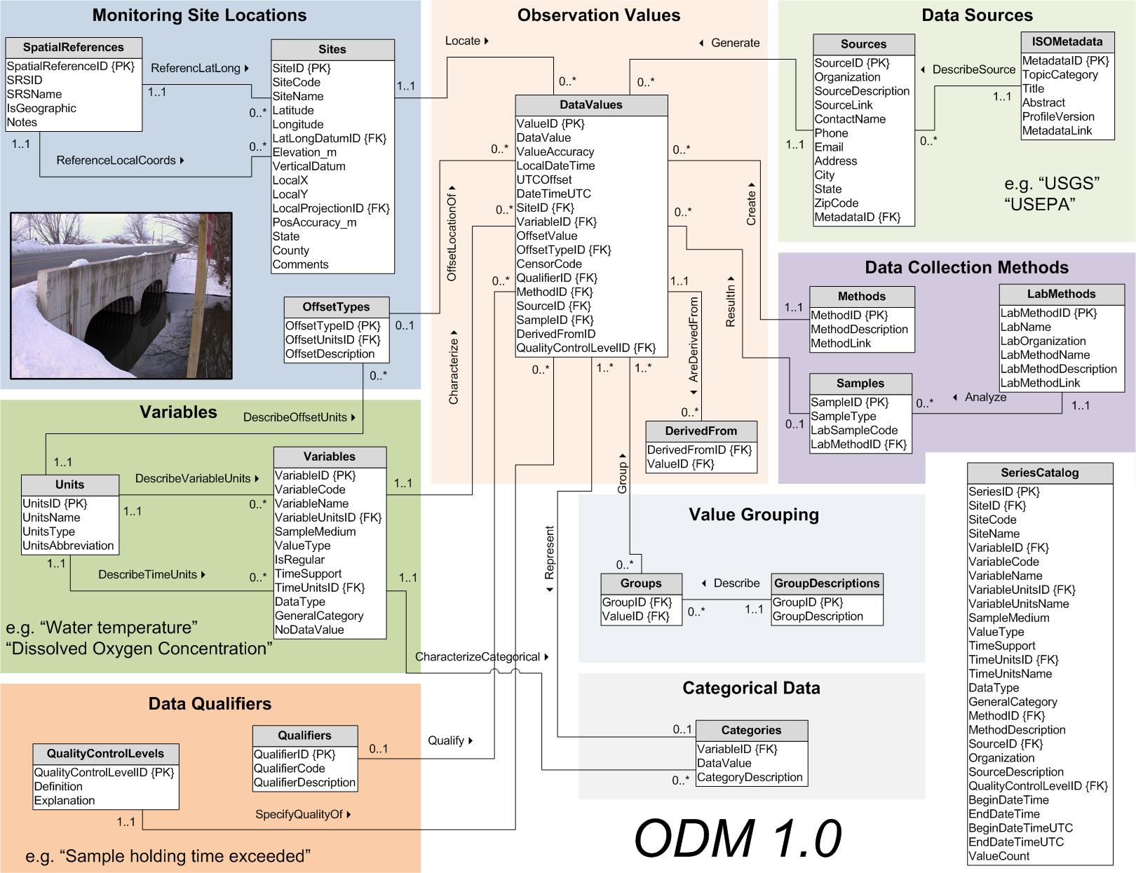
CUAHSI Observations Data Model
http://www.cuahsi.org/his/odm.html

Slide 15
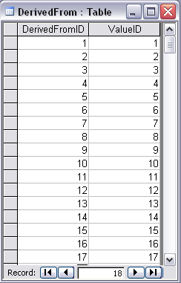
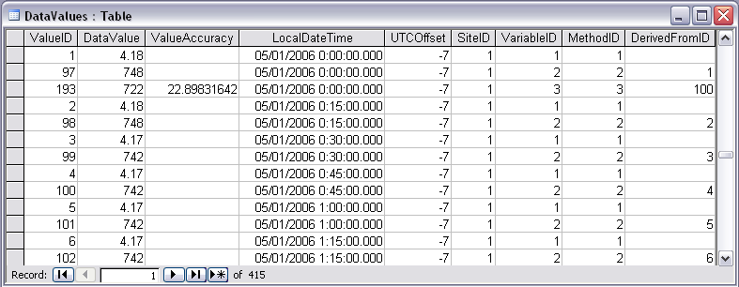
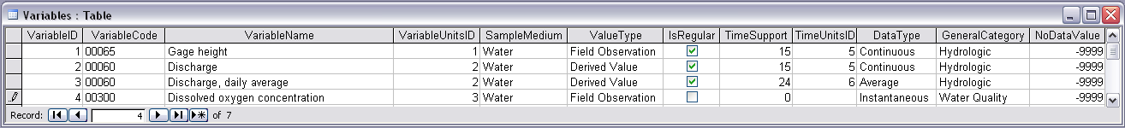
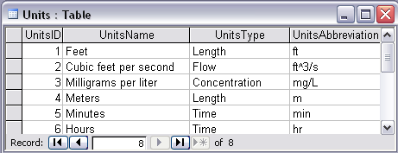
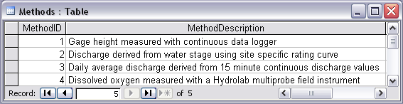
Stage and Streamflow Example
Notes:
Discharge Derived from Gage Height
Concepts:
Data derived from other data – single data point derived from a single observation (discharge from stage)
Data derived using a specific method (discharge from stage using rating curve)
Relationships:
Relationships between Values table and DerivedFrom table on DerivedFromID and ValueID
Relationship between Values table and Variables table on VariableID
Relationship between Values table and Methods table on MethodID
Relationship between Variables table and Units table on UnitID

Slide 16
A Services Oriented Architecture for Water Resources Data
Waters Network Information System
Observations Data Model
Web Services

Slide 17
WaterOneFlow Web Services
A major focus of Web services is to make functional building blocks accessible over standard Internet protocols that are independent from platforms and programming languages.
The Web Services Description Language (WSDL, pronounced 'wiz-dəl' or spelled out, 'W-S-D-L') is an XML-based language that provides a model for describing Web services.
Defined by the World Wide Web Consortium (W3C)

Slide 18
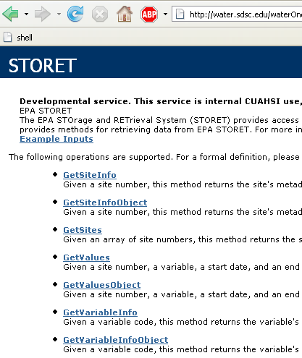
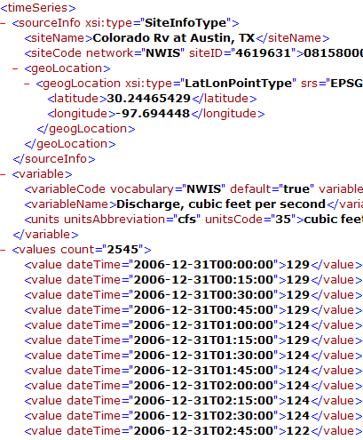
WaterOneFlow
Set of query functions
Returns data in WaterML
Ilya Zaslavsky and David Valentine, SDSC

Slide 19
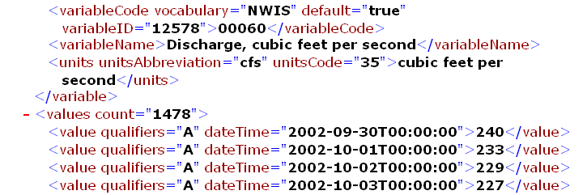
Example: Matlab use of CUAHSI Web Services
% create NWIS Class and an instance of the class
createClassFromWsdl('http://water.sdsc.edu/wateroneflow/NWIS/DailyValues.asmx?WSDL');
WS = NWISDailyValues;
% GetValues to get the data
siteid='NWIS:02087500';
bdate='2002-09-30T00:00:00';
edate='2006-10-16T00:00:00';
variable='NWIS:00060';
valuesxml=GetValues(WS,siteid,variable,bdate,edate,'');

Slide 20
Parse XML and Analyze
% Parse the XML into a Matlab object to work with
valuesobj=xml_parseany(valuesxml);
...
plot(date,flowval);datetick;

Slide 21
Conclusion: Web services work!
The CUAHSI Hydrologic Information System (HIS) is a geographically distributed network of hydrologic data sources and functions that are integrated using web services oriented architecture so that they function as a connected whole.
For more information: http://www.cuahsi.org/his.html

Slide 22
Conclusions
Hydrologic Information Server is functioning at 11 WATERS Network testbed sites across the U.S.
Data are published in a consistent format (WaterML) and are thematically synthesized in Hydroseek with water agency data
Applications and analyses can operate seamlessly over the Waters Network data services
A lot more to be done – GIS, weather and climate, remote sensing, simulation modeling, interpretive analysis, ….. Digital Watershed development!

Slide 23
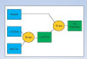
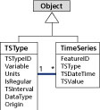
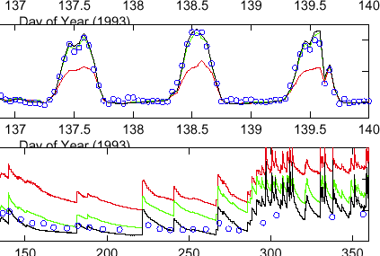
Advancement of water science is critically dependent on integration of water information
Databases: Structured data sets to facilitate data integrity and effective sharing and analysis.
- Standards
- Metadata
- Unambiguous interpretation
Analysis: Tools to provide windows into the database to support visualization, queries, analysis, and data driven discovery.
Models: Numerical implementations of hydrologic theory to integrate process understanding, test hypotheses and provide hydrologic forecasts.
Models
ODM
Web Services
Databases
Analysis

Slide 24
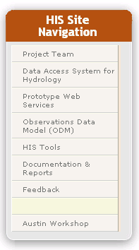
HIS Website http://www.cuahsi.org/his.html
Project Team – Introduces members of the HIS Team
Data Access System for Hydrology – Web map interface supporting data discovery and retrieval
Prototype Web Services – WaterOneFlow web services facilitating downlad of time series data from numerous national repositories of hydrologic data
Observations Data Model – Relational database schema for hydrologic observations
HIS Tools – Links to end-user applications developed to support HIS
Documentation and Reports – Status reports, specifications, workbooks and links related to HIS
Feedback – Let us know what you think
Austin Workshop – Material from WATERS workshop in Austin, TX, Nov 14-17, 2006

Slide 25
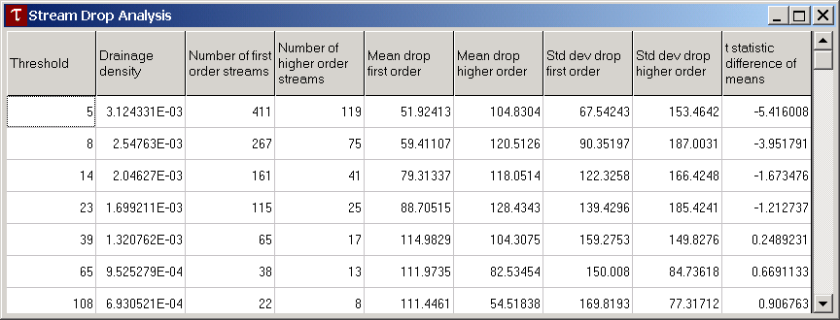
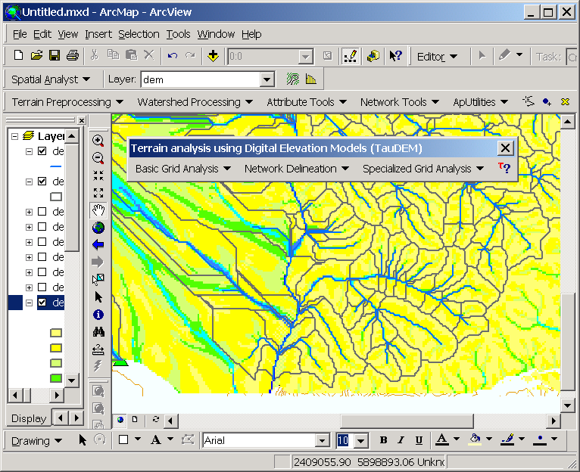
Questions?
AREA 2
3
AREA 1
12

