Slide 1
Integrated Water Science in the Great Salt Lake Basin
David Tarboton
Utah State University Water Initiative
http://water.usu.edu/

Slide 2
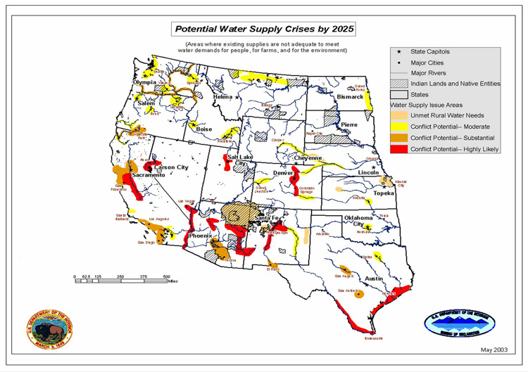
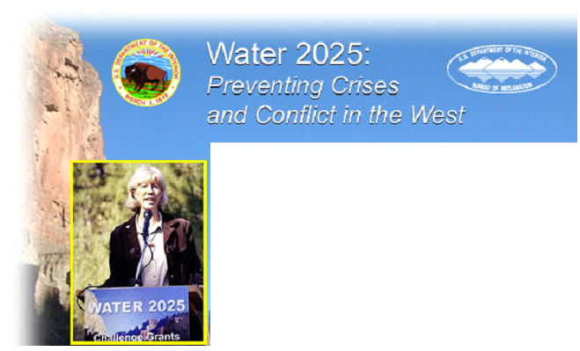
The availability of water to sustain life is perhaps the most recurrent constraint in human history and will remain so in the foreseeable future.
From http://www.doi.gov/water2025/index.html

Slide 3
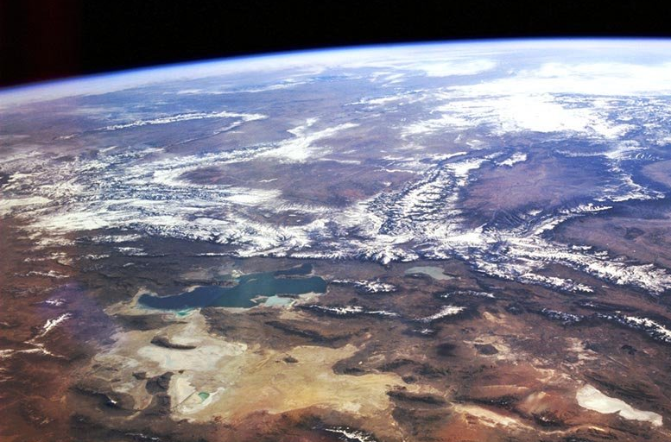
The Great Salt Lake Basin
Strawberry
Bear
Weber
Jordan/Provo
West Desert
A microcosm for many Western Water Issues

Slide 4
A microcosm for many "western" water issues
Climate Gradients (Snow fed, Alpine to semi-arid), variability and vulnerability
Topographic and Land Use Gradients
Mountain Front / Valley groundwater dynamics and interactions
Geologic Diversity (Granite to Karst)
Closed basin for water and constituent balance closure
Development issues (local growth, SLC metropolitan area demands)
Policy Issues (3 states)
Agricultural issues (water supply, environmental compliance)
Environmental Issues (water quality, watershed management practices)
Ecological issues (Stream ecosystems, Bird refuge, GSL ecosystem)

Slide 5
Addressing the water issues of the future requires working across disciplines
  and a workforce that is capable of working across disciplines
  and universities that educate the workforce ready to work across disciplines

Slide 6

Adapted from: National Research Council Committee on Opportunities in the Hydrologic Sciences (COHS), (1991), Opportunities in the Hydrologic Sciences, Editor, P. S. Eagleson, National Academy Press, Washington, D.C.
Interdisciplinary Integration of Water Resources Disciplines
Basic Sciences
Mathematics
Statistics
Physics
Chemistry
Biology
Geosciences
Geology
Soil Science
Atmospheric Science
Ocean Science
Glaciology
Geochemistry
Economics
Law
Sociology
Political Science
Engineering Hydrology
Agriculture
Forestry
Fluid Mechanics
Hydraulic Engineering
Meteorology
Hydrologic Science
Water Resources

Slide 7
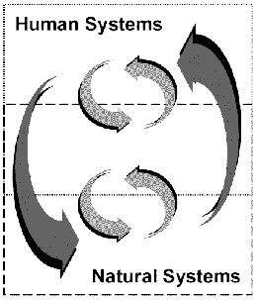
Interdisciplinary work is now emphasized nationally
$14.5 million

Slide 8
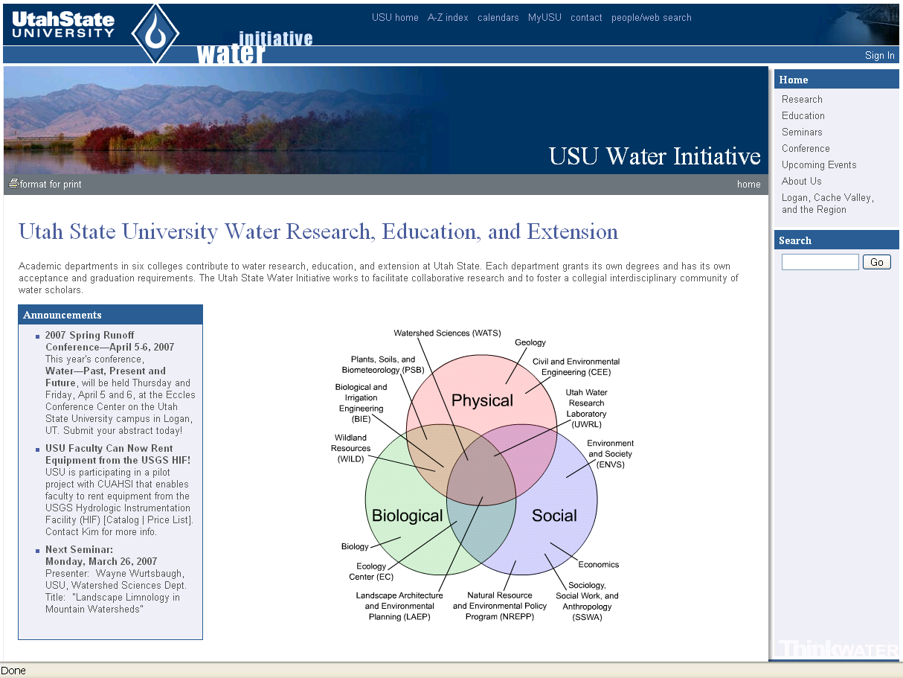
http://water.usu.edu

Slide 9
Community Building Activities
Seminars (archived and webcast)
Spring Runoff Conference
Website (http://water.usu.edu)

Slide 10
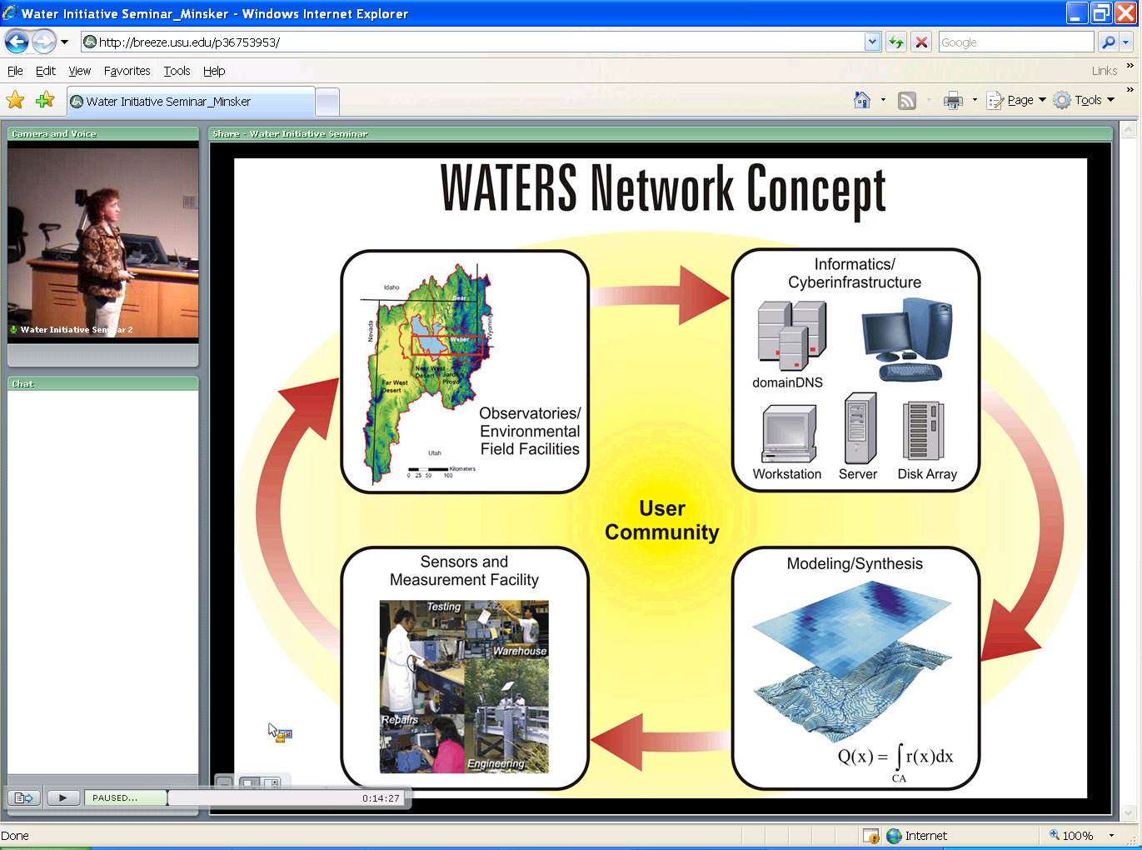
Monday’s Seminar

Slide 11
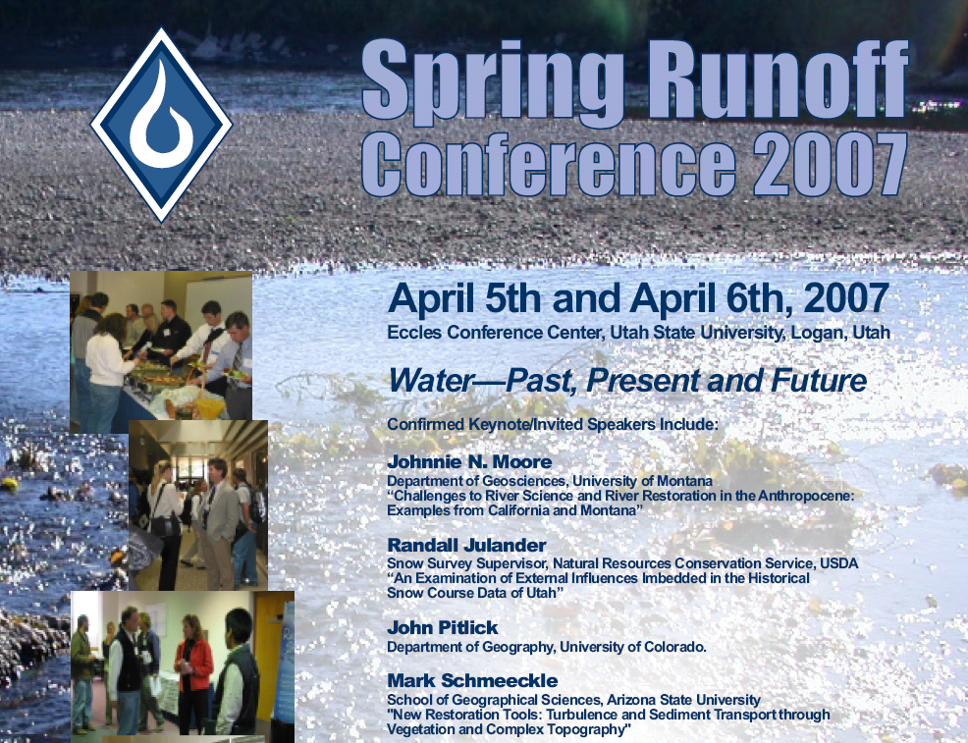

Slide 12
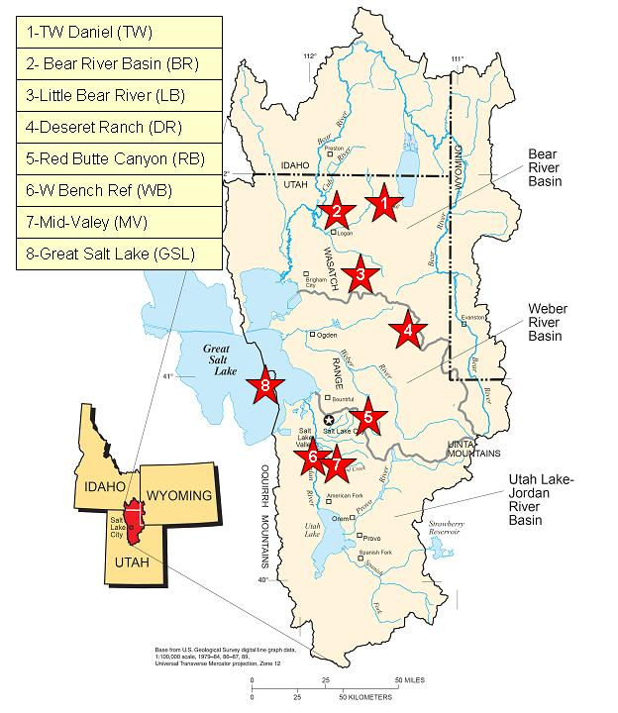
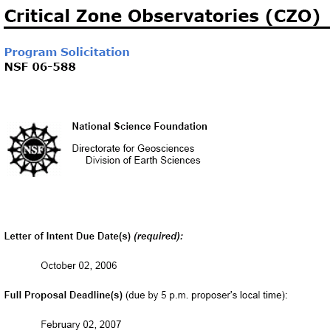
A common playground
The Great Salt Lake Basin Critical Zone Observatory
(Proposal submitted to NSF)

Slide 13
Snowfall
Sublim^{n}
Particulate
Transport
Signal
Grassland
Steppe ET
Forest ET
Urban ET
Lake Evap^{n}
Snowmelt
Infiltration &
Chemistry
Agriculture ET
Runoff
Response
Hyporheic
Zone
Groundwater
Flow
Hyporheic
Zone
Urban
Chemistry
Lake
Chemistry
Basin Fill
Mountain Block

Slide 14
Particulate Feedback
Exposed Lake
Bed Area
Particulate
Generation
Particulate
Transport
Ag/Urban
Discharge
Lake
Area
Ag/Urban
Hydrology
Design
Snowfall
Urban/Ag
Ag/Urban
ET
Ag/Urban
Runoff
Particulate
Deposition
Lake
Salinity
Ag/Urban
GW Recharge
Reactive
oxygen
species
Lake
Evaporation
Snowpack
Ag/Urban
Diversion
Lake
Volume
Sublimation
Population
Snowmelt
Lake
Vegetation
Snow/Veg
Runoff
ET
Precipitation
Hyporheic
Storage
Soil
Storage
GW
Discharge
Residence Time
Mountain Block
GW Recharge
ET = Evapotranspiration
GW = Groundwater
GW
Storage

Slide 15
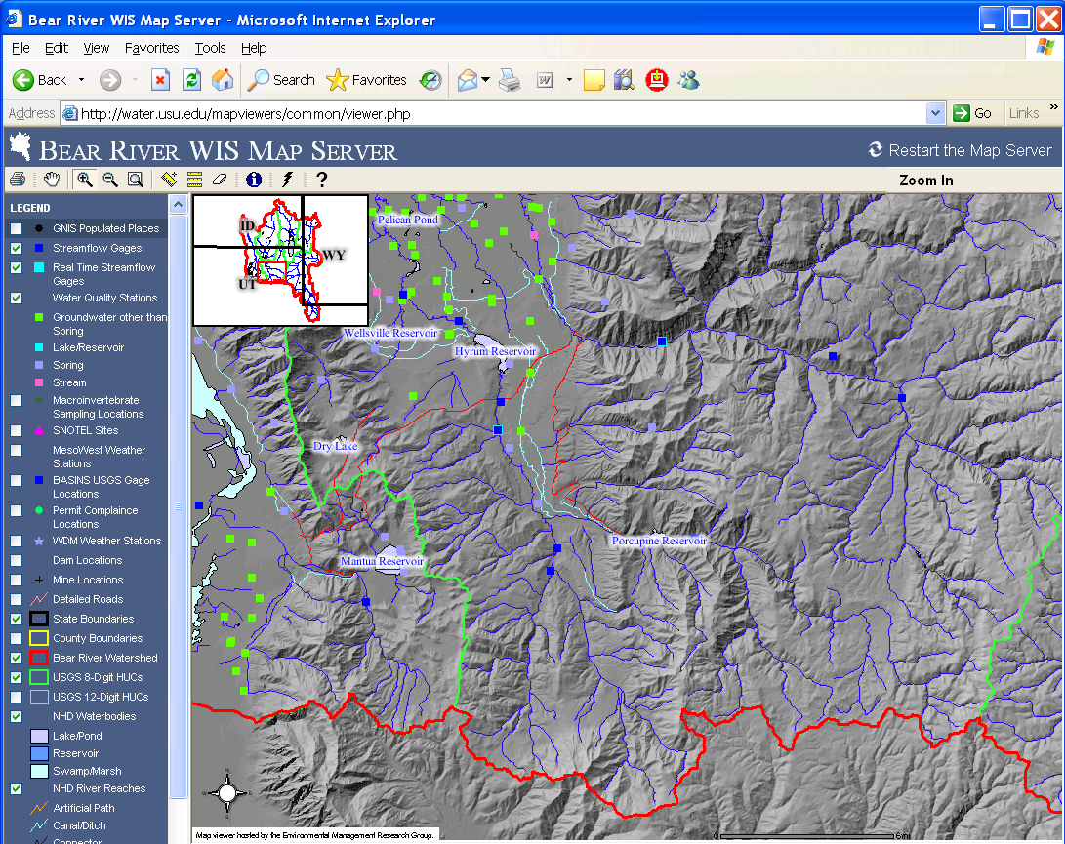
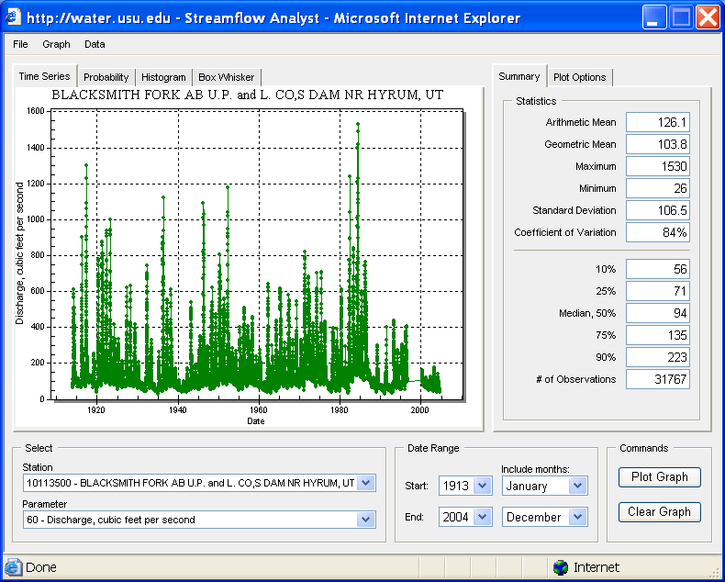
A community data system http://www.bearriverinfo.org

Slide 16
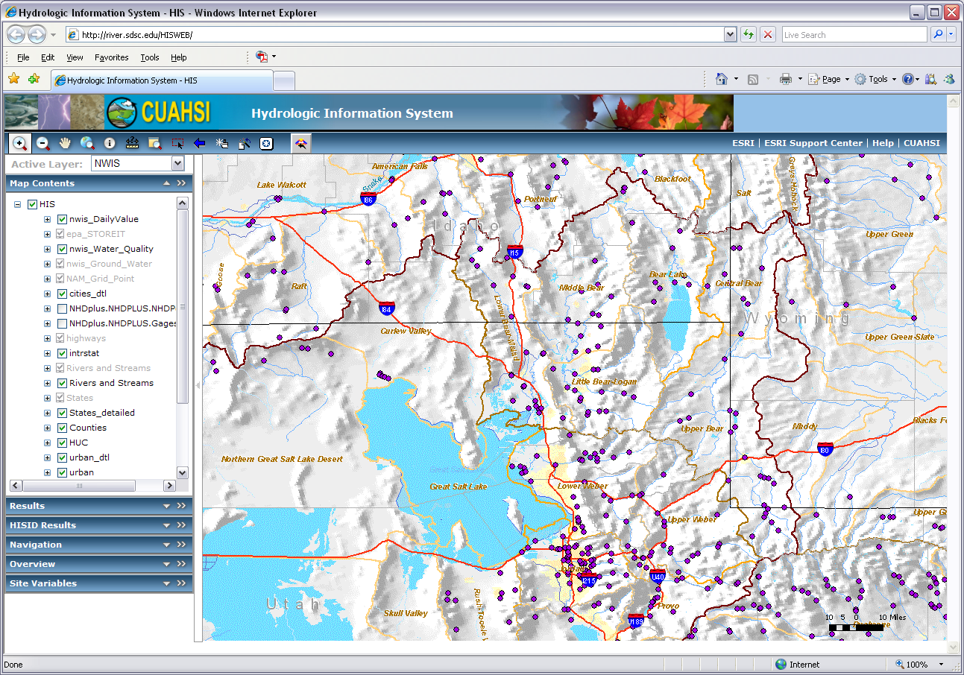
CUAHSI Hydrologic Data Access System

Slide 17
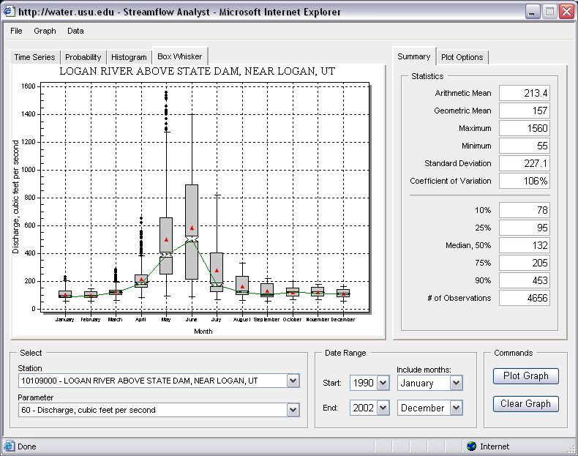
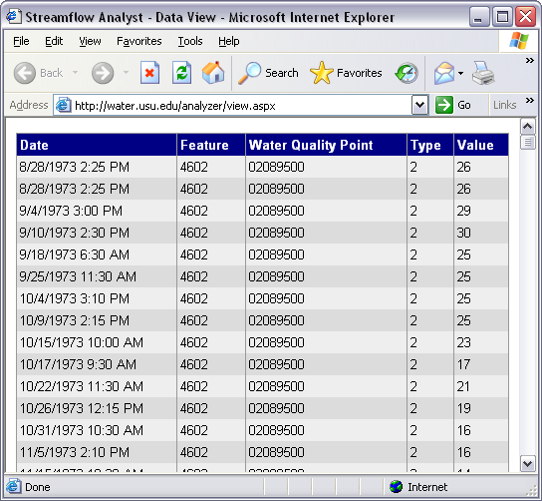
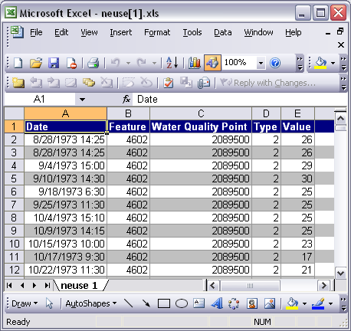
SQL Queries passed from Time Series Viewer to the server database
Query results can be exported to a browser window or directly to Microsoft Excel
User Interaction through Web Browser
Observations
Database (ODM)
Software tools to facilitate analysis
http://water.usu.edu/analyst/

Slide 18
Concluding thoughts on stimulating Interdisciplinary Collaboration
Communication
Enabling Technology
  Putting data in the system should make an individual researchers job easier
  Enhance sharing by enabling analysis otherwise not available
Maps and Geographic Information Systems are important for synthesis
Advancement of water science is critically dependent on integration of water information

