Slide 1
A Geographic Information System Tool for Hydrologic Model Setup
David G. Tarboton
Kiran Chinnayakanahalli
Dan Ames
Ross Woods
http://www.engineering.usu.edu/dtarb

Slide 2
Distributed Hydrologic Modeling
Objective DEM based delineation of watersheds and channel networks
Creation of watershed and channel reach routing network
Computation of topographic model input parameters (drainage area, channel length, width and slope, wetness index distribution)
Computation of watershed parameters based on soil and vegetation classes by zonal averages

Slide 3
Hydrologic processes are different on hillslopes and in channels. It is important to recognize this and delineate model elements that account for this.

Slide 4
Concentrated and dispersed contributing area and specific catchment area

Slide 5
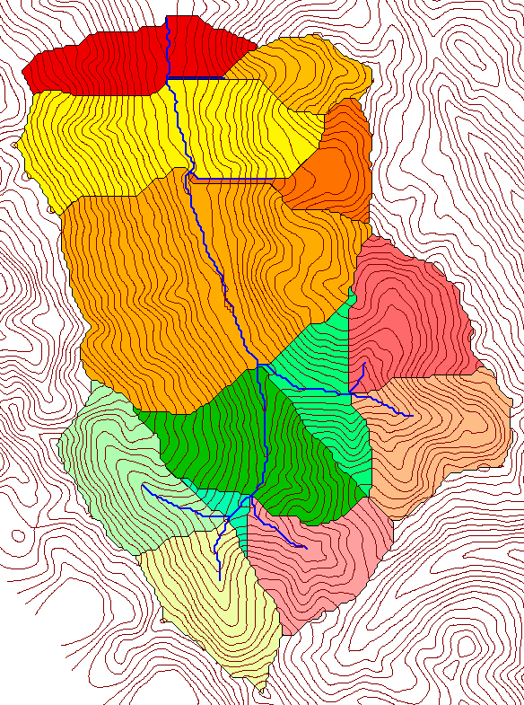
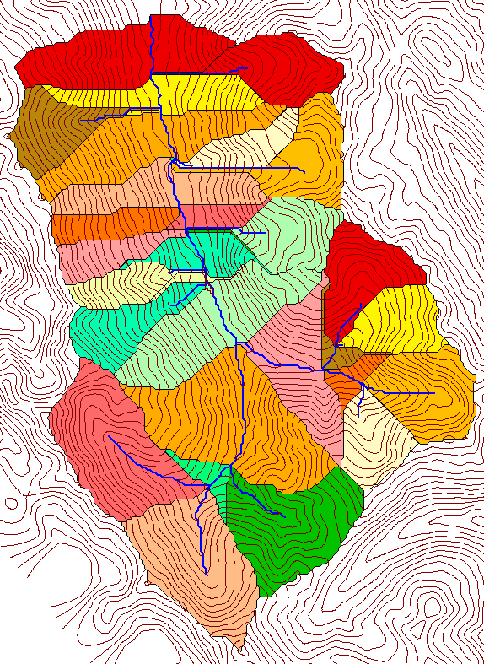
How to decide on drainage area threshold to determine channels and watershed model elements?
500 cell theshold
1000 cell theshold

Slide 6
Topographic Texture and Drainage Density
Driftwood, PA
Same scale, 20 m contour interval
Sunland, CA

Slide 7

Strahler Stream Order
Stream Drop: Elevation difference between ends of stream
most upstream is order 1
when two streams of a order i join, a stream of order i+1 is created
when a stream of order i joins a stream of order i+1, stream order is unaltered
Nodes
Links
Single Stream
Note that a “Strahler stream” comprises a sequence of links (reaches or segments) of the same order

Slide 8
Suggestion: Map channel networks from the DEM at the finest resolution consistent with observed channel network geomorphology ‘laws’.
Look for statistically significant break in constant stream drop property
Break in slope versus contributing area relationship
Physical basis in the form instability theory of Smith and Bretherton (1972), see Tarboton et al. 1992

Slide 9
Statistical Analysis of Stream Drops
Threshold = 10
Dd = 2.5
t = -3.5
Threshold = 15
Dd = 2.1
t = -2.08
Threshold = 20
Dd = 1.9
t = -1.03
Stream drop test for Mawheraiti River. For each upward curved support area threshold the stream drop for each stream is plotted against Strahler stream order. The large circles indicate mean stream drop for each order The weighted support area threshold, drainage density (in km⁻¹) and t statistic for the difference in means between lowest order and all higher order streams is given.

Slide 10
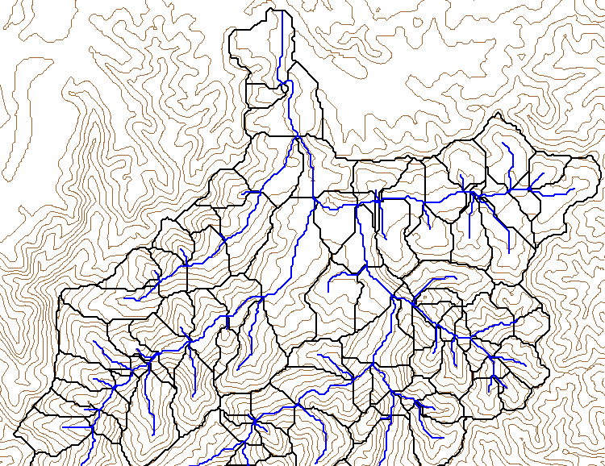
Curvature based stream and watershed delineation with automatic threshold by constant drop analysis

Slide 11
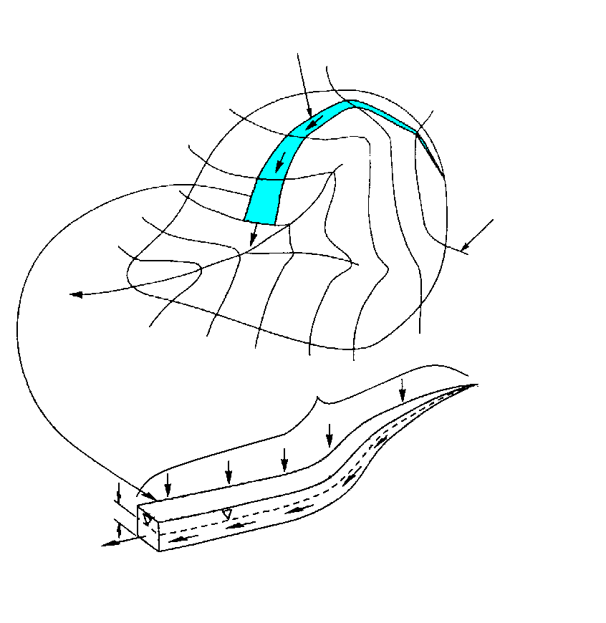
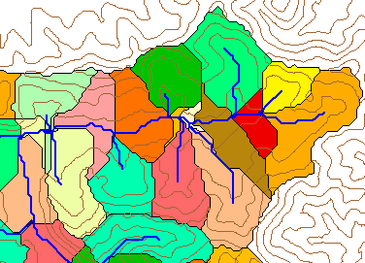
Hydrologic Model
Stream line
TOPMODEL (Beven and Kirkby, 1979 and later) applied to each subwatershed.
Temperature and radiation based potential (reference) evapotranspiration.
Vegetation based interception component.
Modified soil zone
  Adjust ET based on soil moisture availability in root zone
  Infiltration excess runoff generation capabiity
  unsaturated storage and drainage
Parameters scaled by GIS average properties over each subwatershed.
Kinematic wave routing of streamflow through channel network.
Contour line
Upslope contributing area a

Slide 12
Implementation (additions/modifications)

Slide 13
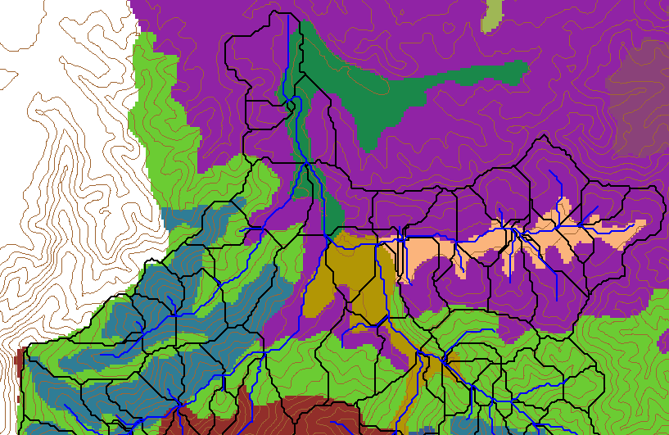
Soils Map

Slide 14
Parameters
Spatially variable
Spatially constant
Hydraulic conductivity K, calibrated using multiplying factor applied to spatially variable values.
The soil capacity parameter ‘soilc’ is estimated as (soil zone depth)/(dth1+dth2)

Slide 15
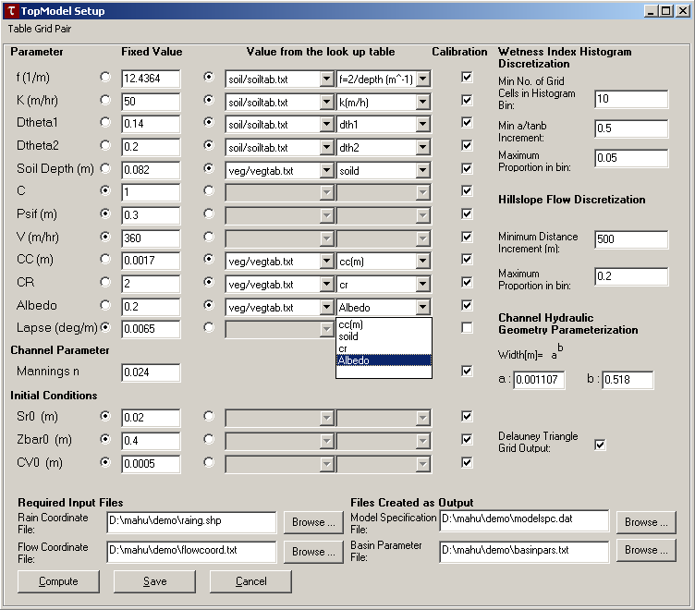

Slide 16
Basin average precipitation
Streamflow at outlet
Cumulative
water balance

Slide 17
TauDEM Software Functionality
Pit removal (standard flooding approach)
Flow directions and slope
  D8 (standard)
  D∞ (Tarboton, 1997, WRR 33(2):309)
  Flat routing (Garbrecht and Martz, 1997, JOH 193:204)
Drainage area (D8 and D∞)
Network and watershed delineation
  Support area threshold/channel maintenance coefficient (Standard)
  Combined area-slope threshold (Montgomery and Dietrich, 1992, Science, 255:826)
  Local curvature based (using Peuker and Douglas, 1975, Comput. Graphics Image Proc. 4:375)
Threshold/drainage density selection by stream drop analysis (Tarboton et al., 1991, Hyd. Proc. 5(1):81)
Wetness index and distance to streams
TopNet model specification file generation

Slide 18
TauDEM Software Architecture
ESRI ArcGIS 8.1
(under development )
VB GUI
application
Standalone
command line
applications
C++ COM DLL interface
Available from
TauDEM C++ library
Fortran (legacy)
components
http://www.engineering.usu.edu/dtarb/
USU TMDLtoolkit modules
(grid, shape, image, dbf, map, mapwin)
ESRI gridio API
(Spatial analyst)
Data
formats
Vector shape
files
ASCII text
grid
Binary direct
access grid
ESRI binary
grid

Slide 19
Conclusions
Terrain analysis using digital elevation models provides considerable capability useful in hydrologic analysis.
Constant stream drop law used to objectively and automatically determine drainage area threshold and drainage density consistent with the natural texture of the topography.
Facilitated the representation of distributed information about hydrologic condition on a watershed
Used in spatially distributed and networked implementation of TOPMODEL for modeling of spatially distributed hydrology based upon topography and GIS data (vegetation and soils).

Slide 20
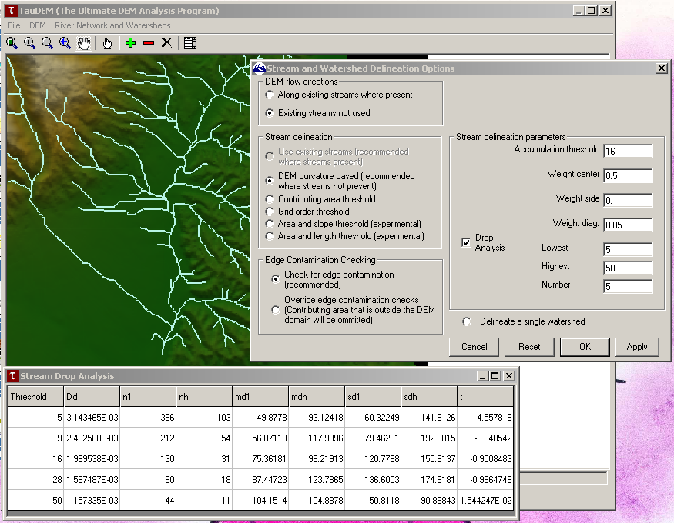
Demonstration

Slide 21

Digital Elevation Model Based Flow Path Analysis
D∞
Eight direction pour point model D8
Grid network
4
3
2
5
1
6
7
8
Drainage Area
1
1
1
1
1
1
4
3
3
1
1
1
12
1
2
1
1
2
16
1
1
3
6
25
2

Slide 22
Constant Stream Drops Law

Slide 23
Contributing area of upwards curved grid cells only

Slide 24
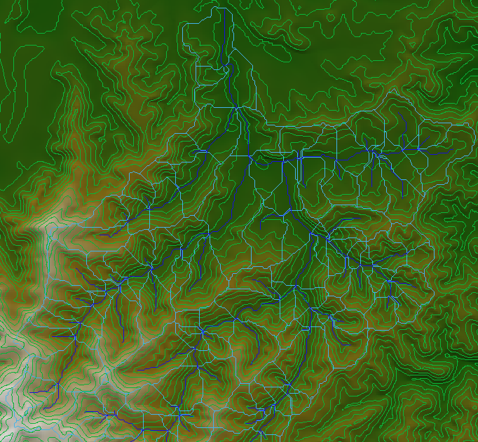
Curvature based stream and watershed delineation with automatic threshold by constant drop analysis

