Slide 1


Sharing Hydrologic Data with the CUAHSI Hydrologic Information System
David Tarboton, David Maidment, Ilya Zaslavsky, Dan Ames, Jon Goodall, Jeffery Horsburgh, Tim Whiteaker, Michael Piasecki, David Valentine, Tom Whitenack, Kim Schreuders
CUAHSI
HIS
Sharing hydrologic data
http://his.cuahsi.org/
Support
EAR 0622374

Slide 2
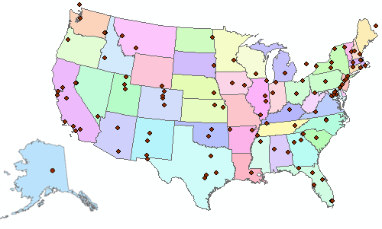

Consortium of Universities for the Advancement of Hydrologic Science, Inc.
110 US University members
6 affiliate members
12 International affiliate members
(as of March 2009)
An organization representing more than one hundred United States universities, receives support from the National Science Foundation to develop infrastructure and services for the advancement of hydrologic science and education in the U.S.
http://www.cuahsi.org/

Slide 3

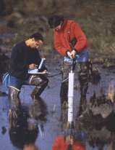
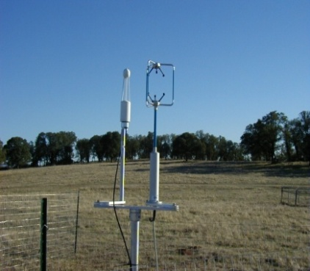
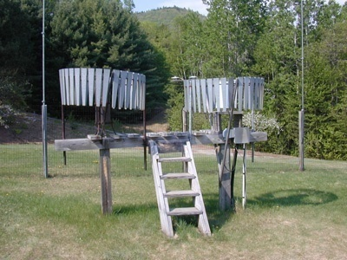
Goal
A system that enhances access to hydrologic data for education and research to better understand hydrologic processes.
How can we better organize hydrologic data to enhance the analysis it can support?
How can we better provide access to the data sources, tools and models that enable the synthesis, visualization and evaluation of the behavior of hydrologic systems?
Water quantity
Water quality
Precipitation
Meteorology
Notes:
HIS helps you discover and access hydrologic data.

Slide 4
CUAHSI HIS
The CUAHSI Hydrologic Information System (HIS) is an internet based system to support the sharing of hydrologic data. It is comprised of hydrologic databases and servers connected through web services as well as software for data publication, discovery and access.
Data Discovery and Integration platform
HIS Central
Like search portals Google, Yahoo, Bing
Metadata Services
Metadata Search
Service registration
Service and data theme metadata
Catalog harvesting
Data carts
HydroServer
Data Services
HydroDesktop
Data Publication platform
Water Data Services
Data Synthesis and Research platform
Spatial Data Services
Like web servers
Like HTML
Like browsers

Slide 5

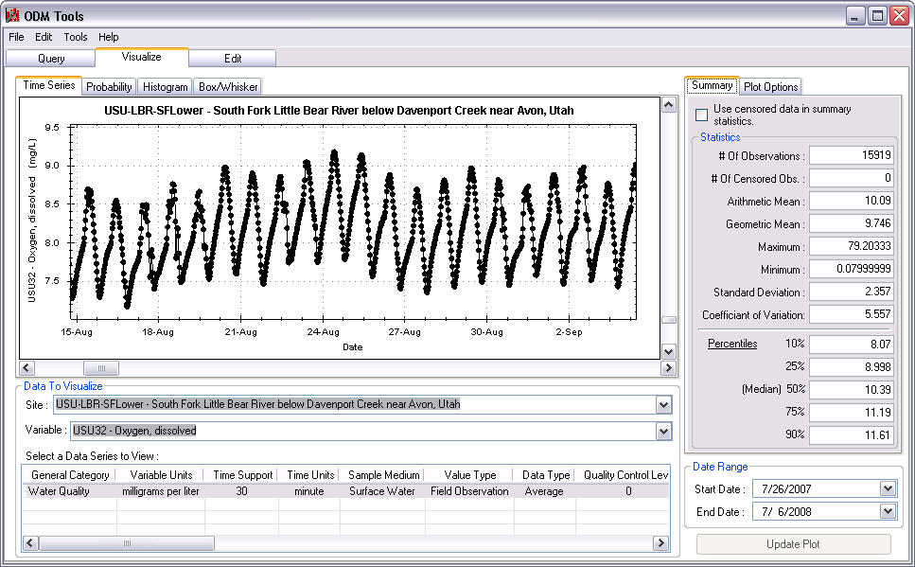
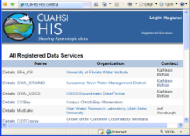
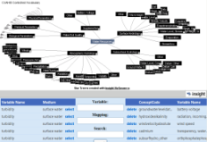
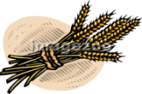

CUAHSI Water Data Services System
Platform independent Analysis
Discovery and Access
Query, Visualize, and Edit data using ODM Tools
GIS
Matlab
Splus
R
IDL
Hydro
Desktop
HydroExcel
Java
C++
VB
ODM
Database
WaterML
Service Registry
Hydrotagger
Streaming Data Loader
GetSites
GetSiteInfo
GetVariableInfo
GetValues
Base Station
Computer(s)
Excel, text
Harvester
HIS Central
USGS NWIS
Water Metadata Catalog
Telemetry Network
WaterOneFlow
Web Service
ODM Data Loader
EPA STORET
NCDC
Others
Sensors

Slide 6
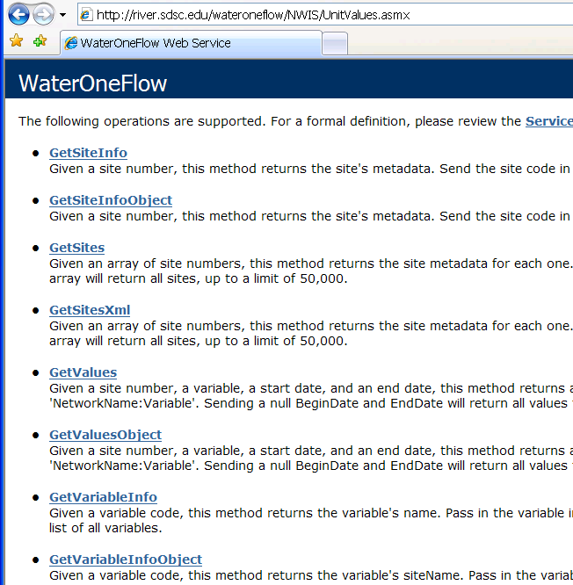
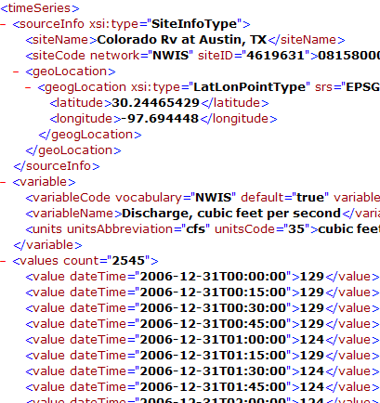
WaterML and WaterOneFlow
WaterML is an XML language for communicating water data
WaterOneFlow is a set of web services based on WaterML
Set of query functions
Returns data in WaterML
Slide from David Valentine
Notes:
6

Slide 7
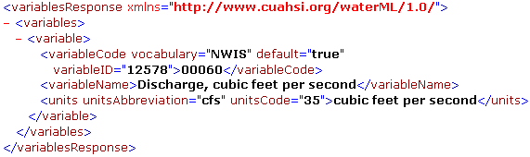
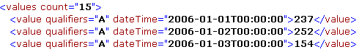
GetValues
GetVariables
qualifier
ISO Time
value
Notes:
7

Slide 8
What are the basic attributes to be associated with hydrologic data values and how can these best be organized?
Streamflow
Groundwater
levels
Precipitation
& Climate
Soil moisture data
Flux tower
data
Water Quality

Slide 9
Observations Data Model (ODM) – a relational model at the single observation level
“When”
Time, T
t
A data value
v_{i} (s,t)
s
“Where”
Space, S
V_{i}
“What”
Variables, V
Stores observation data made at points
Metadata for unambiguous interpretation
Traceable heritage from raw measurements to usable information
Standard format for data sharing
Cross dimension retrieval and analysis

Slide 10
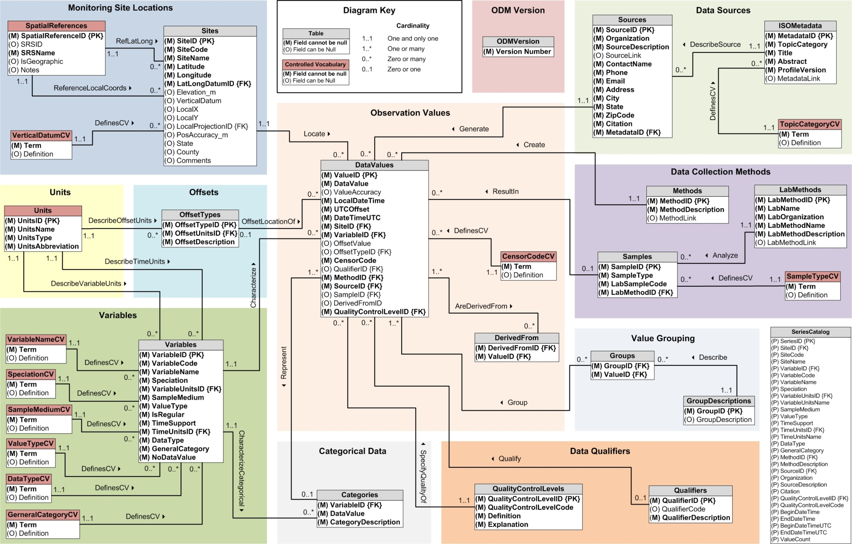
CUAHSI Observations Data Model http://his.cuahsi.org/odmdatabases.html
Horsburgh, J. S., D. G. Tarboton, D. R. Maidment and I. Zaslavsky, (2008), A Relational Model for Environmental and Water Resources Data, Water Resour. Res., 44: W05406, doi:10.1029/2007WR006392.
Notes:
In designing ODM we asked: What are the basic attributes to be associated with each single data value and how can these best be organized? This involved community survey at a workshop and by email and based on the feedback received we came up with the ODM schema illustrated, published last year in WRR
This is quite a detailed slide, but it is the entire schema. Few database designs are simple enough to fit the entire schema on one slide. This shows at the center the data values table and off to the sides, the ancillary or metadata tables that record.

Slide 11
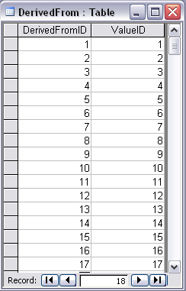
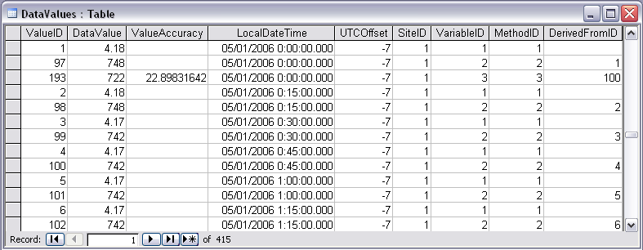
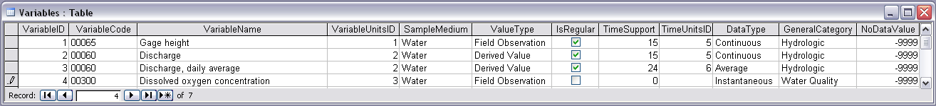
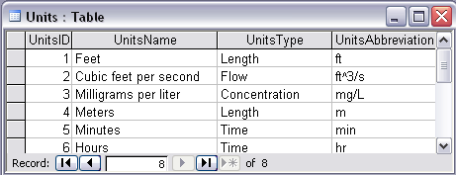
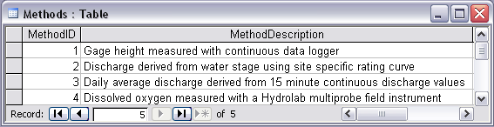
Stage and Streamflow Example
Notes:
Discharge Derived from Gage Height
Concepts:
Data derived from other data – single data point derived from a single observation (discharge from stage)
Data derived using a specific method (discharge from stage using rating curve)
Relationships:
Relationships between Values table and DerivedFrom table on DerivedFromID and ValueID
Relationship between Values table and Variables table on VariableID
Relationship between Values table and Methods table on MethodID
Relationship between Variables table and Units table on UnitID

Slide 12
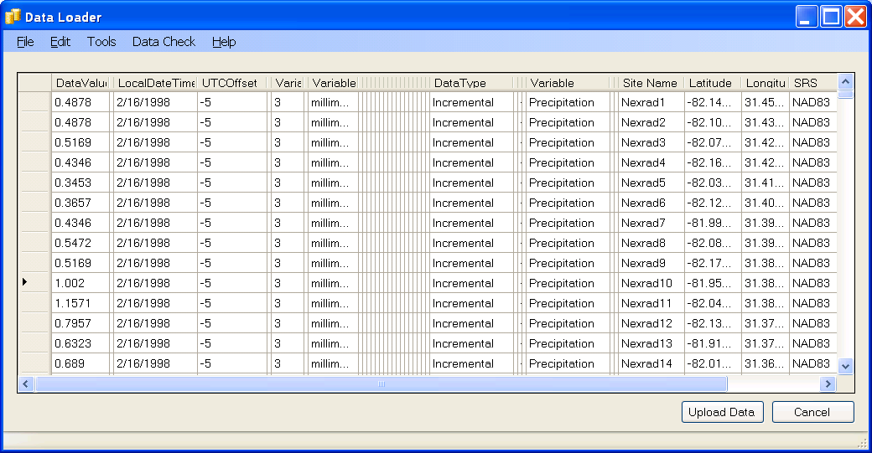
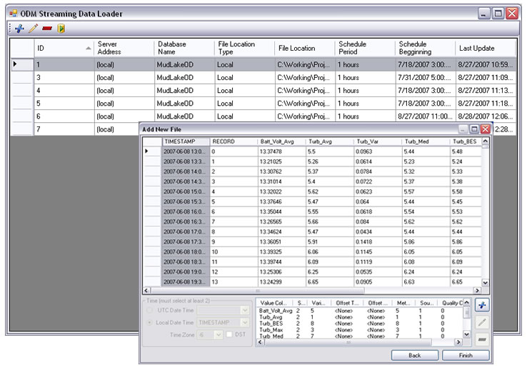
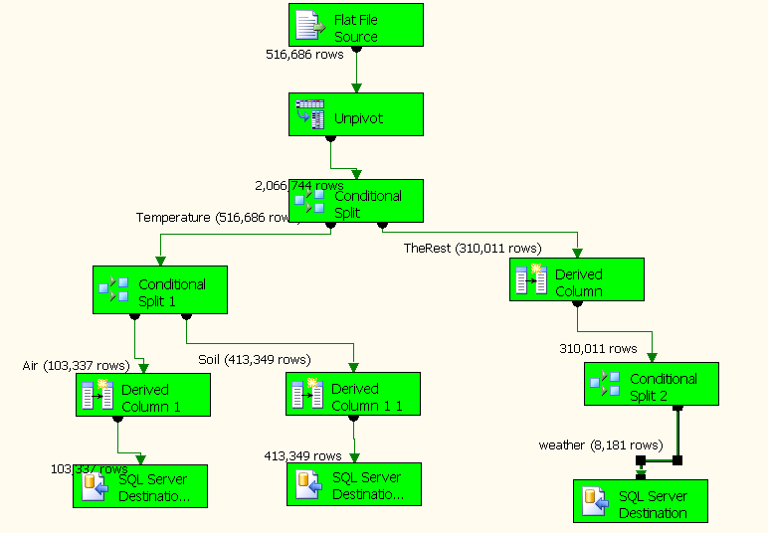
Loading data into ODM
ODM Data Loader
Interactive ODM Data Loader
  Loads data from spreadsheets and comma separated tables in simple format
Streaming Data Loader (SDL)
  Loads data from datalogger files on a prescribed schedule
  Interactive configuration
SQL Server Integration Services (SSIS)
  Microsoft application accompanying SQL Server useful for programming complex loading or data management functions
SDL
SSIS
Notes:
HIS includes two programs for loading data into ODM. The ODM Data Loader is used to load data from simple spreadsheets or CSV files, typically from archived data. The Streaming Data Loader loads data from the output of sensors which are continuously streaming in data. More advanced options for loading data include non-HIS software such as SQL Server Integration Services.

Slide 13

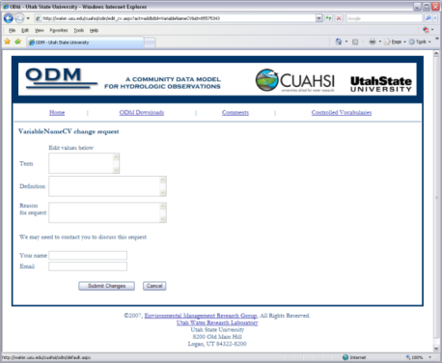

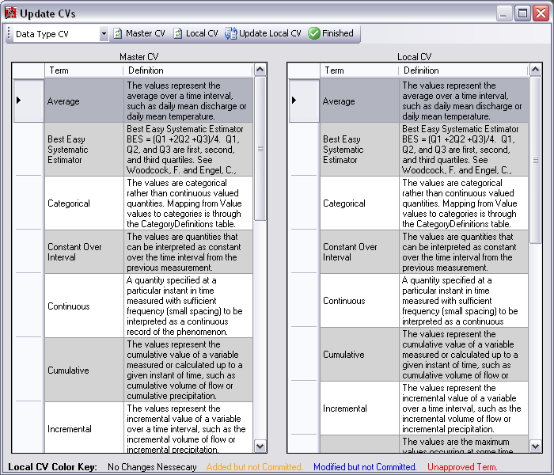
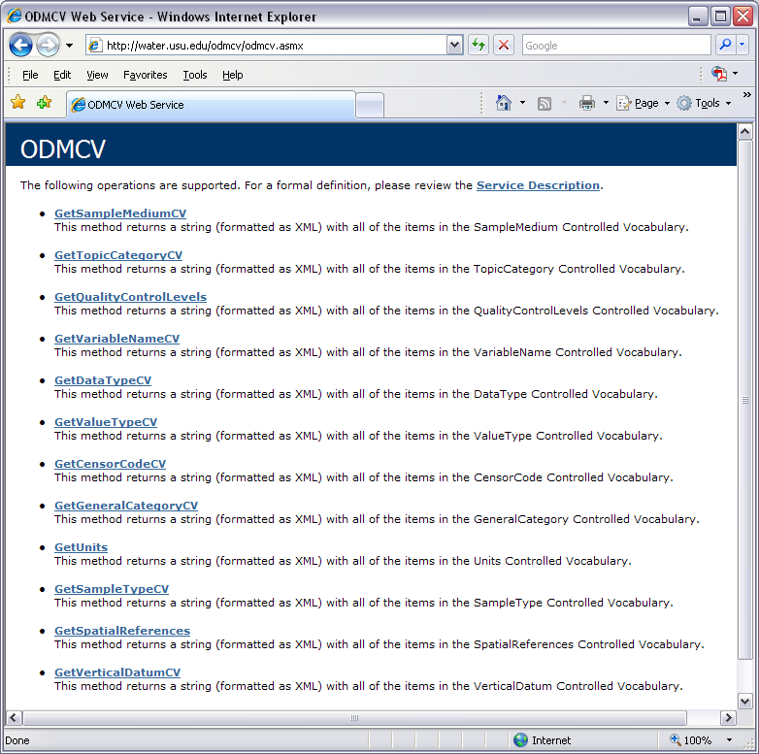
Dynamic controlled vocabulary moderation system
ODM Data Manager
ODM Website
ODM
Tools
ODM Controlled
Vocabulary Moderator
XML
Master ODM Controlled Vocabulary
Local ODM
Database
ODM
Controlled Vocabulary
Web Services
Local
Server
http://his.cuahsi.org/mastercvreg.html
From Jeff Horsburgh

Slide 14
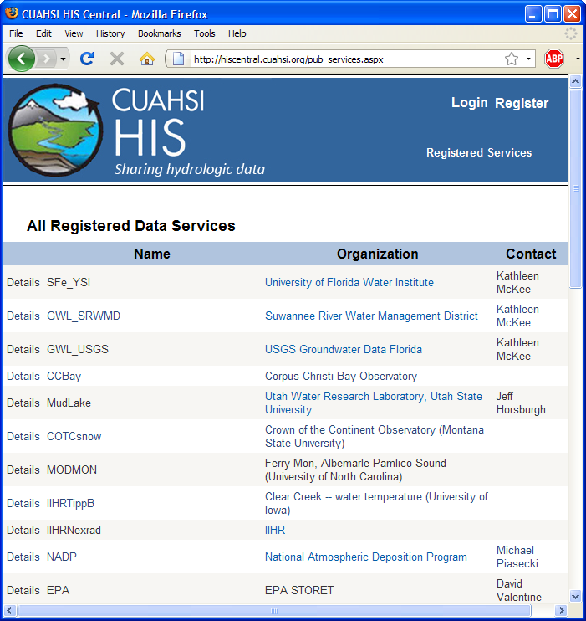
HIS Central
Publishers
  Register a data service
Users
  Find a data service
Supported by
  Metadata Catalog
http://hiscentral.cuahsi.org
Notes:
HIS Central keeps a listing of all registered web services, and also maintains a metadata catalog of site and variable information from those services to enable fast data searching.

Slide 15
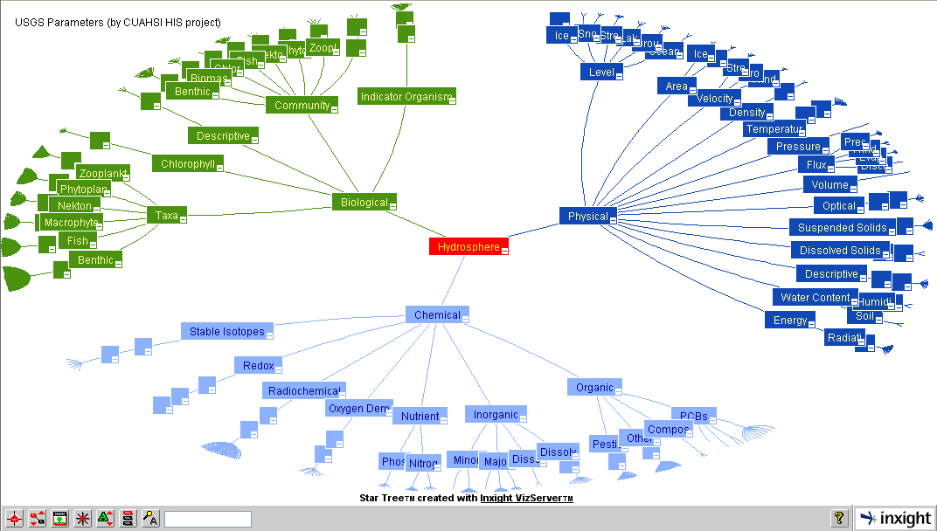
Ontology – to support concept based data discovery
Notes:
Generated by Dave V. It is the star tree for new ontology.

Slide 16
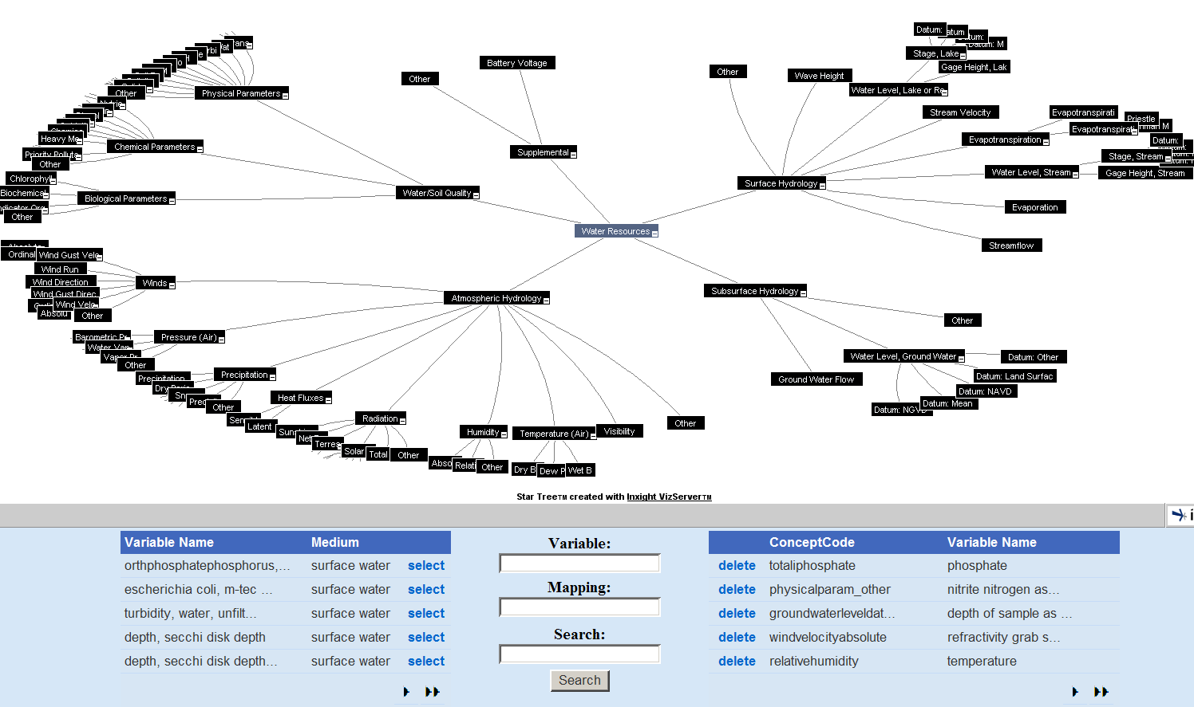
HydroTagger
Each Variable in your data is connected to a corresponding Concept

Slide 17
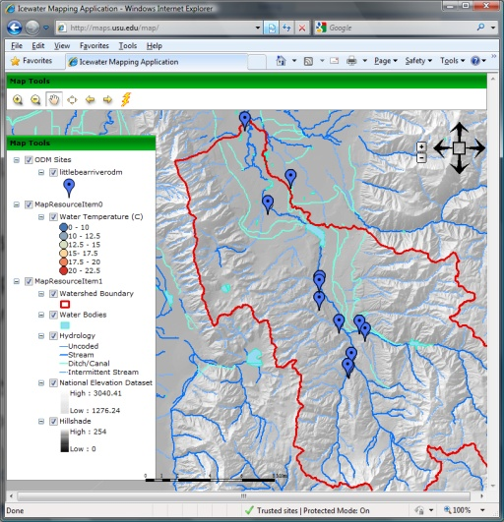
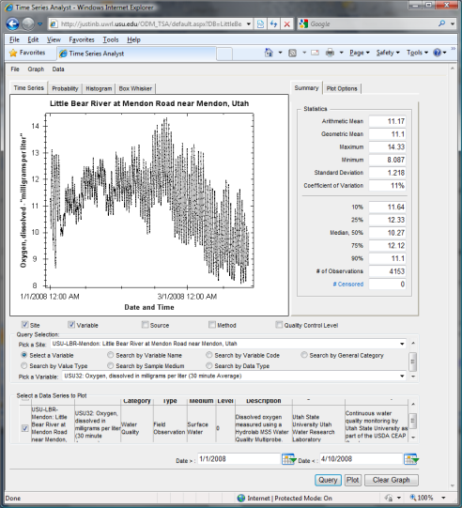
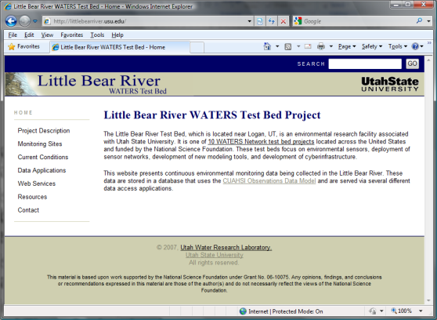
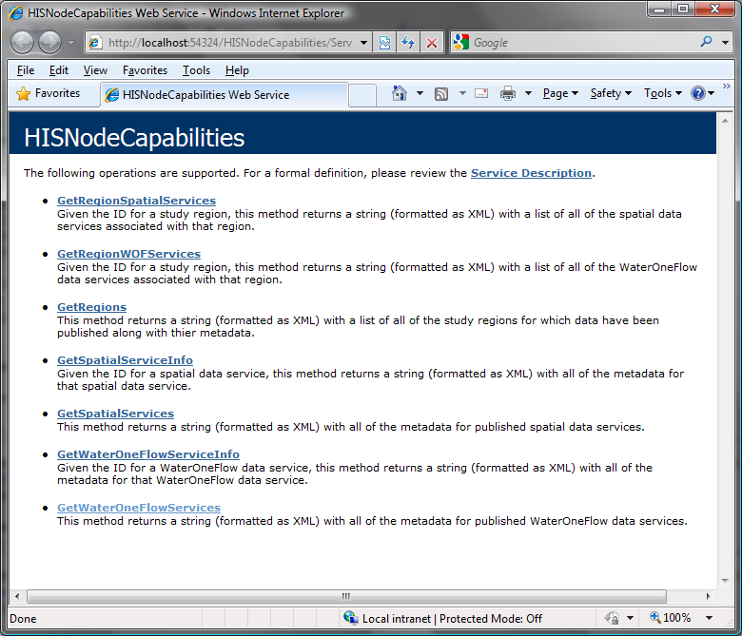
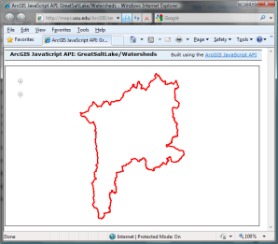
Map Server
Time Series Analyst
HydroServer Website
HydroServer Capabilities Web Service
HydroServer Database Configuration Tool
WaterOneFlow
Services
HydroServer
Database
Spatial
Services
WaterOneFlow
WaterOneFlow
WaterOneFlow
ODM
ODM
ODM
ODM Databases and WaterOneFlow Web Services
ArcGIS Server Spatial Data Services

Slide 18
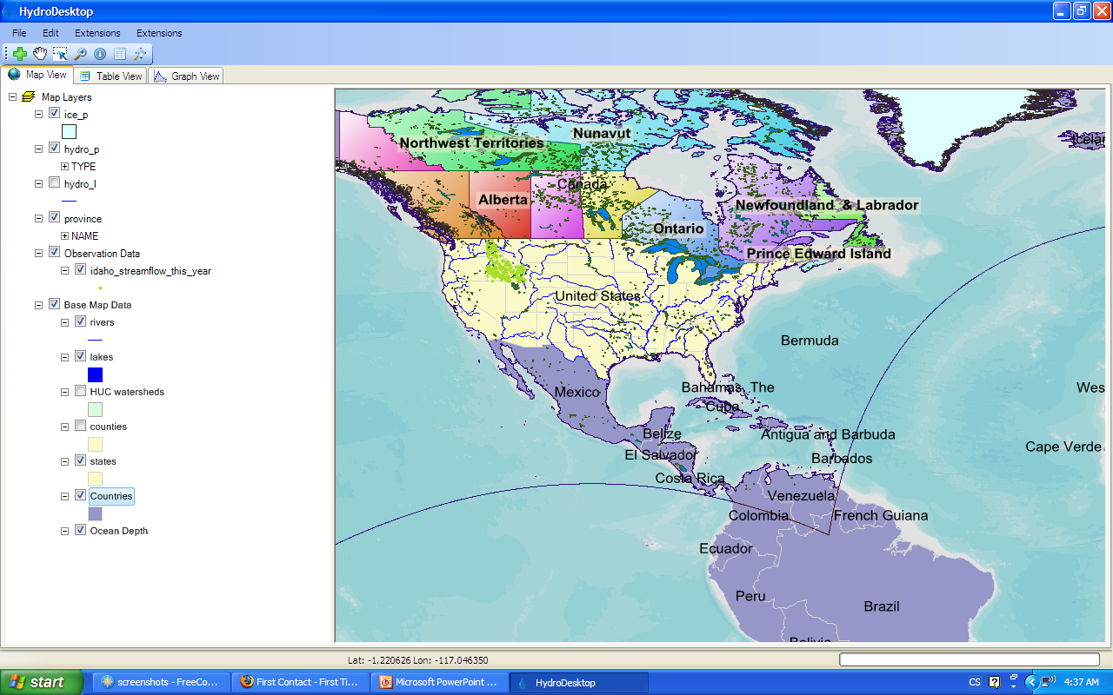
HydroDesktop
Harvesting and analyzing data from web services
GIS
Hydrology
Add shapefiles to map
Change symbology and labels
Print and export map
GIS toolbox
Search for data
Download data
Display time series
Export data
http://hydrodesktop.codeplex.com
Notes:
HydroDesktop is a desktop based software application that serves as a client for HIS Services. This project is being supported by CUAHSI, Idaho EPSCoR and the Inland Northwest Research Alliance.

Slide 19
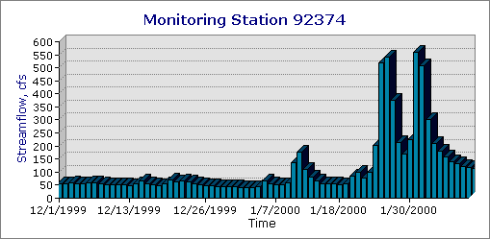
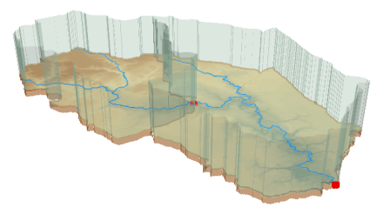
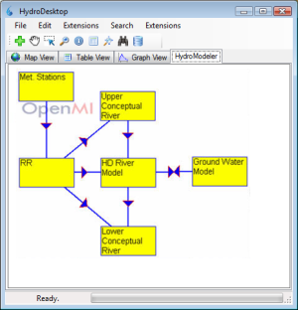
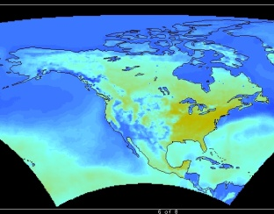
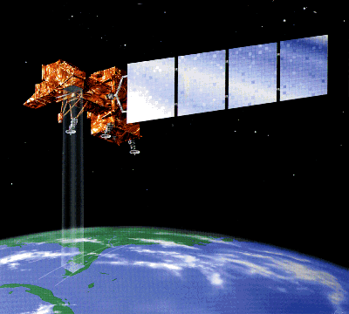
HydroDesktop
Observations
GIS
Models
Climate
Remote Sensing
Platform for data discovery, access, integration and analysis
Uses MapWindow 6 open source GIS software development toolkit
Plug-in architecture (extendibility that enables customization)
Data abstraction layer
http://hydrodesktop.codeplex.com open source software development portal
Windows and Mac compatible (through Mono)

Slide 20
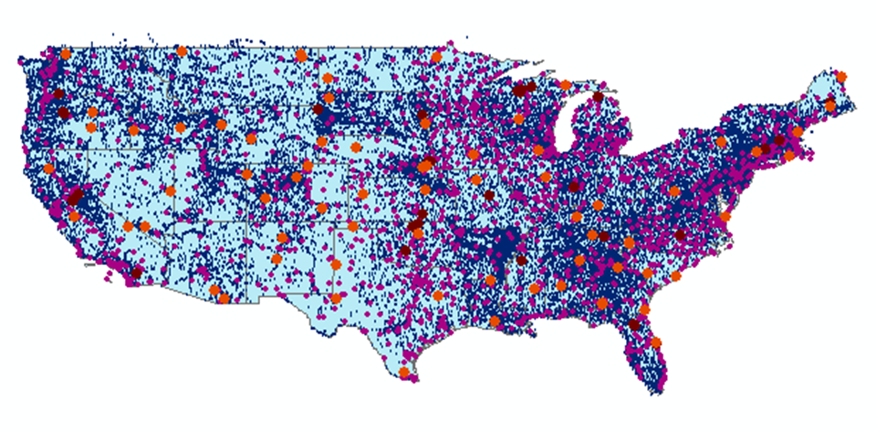
CUAHSI Water Data Services
43 services
15,000 variables
1.8 million sites
9 million series
4.3 billion data

Slide 21

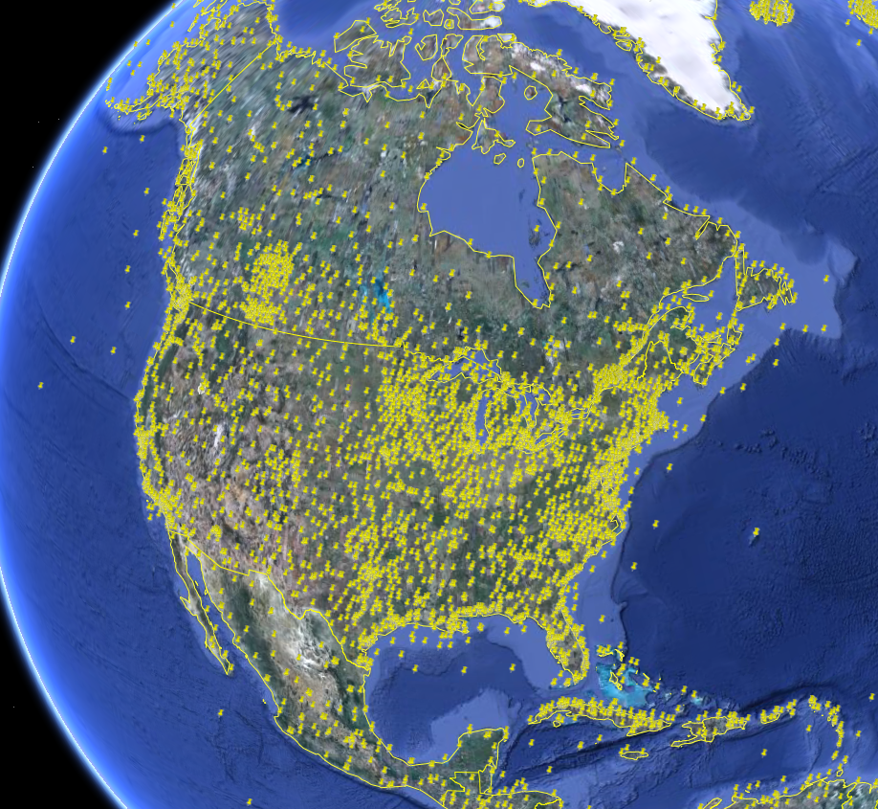
NCDC Integrated Station Hourly Data
Hourly weather data up to 36 hours ago
13,628 sites across globe
34 variables
Published by National Climate Data Center and populated with weather observations from national weather services
http://water.sdsc.edu/wateroneflow/NCDC/ISH_1_0.asmx?WSDL

Slide 22

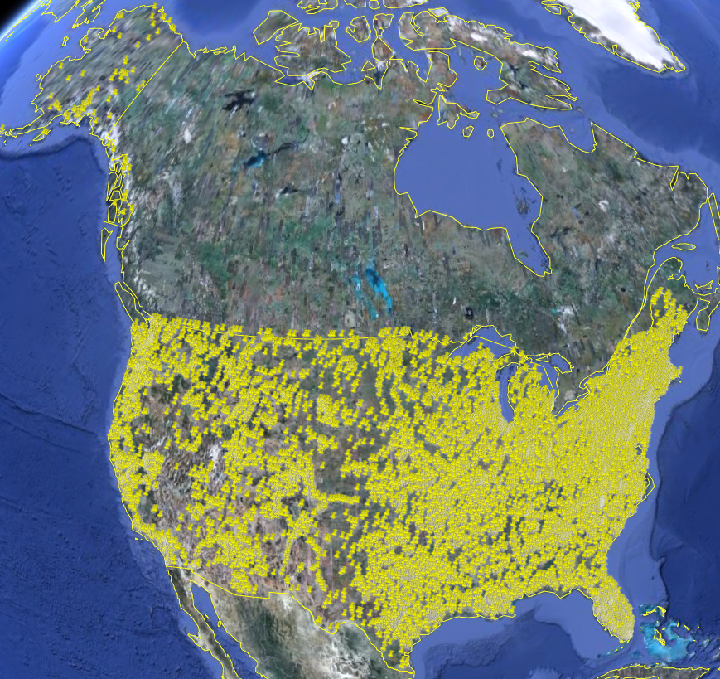
USGS Instantaneous Data
Real time, instantaneous data over the last 60 days
11188 sites, nationally for the US
80 variables
Published by USGS National Water Information System

Slide 23

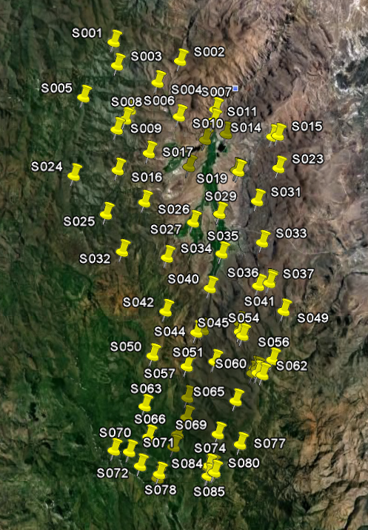
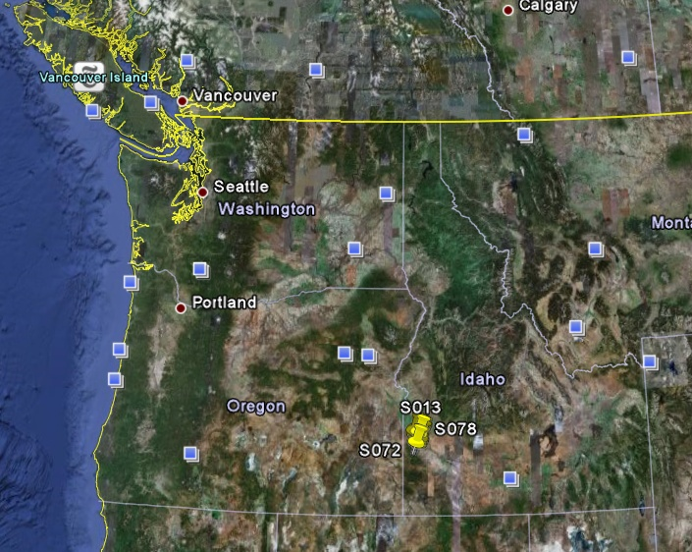
Reynolds Creek Experimental Watershed
1 data service
84 sites
65 variables
372 series
17.8 million data
Published by USDA-ARS as part of an Idaho Waters project
http://idahowaters.uidaho.edu/RCEW_ODWS/cuahsi_1_0.asmx?WSDL

Slide 24
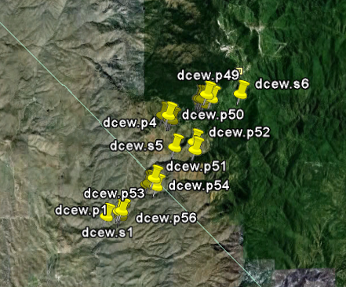
Dry Creek Experimental Watershed (DCEW)
(28 km² semi-arid steep topography, Boise Front)
68 Sites
20 Variables
5924511 values
Published by Jim McNamara, Boise State University
http://icewater.boisestate.edu/dcew2dataservices/cuahsi_1_0.asmx?WSDL

Slide 25
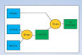
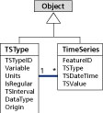
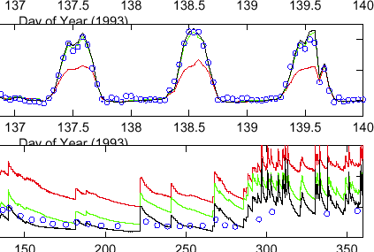
Advancement of water science is critically dependent on integration of water information
Databases: Structured data sets to facilitate data integrity and effective sharing and analysis.
- Standards
- Metadata
- Unambiguous interpretation
Analysis: Tools to provide windows into the database to support visualization, queries, analysis, and data driven discovery.
Models: Numerical implementations of hydrologic theory to integrate process understanding, test hypotheses and provide hydrologic forecasts.
Models
ODM
Web Services
Databases
Analysis

Slide 26
Conclusions
Data Storage in an Observations Data Model (ODM)
Data Access through internet-based Water Data Services using a consistent data language, called WaterML
Data Indexing through a National Water Metadata Catalog
Data Discovery through federated map and thematic keyword search system
The combination of these capabilities creates a common window on water observations data for the United States unlike any that has existed before.

