Slide 1
Terrain Analysis for Water Quality Modeling
David G. Tarboton
Saurabh Gogate
Mariush Kemblowski
Qiang Shu
Eric Wahlstrom
Darwin L. Sorensen
David K. Stevens
http://www.engineering.usu.edu/dtarb
dtarb@cc.usu.edu

Slide 2
Objectives
Incorporate GIS Methodology into the Source Water Protection and Pollution Assessment Process to provide information about potential contamination risks to drinking water supplies
Exploratory low data requirement assessment system for initial screening
Notes:
Used by watershed managers to rank risks, and to prioritize protection activities

Slide 3
Overview
The source water protection problem
Topographically driven screening model methodology
Representing the terrain flow field
TauDEM water quality functions

Slide 4
The Need: Source Water Protection
Identify and Inventory potential sources of contamination
Visualize the locations of potential pollution sources and pathways that pollutants may follow
Exploratory modeling to assess pollution susceptibility for prioritization of analysis
Detailed analysis and risk assessment

Slide 5
Assumptions for GIS Topography driven approach
Surface water and its associated contaminants move in directions following the topography.
Shallow subsurface flow follows topography and sustains baseflow.
Surface flows occur over a fraction of the time. Approximated as steady state.
Discharge separated into stormflow and baseflow assumed to represent surface and subsurface flow paths respectively.
Quantity of runoff generated from each grid cell proportional to annual rainfall.
Notes:
The approach can provide screening level information without detailed modeling of infiltration, soils data etc.
Preferred over arbitrary setting of source water protection zones or buffers.

Slide 6
Methodology
Stormflow/baseflow separation using HYSEP
f = surface runoff time fraction

Slide 7
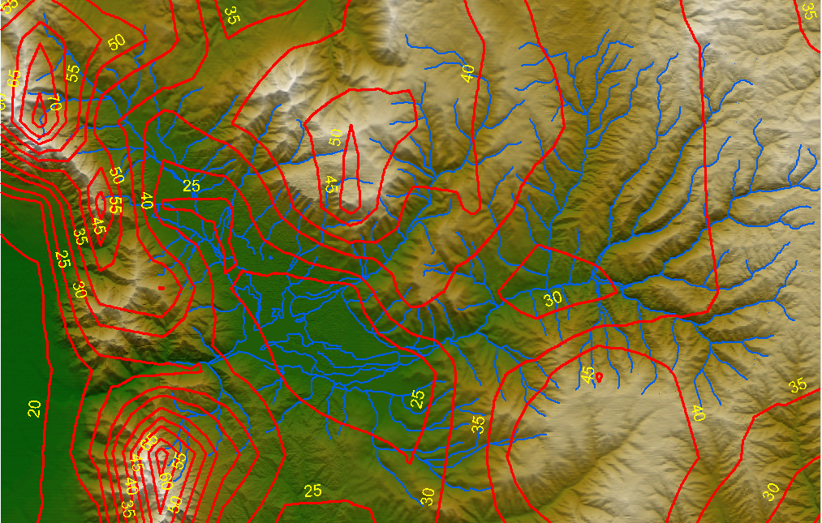
Runoff proportional to PRISM annual rainfall (inches)
Runoff coefficients
Steady state water inputs
Subsurface
Surface - average when active

Slide 8
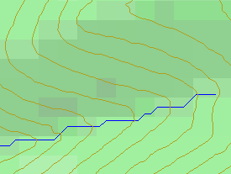
Topographically driven flow path assumption
?
Limitation imposed by 8 grid directions.

Slide 9

D∞ Multiple flow direction model
Proportion flowing to neighboring grid cell 2 is α₁/(α₁ + α₂)
Proportion flowing to neighboring grid cell 1 is α₂/(α₁ + α₂)
Δ
Tarboton, D. G., (1997), "A New Method for the Determination of Flow Directions and Contributing Areas in Grid Digital Elevation Models," Water Resources Research, 33(2): 309-319.) (http://www.engineering.usu.edu/dtarb/tarpubs.htm)

Slide 10
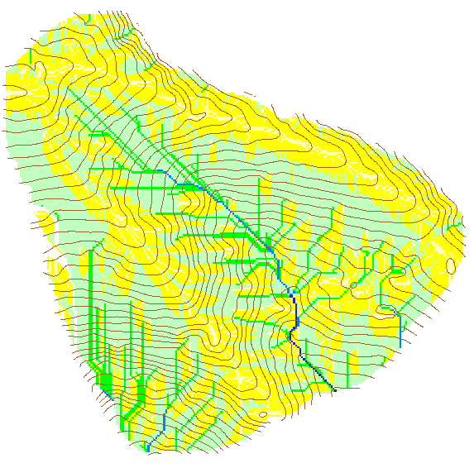

Contributing Area using D∞
Contributing Area using D8

Slide 12
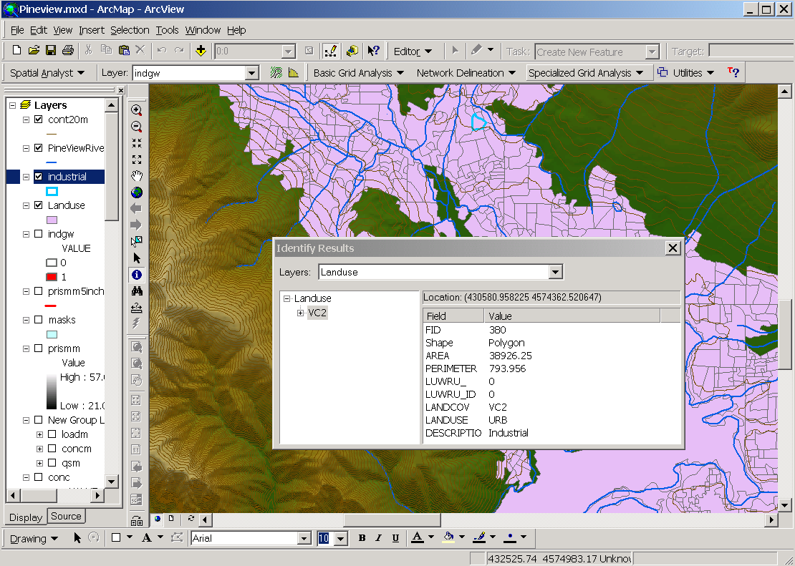
Inventory of potential contamination sources such as landuse designated industrial

Slide 13
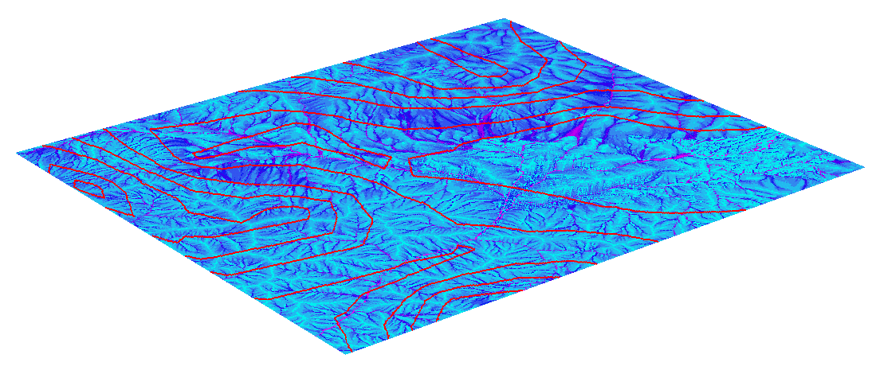
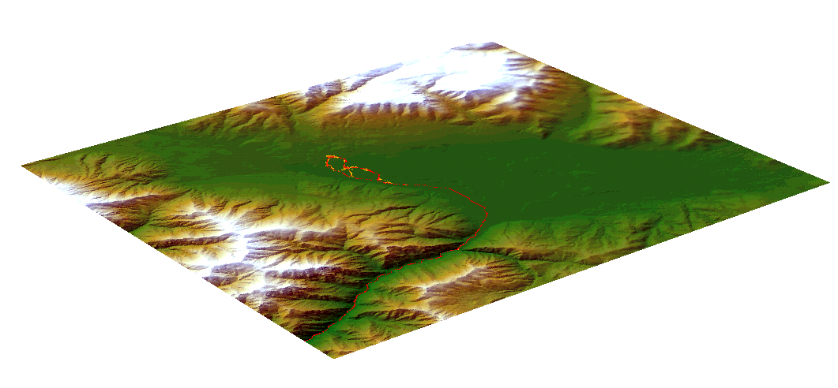
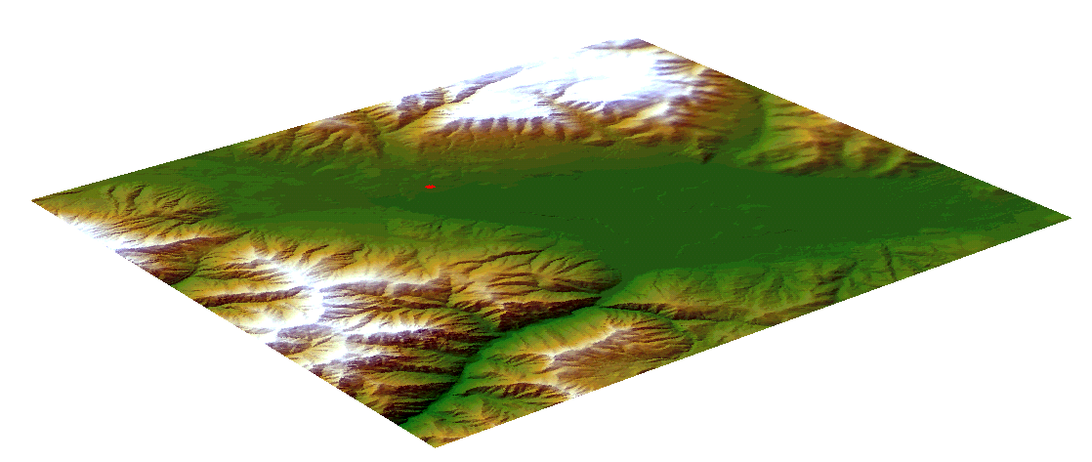
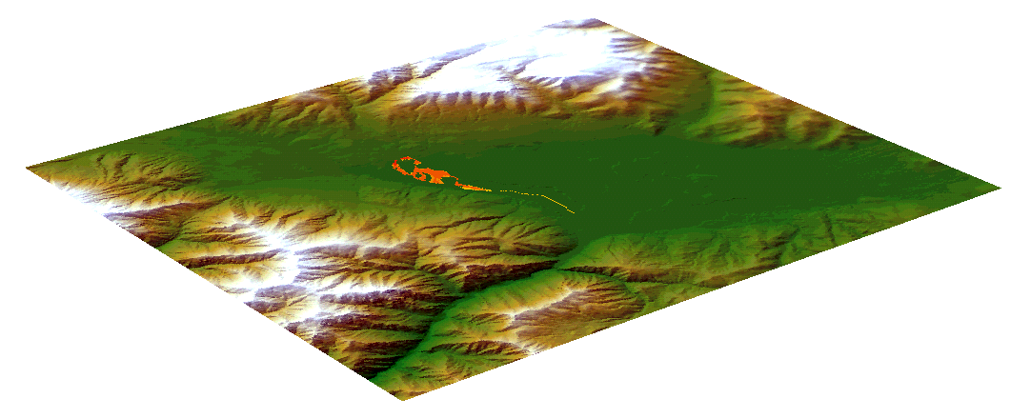
Conservative compound in surface runoff example
Surface runoff
Industrial area potential contamination source
Contaminant load
Contaminant concentration

Slide 14
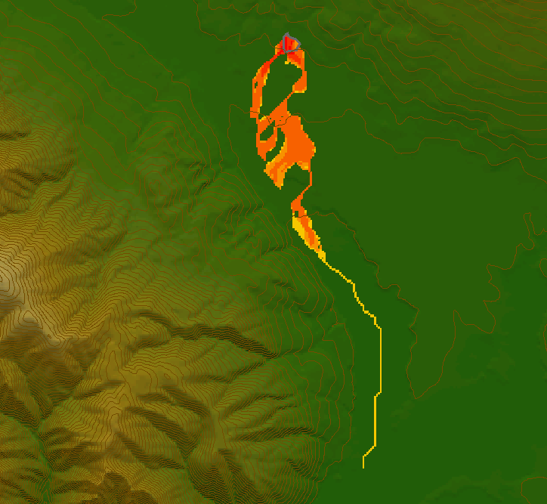
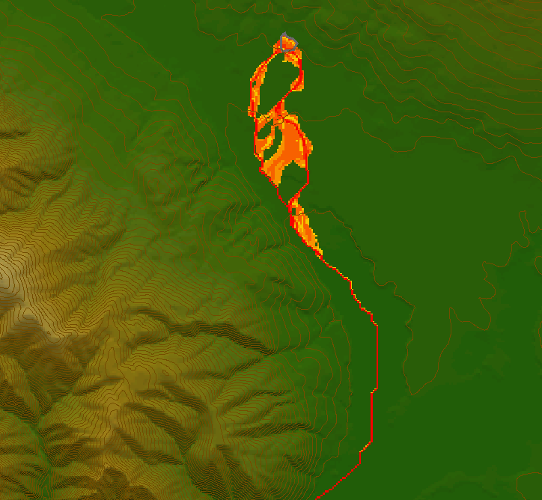
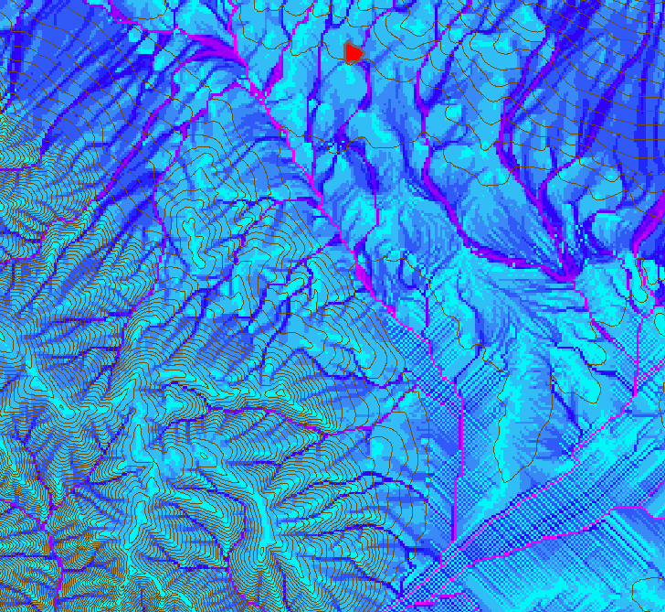
Surface runoff
Contaminant load
Contaminant concentration

Slide 15
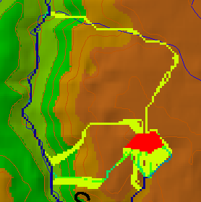
Useful for example to track where sediment or contaminant moves

Slide 16
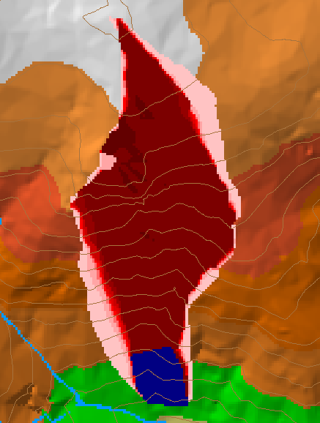
Useful for example to track where a contaminant may come from

Slide 17

Useful for a tracking contaminant or compound subject to decay or attenuation

Slide 18
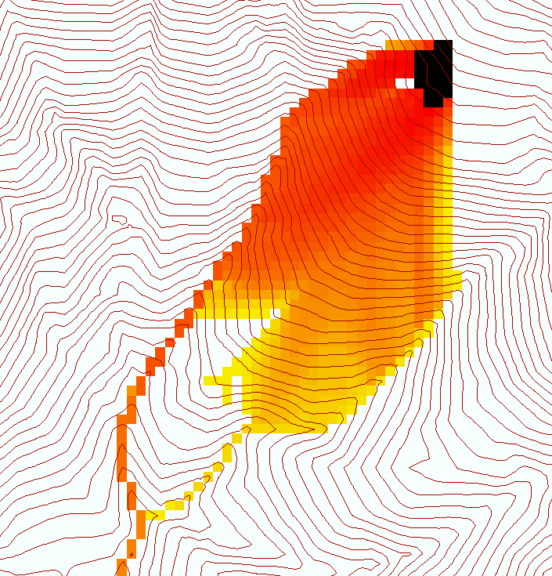
Useful for a tracking a contaminant released or partitioned to flow at a fixed threshold concentration

Slide 19
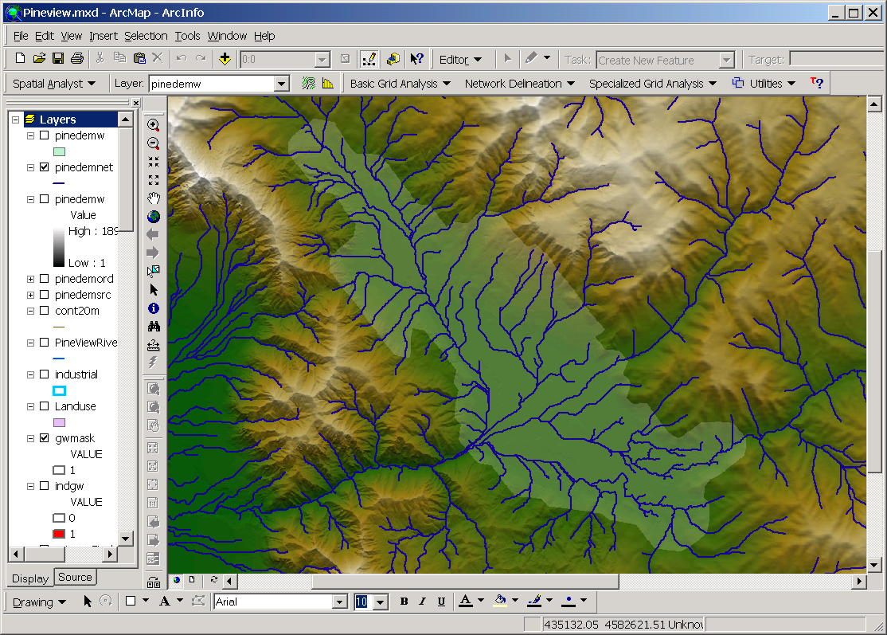
Coupling to MODFLOW for subsurface simulation

Slide 20
MODFLOW Boundary Conditions

Slide 21
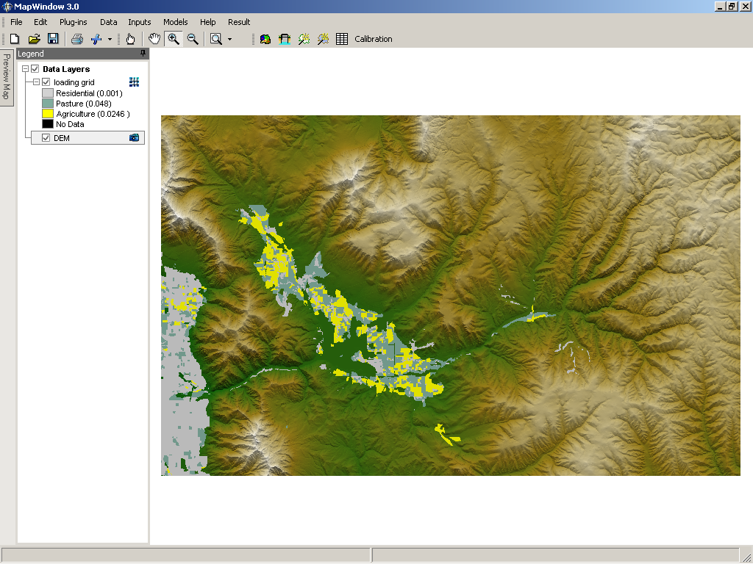
Nonpoint source nitrate loading based on landuse

Slide 22
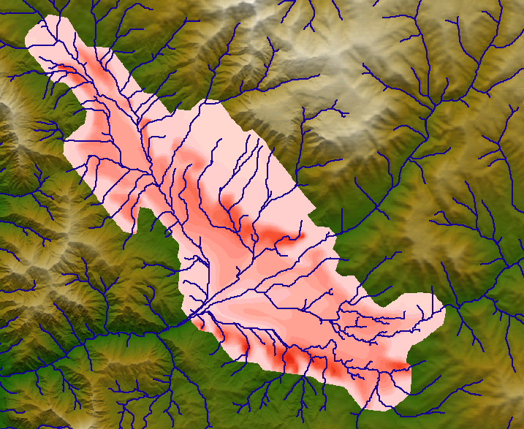
Nitrate concentration from MODFLOW+MT3D

Slide 23
TauDEM Software Architecture
ESRI ArcGIS Toolbar
VB GUI
application
Standalone
command line
applications
C++ COM DLL interface
Available from
TauDEM C++ library
Fortran (legacy)
components
http://www.engineering.usu.edu/dtarb/
gridio C++ library
shapelib C++ library
ESRI grid API
(Spatial analyst)
Data
formats
Vector shape
files
ASCII text
grid
Binary direct
access grid
ESRI binary
grid

Slide 24
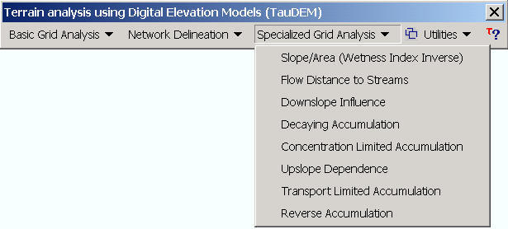
TauDEM Software Functionality
Pit removal
Flow directions and slope
Drainage area (D8 and D∞)
Network and watershed delineation
Threshold/drainage density selection by stream drop analysis (Tarboton et al., 1991, Hyd. Proc. 5(1):81)
Water Quality Functions:
  Down slope Influence
  Upslope Dependence
  Concentration Limited Accumulation
  Transport limited accumulation
  Decaying Accumulation

Slide 25
Conclusions
Take advantage of GIS Extendibility
Inventory and Integrate potential contaminant information from multiple sources
Exploratory screening model based upon simple assumptions facilitates visualization of potential pollution based upon readily available data for prioritization and further analysis

