Slide 1

Salinity, Evaporation and the Rise and Fall of the Great Salt Lake
DAVID G. TARBOTON
IBRAHIM N. MOHAMMED

Slide 2
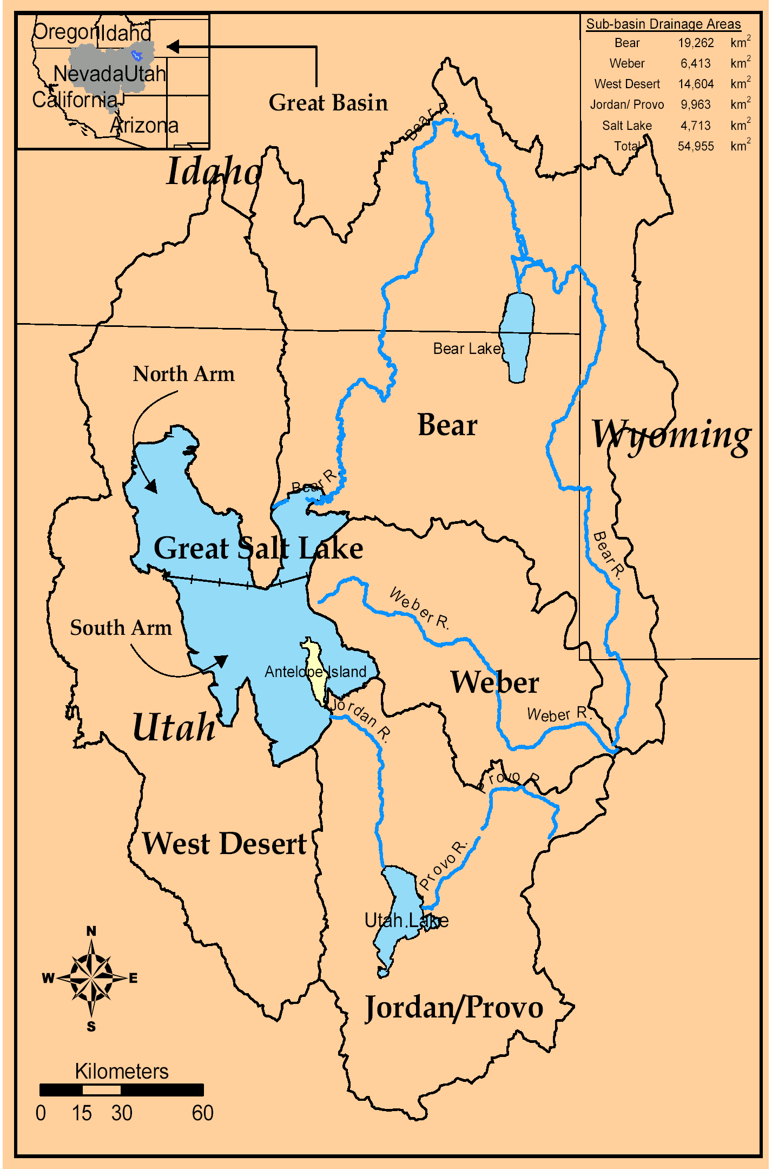
Great Salt Lake Hydrology
Terminal lake with inflow from 3 major rivers to east.
Only outflow is evaporation.
Lake level and area fluctuates dynamically to adjust outflow to inflow.
Lake volume impacts salinity (dilution).
Salinity impacts evaporation (saturation vapor pressure)
Lake levels are important for infrastructure, industry and commerce near and on the lake

Slide 3
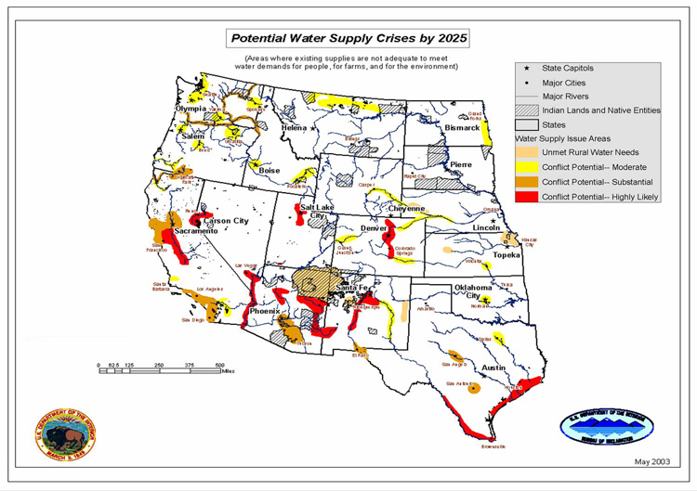

The availability of water to sustain life is perhaps the most recurrent constraint in human history and will remain so in the foreseeable future.
From http://www.doi.gov/water2025/index.html

Slide 4
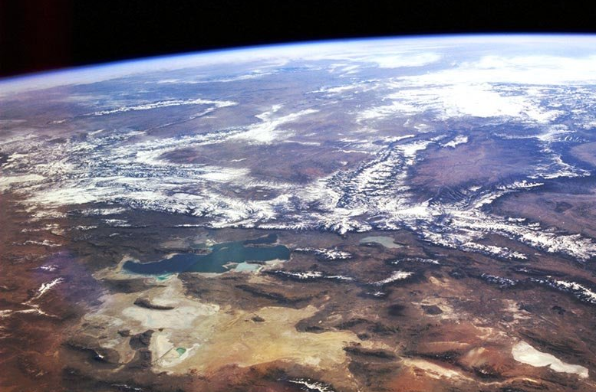
The Great Salt Lake Basin
Strawberry
Bear
Weber
Jordan/Provo
West Desert
A microcosm for many Western Water Issues
Notes:
Here is the perspective from 50 miles up. The Great Salt Lake basin is a place of contrast, typical of much of the semi-arid west. Snow is a driver hydrologically. The lake is an integrator. Growth induces change that is important to understand.
Climate Gradients (Snow fed, Alpine to semi-arid), variability and vulnerability
Topographic and Land Use Gradients
Mountain Front / Valley groundwater dynamics and interactions
Geologic Diversity (Granite to Karst)
Closed basin for water and constituent balance closure
Development issues (local growth, SLC metropolitan area demands)
Policy Issues (3 states)
Agricultural issues (water supply, environmental compliance)
Environmental Issues (water quality, watershed management practices)
Ecological issues (Stream ecosystems, Bird refuge, GSL ecosystem)

Slide 5
A microcosm for many "western" water issues
Climate Gradients (Snow fed, Alpine to semi-arid), variability and vulnerability
Topographic and Land Use Gradients
Mountain Front / Valley groundwater dynamics and interactions
Geologic Diversity (Granite to Karst)
Closed basin for water and constituent balance closure
Development issues (local growth, SLC metropolitan area demands)
Policy Issues (3 states)
Agricultural issues (water supply, environmental compliance)
Environmental Issues (water quality, watershed management practices)
Ecological issues (Stream ecosystems, Bird refuge, GSL ecosystem)

Slide 6
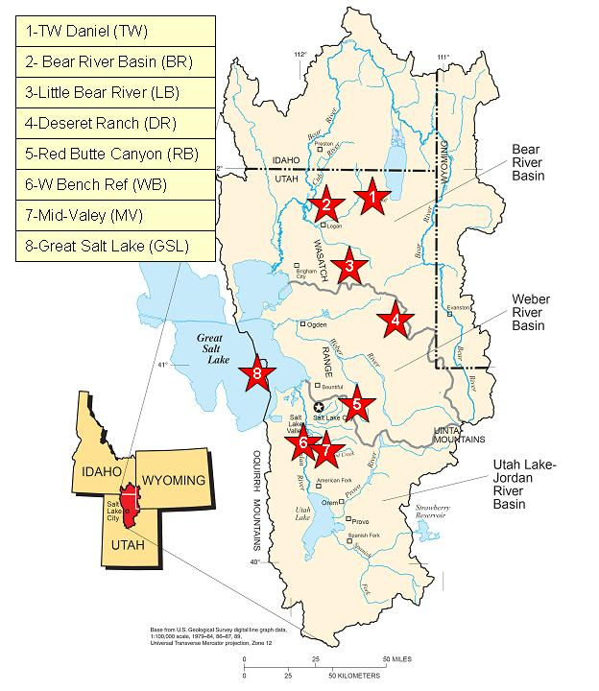
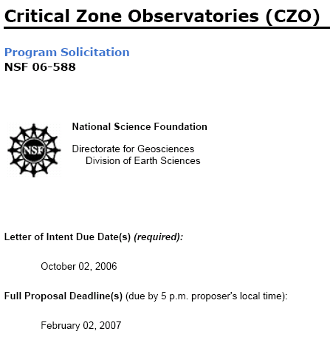
A common playground
The Great Salt Lake Basin Critical Zone Observatory
(Proposal submitted to NSF)

Slide 7
Overarching Questions
How do climate variability and human induced landscape changes influence hydrologic processes, water quality and availability and the functioning of ecosystems to determine the flux of water and chemicals in rivers, lakes and aquifers?
What are the resource, social and economic consequences of these changes?
The Great Salt Lake provides the opportunity for closure of mass and water balances in a unique way useful to address these questions
Notes:
These drive the compelling science

Slide 8
Great Salt Lake Levels
(USGS data)
SLC Airport level
Feet
Meters
5/12/07 4197.4 ft 1279.4 m
The lake was divided into North and South arms by a railroad causeway in 1959. Separate records of level in the North Arm and South Arm are available from 1966.

Slide 9
Level-Area-Volume Relationships
(Loving et al., 2000)
Level (meter)
Level (meter)
Area (km²)
Volume (km³)
Area (km²)
Volume (km³)

Slide 10
Great Salt Lake Volumes
Acre-Feet × 10⁷
km³
GSL was at its lowest water-surface elevation in recent history at about 1,277.4 m (4,191 ft), it covered about 2,460.5 km² (950 mi²) and was about 7.6 m deep at its deepest point in 1963.
1987, when Great Salt Lake was at its highest water-surface elevation at about 1,283.8 m (4,212 ft) on April 1st, 1987, it covered about 6,216 km² (2,400 mi²) and was about 13.7 m at its deepest point.

Slide 11
Conceptual Model
Processes that drive the GSL Volume fluctuations
Solar Radiation
Precipitation
Air Humidity
Air Temp.
Mountain Snowpack
Evaporation
GSL Level Volume Area
Soil Moisture And Groundwater
Salinity
Streamflow

Slide 12
Volume Increase & Decrease each Year
June 15 - Nov 1
Nov 1 - June 15
ΔV (+ or -) m³

Slide 13
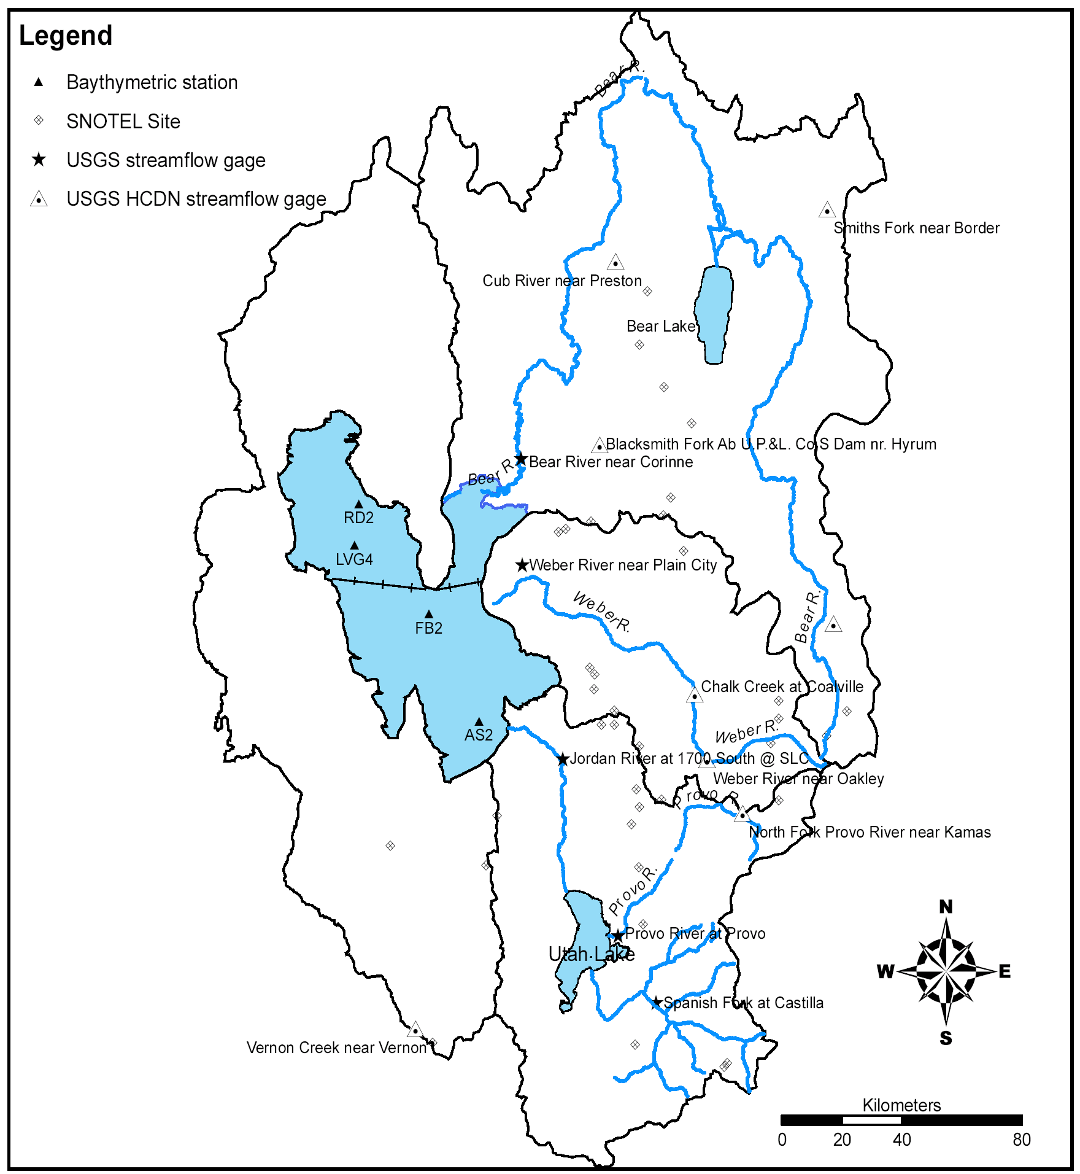
SLC, Jordan/Provo River Drainage area 8,904 km²
Corrine, Bear River
Drainage area 18,205 km²
Streamflow gages
Provo, Provo River Drainage area 1,743 km²
Plain City, Weber River
Drainage area 5,390 km²
Spanish, Jordan River Drainage area 1,689 km²

Slide 14
Annual Streamflows
1600 Mm³/year
520 Mm³/year
126 Mm³/year
m³
USGS Data

Slide 15
Nov 1 - June 15 lake volume increase
LOWESS (R defaults)
1:1 line
ΔV+ (m³) Nov 1 - June 15
Annual total streamflow, Q (m³)
Lake annual precipitation volume, P (m³)

Slide 16
Great Salt Lake Evaporation from annual mass balance E = P+Q-ΔV
LOWESS (R defaults)
E m³
Area m²

Slide 17
Evaporation vs Temperature (Annual)
LOWESS (R defaults)
E/A m
Degrees C

Slide 18
Annual Evaporation Loss E/A
LOWESS (R defaults)
Salinity decreases as volume increases. E increases as salinity decreases.
E/A m
Area m²

Slide 19
Evaporation vs Salinity
LOWESS (R defaults)
Salinity estimated from total load and volume related to decrease in E/A with decrease in lake volume and increase in C
E/A m
C = 3.5 x 10¹² kg/(Volume) g/l

Slide 20
Volume decrease versus E (annual)
1:1 line
Significant E in excess of ΔV⁻.
Evaporation not negligible when lake is rising (Nov 1 - June 15)
Streamflow input when lake is falling not negligible
ΔV⁻ m³ June 15 -Nov 1
LOWESS (R defaults)
E m³
(from annual mass balance E = P+Q-ΔV)

Slide 21
Evaporation...
UGS Salinity Observation Sites
LVG4
(North Arm)
RD2
(North Arm)
Evaporation is the only outflow from the GSL,
Lake volume impacts salinity (dilution).
Evaporation from the GSL is sensitive to salinity which changes the saturation vapor pressure above the lake’s surface,
Salinity decreases as volume increases and visa versa.
AS2
(South Arm)
FB2
(South Arm)

Slide 22
Salinity & Evaporation within Overall System
Solar Radiation
Precipitation
Air Humidity
Air Temp.
Mountain Snowpack
Evaporation
GSL Level Volume Area
Soil Moisture And Groundwater
Salinity
Streamflow

Slide 23
Lake Surface Salinity
West Desert Pumping Project
(Apr 1987 - Jun 1989)
North Arm
TDS (g/l)
Pre 1986
South Arm
Post 1987
LOWESS
Level (m)

Slide 24
Total Salt Load Calculations
0.152 m
0.0m
1.524 m
0.762m
2.286m
3.048 m
3.810m
6.096 m
6.858m
9.144 m
bottom
Salinity recorded with multiple depths at one site
Notes:
Flat line

Slide 25
Salt Load Dynamics, North, South, & Total Lake
Load = 3,620 M ton
Load = 3,200 M ton
kg of TDS
Total Load
RD2
North Arm
North Arm Load
South Arm Load
LVG4
∗
AS2
South Arm
FB2

Slide 26
Constituents of the GSL
Date | TDS g/L | Level ft | Na % WT | K % WT | Mg % WT | Ca % WT | Cl % WT | SO₄ % WT
1987, June 9th | 175.7 | 4210.7 | 32.2 | 3.3 | 1.9 | 0.2 | 56.5 | 5.9
1991, June 12th | 236.1 | 4201.0 | 33.5 | 2.9 | 1.7 | 0.2 | 55.7 | 6.0
1993, April 27th | 293.7 | 4197.4 | 32.5 | 3.3 | 2.1 | 0.1 | 55.7 | 6.3
1970, August 4th | 347.0 | 4194.8 | 31.4 | 3.9 | 3.0 | 0.1 | 53.4 | 8.2
1968, July 16th | 354.5 | 4194.4 | 25.6 | 4.2 | 2.7 | 0.1 | 56.4 | 11.0
Average |  |  | 31.0 | 3.5 | 2.3 | 0.1 | 55.5 | 7.5
Notes:
Showing the constituents of the GSL on 5 dates spanning the range of salinity observed in the north arm from UGS data. The lowest total dissolved solids was 175.7 g/l on June 9th , 1987. The highest TDS was 354.5 g/l on July 16th ,1968. The dominant ions are Na, Cl which comprise 80 % of the ionic mass. Across the range of salinity observed the percentages of ionic mass contributed by each ion remain essentially constant. The high ionic strength observed in the GSL requires use of the Pizter equations to calculate the activity coefficient that is used to obtain vapor pressure. The USGS program PHreeqc was used to evaluate water activity coefficients. I am greatful to Lynn Dudley who helped me to learn how to use this and understand lake salinity and chemistry.

Slide 27
Salinity Impact on Evaporation
Atmosphere
R_{a}
Clouds
Air
αR_{s}
R_{l}
Sensible Heat
Latent Heat
R_{s}
Water surface
R_{ns}
Water activity coefficient
Hydrogen Bond
Water Body
Molecule
Dissolved salts
These molecules have sufficient energy to sever the bonds and enter the air α T_{s}
The rate of re-entering f (concentration)

Slide 28
Penman Equation modified for Salinity
Where:-
R_{n} Net Radiation, λ_{v} latent heat of vaporization,
β water activity coefficient, ν_{a} wind speed
∆´ gradient of saturated vapor content of air corrected for salinity,
γ psychrometric constant, K_{E} bulk latent-heat transfer coefficient.

Slide 29
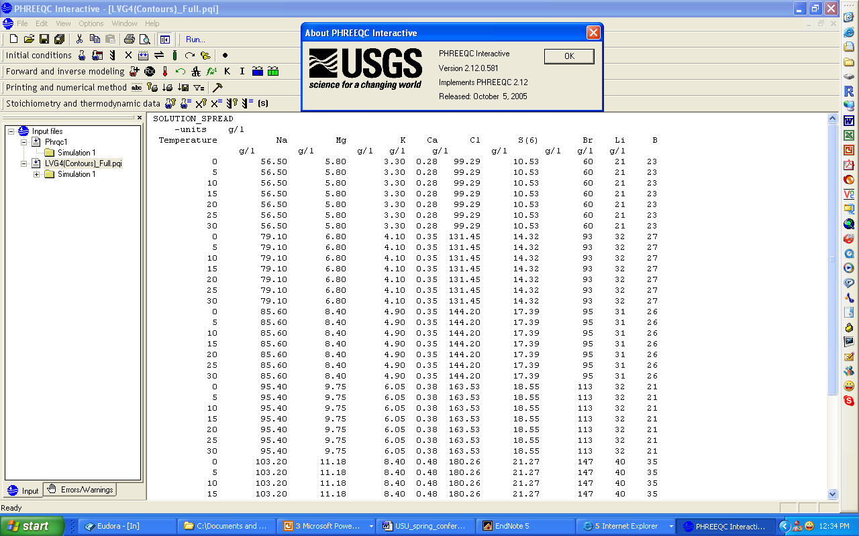
The Activity of Water in Brines Using its Chemical Composition From USGS Model...
(Parkhurst and Appelo, 1999)

Slide 30
Salinity Impact on GSL Saturation Vapor Pressure
Adjusted SVP (kpa)
Temperature (°C)

Slide 31
Evaluation of Modified Penman Equation
1:1 line
modified Penman
+
Un-modified Penman
Mass balance Evaporation (m³)
LOWESS
(R-Defaults)
Penman Evaporation (m³)

Slide 32
Per Unit Area Comparison
Modified Penman Evaporation (meter)

Slide 33
Possible Reasons for remaining Discrepancies
Errors in P, Q
Errors in ET Climate Data (T, T_{dew}, Wind Speed)
Errors in Lake Surface Properties
(Salinity, Roughness)
Errors in Effective Evaporating AreaErrors in Effective Area for Precipitation
Lake Heat Storage
Freshwater surface lenses

Slide 34
Conclusions
Solar Radiation
Precipitation
Air Humidity
Air Temp.
Increases
Reduces
Mountain Snowpack
Evaporation
Area Control
GSL Level Volume Area
Supplies
Reduces
β(T,S)
Soil Moisture And Groundwater
Contributes
Salinity
C≈L/V
Dominant
Streamflow

Slide 35
Summary
Salinity decreases as Lake volume increases. Evaporation increases as salinity decreases. This is a stabilizing feedback.
Across the range of salinity observed the percentages of ionic mass contributed by each ion remain essentially constant.
The saturation vapor pressure over the GSL surface is reduced by (10% - 40%) due to salinity.
The Penman equation modified for salinity is closer to, but underestimates, mass balance evaporation estimates.

