Slide 1
GIS, Hydrology and Terrain Analysis Using Digital Elevation Models
David G. Tarboton
dtarb@cc.usu.edu
http://www.engineering.usu.edu/dtarb

Slide 2
Overview
GIS as a tool for Hydrologic Modeling
The ArcGIS Hydrology Model
Terrain Analysis Using Digital Elevation Models. (Some new Spatial Concepts)
Extendability of ArcGIS (TauDEM as an example)
Demonstration of TauDEM

Slide 3
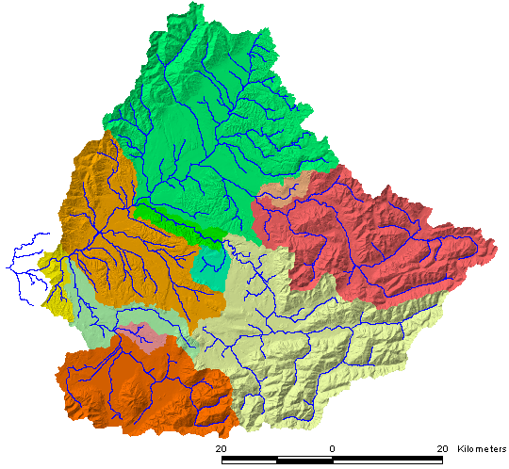
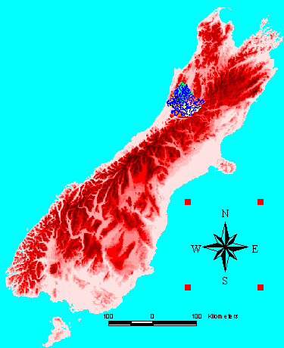
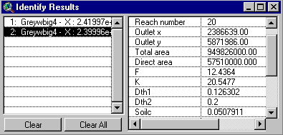
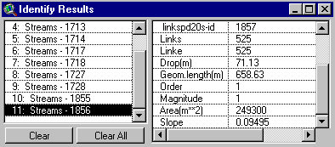
Grey River, New Zealand South Island
TOPNET Model
Basin Area: 3817 km²
Flow: 12.1 x 10⁹ m³
Flow/Area: 3184 mm
Greymouth
Christchurch
Subwatershed attributes
Stream segment attributes
"Data based on contours supplied by Land Information New Zealand"
Notes:
Much of hydrology is spatial, so GIS provides a natural tool for Hydrologic Modeling. This slide illustrates the development of Hydrologic Model information from GIS.

Slide 4
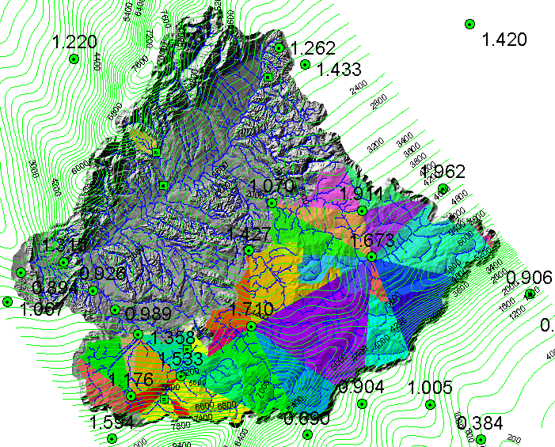
Rainfall interpolation and adjustment
Notes:
Complicate slide, but bear with me as I explain it because rainfall estimation is a crucial problem here. Wanted to model the spatial pattern of rainfall over the watershed, recognizing orographic variability and using the gauges present
Circles show rain gauges.
The contours show the estimate of the mean annual rainfall surface that reflects the orographic effects. The surface was constructed by Roddy Henderson using what he had learnt from doing rainfall-runoff data analysis for many West Coast catchments. He assumed that the upper envelope of measured annual rainfall along each NW->SE path was the best estimate of the actual rainfall process. By doing this, he discounted lower measurements on the grounds that they were perhaps only representative of very local conditions (~1 km), and did not necessarily constitute a representative sample for spatial interploation purposes.
2. By constructing envelope curves for many NW->SE paths on the West Coast, Roddy inferred the location and magnitude of the annual rainfall peak(s). For the Grey, there are peaks slightly
upwind of both the Paparoa Ranges and Southern Alps.
3. He generalised his envelope by fitting a simple surface to it. (I think the rain surface was constrained so that the peak rain along any NW-SE path across the catchment was 12 m/yr. If there were two peaks along a path, then the sum of the peaks was 12 m/yr.) Rain was distributed along each path by assuming an exponential fall-off from the peak(s). The rainfall at sea level on the West Coast, and on the Canterbury Plains was taken to be the observed amounts, since orography does not affect these sites greatly.
Need precipitation at each point as a weighted average of precipitation from nearby weights. Used a scheme to determine weights based upon Delauney triangles, linear interpolation and normalization by annual rainfall estimate.

Slide 5
Parameters
Spatially variable
Spatially constant
Hydraulic conductivity K, calibrated using multiplying factor applied to spatially variable values.
The soil capacity parameter ‘soilc’ is estimated as (soil zone depth)/(dth1+dth2)

Slide 6
Basin average precipitation
Streamflow at outlet
Cumulative
water balance

Slide 7
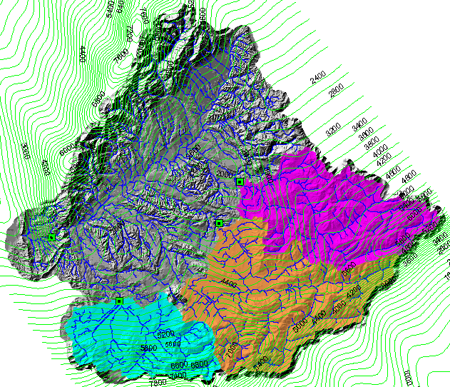
“White space” is the Grey at Dobson minus Ahaura, Arnold and Grey at Waipuna

Slide 8
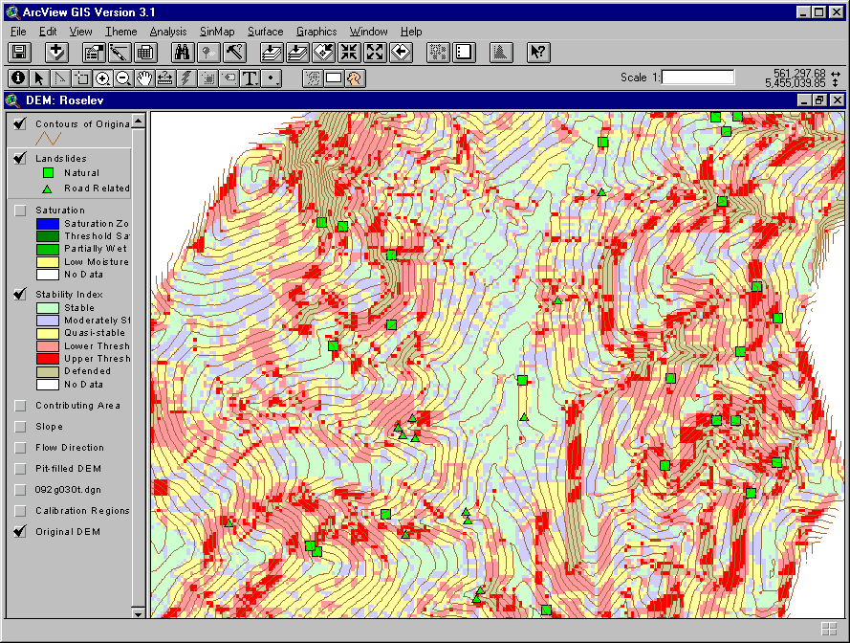
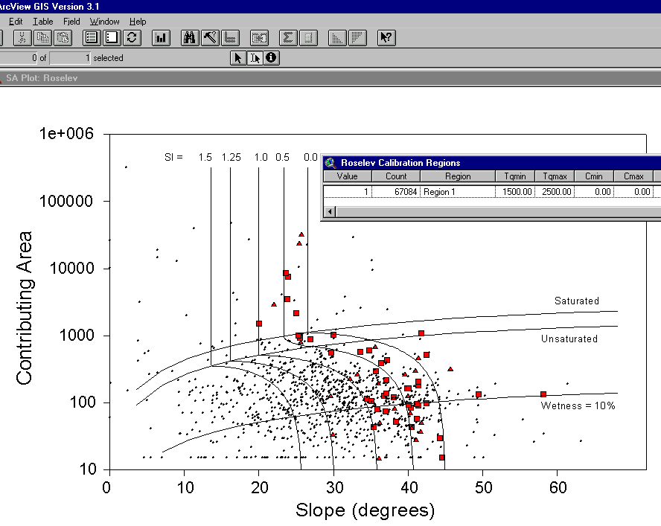
SINMAP
Terrain Stability Mapping

Slide 9
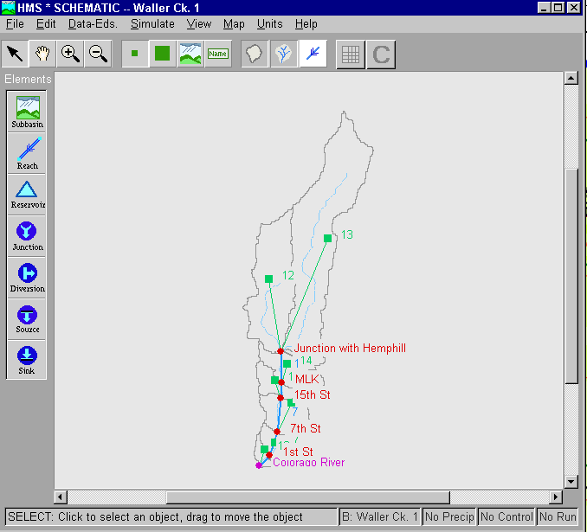
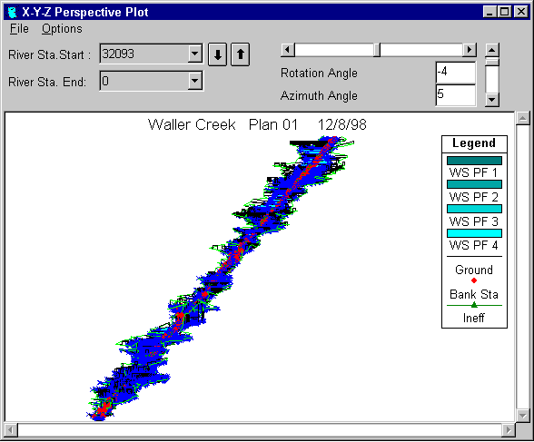
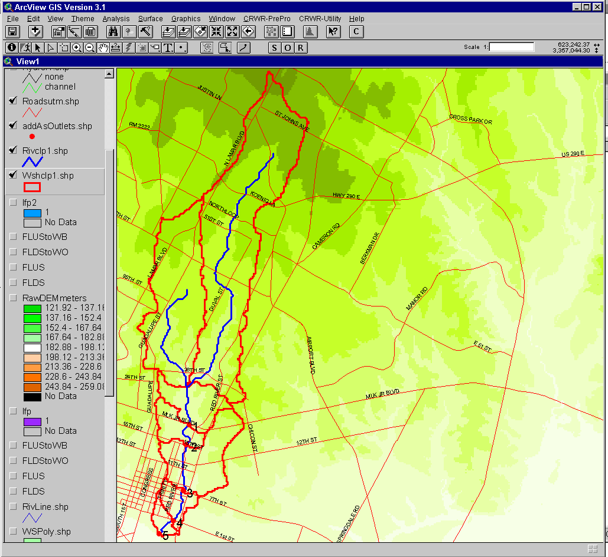
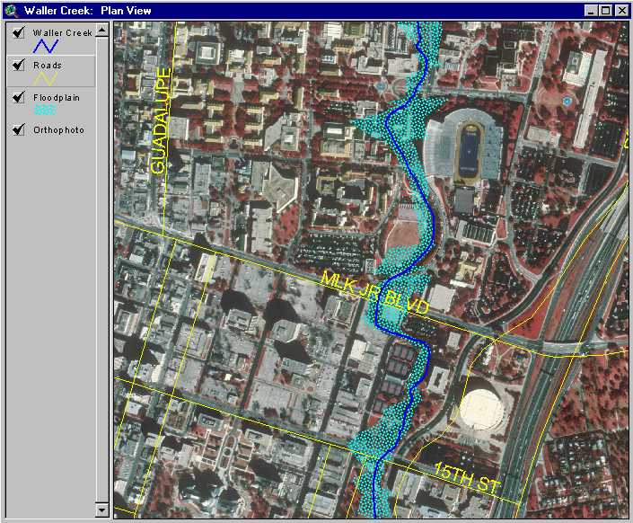
Flood Plain Mapping
HEC-RAS
Water
surface
profiles
HEC-HMS
Flood
discharge
CRWR-PrePro
AvRAS
ArcView
Digital
Elevation
Model
ArcView
Flood
plain maps
Digital Map Database
Slide from David Maidment, University of Texas at Austin.

Slide 10
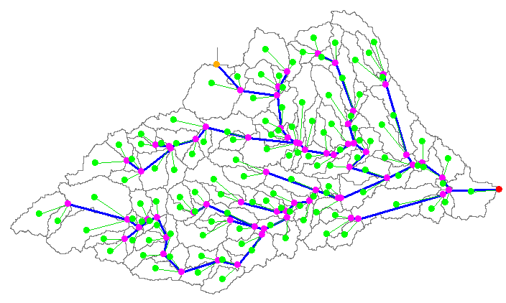
HMS Schematic Prepared with CRWR-PrePro
Mansfield Dam
Colorado
River
Slide from David Maidment, University of Texas at Austin.

Slide 11
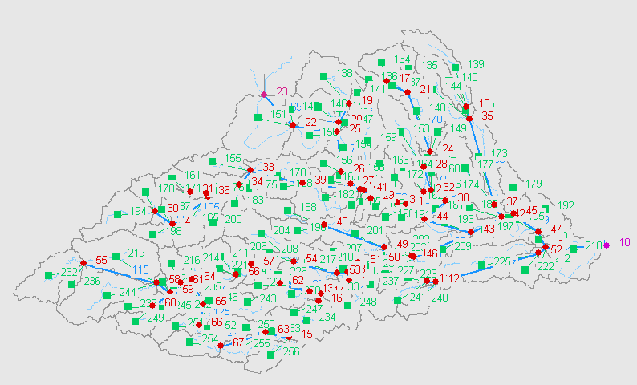
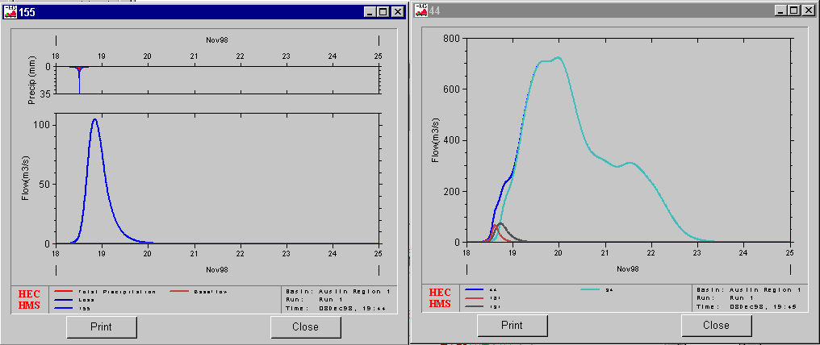
HMS Results
Watershed 155
Junction 44
Slide from David Maidment, University of Texas at Austin.

Slide 12
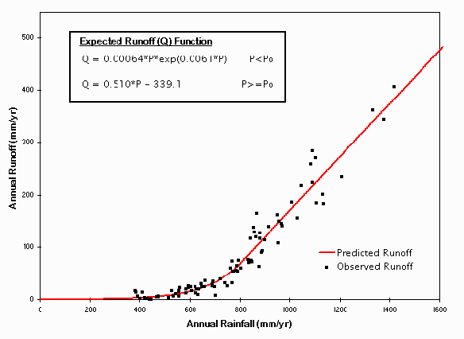
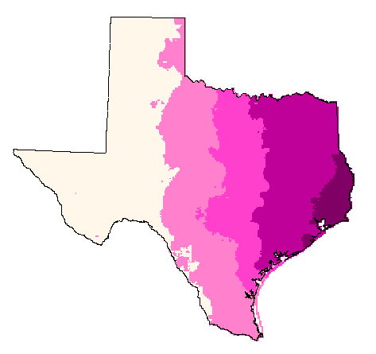
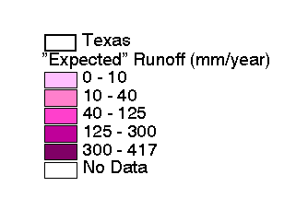
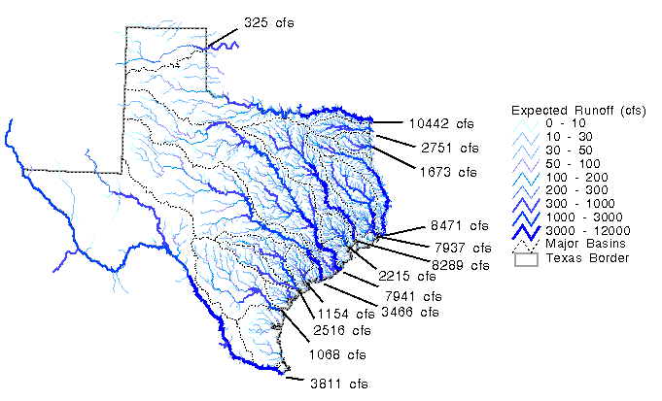
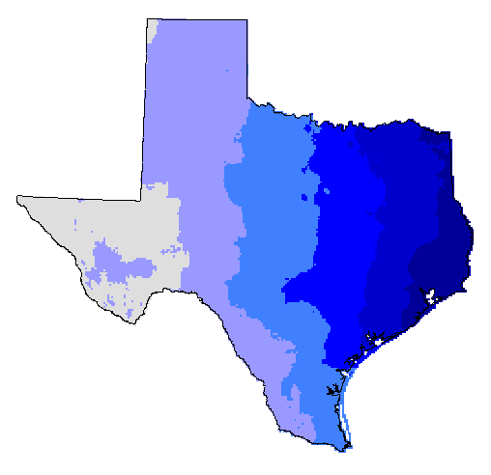
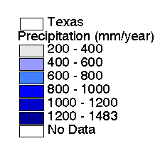
Map-Based Surface Water Runoff
Estimating the surface water yield
by using a rainfall-runoff function
Runoff, Q
(mm/yr)
Q
P
Runoff Coefficient
C = Q/P
Accumulated Runoff
(cfs)
Precipitation, P
(mm/yr)
Slide from David Maidment, University of Texas at Austin.

Slide 13
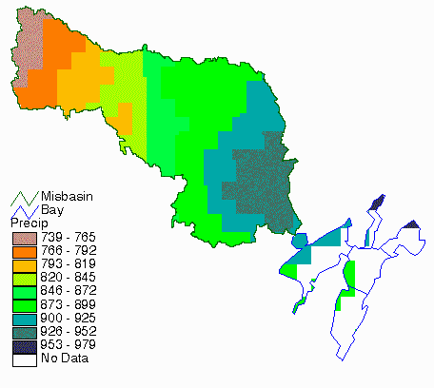
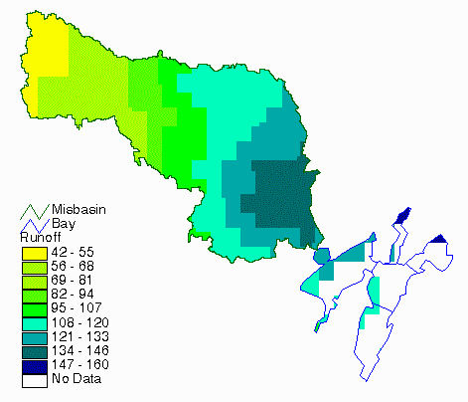
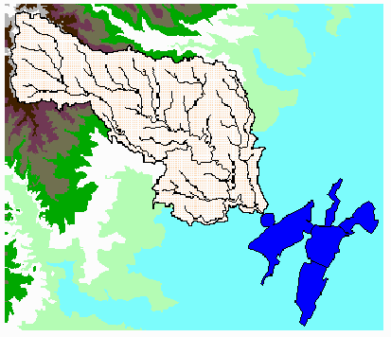
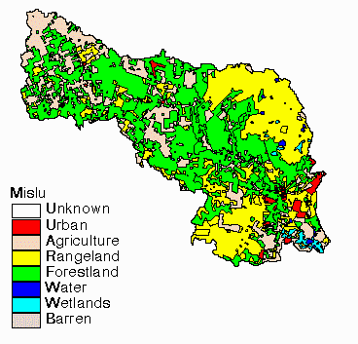
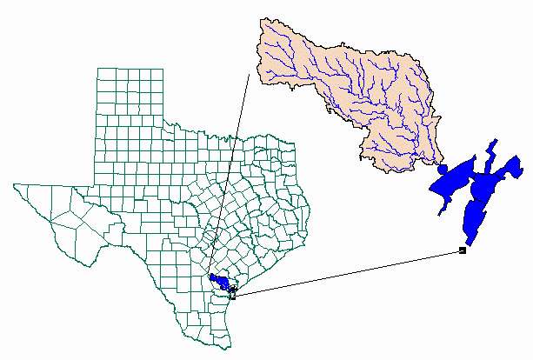
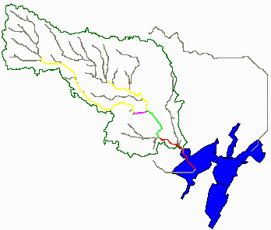
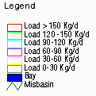
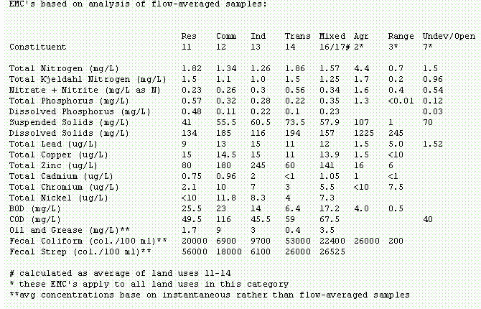
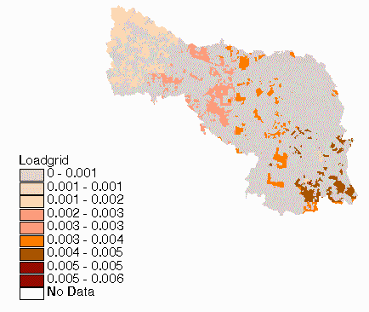
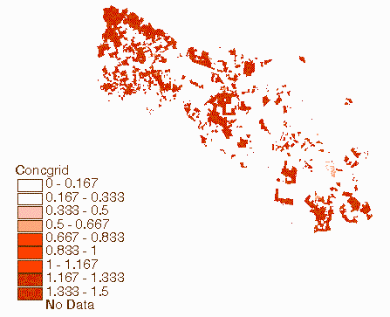
Water Quality: Pollution Loading Module
Load [Mass/Time] = Runoff [Vol/Time] x Concentration [Mass/Vol]
Precip.
Runoff
DEM
LandUse
Accumulated
Load
EMC Table
Load
Concentration
Slide from David Maidment, University of Texas at Austin.

Slide 14

GIS in Water Resources
Consortium
CRWR
Water Resources
GIS
Bringing together these two communities by using a common geospatial data model
http://www.crwr.utexas.edu/giswr
Slide from David Maidment, University of Texas at Austin.

Slide 15
ArcGIS Data Models
Facilitate a process with the user community
Capture the essential, common data model for each discipline
Build a database design template that works well with ArcGIS
Build on experience, not a standards exercise
Share the model on ArcOnline
http://arconline.esri.com/arconline/datamodels.cfm
Slide from David Maidment, University of Texas at Austin.

Slide 16
Essential Data Model
Organization B
Organization A
Something
in common
Organization D
Organization C
The data model for a business organization tends not to change greatly over time unless the business organization changes the fundamental way that it does business
Slide from David Maidment, University of Texas at Austin.

Slide 17
ArcGIS Hydro Data Model
Drainage
Network
Flow
HydroFeatures
Time
Time Series
Hydrography
Channel
Slide from David Maidment, University of Texas at Austin.

Slide 18
Slide from David Maidment, University of Texas at Austin.

Slide 19
Elevation Surface — the ground surface elevation at each point
Terrain Analysis Using Digital Elevation Models
Digital Elevation Model — A digital representation of an elevation surface. Examples include a (square) digital elevation grid, triangular irregular network, set of digital line graph contours or random points.

Slide 20
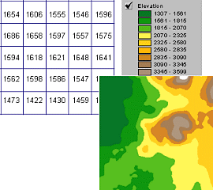
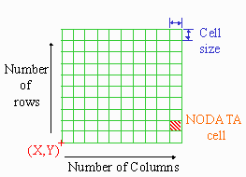
Digital Elevation Grid — a grid of cells (square or rectangular) in some coordinate system having land surface elevation as the value stored in each cell.
Square Digital Elevation Grid — a common special case of the digital elevation grid

Slide 21

Digital Elevation Model Based Flow Path Analysis
D∞
Eight direction pour point model D8
Grid network
4
3
2
5
1
6
7
8
Drainage Area
1
1
1
1
1
1
4
3
3
1
1
1
12
1
2
1
1
2
16
1
1
3
6
25
2

Slide 22
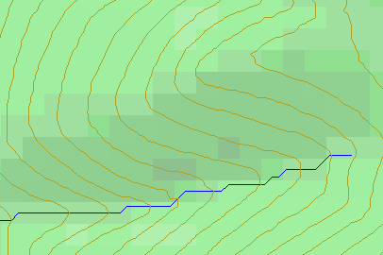
Topographic Slope
?
Topographic Definition Drop/Distance
Limitation imposed by 8 grid directions.
Flow Direction Field — if the elevation surface is differentiable (except perhaps for countable discontinuities) the horizontal component of the surface normal defines a flow direction field.

Slide 23
The D∞ Algorithm
D∞ Flow Direction Grid — A special case of a multiple flow direction grid in which the flow direction is represented by an angle stored in each grid cell
Tarboton, D. G., (1997), "A New Method for the Determination of Flow Directions and Contributing Areas in Grid Digital Elevation Models," Water Resources Research, 33(2): 309-319.) (http://www.engineering.usu.edu/cee/faculty/dtarb/dinf.pdf)

Slide 24
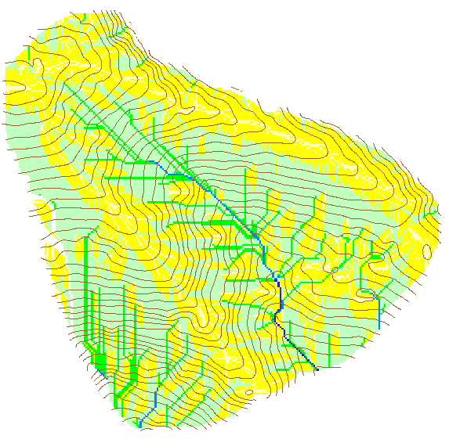

Contributing Area using D∞
Contributing Area using D8

Slide 26
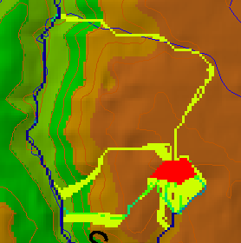
Useful for example to track where sediment or contaminant moves

Slide 27
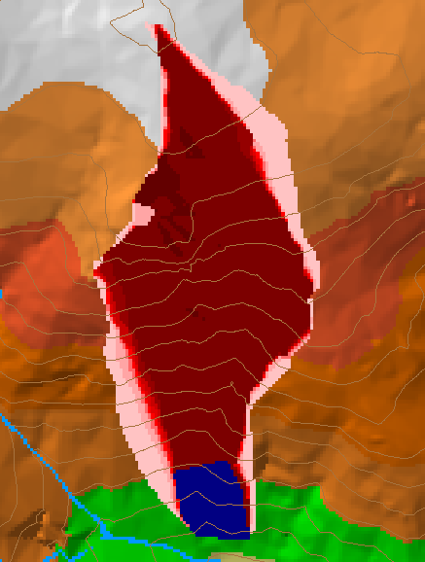
Useful for example to track where a contaminant may come from

Slide 28
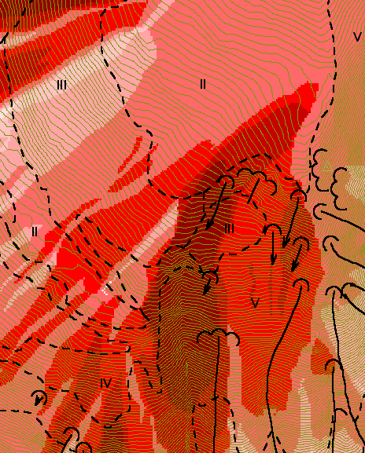
Reverse Accumulation
Useful for destabilization sensitivity in landslide hazard assessment

Slide 29
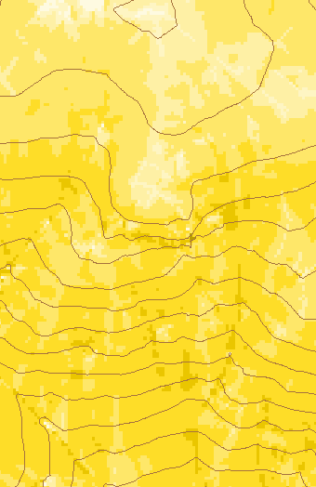
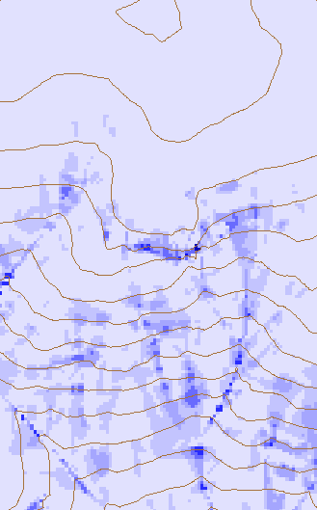
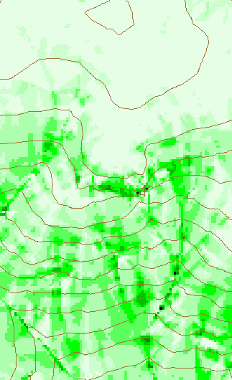
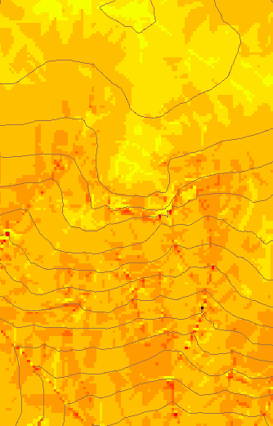
Transport limited accumulation
Useful for modeling erosion and sediment delivery, the spatial dependence of sediment delivery ratio and contaminant that adheres to sediment

Slide 30
Drainage area can be concentrated or dispersed (specific catchment area)

Slide 31
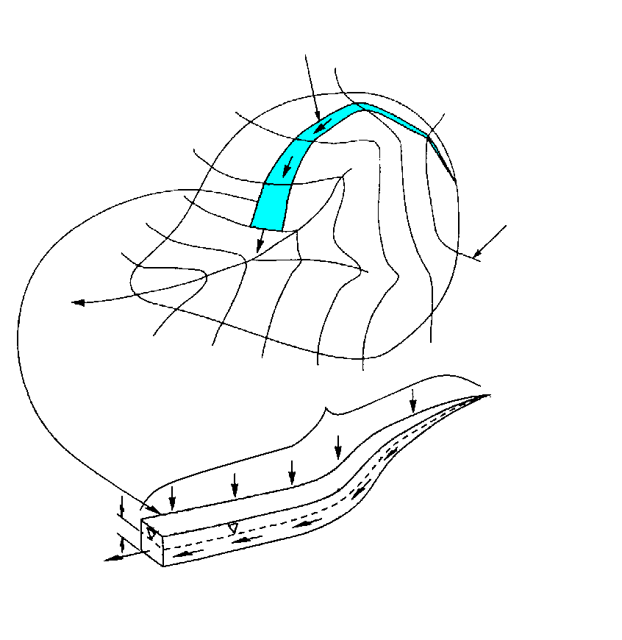
Specific catchment area a is the upslope area per unit contour length [m²/m ⇒ m]
Topographic Definition
Stream line
Contour line
Upslope contributing area a

Slide 32
Contributing Area — a field representing at each point the magnitude of the drainage area upslope of that point. Also called Catchment Area, Drainage Area or Flow Accumulation.
Specific Catchment Area — a field representing contributing area per unit contour width. Units are length.
Concentrated Contributing Area — the contributing area on a smooth surface or flow line where surface flow has concentrated and there is a measurable contributing area to a point. Units are area.
Contributing Area Grid — a grid derived from the flow direction grid, which counts in each cell the number of upstream cells draining through that cell.

Slide 33
Hydrologic processes are different on hillslopes and in channels. It is important to recognize this and delineate model elements that account for this.
Concentrated versus dispersed flow.
Objective delineation of channel networks using digital elevation models.

Slide 34
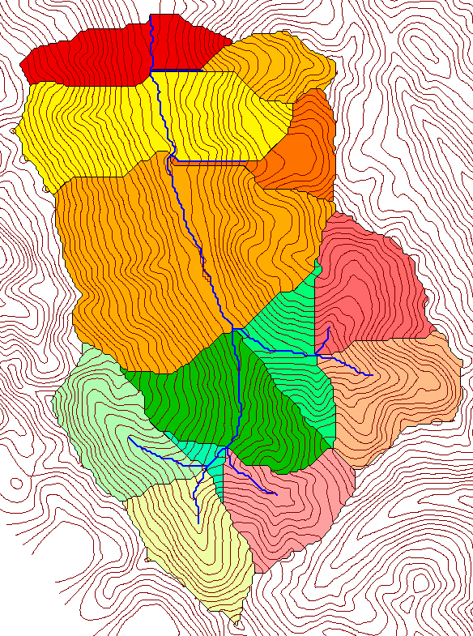
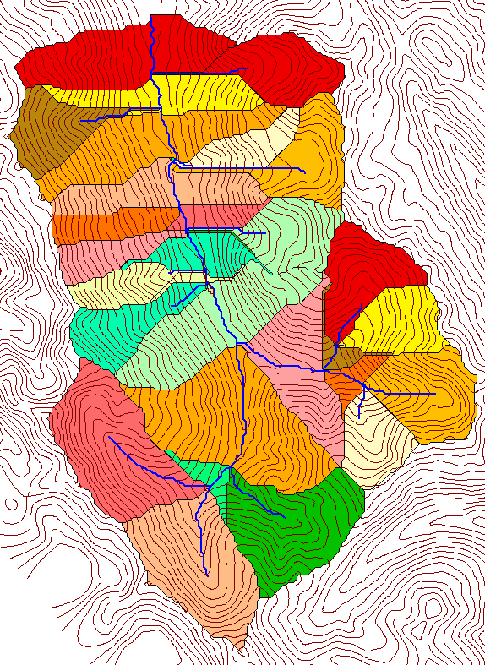
How to decide on drainage area threshold to determine channels and watershed model elements?
500 cell theshold
1000 cell theshold

Slide 35
Topographic Texture and Drainage Density
Driftwood, PA
Same scale, 20 m contour interval
Sunland, CA

Slide 36

Strahler Stream Order
Stream Drop: Elevation difference between ends of stream
most upstream is order 1
when two streams of a order i join, a stream of order i+1 is created
when a stream of order i joins a stream of order i+1, stream order is unaltered
Nodes
Links
Single Stream
Note that a “Strahler stream” comprises a sequence of links (reaches or segments) of the same order

Slide 37
Suggestion: Map channel networks from the DEM at the finest resolution consistent with observed channel network geomorphology ‘laws’.
Look for statistically significant break in constant stream drop property
Break in slope versus contributing area relationship
Physical basis in the form instability theory of Smith and Bretherton (1972), see Tarboton et al. 1992

Slide 38
Statistical Analysis of Stream Drops
Threshold = 10
Dd = 2.5
t = -3.5
Threshold = 15
Dd = 2.1
t = -2.08
Threshold = 20
Dd = 1.9
t = -1.03
Stream drop test for Mawheraiti River. For each upward curved support area threshold the stream drop for each stream is plotted against Strahler stream order. The large circles indicate mean stream drop for each order The weighted support area threshold, drainage density (in km⁻¹) and t statistic for the difference in means between lowest order and all higher order streams is given.

Slide 39
Curvature based stream delineation with threshold by constant drop analysis

Slide 40
Why Programming

Slide 41
TauDEM Software Functionality
Pit removal (standard flooding approach)
Flow directions and slope
  D8 (standard)
  D∞ (Tarboton, 1997, WRR 33(2):309)
  Flat routing (Garbrecht and Martz, 1997, JOH 193:204)
Drainage area (D8 and D∞)
Network and watershed delineation
  Support area threshold/channel maintenance coefficient (Standard)
  Combined area-slope threshold (Montgomery and Dietrich, 1992, Science, 255:826)
  Local curvature based (using Peuker and Douglas, 1975, Comput. Graphics Image Proc. 4:375)
Threshold/drainage density selection by stream drop analysis (Tarboton et al., 1991, Hyd. Proc. 5(1):81)
Wetness index and distance to streams

Slide 42
TauDEM Software Architecture
ESRI ArcGIS 8.1
(Toolbar under
development )
VB GUI
application
Standalone
command line
applications
C++ COM DLL interface
Available from
TauDEM C++ library
Fortran (legacy)
components
http://www.engineering.usu.edu/dtarb/
USU TMDLtoolkit modules
(grid, shape, image, dbf, map, mapwin)
ESRI gridio API
(Spatial analyst)
Data
formats
Vector shape
files
ASCII text
grid
Binary direct
access grid
ESRI binary
grid

Slide 43
Implementation Details
Spatial Analyst includes a C programming API (Application Programming Interface) that allows you to read and write ESRI grid data sets directly.
Excerpt from gioapi.h
/ * GetWindowCell - Get a cell within the window for a layer,
* Client must interpret the type of the output 32 Bit Ptr
* to be the type of the layer being read from.
*
* PutWindowCell - Put a cell within the window for a layer.
* Client must ensure that the type of the input 32 Bit Ptr
* is the type of the layer being read from.
*
*/
int GetWindowCell(int channel, int rescol, int resrow, CELLTYPE *cell);
int PutWindowCell(int channel, int col, int row, CELLTYPE cell);

Slide 44
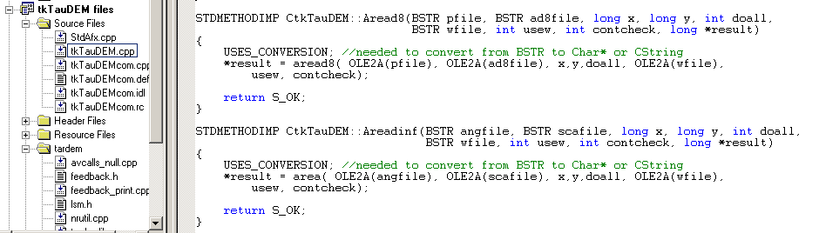
C++ COM Methods used to implement functionality using Microsoft Visual C++
STDMETHODIMP CtkTauDEM::Areadinf(BSTR angfile, BSTR scafile, long x, long y, int doall, BSTR wfile, int usew, int contcheck, long *result)
{
USES_CONVERSION; //needed to convert from BSTR to Char* or String
*result = area( OLE2A(angfile), OLE2A(scafile), x,y,doall, OLE2A(wfile),
usew, contcheck);
return S_OK;
}

Slide 45
Visual Basic for the GUI and ArcGIS linkage
Private TarDEM As New tkTauDEM
…
Private Function runareadinf(Optional toadd As Boolean = False) As Boolean
Dim i As Long
runareadinf = False
i = TarDEM.Areadinf(tdfiles.ang, tdfiles.sca, 0, 0, 1, "", 0, 1)
If TDerror(i) Then Exit Function
If toadd Then
AddMap tdfiles.sca, 8
End If
runareadinf = True
End Function

Slide 46
GIS in Water Resources Online
A Virtual Course Presented On-Line by David Maidment at the University of Texas at Austin in partnership with Utah State University. Next offering Fall 2002.
Goals:
  To teach the principles and operation of geographic information systems, focusing in particular on ArcView and its Spatial Analyst extension.
  To show how spatial hydrologic modeling can be done by developing a digital representation of the environment in the GIS, then adding functions simulating hydrologic processes.
  To develop individual experience in the use of GIS in Water Resources through execution of a term project, and presenting it both orally and written form in html on the world wide web.
http://moose.cee.usu.edu/giswr/

Slide 47
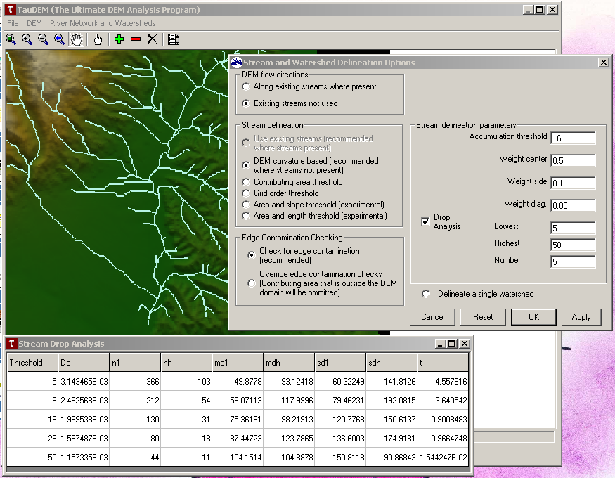
Demonstration

