Slide 1
Advances in the mapping of flow networks from digital elevation data
David G. Tarboton
Dan Ames
http://www.engineering.usu.edu/dtarb

Slide 2
Hydrologic processes are different on hillslopes and in channels. It is important to recognize this and delineate model elements that account for this.
Concentrated versus dispersed flow.
Objective delineation of channel networks using digital elevation models.
Terrain analysis using Digital Elevation Models (TauDEM) software.

Slide 3
Concentrated and dispersed contributing area and specific catchment area

Slide 4

Digital Elevation Model Based Flow Path Analysis
D∞
Eight direction pour point model D8
Grid network
4
3
2
5
1
6
7
8
Drainage Area
1
1
1
1
1
1
4
3
3
1
1
1
12
1
2
1
1
2
16
1
1
3
6
25
2

Slide 5
100 grid cell constant drainage area threshold stream delineation

Slide 6
200 grid cell constant drainage area based stream delineation

Slide 7
How to decide on drainage area threshold ?
AREA 2
3
AREA 1
12

Slide 8
Topographic Texture and Drainage Density
Driftwood, PA
Same scale, 20 m contour interval
Sunland, CA

Slide 9
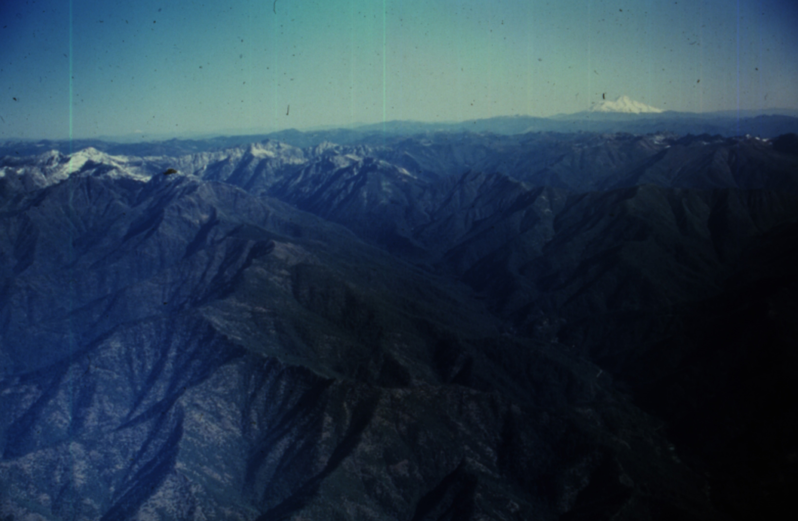
Canyon Creek, Trinity Alps, Northern California.
Photo D K Hagans

Slide 10
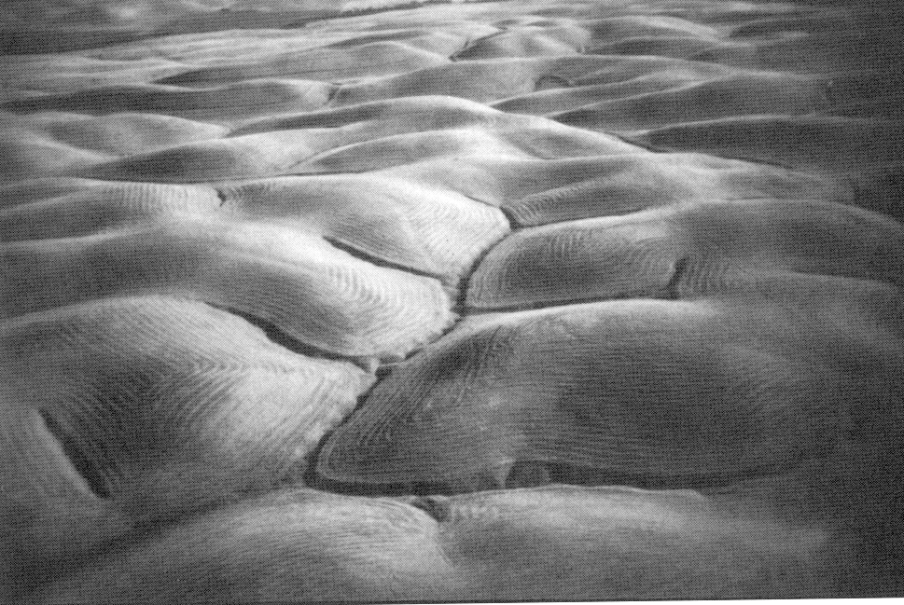
Gently Sloping Convex Landscape
From W. E. Dietrich

Slide 11
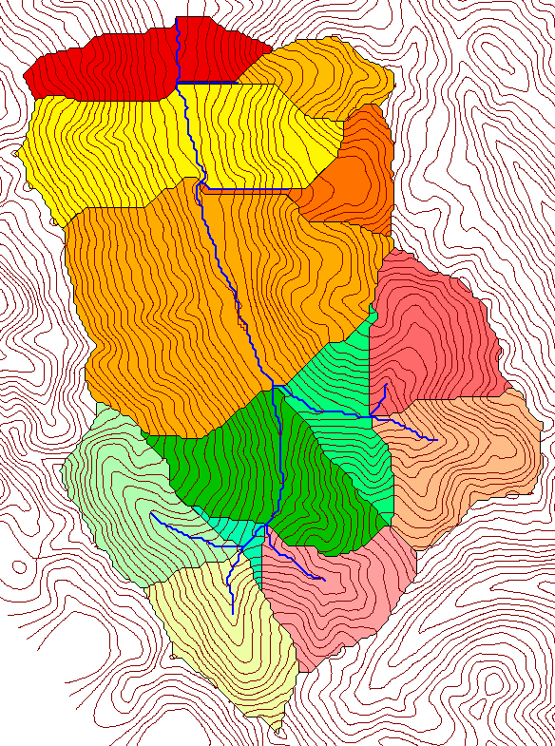
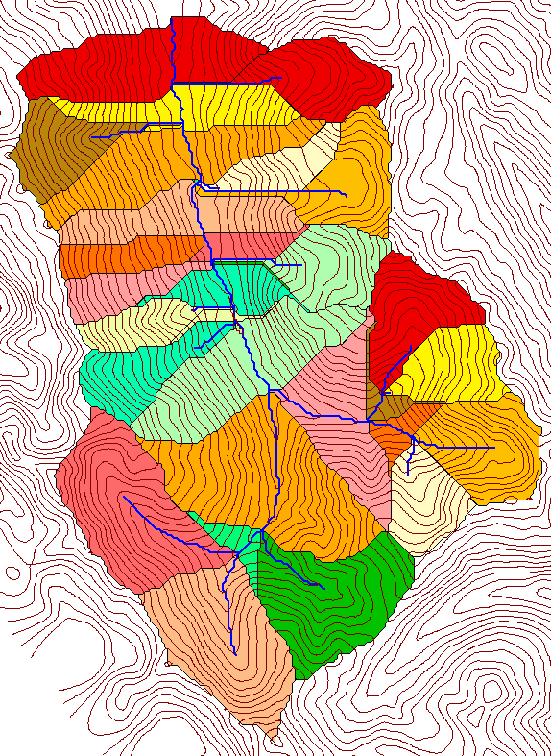
Subwatersheds (hydrologic model elements) with different support area thresholds.
500 cell theshold
1000 cell theshold

Slide 12
Grid Network Ordering Approach (Peckham, 1995)

Slide 13
Slope area threshold (Montgomery and Dietrich, 1992).

Slide 14
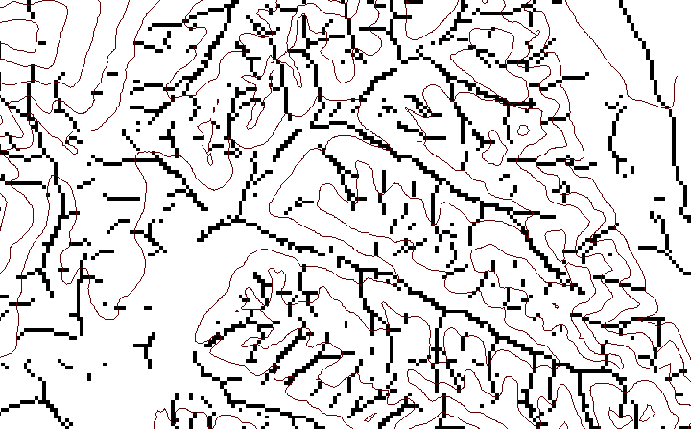
Local Curvature Computation
(Peuker and Douglas, 1975, Comput. Graphics Image Proc. 4:375)
43
48
48
51
51
56
41
47
47
54
54
58

Slide 15
Contributing area of upwards curved grid cells only

Slide 16
How to decide on drainage area threshold ?
AREA 2
3
AREA 1
12

Slide 17
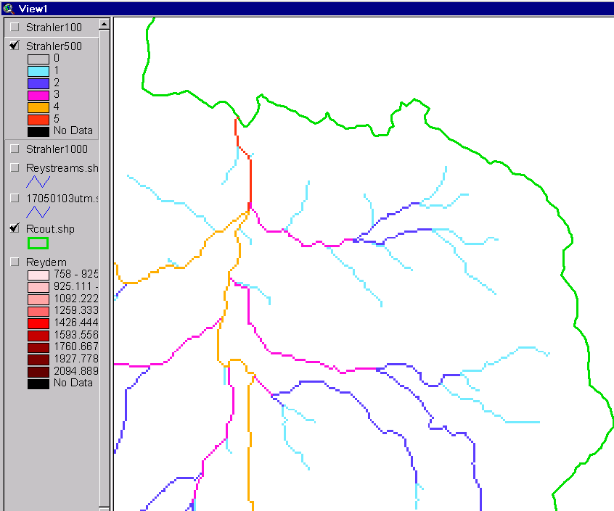
Strahler Stream Order
Order 5
Order 1
most upstream is order 1
when two streams of a order i join, a stream of order i+1 is created
when a stream of order i joins a stream of order i+1, stream order is unaltered
Order 3
Order 4
Order 2

Slide 18
Slope Law

Slide 19
Constant Stream Drops Law

Slide 20

Stream Drop
Elevation difference between ends of stream
Nodes
Links
Single Stream
Note that a “Strahler stream” comprises a sequence of links (reaches or segments) of the same order

Slide 21
Suggestion: Map channel networks from the DEM at the finest resolution consistent with observed channel network geomorphology ‘laws’.
Look for statistically significant break in constant stream drop property
Break in slope versus contributing area relationship
Physical basis in the form instability theory of Smith and Bretherton (1972), see Tarboton et al. 1992

Slide 22
Statistical Analysis of Stream Drops
Threshold = 10
Dd = 2.5
t = -3.5
Threshold = 15
Dd = 2.1
t = -2.08
Threshold = 20
Dd = 1.9
t = -1.03
Stream drop test for Mawheraiti River. For each upward curved support area threshold the stream drop for each stream is plotted against Strahler stream order. The large circles indicate mean stream drop for each order The weighted support area threshold, drainage density (in km⁻¹) and t statistic for the difference in means between lowest order and all higher order streams is given.

Slide 23
Curvature based stream delineation with threshold by constant drop analysis

Slide 24
Software (TauDEM)
Functionality
Pit removal (standard flooding approach)
Flow directions and slope
  D8 (standard)
  D∞ (Tarboton, 1997, WRR 33(2):309)
  Flat routing (Garbrecht and Martz, 1997, JOH 193:204)
Drainage area (D8 and D∞)
Network and watershed delineation
  Support area threshold/channel maintenance coefficient (Standard)
  Combined area-slope threshold (Montgomery and Dietrich, 1992, Science, 255:826)
  Local curvature based (using Peuker and Douglas, 1975, Comput. Graphics Image Proc. 4:375)
Threshold/drainage density selection by stream drop analysis (Tarboton et al., 1991, Hyd. Proc. 5(1):81)

Slide 25
TauDEM Software Architecture
ESRI ArcGIS 8.1
(Awaiting release)
(under development
using beta)
VB GUI
application
Standalone
command line
applications
C++ COM DLL interface
Available from
TauDEM C++ library
Fortran (legacy)
components
http://www.engineering.usu.edu/dtarb/
USU TMDLtoolkit modules
(grid, shape, image, dbf, map, mapwin)
ESRI gridio API
(Spatial analyst)
Data
formats
Vector shape
files
ASCII text
grid
Binary direct
access grid
ESRI binary
grid

Slide 26
Conclusions
Terrain analysis using digital elevation models provides considerable capability useful in hydrologic analysis.
Curvature based methods allow channel network drainage density to be spatially variable and adapt to variable topographic texture.
Constant stream drop law used to objectively determine support area threshold and drainage density consistent with the natural texture of the topography.

Slide 27
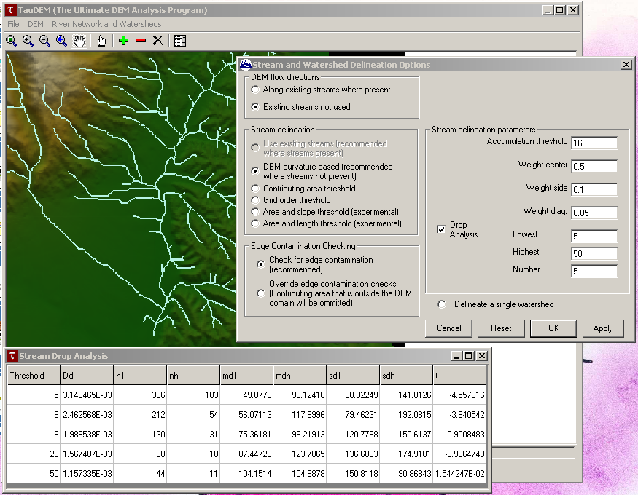
Demonstration

