Slide 1


Community Approaches to Hydrologic Data and Model Sharing using Cloud Resources
David Tarboton, Ray Idaszak, Jeffery Horsburgh, Dan Ames, Jon Goodall, Larry Band, Venkatesh Merwade, Alva Couch, Jennifer Arrigo, Rick Hooper, David Valentine
http://his.cuahsi.org
http://www.hydroshare.org
EAR 0622374 (2007-2012)
OCI-1148453 (2012-2017)
OCI-1148090 (2012-2017)

Slide 2

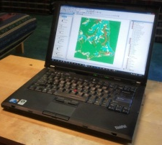
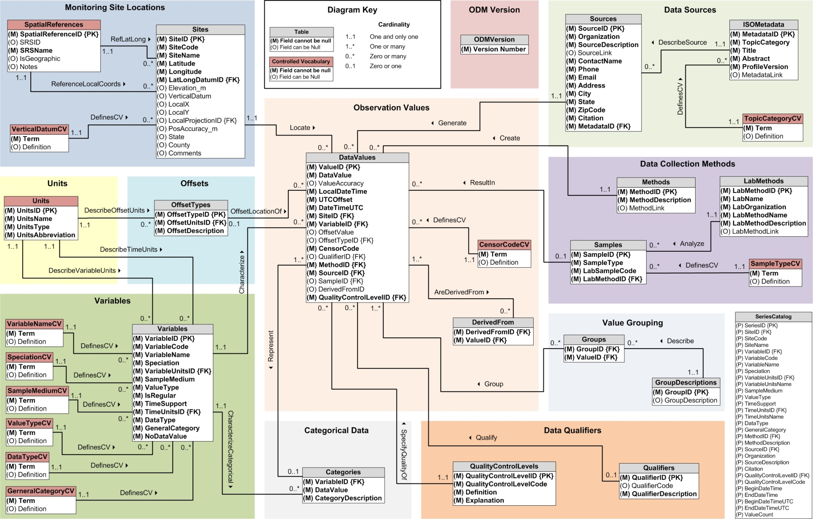
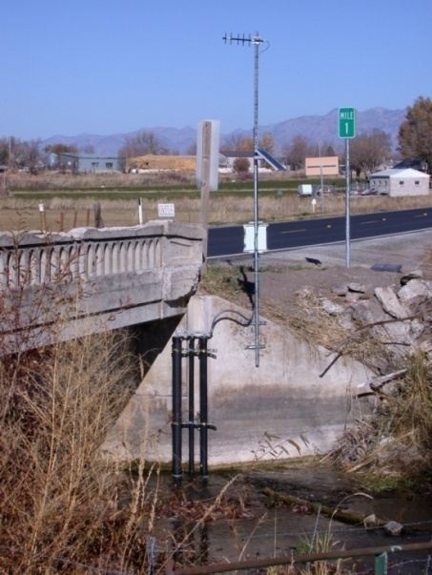
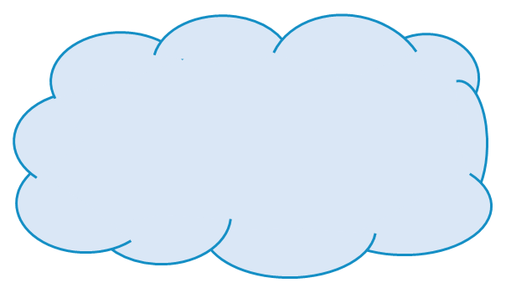
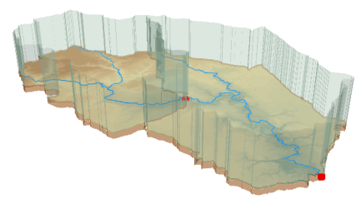



Outline
Cloud Computing
The CUAHSI HIS
  A Services-Oriented Architecture Based System for Sharing Hydrologic Data
HydroShare
  A Web-Based Collaborative Environment for the Sharing of Hydrologic Data and Models

Slide 3
What proportion of your research time do you spend on preparing or preprocessing data into appropriate forms needed for research purposes?
http://his.cuahsi.org/documents/HISStatusSept15.pdf
Notes:
Surveys of the hydrology community have indicated that data gathering and preprocessing is an inordinate fraction of the time required for modeling and analysis
In hydrology most of the easy single site, single variable, low hanging fruit research problems are solved and advances in understanding and better predictions require
combining information from multiple sources,
sharing and collaboration
Easier access to advanced computational capability
Sustainability and reliability in software

Slide 4
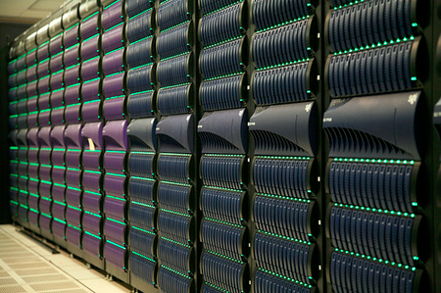
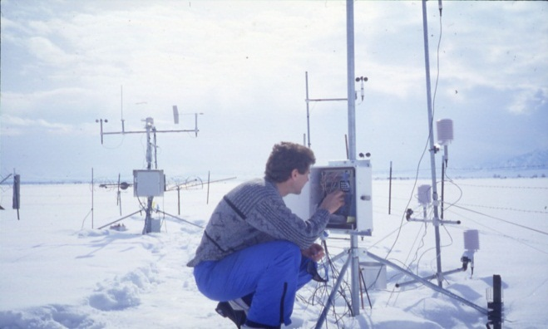
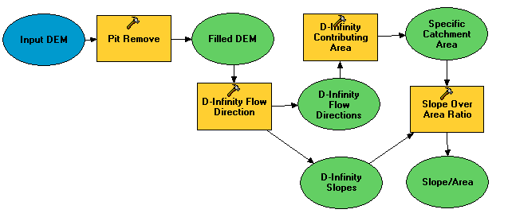

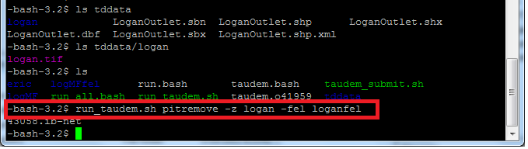
Do you have the access or know how to take advantage of advanced computing capability?
Researchers
Experimentalists
Modelers
HPC Specialists
#!/bin/bash
vi
chmod
#PBS -l nodes=4:ppn=8
grep
awk
mpiexec

Slide 5

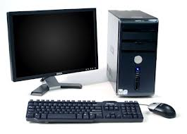



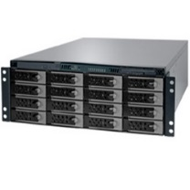
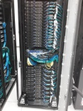
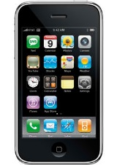
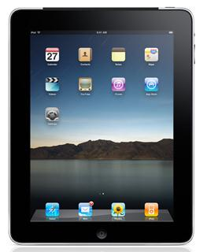
Cloud Computing
Applications
Models
Storage
Computation
Services
Wikipedia: Cloud computing is the use of computing resources (hardware and software) that are delivered as a service over a network (typically the Internet)
Google, Amazon, Microsoft, Apple, DropBox
XSEDE, Condor, BOINC

Slide 6
Cloud Services-Oriented Architecture Paradigm of the World Wide Web
Catalog
(Google)
Crawl and Catalog
Search
Web Server
(CNN.com)
Access
Browser
(Firefox)

Slide 7
CUAHSI Hydrologic Information System: A
Services-Oriented Architecture Based System for Sharing Hydrologic Data
HydroCatalog
Data Discovery and Integration
Metadata Services
WaterML, Other OGC Standards
Search Services
HydroServer
HydroDesktop
Data Publication
Data Services
Data Analysis and Synthesis

Slide 8
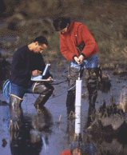


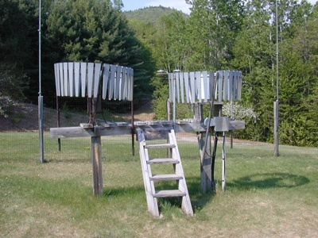
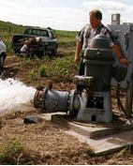
Hydrologic Data Challenges
Water quality
Water quantity
From dispersed federal agencies
From investigators collected for different purposes
Different formats
  Points
  Lines
  Polygons
  Fields
  Time Series
Rainfall and Meteorology
Soil water
Groundwater
GIS
Data Heterogeneity

Slide 9

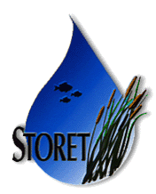








Data Searching – What we used to have to do
Searching each data source separately
NWIS
request
return
request
request
return
return
NAWQA
request
return
NAM-12
request
return
request
return
request
return
request
return
NARR
Michael Piasecki
Drexel University
Notes:
9

Slide 10

What CUAHSI HIS enables
Searching all data sources collectively
GetValues
GetValues
NWIS
GetValues
GetValues
generic
request
GetValues
GetValues
NAWQA
Michael Piasecki
Drexel University
GetValues
NARR
GetValues
ODM
Notes:
10

Slide 11
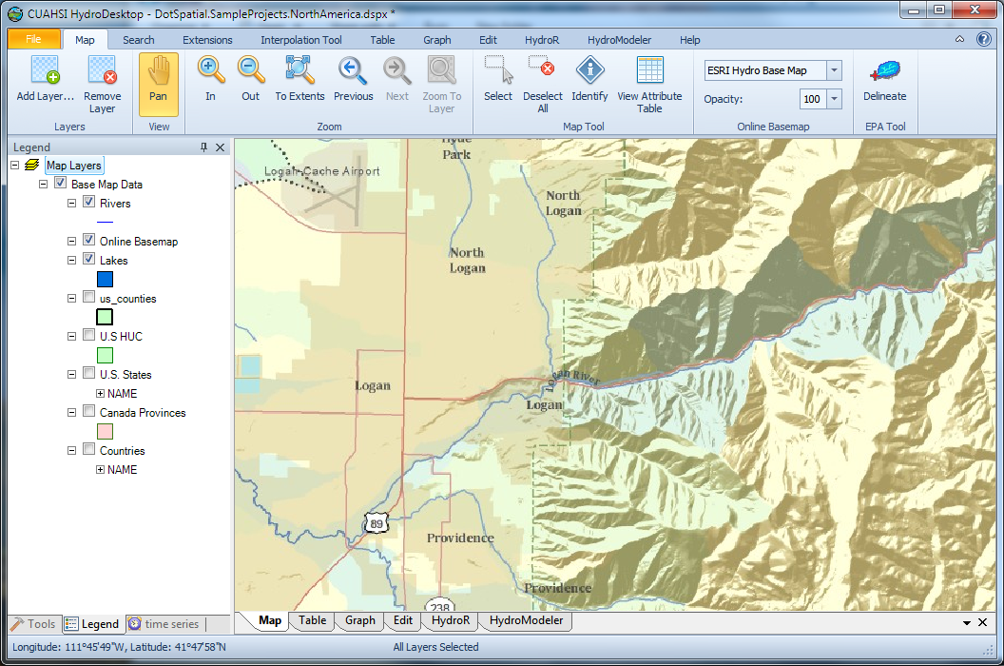
HIS Example.
1. Delineate Watershed using EPA Web Services
Uses EPA WATERS Web, Mapping, and Database Services at http://www.epa.gov/waters/geoservices/index.html
Notes:
The service URLs that the HD tool uses are seen in http://hydrodesktop.codeplex.com/SourceControl/changeset/view/475b15a84bf4#Source%2fEPADelineation%2fCallWebService.cs The HD tool uses the Point Indexing Service to find the nearest NHD reach to where the user clicked. This returns a location on that reach. This point location is then used as input to the Navigation Delineation Service to get the watershed, and the Upstream/Downstream Service to get the river lines. The delineation service has two limitations: * It only works up to a certain distance upstream. I think we have it set to 100km. So for large watersheds (those with more than 100km of stream length upstream of where the user clicked), we don't get the most upstream portions of the watershed. * It doesn't delineate exactly to where the user clicked. It delineates to the endpoint of the NHD reach. (Can't remember if it is the clicked reach or the upstream reach -- try it and see.)

Slide 12
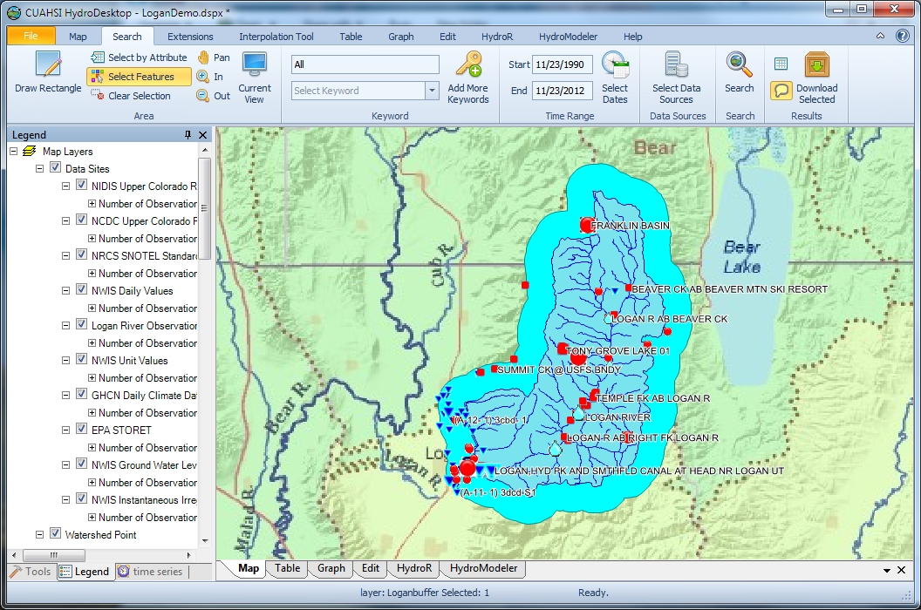
2. Search last 22 years for all data in buffer around watershed

Slide 13
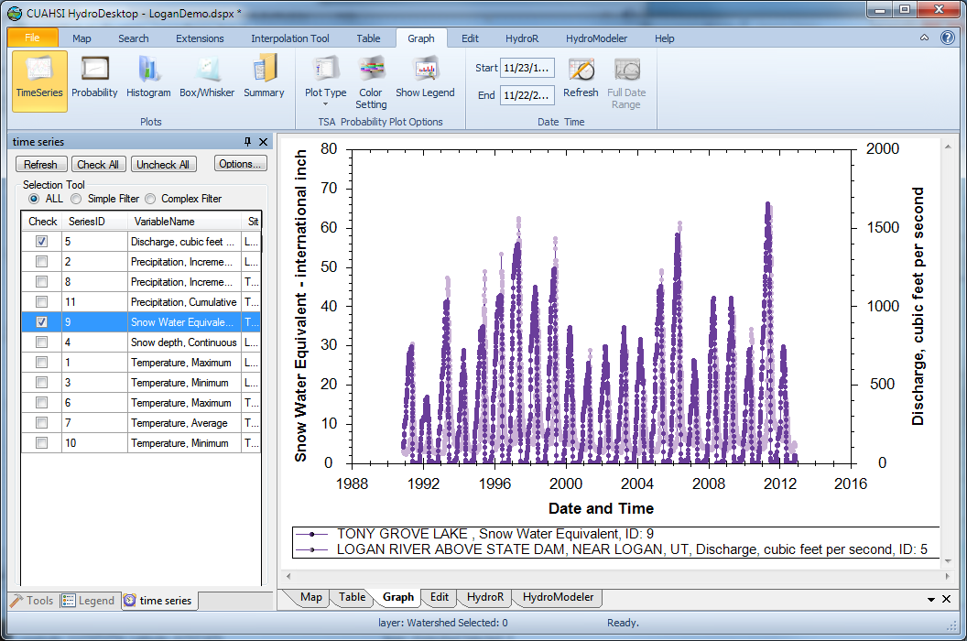
3. Download and plot data from multiple sources

Slide 14
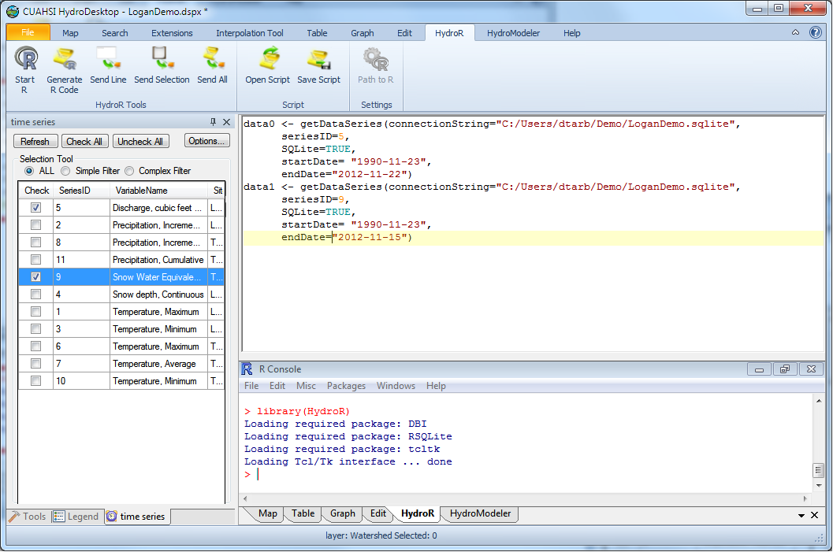
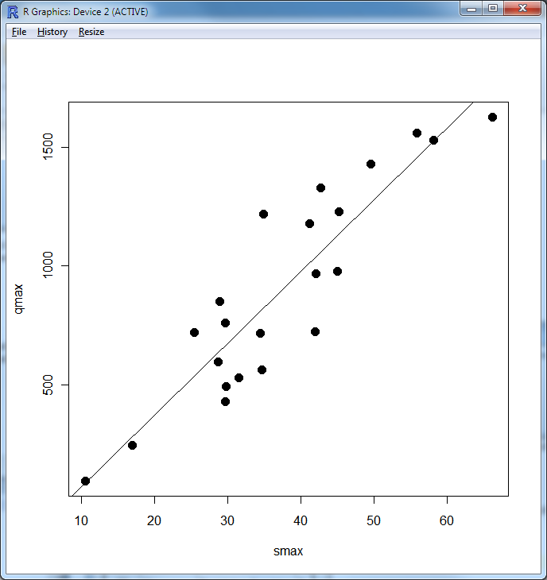
4. Analyze with R using the HydroR plugin
You have the full analysis capability of R at your fingertips for data from multiple sources accessed using HydroDesktop using the HIS cloud data resources.

Slide 15
CUAHSI HIS: A common window on water observations data for the United States unlike any that has existed before
Storage in a community data model
Publication from a server
Data access through internet-based services using consistent language and format
Tools for access and analysis
Discovery through thematic and geographic search functionality
Integrated modeling and analysis combining information from multiple sources
Desktop
Catalog
Server

Slide 16
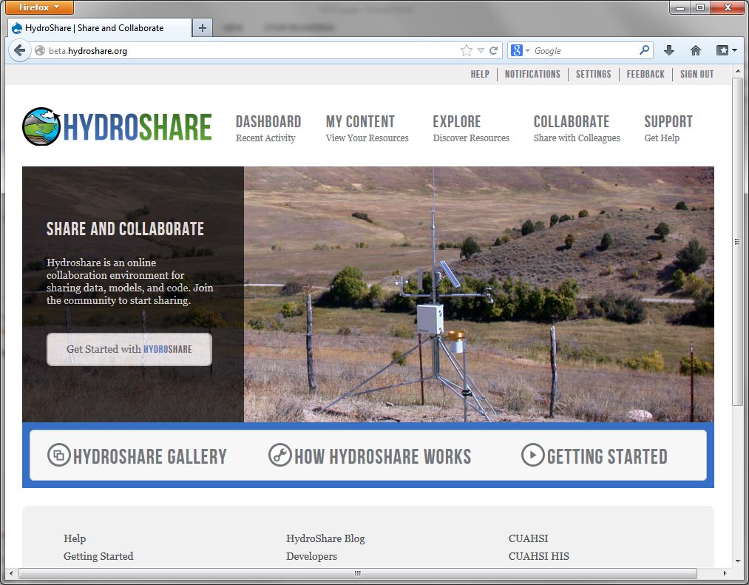
HydroShare - A web-based collaborative environment for the sharing of hydrologic data and models
Looking to the Future
beta.hydroshare.org
Can sharing data and models be as easy as sharing photos on Facebook or videos on YouTube?
Can finding data and models be as easy as shopping on Amazon?
Notes:
HydroShare will be a collaborative environment for sharing hydrologic data and models aimed at giving hydrologists the technology infrastructure they need to address critical issues related to water quantity, quality, accessibility, and management.
HydroShare will expand the data sharing capability of the CUAHSI Hydrologic Information System by broadening the classes of data accommodated, expanding capability to include the sharing of models and model components, and taking advantage of emerging social media functionality to enhance information about and collaboration around hydrologic data and models.
Functionality will include
A web portal for model and data sharing
Sharing features added to HydroDesktop client software
Access to more types of hydrologic data using standards compliant data formats and interfaces
Enhanced catalog functionality that broadens discovery functionality to different data types and models
New model sharing and discovery functionality
Enhanced easy to use access to high performance computing
Social media and collaboration functionality
Linkages to other data and modeling systems such as USGS and CUAHSI data services, NASA earth exchange and HPC resources e.g. at CSDMS

Slide 17
HydroShare Functionality to be Developed
A new, web-based system for advancing model and data sharing
Sharing features to HydroDesktop
Access more types of hydrologic data using standards compliant data formats and interfaces
Enhance catalog functionality that broadens discovery functionality to different data types
New model sharing and discovery functionality
Facilitate and ease access to use of high performance computing
New social media and collaboration functionality
Links to other data and modeling systems

Slide 18
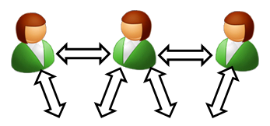

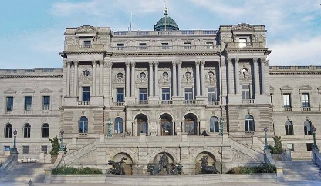
Imagine the Possibilities Enabled by Cloud-Based Systems
Collaboration
Analysis
Observers and instruments
Data
Models
Publication, Archival, Curation
HydroShare to support integrated collaborative analysis, modeling and data publication

Slide 19

Imagine the Possibilities Enabled by Cloud-Based Systems
Discover and Analyze/Model (in Desktop or Cloud)
Observe
Publish and Catalog
Collaboration
Analysis
3
Observers and instruments
HydroServer (ODM)
Data
Models
1
2
Publication, Archival, Curation
HydroShare to support integrated collaborative analysis, modeling and data publication

Slide 20
Imagine the Possibilities Enabled by Cloud-Based Systems
Share the results (Data and Models)
Collaboration
Analysis
4
Observers and instruments
HydroShare resource
store
Data
Models
Publication, Archival, Curation
HydroShare to support integrated collaborative analysis, modeling and data publication

Slide 21

Imagine the Possibilities Enabled by Cloud-Based Systems
Collaboration with group using the cloud system
Preparation of a paper
Collaboration
5
Analysis
6
Observers and instruments
Data
Models
Publication, Archival, Curation
HydroShare to support integrated collaborative analysis, modeling and data publication

Slide 22
Imagine the Possibilities Enabled by Cloud-Based Systems
Submittal of paper, review, archival of electronic paper with data, methods and workflow
Collaboration
Analysis
7
Observers and instruments
Data
Models
Publication, Archival, Curation
HydroShare to support integrated collaborative analysis, modeling and data publication
DataOne, EarthCube, …

Slide 23

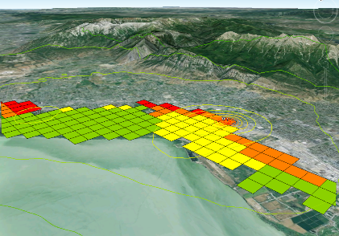
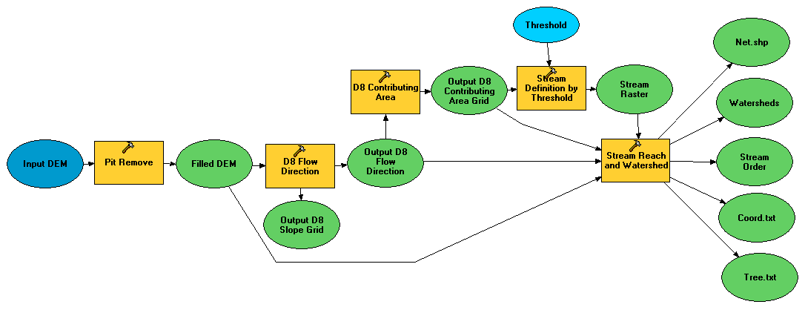

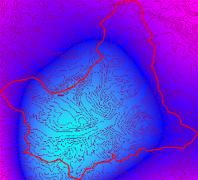

Imagine Cloud Modeling
Flow
Time
t
y
x
Data: Links to national and global data sets of essential terrestrial variables (e.g. NASA NEX, HydroTerre)
Tools to preprocess and configure inputs
Preconfigured models and modeling systems as services (CI-WATER)
Standards for information exchange for interoperability (OpenMI, CSDMS BMI)
Tools for visualization and analysis
Automated reasoning to couple models based on purpose, context, data and resources
Notes:
Data: Links to national and global data sets of essential terrestrial variables (e.g. NASA NEX, HydroTerre)
Tools to preprocess and configure inputs
Preconfigured models and modeling systems as services
Standards for information exchange for interoperability (OpenMI, CSDMS BMI)
Tools for Visualization and Analysis
Automated reasoning to couple models based on purpose, context, data and resources

Slide 24
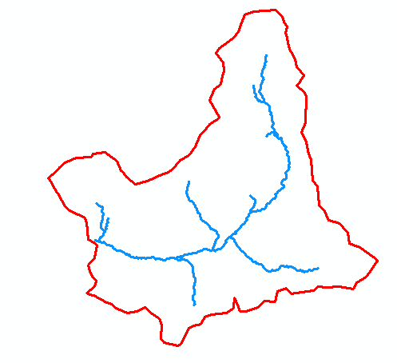
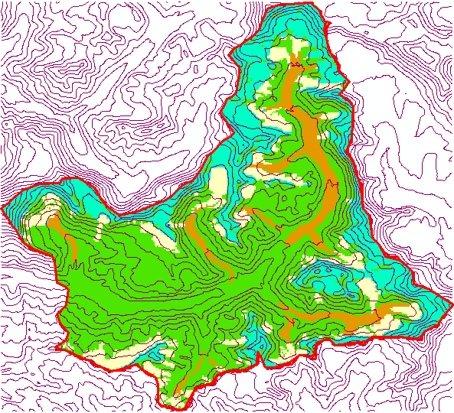
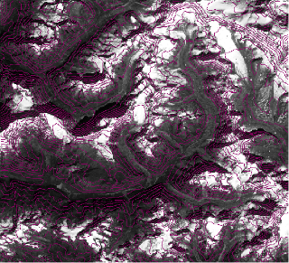
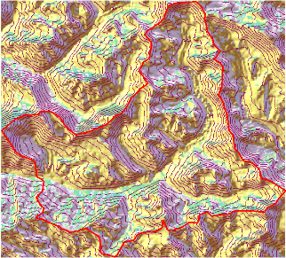
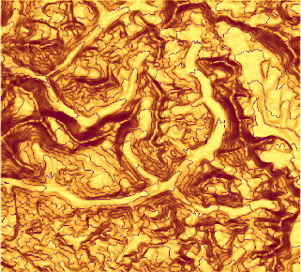
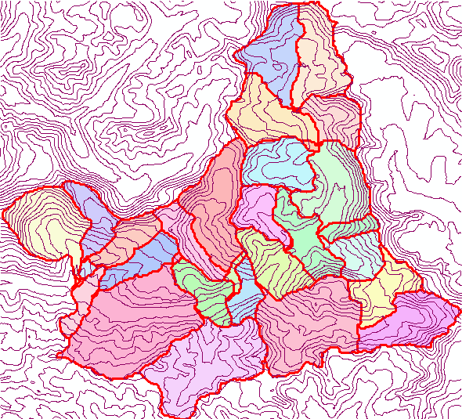
Another Example
Big snow year
Will my city flood?
Click to delineate watershed (model domain)
Generate model package from Essential Terrestrial Variables
Generate suite of input scenarios
Execute model and view results
P
Time
Flow
Time

Slide 25
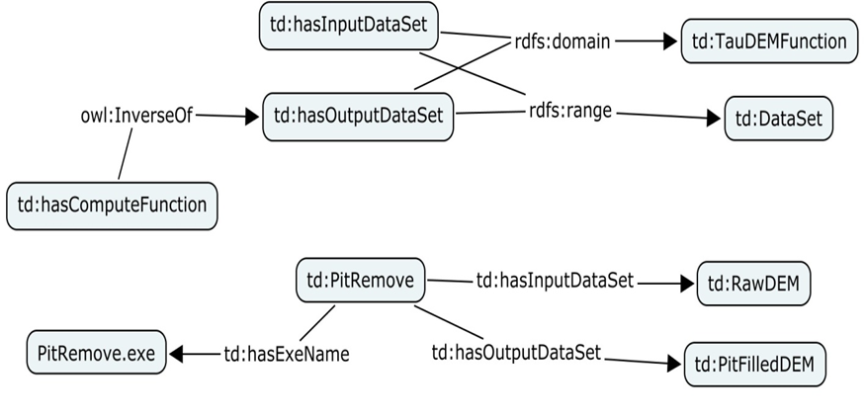
But there is more…
What if I could express my decision needs to the system and have it reason and deduce which models need to run, then configure and run them based on the inputs available, precision needs and resources and time available.

Slide 26
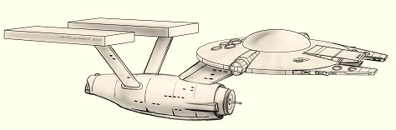
Summary and Conclusions
Cloud Computing and Data Services
  Community Participation
  Interoperability
  Standards
  Open Development
CUAHSI HIS
  Enhanced Access to Hydrologic Data
  Combining information from multiple sources
HydroShare
  A collaborative website for the sharing of hydrologic data and models
  To expand data sharing capability of CUAHSI HIS
    Additional data classes
    Models, scripts, tools and workflows
  To boldly go where no one has gone before

Slide 27
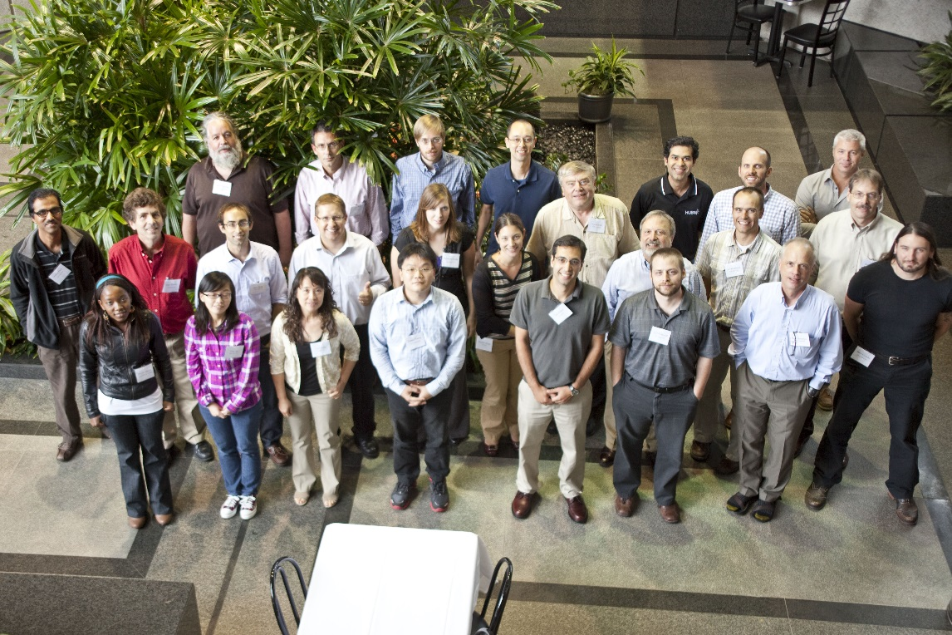
Thanks to a lot of people
  USU
  RENCI/UNC
  CUAHSI
  BYU
  Tufts
  USC
  Texas
  Purdue
  SDSC
HydroShare team, CUAHSI HIS team, CI-WATER team, Students and Colleagues (Ray Idaszak, Dan Ames, Jeff Horsburgh, Jon Goodall, Larry Band, Venkatesh Merwade, Carol Song, Alva Couch, David Valentine, Rick Hooper, Jennifer Arrigo, David Maidment, Tim Whiteaker, Alex Bedig, Jason Coposky, Pabitra Dash, Tian Gan, Karl Gustafson, Taehee Hwang, Stephen Jackson, Harry Johnson, Yuri Kim, Phyllis Mbewe, Brian Miles, Jon Pollak, Stephanie Reeder, Terrell Russell, Tom Whitenack, Ilya Zaslavsky, Lan Zhao, Michael Piasecki, Kim Schreuders, Jiri Kadlec, Scott Peckham, Chris Duffy, Lorne Leonard, Tseganeh Gichamo, Norm Jones, Fred Ogden, Aaron Byrd)
http://www.cuahsi.org/hydroshare.aspx
EAR 0622374 (2007-2012)
OCI-1148453 (2012-2017)
OCI-1148090 (2012-2017)
Notes:
The HydroShare project is part of a broad effort in CUAHSI in the area of Hydrologic Information Systems. We have a team of developers and domain scientists from eight universities working on HydroShare. This is part of the even broader focus in NSF on data management, Cyberinfrastructure and sustainable software.

Slide 28
