Slide 1
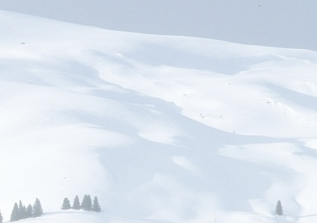
A parsimonious energy balance snowmelt model and its use in spatially distributed modeling
David G. Tarboton
Charlie Luce
Jinsheng You
Utah Water Research Laboratory
Utah State University
email: david.tarboton@usu.edu
www: http://www.engineering.usu.edu/dtarb/snow/snow.html
Notes:
I appreciate the invitation to talk about snowmelt modeling in this session. I am going to describe the Utah Energy Balance snowmelt model that Charlie and I have developed over several years as an effort to capture the key snow processes involved in the generation of snowmelt for input to hydrologic models at a level of complexity that allows application over large areas. In building this model we tried to strike a balance between details that mattered for energy exchanges that drive snowmelt and those that did not. We wanted a model that had a limited number of state variables, so have kept it to one layer. We may not always have got it right, and there are sensitivities to decision inputs that the model does not capture well that are still being worked on. Nevertheless I present this here today as an example and case study of some ideas that I hope have greater generality than applying just to this model. I hope that some of the approach and ideas has transfer value to other models.

Slide 2
Why a simple, physically based snowmelt model
Physically based
  Predictive capability in changed settings
  Get sensitivities to changes right
Simple
  Avoid assumptions and parameterizations that make no difference
  Computational efficiency and feasibility
Notes:
Why a simple, physically based snowmelt model?
Physical basis to provide predictive capability in changed setting
Get sensitivity to changes right
Simple to avoid assumptions and parameterizations that make no difference
Computational efficiency and feasibility

Slide 3
Utah Energy Balance Model design considerations
Physically based calculation of snow energy balance.
Simplicity. Small number of state variables and adjustable parameters.
Transportable. Applicable without calibration at different locations.
Match diurnal cycle of melt outflow rates
Match overall accumulation and ablation for water balance.
Distributed by application over a spatial grid.
Subgrid variability using depletion curve approach.
Spatial variability due to wind blown snow drifting
(Effects of vegetation on interception, radiation, wind fields)

Slide 4
Point Model Physics and Parameterizations
Inputs
Q_{si}
e_{a}
T_{a}
Precip
Wind
Fluxes dependent on
surface temperature
Q_{si}
Q_{si}A
Q_{li}
Q_{p}
Q_{h}(T_{a}, T_{s})
Q_{e}(e_{a}, T_{s})
Q_{le}(T_{s})
Thermally
active
layer
Q_{sn}
State variables
Snow
Energy Content U
Q
Water Equivalent W
D
Soil
e
Q_{g}
Q_{m}

Slide 5
Focus on parameterizations of
Snow surface temperature
Refreezing at the surface
Spatial variability

Slide 6
Snow surface temperature
Heat diffusion into a semi-infinite medium with periodic (diurnal) boundary conditions
Solution
where, k = λ/Cρ
where, d = (2kω)^{1/2}
Three Alternative Models
Equilibrium Gradient (EQG)
Force-Restore (FR)
Modified Force-Restore (MFR)

Slide 7
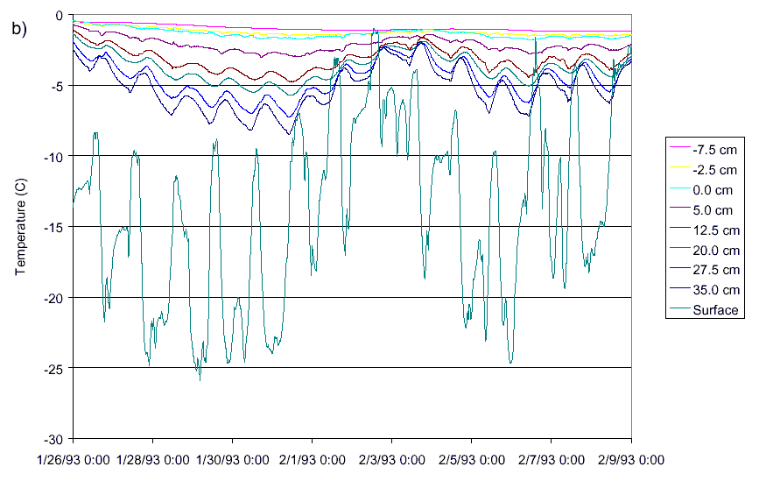
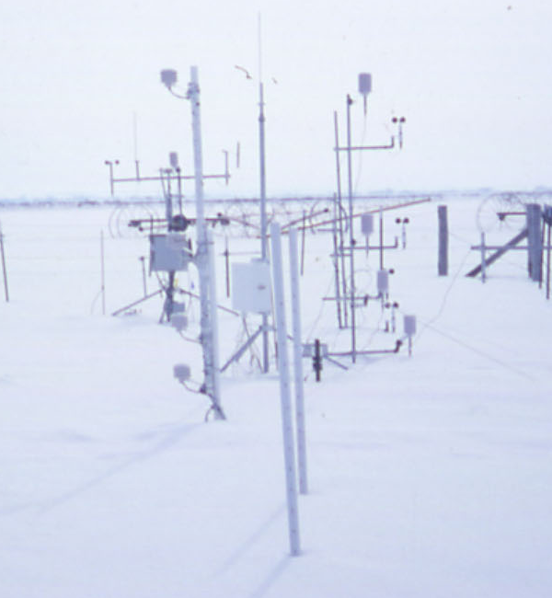
Temperature time series at different depths

Slide 8
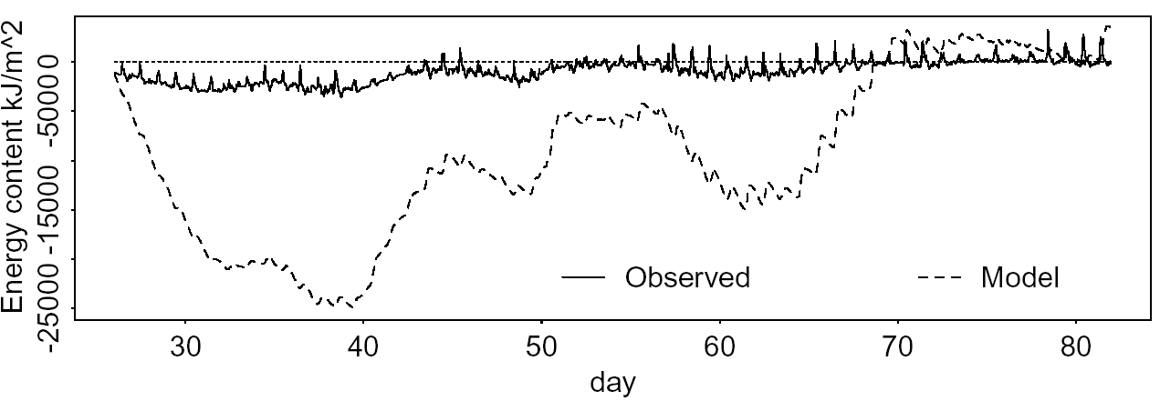
SWE at CSSL (1986)
MFR
EQG
U at Logan, UT (1993)
Equilibrium Gradient

Slide 9
Modeled energy content with different surface temperature parameterizations

Slide 10
Refreezing at the surface
T_{s}
0
d_{r}
With these assumptions
⇒
⇒

Slide 11
Effect of refreezing on energy content modeling

Slide 12
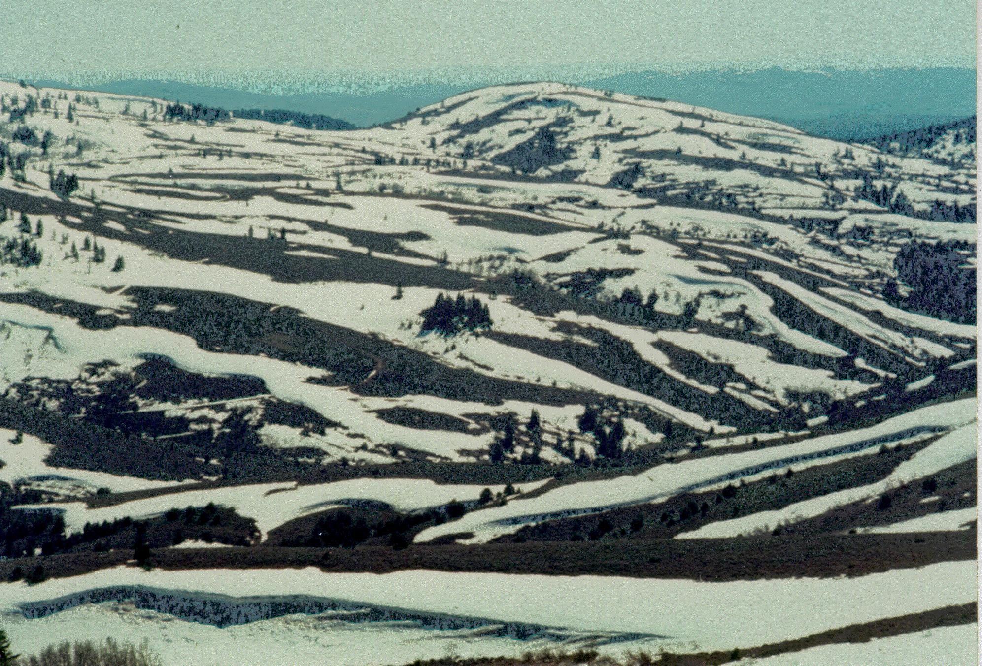
Spatial Variability

Slide 13
Semi distributed implementation: Extending model over elements that include spatial variability
Notes:
This slide shows how a depletion curve is used to evolve a point model using energy and mass fluxes over only the snow covered area.

Slide 14
Depletion curve for parameterization of subgrid variability in accumulation and melt
Accumulation variability
Melt variability
Luce, C. H., D. G. Tarboton and K. R. Cooley, (1999), "Subgrid Parameterization Of Snow Distribution For An Energy And Mass Balance Snow Cover Model," Hydrological Processes, 13: 1921-1933
Notes:
This slide shows a method we developed to use a depletion curve to represent subgrid variability.

Slide 15
Upper Sheep Creek.
Luce, C. H., D. G. Tarboton and K. R. Cooley, (1999), "Subgrid Parameterization Of Snow Distribution For An Energy And Mass Balance Snow Cover Model," Hydrological Processes, 13: 1921-1933
Notes:
This shows how this works, in comparison to observations and a spatially explicit fully distributed model.

Slide 16
Depletion curves derived using distributions of surrogate variables
Distributed model reference
Elevation, z
Accumulation factor, Φ
Peak accumulation
regression
combining Φ, z
Jinsheng You, PhD 2004
Notes:
This shows how this works, in comparison to observations and a spatially explicit fully distributed model.

Slide 17
Time Stability of Depletion Curves
Depletion curves from several years of data at Upper Sheep Creek (data provided by K. Cooley)
Notes:
In this slide we examine the time stability of depletion curves. One of the foundations of the depletion curve approach is that the same shape of depletion curve is assumed for low and high snow years. The rescaling based on maximum accumulation is important for the ease of practical implementation free from specific date assumptions for peak accumulation. This shows in data from Keith Cooley at Upper sheep creek for 9 years that the depletion curve (at least here) appears to be relatively stable across years. This stability is the basis for another idea for the use of depletion curves. Snow covered area is relatively easy to measure, and if one during a melt season observed Af, one can infer from a depletion curve the fraction of basin average snow water equivalent that has melted and the fraction that remains in the basin. One then just needs an index of scale to infer the actual melt amounts or water equivalent remaining. Potential indices include point measurements, e.g. from SNOTEL, or measurements of melt runoff at a stream gage. This idea is developed further in a minute.

Slide 18
Conclusions
Able to obtain satisfactory results from a parsimonious one layer model that is efficient for distributed application over a watershed
Modified force restore approach works well as a parameterization for snow surface temperature
Refreezing heat conduction scheme improves modeling of the heat loss during the melting/refreezing period
The depletion curve approach is an effective parameterization for spatial (subgrid) variability (but is empirical so may not be stable under climate/land use changes)

