Slide 1

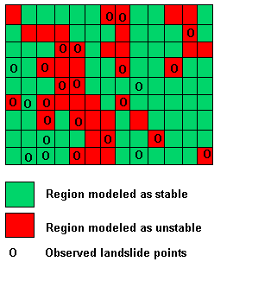
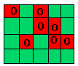
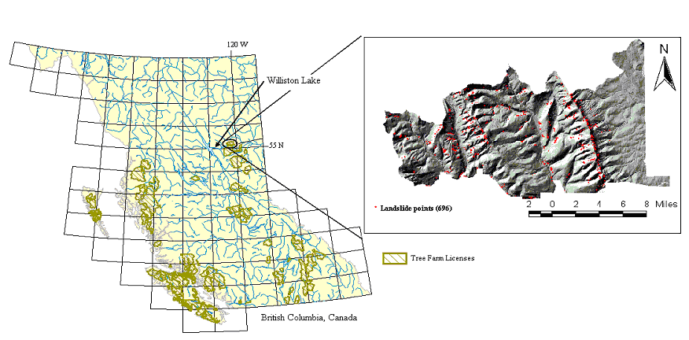
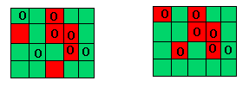
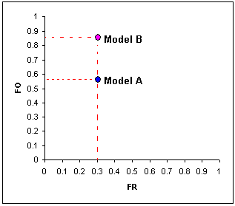
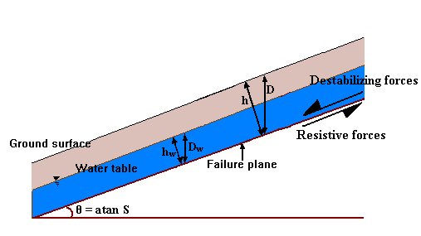
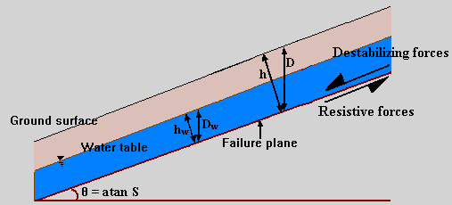
An Objective Method for the Intercomparison of Terrain Stability Models.
Kiran Chinnayakanahalli, David G. Tarboton, Robert T Pack
Utah State University, Civil & Environmental Engineering Department, Logan, UT
Abstract
Problem statement
A terrain stability map quantifies the propensity for landslide initiation at a point in space. There are a number of process based models used for terrain stability mapping. SHALSTAB (Montgomery et al., 1998; Dietrich et al., 2001) and SINMAP (Pack et al., 1998) are two such models that combine steady-state hydrology assumptions with the infinite slope stability model to quantify slope stability. Inputs are digital elevation data from which slope and drainage area are evaluated as well as hydrologic and soil parameters. SHALSTAB quantifies terrain instability in terms of the critical effective rainfall required to trigger pore pressure induced instability. SINMAP quantifies terrain stability in terms of the probability that the infinite slope stability model factor of safety is greater than one over uniform probability distributions quantifying the uncertainty in model parameters. These are two models with similar physical basis but they use different indices to quantify instability. Because of this the relative performance of these models, when compared to observed landslide locations, is difficult to assess. A new statistic based on the cumulative fraction of the stability index at locations of observed landslides, relative to the cumulative fraction of the stability index over the terrain has been developed. This statistic quantifies the discriminatory capability of a stability map in terms of the degree to which a terrain stability map is successful in "capturing" observed landslides in areas mapped as unstable while minimizing the extent of these areas. This statistic provides a way to compare models that use different stability indices and is a quantity that can be used for the calibration or optimization of model parameters using observed landslide initiation locations. This is useful when physical data necessary to estimate model parameters is limited. We show results where the performance of these models that use different indices are compared using data from the Chetwynd area in east central British Columbia where 696 landslide initiation locations were mapped. We found that in this particular region slope was the dominant variable that discriminated terrain instability. The optimally calibrated SHALSTAB and SINMAP models that also use drainage area as a predictor offered only marginal improvement over slope alone. The additional flexibility of the probability framework used by SINMAP gave it a slight advantage over SHALSTAB in discriminating unstable terrain.
If x (τ, ζ ) is an index of slope stability.
( x = SI of SINMAP or R/T of SHALSTAB or just slope )
How to quantify the predictive capability of x? Given
a map where x is defined for each grid cell
a set of points where landslide initiations were observed
Example of computing different fractions:
Observed landslide points = 7
Total terrain points = 20
Points modeled as unstable = 7
For a model with a threshold x_{T}
that has good discerning power
(Ideal case):
F_{O}(X_{T}) =7/7 = 1
F_{R}(X_{T}) = 7/20 = 0.35
Basic premise:
A terrain stability map which captures more observed landslides in its unstable zone, while minimizing the extent of such area is a better discriminator of potentially unstable terrain.
Study area
Methodology
The study area was in Chetwynd, British Columbia, Canada. The area studied is about 497 km², with an elevation range of 1230m (675 to 1909m). Much of the bedrock is made up of layered Mesozoic sedimentary rock, mostly Jurassic and Cretaceous. There were a total of 696 landslides observed on 1994 aerial photography.
Land area with slope gradients greater than 25º accounts for 12% percent of the total land area.
From a given terrain stability map, for a parameter set ζ_{K}
we can formulate two sets,
O = {X_{i} defined for observed landslide points}
R= {X_{j} defined for terrain points}
Define:
F_{O}(x_{T}) = Probability(X_{i} belonging to O < a given threshold x_{T})
F_{R}(x_{T}) = Probability(X_{j} belonging to R < a given threshold x_{T})
Example
Model A (x_{TA}) Model B (x_{TB})
At thresholds (may be different between models) where 30% of the terrain is mapped as unstable, model B that “captures” a greater percentage of landslides is better.
F_{O}(x_{TA})_{A} = 4/7 = 0.57 F_{O}(x_{TB})_{B} = 6/7 = 0.86
F_{R}(x_{TA})_{A} = 6/20 = 0.3 F_{R}(x_{TB})_{B} = 6/20 = 0.3
Terrain stability models
Generalized terrain stability model
framework
Terrain stability models of the type considered in this study couple an infinite-slope stability model with a hydrologic
model to output an index of stability, x which quantifies landslide potential at a point.
Input
Infinite-slope stability model
Specific terrain
stability index
The infinite slope stability model (e.g. Hammond et al., 1992;
Montgomery and Dietrich, 1994) balances the destabilizing
components of gravity and the restoring components of
friction and cohesion on a failure plane parallel to the
ground surface.
Over a range of thresholds the graph F_{O} versus F_{R} facilitates model intercomparison between models that use different stability measures (Borga et al., 2002).
Output
h
D
Destabilizing forces
Hydrologic model
Terrain stability index, x
Ground surface
h_{w}
D_{w}
Resisting forces
x = SI, SINMAP
Water table
Failure plane
θ = atan S
The pore pressure due to soil moisture reduces the effective normal stress, which through the friction angle is related to the shear strength (reduces the resistive force in the FS equation). Pore water pressure is obtained from a steady-state hydrologic model.
An integral measure of discriminating capability is defined by the area under an F_{O} versus F_{R} curve
Digital elevation model,
Hydrologic and soil parameters
Stability indices
SHALSTAB: x = R/T the critical ratio of recharge to transmissivity, needed to induce instability ( FS <1)
SINMAP, x = SI = probability(FS>1) given,
uniform distributions C_{min}<C<C_{max}, Φ_{min} < Φ < Φ_{max}, and, R/T_{min} <R/T < R/T_{max}
x = R/T, SHALSTAB
Parameters for SINMAP and SHALSTAB:
Where,
R = steady state recharge rate [L T⁻¹] ,
T = transmissivity =h.K[L² T ⁻¹],
K = hydraulic conductivity [L T⁻¹]
θ = slope angle,
Φ = friction angle,
a = specific catchment area [L],
r = ρ_{w}/ρ_{s} = water density / soil bulk density
C = dimensionless cohesion
SINMAP
SHALSTAB
Calibration of parameters changes model performance. Q can be used to calibrate a model or to compare between models that have been calibrated.
τ
Slope, θ
Specific catchment area, a
Slope, θ
Specific catchment area, a
ζ
C_{min}, C_{max}, Φ_{min}, Φ_{max} , R/T_{min}, R/T_{max}
C*, Φ
=
c
τ - represents terrain variables (derived from digital elevation model),
ζ - represents model parameters (hydrologic and soil parameters)
C*=
c
hρ_{s}g
Dρ_{s}g
c = combined cohesion of root and soil

Slide 2
Parameter uncertainty, non- uniqueness
and calibration
We used a Monte-Carlo random search to find parameter sets for which Q was close to its maximum value. These are regarded as behavioral parameter sets in the Generalized Likelihood Uncertainty Estimation method (GLUE) of Beven and Binley (1992).
Representative terrain points sampled = 5000
Parameter sets generated by Monte Carlo simulation = k =10000
Number of observed landslides = 696
Define feasible parameter ranges.
Representative
terrain
points.
(θ, a )_{i}
Landslide
initiation
points
(θ, a )_{j}
Parameter sets generated by Monte-Carlo simulations, ζ_{k}
Model | Parameters | Lower limit | Upper limit
SHALSTAB | C | 0.0 | 0.5
 | Φ[degree] | 20⁰ | 60⁰
SINMAP | T/R_{max} [m] | 200 | 5000
 | T/R_{min} [m] | 200 | 5000
 | C_{max} | 0.0 | 0.5
 | C_{min} | 0.0 | 0.5
 | Φ_{max}[degree] | 20⁰ | 60⁰
 | Φ_{min}[degree] | 20⁰ | 60⁰
  Evaluate model (SHALSTAB or SINMAP) for all terrain and landslide points for each parameter set.
Stability index sets O={x_{i}}, R={x_{j}}for
all ζ_{k}
Results
SHALSTAB
Evaluation of objective function ,Q.
Dot plots of the 10000 parameter sets from the GLUE method
List of Q_{k} for each parameter set ζ_{k}
SINMAP
Chi-square test
Tests difference between observed and expected frequencies used to evaluate whether models are different at thresholds corresponding to specific proportions of unstable terrain.
The null hypothesis(Ho) of the test is that there is no significant difference between the models in capturing the number of
landslides within their unstable zones while mapping F’R(x) fraction of the terrain as unstable.
We evaluate the level of significance at which the null hypothesis must be accepted.
F_{O} versus F_{R} comparison plot for parameter sets with highest Q
Flatter terrain
One model is designated as the reference model used to obtain the expected frequencies, e_{i}.
The null hypothesis is that the observed frequencies from the other model are not significantly different.
 | At F_{R}(x) | χ² | α
SINMAP versus SHALSTAB* | 0.05 | 3.67 | 0.055
 | 0.1 | 4.56 | 0.033
 | 0.15 | 7.82 | 0.0052
 | 0.2 | 19.50 | 1x10⁻⁵
 | 0.25 | 16.44 | 0.0001
 | 0.3 | 14.26 | 0.0002
 | 0.35 | 1.42 | 0.233
SINMAP versus SLOPE* | 0.05 | 6.46 | 0.011
 | 0.1 | 34.71 | 4x10⁻⁹
 | 0.15 | 25.40 | 5x10⁻⁸
 | 0.2 | 23.47 | 1.3x10⁻⁶
 | 0.25 | 5.71 | 0.017
 | 0.3 | 3.01 | 0.083
 | 0.35 | 0.06 | 0.799
SHALSTAB versus SLOPE* | 0.05 | 0.38 | 0.538
 | 0.1 | 14.63 | 0.0001
 | 0.15 | 5.72 | 0.017
 | 0.2 | 0.25 | 0.614
 | 0.25 | 4.48 | 0.034
 | 0.3 | 8.36 | 0.004
 | 0.35 | 1.20 | 0.272
e₁ = Number of observed landslides in reference model
unstable area.
e₂ = Number of observed landslides in reference model
stable area.
o₁ = Number of observed landslides in other model
unstable area.
o₂ = Number of observed landslides in other model
stable area.
N = e₁ +e₂ = o₁ +o₂ = Total number of landslides
Degrees of freedom = 1.
SA plots for the parameter set with highest Q
For the case being tested, the Chi-square statistic, χ² can be written as,
such that,
where,
χ² = 0 means that models are perfectly identical and higher the value of χ² higher is the discrepancy between the models. Results from this test is given in Table, where α is the level of significance at which the null hypothesis is accepted.
SHALSTAB
SINMAP
* Designates reference model.
Highlighted values represent the cases for which the null hypothesis is rejected at level of significance of 0.05. i.e. for these cases the difference between the model performances is significantly different.
SHALSTAB
 | For default parameter set C= 0.0, Φ=45 |  | For parameter set with highest Q C =0.011, Φ=27.6º
Landslide percentage identified | 50 | 64* | 50 | 90 | 95
Threshold log₁₀(R/T) | -2.95 | -2.12 | -6.00 | - 3.66 | -3.33
Percentage of area marked unstable | 7.16 | 9.04 | 7.39 | 20.7 | 29.24
Conclusions
An objective measure Q has been developed to quantify the predictive capability of a terrain stability model.
Quantitative intercomparisons using Q are possible even if stability indices are different.
GLUE methodology facilitates quantification of parameter and model prediction uncertainty for terrain stability models
In this study the quantified improvements in discriminatory capability moving from slope alone to the two parameter SHALSTAB to the more parameter intensive (6 parameter) SINMAP models was small in terms of percentage area mapped as unstable and small in terms of the Q statistic. However, the improvement is statistically significant under a Chi-square test.
SINMAP has good discriminatory capability for almost all realistic parameters set, while for SHALSTAB selection of parameters is more important. This is due to SINMAP using FS as SI in the domain where the infinite-slope model predicts conditional stability while SHALSTAB is non-discriminating in this domain. The random distributions of Φ and C increase the range of slope that SINMAP is sensitive to, relative to SHALSTAB.
Lower the values of α, greater is the difference between the models. Generally α is not allowed to be less than 0.05 representing 95% confidence in accepting the hypothesis. Alternatively the null hypothesis is rejected with 95% confidence (i.e. there is significant difference between the models), when α is less than 0.05. From the table it can be seen that there is significant difference between the model performances most of the times which is not evident from the values of Q statistic.
SINMAP
 | For default parameter set C_{min}= 0.0, C_{max}= 0.25 Φ_{min}=30^{o,} Φ_{max}=45º T/R_{min}=2000 m, T/R_{min}=3000 m |  |  | For parameter set with highest Q C_{min}= 0.15, C_{max}= 0.231 Φ_{min}=22.12^{o,} Φ_{max}=31.46º T/R_{min}=2620.6 m, T/R_{min}=4925.9 m
Landslide percentage identified | 50 | 90 | 95 | 50 | 90 | 95
Threshold SI | 0.97 | 1.2 | 1.35 | 0.99 | 1.34 | 1.47
Percentage of area marked unstable | 5.95 | 20.56 | 27.34 | 5.95 | 19.59 | 24.68
Slope
References
Landslide percentage identified | 50 | 90 | 95
Slope threshold | 0.55(29º) | 0.37(20º) | 0.32(18º)
Percentage of area marked unstable | 6.47 | 20.39 | 27.19
Beven, K. and A. Binley (1992). “The Future of Distributed Models: Model Calibration and Uncertainty Prediction.” Hydrological Processes 6: 279-298.
Borga, M., G. D. Fontana, et al. (2002). “Analysis of topographic and climatic control on rainfall-triggered shallow landsliding using a quasi-dynamic wetness index.” Journal of Hydrology 268: 56-71.
Dietrich, W. E., D. Bellugi, et al. (2001). “Validation of Shallow Landslide Model, SHALSTAB, for Forest Management.” Water Science and Application 2: 195-227.
Hammond, C., D. Hall, et al. (1992). Level I Stability Analysis (LISA) Documentation for Version 2.0, USDA Forest Service Intermountain Research Station.
Montgomery, D. R. and W. E. Dietrich (1998). “A Physically Based Model for the Topographic Control on Shallow Landsliding.” Water Resource Research 30(4): 1153-1171.
Pack, R. T., D. G. Tarboton, et al. (1998). Terrain Stability Mapping with SINMAP, technical description and users guide for version 1.00, Terratech Consulting Ltd., Salmon Arm, B.C., Canada (report and software available from http://www.engineering.usu.edu/dtarb/).
Smaller percent area with greater percent of landslides is an indicator of better discriminating powers.
*36% of the landslides are in the area classified as always stable.

