Slide 1
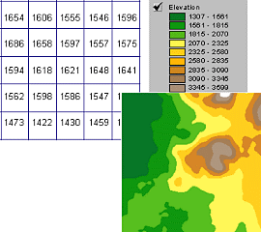
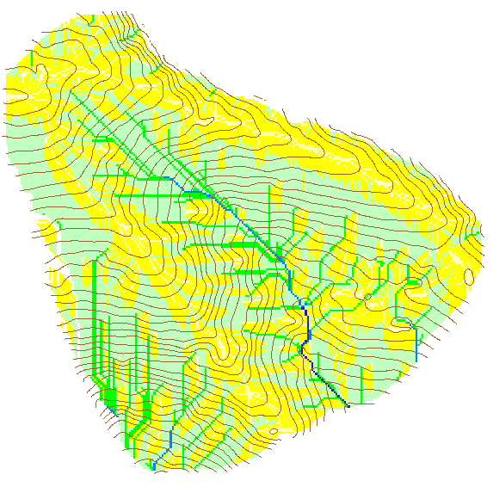
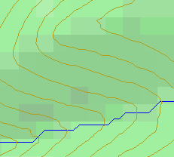


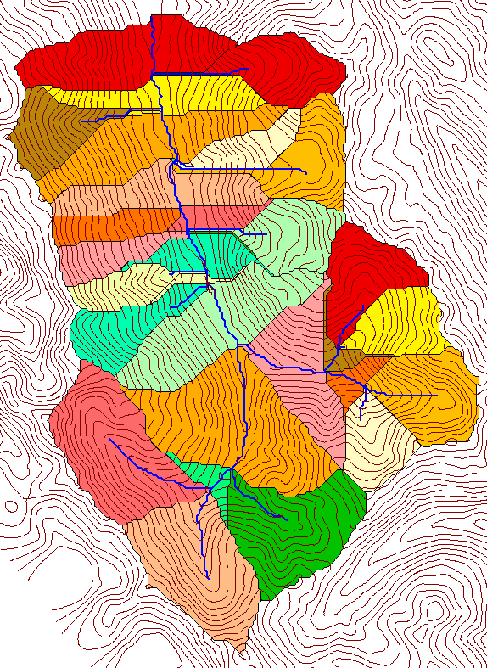
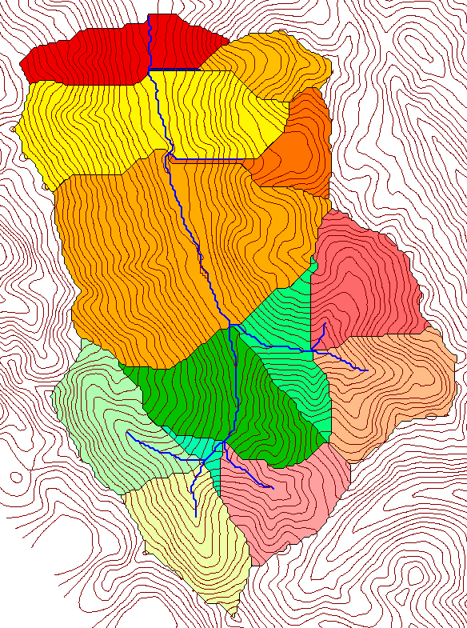

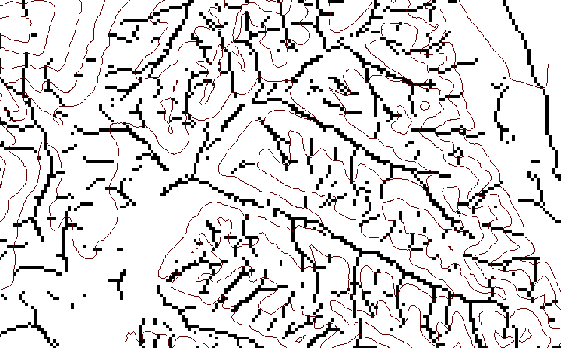
Digital Elevation Models and Hydrology
David G. Tarboton
Utah State University, Civil & Environmental Engineering Department, Logan, UT
Abstract
Digital elevation models (DEMs) are a useful data source for the automatic delineation of flow paths, sub watersheds and channel networks for hydrologic modeling. The scale (drainage density) of the flow network used, controls the scale of hillslope and channel model elements and the distinction between hillslope and channel processes. Although field mapping is acknowledged as the most accurate way to determine channel networks and drainage density, it is often impractical, especially for large watersheds, and DEM derived flow networks then provide a useful surrogate for channel or valley networks. There are a variety of approaches to delineating flow networks, using different algorithms such as single (drainage to a single neighboring cell) and multiple (partitioning of flow between multiple neighboring cells) flow direction methods for the computation of contributing area, and local identification of upwards curvature. The scale of the delineated network is sometimes controlled by a support area threshold, which may impose an arbitrary and spatially constant drainage density. This paper reviews methods for the delineation of flow networks using grid DEMs. The question of objective estimation of drainage density is addressed and a method based on terrain curvature that can accommodate spatially variable drainage density is presented. The spatial flow field determined from a DEM can also serve as a basis for routing overland and topographically driven subsurface flows useful in water quality, erosion and terrain stability modeling. New DEM derived quantities, such as downslope influence, upslope dependence, decayed accumulation, downslope accumulation and transport limited accumulation are illustrated. The methods presented have been incorporated into software (TauDEM) developed to support hydrologic and water quality modeling and available from the author's website.
Purposes
Hillslope, channel partitioning and objective drainage density estimation
New DEM analysis concepts that may be useful in hydrology
Digital Elevation Model Based Flow Path Analysis
What is a digital elevation model (DEM) grid
Eight direction pour point model D8
D∞ flow direction model
Contributing Area using D8
A grid of cells (square or rectangular) in some coordinate system having land surface elevation as the value stored in each cell
4
3
2
5
1
6
7
8
Contributing Area Threshold
Grid network
Limitation imposed by 8 grid directions.
Contributing Area using D∞
1
1
1
1
1
Hydrologic processes are different on hillslopes and in channels. It is important to recognize this and delineate model elements that account for this.
1
4
3
3
1
1
1
12
1
2
?
1
1
2
16
1
1
3
6
25
2
Tarboton, D. G., (1997), "A New Method for the Determination of Flow Directions and Contributing Areas in Grid Digital Elevation Models," Water Resources Research, 33(2): 309-319.)
Flow Network Delineation Methods
Grid Network Ordering Approach (Peckham, 1995)
100 grid cell constant drainage area threshold stream delineation
Drainage area can be concentrated or dispersed (specific catchment area).
500 cell theshold
1000 cell theshold
Different subwatersheds (hydrologic model elements) are delineated with different support area thresholds.
How to decide on drainage area threshold ?
Constant Strahler Stream Drop Property as an empirical geomorphology 'law'
Slope area threshold (Montgomery and Dietrich, 1992).
200 grid cell constant drainage area based stream delineation
Nodes
most upstream is order 1
when two streams of a order i join, a stream of order i+1 is created
when a stream of order i joins a stream of order i+1, stream order is unaltered
Links
Single Stream
Note that a “Strahler stream” comprises a sequence of links (reaches or segments) of the same order
Suggestion: Map channel networks from the DEM at the finest resolution consistent with observed channel network geomorphology ‘laws’. Here the constant drop property is used. We test for a statistically significant break in the 'constant' stream drops across stream orders.
Statistical Analysis of Stream Drops
Accumulation of Local Curvature identified by Peuker and Douglas (1975, Comput. Graphics Image Proc. 4:375) algorithm used to account for spatially variable drainage density
Threshold = 10
Dd = 2.5
t = -3.5
Threshold = 15
Dd = 2.1
t = -2.08
Threshold = 20
Dd = 1.9
t = -1.03
43
48
48
51
51
56
Curvature based stream delineation with threshold by constant drop analysis
41
47
47
54
54
58
Stream drop test for Mawheraiti River. For each upward curved support area threshold the stream drop for each stream is plotted against Strahler stream order. The large circles indicate mean stream drop for each order The weighted support area threshold, drainage density (in km⁻¹) and t statistic for the difference in means between lowest order and all higher order streams is given.

Slide 2
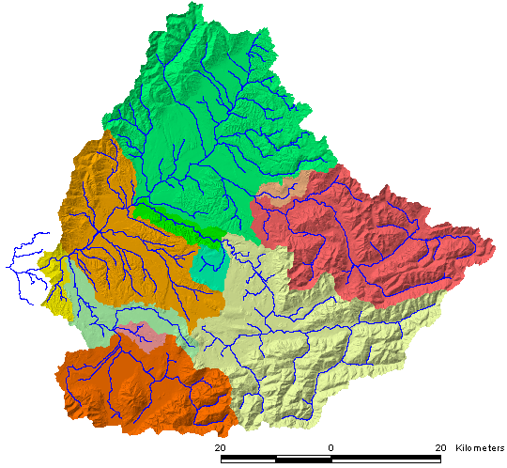
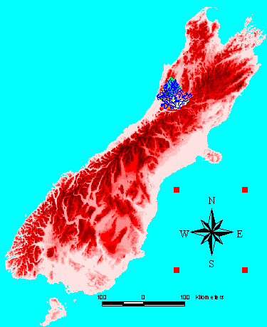
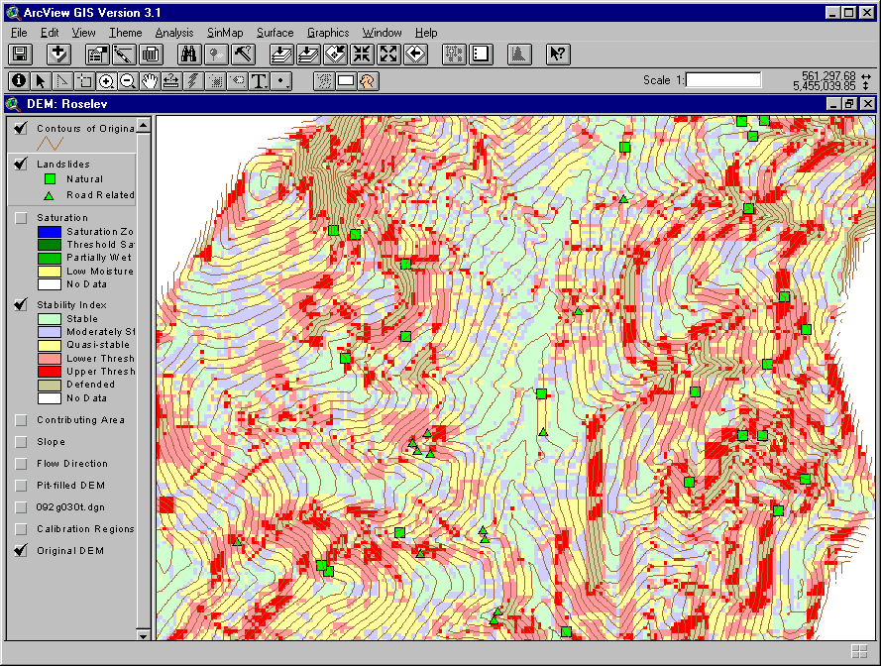
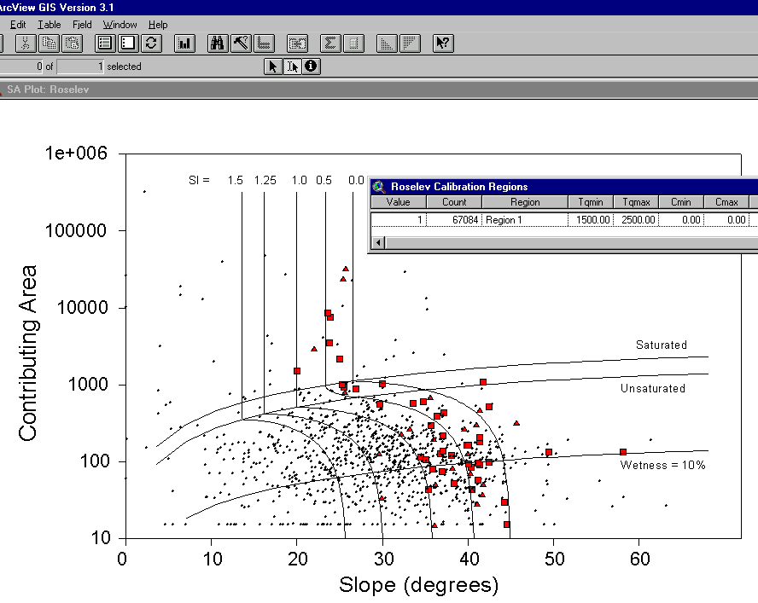
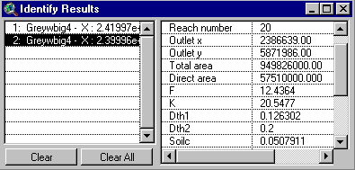
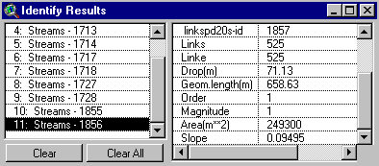
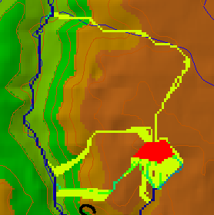

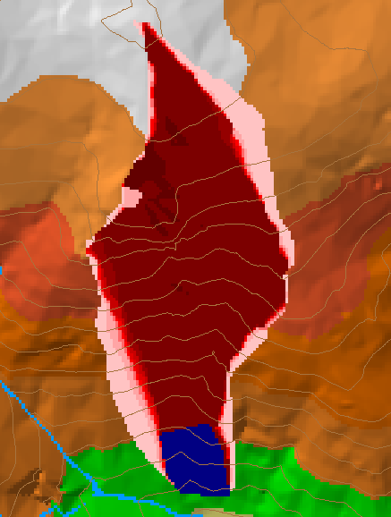
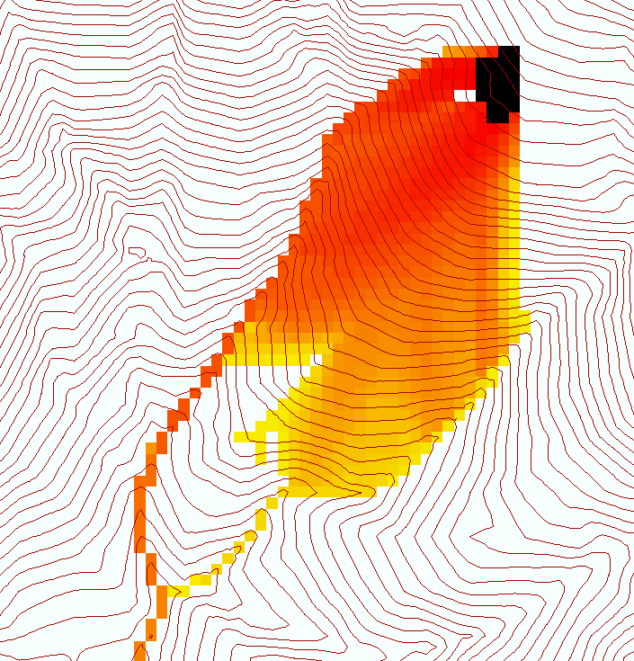
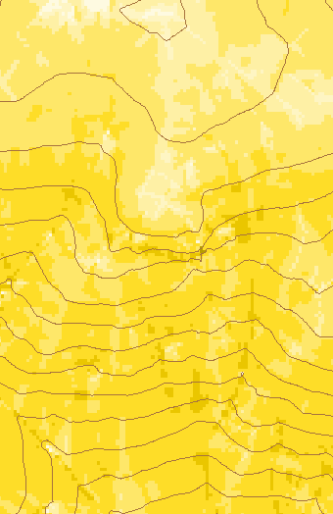
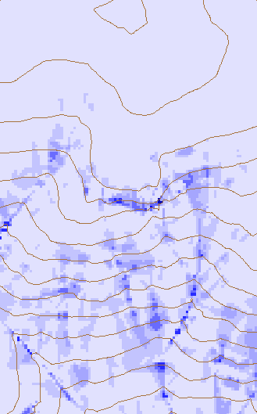
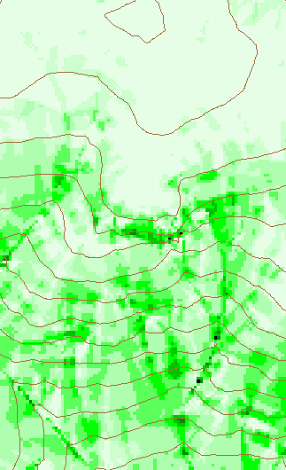
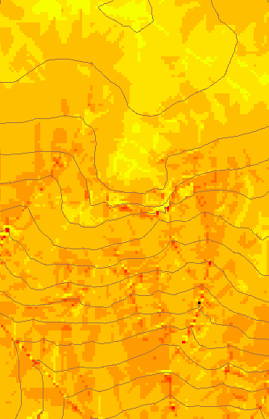
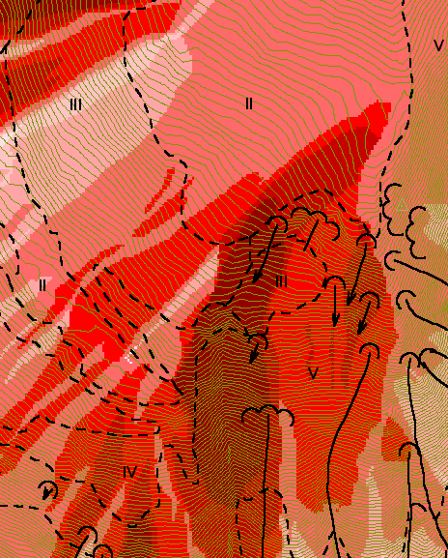
New (and not so new) DEM Analysis Concepts and Uses
Hydrologic Model Parameterization
Terrain Stability Mapping based on slope and specific catchment area.
Basin Area: 3817 km²
Flow: 12.1 x 10⁹ m³
Flow/Area: 3184 mm
Grey River, New Zealand South Island
Greymouth
Christchurch
Subwatershed attributes
Stream segment attributes
SINMAP software available from http://www.engineering.usu.edu/dtarb
Specialized Functions based on Generalization of D∞ Flow path analysis
Useful for example to track where sediment or contaminant moves
Useful for a tracking contaminant or compound subject to decay or attenuation
Useful for a tracking a contaminant released or partitioned to flow at a fixed threshold concentration
Useful for example to track where a contaminant may come from
Transport limited accumulation
Reverse Accumulation
Useful for modeling erosion and sediment delivery, the spatial dependence of sediment delivery ratio and contaminant that adheres to sediment
Useful for destabilization sensitivity in landslide hazard assessment
TauDEM software available from http://www.engineering.usu.edu/dtarb

